Slide 1
Back-Propagation Algorithm
An introduction to learning internal representations By error Propagation
Presented by:
Kunal Parmar
UHID: 1329834

Slide 2
Outline of the Presentation
Introduction
Historical Background
Perceptron
Back propagation algorithm
Limitations and improvements
Questions and Answers

Slide 3
Introduction
Artificial Neural Networks are crude attempts to model the highly massive parallel and distributed processing we believe takes place in the brain.
Back propagation, an abbreviation for "backward propagation of errors", is a common method of training artificial neural networks used in conjunction with an optimization method such as gradient descent.
The method calculates the gradient of a loss function with respect to all the weights in the network.
The gradient is fed to the optimization method which in turn uses it to update the weights, in an attempt to minimize the loss function.

Slide 4
Why do we need multi layer neural networks??
Some input and output patterns can be easily learned by single-layer neural networks (i.e. perceptron). However, these single-layer perceptron cannot learn some relatively simple patterns, such as those that are not linearly separable.
Single layer neural network can’t learn any abstract features of the input since it is limited to having only one layer. A multi-layered network overcomes this limitation as it can create internal representations and learn different features in each layer.
Each higher layer learns more and more abstract features that can be used to classify the image. Each layer finds patterns in the layer below it and it is this ability to create internal representations that are independent of outside input that gives multi-layered networks their power.

Slide 5
Historical Background
Early attempts to implement artificial neural networks: McCulloch (Neuroscientist) and Pitts (Logician) (1943)
Based on simple neurons (MCP neurons)
Based on logical functions
Donald Hebb (1949) gave the hypothesis in his thesis “The Organization of Behavior”:
“Neural pathways are strengthened every time they are used.”
Frank Rosenblatt (1958) created the perceptron, an algorithm for pattern recognition based on a two-layer computer learning network using simple addition and subtraction .
[1]
[1]

Slide 6
Historical Background
However, neural network research stagnated when Minsky and Papert (1969) criticized the idea of the perceptron discovering two key issues in neural networks:
Could not solve the XOR problem.
Training time grows exponentially with the size of the input.
Neural network research slowed until computers achieved greater processing power. Another key advance that came later was the back propagation algorithm which effectively solved the exclusive-OR problem (Werbos 1975) .
[1]
[1]

Slide 7
Perceptron
It is a step function based on a linear combination of real-valued inputs. If the combination is above a threshold it outputs a 1, otherwise it outputs a –1
A perceptron can only learn examples that are linearly separable.
x₁
w₁
x₂
w₂
Σ
{1 or –1}
w₀
[3]
x_{n}
w_{n}
X₀=1

Slide 8
Delta Rule
The delta rule is used for calculating the gradient that is used for updating the weights.
We will try to minimize the following error:
E = ½ Σ_{i} (t_{i} – o_{i}) ²
For a new training example X = (x₁, x₂, …, x_{n}), update each weight according to this rule:
w_{i} = w_{i} + Δw_{i}
where, Δw_{i}= -n * E’(w)/w_{i}

Slide 9
Delta Rule
The derivative gives,
E’(w)/w_{i}= Σ_{i} (t_{i} – o_{i})*(- x_{i})
So that gives us the following equation:
∆ w_{i} = η Σ_{i} (t_{i} – o_{i}) x_{i}

Slide 10
Multi-layer neural networks
In contrast to perceptrons, multilayer neural networks can not only learn multiple decision boundaries, but the boundaries may be nonlinear.
Output nodes
Internal nodes
Input nodes
[3]

Slide 11
Learning non-linear boundaries
To make nonlinear partitions on the space we need to define each unit as a nonlinear function (unlike the perceptron). One solution is to use the sigmoid (logistic) function. So,
We use the sigmoid function because of the following property,
d σ(y) / dy = σ(y) (1 – σ(y))
O(x1,x2,…,xn) =
σ ( WX )
where: σ ( WX ) = 1 / 1 + e ^{-WX}
[3]

Slide 12
Back propagation Algorithm
The back propagation learning algorithm can be divided into two phases:
Phase 1: Propagation
Forward propagation of a training pattern's input through the neural network in order to generate the propagation's output activations.
Backward propagation of the propagation's output activations through the neural network using the training pattern target in order to generate the deltas (the difference between the input and output values) of all output and hidden neurons.
Phase 2: Weight update
Multiply its output delta and input activation to get the gradient of the weight.
Subtract a ratio (percentage) of the gradient from the weight.

Slide 13
Back propagation Algorithm (contd.)
[2]

Slide 14
What is gradient descent algorithm??
Back propagation calculates the gradient of the error of the network regarding the network's modifiable weights.
This gradient is almost always used in a simple stochastic gradient descent algorithm to find weights that minimize the error.
E(W)
w₁
[3]
w₂

Slide 15
Propagating forward
Given example X, compute the output of every node until we reach the output nodes:
Output nodes
Compute sigmoid function
Internal nodes
Input nodes
[3]
Example X

Slide 16
Propagating Error Backward
For each output node k compute the error:
δ_{k} = O_{k} (1-O_{k})(t_{k} – O_{k})
For each hidden unit h, calculate the error:
δ_{h} = O_{h} (1-O_{h}) Σ_{k} W_{kh} δ_{k}
Update each network weight:
W_{ji} = W_{ji} + Δw_{ji}
where Δw_{ji} = η δ_{j} X_{ji} (W_{ji} and X_{ji} are the input and
weight of node i to node j)

Slide 17
Number of Hidden Units
The number of hidden units is related to the complexity of the decision boundary.
If examples are easy to discriminate few nodes would be enough. Conversely complex problems require many internal nodes.
A rule of thumb is to choose roughly m / 10 weights, where m is the number of training examples.

Slide 18
Learning Rates
Different learning rates affect the performance of a neural network significantly.
Optimal Learning Rate:
Leads to the error minimum in one learning step.

Slide 19
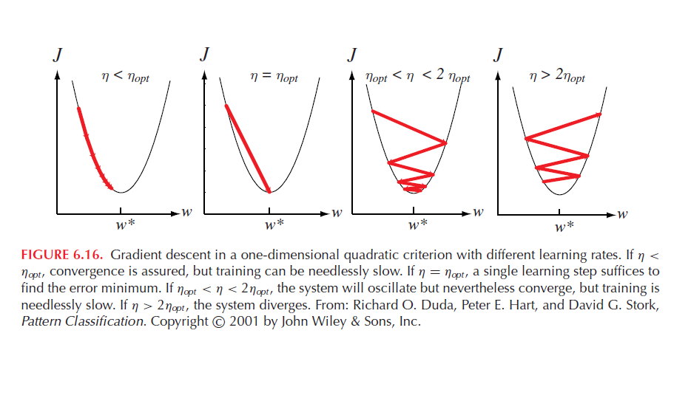
Learning Rates
[3]

Slide 20
Limitations of the back propagation algorithm
It is not guaranteed to find global minimum of the error function. It may get trapped in a local minima,
Improvements,
Add momentum.
Use stochastic gradient descent.
Use different networks with different initial values for the weights.
Back propagation learning does not require normalization of input vectors; however, normalization could improve performance.
Standardize all features previous to training.

Slide 21
Generalization and Overfitting
Solutions,
Use a validation set and stop until the error is small in this set.
Use 10 fold cross validation
Validation set error
Error
Training set error
Number of weight updates
[3]

Slide 22
References
Artificial Neural Networks, https://en.wikipedia.org/wiki/Artificial_neural_network
Back propagation Algorithm, https://en.wikipedia.org/wiki/Backpropagation
Lecture Slides from Dr. Vilalta’s machine learning class

Slide 23
Questions??

Slide 24
Thank you!!

