Slide 1
Target Propagation
Lifeng Yan
1361158

Slide 2

Back propagation and why target propagation
Back propagation exploits the chain rule of derivatives in order to convert a loss gradient on the activations over a layer into a loss gradient on the activations over previous layer
Derivatives obtained by back propagation will become either very small (most of the time) or very large (in a few places) when dealing with deep or nonlinear network, and thus this method will fail
Target propagation is a replacement of back propagation that should be used in very deep or strong nonlinear network
Notes:
h_i is the output of ith layer
Very deep means 19 to 22 layers
Strong nonlinear often leads to discrete functions

Slide 3
Other motivations of using target propagation
(1) The back-propagation computation is purely linear, whereas biological neurons interleave linear and non-linear operations
(2) Precise knowledge of the derivatives of the nonlinearities at the operating point will be needed in the feedback paths
(3) Have to use exact symmetric weights
(4) Real neurons communicate by (possibly stochastic) binary values
Notes:
(1)Deep learning architecture, especially CNN is at least partly motivated by biological knowledge
(2)If the feedback paths were used to propagate credit assignment by back propagation, they would need precise knowledge of the derivatives of the nonlinearities at the operating point used in the corresponding feedforward computation
(3)Similarly, these feedback paths would have to use exact symmetric weights(with the same connectivity, transposed) of the feedforward connections

Slide 4
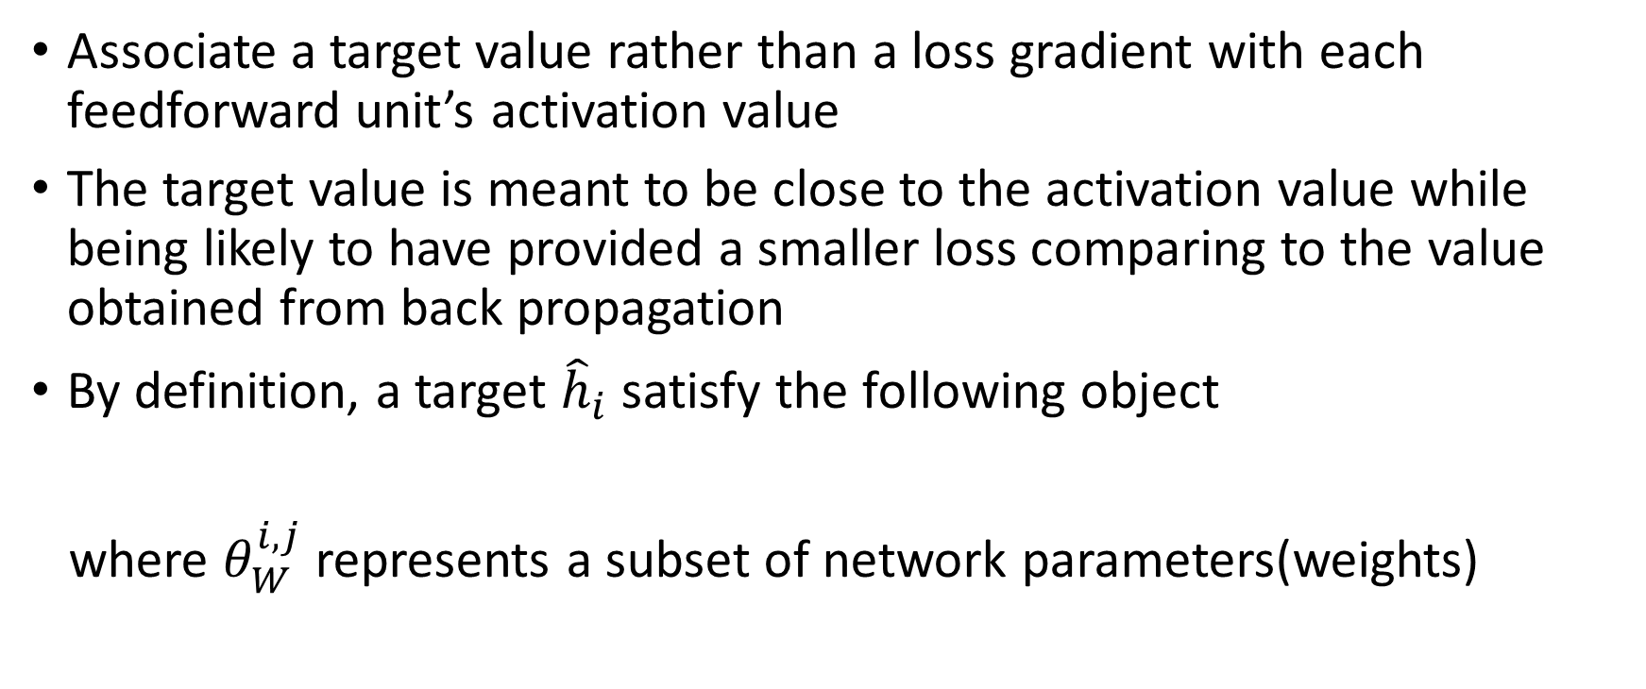
Main idea and what is a target
Associate a target value rather than a loss gradient with each feedforward unit’s activation value
The target value is meant to be close to the activation value while being likely to have provided a smaller loss comparing to the value obtained from back propagation
By definition, a target ${\hat{h}}_{i}$ satisfy the following object
where $θ_{W}^{i,j}$ represents a subset of network parameters(weights)
Notes:
h_i is the output of ith layer, h_M is the output of the entire network
The parameters W_i could also include bias
Loss can be any kind of loss measurement function, say MSE or Binomial cross-entropy

Slide 5

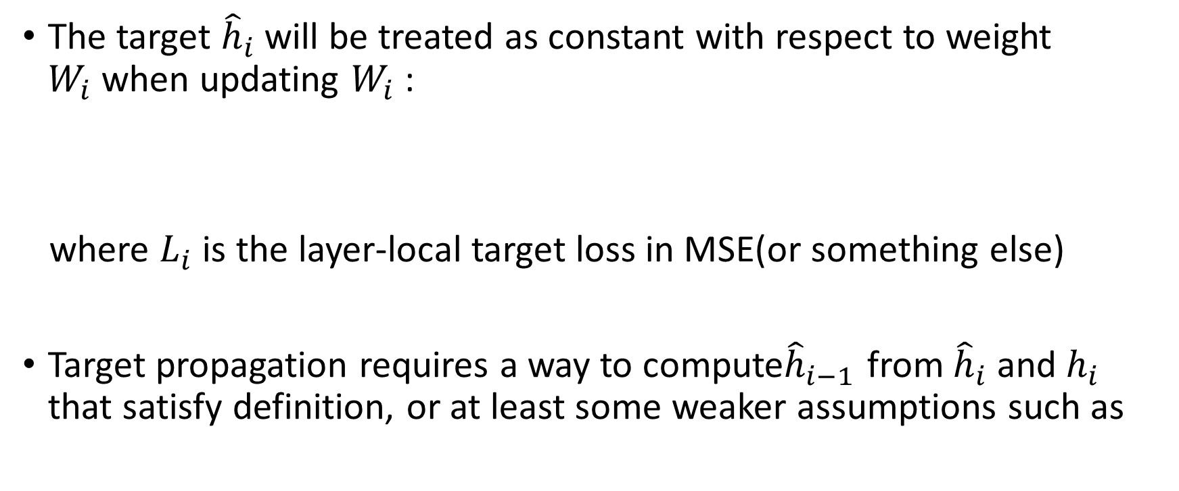
How to propagate
The target ${\hat{h}}_{i}$ will be treated as constant with respect to weight $W_{i}$when updating $W_{i}$:
where $L_{i}$ is the layer-local target loss in MSE(or something else)
Target propagation requires a way to compute${\hat{h}}_{i−1}$ from ${\hat{h}}_{i}$ and $h_{i}$ that satisfy definition, or at least some weaker assumptions such as
Notes:
Eta is the learning rate
Derivatives can be used within a local layer because they typically correspond to computation performed inside each neuron

Slide 6


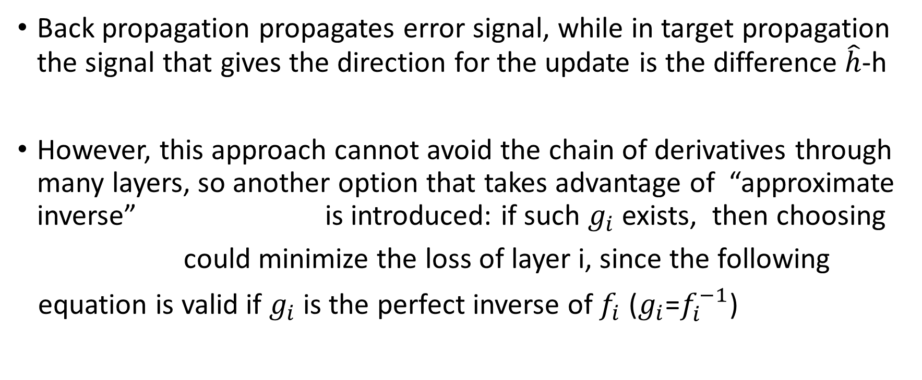
Assign a proper target to each layer
Back propagation propagates error signal, while in target propagation the signal that gives the direction for the update is the difference $\hat{h}$-h
However, this approach cannot avoid the chain of derivatives through many layers, so another option that takes advantage of “approximate inverse” is introduced: if such $g_{i}$ exists, then choosing
could minimize the loss of layer i, since the following
equation is valid if $g_{i}$ is the perfect inverse of $f_{i}$ ($g_{i}$=$f_{i}^{−1}$)
Notes:
Back propagation computes the gradient of the loss with respect to the output of each layer, and it is the error signal that gets propagated recursively from the top layer to the bottom layer using the chain rule
f_i is the objective(loss) function and g_i is the approximate inverse

Slide 7
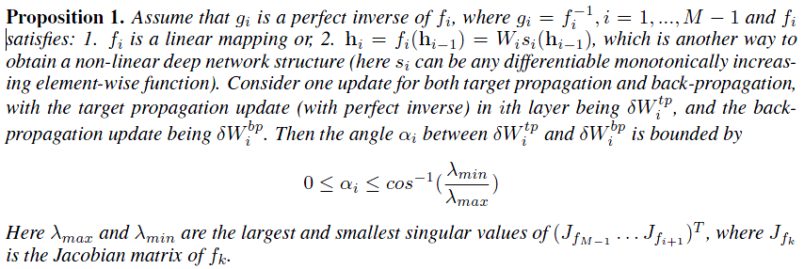
Descent direction of target propagation
Notes:
Proposition 1 points out that descent direction of target propagation with perfect inverse at least partly matches with the gradient descent direction, which makes the global loss always decrease, for feed-forward mappings in each hidden layer that satisfy given assumptions

Slide 8


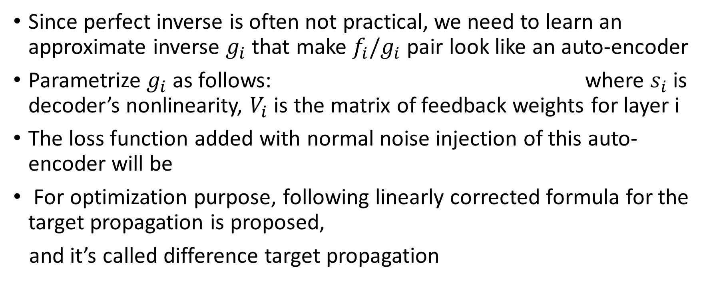
Auto-encoder like structure and difference target propagation
Since perfect inverse is often not practical, we need to learn an approximate inverse $g_{i}$ that make $f_{i}/g_{i}$ pair look like an auto-encoder
Parametrize $g_{i}$ as follows: where $s_{i}$ is decoder’s nonlinearity, $V_{i}$ is the matrix of feedback weights for layer i
The loss function added with normal noise injection of this auto-encoder will be
For optimization purpose, following linearly corrected formula for the target propagation is proposed,
and it’s called difference target propagation
Notes:
The additional auto-encoder-like loss function is used for training the decoder
Noise was introduced to get inverse mapping around the targets and could help to compute targets which have never been seen before

Slide 9
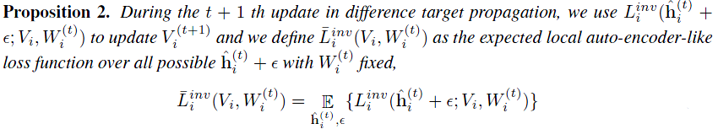
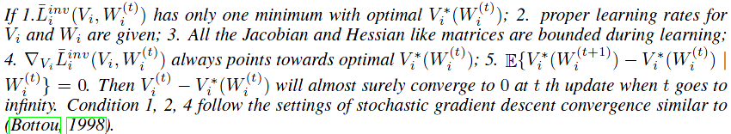
Good approximate inverse could be learned
Notes:
Proposition 2 points out that good approximate inverse could be learned in target propagation that will quickly minimize the auto-encoder like error.

Slide 10


Issues about the top layer
The top layer does not have a layer above it and it has its own loss function which is also the global loss function, and the first target should satisfy , so the target could be set as follows:
Making the first target at layer M-1 with the specific output and loss function instead of the output layer can reduce dependency on specific type of output and loss function, and consistent formulation can be applied to compute target in lower layers
Optimize layer-local target losses to decrease global loss function after targets are assigned properly to each layer
Notes:
$η_{0}$ is a target propagation learning rate

Slide 11
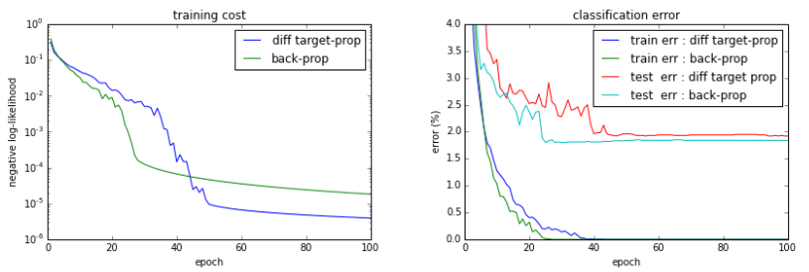
Results for very deep network
Notes:
7 hidden layers and 240 hidden units, activation function is the hyperbolic tangent (tanh).

Slide 12
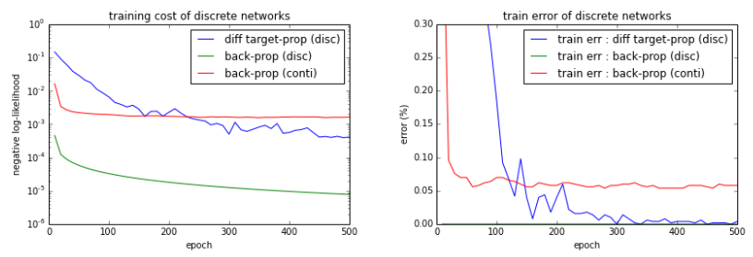
Result for discrete networks
Notes:
784-500-500-10 architecture and only the first hidden layer is discretized
(backprop disc) Train the discrete networks directly so we cannot train W1 using backprop
Training signals cannot go across a discretization step, so layer 1 cannot be trained by back propagation
Though training cost is very low, it overfits, and test error is high.
(backprop conti) Train continuous-activation networks with hyperbolic tangent (tanh) and to test with the discrete networks (that is, indirect training)
Use a biased gradient estimator when we train the network as if it were continuous, and test on the discretized version of the network. It is an indirect training, not overcoming the discreteness during training. Training error cannot approach zero due to the biased estimator.
(diff target-prop) Target propagation can train discrete networks directly, so training error actually approaches zero.
Moreover, test error is comparable to (backprop conti). It clearly suggests that using target-prop, training signals can go across a discretization step successfully.

Slide 13
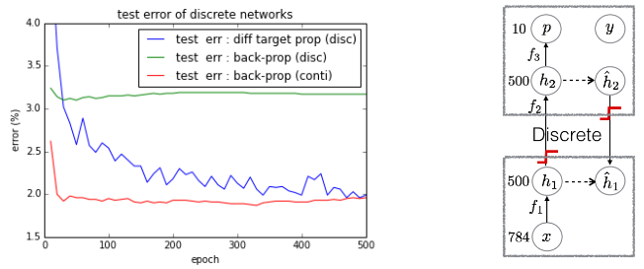
Result for discrete networks
Notes:
Output of h1 is discretized, and training signals are also discretized, so it is very difficult to train the network directly
The test error of diff target-prop is comparable to (backprop conti) even though both feedforward signals and training signals are discretized

Slide 14
Conclusion
This paper presented a new method that could replace back propagation while using very deep or nonlinear network
Introduced propositions which they provided proof in appendix to show that their method is valid
Didn’t explain very clearly the differences between two kinds of discrete network and how these differences effect their experimental result
The paper itself doesn’t have a conclusion part

Slide 15
Thanks
Q&A

