Slide 1
Ensemble Methods in Machine Learning
Lifeng Yan
1361158
Notes:
Present this paper and some further discussion about week classifiers and overfitting issues

Slide 2
Ensemble of classifiers
Given a set of training examples, a learning algorithm outputs a classifier which is an hypothesis about the true function f that generate label values y from input training samples x. Given new x values, the classifier predicts the corresponding y values.
An ensemble of classifiers is a set of classifiers whose individual decisions are combined in some way (typically by weighted or unweighted voting) to classify new examples.
Main discovery from some researches shows that ensembles are often much more accurate than the individual classifiers that make them up.
Notes:
For classification situation, y values are typically drawn from a discrete set of classes
Training samples may corrupted by x

Slide 3
Make sure ensemble learning works
A necessary and sufficient condition for an ensemble of classifiers is that the classifiers should be accurate and diverse.
Accurate means better than random guessing, diverse means make different errors on new data inputs, or make uncorrelated errors.
In theory, with hypothesis that are diverse and error rate over 0.5, error rate voting result of ensemble method will increase. So the classifiers should be accurate.
But there in some version of adaboost algorithm, negative weights are given to those classifiers with accuracy less that 0.5

Slide 4
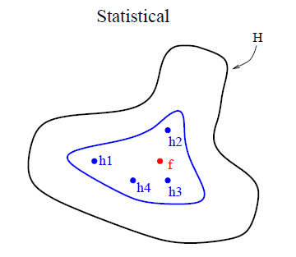
Why it works
Three main reasons for why the ensemble method work: statistical, computational and representational reasons
Statistical reason: A learning algorithm can be viewed as searching a space H of hypotheses to identify the best one in the space. The number of training samples available is small comparing to the size of hypotheses space, and as a result the learning algorithm could find different hypotheses(classifier) that all give out same accuracy. So the ensemble of these classifiers could average their votes and reduce the risk of choosing the wrong classifier.
Notes:
Statistical: The outer curve denotes the hypothesis space H. The inner curve denotes the set of hypotheses that all give good accuracy on the training data. The point labeled f is the true hypothesis and we can see that by averaging the accurate hypotheses we can find a good approximation to f.

Slide 5
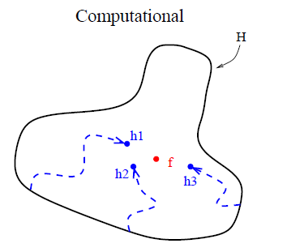
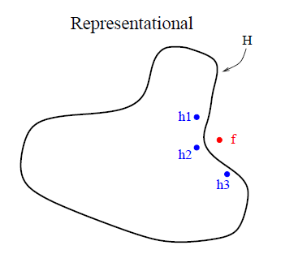
Why it works
Computational reason: Local search algorithms may be trapped in a local minima, and if there is enough training data, it is computationally hard to get the best hypotheses. For ensemble learning the local search could start from different points and may provide a better approximation than any of the individual ones.
Representational reason: The true function f cannot be represented by any of the hypotheses in the space in most machine learning applications, but weighted sum of hypotheses drawn from the space may expand the space of representation functions.
Notes:
optimal training of both neural networks and decisions trees is NP hard
The author admitted that nn and decision trees are more flexible algorithms and could search the whole space. But with finite samples, finite number of hypotheses can be searched, and they will stop when find a hypotheses fits the training sample. So the hypotheses itself must be effective
Computational: Start from different starting point and the combination get better approximation
Representational: Expand representational space by combination

Slide 6
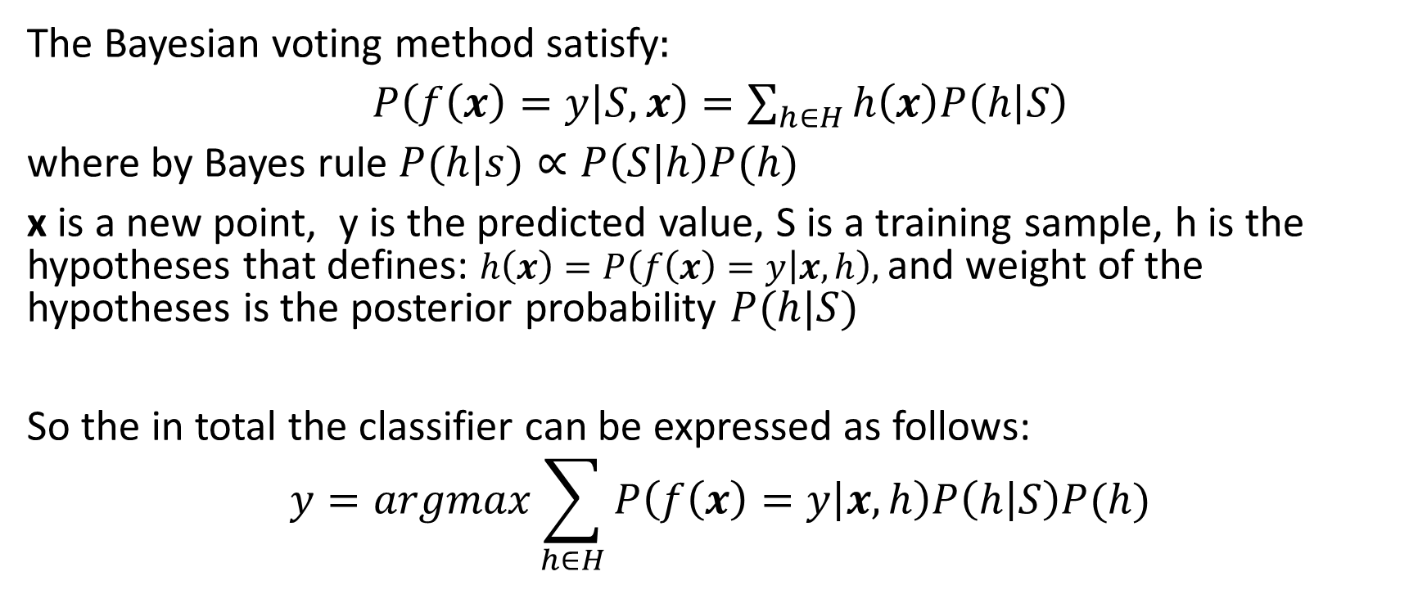
Methods: Bayesian Voting
The Bayesian voting method satisfy:
$P\left(f\left(x\right)=y | S,x\right)=\sum_{h∈H}{h\left(x\right)P\left(h | S\right)}$
where by Bayes rule $P(h|s)∝P\left(S | h\right)P(h)$
x is a new point, y is the predicted value, S is a training sample, h is the hypotheses that defines: $h\left(x\right)=P\left(f\left(x\right)=y | x,h\right),$and weight of the hypotheses is the posterior probability $P(h|S)$
So the in total the classifier can be expressed as follows:
$$y=argmax\sum_{h∈H}{P\left(f\left(x\right)=y | x,h\right)P\left(h | S\right)P(h)}$$
Notes:
The probability that testing sample in class y is equal to the summation of the product of the hypotheses h and the probability of the hypotheses given the training sample, where hypotheses h is the probability of testing sample x is in class y given the hypotheses and testing data.
Maximize the objective function: summation of the production of likelihood, posterior probability and prior

Slide 7
Methods: Bayesian Voting
When the training sample is small, many hypotheses will have significantly large posterior probabilities, and the voting process can average these to eliminate the remaining uncertainty.
When the training sample is large, typically only one hypothesis has substantial posterior probability and the ensemble effectively shrinks to contain only a single hypothesis.
Enumerating the hypotheses, could be optical theoretically, but not in practical, since the space H and prior belief P(h) are hard to decide

Slide 8
Methods: Manipulating the Training Examples
The learning algorithm is run several times, each time with a different subset of the training examples, which works especially well for unstable algorithms.
Bagging: training set is consisted of a sample of m training examples drawn randomly with replacement from the original training set of m items, which is called a bootstrap replicate of the original dataset.
Cross-validated committees: divide the training set into k disjoint subsets, repeat dropping one of these k sets k times and get k overlapped training sets.
Notes:
Unstable: Output changes large when input changes a little
Decision tree, neural network and rule learning algorithms are all unstable
Linear regression nearest neighbor and linear threshold algorithms are generally very stable
Each bootstrap replicate contains on the average63.2% of the original training set with several training examples appearing multiple times

Slide 9
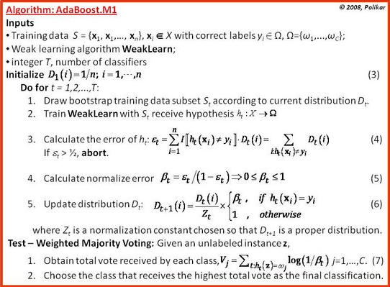
Methods: Manipulating the Training Examples
Adaboost
Notes:
Repeatedly generate new hypotheses and

Slide 10
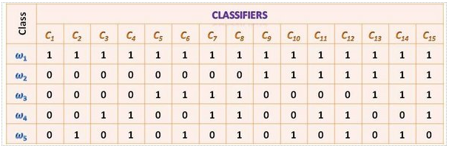

Methods: Manipulating the Output Targets
Error-correcting output coding: Useful when the number of classes K is large. Each class is encoded with a L-bit codeword, The $l^{th}$ learned classifier attempts to predict bit $l$ of these codewords. When the L classifiers are applied to classify a new point x their predictions are combined into an L-bit string. Then class j with codeword closest to the output string is chosen as classification result.

Slide 11
Methods: Injecting Randomness
In the backpropagation algorithm, the initial weights of the network are set randomly if the algorithm is applied to the same training examples but with different initial weights, the resulting classifier can be quite different.
It also works with decision trees (e.g. C4.5): chooses randomly among the top best tests instead of top-ranked feature-value test during the key decision that choose a feature to test at each internal node.
Works with FOIL, bootstrap sampling and Markov chain Monte Carlo methods, where posterior probability should be introduced as voting weight instead of uniform vote.
Notes:
FOIL is similar to decision trees

Slide 12
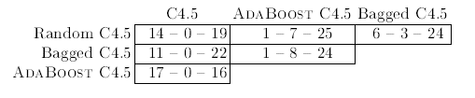

Comparison of different ensemble methods
Without noise
20% artificial noise
Notes:
Each cell contains the number of wins, losses, and ties between the algorithm in that row and the algorithm in that column
Without noise case Adaboost often the best, bagged and randomize are close
With noise case Adaboost overfits badly, bagging is good at noise, randomize not well

Slide 13
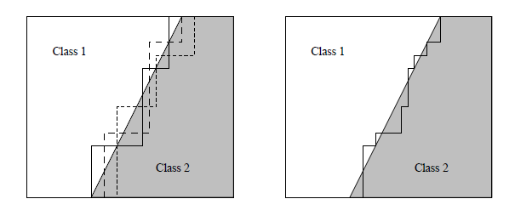
Some explanation of the result
Statistical: If large decision tree is needed, then large training dataset is needed, which can not be guaranteed.
Computational: If a mistake is made while greedily searching the best (smallest) decision tree, then all subsequence are likely to be affected. So the C4.5 decision tree algorithm is not stable.
Representational: a voted combination of small decision trees is equivalent to a much larger single tree so an ensemble method can construct a good approximation to a diagonal decision boundary using several small trees
Notes:
left figure shows the true diagonal decision boundary and three staircase approximations to it
right figure shows the voted decision boundary which is a much better approximation to the diagonal boundary

Slide 14
Further analysis
Bagging randomized trees, these two methods are acting somewhat like Bayesian voting: they are sampling from the space of all possible hypotheses with a bias toward hypotheses that give good accuracy on the training data, so they could mainly deal with statistical problem and also computational problem in some sense, but not directly solve the representational one.
However, Adaboost is directly trying to optimize the weighted vote and deal with representational problem. But directly optimizing an ensemble can increase the risk of overfitting because the space of ensembles is usually much larger than the hypothesis space of the original algorithm.

Slide 15
Conclusions of previous results and analysis
Adaboost is good with low-noise input, but put a large weight on mislabeled samples which leads to overfitting, while bagging and randomization do well with or without noise, since they could solve the statistical problem which noise could make it worse.
For large datasets, bootstrap replicates are similar to the whole training set itself and bagging method can no longer give out diverse decision trees. But randomization can create diverse, so it can do well.

Slide 16
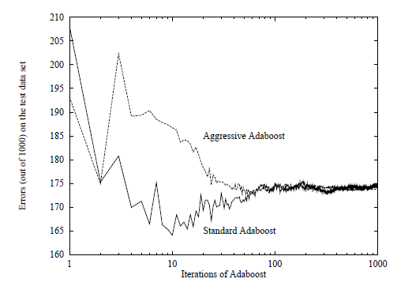
Discussion of Adaboost overfitting
AdaBoost aggressively attempts to maximize the margins on the training set, so it seems that it will overfit more often, so why not?
Stage-wise nature: adaboost keeps constructing new hypotheses and and weights doesn’t go back and modify previously decided ones
An experiment is conducted of aggressive adaboost, which is a modified version of the original adaboost. Gradient descent search is performed after each hypotheses and their weights are decided.
Notes:
Aggressive AdaBoost initially has much higher error rates on the test set than Standard version, and gradually improves
The standard one overfits when more classifiers are added.
They are minimizing the same function, so they finally merged.

Slide 17
Advantages of weak classifiers
Boosting with a large number of iterations has the potential to make a very weak learner almost optimal when compared with the best
Provided that the learner is sufficiently weak, boosting always improves
When the initial learner is too strong, boosting decreases performance due to overfitting
Boosting very weak learners is relatively safe, provided that the number of iterations is large
Notes:
A paper about another kind of boosting (L2-boosting) discussed about the strength of weak classifiers

Slide 18
Further discussion of boosting methods overfitting
MSE is defined to be the sum of squared bias and variance of the boosting algorithm, and for weak classifiers, squared bias decays exponentially fast and variance exhibits exponentially small increase with increasing iterations, which means it overfits much slower than other methods.
But apart from noisy data, there are still situations that boosting methods will easily overfit: for those dataset that has Bayes error rate far from 0, boosting methods try to reduce the error rate to 0 while in reality even the optimal classifier have a high error rate, so overfitting seems inevitable.
Also, for data in high dimensional space which in general causes individual classifiers easier to overfit, adaboost will overfit too since it’s a linear combination of those overfitted classifiers.

Slide 19
Reference
Thomas G. Dietterich “Ensemble Methods in Machine Learning”
Robi Polikar “Ensemble learning”
Peter Buhlmann, Bin Yu “Boosting with the L2-Loss: Regression and Classification ”
https://en.wikipedia.org/wiki/Ensemble_learning
https://chrisjmccormick.wordpress.com/2013/12/13/adaboost-tutorial/
http://stats.stackexchange.com/questions/20622/is-adaboost-less-or-more-prone-to-overfitting

Slide 20
Thank you!
Q&A

