Slide 1
Robust Kernel Density Estimation by Scaling and Projection in Hilbert Space
Presented by:
Nacer Khalil

Slide 2
Table of content
Introduction
Definition of robustness
Robust Kernel Density Estimation
Nonparametric Contamination Models
Scaled project Kernel Density Estimator
Experiment and conclusion
Case study

Slide 3
Introduction What is robustness
robustness is the ability of a computer system to cope with errors during execution (wikipedia)
Robustness:
Reliability
Availability
Resilience

Slide 4
Introduction What is robustness
Robustness in machine learning is:
The extend to which testing errors is consistent with training errors
The extent to which the performance of the algorithm resists to noise

Slide 5
Introduction Robust kernel density estimation
Density Estimation
Parametric
Nonparametric
Non parametric density estimation:
Enables working under more general assumptions, but not robust
Difficulty in making it robust

Slide 6
Introduction Problem statement
How to make non parametric kernel density estimation robust?
We consider the situation where most observations come from a target density f_{tar} but some are drawn from contaminating function f_{con}

Slide 7
Introduction Contribution
The authors introduce a new formalism to describe transformations that “decontaminates” f_{obs}
The process of decontamination is:
Scaling: Multiply the KDE by a real number to scale
Shifting: Find closest pdf to the scaled KDE in the L² norm

Slide 8
2. Nonparametric Contamination Models
Problem setting:
We know:
ε
We do not know f_{tar} and f_{con}

Slide 9
Nonparametric Contamination Models New formalism
Let D be the set of all pdfs in R^{d}
Let the term contamination model refers to any subset V in D x D. i.e. (f_{tar},f_{con})
Let R_{ε}: D -> D be a set of transformations on D indexed by ε in [0,1)
We say R_{ε} decontaminates V for all (f_{tar},f_{con}) in V ε in [0,1) we have:

Slide 10
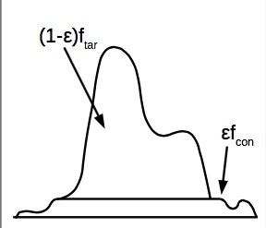
Nonparametric Contamination Models Proposed contamination method

Slide 11
Decontamination procedure
To recover f_{tar}, we need to scale f_{obs} by β= 1/(1-ε)
Let

Slide 12
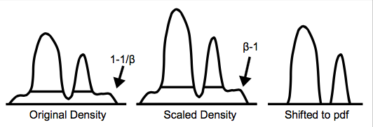
Decontamination procedure

Slide 13
Other possible decontamination models
Use anomaly detection and construct KDE from non-anomalous samples.
Level set method: for a probability measure μ, this method finds the set S with smallest Lebesque measure such that μ(S) > t (threshold). The samples outside the sample are declared anomalous
Find connected components and declare those that are as being anomalous

Slide 14
Other possible decontamination models

Slide 15
Scaled Projection Kernel Density Estimator
Let’s consider approximating Rª_{ε} in a finite sample situation. Let f in L²(R²) be a pdf and X_{1,}…,X_{n} be samples from f. Let k_{σ}(x,x’) be a smoothing kernel with bandwidth σ.
The classic density estimator is:
Since we do not know ε, we will scale β > 1

Slide 16
Classic kernel estimator
We define
SPKDE is defined
Can be represented

Slide 17
The minimization is a quadratic program
a = [a_{1,}…,a_{n}]
G: Gram matrix of k_{σ}(.,X₁),…, k_{σ}(.,X_{n})
b: G 1 β/n

Slide 18
In infinite sample
SKPDE decontamination

Slide 19
Experiment and conclusion Datasets
To show SPKDE properties:
Used Synthetic data
Idealized experiment where contamination is uniform
Sample size of 500 and ε = 0.2 therefore β = 1.25
For the remaining experiments:
12 classification datasets
ε = 0, 0.05, 0.1, 0.2, 0.25, 0.3
Each test is performed on 15 permutations of the dataset

Slide 20
Experiment and conclusion Performance criteria
Investigated Kullback Leibler (KL) divergence
Given performance metric and contamination amount, we compare the mean performance using the Wilcoxon signed test

Slide 21
Kullback Leibler (KL) divergence

Slide 22
Experiment and conclusion Methods

Slide 23
Experiment and conclusion
SPKDE is effective at compensating for contamination using the DKL metric
SPKDE outperforms RKDE
RejKDE is significantly worse than SPKE
SPKDE also outperforms KDE when no contamination takes place

Slide 24
Mini case study
Apply SPKDE to the old faithful dataset
We generate a new contaminated dataset using a Gaussian
We mix the clean and contaminated dataset and apply SPKDE

Slide 25
Old faithful density clean data

Slide 26
Old faithful density contaminated data, ε = 0.15

Slide 27
SPKDE Scaling
We multiply the density by β = 1/(1-ε)

Slide 28
Shifting
Search for uniform function that has matches highest number of points in distribution
Slice the uniform function from the distribution
Start with threshold and count how many points are close
Increase threshold until number of points decreases
Slice those points from distribution

Slide 29
Shifting

Slide 30
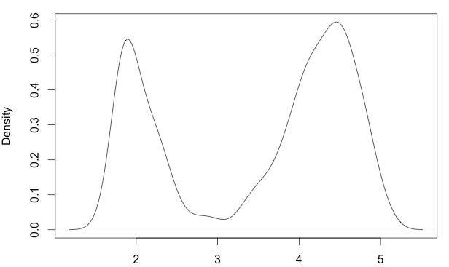
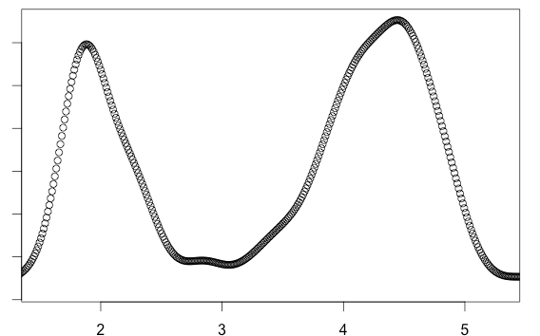

Slide 31
Conclusion
Paper presents a way to construct a robust kernel density estimation
Makes a number of assumptions
Contamination rate is known
The contamination is uniform (Shape of distribution does not change)
You need more information about the contamination
Distribution and contamination rate

