Slide 1
Temporal Clustering of Human Behavior
Authors: Zhou F., De la Torre F. and Hodgins J.
Presenter: Nikolaos Sarafianos
Advanced Machine Learning, 11.09.2015
Prof: Dr. Eick

Slide 2
Contents
Prerequisites (DTW)
Goal of the temporal clustering for human motion analysis
K-means and Kernel k-means
Frame Kernel Matrix
Dynamic Time Alignment Kernel
Aligned Cluster Analysis
Results in Motion Capture Data

Slide 3
Prerequisites
Dynamic Time Warping (DTW):
Measures similarity between two temporal sequences which may vary in time or speed.
For instance, similarities in walking patterns could be detected using DTW, even if one person is walking faster than the other.
Calculates an optimal match between two given sequences (e.g. time series) with certain restrictions.

Slide 4
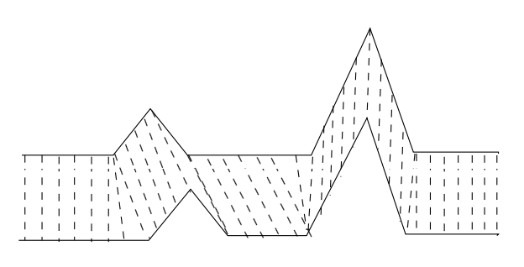
Prerequisites (2)
Dynamic Time Warping (DTW):
Limitation: It doesn't guarantee the triangle inequality to hold.

Slide 5
Goal

Slide 6
Challenges
Variability in the temporal scale of human actions
The complexity of representing articulated motion
The exponential nature of all possible movement combinations

Slide 7
k-means
Finds the partition of the data that is local optima of the following energy function:
$x_{i}$is a vector representing the $i^{th}$data point
$z_{c}$the geometric centroid of the data points
$G∈{\{0,1\}}^{k×n}$ is the binary indicator matrix such that $g_{ci}=1$ if the sample${ x}_{i}$belongs to cluster c and 0 otherwise

Slide 8
k-means (2)
Performs coordinate descent in the energy function $J_{km}(Z,G)$
Limitation: Optimal only for spherical clusters
Solution: Kernel k-means (KKM) which maps the data to a higher dimensional space using kernels

Slide 9
Kernel k-means
Minimizes:
${dist}_{φ}^{2}(x_{i},z_{c})$ the squared distance between the $i^{th}$ sample and the center of the class c in the feature space
$n_{c}=\sum_{j=1}^{n}{g_{cj}}$ the number of samples that belong to class c
κ is the kernel function defined as: $κ_{ij}={φ(x_{i})}^{T}φ(x_{j})$

Slide 10
Kernel k-means (2)
KKM assigns the sample to the closest cluster mean computed in the previous step:
In KKM the mean cannot be computed explicitly as in k-means but there’s no need since the kernel matrix calculates the ${dist}_{φ}^{2}(x_{i},z_{c})$

Slide 11
Frame Kernel Matrix
$K={φ(Χ)}^{Τ}φ(Χ)$, X a multidimensional time series of length n
Each entry $κ_{ij}$ defines the similarity between 2 frames by means of a Gaussian kernel function:
$κ_{ij}=\exp\left(−\frac{{\left|\left|x_{i}−x_{j}\right|\right|}^{2}}{2σ^{2}}\right)$which for σ->0 we get the binary frame kernel matrix

Slide 12
Frame Kernel Matrix (2)
Problem: Period ambiguity: 2 different but valid decompositions of the same time series at 2 different temporal scales.
Solution: Constrain the length of the segments (2 and 4)

Slide 13
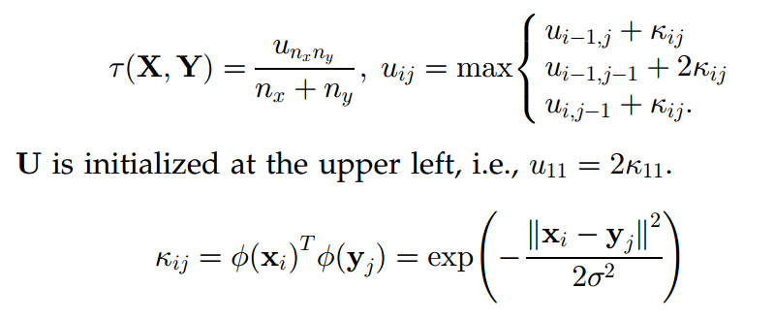
Dynamic Time Alignment Kernel
Extends DTW
Computes the similarity of 2 time sequences using Dynamic Programming
Uses the cumulative kernel matrix U:

Slide 14
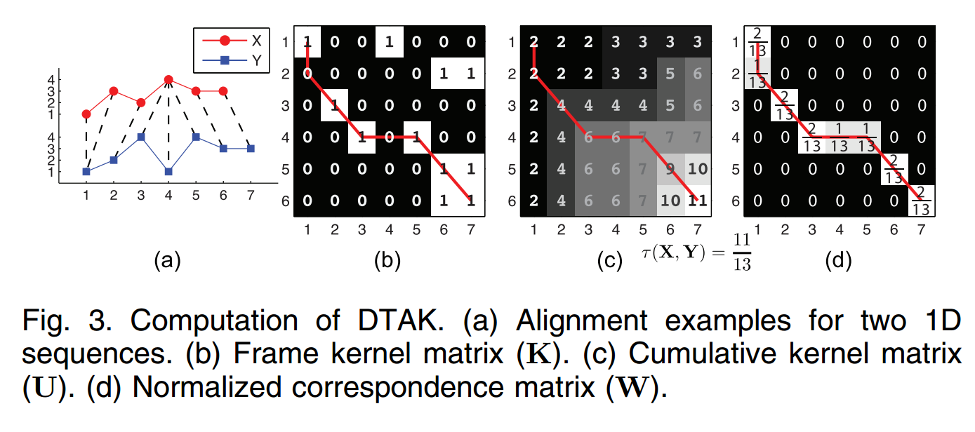
Dynamic Time Alignment Kernel (2)
$w_{ij}=\frac{1}{n_{x}+n_{y}}\left(p_{c}−p_{c−1}+q_{c}−q_{c−1}\right)$ if there exist $p_{c}=i and{ q}_{c}=j$ for some c (i.e. for every one of the steps we have 2 indexes that encode the correspondence between the 2 time series)

Slide 15
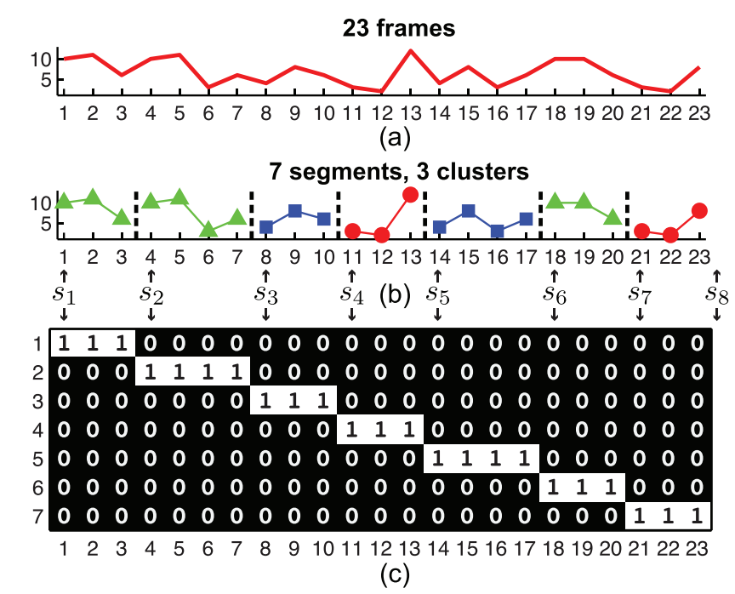
Energy Function for ACA
Given a sequence X with n samples ACA decomposes X into m disjoint segments each of which corresponds to one of k classes.
Encodes the correspondence between samples and segments such that $h_{ij}=1$ if the $j^{th}$sample belongs to the $i^{th}$segment

Slide 16
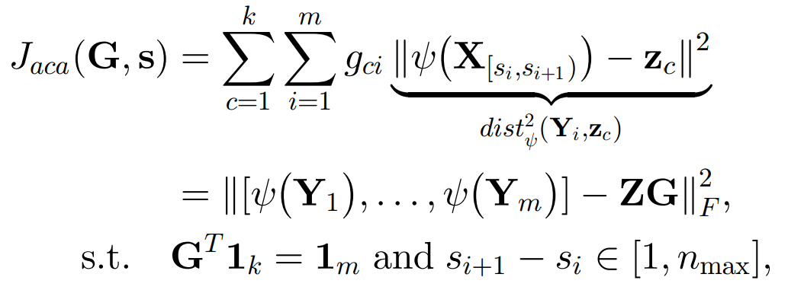
Energy Function for ACA (2)
Combine KKM and Spectral Clustering with DTAK to achieve temporal clustering.
${dist}_{ψ}^{2}\left(Y_{i},z_{c}\right)$ the squared distance between the $i^{th} segment$ and the center of the class c in the feature space defined by the non-linear mapping ψ().
Notes:
G is the class indicator. S

Slide 17
Energy Function for ACA (3)
Defines 2 kernel matrices:
The segment kernel matrix (kernel between segments). Each element is the DTAK between the $i^{th}$ and the $j^{th}$segments.
The frame kernel matrix (kernel between frames)

Slide 18
Coordinate Descent Optimization
Forward Step: Scan from the beginning (v=1) to the end (v=n) of the sequence. For each v compute J(v) according to
$$J\left(v\right)=⁡\min_{v−n_{max<i≤v}}(J\left(i−1\right)+\min_{g}{\sum_{c=1}^{k}{g_{c}}{dist}_{ψ}^{2}(}X_{\left[i,v\right]}−\dot{z_{c}}))$$
That is for every position compute DTAK between the segment $X_{\left[i,v\right]}$ and each of the segments for each of the classes
Backward Step: Trace back from the end of sequence and cut off the segment whose head $s=\dot{iv}$
Notes:
Initial Segmentation

Slide 19
Aligned Cluster Analysis (ACA)
Key characteristics:
Finds a partition of a given multi-dimensional time series into m disjoint segments, such that each segment belongs to one of k clusters.
Combines kernel k-means with the dynamic time alignment kernel to cluster time series.
Provides a natural framework to find a low-dimensional embedding for time series.
Efficiently optimized with a coordinate descent strategy and dynamic programming.

Slide 20
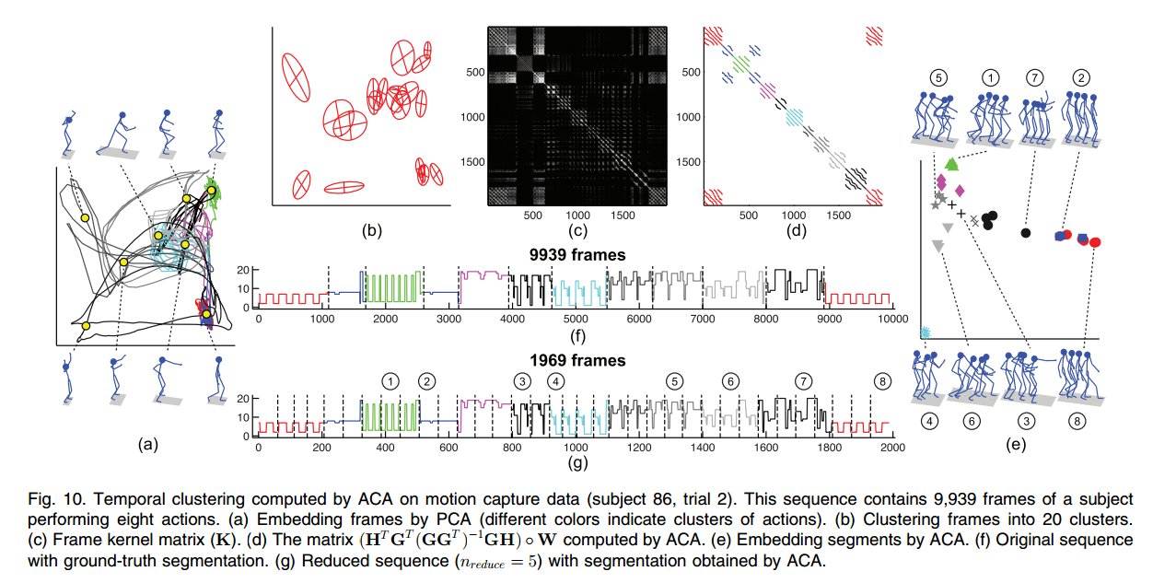
Experiments on MoCap data

Slide 21
Experiments on MoCap data (2)

Slide 22
Experiments on MoCap data (3)

Slide 23
References
Hierarchical Aligned Cluster Analysis for Temporal Clustering of Human Motion IEEE Transactions on Pattern Analysis and Machine Intelligence (PAMI), vol. 35, no. 3, pp. 582-596, 2013 F. Zhou, F. De la Torre and J. K. Hodgins
Aligned Cluster Analysis for Temporal Segmentation of Human Motion International Conference on Automatic Face and Gesture Recognition (FG), 2008 F. Zhou, F. De la Torre and J. K. Hodgins
Segmenting Motion Capture Data into Distinct Behaviors Graphics Interface (GI), 2004. J. Barbic, A. Safonova, J.-Y. Pan, C. Faloutsos, J. K. Hodgins and N. S. Pollard
https://en.wikipedia.org/wiki/Dynamic_time_warping
https://en.wikipedia.org/wiki/Spectral_clustering
Available Code: http://www.f-zhou.com/tc.html

Slide 24
Thank You

