Slide 1
Trajectory Clustering
Tianxiao Jiang, Biomedical Engineering Department, University of Houston

Slide 2
Visual aided approach
Automatic method may discover movement patterns that are interesting but trivial.
Visual analytics can control the computational process.
Notes:
by setting different input parameters, interpret the results and direct the algorithm towards meaningful solution

Slide 3
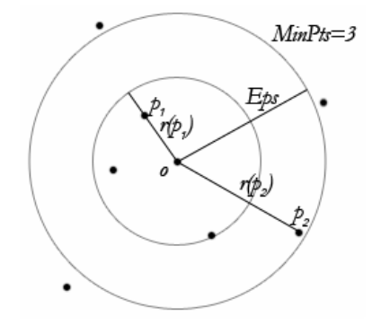
A density based clustering method: OPTICS
Definition 1 (Core Object): Let p be an object in a dataset D, Eps a distance threshold, MinNbs (minimum number of neighbors), p is a core object if NEps(p) >= MinNbs.
Definition 2 (Reachability Distance): The reachability distance of p with respect to o is essentially the distance between the two objects except for the case when p is too close. In this case, the distance is normalized to the core distance.
Initially a random object p0 is chosen. Then, at each iteration i, the next object pi chosen from D is the object with the smallest reachability distance with respect to all already visited core objects. The process is repeated until all objects in D have been considered.
Notes:
Brief introduction of OPTICS

Slide 4
Progressive Clustering
A large value MinNbs (decide core object) is applied
Analyst play with parameters (Eps, MinNbs) until getting a few clusters that are spatially coherent and well interpretable
After examining, describing, and explaining the most significant clusters, the analyst excludes their members from the further analysis and applies clustering with smaller MinNbs to the remaining data
Repeat the process (Go to the second step)

Slide 5
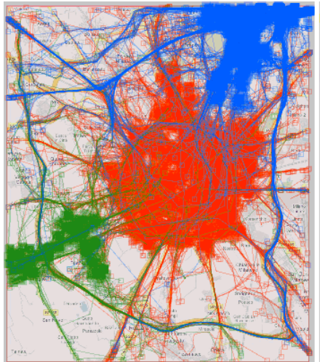
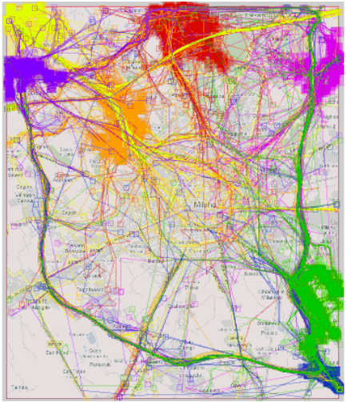
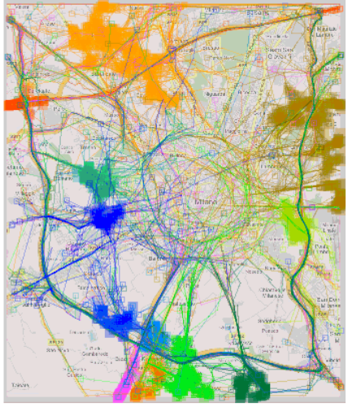
Common Destination
GPS-tracking of 17241 cars in Milan.
A subset of 6187 trajectories on Wednesday from 6:00 AM to 10:00 AM were analyzed
Reduce
Reduce
Eps=500m
MinNbs=15
Eps=500m
MinNbs=10
Eps=500m
MinNbs=5
It is usually difficult for density-based clustering technique to detect uneven density dataset
Notes:
Same distance function: common destination. Different parameters
It is usually difficult for density-based clustering technique to detect uneven density dataset

Slide 6
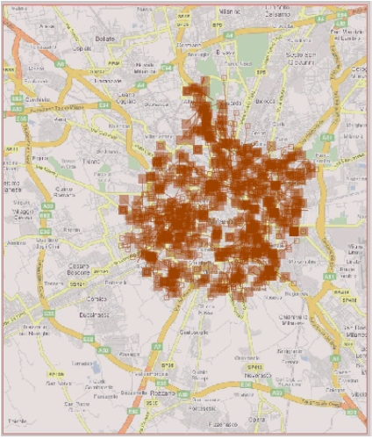
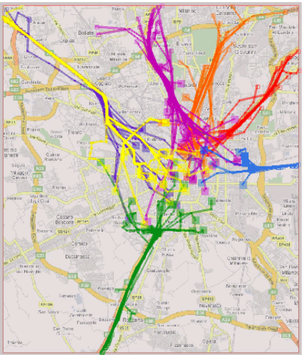
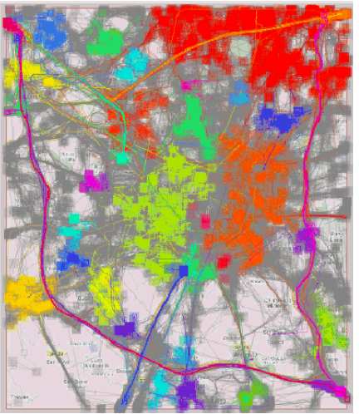
Route similarity & Common source and destination
Reduce
On center of Milan (red)
Route similarity
Eps =1000m, MinNbs=5
512 trajectories (29%)
On center of Milan (red)
Route similarity
Eps =1000m, MinNbs=5
Cluster size 29%
11 to 28 trajectories
Whole data set
Common source and destination
Eps =800, MinNbs=8
Cluster size 29%
11 to 28 trajectories
Notes:
A great part of them are very short trajectories within the center.
1074 trajectories, i.e. 63% of 1781, have been classified as “noise”, which means the absence of frequent routes among them.
In most cases when trajectories have close starts and close ends are short. Only 127 trajectories (2%) are long.
Clusters where the starts are close to the ends include 1439 trajectories, or 23% of all (75% have been regarded as “noise”; they are shown in grey).

Slide 7
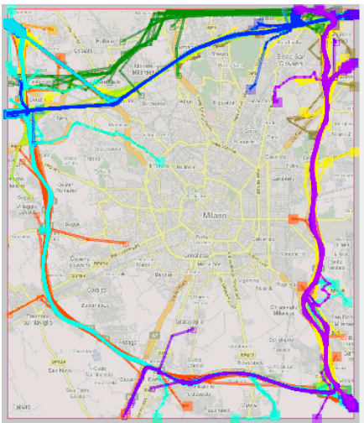
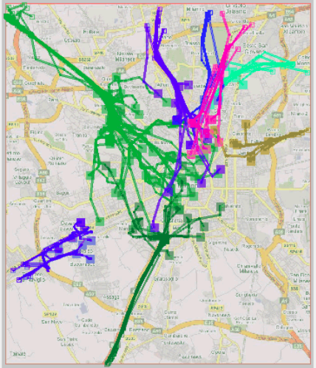
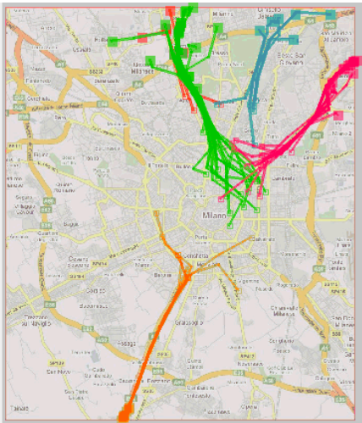
Frequently taken route (Route similarity)
peripheral routes using the belt around the city
radial routes from the periphery towards the inner city
radial routes from the inner city towards the periphery
Long trajectories
Route similarity
Eps =800 m, MinNbs=5
Long trajectories
Route similarity
Eps =800 m, MinNbs=5
Long trajectories
Route similarity
Eps =800 m, MinNbs=5
Notes:
Local and round trips are excluded (25%).
The biggest cluster (bright green lines in the middle image) consists of 66 trajectories.
In different experiments, from 77 to 90% of the trajectories are treated as “noise”, i.e. no frequent routes are found among them.

Slide 8
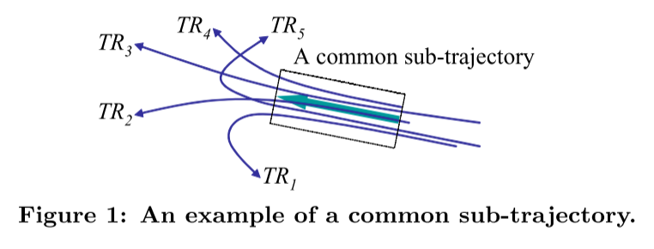
Micro-clustering
Traditional trajectory clustering algorithm group similar trajectory as a whole, sometimes it can miss common sub-trajectory.
Trajectory might have different lengths
Discovering common sub-trajectory is very useful in some applications.

Slide 9
Micro clustering 1
Represent trajectory as piece-wise segments (possibly with missing intervals)
Find a maximal segment where all trajectories are pair-wise close to each other
The similarity of trajectories is based on the time length of close segments

Slide 10
Micro clustering 2
Segments of different trajectories within a given rectangle are grouped together if they occur in similar time intervals
Determine the maximal group size and temporal dimension within the threshold rectangle

Slide 11
Micro clustering 3
A Partition-and-Group Framework
Partition trajectory into sub-trajectories using minimum description length (MDL) principle
Group similar segments using a density based clustering algorithm
Notes:
Notice that a trajectory can belong to multiple clusters since a trajectory is partitioned into multiple line segments, and clustering is performed over these line segments.

Slide 12
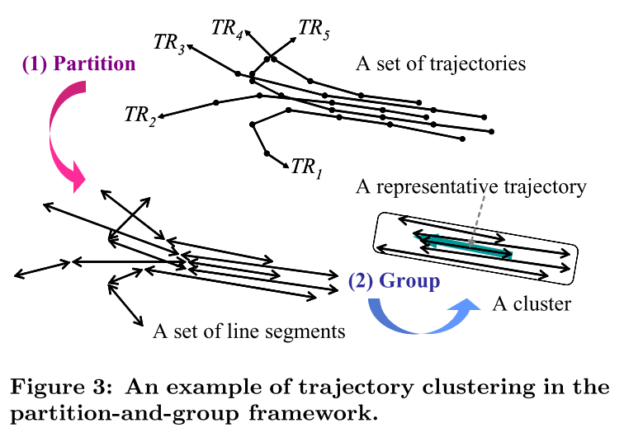
Partition and group framework

Slide 13
Q: Why not prune the ‘useless’ part of the trajectory so that we can use traditional clustering algorithm on the ‘interesting’ part of the trajectory ?
It is tricky to determine which part is ‘useless’ and which part is ‘important’.
‘Pruning’ forbids us from discovering unexpected clustering results.

Slide 14
Q: Why density-based clustering ?
Trajectory is often of arbitrary shapes and noisy
Density-based clustering methods [2, 6] are the most suitable for line segments because they can discover clusters of arbitrary shape and can filter out noises [11].
Notes:
2, Ankerst, M., Breunig, M. M., Kriegel, H.P., and Sander, J., “OPTICS: Ordering Points to Identify the Clustering Structure,” In Proc. 1999 ACM SIGMOD Int’l Conf. on Management of Data, Philadelphia, Pennsylvania, pp. 49–60, June 1999.
6, Ester, M., Kriegel, H.-P., Sander, J., and Xu, X., “A Density-Based Algorithm for Discovering Clusters in Large Spatial Databases with Noise,” In Proc. 2nd Int’l Conf. on Knowledge Discovery and Data Mining, Portland, Oregon, pp. 226–231, Aug. 1996.
11,Han, J. and Kamber, M., Data Mining: Concepts and Techniques, 2nd ed., Morgan Kaufmann, 2006.

Slide 15
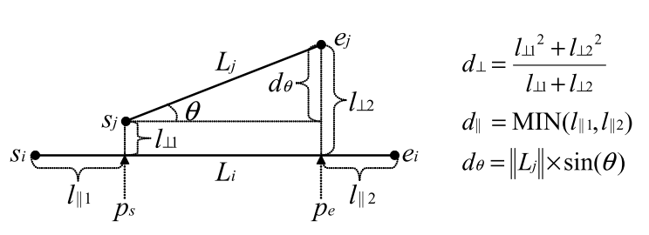
Distance function
Perpendicular distance (d⊥, Lehmer mean of order 2)
Parallel distance (d||)
Angle distance dθ
Notes:
The parallel distance is designed to be robust to detection errors, especially broken line segments. If we use MAX instead of MIN, the parallel distance could be significantly distorted by broken line segments.
The angle distance is designed for trajectories with directions. If we handle trajectories without directions, the angle distance is defined as simply L×sin(θ)

Slide 16
Distance function
dist(Li,Lj) = w1*d⊥(Li,Lj)+w2 *d||(Li,Lj)+ w3*dθ(Li,Lj).
The weights w1, w2 and w3 are determined depending on applications. Equal weights generally works well in many applications.
Symmetric: dist(Li,Lj) = dist(Lj,Li)
Notes:
Symmetry is important to avoid ambiguity of the clustering result. If a distance function is asymmetric, a different clustering result can be obtained depending on the order of processing.

Slide 17
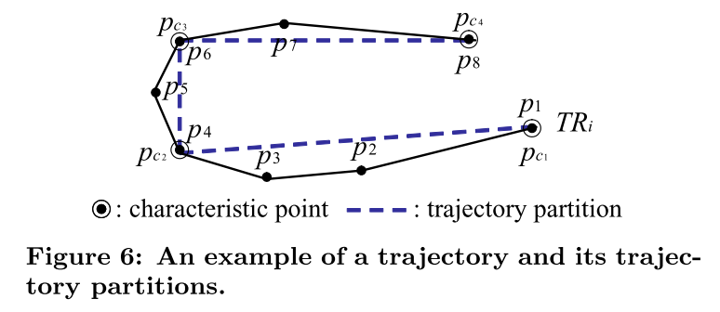
Phase-1: Partition
Characteristic points: points where the behavior of a trajectory changes rapidly.
Notes:
The optimal partitioning of a trajectory is a tradeoff between preciseness and conciseness.
Preciseness means that the difference between a trajectory and a set of its trajectory partitions should be as small as possible.
Conciseness means that the number of trajectory partitions should be as small as possible.

Slide 18
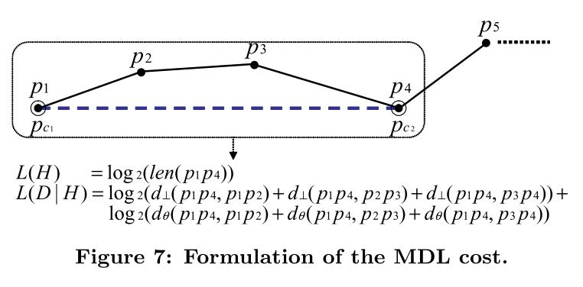
Minimum description length (MDL)
Objective: Minimize L(H)+L(D|H)
L(H) measures the degree of conciseness
L(D|H) that of preciseness.
Notes:
MDL is widely used in information theory for data compression.
Due to the triangle inequality, L(H) increases as the number of trajectory partitions.
L(D|H) increases as a set of trajectory partitions deviates from the trajectory.

Slide 19
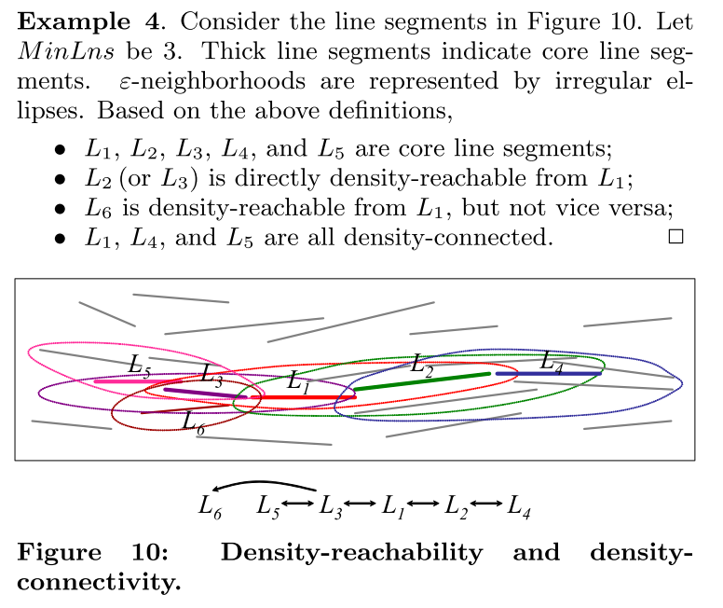
Phase-2: Line segments clustering
(DBSCAN)
Notes:
ε-neighborhood in line segments is not a circle or a sphere but likely to be an ellipse or an ellipsoid. The shapes are affected by the direction and length of a core line segment and those of border line segments.

Slide 20
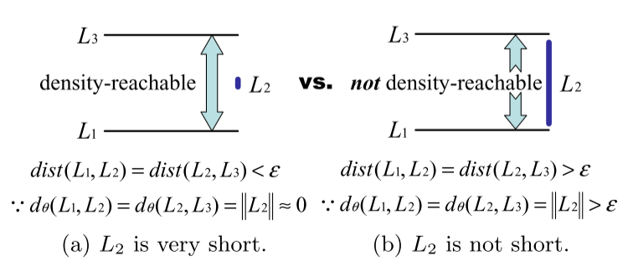
Short segments induce over-clustering
Notes:
If one of line segments is very short, angle distance is small regardless of the actual angle.
The result in (a) is counter-intuitive since L1 and L3 are far apart
To overcome this problem, segments can be made longer at the cost of preciseness

Slide 21
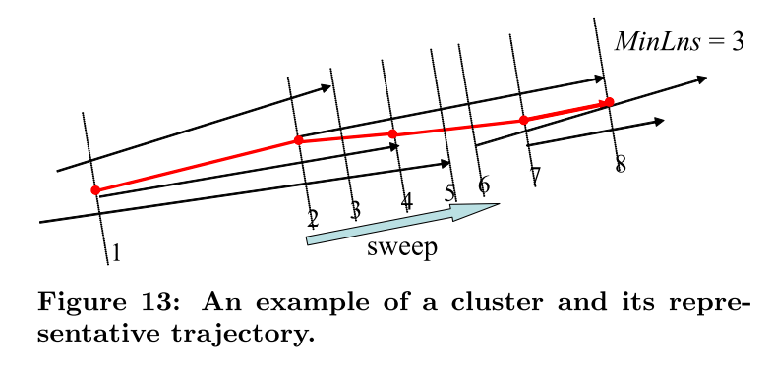
Representative Trajectory of a Cluster
Notes:
While sweeping a vertical line across line segments in the direction of the major axis of a cluster, we count the number of the line segments hitting the sweep line. This number changes only when the sweep line passes a starting point or an ending point. If this number is equal to or greater than MinLns, we compute the average coordinate of those line segments with respect to the major axis and insert the average into the representative trajectory; otherwise, we skip the current point (e.g., the 5th and 6th positions in Figure 13). Besides, if a previous point is located too close (e.g., the 3rd position in Figure 13), we skip the current point to smooth the representative trajectory

Slide 22
Heuristic Parameter Selection
ε: Minimize entropy
Maximum Entropy
Carbon crystal !
MinLns: avg|Nε(L)| + 1 ∼ 3.
Notes:
A meaningful cluster will have skewed structure and small entropy.
This is natural since MinLns should be greater than avg|Nε(L)| to discover meaningful clusters

Slide 23
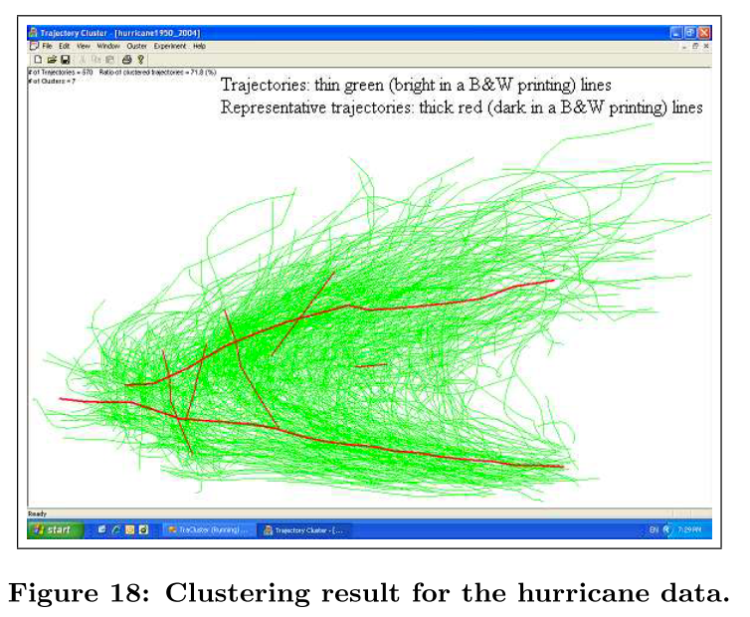
Hurricane track
Notes:
The result in Figure 18 is quite reasonable. We know that
some hurricanes move along a curve, changing their direction from east-to-west to south-to-north, and then to west- to-east. On the other hand, some hurricanes move along a straight east-to-west line or a straight west-to-east line. The lower horizontal cluster represents the east-to-west movements, the upper horizontal one the west-to-east movements, and the vertical ones the south-to-north movements.

Slide 24
Flocks and Convoy
Discovering group of objects that move together during a given period of time. For example, migrating animals, flocks of birds or convoys of vehicles
e.g. propose moving clusters to describe the problem of discovery of sequence of clusters in which objects may leave or enter the cluster during some time interval but having the portion of common objects higher than a predefined threshold…

Slide 25
The End

