Slide 1
A New Fuzzy Stacked Generalization Technique and Analysis of its Performance
Mete Ozay, Fatos T. Yarman Vural
—Presented by Tianxiao Jiang

Slide 2
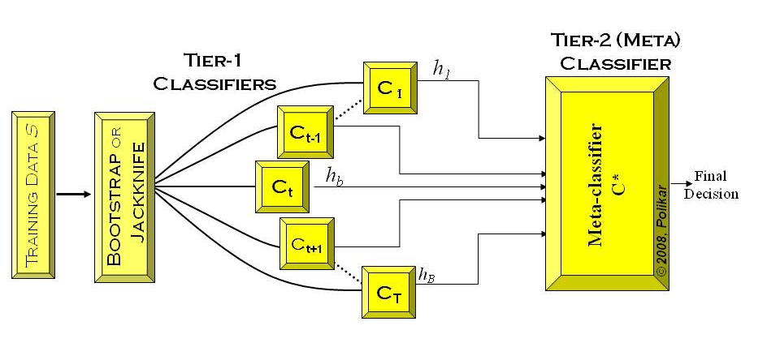
Stacked Generalization
http://www.scholarpedia.org/article/Ensemble_learning

Slide 3
Black art problem
SG usually boosts the classification result.
SG may get worse than that of the individual classifiers in some other cases.
Selection of the parameters of the SG, and designing classifiers and feature spaces have been considered as a black art.

Slide 4
Main idea
Fuzzy Stacked Generalization (FSG) technique was introduced to resolve the black art problem for the minimization of classification error of the nearest neighbor rule.

Slide 5
Highlights of ‘hierarchical distance learning’
Minimize the error difference between N-sample and large-sample error rather than just minimize large-sample error.
Use class posterior probabilities of the samples as feature vectors for meta-classifier input rather than a discriminative transformation
Different feature space mappings can be employed in different classifiers in the ensemble

Slide 6
Asymptotic convergence of nearest neighbor (NN) classifier

Slide 7
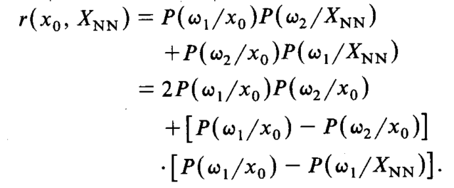
Optimal distance measure for nearest neighbor classifier
Misclassifying probability for two-class problem
w1 and w0 denotes the class label, x0 is the new sample to be classified and Xnn is its nearest neighbor

Slide 8
Optimal distance measure for nearest neighbor classifier
Asymptotical misclassification rate
N is large enough
Difference between N-sample and asymptotical
as x0 is fixed
Minimize
Minimize
Notes:
Increasing the number of data sample vectors results in a decrease in the difference, However, this same effect may be realized by the proper choice of d(x, .), without the added cost of more samples

Slide 9
Optimal distance measure for nearest neighbor classifier
Taylor series approximation on local region of x0
Best local distance measure
Notes:
The optimal distance function should find the XNN that minimize the difference. If choose the mentioned distance function, it is guaranteed that the difference will be the minimal among local regions of x0

Slide 10
N-sample and large-sample classification errors of NN
The classification error rate of Bayes classifier is defined as
?
s is sample; xj is a feature vector representation of s; Wc is the class label; L is the loss function
Expected error is defined as
Notes:
Why min on c, it is meaningless if you take a summation of all possible c

Slide 11
N-sample and large-sample classification errors of NN
The probability of error is given by
The asymptotic error

Slide 12
N-sample and large-sample classification errors of NN
Bayes error
k-NN error
Asymptotic error
Or 2e(1-e) ?
Main goal is to minimize the error difference

Slide 13
N-sample and large-sample classification errors of NN
typo
Minimizing the error difference is equivalent to minimize the error function
Notes:
Should be Ec, by taylor approximation, either increase N or design a distance function can decrease the error function

Slide 14
A proper distance function
Where

Slide 15
Averaged error
Each feature dimension will have a classifier, an averaged error over an ensemble of classifiers is defined as:
Minimize:

Slide 16
Hierarchical decision
fusion algorithm
Estimate posterior probability using individual k-NN as base-layer classifier
Concatenate probability estimate vector from each classifier (feature dimension)
One k-NN based on
is used as
Meta-layer classifier

Slide 17
Fuzzy k-NN
The classification algorithms that implement fuzzy rules usually outperforms the algorithms that implement crisp rules. However, the effect of the employment of fuzzy rules to the classification performance of SG is given as an open problem

Slide 18
Estimate posterior probability in fuzzy k-NN
parameter

Slide 19
Benefit
Split the feature and assign individual classifier may increase the diversity the classifier
Concatenating on the fusion space may improve the overall performing at the cost of dimensionality boosting (CJ).If C is too large, this will affect its performance.
Too many parameters, no generalized framework
FSG establish the balance between dimensionality curse and the information deficiency by using individual feature and classifier rather than concatenating all the features and do feature selection or normalization in a single classifier. And no matter how high the dimension of the base-layer classifier, the fusion space dimension of will always be CJ. This can be a partial solution to dimensionality curse.

Slide 20
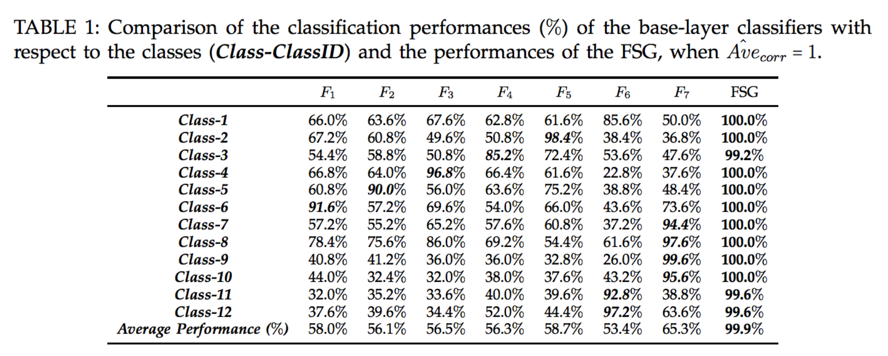
Performance on artificial dataset
Datasets are constructed in such a way that each sample is correctly recognized by at least one of the base-layer classifiers

Slide 21
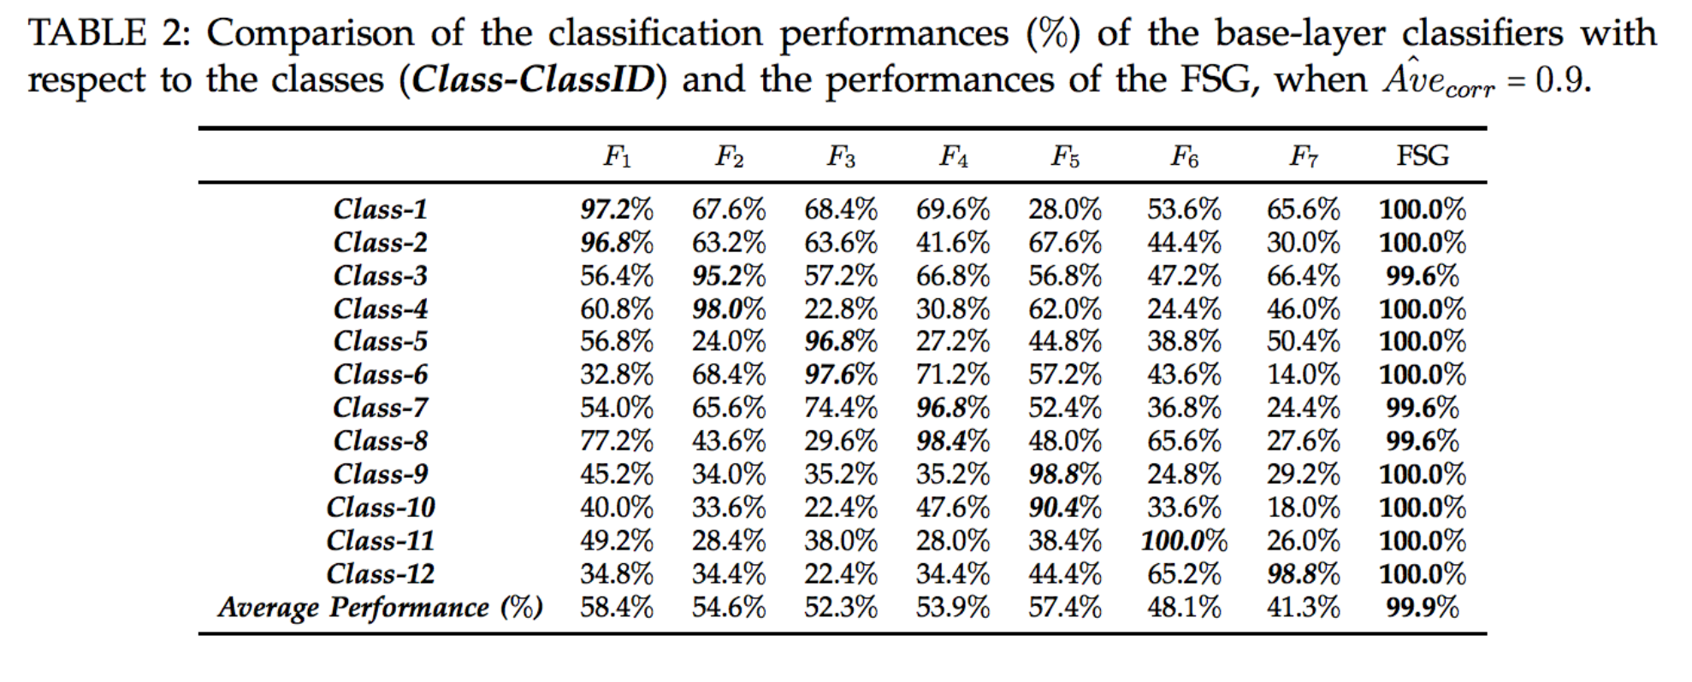
Performance on artificial dataset
90% of the samples are correctly classified by at least one of the base-layer classifiers

Slide 22
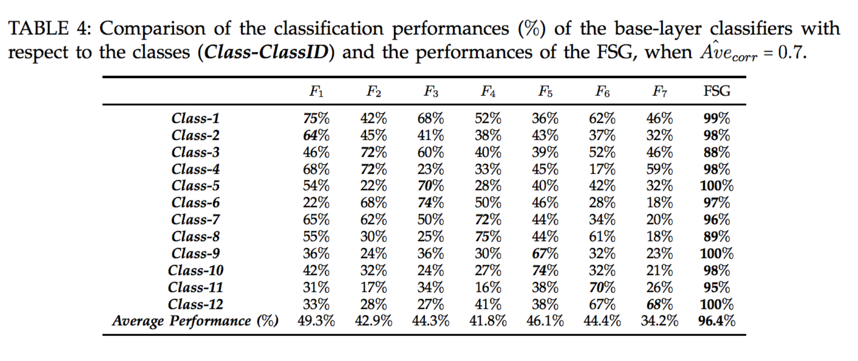

Slide 23
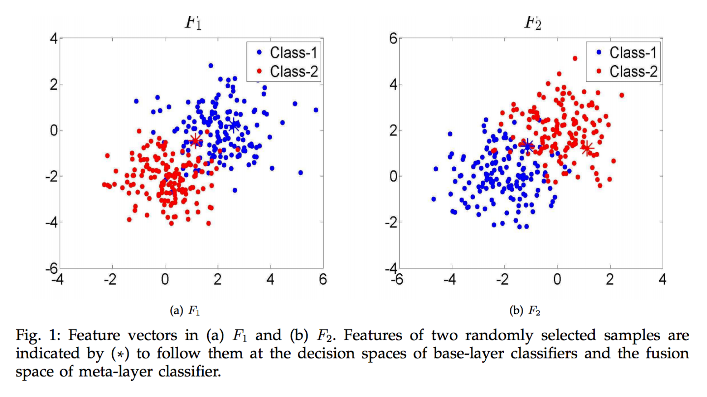
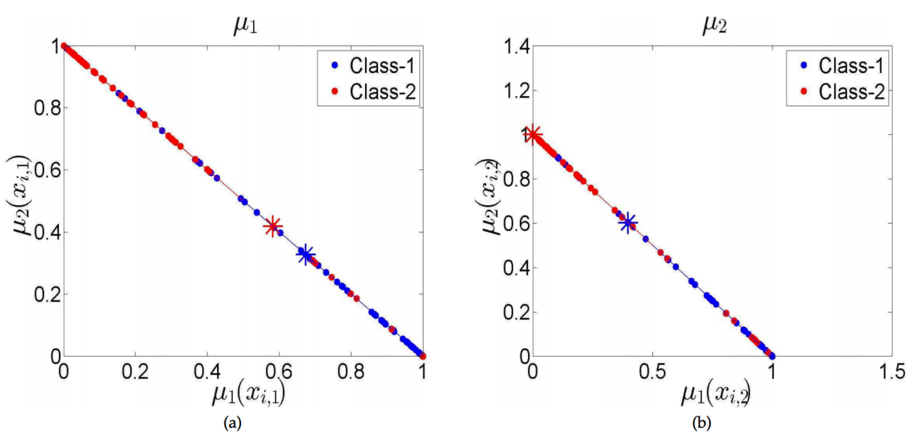
Notes:
For instance, the sample marked with red star s1 is misclassified by the first classifier as shown in Fig. 2.a, but correctly classified by the second classifier as shown in Fig. 2.b. In addition, the feature of the sample marked with blue star s2 is correctly classified by the first classifier as shown in Fig. 2.a, but misclassified by the second classifier as shown in Fig. 2.b.

Slide 24
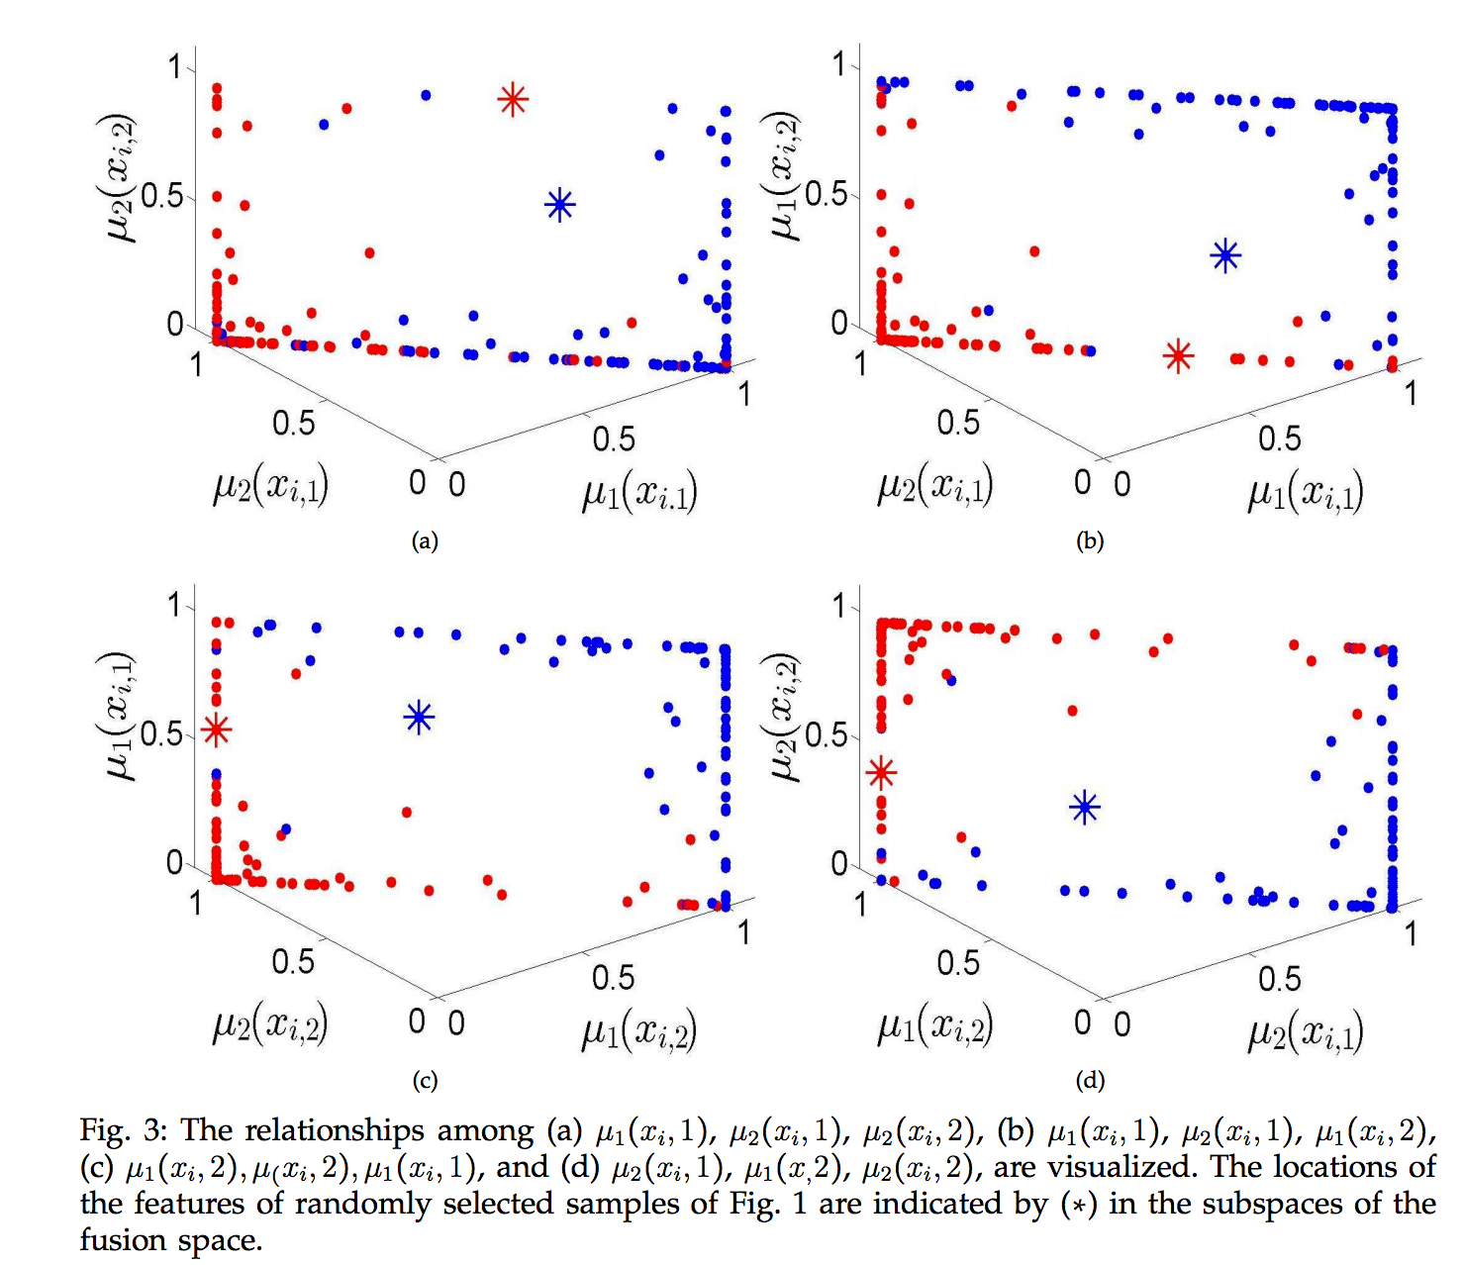
Notes:
The concatenation operation creates a 4 (2×2) dimensional fusion space at the meta-layer input feature space, i.e. fusion space.

Slide 25
Experiments on multi-attribute datasets
Notes:
Due to dimensionality curse, the performance gain of FSG compared to the classification performances of the aforementioned algorithms decreases as A increases

Slide 26
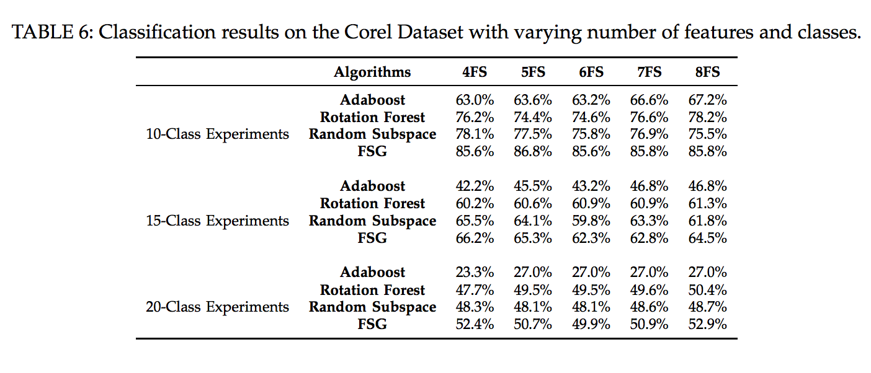
Experiments on multi-feature datasets

Slide 27
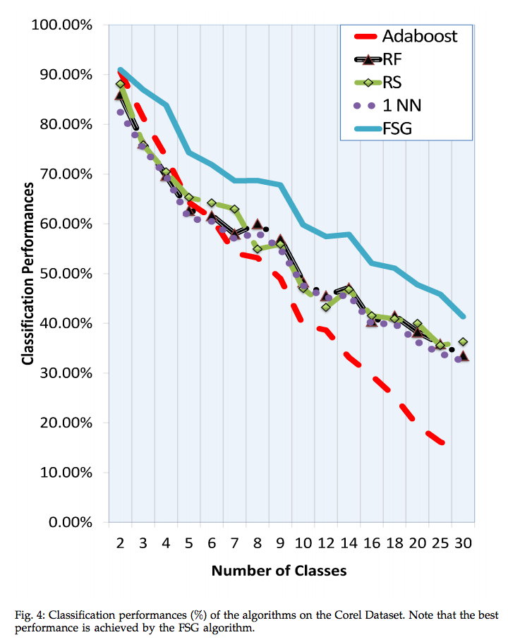

Slide 28
The End

