Slide 1
News November 18, 2024
We decided to drop Task6 and to extend the deadline to submit Task5 to Mo., Nov. 24.
Today’s Plan
  AI Arms Race (was kind of cancelled on Oct. 28)
  European Regulations (GHC Presentation)
  Application of Reinforcement Learning (GHC Presentation)
  Continue the Discussion of Hidden Markov Models

Slide 2
The AI Arms Race (as of 2024)
By Nathan Cao, Rikki Casupanan, Alexander Catchings, Jusvin Charles, Tim Chou and Christoph F. Eick

Slide 3
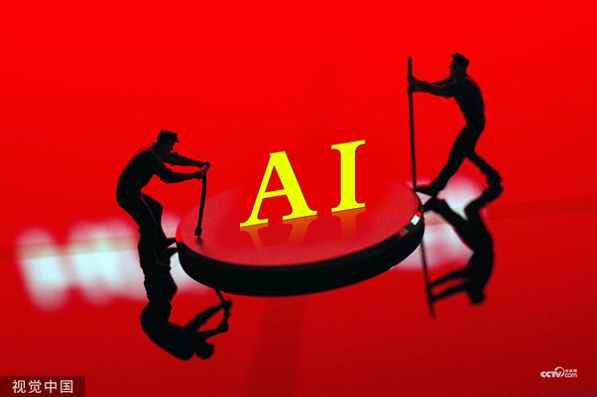

Slide 4
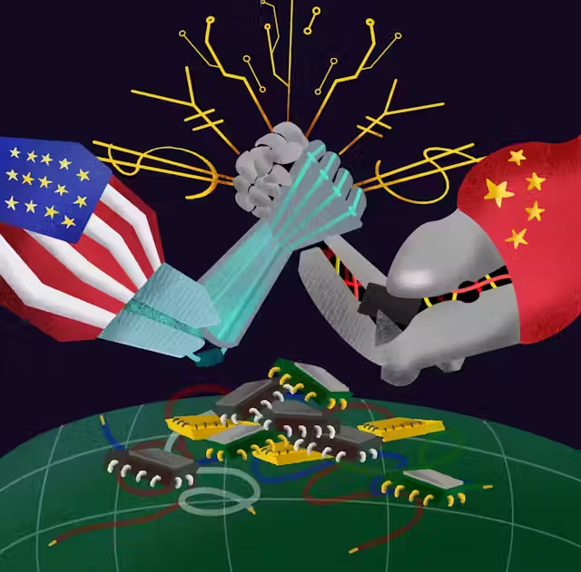
What is the AI arms race?
The AI arms race is the competitive struggle between nations, corporations, and other establishments to obtain superiority or dominance in artificial intelligence technology.
Competition is driven by the belief AI will play a huge role in future economic, military, and technological power.
Parties involved invest heavily in AI research and development in order to gain advantages that become integrated into various sectors such as national security, economic growth, and global influence.

Slide 5
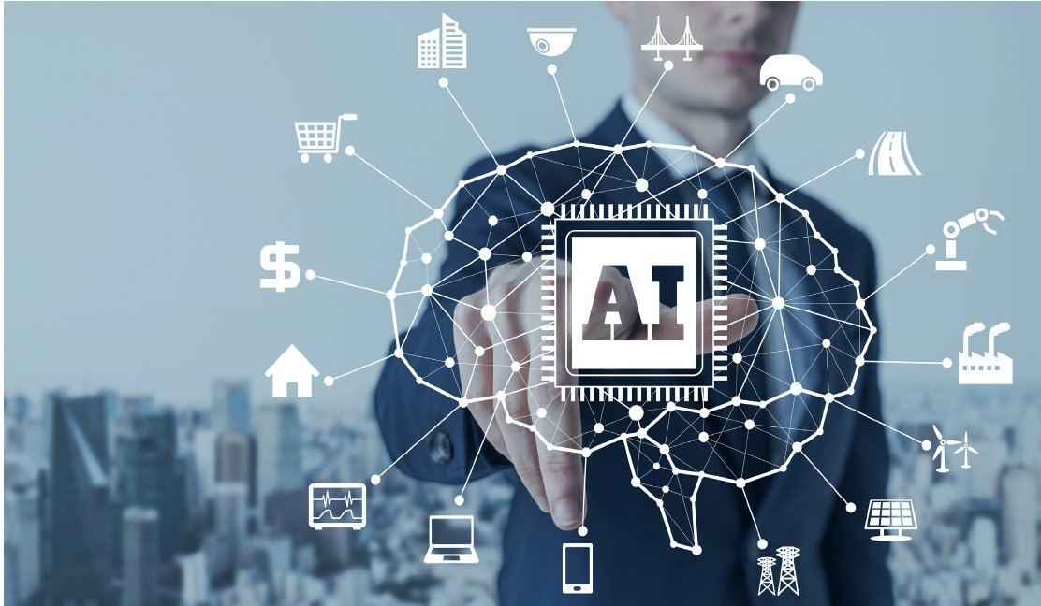
Areas of Competition
National defense
  AI-driven autonomous weapons, cyber warfare, and intelligence gathering.
Economics
  Potential of automating processes, increase productivity, redefine industries like manufacturing, finance.
Social
  Media outreach, education reforms, and cultural shifts.
Healthcare
  AI-driven diagnosis, robot assisted surgery, and patient management.
Notes:
Why is this topic important? If the belief that AI will play a huge role in the previous categories mentioned, then there could potentially shift the powers of balance between nations.

Slide 6
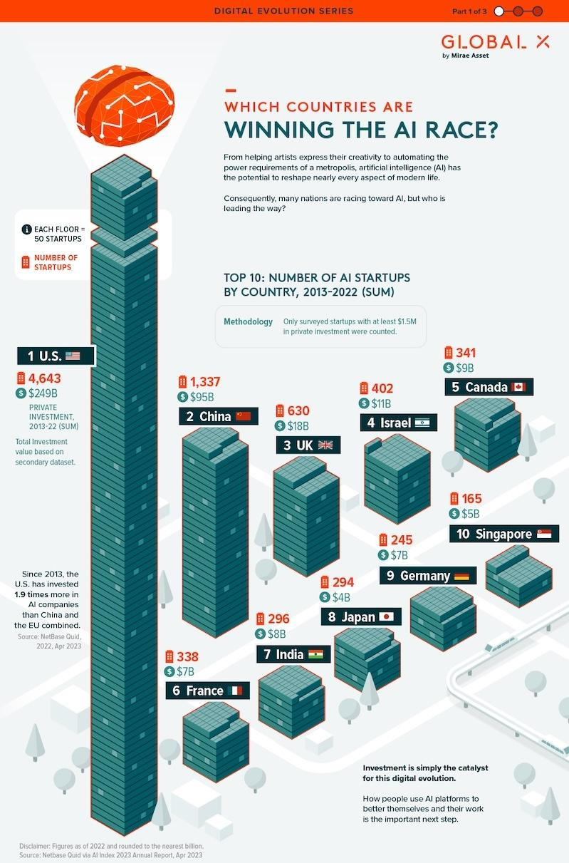

Slide 7
Key Factors Influencing AI Dominance
Government regulation
  Influences both the pace and direction of AI development
  Excessive regulation can stifle innovation
  Insufficient regulation may jeopardize individual rights
Access to Resources
  Silicon chips a core component for AI microprocessors and semiconductors
  Computational power is needed to enable processing of AI’s complex data and Algorithms
  Funding for innovation is key for R&D as well as bringing AI technologies to the market
Infrastructure Development
  Powerful computing infrastructure is necessary for advance algorithms that drive Ai
  Network reliability making sure constant connectivity for AI applications
  Education lays foundation for AI infrastructure by equipping individuals with skills to innovate and mange AI systems.
Notes:
Tim Chou

Slide 8
Current State
China
  National AI strategy focuses on data collection and applied AI.
  Competing for supremacy through broad research and development initiatives and public-private partnership.
  Advanced in facial recognition, surveillance, and social control applications.
  More government involvement
  China want to be number 1 in AI in 2030
U.S.
  Focused on private sector innovation and academic research.
  Firm on AI research fundamentals, ethical considerations, and military uses.
  Innovative models and ideas seen show how advanced America is compared to other nations.
  There is a concern, if AI companies should be given exclusive control over AI products
European Union
  More balanced approach. Concentrates on regulation, ethical guidelines, and human-centric AI.
  Excel in AI for healthcare, public services, and sustainability.
Countries are worried to use powerful AI tools from other cultures.

Slide 9
State of the Future
Both China and US are highly invested into AI and likely be AI leaders in the future
EU have higher focused on regulatory/ethical practices (France National Consultative Ethics Committee for Health and Life Sciences)
Currently, China has a lead on US in terms of academic citations and US is lagging behind in militaristic funding of AI, AI gaps are subject to change in the future
Both countries are purported to embrace regulatory practices but outcomes may appear in the forms of treaties or regulatory frameworks, however the ‘Arms Race’ will heighten tensions between countries.

Slide 10
The AI Arms Race
The Global Race for AI Dominance: Can the US Maintain Its Edge? (newsweek.com)
The AI Arms Race: How Global Powers are Vying for Dominance - AI Technology Reviews
AI arms race: This global index ranks which nations dominate AI development | ZDNET
How artificial intelligence is changing society – DW –28:10-36:00 (centering what is unique about AI in China centering on education)

Slide 11
How can the U.S. stay on top?
Continue to block exports of AI chips, tools, and investments to China
  Currently blocking export of Nvidia’s AI chips to China
  Worked with the Netherlands and Japan to block exports of chipmaking technology tools
  Biden signed an executive order blocking US investment into blacklisted Chinese AI companies
Promote an open policy regarding AI research for innovation
  The EU and China have been stricter on regulating AI
  China is less restrictive on data privacy however
Increase efforts to pull more international talent into US-based AI research
  38% of the top American researchers are Chinese-born whereas only 37% are American-born
Increase public funding for AI research
  The US currently relies on private AI spending to reach a total of $47.4 billion (2022)
  China publicly funds $3 billion into research and $13.4 billion in private AI spending (2022)
  Germany has more than doubled their public funding to one billion Euros (2023)
Improve the US education system to be more competitive
Notes:
Nathan Cao
https://www.theguardian.com/world/2024/jan/09/in-the-race-for-ai-supremacy-china-and-the-us-are-travelling-on-entirely-different-tracks
https://hbr.org/2021/02/is-china-emerging-as-the-global-leader-in-ai
https://www.axios.com/2023/06/29/us-china-chip-export-restrictions-ai-race
https://www.reuters.com/technology/us-commerce-updates-export-curbs-ai-chips-china-2024-03-29/
https://www2.deloitte.com/us/en/insights/focus/cognitive-technologies/ai-investment-by-country.html
https://www.reuters.com/technology/us-investors-have-plowed-billions-into-chinas-ai-sector-report-shows-2023-02-01/
https://apnews.com/article/biden-china-investment-ai-national-security-dd6a5b138e6c7cba31468dc89f776e8d#:~:text=WASHINGTON%20(AP)%20%E2%80%94%20President%20Joe,the%20world's%20two%20biggest%20powers.
https://macropolo.org/digital-projects/the-global-ai-talent-tracker/
http://www.bhpanel.org/china-or-the-us-who-has-the-better-education-system/

Slide 12
More References
https://www.theguardian.com/world/2024/jan/09/in-the-race-for-ai-supremacy-china-and-the-us-are-travelling-on-entirely-different-tracks
https://hbr.org/2021/02/is-china-emerging-as-the-global-leader-in-ai
https://www.axios.com/2023/06/29/us-china-chip-export-restrictions-ai-race
https://www.reuters.com/technology/us-commerce-updates-export-curbs-ai-chips-china-2024-03-29/
https://www2.deloitte.com/us/en/insights/focus/cognitive-technologies/ai-investment-by-country.html
https://www.reuters.com/technology/us-investors-have-plowed-billions-into-chinas-ai-sector-report-shows-2023-02-01/
https://apnews.com/article/biden-china-investment-ai-national-security-dd6a5b138e6c7cba31468dc89f776e8d#:~:text=WASHINGTON%20(AP)%20%E2%80%94%20President%20Joe,the%20world's%20two%20biggest%20powers.
https://macropolo.org/digital-projects/the-global-ai-talent-tracker/
https://aitechnologyreviews.com/2023/12/05/the-ai-arms-race-how-global-powers-are-vying-for-dominance/
https://www.newsweek.com/global-race-ai-dominance-can-us-maintain-its-edge-1828232
https://digichina.stanford.edu/work/full-translation-chinas-new-generation-artificial-intelligence-development-plan-2017/
https://www.visualcapitalist.com/sp/global-ai-investment/

