Slide 1
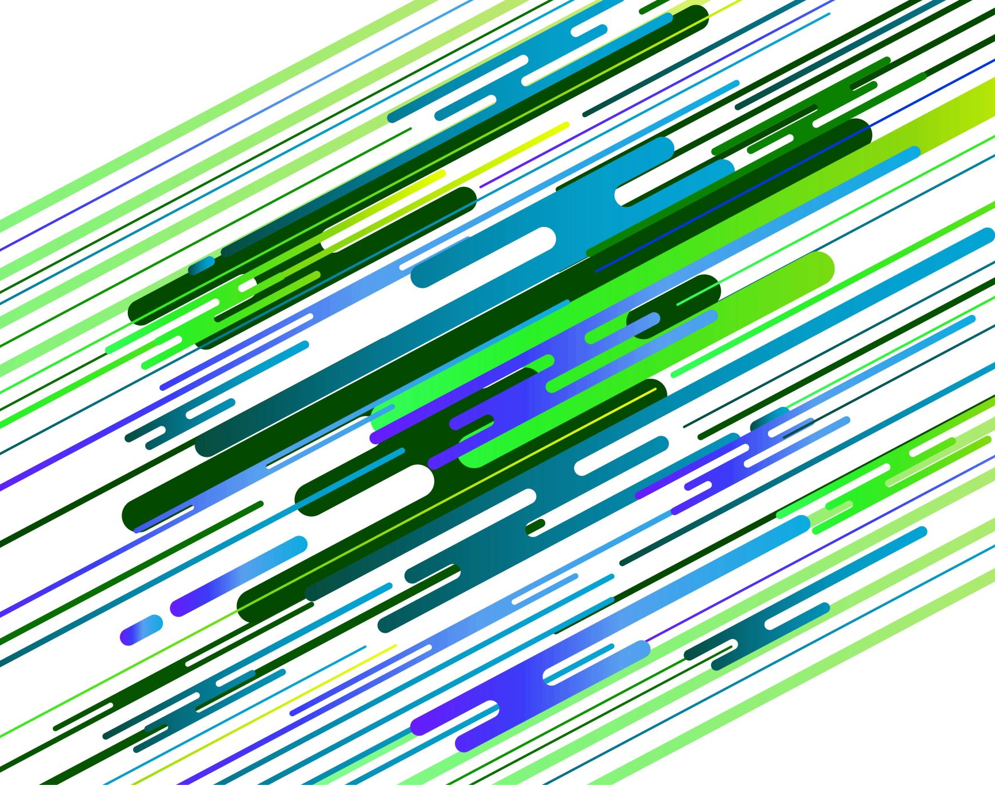
Autoencoders and Variational Autoencoders
Md Mahin
COSC 4368
March 25, 2024

Slide 2
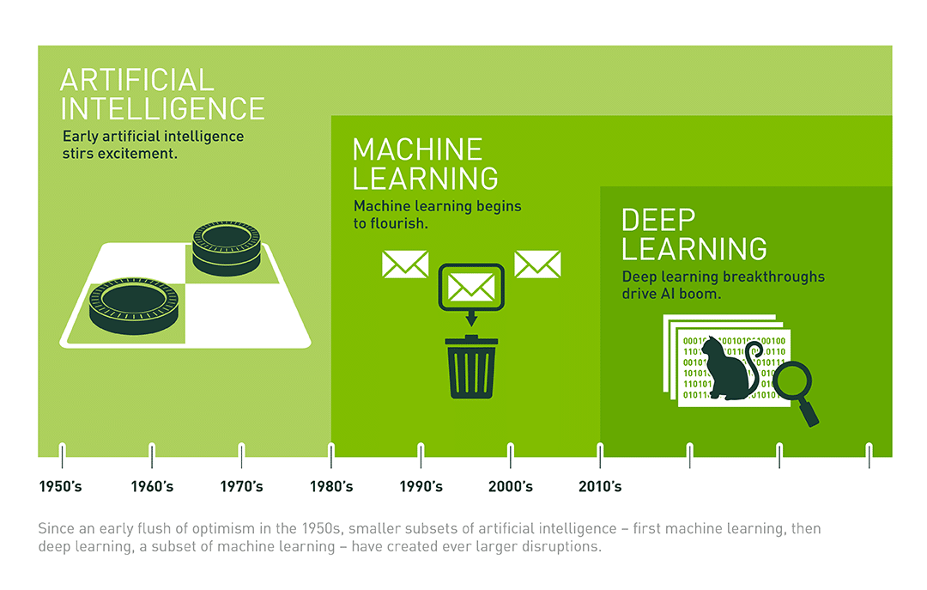
Introduction
Deep Dive:
https://people.idsia.ch/~juergen/deep-learning-history.html
Source:
Nvidia (2016) https://blogs.nvidia.com/blog/whats-difference-artificial-intelligence-machine-learning-deep-learning-ai/

Slide 3
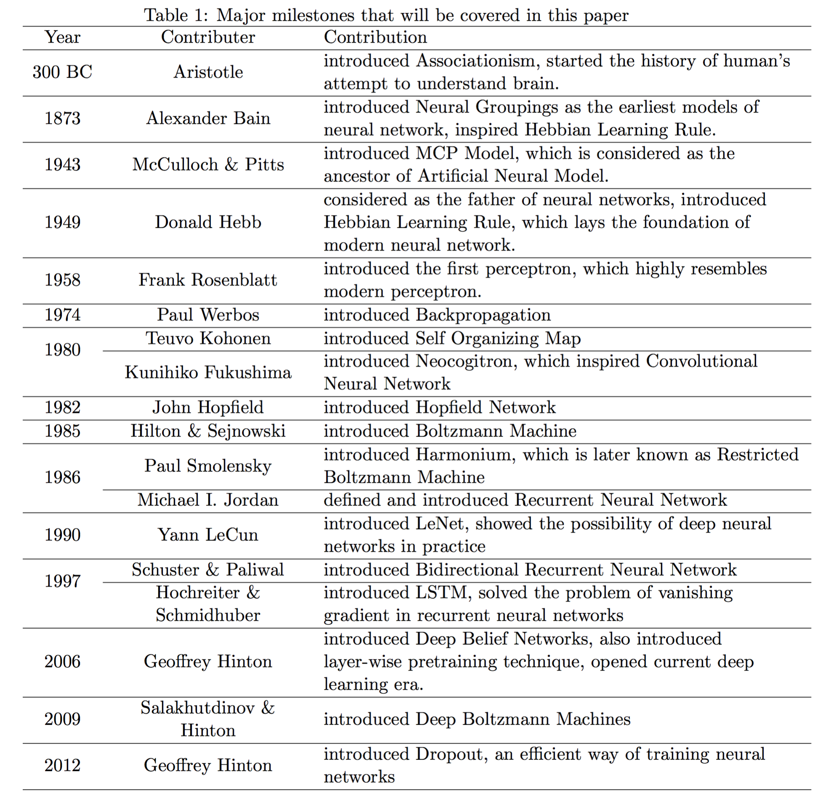
The Origins of Modern Deep Learning
Source: Wang & Raj: On the Origin of Deep Learning (2017)
2014 Ian Goodfellow, et al Generative adversarial networks
2015 Kaiming He et al. Deep residual learning for image recognition
2017 Google Transformer “Attention is all you need”.
Notes:
Learning representations by back-propagating errors (1986) by David Rumelhart, Geoffrey Hinton, and Ronald Williams: This paper introduced the backpropagation algorithm, which is a crucial technique for training neural networks.
Gradient-based learning applied to document recognition (1998) by Yann LeCun, Léon Bottou, Yoshua Bengio, and Patrick Haffner: This paper demonstrated the effectiveness of deep learning for image recognition tasks.
Reducing the dimensionality of data with neural networks (2006) by Geoffrey Hinton and Ruslan Salakhutdinov: This paper introduced the concept of autoencoders, which are neural networks that can learn to compress and reconstruct data.
Learning deep architectures for AI (2007) by Yoshua Bengio: This paper provided a comprehensive overview of deep learning and its potential applications.
A fast learning algorithm for deep belief nets (2006) by Geoffrey Hinton: This paper introduced the use of contrastive divergence for training deep belief nets, which are a type of neural network that can learn unsupervised features from data.
Deep residual learning for image recognition (2015) by Kaiming He, Xiangyu Zhang, Shaoqing Ren, and Jian Sun: This paper introduced the concept of residual connections, which made it possible to train very deep neural networks for image recognition.
Attention is all you need (2017) by Vaswani, Ashish, et al.: This paper introduced the transformer architecture, which is a type of neural network that is particularly well-suited for natural language processing tasks.
Generative adversarial networks (2014) by Ian Goodfellow, Jean Pouget-Abadie, Mehdi Mirza, Bing Xu, David Warde-Farley, Sherjil Ahmed, and Aaron Courville: This paper introduced generative adversarial networks (GANs), which are a type of neural network that can be used to generate realistic images, videos, and other types of data.

Slide 4
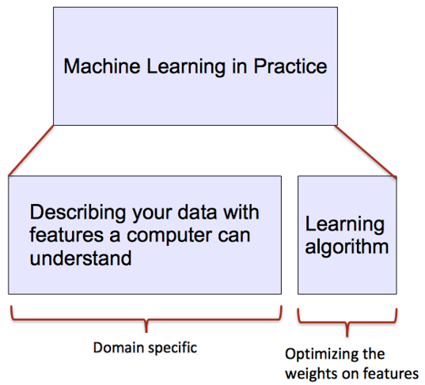
ML vs DL
Conventional machine learning methods rely on human-designed feature representations
ML becomes just optimizing weights to best make a final prediction

Slide 5
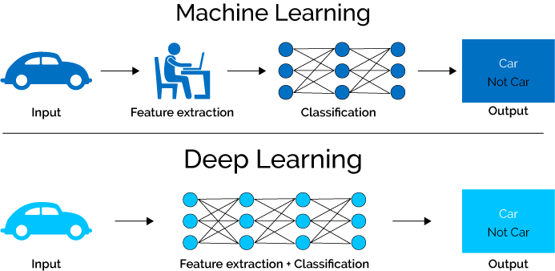
ML vs DL
Deep learning (DL) is a machine learning subfield that uses multiple layers for learning data representations
DL is exceptionally effective at learning patterns

Slide 6
Autoencoders
Supervised learning uses explicit labels/correct output in order to train a network.
E.g., classification of images.
Unsupervised learning relies on data only.
E.g., CBOW and skip-gram word embeddings: the output is determined implicitly from word order in the input data.
Key point is to produce a useful embedding of words.
The embedding encodes structure such as word similarity and some relationships.
Still need to define a loss – this is an implicit supervision.

Slide 7
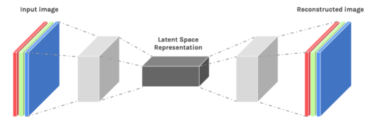
Autoencoders
Autoencoders are designed to reproduce their input, especially for images.
Key point is to reproduce the input from a learned encoding.
https://www.edureka.co/blog/autoencoders-tutorial/

Slide 8
Autoencoders
Compare PCA/SVD
PCA takes a collection of vectors (images) and produces a usually smaller set of vectors that can be used to approximate the input vectors via linear combination.
Very efficient for certain applications.
Fourier and wavelet compression is similar.
Neural network autoencoders
Can learn nonlinear dependencies
Can use convolutional layers
Can use transfer learning
https://www.edureka.co/blog/autoencoders-tutorial/

Slide 9
Autoencoders: structure
Encoder: compress input into a latent-space of usually smaller dimension. h = f(x)
Decoder: reconstruct input from the latent space. r = g(f(x)) with r as close to x as possible
https://towardsdatascience.com/deep-inside-autoencoders-7e41f319999f

Slide 10
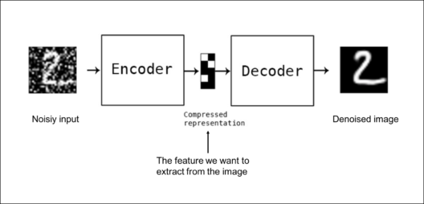
Autoencoders: applications
Denoising: input clean image + noise and train to reproduce the clean image.
https://www.edureka.co/blog/autoencoders-tutorial/

Slide 11
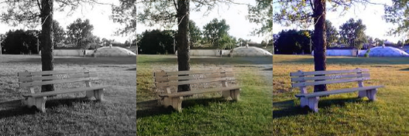
Autoencoders: Applications
Image colorization: input black and white and train to produce color images
https://www.edureka.co/blog/autoencoders-tutorial/

Slide 12
Autoencoders: Applications
Watermark removal
https://www.edureka.co/blog/autoencoders-tutorial/

Slide 13
Properties of Autoencoders
Data-specific: Autoencoders are only able to compress data similar to what they have been trained on.
Lossy: The decompressed outputs will be degraded compared to the original inputs.
Learned automatically from examples: It is easy to train specialized instances of the algorithm that will perform well on a specific type of input.
https://www.edureka.co/blog/autoencoders-tutorial/

Slide 14
Capacity
As with other NNs, overfitting is a problem when capacity is too large for the data.
Autoencoders address this through some combination of:
Bottleneck layer – fewer degrees of freedom than in possible outputs.
Training to denoise.
Sparsity through regularization.
Contractive penalty.

Slide 15
Bottleneck layer (undercomplete)
Suppose input images are nxn and the latent space is m < nxn.
Then the latent space is not sufficient to reproduce all images.
Needs to learn an encoding that captures the important features in training data, sufficient for approximate reconstruction.

Slide 16
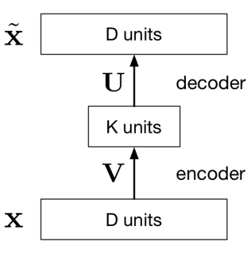
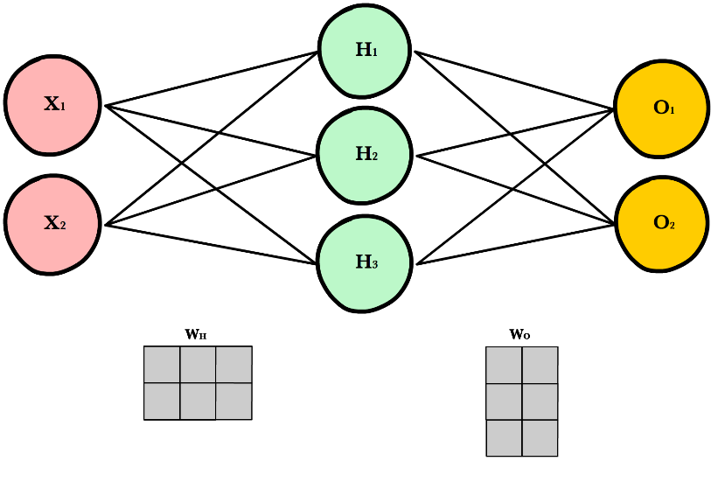
How Autoencoders Works
x: Input vector or array
$\hat{x}:$ Output vector or array
V: A matrix of weights. For example if D has 3 neurons, K has 2 neuron, for every connection there will be a weight and it is a 3 * 2 weight matrix
U: Another matrix of weights. For example if D has 3 neurons, K has 2 neuron, for every connection there will be a weight and it is a 2 * 3 weight matrix

Slide 17
How it works
Vx: A matrix multiplication project D dimensional x to k dimensional plane. Shown for 3 to 2. Dimensionality Reduction
Ux : Project k dimensional hidden unit to D dimensional $\hat{x}$
Overall Output is: $\hat{x}=UVx$ [A linear function]
How it learn:
Learn the U, V matrix or all weights so that we get minimum loss
L(x, $\hat{x})={|\left|x−\hat{x}\right||}^{2}$
We minimize L to learn U,V

Slide 18
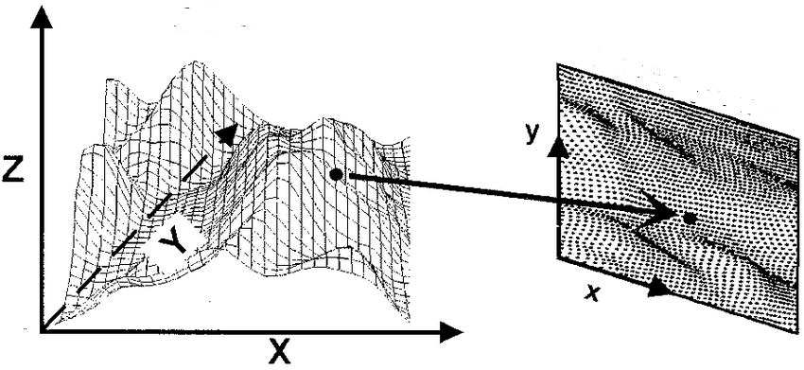
Real Life Similarity
You take a picture (3D-> 2D)
Create a 3D print from the 2D plot

Slide 19
Simple bottleneck layer in Keras
input_img = Input(shape=(784,))
encoding_dim = 32
encoded = Dense(encoding_dim, activation='relu')(input_img)
decoded = Dense(784, activation='sigmoid')(encoded)
autoencoder = Model(input_img, decoded)
Maps 28x28 images into a 32 dimensional vector.
Can also use more layers and/or convolutions.
https://blog.keras.io/building-autoencoders-in-keras.html

Slide 20
Denoising autoencoders
Basic autoencoder trains to minimize the loss between x and the reconstruction g(f(x)).
Denoising autoencoders train to minimize the loss between x and g(f(x+w)), where w is random noise.
Same possible architectures, different training data.
Kaggle has a dataset on damaged documents.
https://blog.keras.io/building-autoencoders-in-keras.html

Slide 21
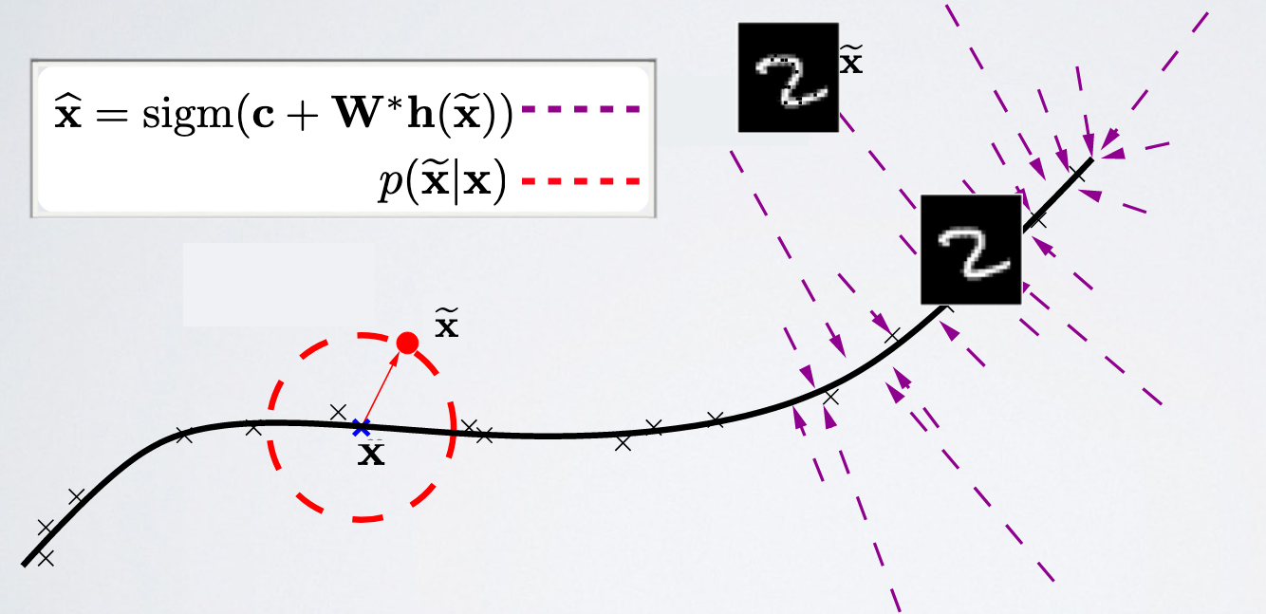
Denoising autoencoders
Denoising autoencoders can’t simply memorize the input output relationship.
Intuitively, a denoising autoencoder learns a projection from a neighborhood of our training data back onto the training data.
https://ift6266h17.files.wordpress.com/2017/03/14_autoencoders.pdf

Slide 22
Sparse autoencoders
Construct a loss function to penalize activations within a layer.
Usually regularize the weights of a network, not the activations.
Individual nodes of a trained model that activate are data-dependent.
Different inputs will result in activations of different nodes through the network.
Selectively activate regions of the network depending on the input data.
Good for learning features, learn specific feature by making the encoder sensitive for those features while insensitive for other features
Example use: outlier detection
https://www.jeremyjordan.me/autoencoders/

Slide 23
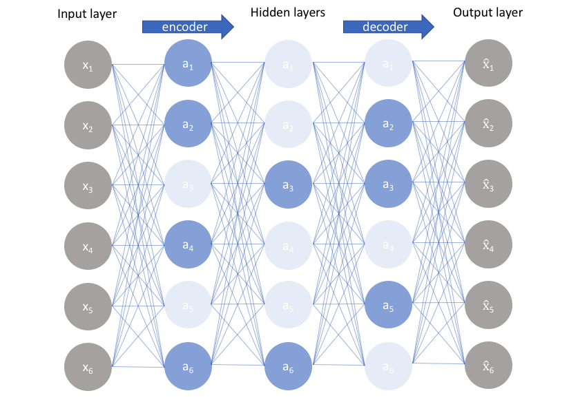
Sparse autoencoders
Construct a loss function to penalize activations the network.
L1 Regularization: Penalize the absolute value of the vector of activations a in layer h for observation I
KL divergence: Use cross-entropy between
average activation and desired activation
https://www.jeremyjordan.me/autoencoders/

Slide 24
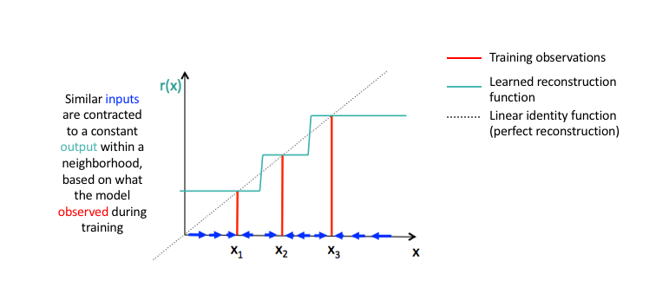
Contractive autoencoders
Arrange for similar inputs to have similar activations.
I.e., the derivative of the hidden layer activations are small with respect to the input.
Denoising autoencoders make the reconstruction function (encoder+decoder) resist small perturbations of the input
Contractive autoencoders
make the feature extraction
function (ie. encoder)
resist infinitesimal perturbations
of the input.
https://www.jeremyjordan.me/autoencoders/

Slide 25
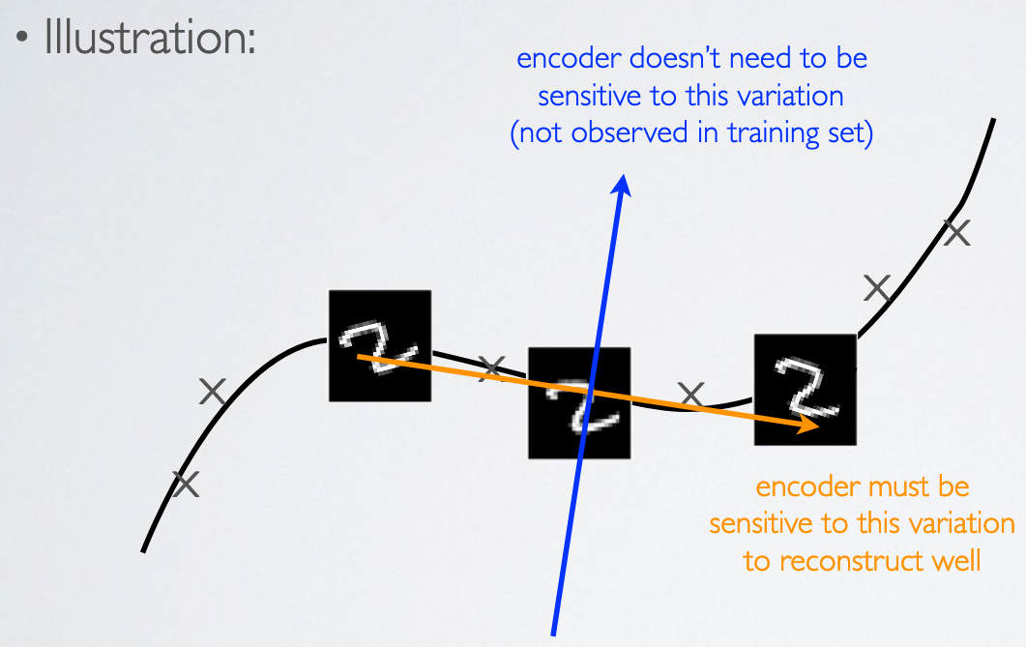
Contractive autoencoders
Contractive autoencoders make the feature extraction function (ie. encoder) resist infinitesimal perturbations of the input.
https://ift6266h17.files.wordpress.com/2017/03/14_autoencoders.pdf

Slide 26
Autoencoders
Both the denoising and contractive autoencoder can perform well
Advantage of denoising autoencoder : simpler to implement-requires adding one or two lines of code to regular autoencoder-no need to compute Jacobian of hidden layer
Advantage of contractive autoencoder : gradient is deterministic -can use second order optimizers (conjugate gradient, LBFGS, etc.)-might be more stable than denoising autoencoder, which uses a sampled gradient
To learn more on contractive autoencoders:
Contractive Auto-Encoders: Explicit Invariance During Feature Extraction. Salah Rifai, Pascal Vincent, Xavier Muller, Xavier Glorot et Yoshua Bengio, 2011.
https://ift6266h17.files.wordpress.com/2017/03/14_autoencoders.pdf

Slide 27
Where Autoencoders Suffers
"collapsing problem" where the hidden layer representation becomes overly simplified. All inputs might map to a single point in the latent space, hindering the model's ability to capture diverse features.
Good at Reconstruction, Bad at Generation: Primarily focus on reconstruction, aiming to recreate the original input from the compressed code. As a result do not have generative capabilities.

Slide 28
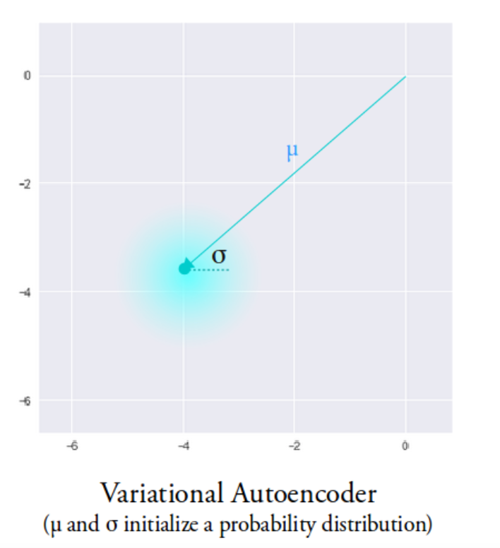
Variational Autoencoder (Kingma and Welling, 2013)
The VAE latent space is continuous
Allows easy random sampling and interpolation
Instead of outputting a vector of size n, the encoder outputs two vectors:
Vector 𝝁 of means (vector size n)
Vector 𝝈 of standard deviations (vector size n)
Output is an approximate posterior distribution q(z|x)
Sample from this distribution to get z
Image source: https://towardsdatascience.com/intuitively-understanding-variational-autoencoders-1bfe67eb5daf

Slide 29
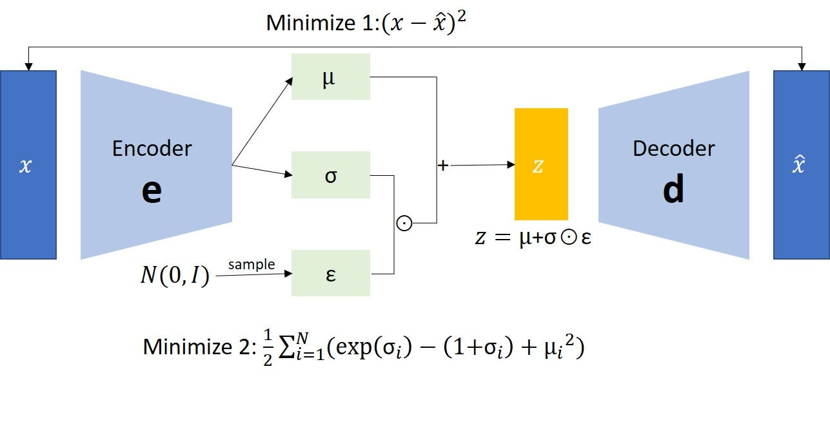
Variational Autoencoder (VAE)
Source: https://medium.com/geekculture/variational-autoencoder-vae-9b8ce5475f68

Slide 30
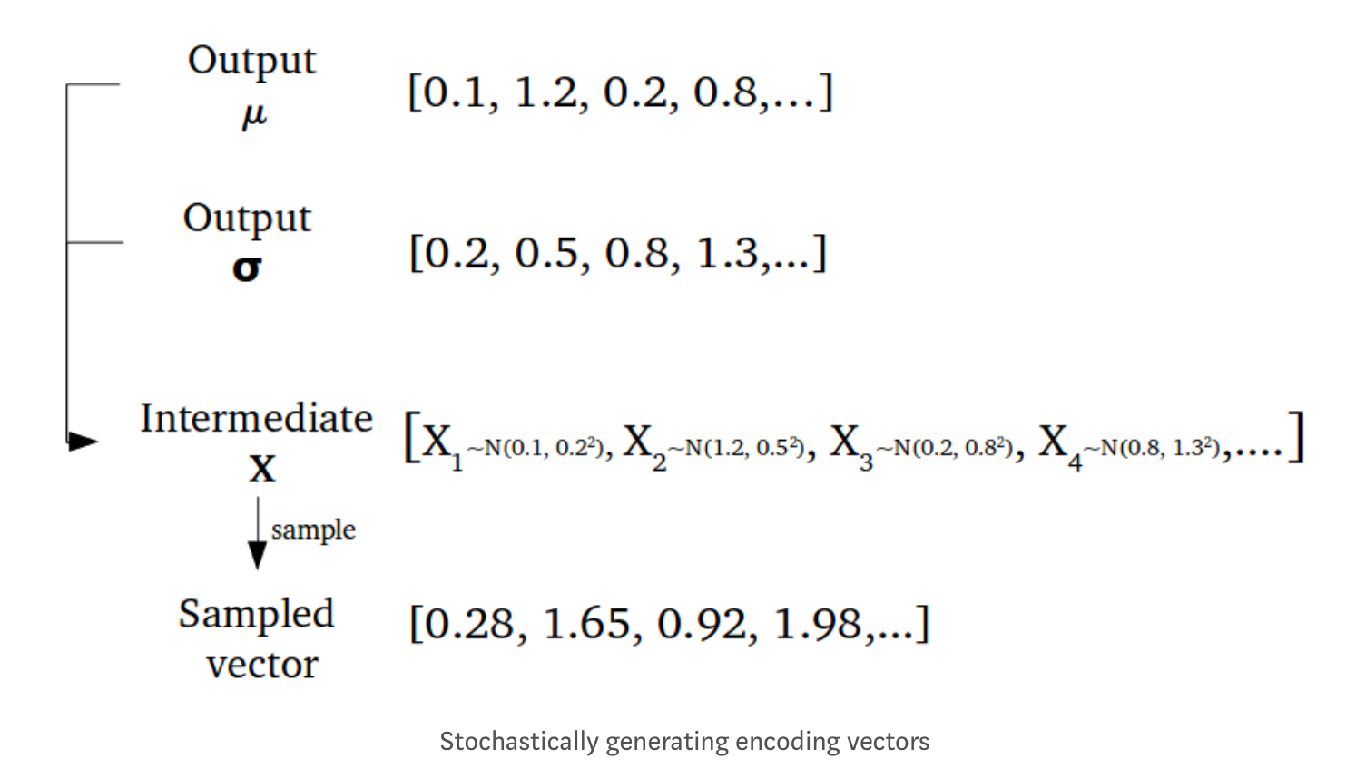
Sampling example
Source: https://towardsdatascience.com/intuitively-understanding-variational-autoencoders-1bfe67eb5daf

Slide 31
Standard Autoencoder vs VAE

Slide 32
VAE Latent Space and Sampling
While the mean and standard deviation are the same for one input, the results are different due to sampling
The encoder can learn to:
Generate different 𝝁 for different classes, clustering them apart
Minimize 𝝈 to ensure that the encodings don’t vary too much

Slide 33
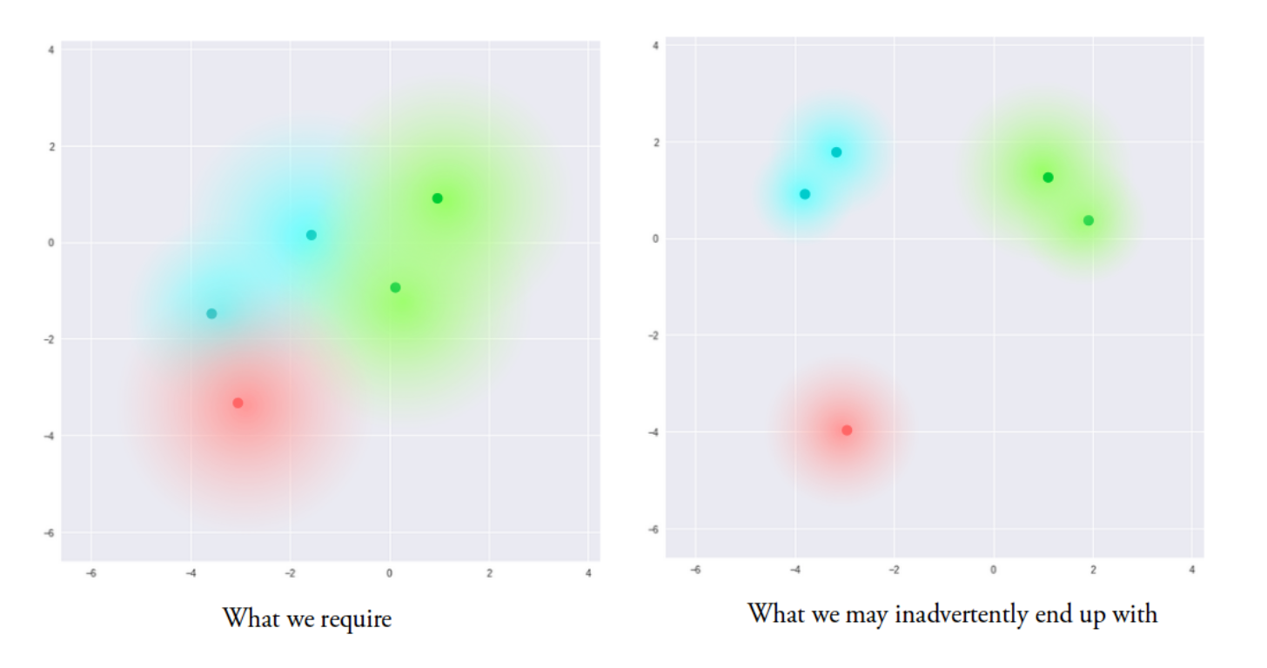
But there is a problem...
Source: https://towardsdatascience.com/intuitively-understanding-variational-autoencoders-1bfe67eb5daf
Notes:
The model is now exposed to a certain degree of local variation by varying the encoding of one sample, resulting in smooth latent spaces on a local scale, that is, for similar samples. Ideally, we want overlap between samples that are not very similar too, in order to interpolate between classes. However, since there are no limits on what values vectors μ and σ can take on, the encoder can learn to generate very different μ for different classes, clustering them apart, and minimize σ, making sure the encodings themselves don’t vary much for the same sample (that is, less uncertainty for the decoder). This allows the decoder to efficiently reconstruct the training data.
What we ideally want are encodings, all of which are as close as possible to each other while still being distinct, allowing smooth interpolation, and enabling the construction of new samples.

Slide 34
Solution: Kullback-Leibler divergence
KL divergence is a measure of divergence between two distributions
Minimizing KL divergence means:
Optimizing 𝝁 and 𝝈 of one distribution to resemble 𝝁 and 𝝈 of the target distribution
KL divergence is the sum of KL divergences between the component X_{j}~N(μ_{j}, σ_{j}²) in X, and the standard normal
Notes:
In order to force this, we introduce the Kullback–Leibler divergence (KL divergence[2]) into the loss function. The KL divergence between two probability distributions simply measures how much they diverge from each other. Minimizing the KL divergence here means optimizing the probability distribution parameters (μ and σ) to closely resemble that of the target distribution.

Slide 35
VAE loss
KL objective is to minimize the divergence between the approximate posterior q(z|x) and the prior p(z)~N(0,I)
VAE total loss = Reconstruction loss (cross-entropy) + KL loss
𝜃 – model parameters

Slide 36
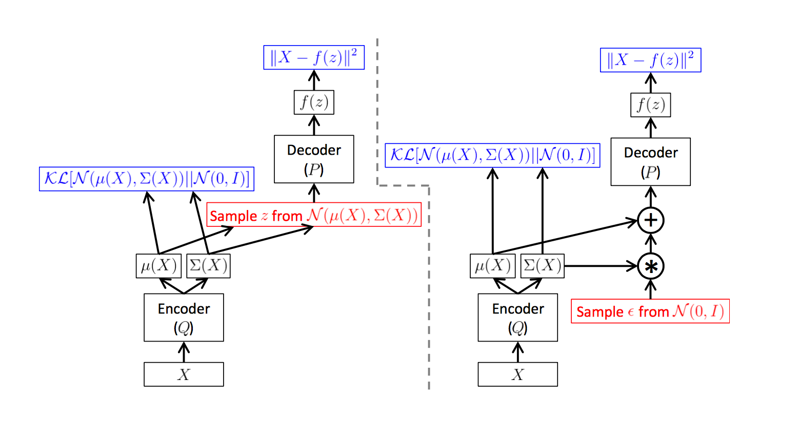
Reparameterization trick
Source: C. Doersch “Tutorial on Variational Autoencoders” (https://arxiv.org/pdf/1606.05908.pdf)
Notes:
A training-time variational autoencoder implemented as a feed-forward neural network, where P(X|z) is Gaussian. Left is without the“reparameterization trick”, and right is with it. Red shows sampling operations that are non-differentiable. Blue shows loss layers. The feedforward behavior of these networks is identical, but backpropagation can be applied only to the right network.
The VAE predicts the parameters of a distribution which then is used to generate encoded embeddings. This process of sampling from a distribution that is parameterized by our model is not differentiable. If something is not differentiable that is a problem, at least for gradient-based approaches like ours. So we need some method of making our predictions separate from the stochastic sampling element.
3. The Solution: Reparameterization
We can solve this problem by applying the reparameterization trick to our embedding function. What does that mean? It means rewriting our implementation of how we parameterize our Gaussian sampling. We now treat random sampling as a noise term.
In the case of a Gaussian distribution, we treat our noise as a standard normal distribution. That is, a Gaussian that has a mean and a variance of . This noise term is now independent of and not parameterized by our model.
A nice property of the Gaussian is that to change the mean and variance of a sample we can simply add the mean and multiply by the variance. This has the effect of scaling a sample from our noise distribution. The benefit is the prediction of mean and variance is now no longer tied to the stochastic sampling operation. This means that we can now differentiate with respect to our models’ parameters again.

Slide 37
Visualizing the VAE latent space
MNIST handwritten digit dataset
Smooth interpolation between two points is possible
Image source: https://towardsdatascience.com/intuitively-understanding-variational-autoencoders-1bfe67eb5daf

Slide 38
VAE optimization challenges
Successfully trained model should have:
non-zero KL term
small cross-entropy term
Straightforward implementation fails to achieve this
KL term drops to zero
What are the consequences?

