Slide 1
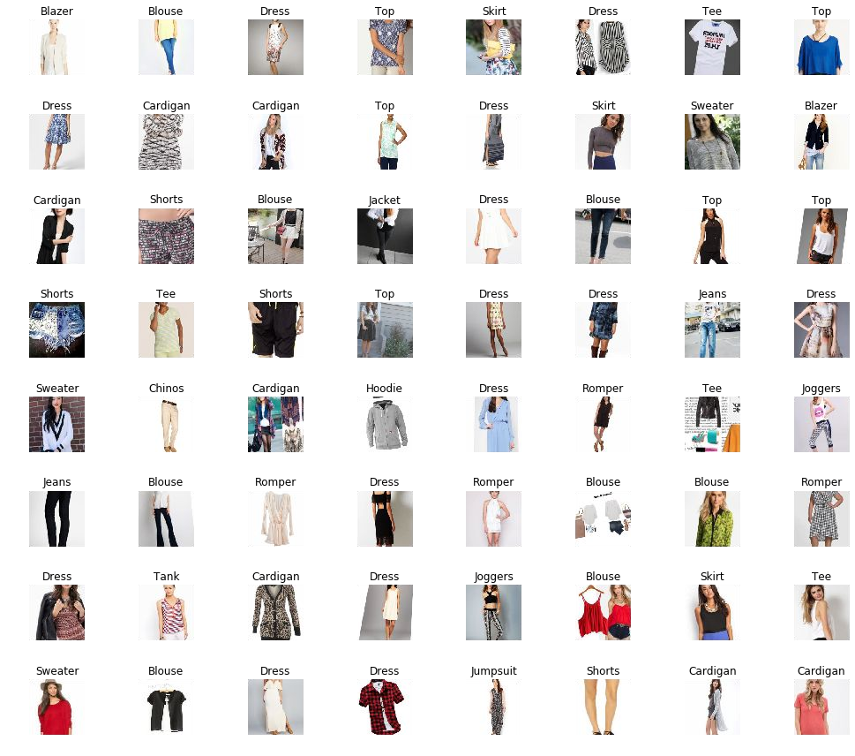
Convolutional Neural Networks (CNNs)
COSC 4368 Fundamentals of AI
TA: Natnael Sinshaw
Email: ntilahun@cougarnet.uh.edu

Slide 2
What We'll Cover Today
01
Why CNN?
02
Architecture Overview
The problem with regular neural networks for image recognition
The building blocks of CNNs
03
Convolution & Pooling
04
Complete Pipeline
Feature extraction and downsampling
From input to classification
05
Famous Architectures
06
Data augmentation & Transfer learning
LeNet, AlexNet, VGG, ResNet
How these two approaches used in CNN

Slide 3
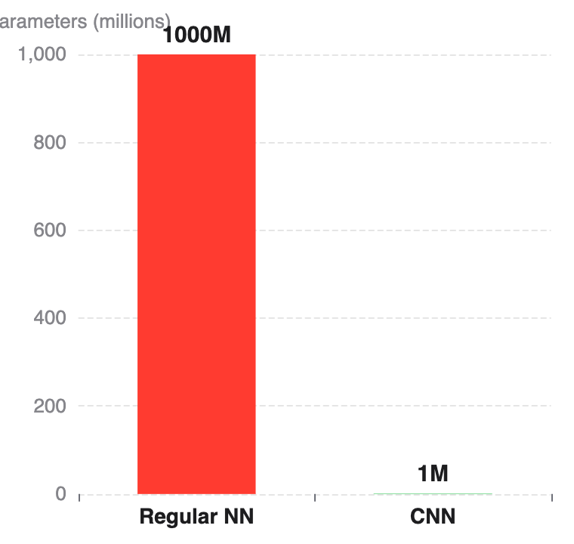
The Image Recognition Challenge
Why regular neural networks fail with images
The Problem
Parameter Comparison
❌ Full connectivity is wasteful
A 1000×1000 image has 1 million pixels. Connecting each to 1000 neurons = 1 billion parameters!
❌ Spatial structure is lost
Flattening destroys the 2D spatial relationships between pixels that are crucial for understanding images.
❌ Massive overfitting risk
With so many parameters, the model memorizes training data instead of learning general patterns.
The Solution: CNN
✓ Local connectivity: Each neuron connects only to a small region (receptive field)
✓ Parameter sharing: Same filter slides across entire image, detecting features everywhere
CNNs reduce parameters by 99.9% while preserving spatial information!
✓ Hierarchical features: Automatically learns edges → textures → shapes → objects

Slide 4
Architecture Comparison
How CNNs solve the parameter explosion problem
Regular Neural Network
Convolutional Neural Network
Architecture
Architecture
Input → Flatten → Dense Layers → Output
Input → Conv → ReLU → Pool → [Repeat] → Flatten → Dense → Output
How it works:
How it works:
1.
Image is flattened to 1D vector
1.
Filters slide across image (local connectivity)
2.
Every pixel connects to every neuron
2.
Same filter used everywhere (parameter sharing)
3.
Spatial relationships are destroyed
3.
Spatial structure is preserved
Example: 28×28 image
Example: 28×28 image
784 pixels × 1000 neurons = 784,000 parameters in first layer alone!
32 filters × (3×3 + 1 bias) = 320 parameters in first layer!
Regular NN
vs
CNN
2,450× fewer parameters!
784,000 params (layer 1)
320 params (layer 1)

Slide 5

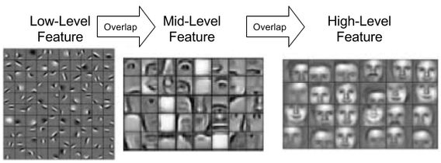
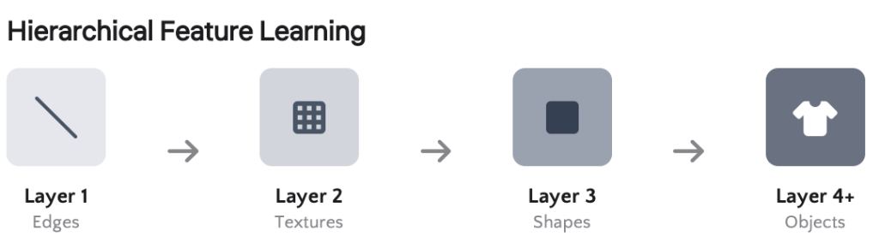
Why CNN?
Task: Images recognition, video processing (grid-like data)
Learn hierarchical feature map

Slide 6
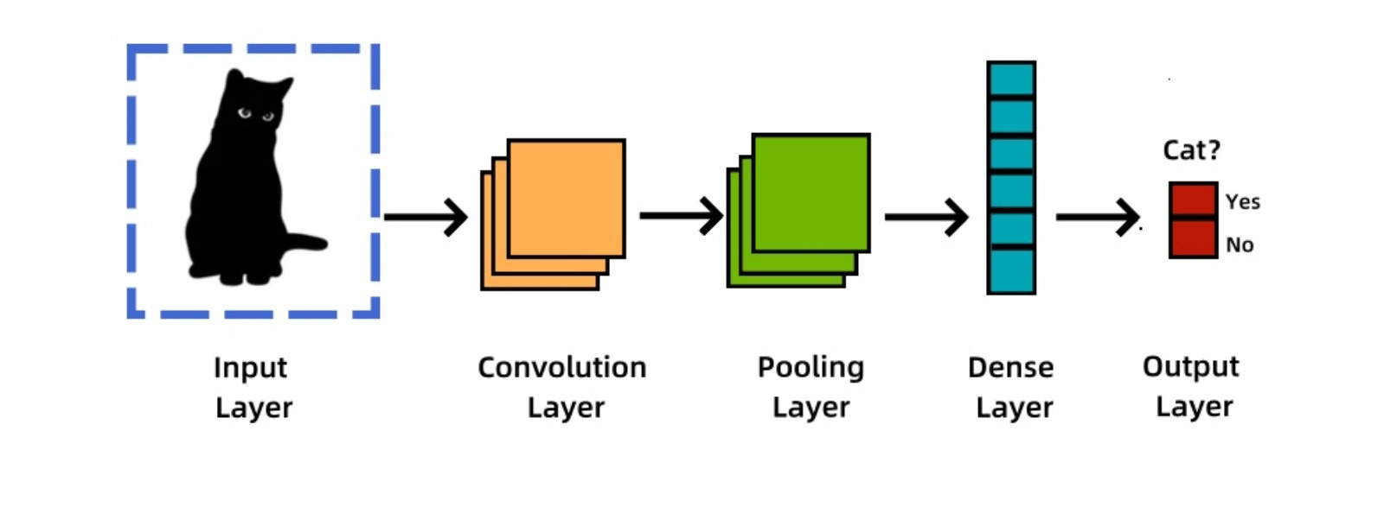
CNNs
Other names
ConvNet
CNN Model
Deep Convolutional Networks
Layers
What is it?
Input(2D or 3D input)
Convolutional Layer
Pooling Layer
Fully Connected Layers
Additional like [Dropout Layer]
Are neural network architectures inspired by the human visual system.
Are widely used in computer vision tasks.

Slide 7
High-level features
Low-level features
Mid-level features

Slide 8
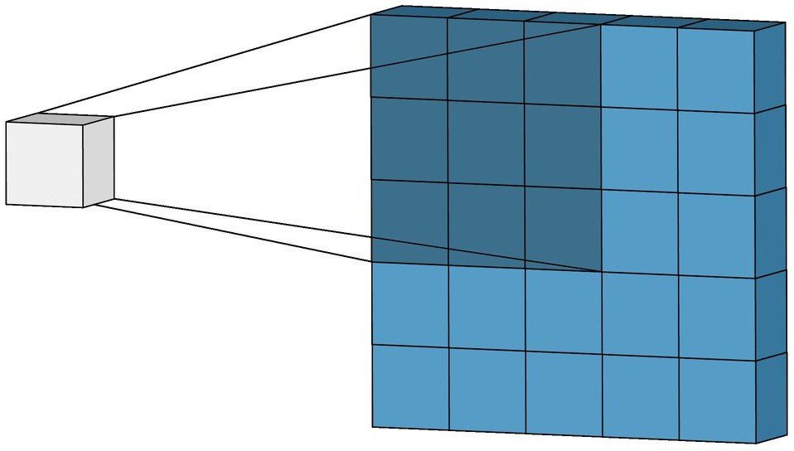
Convolution Operation – Kernel
Input Image
Kernel (filter) slides or convolves across the input image to learn features
We need to decide:
Feature Map
The size of kernels (big kernel learn big features)
The number of kernels (more kernels the model learn more diversified features)
How many pixels the kernel moves
→ stride
Key Concepts
1
Kernel/Filter
Small matrix (e.g., 3×3) that slides across the image to detect specific features like edges, textures, or shapes.
2
Feature Map
Output matrix showing where the filter detected its pattern. Brighter = stronger match.
3
Multiple Filters
Each layer has multiple filters (e.g., 32, 64, 128) to detect different features simultaneously.

Slide 9
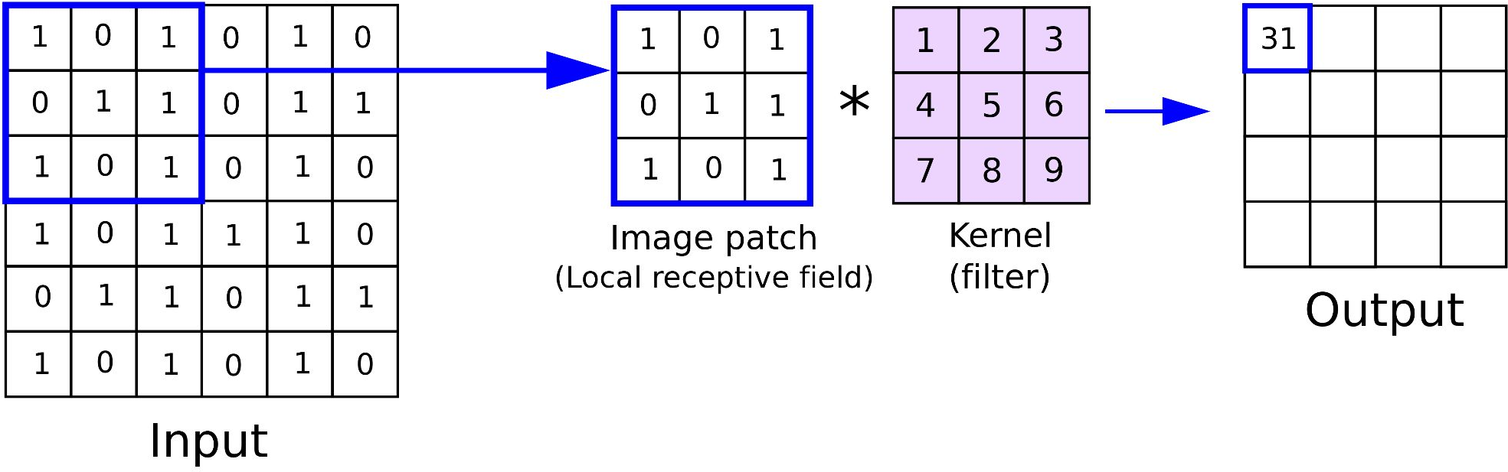
Convolution Operation
How much weight the region has this feature
(1×1) + (0×2) + (1×3)+(0×4) + (1×5) + (1×6) (1×7) + (0×8) + (1×9) = 1 + 0 + 3 + 0 + 5 + 6 + 7 + 0 + 9 = 31
(4x4)
Input (6x6)

Slide 10
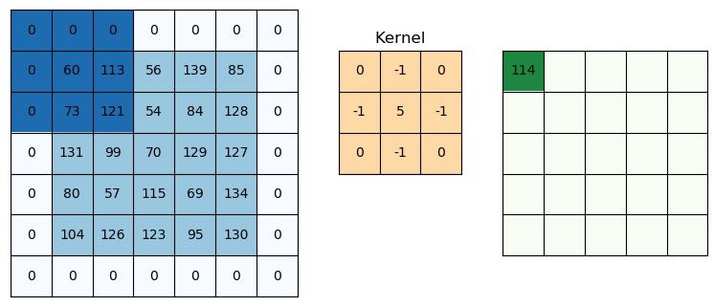
Convolution Operation – Padding
1. Valid Padding: no padding
Output size: , where n is the input size, f kernel size
1+(n − f)/s
Same Padding (Zero Padding): preserve the same size
Padding = 1
Output size:
1+(n + 2p - f )/s
Output size
1+(5 + 2 x 1 - 3)/1 = 5

Slide 11

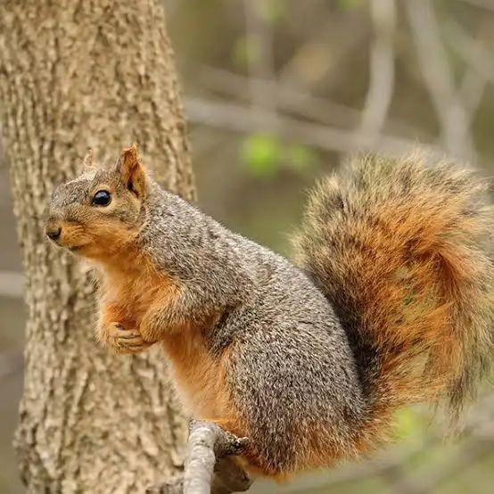
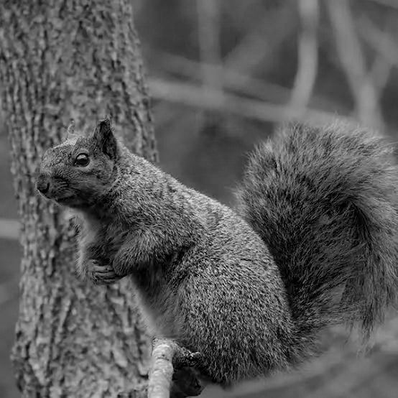
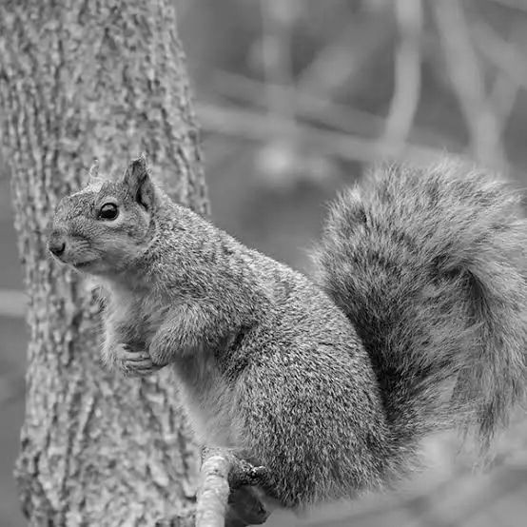
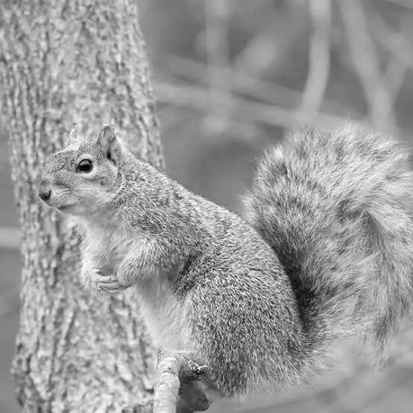

Pooling Operation (downsampling or subsampling)
Purpose: to reduce the spatial dimensions of feature maps
Control the size of filter and sliding stride over each channel (depth) of the whole image.
Channel 1
Channel 2
Channel 3

Slide 12
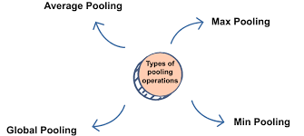
Spatial Downsampling
Reducing dimensions while preserving important information
Pooling Operation
Why Pooling?
Reduce Computation
Smaller feature maps = fewer parameters and faster training
Translation Invariance
Small shifts in input don't change the output dramatically
Prevent Overfitting
Reduces redundant information, forces learning of robust features
Control Model Size
Essential for deep networks with many layers
Max Pooling
Average Pooling
Takes the maximum value in each window. Most commonly used.
Takes the average value in each window. Smoother downsampling.
Pros: Preserves strongest activation, detects presence of features
Pros: Preserves background info, smoother transitions
Common: 2×2 window, stride 2 (reduces size by 75%)
Use case: Final layers, when you want to retain more context

Slide 13

Examples of Pooling
Max Pooling
Pooling filter 2x2
Stride 2x2
Average Pooling
2 | 3
1 | 3
0 | 2 | 1 | 3
2 | 0 | 3 | 1
1 | 0 | 3 | 2
0 | 0 | 0 | 1
1 | 2
1/4 | 6/4
Output size
(4 - 2)/2 + 1 = 2
Feature Map
Output size = [(n - f) / stride] + 1

Slide 14
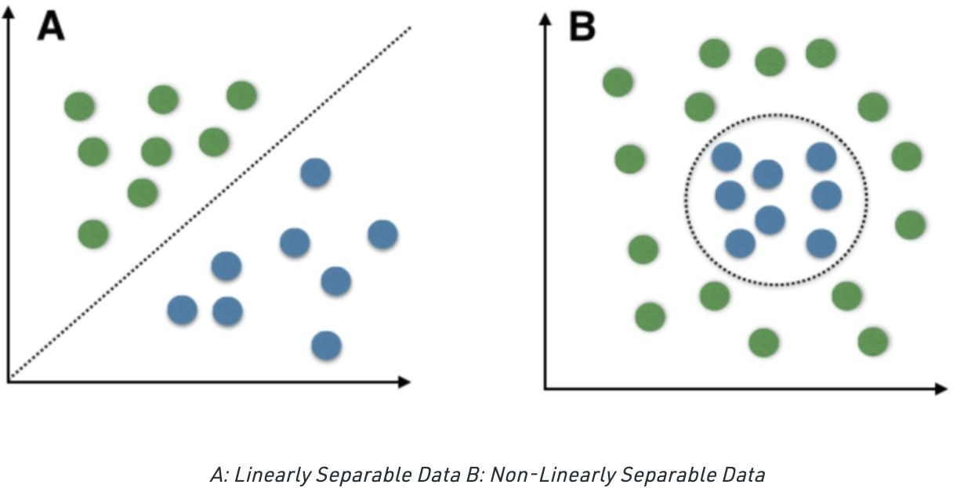
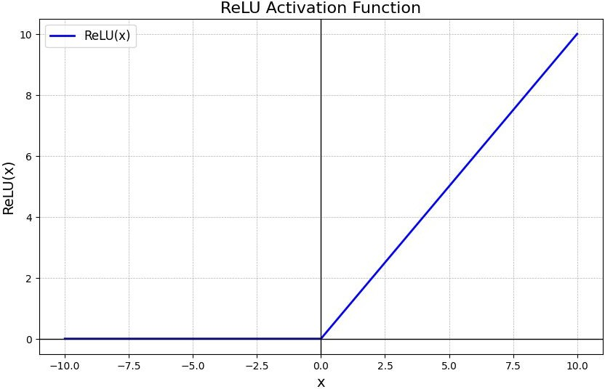
Non-linearity in Classification Tasks
ReLU helps models learn nonlinearity because it breaks linearity by introducing a threshold at 0.
ReLU(x) = max(x, 0)

Slide 15
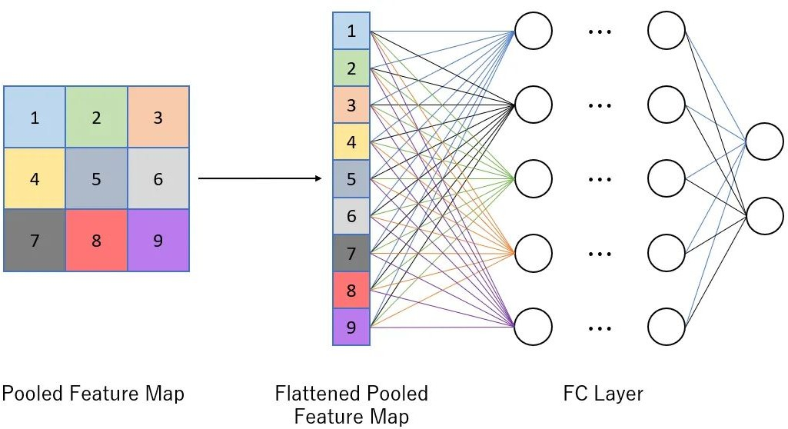
Fully Connected (Dense) Layers
Purpose: capturing global patterns and relationships
Add dropout (deactivate some neuron) to prevent overfitting
→ usually 20-50%
Softmax to turn into probability for classification

Slide 16
Famous Architectures
Evolution of CNNs
Milestone architectures that shaped deep learning
LeNet-5
1998
AlexNet
2012
VGG-16
2014
ResNet
2015
5 layers
8 layers
16 layers
152+ layers
2 Conv + 3 FC
5 Conv + 3 FC
13 Conv + 3 FC
Very deep networks
Pioneered by
Breakthrough
Simplicity
Revolutionary
Yann LeCun
ImageNet winner
Uniform 3×3 filters
Skip connections
Use: Handwritten digit recognition (MNIST)
Innovations: ReLU, Dropout, GPU training
Key: Depth matters, small filters
Innovation: Residual learning
Evolution Timeline: Key Improvements
Depth
Activation
Regularization
Connections
5 → 152+ layers
Sigmoid → ReLU
Dropout, BatchNorm
Skip/Residual
Key Insight: Deeper networks with proper techniques (skip connections, batch normalization) achieve better performance!

Slide 17
4 Things U must know about CNN!!!
CNN can handle IMAGE or VIDEO data.
CNN extract local features with kernels to construct hierarchical feature map.
Convolution operation is to extract features and learn which features are important.
Pooling operation is to reduce spatial dimension to reduce computational cost & redundant information.

Slide 18

Implementation – Tensorflow
we set 32 kernels with the size of 3 in 1st convolution layer.
def create_cnn_model():
model = models.Sequential([
# First convolutional block
layers.Conv2D(32, (3, 3), activation='relu', input_shape=(28, 28, 1)),
layers.MaxPooling2D((2, 2)),
# Second convolutional block layers.Conv2D(64, (3, 3), activation='relu'),
layers.MaxPooling2D((2, 2)),
No pooling after the 3rd convolution bc the dimension is already small. Applying one more pooling could discard too much info
# Third convolutional block
layers.Conv2D(64, (3, 3), activation='relu'),
# Flatten and dense layers layers.Flatten(),
layers.Dense(64, activation='relu'), layers.Dropout(0.5),
layers.Dense(10, activation='softmax') # 10 classes for Fashion-MNIST
])
return model

Slide 19
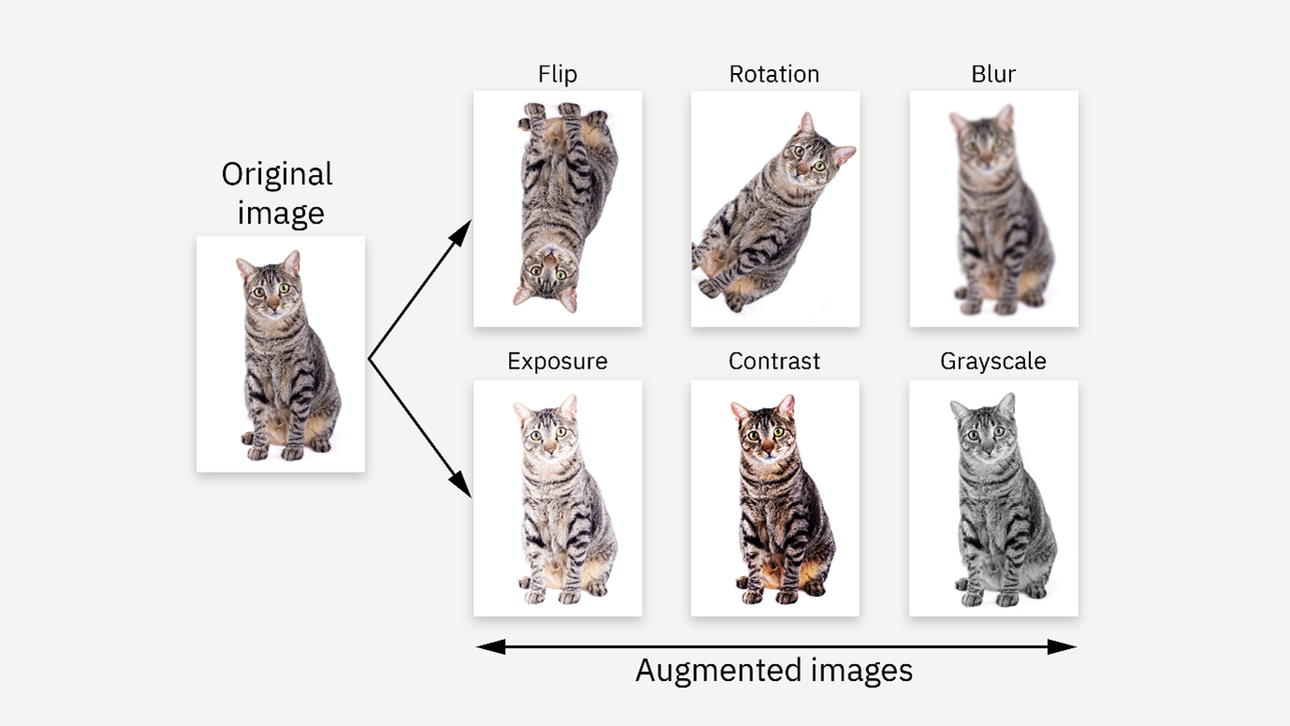
Data Preprocessing
Data augmentation: artificially increase the size and diversity of a dataset

Slide 20
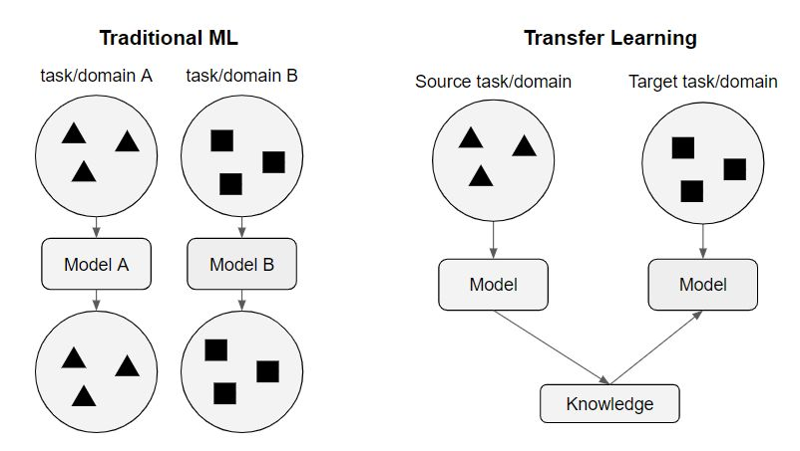
Transfer Learning
It uses knowledge gained while solving one problem and applying it to a different but related problem.
For example, knowledge gained while learning to recognize cars can be used to some extent to recognize trucks.

Slide 21
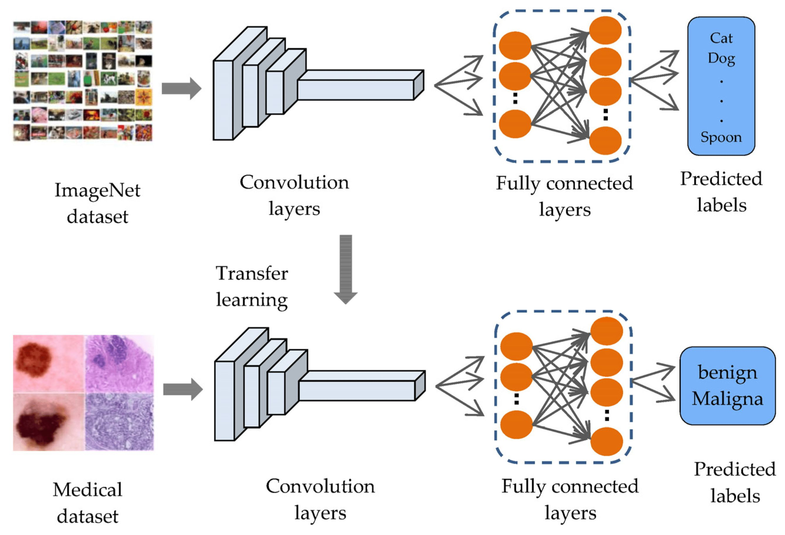
Transfer Learning (Cont.)
Applying transfer learning on ImageNet—a dataset of more than 14 million pictures distributed over 1000 classes—for medical image analysis.

Slide 22
Lab (Multi-classification Problem)
Source code: https://drive.google.com/file/d/1gGzNbh3hie-qlOPVCmY9rwQwBUw1qrSe/view?usp=sharing

