Slide 1
Solving CSP Problems: Challenges
Formulation of the CSP Problem
Variable ordering (which variables should you choose first to search)
Variable value ordering (which value for a particular variable should be tried first, second…)
Filtering: Apply Constraint propagation to restrict values a particular variable can take to reduce variable combinations that need to be explored and to abandon dead-end paths more quickly.
What Search technique to choose? Backtracking is a popular choice.
Interactions of the techniques, listed in 2-5.

Slide 2
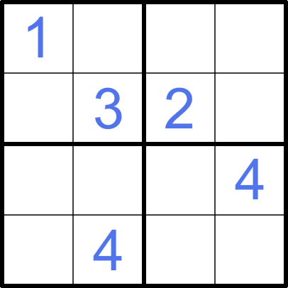
Sudoku Solver for The Times
In 2004, The Times newspaper wanted to automate verification of their daily Sudoku puzzles to ensure each puzzle had exactly one valid solution before publication.
You've been hired to build a CSP solver for a simplified 4×4 Sudoku variant.
Rules of 4x4 Sudoku:
4×4 grid divided into four 2×2 boxes
Fill grid with numbers 1-4
Each row must contain 1, 2, 3, 4 (no repeats)
Each column must contain 1, 2, 3, 4 (no repeats)
Each 2×2 box must contain 1, 2, 3, 4 (no repeats)

Slide 3
Your Task:
Formulate as a CSP: What are the variables, domains, and constraints? Define variables left to right going down.
Apply constraint propagation: Use forward checking or arc consistency to reduce domains
Select heuristics: Which variable should you assign first? Which value?
Solve the puzzle: Find the complete solution
Bonus:
How would you verify there's only ONE solution?
Consider: How many constraints does this problem have?
Which CSP techniques make solving efficient?
What do you think makes Sudoku a "perfect" CSP problem?

