Slide 1
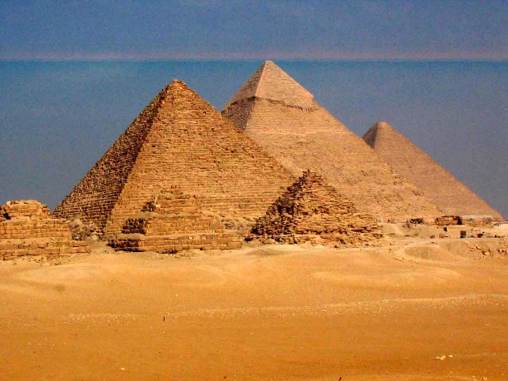
SETS Conference, Houston, June 9, 2019
1
Christoph F. Eick
Department of Computer Science
University of Houston
Artificial Intelligence: Success Stories, Promises, and Stumbling Blocks

Slide 2
Talk Organization
One Slide about Myself
AI: Success Stories, Promises, and Stumbling Blocks
What is Artificial Intelligence?
Success Stories
Promises
Stumbling Blocks
Conclusion

Slide 3
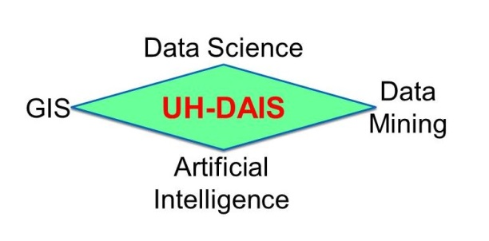
Christoph F. Eick

Slide 4
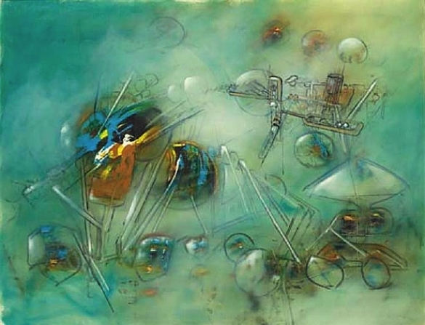
UH-DAIS Research Projects 6/18-5/19
Current Research Projects
Spatial and Spatio-temporal Data Analysis Frameworks
Understanding US Wellbeing in Time and Space
St^2—Tools for Spatio-temporal Data Storytelling
Scalable Algorithms for Spatial Data Mining
Educational Data Mining
Using AI and Data Science to Help with Disasters
Intelligent Crowdsourcing

Slide 5
Talk Organization
One Slide about Myself
AI: Success Stories, Promises, and Stumbling Blocks
What is Artificial Intelligence?
Success Stories
Promises
Stumbling Blocks
Conclusion

Slide 6
2. Definitions of AI
“AI centers on the simulation of intelligence using computers”
“AI develops programming paradigms, languages, tools, and environments for application areas for which conventional programming fails”
Symbolic programming (LISP)
Functional programming
Heuristic Programming
Logical Programming (PROLOG)
Rule-based Programming (Expert system shells)
Soft Computing (Belief network tools, fuzzy logic tool boxes,…)
Object-oriented programming (Smalltalk)

Slide 7
More Definitions of AI
Rich/Knight: ”AI is the study of how to make computers do things which, at the moment, people do better”
Winston: “AI is the study of computations that make it possible to perceive, reason, and act.
Turing Test: If an artificial intelligent system is not distinguishable from a human being, it is definitely intelligent.
https://en.wikipedia.org/wiki/Turing_test
Eugene Goostman Winner 2014 Touring Test: https://en.wikipedia.org/wiki/Eugene_Goostman
Please read: http://www.zdnet.com/article/beyond-cortana-what-artificial-intelligence-means-for-the-future-of-microsoft/

Slide 8
Physical Symbol System Hypothesis
“What the brain does can be thought of at some level as a kind of computation”
Physical Symbol System Hypothesis (PSSH): A physical symbol system has the sufficient and necessary means for general, intelligent actions.
Remarks PSSH:
Subjected to empirical validation
If false → AI is quite limited
Important for psychology and philosophy

Slide 9
Two views of AI
AI agents: how can we re-create intelligence?
AI tools: how can we benefit society?

Slide 10
AI tools...
Approach: Provide AI techniques in a non-agent tool setting, e.g.
Learn models from examples; e.g. if a person will pay back a loan
Annotate images with categories
Predict poverty from satellite images
Translate from language to another language
Tools, e.g. belief networks, for probabilistic reasoning
Planning and Scheduling Tools
…
33

Slide 11
Important AI Paradigms
Modeling
Inference
Learning

Slide 12
Paradigm: Modeling
But where does the model come from? Remember that the real world is rich, so if the model is to be faithful, the model has to be rich as well. But we can’t possibly write down such a rich model manually.
The idea behind (machine) learning is to instead get it from data. Instead of constructing a model, one constructs a skeleton of a model (more precisely, a model family), which is a model without parameters. And then if we have the right type of data, we can run a machine learning algorithm to tune the parameters of the model.
Real world
Modeling
5
6
7
4
Model
0
8
5
5
3
1
6
3
8
8
1
1
4
7
2
3
6
7
2
6
8

Slide 13
Paradigm: Inference
5
6
7
4
Model
0
8
5
5
3
1
6
3
8
8
1
1
4
7
2
3
6
7
2
6
8
Inference
5
6
7
4
Predictions
0
8
5
5
3
1
6
3
8
8
1
1
4
7
2
3
6
7
2
6
8
54

Slide 14
Paradigm: Learning
?
?
?
?
Model without parameters
?
?
?
?
?
?
?
?
?
?
?
?
?
?
?
?
?
?
?
?
?
+data
Learning
5
6
7
4
Model with parameters
0
8
5
5
3
1
6
3
8
8
1
1
4
7
2
3
6
7
2
6
8

Slide 15
Questions/Thoughts about AI
What are the limitations of AI? Can computers only do what they are told? Can computers be creative? Can computers think? What problems cannot be solved by computers today?
Computers show promise to control the current waste of energy and other natural resources.
Computer can work in environment that are unsuitable for human beings.
If computers control everything---who controls the computers?
If computers are intelligent what civil rights should be given to computers?
If computers can perform most of our work; what should the human beings do?
Only those things that can be represented in computers are important.
It is fun to play with computers.

Slide 16
Talk Organization
One Slide about Myself
AI: Success Stories, Promises, and Stumbling Blocks
What is Artificial Intelligence?
Success Stories
Promises
Stumbling Blocks
Conclusion

Slide 17
3,AI Success Stories
https://en.wikipedia.org/wiki/Watson_%28computer%299
https://en.wikipedia.org/wiki/Watson_%28computer%29
https://techcrunch.com/2017/05/24/alphago-beats-planets-best-human-go-player-ke-jie/
Image Annotation
https://www.bosch.com/stories/experience-automated-driving/
https://venturebeat.com/2018/10/22/googles-fluid-annotation-uses-ai-to-speed-up-image-dataset-annotation/

Slide 18
Google AI Beats Go World Champion
A machine learning approach was used which heavily relied on experience of artificial go-playing programs playing against each other and then to use this feedback to enhance the strategies of the individual Go programs.
In contrast to the Deep Blue Chess program, human Go-experts only played only a minor role in the project.
Reinforcement Learning and Deep Learning played a key role in developing a very smart Go program.

Slide 19
Different Forms of Learning
Learning agent receives feedback with respect to its actions (e.g. using a teacher)
Supervised Learning/Learning from Examples/Inductive Learning: feedback is received with respect to all possible actions of the agent
Reinforcement Learning: feedback is only received with respect to the taken action of the agent
Unsupervised Learning: Learning without feedback
Notes:
The last technology I like to introduce in today’s presentation are shared ontologies. Shared ontologies are important to standardize communication, and for gathering information from different information sources. Ontologies play an important role for agent-based systems.
Ontologies basically describe...

Slide 20
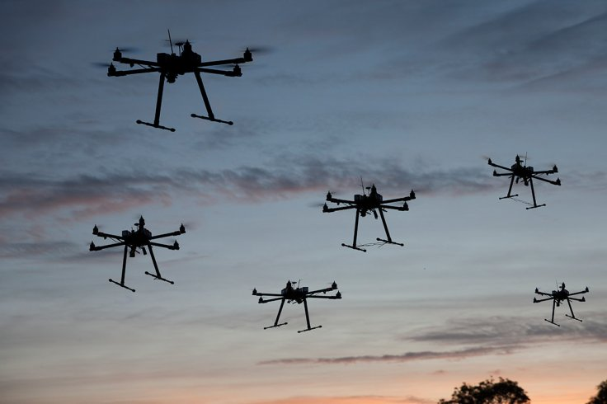
Flying SWARM Robots
http://arstechnica.com/science/2012/03/robots-swarm-the-stage-at-ted/
Watch First 2 minutes. 4:30, 10:15. 15:30
Requires:
Planning
Multi-Agent System and Distributed AI
Search
Reasoning in uncertain Environments
Machine Leaning
Computer Vision
……
Notes:
The first technology I like to …
The above picture is, in my opinion, a good description of the task of knowledge discovery in that it illustrates a huge search space that contains very very few interesting things, and if applied in practice, KDD is frequently like finding a needle in a hay stack, except that you are not sure what you are looking for...

Slide 21
Companies
”An important shift from a mobile first world to an AI first world” [CEO Sundar Pichai @ Google I/O 2017]
Created AI and Research group as 4th engineering division, now 8K people [2016]
Created Facebook AI Research, Mark Zuckerberg very optimistic and invested
Others: IBM, Amazon, Apple, Uber, Salesforce, Expedia,Baidu, Tencent, etc.

Slide 22
AI index: number of published AI papers

Slide 23
AI index: number of AI startups

Slide 24
Stanford CS221 enrollments
800
600
400
200
0
2012
2013
2014
2015
2016
2017
2018
Slowing down? Probably due to the CS221 spring offering...
14

Slide 25
AI
Knowledge Representation
Knowledge-based
and Expert Systems
Planning
Coping with Vague,
Incomplete and
Uncertain Knowledge
Searching
Intelligently
Logical Reasoning
& Theorem Proving
Communicating,
Perceiving and
Acting
Intelligent Agents
& Distributed AI
AI Programming
Learning & Knowledge Discovery

Slide 26
AAAI 2019 #Session Counts
NLP: 20
Vision (and Video Analytics): 12
Game Theory and Economic Paradigms: 10 ←surprise, surprise
AI and the Web: 9
Machine Learning: 7
AI for Social Impact: 7
Search, Constraint Satisfaction and Optimization: 7
Knowledge Representation and Reasoning: 6
Deep Learning: 5
Planning, Routing and Scheduling: 4
Reinforcement Learning: 3
Multi-Agent Systems: 3
Reasoning under Uncertainty: 3
Remarks: Only topics with 3 AAAI sessions are mentioned; NLP, vision and AI&Web were aggregated into a single category! AAAI 2018 received 3900 papers, and AAAI 2019 received 7764 paper; about 2500 reviewers were needed to review the papers (Dr. Laszka and Dr. Eick were reviewing papers for AAAI 2019)

Slide 27
Positive Forces for AI
Data Science &Data Mining (KDD) / Learning for Examples
Robotics
Multi-Agent Systems
AI and NLP: Chatbots, intelligent user interfaces that can communicate in natural language, doing intelligent things with text
Computer Chess/Go and Computer Games in General
Speech Recognition, Image Annotation
Computer Vision and Video Analytics
Deep Learning
Reinforcement Learning
AI for Social Impact
Intelligent “this and that”
https://www.clickatell.com/articles/customer-relationship-management/amazon-chatbots-customer-service/
Amazon Chatbots

Slide 28
Talk Organization
One Slide about Myself
AI: Success Stories, Promises, and Stumbling Blocks
What is Artificial Intelligence?
Success Stories
Promises
Stumbling Blocks
Conclusion

Slide 29
Governments
”The Trump Administration has prioritized funding for fundamental AI research and computing infrastructure, machine learning, and autonomous systems.”
https://www.whitehouse.gov/briefings-statements/artificial-intelligence-american-people/
Released domestic strategic plan to become world leader in AI by 2030 [2017] https://www.nytimes.com/2017/07/20/business/china-artificial-intelligence.html
”Whoever becomes the leader in this sphere [AI] will become the ruler of the world” [Putin, 2017] https://www.theverge.com/2017/9/4/16251226/russia-ai-putin-rule-the-world
https://www.cnbc.com/2018/05/11/artificial-intelligence-india-wants-to-fire-up-its-a-i-industry.html
https://yourstory.com/2018/02/budget-2018-artificial-intelligence-fuel-indian-economy/
Pentagon: http://www.nationaldefensemagazine.org/articles/2019/3/29/the-future-of-ai-pentagons-new-center-leading-the-way

Slide 30
Talk Organization
One Slide about Myself
AI: Success Stories, Promises, and Stumbling Blocks
What is Artificial Intelligence?
Success Stories
Promises
Stumbling Blocks
Conclusion

Slide 31
5. Stumbling Blocks
Japan:
https://www.dogonews.com/2019/1/23/japanese-robot-staffed-hotel-chain-fires-employees-for-incompetence
Common Sense Reasoning: (“simulating the human ability to make presumptions about the type and essence of ordinary situations they encounter every day”) World’s first robot hotel loses love for robots | Daily News Japanese Robot-Staffed Hotel Chain "Fires" Employees For Incompetence Kids News Article (dogonews.com)
Translation of arbitrary texts; e.g. fiction or non-fiction novels (see next slide)
Reading a course textbook and then apply the content of the textbook the next day to solve a homework associated with the course.
Planning for very complex tasks; e.g. military deployment
….
Ethics and Responsible AI (see slide after next)

Slide 32
Natural Language Understanding
I saw the Golden Gate Bridge flying to San Francisco.
I ate dinner with a friend. I ate dinner with a fork.
John went to a restaurant. He ordered a steak. After an hour John left happily.
I went to three dentists this morning.

Slide 33
Ethical Aspects of AI
Human Do not Need to Apply (a video that analyzes the influence of AI on jobs)
Ethics for AI (short video, motivating the need for ethics for AI)
AI FOR GOOD - Ethics in AI (a video discussing how to incorporate ethics into AI systems)
Top 9 Ethical Issues in AI
European Commission efforts in building trust into human-centric AI
European Commission Ethics Guidelines for "Trust-worthy" AI
MIT to Spend $1 Billion on Program to Study AI Ethics

Slide 34
6. Conclusion
We told some success stories of deployed AI systems.
We have seen that currently governments all over the world heavily invest into AI.
However, there are still a lot of areas in which human still significantly outperform AI systems.
Moreover, the successful deployment of AI-systems in the future also requires solutions to the ethical challenges of AI technology, such as:
Fairness/Bias
Following ethical standards in decision making
Security
Transparency in decision making
Robot Stupidity
How do we distribute the wealth created by machines?
Impacts of AI technology on the job market
…

