Slide 1
COSC 6368 Machine Learning Organization
Introduction to Machine Learning
Reinforcement Learning
Introduction to Decision Trees (and Classification in general)
Neural Networks
Deep Learning (brief; at the end of semester!)

Slide 2
Classification: Definition
Given a collection of records (training set )
Each record contains a set of attributes, one of the attributes is the class.
Find a model for the class attribute as a function of the values of other attributes.
Goal: previously unseen records should be assigned a class as accurately as possible.
A test set is used to determine the accuracy of the model. Usually, the given data set is divided into training and test sets, with training set used to build the model and test set used to validate it.

Slide 3
Illustrating Classification Task

Slide 4
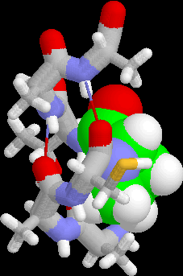
Examples of Classification Task
Predicting tumor cells as benign or malignant
Classifying credit card transactions as legitimate or fraudulent
Classifying secondary structures of protein as alpha-helix, beta-sheet, or random coil
Categorizing news stories as finance, weather, entertainment, sports, etc

Slide 5
Classification Techniques
Decision Tree based Methods covered
Rule-based Methods
Memory based reasoning, instance-based learning
Neural Networks covered
Naïve Bayes and Bayesian Belief Networks
Support Vector Machines
Ensemble Methods

Slide 6
COSC 6368 Decision Tree Organization
Examples of Decision Trees
Decision Tree Induction
Overfitting
Other Issues
Data Fragmentation
Expressiveness
Decision Boundaries
Oblique Trees
Metrics for Model Evaluation
Learning Curves
Advantages and Disadvantages of Decision Tree Models

Slide 7
1. Examples of Decision Trees
categorical
categorical
continuous
class
Splitting Attributes
Refund
Yes
No
NO
MarSt
Single, Divorced
Married
TaxInc
NO
< 80K
> 80K
NO
YES
Training Data
Model: Decision Tree

Slide 8
Another Example of Decision Tree
categorical
categorical
continuous
class
MarSt
Single, Divorced
Married
NO
Refund
Yes
No
NO
TaxInc
< 80K
> 80K
NO
YES
There could be more than one tree that fits the same data!

Slide 9
Decision Tree Classification Task
Decision Tree

Slide 10
Apply Model to Test Data
Test Data
Start from the root of tree.
Refund
Yes
No
NO
MarSt
Single, Divorced
Married
TaxInc
NO
< 80K
> 80K
NO
YES

Slide 11
Apply Model to Test Data
Test Data
Refund
Yes
No
NO
MarSt
Single, Divorced
Married
TaxInc
NO
< 80K
> 80K
NO
YES

Slide 12
Apply Model to Test Data
Test Data
Refund
Yes
No
NO
MarSt
Single, Divorced
Married
TaxInc
NO
< 80K
> 80K
NO
YES

Slide 13
Apply Model to Test Data
Test Data
Refund
Yes
No
NO
MarSt
Single, Divorced
Married
TaxInc
NO
< 80K
> 80K
NO
YES

Slide 14
Apply Model to Test Data
Test Data
Refund
Yes
No
NO
MarSt
Single, Divorced
Married
TaxInc
NO
< 80K
> 80K
NO
YES

Slide 15
Apply Model to Test Data
Test Data
Refund
Yes
No
NO
MarSt
Single, Divorced
Married
Assign Cheat to “No”
TaxInc
NO
< 80K
> 80K
NO
YES

Slide 16
Decision Tree Classification Task
Decision Tree

Slide 17
2. Decision Tree Induction
Many Algorithms:
Hunt’s Algorithm (one of the earliest)
CART
ID3, C4.5
SLIQ,SPRINT

Slide 18
General Structure of Hunt’s Algorithm
Let D_{t} be the set of training records that reach a node t
General Procedure:
If D_{t} contains records that belong the same class y_{t}, then t is a leaf node labeled as y_{t}
If D_{t} is an empty set, then t is a leaf node labeled by the default class, y_{d}
If D_{t} contains records that belong to more than one class, use an attribute test to split the data into smaller subsets. Recursively apply the procedure to each subset.
D_{t}
?

Slide 19
Hunt’s Algorithm
Refund
Don’t
Cheat
Yes
No
Don’t
Cheat
Don’t
Cheat
Refund
Refund
Yes
No
Yes
No
Don’t
Cheat
Marital
Status
Don’t
Cheat
Marital
Status
Single,
Divorced
Single,
Divorced
Married
Married
Cheat
Don’t
Cheat
Taxable
Income
Don’t
Cheat
< 80K
>= 80K
Don’t
Cheat
Cheat

Slide 20
Tree Induction
Greedy strategy.
Split the records based on an attribute test that optimizes certain criterion.
Issues
Determine how to split the records
How to specify the attribute test condition?
How to determine the best split?
Determine when to stop splitting

Slide 21
Tree Induction
Greedy strategy.
Creates the tree top down starting from the root, and splits the records based on an attribute test that optimizes certain criterion.
Issues
Determine how to split the records
How to specify the attribute test condition?
How to determine the best split?
Determine when to stop splitting

Slide 22
How to Specify Test Condition?
Depends on attribute types
Nominal
Ordinal
Continuous
Depends on number of ways to split
2-way split
Multi-way split

Slide 23
Splitting Based on Nominal Attributes
Multi-way split: Use as many partitions as distinct values.
Binary split: Divides values into two subsets. Need to find optimal partitioning.
CarType
Family
Luxury
Sports
CarType
CarType
{Sports, Luxury}
OR
{Family, Luxury}
{Family}
{Sports}

Slide 24
Splitting Based on Ordinal Attributes
Multi-way split: Use as many partitions as distinct values.
Binary split: Divides values into two subsets. Need to find optimal partitioning.
What about this split?
Size
Small
Large
Medium
Size
Size
{Small, Medium}
OR
{Medium, Large}
{Large}
{Small}
Size
{Small, Large}
{Medium}

Slide 25
Splitting Based on Continuous Attributes
Different ways of handling
Discretization to form an ordinal categorical attribute
Static – discretize once at the beginning
Dynamic – ranges can be found by equal interval bucketing, equal frequency bucketing (percentiles), clustering, or supervised
clustering.
Binary Decision: (A < v) or (A ≥ v)
consider all possible splits and finds the best cut v
can be more compute intensive

Slide 26
Splitting Based on Continuous Attributes

Slide 27
Tree Induction
Greedy strategy.
Split the records based on an attribute test that optimizes certain criterion.
Issues
Determine how to split the records
How to specify the attribute test condition?
How to determine the best split?
Determine when to stop splitting

Slide 28
How to determine the Best Split
Before Splitting: 10 records of class 0, 10 records of class 1
Which test condition is the best?

Slide 29
How to determine the Best Split
Greedy approach:
Nodes with homogeneous class distribution (pure nodes) are preferred
Need a measure of node impurity:
Non-homogeneous,
High degree of impurity
Homogeneous,
Low degree of impurity

Slide 30
Measures of Node Impurity
Entropy (only this measure will be covered in detail)
GINI
IMPURITY= (1-PURITY)
Purity(X)= (Number of Majority Class Examples in X) /
(Number of Example of X)
Useful to use class proportion vectors to characterize class distributions; e.g (1/8, 5/8. 1/4).

Slide 31
How to Find the Best Split
Before Splitting:
M0
A?
B?
Yes
No
Yes
No
Node N1
Node N2
Node N3
Node N4
M1
M2
M3
M4
M12
M34
Gain = M0 – M12 vs M0 – M34

Slide 32
Splitting Continuous Attributes
For efficient computation: for each attribute,
Sort the attribute on values
Linearly scan these values, each time updating the count matrix and computing gini index
Choose the split position that has the least gini index
Sorted Values
Split Positions

Slide 33
Alternative Splitting Criteria based on INFO
Entropy at a given node t:
(NOTE: p( j | t) is the relative frequency of class j at node t).
Measures homogeneity of a node.
Maximum (log n_{c}) when records are equally distributed among all classes implying least information
Minimum (0.0) when all records belong to one class, implying most information
Entropy based computations are similar to the GINI index computations

Slide 34
Examples for computing Entropy
P(C1) = 0/6 = 0 P(C2) = 6/6 = 1
Entropy = – 0 log 0 – 1 log 1 = – 0 – 0 = 0
P(C1) = 1/6 P(C2) = 5/6
Entropy = – (1/6) log₂ (1/6) – (5/6) log₂ (1/6) = 0.65
P(C1) = 2/6 P(C2) = 4/6
Entropy = – (2/6) log₂ (2/6) – (4/6) log₂ (4/6) = 0.92

Slide 35
Splitting Based on INFO...
Information Gain:
Parent Node, p is split into k partitions;
n_{i} is number of records in partition i
Measures Reduction in Entropy achieved because of the split. Choose the split that achieves most reduction (maximizes GAIN)
Used in ID3 and C4.5
Disadvantage: Tends to prefer splits that result in large number of partitions, each being small but pure.

Slide 36
Splitting Based on INFO...
Gain Ratio:
Parent Node, p is split into k partitions
n_{i} is the number of records in partition i
Adjusts Information Gain by the entropy of the partitioning (SplitINFO). Higher entropy partitioning (large number of small partitions) is penalized!
Used in C4.5
Designed to overcome the disadvantage of Information Gain

Slide 37
Entropy and Gain Computations
Assume we have m classes in our classification problem. A test S subdivides the examples D= (p₁,…,p_{m}) into n subsets D₁ =(p₁₁,…,p_{1m}) ,…,D_{n} =(p₁₁,…,p_{1m}). The qualify of S is evaluated using Gain(D,S) (ID3) or GainRatio(D,S) (C5.0):
Let H(D=(p₁,…,p_{m}))= Σ_{i=1} (p_{i} log₂(1/p_{i})) (called the entropy function)
Gain(D,S)= H(D) − Σ_{i=1} (|D_{i}|/|D|)*H(D_{i})
Gain_Ratio(D,S)= Gain(D,S) / H(|D₁|/|D|,…, |D_{n}|/|D|)
Remarks:
|D| denotes the number of elements in set D.
D=(p₁,…,p_{m}) implies that p₁+…+ p_{m} =1 and indicates that of the |D| examples p₁*|D| examples belong to the first class, p₂*|D| examples belong to the second class,…, and p_{m}*|D| belong the m-th (last) class.
H(0,1)=H(1,0)=0; H(1/2,1/2)=1, H(1/4,1/4,1/4,1/4)=2, H(1/p,…,1/p)=log₂(p).
C5.0 selects the test S with the highest value for Gain_Ratio(D,S), whereas ID3 picks the test S for the examples in set D with the highest value for Gain (D,S).
m
n

Slide 38
Information Gain vs. Gain Ratio
Result:
I_Gain_Ratio:
city>age>car
Result:
I_Gain:
age > car=city
D=(2/3,1/3)
Gain(D,city=)= H(1/3,2/3) – ½ H(1,0) –
½ H(1/3,2/3)=0.45
G_Ratio_pen(city=)=H(1/2,1/2)=1
city=la
city=sf
D1(1,0)
D2(1/3,2/3)
G_Ratio_pen(car=)=H(1/2,1/3,1/6)=1.45
D=(2/3,1/3)
Gain(D,car=)= H(1/3,2/3) – 1/6 H(0,1) –
½ H(2/3,1/3) – 1/3 H(1,0)=0.45
car=merc
car=taurus
car=van
D1(0,1)
D2(2/3,1/3)
D3(1,0)
G_Ratio_pen(age=)=log₂(6)=2.58
D=(2/3,1/3)
Gain(D,age=)= H(1/3,2/3) – 6*1/6 H(0,1)
= 0.90
age=22
age=25
age=27
age=35
age=40
age=50
D1(1,0)
D2(0,1)
D3(1,0)
D4(1,0)
D5(1,0)
D6(0,1)

Slide 39
Tree Induction
Greedy strategy.
Split the records based on an attribute test that optimizes certain criterion.
Issues
Determine how to split the records
How to specify the attribute test condition?
How to determine the best split?
Determine when to stop splitting

Slide 40
Stopping Criteria for Tree Induction
Stop expanding a node when all the records belong to the same class
Stop expanding a node when all the records have similar attribute values
Early termination (to be discussed later)

Slide 41
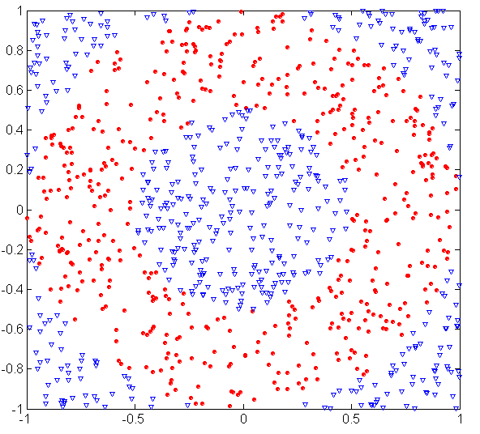
3. Underfitting and Overfitting
500 circular and 500 triangular data points.
Circular points:
0.5 ≤ sqrt(x₁²+x₂²) ≤ 1
Triangular points:
sqrt(x₁²+x₂²) > 0.5 or
sqrt(x₁²+x₂²) < 1

Slide 42
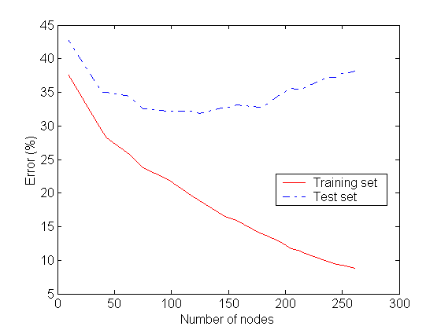
Underfitting and Overfitting
Underfitting
Overfitting
Complexity of a Decision
Tree := number of nodes
It uses
Complexity of the classification function
Underfitting: when model is too simple, both training and test errors are large

Slide 43
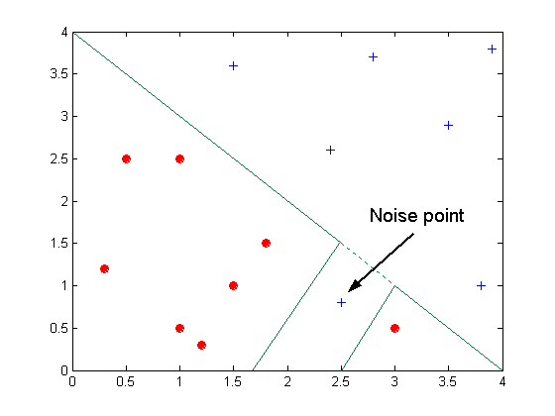
Overfitting due to Noise
Decision boundary is distorted by noise point

Slide 44
Overfitting due to Insufficient Examples
Lack of data points in the lower half of the diagram makes it difficult to predict correctly the class labels of that region
- Insufficient number of training records in the region causes the decision tree to predict the test examples using other training records that are irrelevant to the classification task

Slide 45
Notes on Overfitting
Overfitting results in decision trees that are more complex than necessary
More complex models tend to be more sensitive to noise, missing examples,…
If you use complex models a lot of “representative” training examples are needed to avoid overfitting. This is one way to reduce overfitting is to use more training examples. If you have only a few training examples, use less complex models!
Models that are less sensitive to minor changes in training models are less prone to overfitting.
Training error no longer provides a good estimate of how well the tree will perform on previously unseen records
Need new ways for estimating errors

Slide 46
Occam’s Razor
Given two models of similar generalization errors, one should prefer the simpler model over the more complex model
For complex models, there is a greater chance that it was fitted accidentally by noise in data
Usually, simple models are usually more robust with respect to noise
Therefore, one should include model complexity when evaluating a model

Slide 47
How to Address Overfitting
Pre-Pruning (Early Stopping Rule)
Stop the algorithm before it becomes a fully-grown tree
Typical stopping conditions for a node:
Stop if all instances belong to the same class
Stop if all the attribute values are the same
More restrictive conditions:
Stop if number of instances is less than some user-specified threshold
Stop if class distribution of instances are independent of the available features (e.g., using χ ² test)
Stop if expanding the current node does not improve impurity measures (e.g., Gini or information gain).

Slide 48
How to Address Overfitting…
Post-pruning
Grow decision tree to its entirety
Trim the nodes of the decision tree in a bottom-up fashion
If generalization error improves after trimming, replace sub-tree by a leaf node.
Class label of leaf node is determined from majority class of instances in the sub-tree

Slide 49
4. Other Issues
Data Fragmentation
Expressiveness
Decision Boundaries
Oblique Trees
Metrics for Model Evaluation
Learning Curves

Slide 50
Data Fragmentation
Number of instances gets smaller as you traverse down the tree
Number of instances at the leaf nodes could be too small to make any statistically significant decision ➔ increases the danger of overfitting

Slide 51
Expressiveness
Decision tree provides expressive representation for learning discrete-valued function
But they do not generalize well to certain types of Boolean functions
Example: parity function:
Class = 1 if there is an even number of Boolean attributes with truth value = True
Class = 0 if there is an odd number of Boolean attributes with truth value = True
For accurate modeling, must have a complete tree
Not expressive enough for modeling continuous variables
Particularly when test condition involves only a single attribute at-a-time

Slide 52
Decision Boundary
Border line between two neighboring regions of different classes is known as decision boundary
Decision boundary is parallel to axes because test condition involves a single attribute at-a-time
Regression Trees use the same appraoch

Slide 53
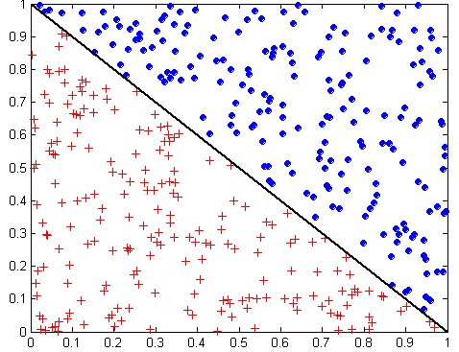
Oblique Decision Trees
x + y < 1
Class = +
Class =
Test condition may involve multiple attributes
More expressive representation
Finding optimal test condition is computationally expensive

Slide 54
Model Evaluation
Metrics for Performance Evaluation
How to evaluate the performance of a model?
Methods for Performance Evaluation
How to obtain reliable estimates?
Learning Curves

Slide 55
Metrics for Performance Evaluation
Focus on the predictive capability of a model
Rather than how fast it takes to classify or build models, scalability, etc.
Confusion Matrix:
https://en.wikipedia.org/wiki/Confusion_matrix
Important: If there are problems with obtaining
a “good” classifier inspect the confusion matrix!
 | PREDICTED CLASS
ACTUAL CLASS |  | Class=Yes | Class=No
 | Class=Yes | a | b
 | Class=No | c | d
a: TP (true positive)
b: FN (false negative)
c: FP (false positive)
d: TN (true negative)

Slide 56
Metrics for Performance Evaluation…
Most widely-used metric:
 | PREDICTED CLASS
ACTUAL CLASS |  | Class=Yes | Class=No
 | Class=Yes | a (TP) | b (FN)
 | Class=No | c (FP) | d (TN)

Slide 57
Cost Matrix
 | PREDICTED CLASS
ACTUAL CLASS | C(i|j) | Class=Yes | Class=No
 | Class=Yes | C(Yes|Yes) | C(No|Yes)
 | Class=No | C(Yes|No) | C(No|No)
C(i|j): Cost of misclassifying class j example as class i

Slide 58
Computing Cost of Classification
Cost Matrix | PREDICTED CLASS
ACTUAL CLASS | C(i|j) | + | -
 | + | -1 | 100
 | - | 1 | 0
Model M₁ | PREDICTED CLASS
ACTUAL CLASS |  | + | -
 | + | 150 | 40
 | - | 60 | 250
Model M₂ | PREDICTED CLASS
ACTUAL CLASS |  | + | -
 | + | 250 | 45
 | - | 5 | 200
Accuracy = 80%
Cost = 3910
Accuracy = 90%
Cost = 4255

Slide 59
Cost vs Accuracy
Count | PREDICTED CLASS
ACTUAL CLASS |  | Class=Yes | Class=No
 | Class=Yes | a | b
 | Class=No | c | d
Accuracy is proportional to cost if 1. C(Yes|No)=C(No|Yes) = q 2. C(Yes|Yes)=C(No|No) = p
N = a + b + c + d
Accuracy = (a + d)/N
Cost = p (a + d) + q (b + c)
= p (a + d) + q (N – a – d)
= q N – (q – p)(a + d)
= N [q – (q-p) × (a+d)/N]
= N [q – (q-p) × Accuracy]
Cost | PREDICTED CLASS
ACTUAL CLASS |  | Class=Yes | Class=No
 | Class=Yes | p | q
 | Class=No | q | p

Slide 60
Methods for Estimating Model Accuracy
Holdout
Reserve 2/3 for training and 1/3 for testing
Random subsampling
Repeated holdout
k-fold Cross validation
Partition data into k disjoint subsets
k-fold: train on k-1 partitions, test on the remaining one
Leave-one-out: k=n
Class stratified k-fold cross validation
Stratified sampling
oversampling vs undersampling
Most popular!

Slide 61
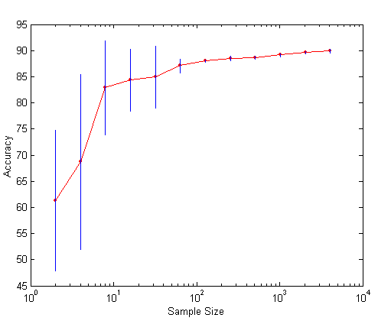
Learning Curve
Learning curve shows how accuracy changes with varying sample size
Requires a sampling schedule for creating learning curve:
Arithmetic sampling (Langley, et al)
Geometric sampling (Provost et al)
Effect of small sample size:
Bias in the estimate
Variance of estimate

Slide 62
5. Advantages Decision Tree Models
Inexpensive to construct
Extremely fast at classifying unknown records
Easy to interpret for small-sized trees
Okay for noisy data
Can handle both continuous and symbolic attributes
Accuracy is comparable to other classification techniques for many simple data sets
Decent average performance over many datasets
Kind of a standard—if you want to show that your “new” classification technique really “improves the world” → compare its performance against decision trees (e.g. C 5.0) using 10-fold cross-validation
Does not need distance functions; only the order of attribute values is important for classification: 0.1,0.2,0.3 and 0.331,0.332, and 0.333 is the same for a decision tree learner.

Slide 63
5. Disadvantages Decision Tree Based Classification
Relies on rectangular approximation that might not be good for some datasets
Selecting good learning algorithm parameters (e.g. degree of pruning) is non-trivial
Ensemble techniques, support vector machines, and kNN might obtain higher accuracies for a specific dataset.
More recently, Random forests (ensembles of decision trees) have gained some popularity.

