Slide 1
Group D (to present We., Feb. 22, 2023)
Specify the constraints of the 6x6 Sudoku CSP depicted on the next page; it is okay to describe the constrains only involving a subset of the variables (and not all, as there are many of them)
Take a look at: Tips and Tricks to solve a 6x6 Sudoku Puzzle step by step – YouTube and How to Solve Sudoku Puzzles – A Complete Walkthrough, Part 1 | Play Free Sudoku, a Popular Online Puzzle Game; see if you find other online advice on solving 6x6 Sudoku Puzzles; briefly summarize what you found!
Assume you have to design a Solver for 6x6 Sudoku puzzles, as the one listed below; give a sketch of what strategies/approach your solver will use. 6x6 Sudoku Solver Online | Sudoku.vip

Slide 2
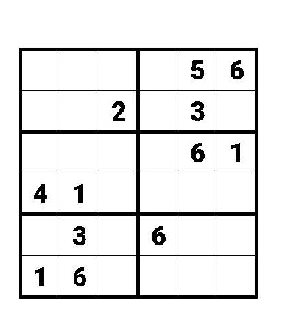
Sudoku 6x6 Puzzle

