Slide 1
Outline
Natural Language Processing
Language Models
Transformers
RNN
BERT
Fine Tuning/ In Context Learning
GPT
Presented by Md Mahin on April 22, 2024
DAIS

Slide 2
Slide Sources
https://dijkstra.eecs.umich.edu/eecs498/
https://www.cs.princeton.edu/courses/archive/fall22/cos597G/
https://courses.grainger.illinois.edu/cs447/sp2024/
DAIS

Slide 3
Natural Language Processing (NLP)
is the field of CS, AI, and CL concerned with interactions in natural languages
NLP is hard because human language is messy, ambiguous, and constantly changing
- We rely on a lot of contextual information as humans
Implicit references
Implicit memory
Colloquialism

Slide 4
What is NLP
“Natural” languages
English, Mandarin, French, Swahili, Arabic
→ Ultimate goal: Natural human-to-computer communication

Slide 10
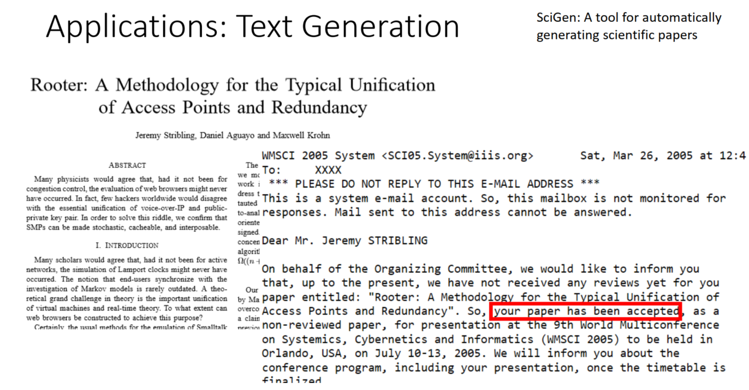

Slide 11
Challenges in NLP
Human languages are messy, ambiguous, and ever-changing
What challenges get in the way of understanding and responding to natural language?
Implicit references
Ambiguous references / semantics
Implicit memory
Imprecise rules
Myriad languages
Scale

Slide 19
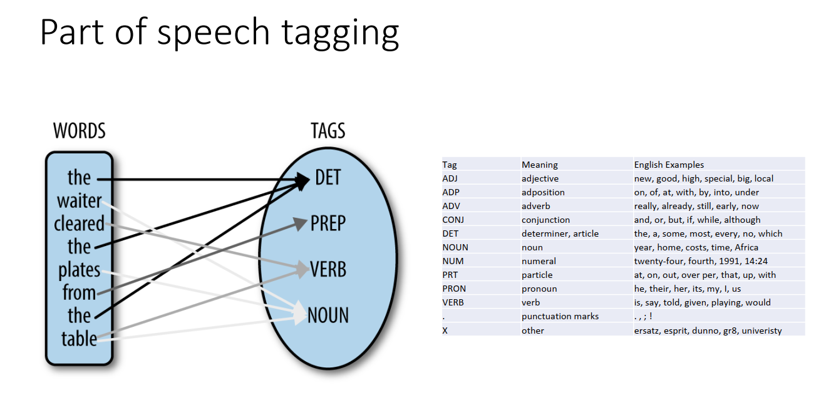
Example Task

Slide 20
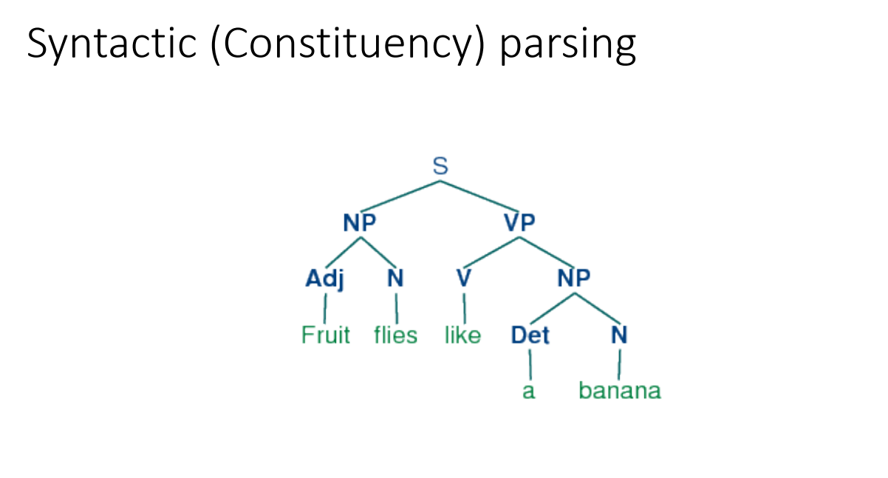
Example Task: Use PoS Tags to Understand Language

Slide 24
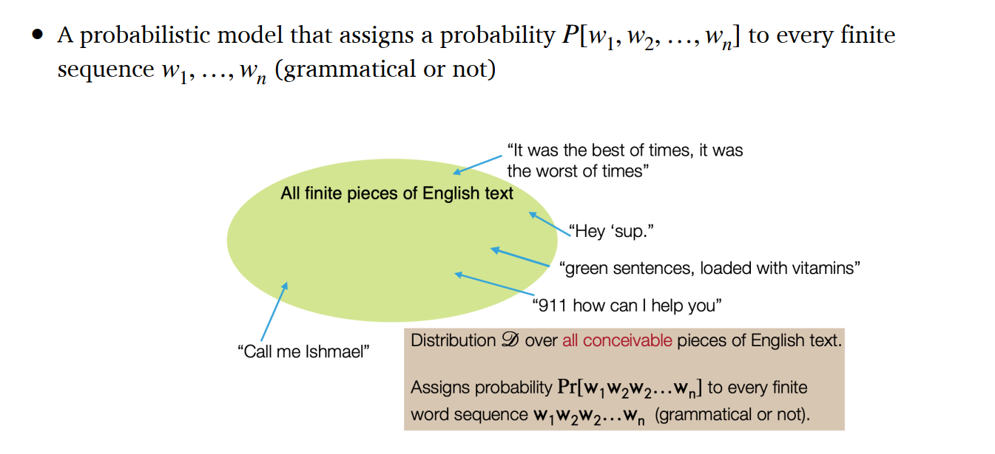
Language Models
A language model tries to predict the next most appropriate word to fill in a blank space in a sentence or phrase based on the context of the given word
DAIS

Slide 26
Language Models
Language models are grouped into two categories: statistical language models and neural language models
Statistical language models are a type of model that use statistical patterns in the data to make predictions about the likelihood of specific sequences of words.
Neural language models, as the name suggests, use neural networks to predict the likelihood of a sequence of words.
These models are trained on a large corpus of text data and can learn the underlying structure of the language.
DAIS

Slide 27
Language Models
Neural language models can handle large vocabularies and deal with rare or unknown words by using distributed representations.
They can capture context better than traditional statistical models.
They can handle more complex language structures and longer dependencies between words.
Earlier language models for NLP were based on the RNN, LSTM architectures.
Recurrent models require linear sequential computation, hard to parallelize.
DAIS

Slide 29
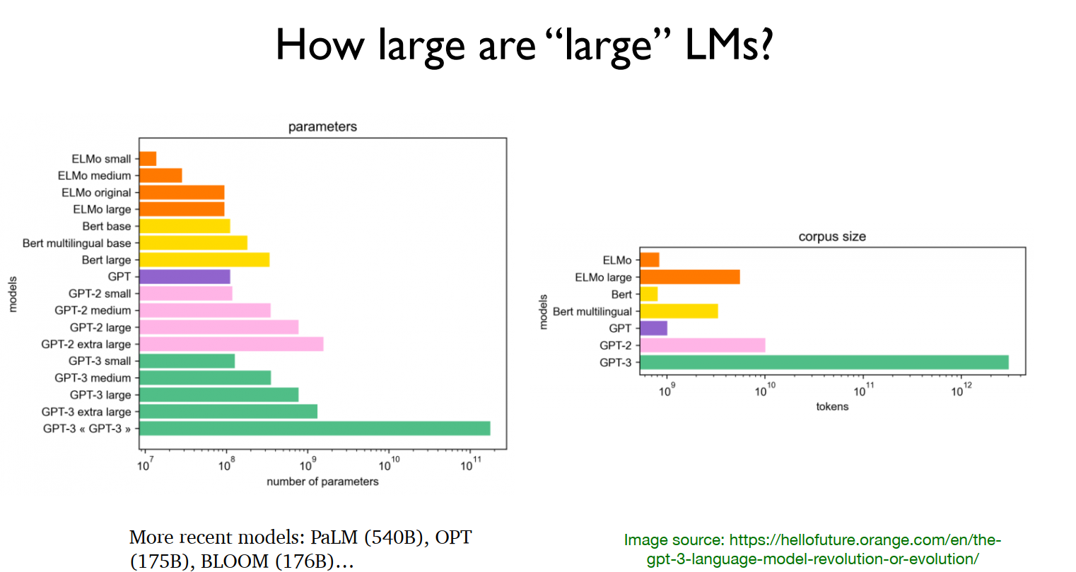

Slide 32
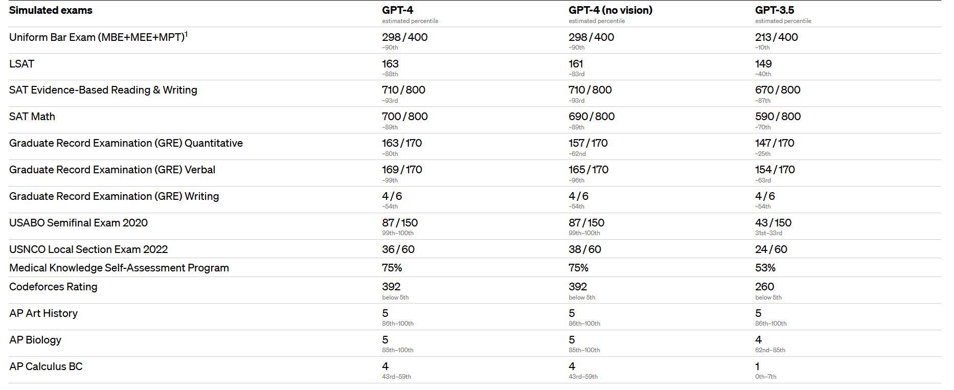
How Intelligent Are Language Models? (GPT)
Source: https://openai.com/research/gpt-4 [3]

Slide 33
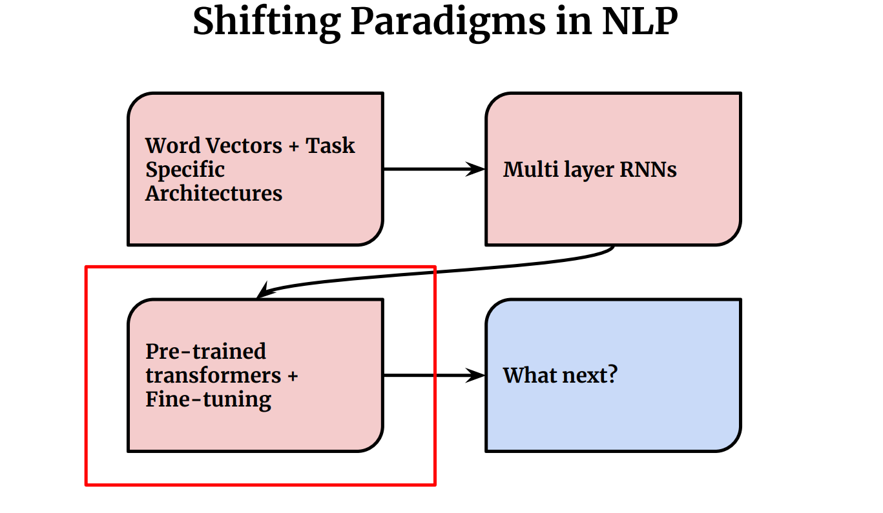

Slide 34
Transformers
RNNs, LSTMs and GRUs were the main architectures for all NLP tasks until Transformers came along
RNN-based models performed well, and even with Attention mechanism
However, they had two limitations:
It was difficult to deal with long-range dependencies between words
They process the input sequentially
The Transformers architecture address both limitations and got rid of RNNs relying exclusively on Attention mechanism
DAIS

Slide 35
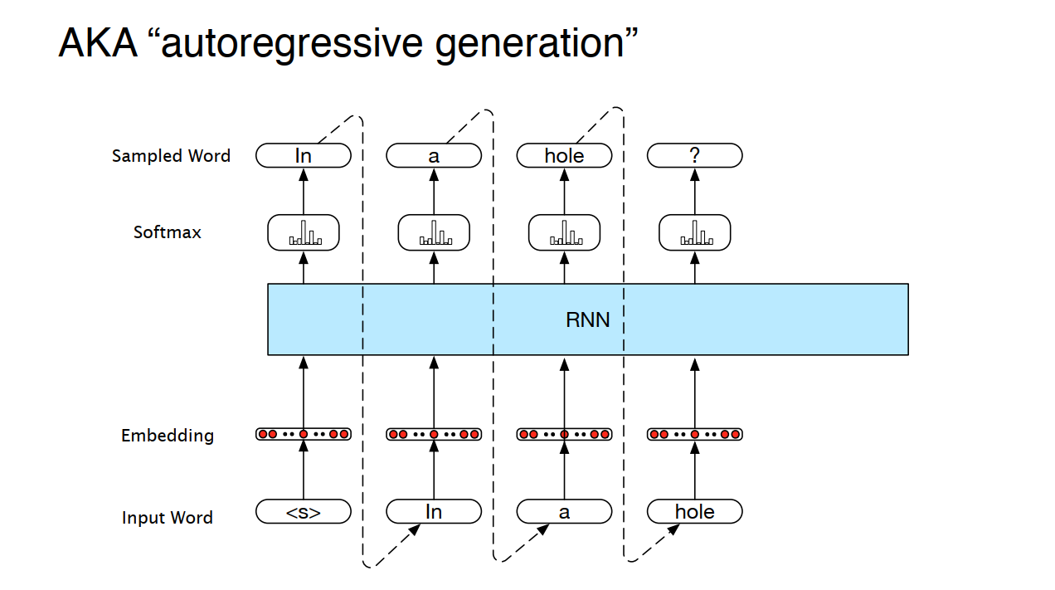

Slide 37
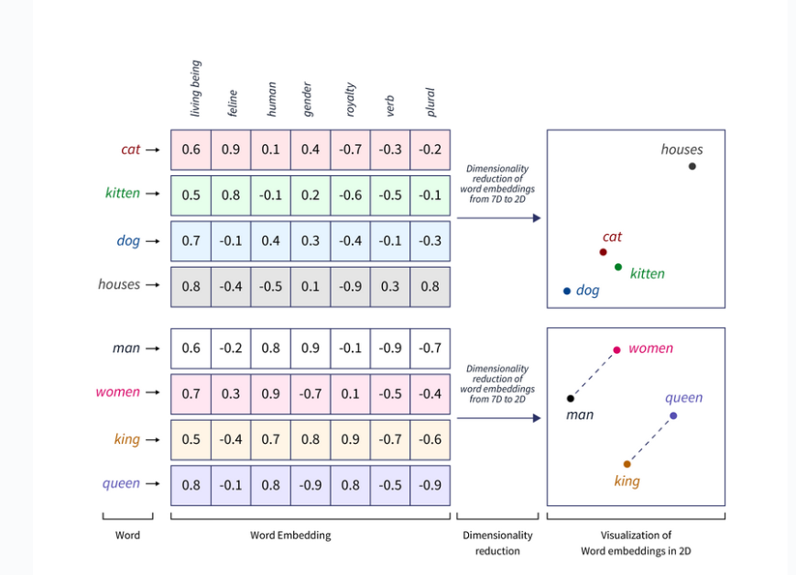
Word Embedding
Source: https://www.scaler.com/topics/tensorflow/tensorflow-word-embeddings/

Slide 38
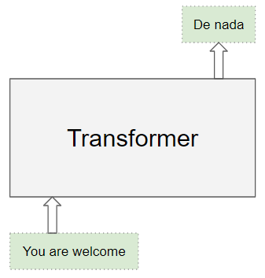
Transformers
Transformers were introduced in 2017 by Vaswani et al., (Attention Is All You Need)
The Transformer architecture excels at handling text data which is inherently sequential
They take a text sequence as input and produce another text sequence as output
Transformers Explained Visually (Part 1): Overview of Functionality | by Ketan Doshi | Towards Data Science
DAIS

Slide 39
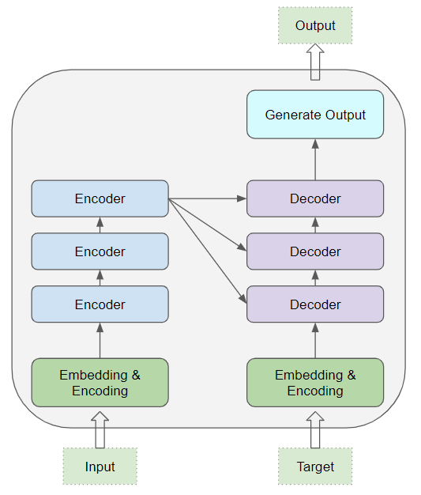
Transformers
At the core, Transformers contain a stack of Encoder layers and Decoder layers
The Encoder stack and the Decoder stack each have their corresponding Embedding layers for their respective inputs as well an output layer to generate the final output
All the Encoders are identical to one another. Similarly, all the Decoders are identical
DAIS

Slide 40
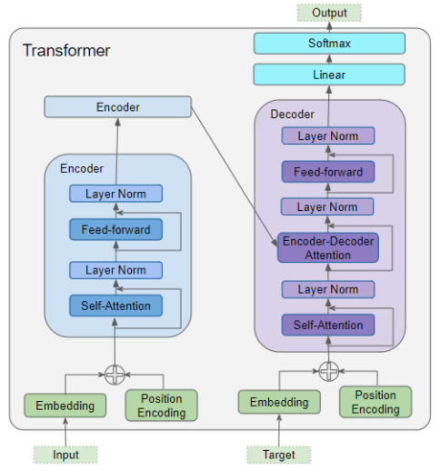
Transformers
The Encoder contains the Self-attention layer that computes the relationship between different words in the sequence, as well as a Feed-forward layer.
The Decoder contains the Self-attention layer and the Feed-forward layer, as well as a second Encoder-Decoder attention layer.
Each Encoder and Decoder has its own set of weights.
DAIS

Slide 41
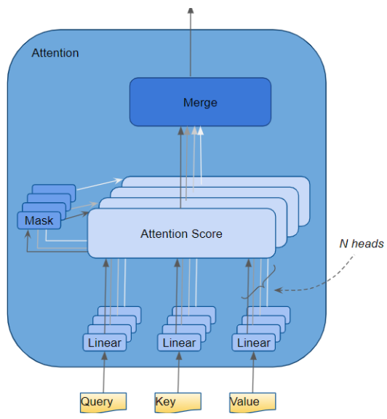
Transformers
The Attention layer takes its input in the form of three parameters, known as the Query, Key, and Value.
These three values helps to capture key context
DAIS

Slide 42
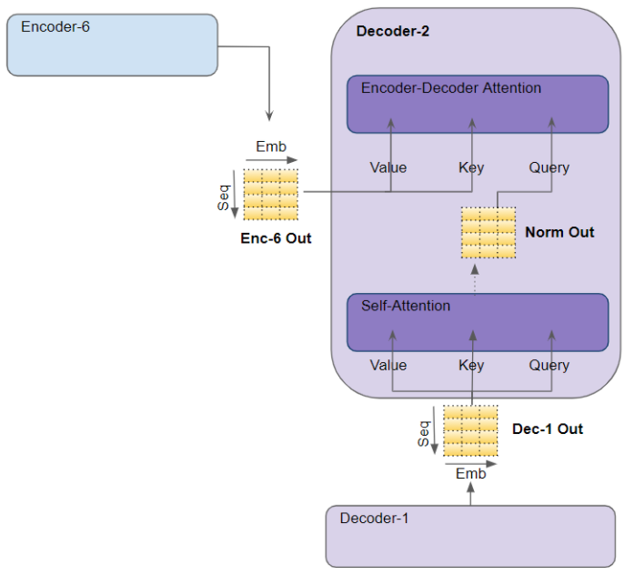
Transformers
In the Decoder’s Self-attention, the Decoder’s input is passed to all three parameters, Query, Key, and Value.
In the Decoder’s Encoder-Decoder attention, the output of the final Encoder in the stack is passed to the Value and Key parameters. The output of the Self-attention module below it is passed to the Query parameter.
DAIS

Slide 43
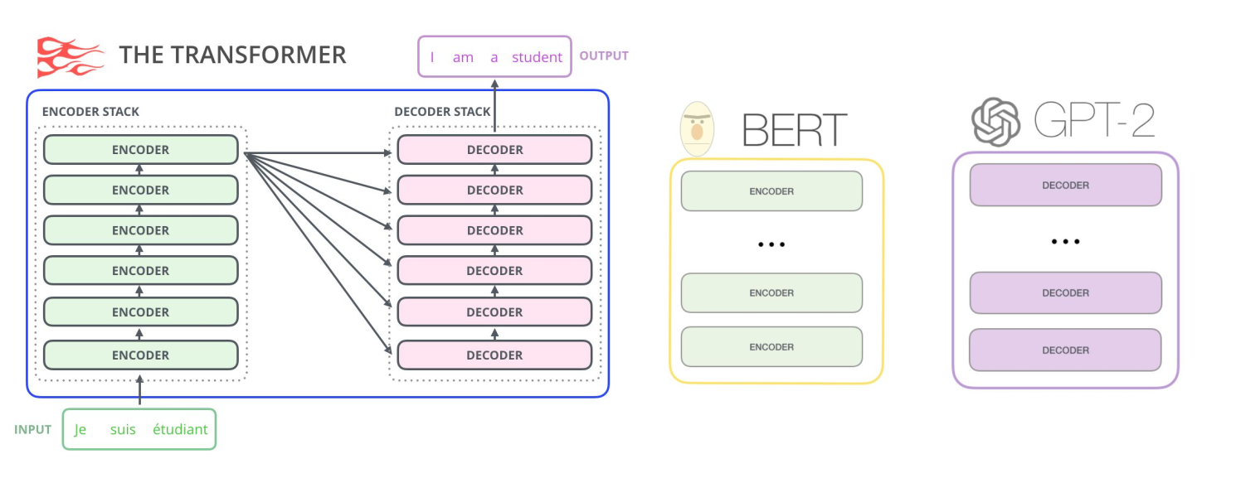

Slide 44
BERT – Bidirectional Encoder Representation from Transformers Pre-training of Deep Bidirectional Transformers for Language Understanding (Google AI, 2018)
https://arxiv.org/abs/1810.04805
DAIS

Slide 45
BERT - Why?
Those contextual LMs have a problem: They only use left context or right context
But language understanding is bidirectional
The reason for unidirectionality: Words can “see themselves” in a bidirectional encoder
BERT came to the rescue!
DAIS

Slide 46
BERT - How it works
BERT generates a language model by training in both directions which gives words more context
BERT provided a way to more accurately pre-train models with less data
It involved a pre-training and fine-tuning stages
It is based on the Transformer architecture (encoders)
DAIS

Slide 47
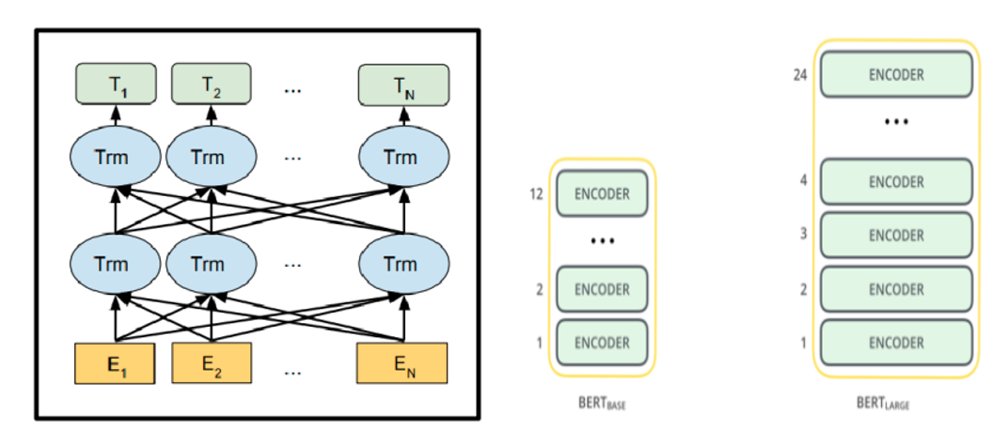
BERT - How it works
BERT Language Model Structure
DAIS

Slide 48
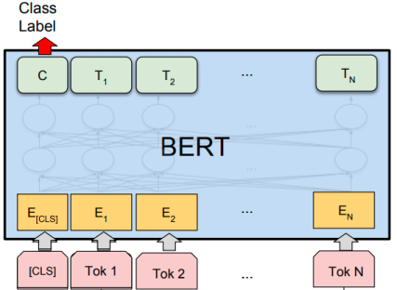
BERT - When and how can we use it
DAIS

Slide 49
BERT - How it works
Each token is represented by summing the corresponding token, segment and position embeddings
DAIS

Slide 50
BERT - How it works
BERT works by taking inputs (sequence of tokens), which are converted into vectors and then processed in the neural network
3 transformative operations are first performed on the input tokens before feeding to the network
Token embeddings: Add [CLS] and [SEP] to the input tokens
Segment embeddings: Add sentence markers to the input tokens
Positional embeddings: Add position indicators to the input tokens
DAIS

Slide 51
BERT - How it works
The pre-training of BERT makes use of two strategies: MLM and NSP
In MLM (Masked Language Model), BERT randomly masks out 15% of words in the input (replacing them with a [MASK] token)
Problem: Mask token never seen at fine-tuning
Solution: 15% of the words to predict, but do not replace with [MASK] 100% of the time. Instead:
80% of the time, replace with [MASK]
went to the store → went to the [MASK]
10% of the time, replace random word
went to the store → went to the running
10% of the time, keep same
went to the store → went to the store
DAIS

Slide 52
BERT – Data Pertained Model Trained with
Data: Wikipedia (2.5B words) + BookCorpus (800M words)
Batch Size: 131,072 words (1024 sequences * 128 length or 256 sequences * 512 length)
Training Time: 1M steps (~40 epochs)
Optimizer: AdamW, 1e-4 learning rate, linear decay
BERT-Base: 12-layer, 768-hidden, 12-head
BERT-Large: 24-layer, 1024-hidden, 16-head
Trained on 4x4 or 8x8 TPU slice for 4 days
DAIS

Slide 53
BERT - When and how can we use it
BERT can be used for most NLP tasks such text classification, question answering, sentiment analysis, NER, paraphrase detection etc.
The process of using BERT for a specific task is known as fine-tuning.
To fine-tune the BERT pre-trained model on our dataset, we do so by just adding a single layer on top of the core model.
DAIS

Slide 54
BERT - When and how can we use it
You can use BERT by downloading the pre-trained model files from the official BERT GitHub page (https://github.com/google-research/bert#pre-trained-models)
The BERT pre-trained models are either Cased or Uncased
You can choose which BERT pre-trained model you want depending on the task and computing resource
DAIS

Slide 55
Example Application
Text Classification: classifying emails as spam or not spam, or classifying movie reviews as positive, negative, or neutral.
Question Answering: Imagine you have a document about different animal species and want to fine-tune BERT to answer questions like "What do lions eat?" or "Where do penguins live?"
Sentiment Analysis: Fine-tuning can make BERT understand the sentiment of a text. This can be used to analyze social media posts, customer reviews, or any other kind of text data to gauge the overall sentiment expressed.
Named Entity Recognition (NER): BERT can be adapted to identify and classify named entities in text, such as people, organizations, locations, money amounts, etc.
Summarization: Imagine summarizing news articles or creating product descriptions based on longer product information.
DAIS

Slide 56
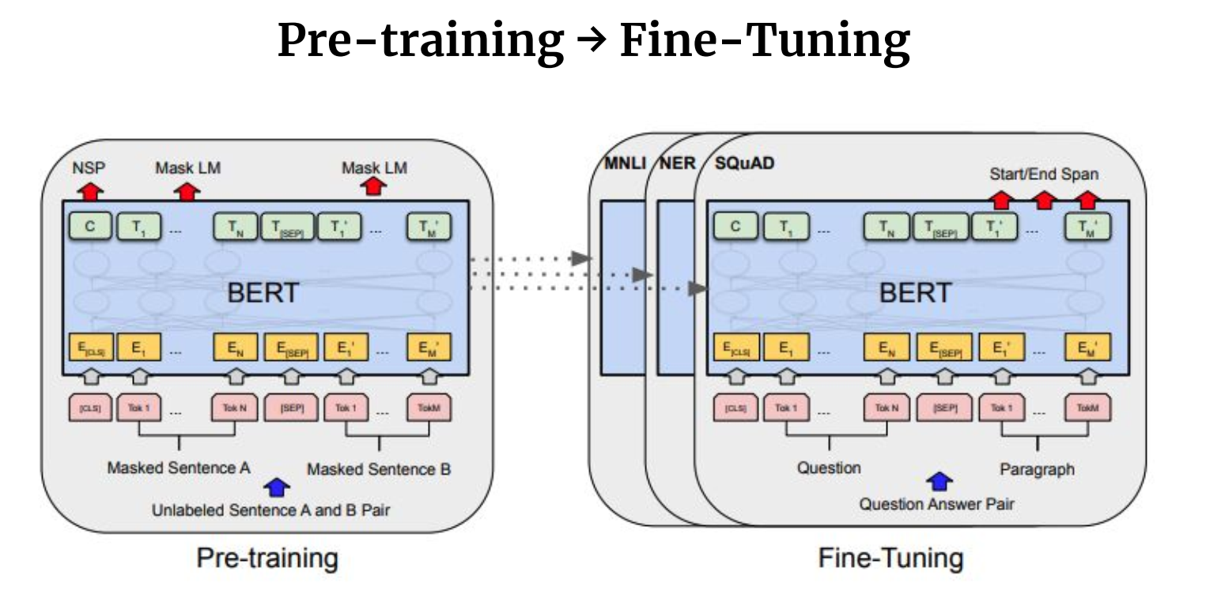

Slide 57
Fine Tuning
Focus on the Core: The core layers of BERT, which hold the general language knowledge, are mostly left untouched. This pre-trained knowledge serves as the foundation for the specific task.
Adding Expertise: A new layer, often called the "output layer," is added on top. This layer is designed for the target task, be it sentiment analysis, question answering, or something else. It's like giving the student the necessary tools for their chosen field.
Task-Specific Training: The entire model, including both the pre-trained layers and the new output layer, is then trained on a dataset specific to the desired task. This helps BERT refine its understanding to excel in that particular area. Imagine the student applying their general knowledge to solve problems specific to their field

Slide 58
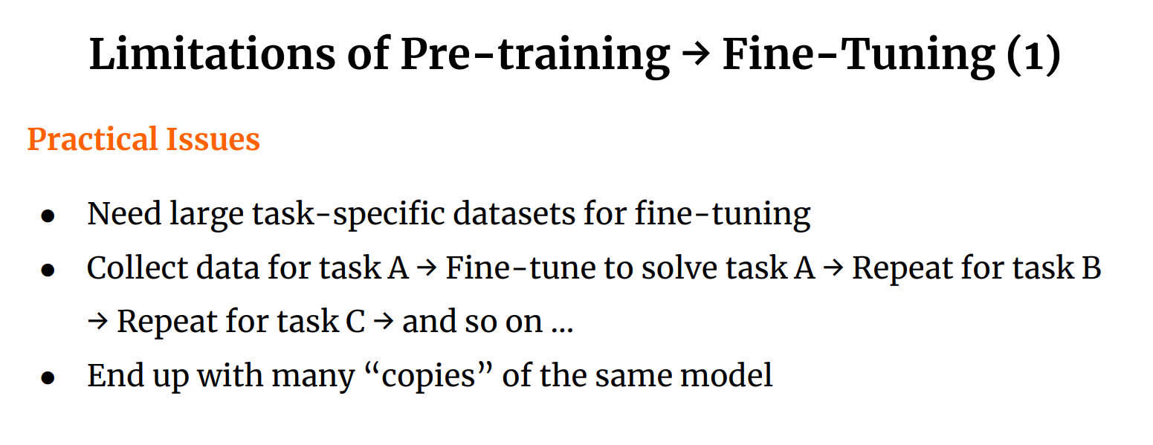

Slide 59
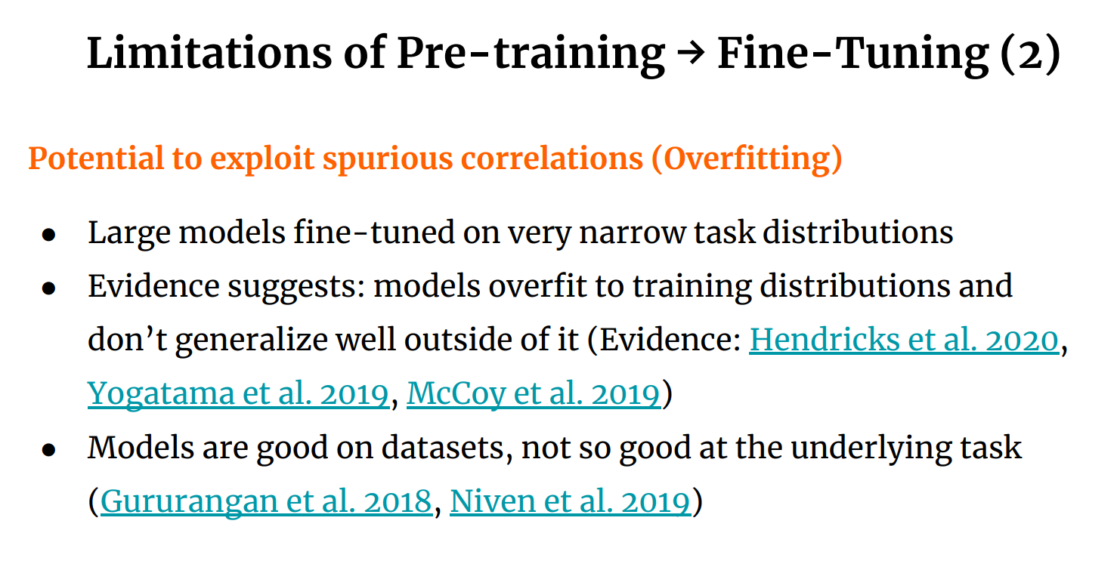

Slide 61
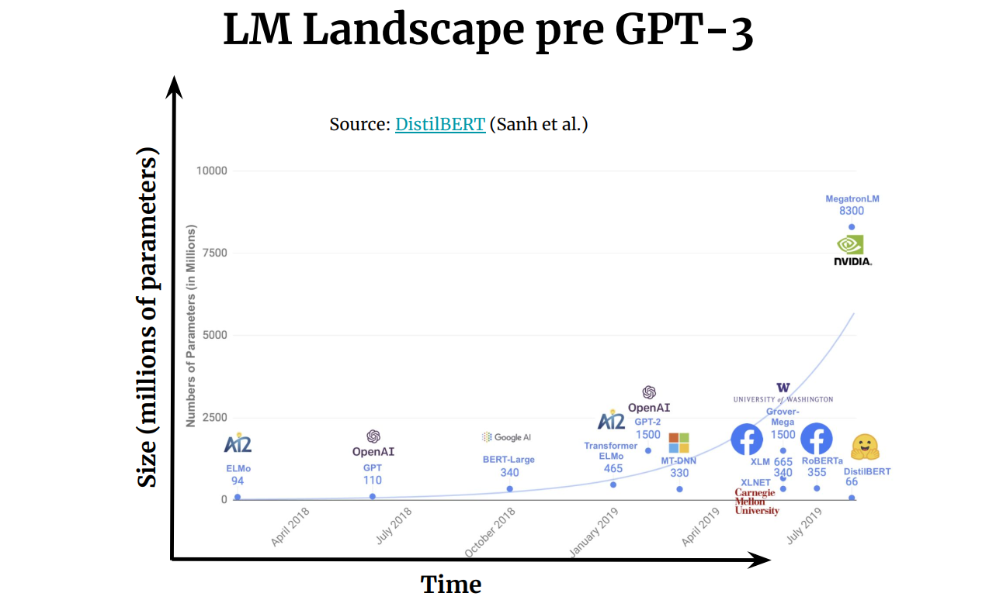

Slide 62
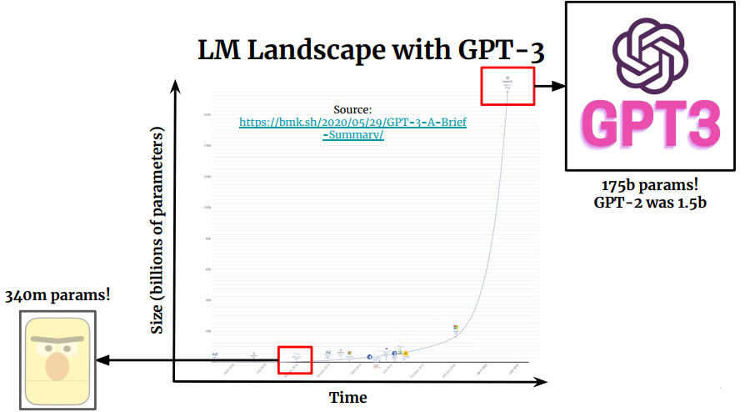

Slide 66
Zero-Shot Learning: Making Predictions Without Examples
Imagine a student who can answer a question on a topic they've never been explicitly taught about. That's the idea behind zero-shot learning. The model makes predictions for entirely new classes it hasn't seen during training. Here's how it works:
Pre-trained Knowledge is Key: The model relies heavily on its pre-trained knowledge of language or concepts. This knowledge could come from massive datasets of text and code.
Transfer Learning: The model leverages relationships between existing categories (like "horse" and "animal") to understand new, unseen categories (like "zebra").

Slide 67
One-Shot Learning: Learning from a Single Example
This is like a student correctly identifying an animal they've only seen once in a picture. In one-shot learning, the model is given just one labeled example per new class. It uses this single example to infer characteristics of the new class and then attempts to classify new data points.
Few-Shot Learning: A Balancing Act
Few-shot learning falls between zero-shot and one-shot. The model gets a few examples, typically ranging from 2 to 5 per new class, to learn from. This small amount of data allows the model to perform better than zero-shot learning and provides more refinement than one-shot learning

Slide 68
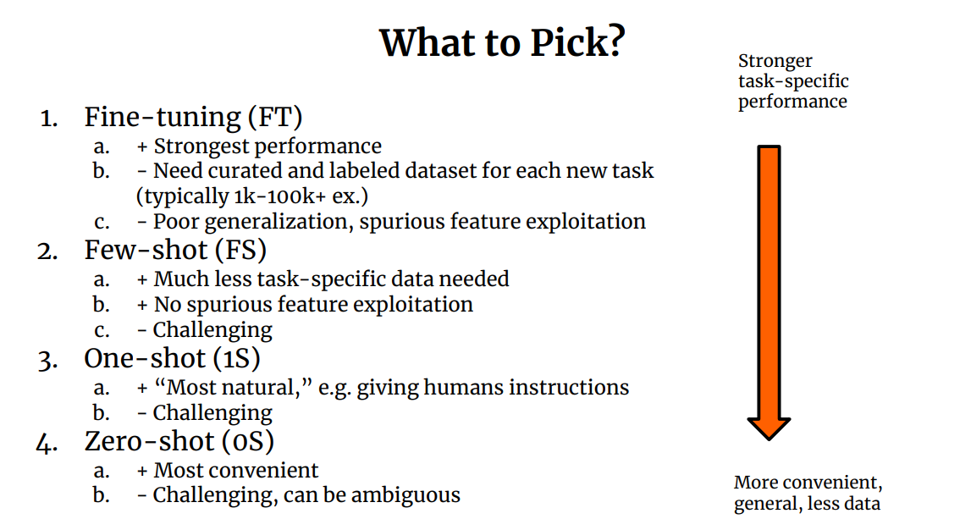

Slide 71
GPT

