Slide 1


A Short Dive Into
Supervised Learning
&
Neural Networks
Raunak Sarbajna
COSC 4368
October 2nd, 2025

Slide 2
Supervised Learning Basics
Given a collection of records (training set )
  Each record contains a set of attributes, one of the attributes is the class.
Find a model for the class attribute as a function of the values of other attributes.
Goal: previously unseen records should be assigned a class/a number as accurately as possible.
  A test set is used to determine the accuracy of the model. Usually, the given data set is divided into training and test sets, with training set used to build the model and test set used to validate it.

Slide 3
Structure of Supervised Learning Approach
Training Phase
Feed the model labeled examples (input + correct output)
Learning Phase
Model finds patterns and relationships in the data
Prediction Phase
Model makes predictions on new, unseen data

Slide 4
Illustrating Classification Task

Slide 5

Spam Email Detector
Email Ingress (SMTP/IMAP)
↓
Preprocessing Layer (parsing, normalization)
↓
Feature Extraction Service (parallel workers)
↓
├── Authentication Checker (SPF/DKIM/DMARC)
├── Reputation Lookup (Redis cache + database)
├── Content Analyzer (NLP pipeline)
└── URL Scanner (threat intelligence APIs)
↓
Model Inference Service
↓
├── Quick Filter (linear model, 50ms)
├── Deep Filter (ensemble, 200ms)
└── Manual Review Queue (borderline cases)
↓
Action Router
↓
├── Deliver to Inbox
├── Quarantine (spam folder)
└── Block (reject/discard)
↓
Feedback Collection & Monitoring
↓
Retraining Pipeline (scheduled jobs)

Slide 6
Classification Techniques
Decision Tree based Methods very briefly covered
Rule-based Methods
instance-based learning, nearest neighbor classifiers
Neural Networks covered today
Naïve Bayes and Bayesian Belief Networks
Support Vector Machines not covered in 2025
Ensemble Methods

Slide 7

Neural Dreaming
Neural networks can be used to create surreal and psychedelic images!
Google's DeepDream project, released in 2015, gained widespread attention for its hallucinatory images generated by convolving neural networks with themselves, resulting in mesmerizing and bizarre compositions.
While initially a curiosity, deep dreaming has found applications in art, entertainment, and neuroscience research, offering insights into the inner workings of neural networks and the human mind's perception of visual stimuli.
In the rain, Shibuya, Tokyo Leonid Afremov Style
Notes:
Neural networks have exhibited a phenomenon akin to dreaming when trained on images or data. This process, called "hallucination" or "deep dreaming," involves the network amplifying patterns it detects in input data to create surreal and sometimes psychedelic visuals.
In the rain, Shibuya, Tokyo Leonid Afremov Style

Slide 8
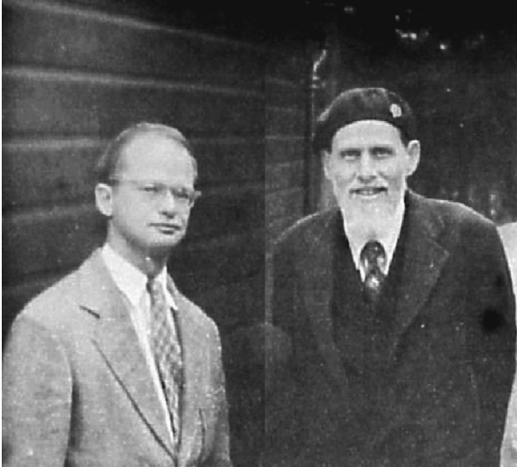
Brief History
In the 1940s, scientists Warren McCulloch and Walter Pitts were fascinated by the human brain.
They wondered if it would be possible to create a machine that mimicked the way neurons connect and transmit information.
Their work in 1943 led to the development of the first artificial neural network model, a simple design that laid the foundation for future advancements.
McCulloch (right) and Pitts (left) in 1949
Notes:
In 1943 American neurophysiologist and cybernetician of the University of Illinois at Chicago Warren McCulloch and self-taught logician and cognitive psychologist Walter Pitts published “A Logical Calculus of the ideas Imminent in Nervous Activity,” describing the “McCulloch - Pitts neuron, ”the first mathematical model of a neural network.
Building on ideas in Alan Turing’s “On Computable Numbers”, McCulloch and Pitts's paper provided a way to describe brain functions in abstract terms, and showed that simple elements connected in a neural network can have immense computational power. The paper received little attention until its ideas were applied by John von Neumann, Norbert Wiener, and others.

Slide 9
Rise and Fall (And Rise)
Initial surge of excitement in the 1950s with the Perceptron model
Limitations of early models led to a period of decline in the 1960s and 1970s
Breakthroughs in algorithms and computing power revived interest in the 1980s
Notes:
The perceptron, developed by Frank Rosenblatt in 1957, marked a significant milestone in neural network history. It was capable of learning simple binary classifications and became the foundation for future developments.
In the 1980s, renewed interest in neural networks emerged with the development of backpropagation, a powerful algorithm for training multi-layer perceptrons, by Geoffrey Hinton, David Rumelhart, and Ronald Williams.
Throughout the 1990s and early 2000s, neural networks experienced a resurgence in popularity fueled by advancements in computing power, data availability, and algorithmic improvements.Initial optimism surrounding neural networks waned in the 1960s due to limitations in computational power and a lack of understanding of learning algorithms, leading to the first "AI winter."

Slide 10

Universal Approximation
All models are wrong, but some are useful.
-- George Box
What is a Universal Approximator?
  A system capable of approximating any continuous function to an arbitrary degree of accuracy.
  In simpler terms, it can learn to represent any complex relationship between inputs and outputs, given enough data and the right architecture.
Truth is much too complicated to allow anything but approximations.
-- von Neumann
Notes:
Neural networks possess a remarkable ability – they can be considered universal approximators. This means they can, in theory, approximate any continuous function to an arbitrary degree of accuracy. Imagine a function that maps any input to an output, like predicting house prices based on size and location. A universal approximator, like a neural network, can learn this complex relationship between inputs and outputs with enough data and the right internal structure. This property makes neural networks incredibly versatile and powerful tools for various tasks, from image recognition to natural language processing.

Slide 11
Universal Approximation Theorem
The UAT, first proven by George Cybenko in 1989 and later refined by Kurt Hornik in 1991, states that a feedforward neural network with a single hidden layer containing a finite number of neurons can approximate any continuous function to arbitrary accuracy.
This theorem provides a mathematical foundation for the remarkable ability of neural networks to learn complex mappings between input and output data, making them powerful tools for function approximation and pattern recognition tasks.
By adjusting the weights and biases of the neurons within the network during the training process, neural networks can effectively model highly nonlinear relationships, enabling them to solve a wide range of problems across various domains.
Notes:
The Universal Approximation Theorem has profound implications for the practical application of neural networks in fields such as image and speech recognition, natural language processing, and predictive modeling.
It suggests that, given enough data and computational resources, neural networks are capable of approximating any function, making them versatile and adaptable tools for solving real-world problems.
However, while neural networks can theoretically represent any function, the challenge lies in training them effectively, avoiding overfitting, and generalizing well to unseen data, highlighting the importance of robust training procedures and model evaluation techniques in practice.

Slide 12
Universal Approximation Theorem (contd.)
Support Vector Machines - SVMs with standard kernels (including Gaussian, polynomial, and several dot product kernels) can approximate any measurable or continuous function up to any desired accuracy.
Polynomials - We can approximate any continuous function with polynomials (see the Stone-Weierstrass theorem). You can use polynomial regression to fit polynomials to your labelled data.
Fourier decomposition – Can achieve universal approximation with large number of coefficients.

Slide 13
So Why Neural Networks?
The distinguishing feature of neural networks is that, for certain applications, they provide sufficiently-accurate approximations for high-dimensional functions.
This isn't true for all applications, it's worth noting; whether or not a neural network works well depends on the kind of function you're approximating and on the level of accuracy that you need.
Machine learning applications are notable in that they have a (comparatively) small number of correlations between variables that you need to capture in your data, and you can get good results with very poor accuracy in your function approximation.

Slide 14

Functions Can be Made Linear
Data is not linearly separable in one dimension
Not separable if you insist on using a specific class of functions
$$x$$

Slide 15



Blown Up Feature Space
Data are separable in $<x, x^{2}>$space
$$x2$$
$$x$$

Slide 16
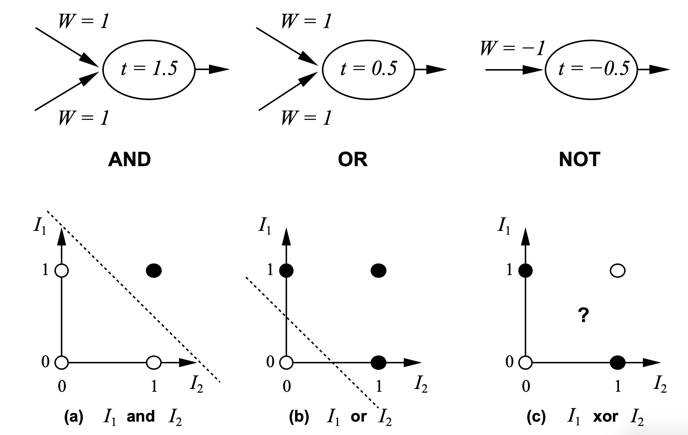

Neural Computation
McCulloch and Pitts (1943) showed how linear threshold units can be used to compute logical functions
$$y=sign(∑w_{i}I_{i} − T)$$

Slide 17
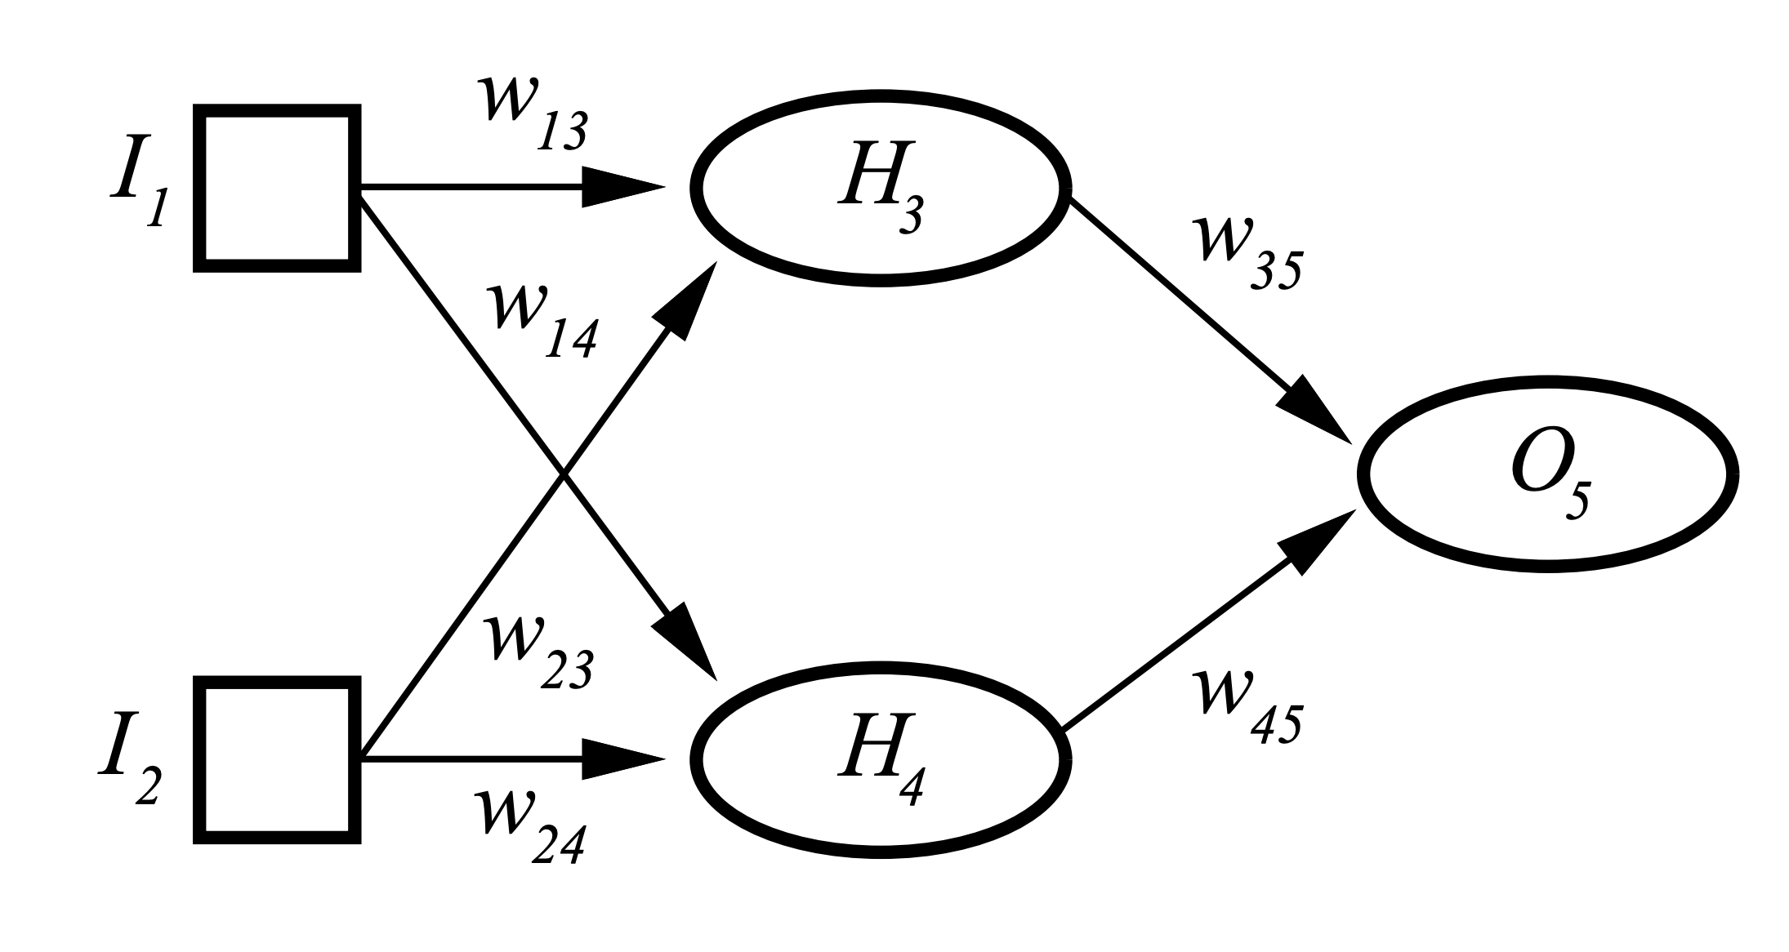
Neural Computation (contd)
But XOR?
Two Layered Two Unit Network

Slide 18
Artificial Neural Networks (ANN)
Output Y is 1 if at least two of the three inputs are equal to 1.

Slide 19
Artificial Neural Networks (ANN)

Slide 20
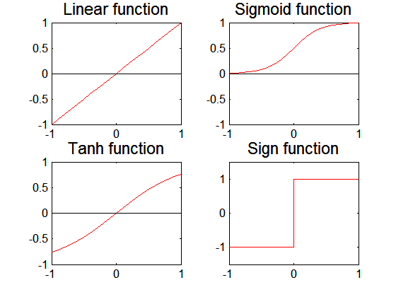
Artificial Neural Networks (ANN)
Various types of neural network topology
  single-layered network (perceptron) versus
  multi-layered network
  Feed-forward versus recurrent network
Various types of
activation functions (f)

Slide 21
Multilayer Neural Network
Hidden layers
  intermediary layers between input & output layers
More general activation functions (sigmoid, linear, etc)

Slide 22
General Structure of ANN
Training ANN means learning the weights of the neurons

Slide 23
Neural Network Terminology
A neural network is composed of a number of units (nodes) that are connected by links. Each link has a weight associated with it. Each unit has an activation level and a means to compute the activation level at the next step in time.
Most neural networks are decomposed of a linear component called input function, and a non-linear component call activation function. Popular activation functions include: relu, tanh, and sigmoid function.
The architecture of a neural network determines how units are connected and what activation function are used for the network computations. Architectures are subdivided into feed-forward and recurrent networks. Moreover, single layer and multi-layer neural networks (that contain hidden units) are distinguished.
Learning in the context of neural networks centers on finding “good” weights for a given architecture so that the error in performing a particular task is minimized. Most approaches center on learning a function from a set of training examples, and use hill-climbing and steepest decent hill-climbing approaches to find the best values for the weights that lead to the “lowest error”.
Loss functions are mechanisms that compute a NN’s error for a training set; NN training looks for finding weights which minimize this function.

Slide 24
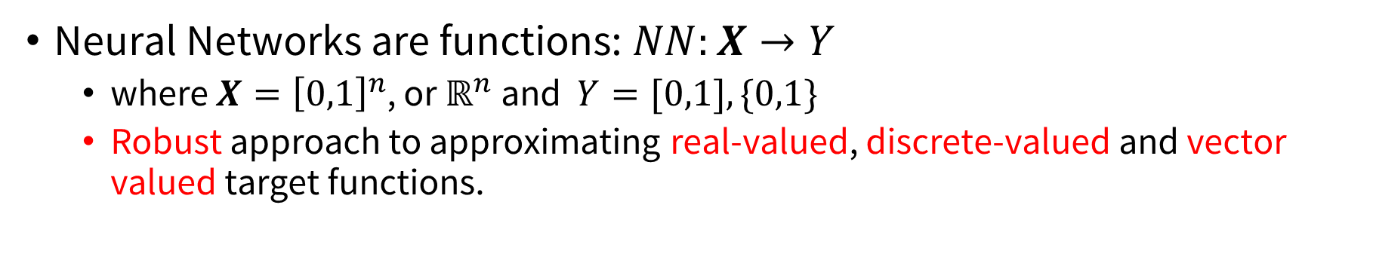
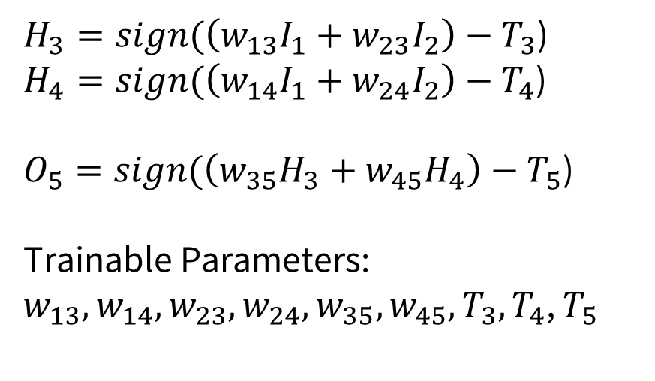
NN Architecture
Neural Networks are functions: $NN:X→Y$
  where $X={\left[0,1\right]}^{n}$, or $ℝ^{n}$ and $Y=[0,1], \{0,1\}$
  Robust approach to approximating real-valued, discrete-valued and vector valued target functions.
$H_{3}=sign(\left(w_{13}I_{1}+w_{23}I_{2}\right)−T_{3}$)
$H_{4}=sign(\left(w_{14}I_{1}+w_{24}I_{2}\right)−T_{4}$)
$O_{5}=sign(\left(w_{35}H_{3}+w_{45}H_{4}\right)−T_{5}$)
Trainable Parameters:
$w_{13},w_{14}, w_{23}, w_{24}, w_{35}, w_{45}, T_{3},T_{4}$, $T_{5}$

Slide 25
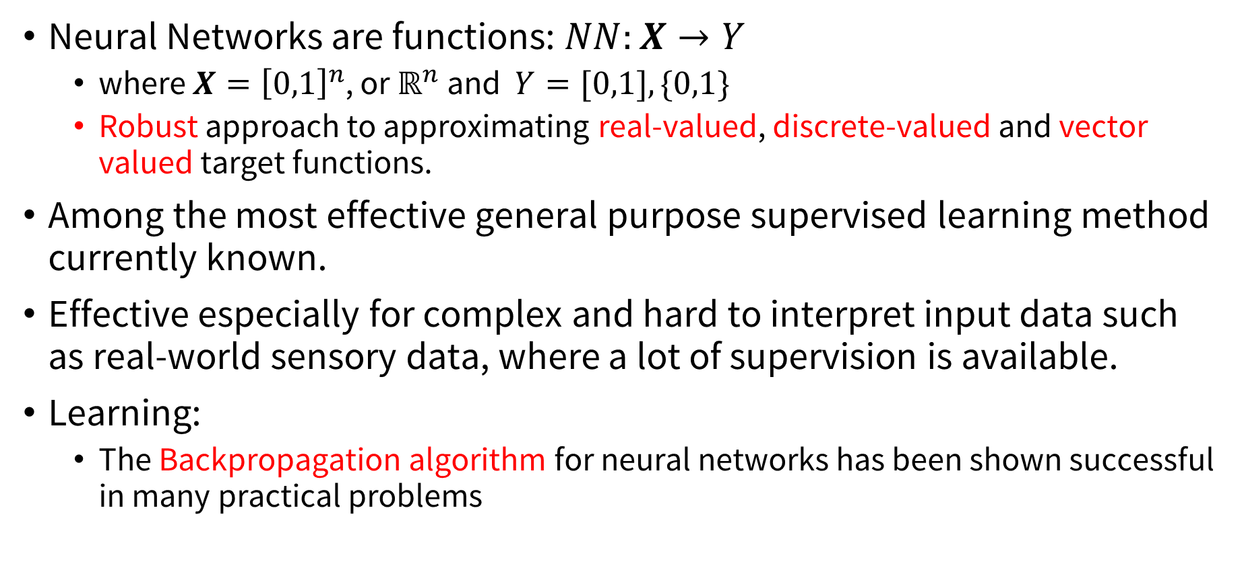
NN Architecture (Contd.)
Neural Networks are functions: $NN:X→Y$
  where $X={\left[0,1\right]}^{n}$, or $ℝ^{n}$ and $Y=[0,1], \{0,1\}$
  Robust approach to approximating real-valued, discrete-valued and vector valued target functions.
Among the most effective general purpose supervised learning method currently known.
Effective especially for complex and hard to interpret input data such as real-world sensory data, where a lot of supervision is available.
Learning:
  The Backpropagation algorithm for neural networks has been shown successful in many practical problems

Slide 26
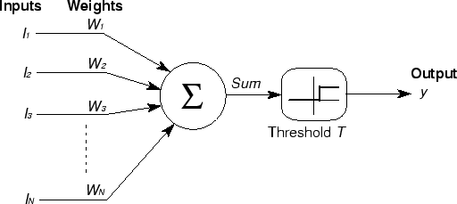
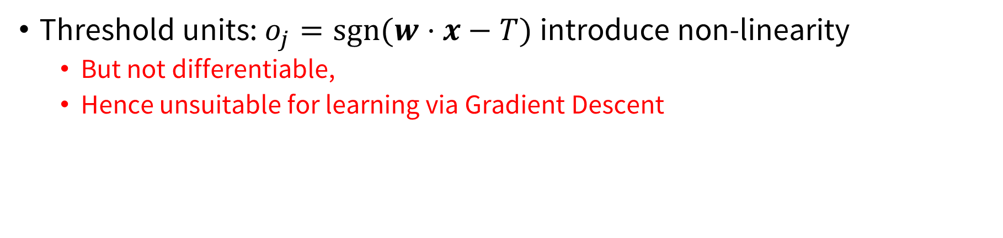
Basic Unit in Multi-Layer Neural Network
Threshold units: $o_{j}=sgn⁡(w⋅x−T)$introduce non-linearity
  But not differentiable,
  Hence unsuitable for learning via Gradient Descent
activation
Output
Hidden
Input

Slide 27
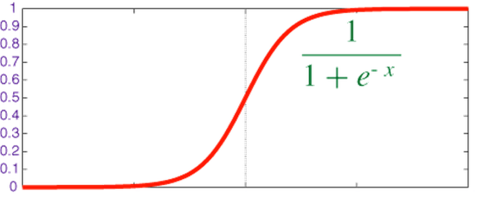


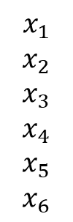
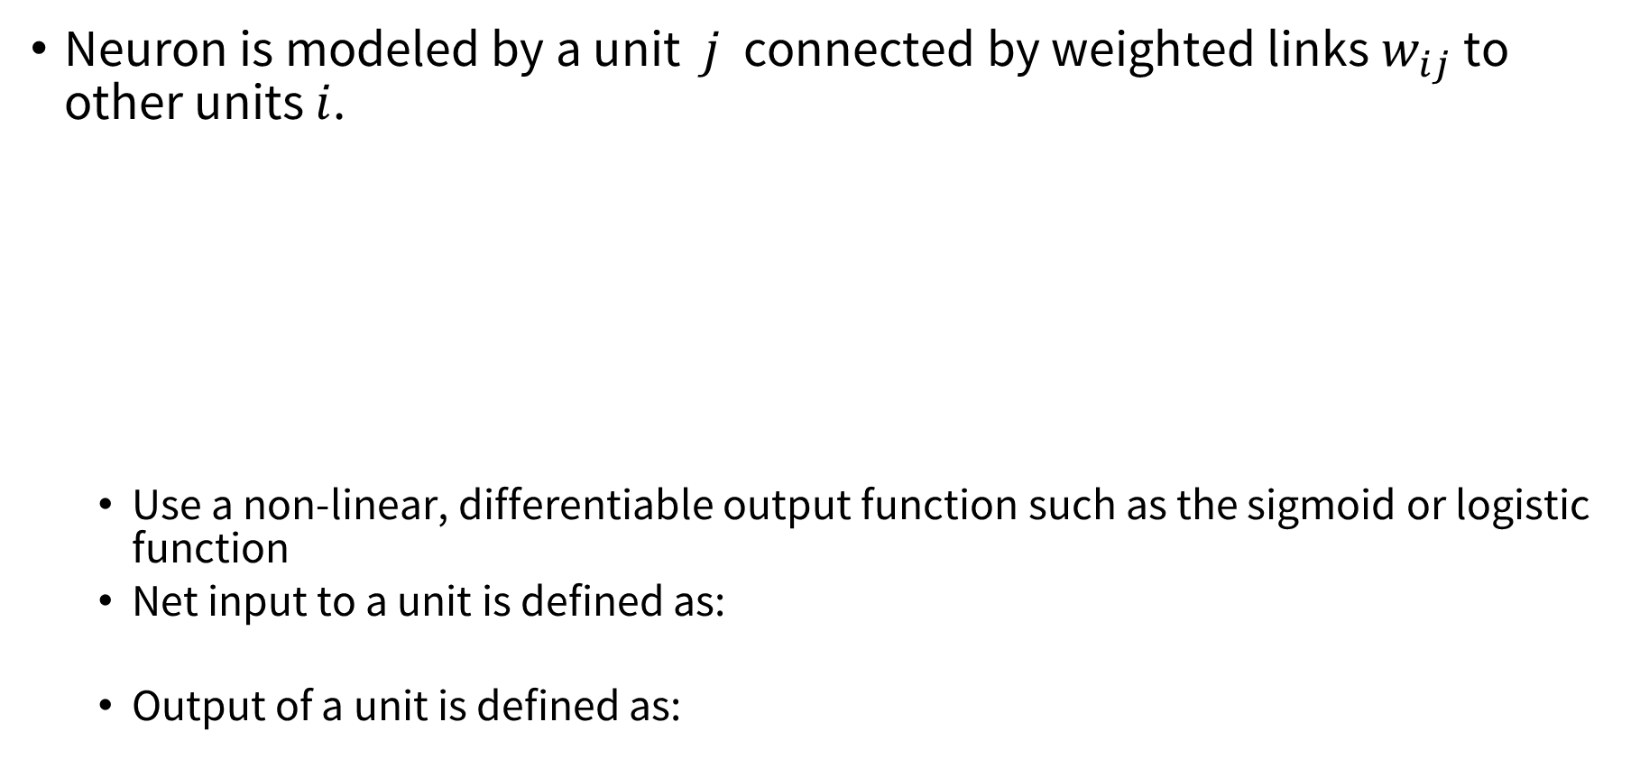


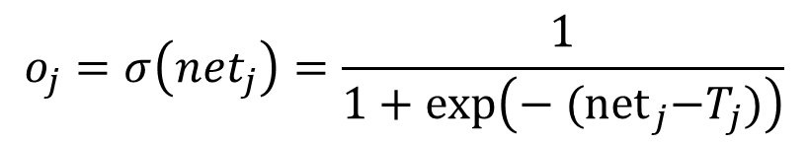

Logistic Neuron / Sigmoid Activation
Neuron is modeled by a unit $j$ connected by weighted links $w_{ij}$ to other units $i$.
  Use a non-linear, differentiable output function such as the sigmoid or logistic function
  Net input to a unit is defined as:
  Output of a unit is defined as:
$$x_{1}$$
$$x_{2}$$
$$x_{3}$$
$$x_{4}$$
$$x_{5}$$
$$x_{6}$$
$$w_{1j}$$
$$x_{j}$$
$$o_{j}$$
$$w_{6j}$$
$${net}_{j}=∑w_{ij}⋅x_{i}$$
$$o_{j}=σ\left(net_{j}\right)=\frac{1}{1+exp\left(− {(net}_{j}−T_{j})\right)}$$

Slide 28
Representational Power
Any Boolean function can be represented by a two layer network (simulate a two layer AND-OR network)
Any bounded continuous function can be approximated with arbitrary small error by a two layer network.
Sigmoid functions provide a set of basis functions from which arbitrary function can be composed.
Any function can be approximated to arbitrary accuracy by a three layer network.

Slide 29
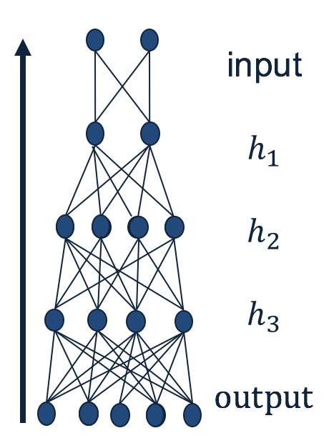
Small Quiz
Given an arbitrary neural network, how do we make predictions?
  Given input, calculate the output of each layer (starting from the first layer), until you get to the output.
What do you need to fully specify a neural network?
  The weights.
Why do you think NN predictions are quick?
  Because many of the computations could be parallelized.
What makes a neural networks expressive?
  The non-linear units.

Slide 30

Training a NN
$H_{3}=σ(\left(w_{13}I_{1}+w_{23}I_{2}\right)−T_{3}$)
$H_{4}=σ(\left(w_{14}I_{1}+w_{24}I_{2}\right)−T_{4}$)
$O_{5}=σ(\left(w_{35}H_{3}+w_{45}H_{4}\right)−T_{5}$)
Trainable Parameters:
$w_{13},w_{14}, w_{23}, w_{24}, w_{35}, w_{45}, T_{3},T_{4}$, $T_{5}$

Slide 31
NN Comp.
w13
Example:
all weights are 0.1 except w45=1; γ=0.2
Training Example: (I1=1,I2=1;a5=1)
g is the sigmoid activation function
I1
a3
w35
w23
a5
a_{i}:= activation of node i
z_{i} := linear input of node i:
a_{i} =g(z_{i})
w14
w45
I2
a4
w24
a4=g(z4)=
g(x1*w14+x2*w24)=g(0.2)=0.550
a3=g(z3)=
g(x1*w13+x2*w23)=g(0.2)=0.550
a5=g(z5)=
g(a3*w35+a4*w45)=g(0.605)=0.647
error(a5)=
1-0.647=0.353
g(x)= 1/(1+e^{−x} )
g’(x)= g(x)*(1-g(x))
γ is the learning rate

Slide 32

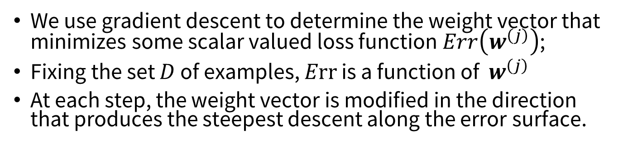


Gradient Descent
We use gradient descent to determine the weight vector that minimizes some scalar valued loss function $Err\left(w^{\left(j\right)}\right)$;
Fixing the set $D$ of examples, $Err$ is a function of $w^{\left(j\right)}$
At each step, the weight vector is modified in the direction that produces the steepest descent along the error surface.
$Err(w)$
$w_{3}$ $w_{2}$ $w_{1}$ $w_{0}$
$$w$$

Slide 33
Gradient Descent for Multilayer NN
Weight update:
Error function:
Activation function f must be differentiable
For sigmoid function:

Slide 34
Neural Network Learning ---Mostly Steepest Descent Hill Climbing on a Differentiable Error Function
Current Weight Vector
Important! How far you jump depends on:
the learning rate α.
On the error |T-O|
The input activation of the node
Gradient of the Error Function
Remarks on α:
too low → slow convergence
too high → might overshoot goal
New Weight Vector

Slide 35
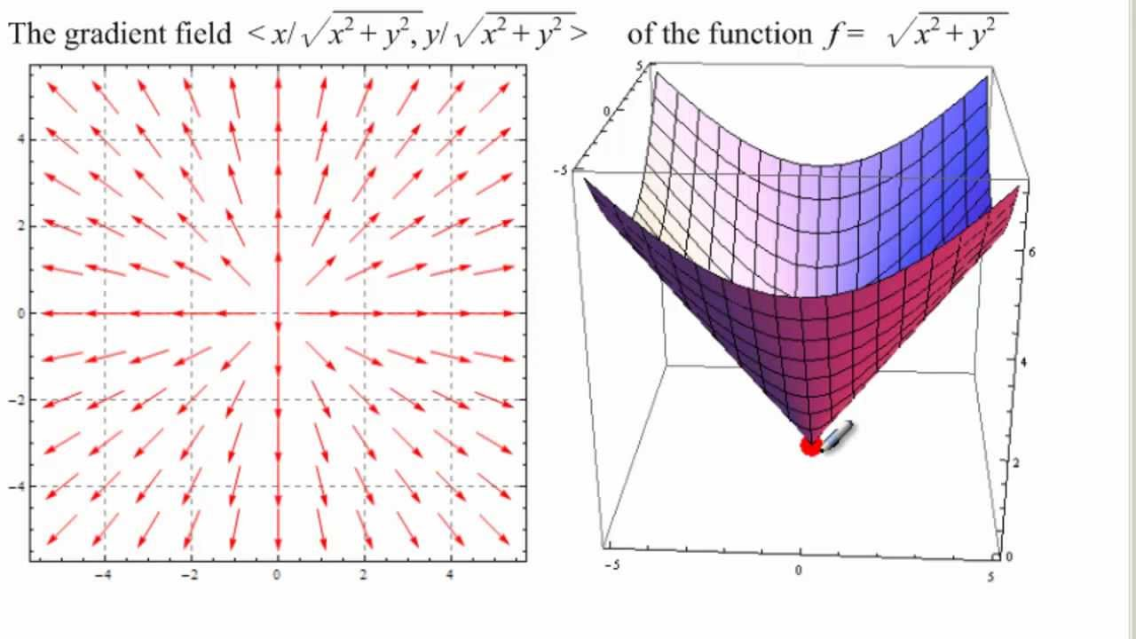
Error Function Gradient based on 2 Weights
Video on this topic at starting at 2:50: https://www.youtube.com/watch?v=IHZwWFHWa-w&index=3&list=PLZHQObOWTQDNU6R1_67000Dx_ZCJB-3pi&t=0s
Remark: To minimize the error/loss function we will walk in the inverse direction of the arrows!
If the steepest gradient is for example (1,2) then the second weight contributes more to the error;
Consequently, it is increased twice as much in comparison to the increase of the first weight.

Slide 36
Learning with a Multi-Layer Perceptron
The problem is what to do with the other set of weights – we do not get feedback in the intermediate layer(s).
Solution: If all the activation functions are differentiable, then the output of the network is also a differentiable function of the input and weights in the network.
Define an error function (e.g., sum of squares) that is a differentiable function of the output, i.e. this error function is also a differentiable function of the weights.
We can then evaluate the derivatives of the error with respect to the weights, and use these derivatives to find weight values that minimize this error function, using gradient descent (or other optimization methods).
This results in an algorithm called back-propagation.
activation
Output
w²_{ij}
Hidden
w¹_{ij}
Input

Slide 37
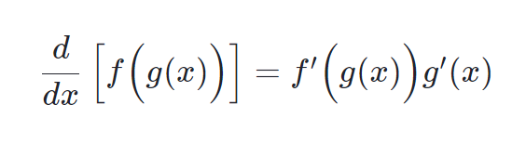

Quiz!
What is the chain rule for differentiating a composite function?
$\frac{d}{dx}$ $\left(\left[f\left(g\left(x\right)\right)\right]\right)$
$\frac{df}{dx}$= $\frac{df}{dg}$ $\frac{dg}{dx}$

Slide 38
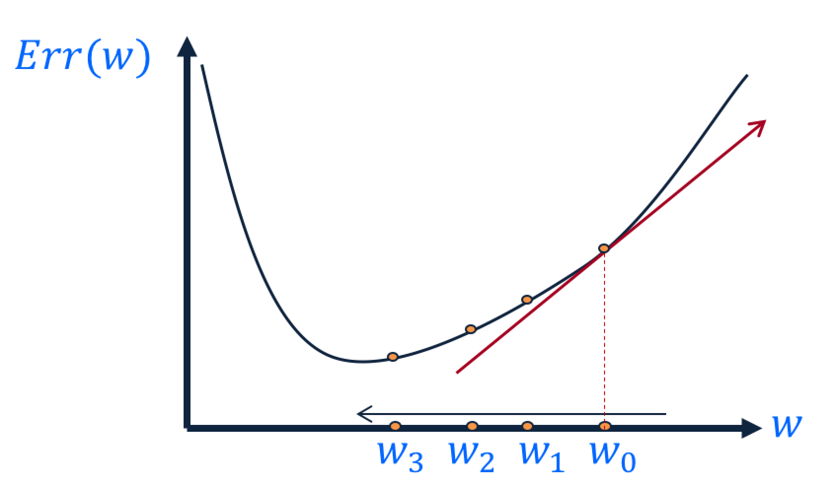

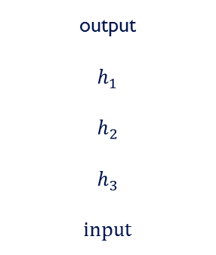
Backpropagation Intuition
Gradient Descent
  Change the weights in the direction of gradient to minimize the error function.
Chain Rule
  Use the chain rule to calculate the weights of the intermediate weights
Dynamic Programming (Memoization)
  Memoize the weight updates to make the updates faster.
output
$$h_{1}$$
$$h_{2}$$
$$h_{3}$$
input
$$\frac{∂E}{∂w_{ij}}$$

Slide 39

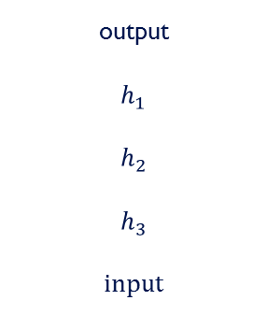
Backpropagation Steps
Loop over instances:
  The forward step
    Given the input, make predictions layer-by-layer, starting from the first layer)
  The backward step
    Calculate the error in the output
    Update the weights layer-by-layer, starting from the final layer
output
$$h_{1}$$
$$h_{2}$$
$$h_{3}$$
input
$$\frac{∂E}{∂w_{ij}}$$

Slide 40

Backpropagation Algorithm
Create a fully connected three layer network. Initialize weights.
Until all examples produce the correct output within $ε$ (or other criteria)
For each example in the training set do:
  Compute the network output for this example
  Compute the error between the output and target value
  $$δ_{k}=\left(t_{k}−o_{k}\right)o_{k}\left(1−o_{k}\right)$$
  For each output unit k, compute error term
  $${δ_{j}= o}_{j}\left(1−o_{j}\right).\sum_{k∈downstream\left(j\right)}{−δ_{k} w_{jk} }$$
  For each hidden unit, compute error term: $Δw_{ij}=Rδ_{j}x_{i}$
  Update network weights with $Δw_{ij}$
End epoch

Slide 41
Updating Weights in Neural Networks
w_{ij}:= Old_w_{ij} + a*input_activation_{i}*associated_error_{j}
Multi-layer Network: Associated_Error (Δi)):=
  Output Node i: g’(z_{i})*(T-O)
  Intermediate Node k connected to i: g’(z_{i})*w _{ki} *error_at_node_i
w13
Δ3
a1
a3
Δ5
I1
Δ3
w35
w23
a5
Δ4
Δ5
w14
Δ4
w45
a2
a4
w24
I2
Multi-layer Network

Slide 42
Back Propagation Formula Example
g(x)= 1/(1+e^{−x} )
g’(x)= g(x)*(1-g(x))
γ is the learning rate
w13
I1
a3
w35
w23
a5
a_{i}:= activation of node i
z_{i} := linear input of node i:
a_{i} =g(z_{i})
w14
w45
I2
a4
w35= w35 + γ*a3*Δ5
w45= w45 + γ*a4*Δ5
w13= w13 + γ*x1*Δ3
w23= w23 + γ*x2*Δ3
w14= w14 + γ*x1*Δ4
w24= w24 + γ*x2*Δ4
w24
a4=g(z4)=g(x1*w14+x2*w24)
a3=g(z3)=g(x1*w13+x2*w23)
a5=g(z5)=g(a3*w35+a4*w45)
Δ5=error*g’(z5)=error*a5*(1-a5)
Δ4= Δ5*w45*g’(z4)=Δ5*w45*a4*(1-a4)
Δ3=Δ5*w35*a3*(1-a3)

Slide 43
Example BP
We assume all weights are 0.1 except w45=1; γ=1 and
That the batch contains single example: (x1=1,x2=1;a5=1)
g is the sigmoid function
w13
a5 is 0.6594 with the adjusted
weights!
I1
a3
w35
w23
a5
w14
w45
w35= w35 + γ*a3*Δ5=
0.1+1*0.55*0.08=0.145
w45= w45 + γ*a4*Δ5=1.045
w13= w13 + γ*x1*Δ3=0.102
w23= w23 + γ*x2*Δ3=0.102
w14= w14 + γ*x1*Δ4=0.12
w24= w24 + γ*x2*Δ4=0.12
a4’=g(0.24)=0.557
a3’=g(0.204)=0.554
a5’=g(0.66045)=0.66
I2
a4
w24
a4=g(z4)=g(x1*w14+x2*w24)=g(0.2)=0.550
a3=g(z3)=g(x1*w13+x2*w23)=g(0.2)=0.550
a5=g(z5)=g(a3*w35+a4*w45)=g(0.605)=0.647
Δ5=error*g’(z5)=error*a5*(1-a5)=
*0.353*0.647*0.353=0.08
Δ4=Δ5*w45*a4*(1-a4)=0.02
Δ3=Δ5*w35*a3*(1-a3)=0.002

Slide 44
Example BP
Example: all weights are 0.1 except w45=1; γ=0.2
Training Example: (x1=1,x2=1;a5=1)
g is the sigmoid function
g(x)= 1/(1+e^{−x} )
g’(x)= g(x)*(1-g(x))
γ is the learning rate
w13
I1
a3
w35
w23
a5
a5 is 0.6483 with the adjusted
weights!
w14
w45
w35= w35 + γ*a3*Δ5=
0.1+0.2*0.55*0.08=0.109
w45= w45 + γ*a4*Δ5=1.009
w13= w13 + γ*x1*Δ3=0.1004
w23= w23 + γ*x2*Δ3=0.1004
w14= w14 + γ*x1*Δ4=0.104
w24= w24 + γ*x2*Δ4=0.104
a4’=g(0.208)=0.551
a3’=g(0.2008)=0.551
a5’=g(0.611554)=0.6483
I2
a4
w24
a4=g(z4)=g(x1*w14+x2*w24)=g(0.2)=0.550
a3=g(z3)=g(x1*w13+x2*w23)=g(0.2)=0.550
a5=g(z5)=g(a3*w35+a4*w45)=g(0.605)=0.647
Δ5=error*g’(a5)=error*a5*(1-a5)=
0.353*0.353*0.647=0.08
Δ4=Δ5*w45*a4*(1-a4)=0.02
Δ3=Δ5*w35*a3*(1-a3)=0.002

Slide 45
Comments on Training
No guarantee of convergence; neural networks form non-convex functions with multiple local minima
In practice, many large networks can be trained on large amounts of data for realistic problems.
Many epochs (tens of thousands) may be needed for adequate training. Large data sets may require many hours of CPU
Termination criteria: Number of epochs; Threshold on training set error; No decrease in error; Increased error on a validation set.
To avoid local minima: several trials with different random initial weights with majority or voting techniques

Slide 46
Over-training Prevention
Running too many epochs and/or a NN with many hidden layers may lead to an overfit network
Keep an held-out validation set and test accuracy after every epoch
Early stopping: maintain weights for best performing network on the validation set and return it when performance decreases significantly beyond that.
To avoid losing training data to validation:
  Use 10-fold cross-validation to determine the average number of epochs that optimizes validation performance
  Train on the full data set using this many epochs to produce the final results

Slide 47
Over-fitting prevention
Too few hidden units prevent the system from adequately fitting the data and learning the concept.
Using too many hidden units leads to over-fitting.
Similar cross-validation method can be used to determine an appropriate number of hidden units. (general)
Another approach to prevent over-fitting is weight-decay: all weights are multiplied by some fraction in (0,1) after every epoch.
  Encourages smaller weights and less complex hypothesis
  Equivalently: change Error function to include a term for the sum of the squares of the weights in the network. (general)

Slide 48
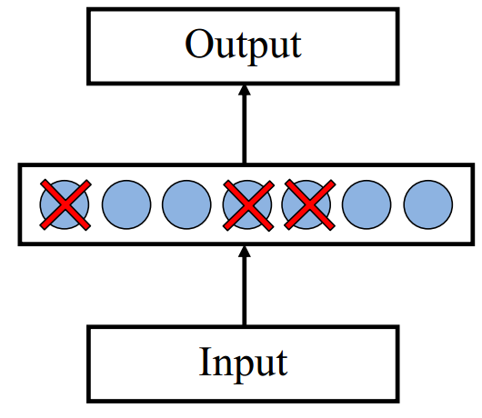

Dropout training
Proposed by (Hinton et al, 2012)
Each time decide whether to delete one hidden unit with some probability $p$

Slide 49
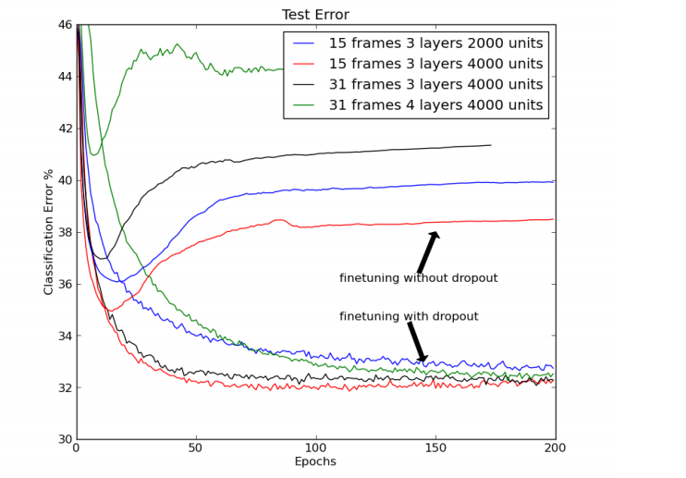

Dropout training
Dropout of $50\%$ of the hidden units and $20\%$ of the input units (Hinton et al, 2012)

Slide 50
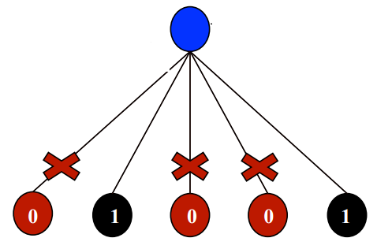
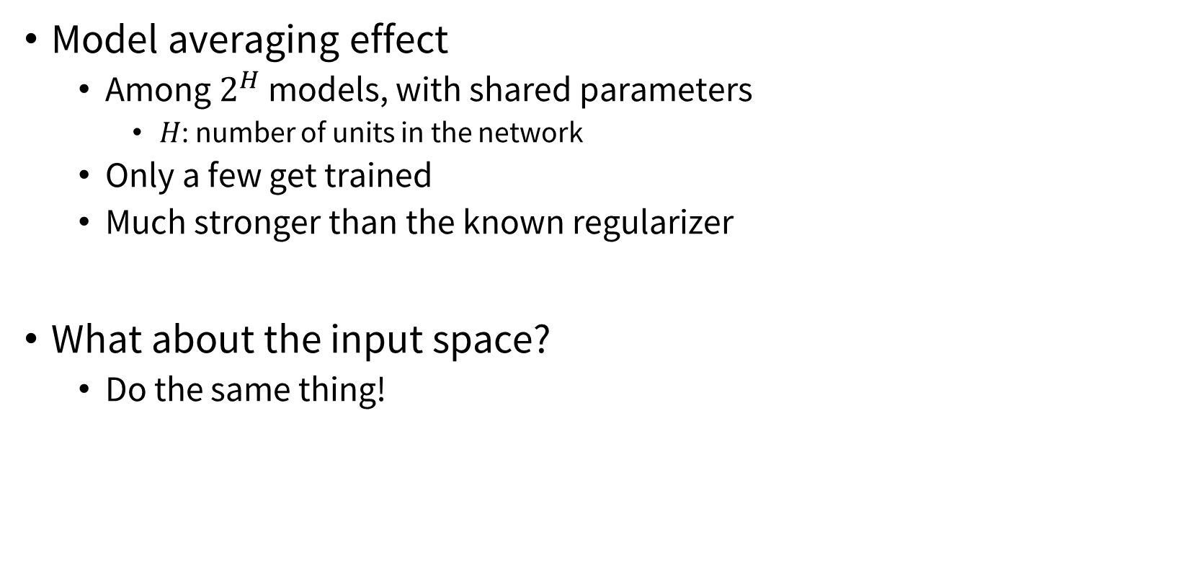
Dropout training
Model averaging effect
  Among $2^{H}$ models, with shared parameters
    $H$: number of units in the network
  Only a few get trained
  Much stronger than the known regularizer
What about the input space?
  Do the same thing!

Slide 51
Demo + Lab
Link:
  https://playground.tensorflow.org/
Lab:
  https://nnfs.io

