Slide 1

CM20315 - Machine Learning
Prof. Simon Prince
6. Fitting models

Slide 2
Graph regression
Multivariate regression problem (>1 output, real value)

Slide 3
Text classification
Binary classification problem (two discrete classes)

Slide 4
Music genre classification
Multiclass classification problem (discrete classes, >2 possible values)

Slide 5
News March 31, 2026
Deliverables for Task3
Student Presentations on April 7 and 9
Today:
  Fitting NN Models
  Gradients
  Regularization
  NN In-Class Activity

Slide 6
Regression
Univariate regression problem (one output, real value

Slide 7
Loss function
Training dataset of I pairs of input/output examples:
Loss function or cost function measures how bad model is:
or for short:
Returns a scalar that is smaller when model maps inputs to outputs better

Slide 8
Training
Loss function:
Find the parameters that minimize the loss:
Returns a scalar that is smaller when model maps inputs to outputs better

Slide 9
Example: 1D Linear regression loss function
Loss function:
“Least squares loss function”

Slide 10
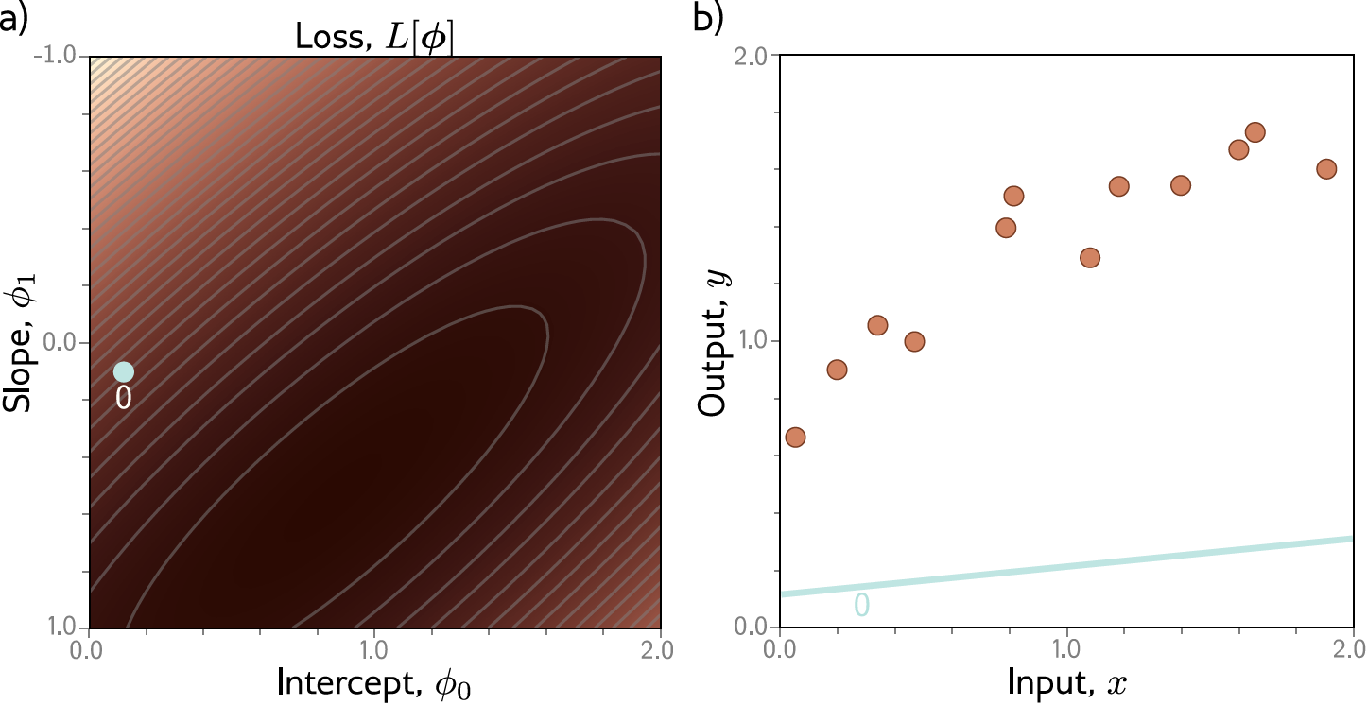
Example: 1D Linear regression training

Slide 11
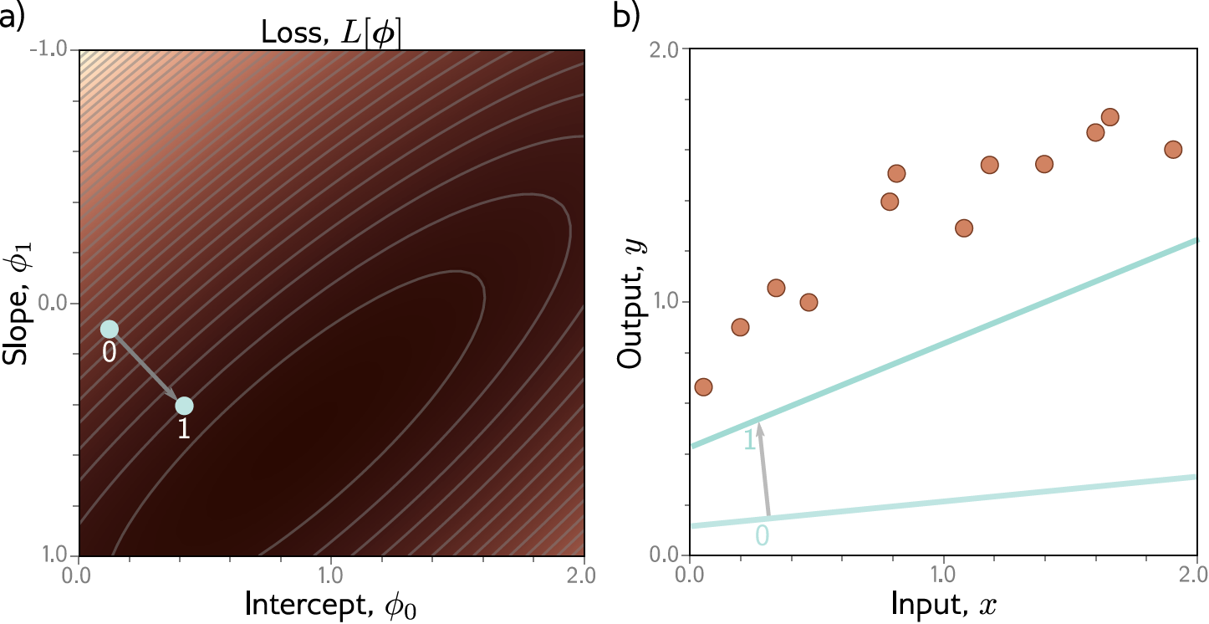
Example: 1D Linear regression training

Slide 12
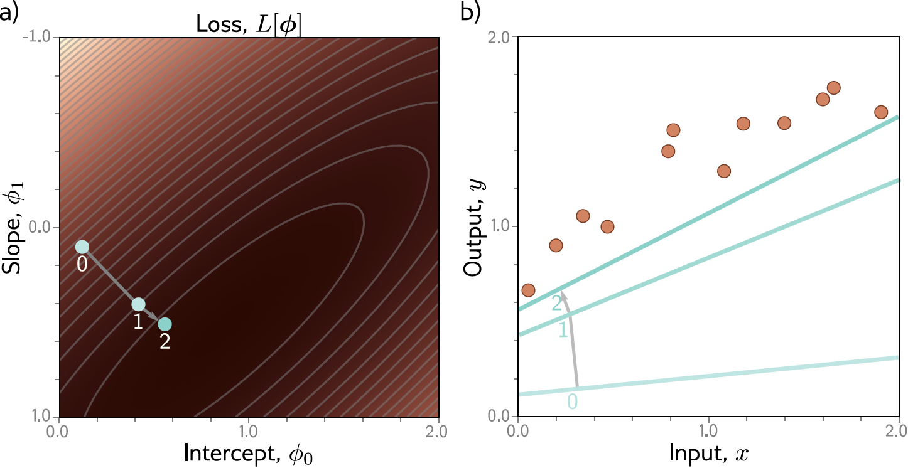
Example: 1D Linear regression training

Slide 13

Example: 1D Linear regression training

Slide 14
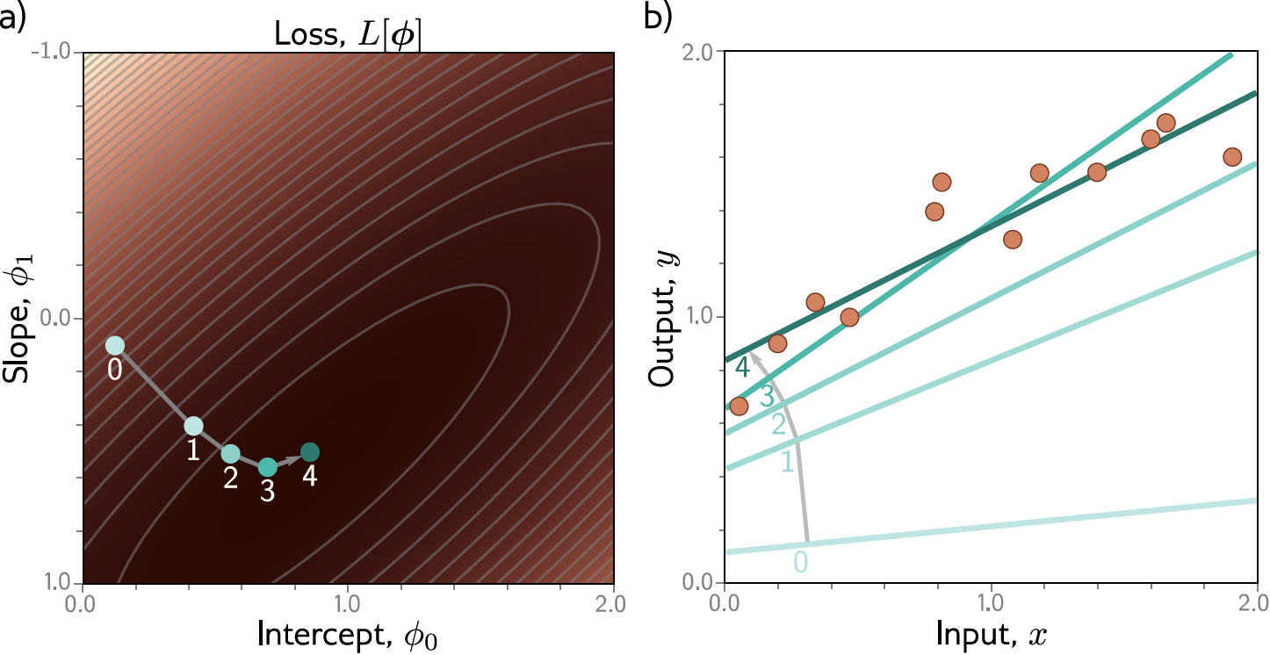
Example: 1D Linear regression training
This technique is known as gradient descent

Slide 15
Fitting models
Maths overview
Gradient descent algorithm
Linear regression example
Gabor model example
Stochastic gradient descent
Momentum
Adam

Slide 16
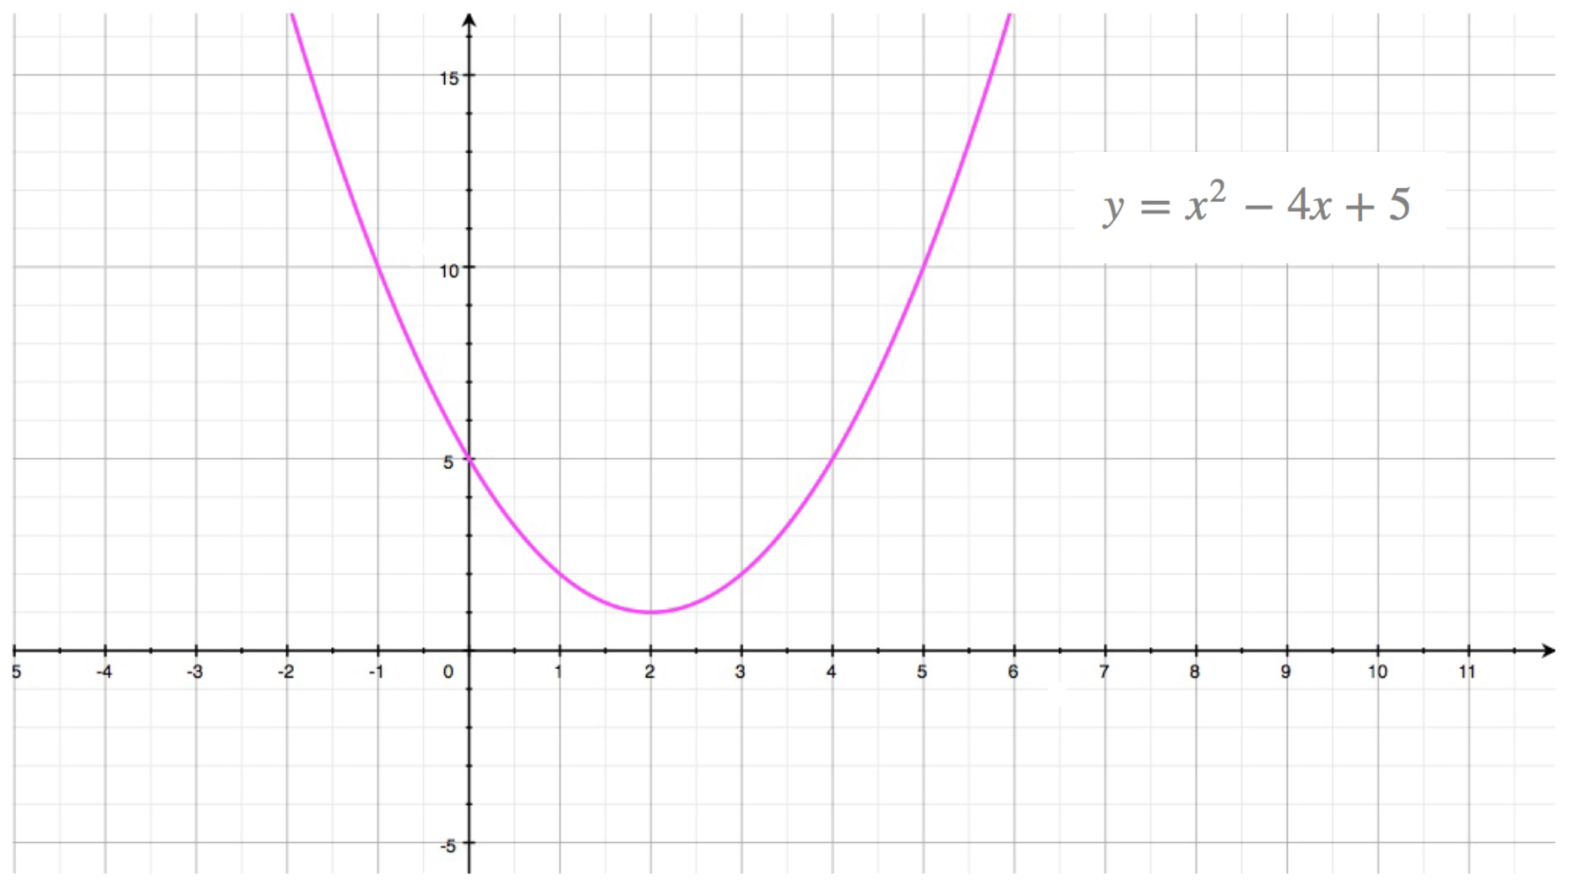

Slide 22
Fitting models
Maths overview
Gradient descent algorithm
Linear regression example
Gabor model example
Stochastic gradient descent
Momentum
Adam

Slide 23
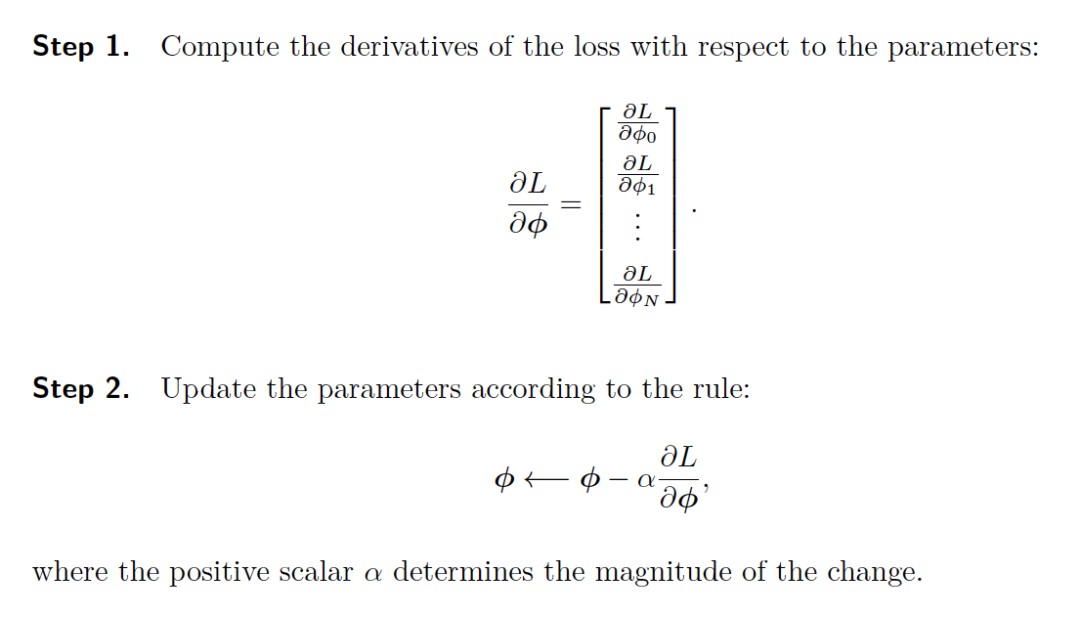
Gradient descent algorithm

Slide 24
Fitting models
Maths overview
Gradient descent algorithm
Linear regression example
Gabor model example
Stochastic gradient descent
Momentum
Adam

Slide 25
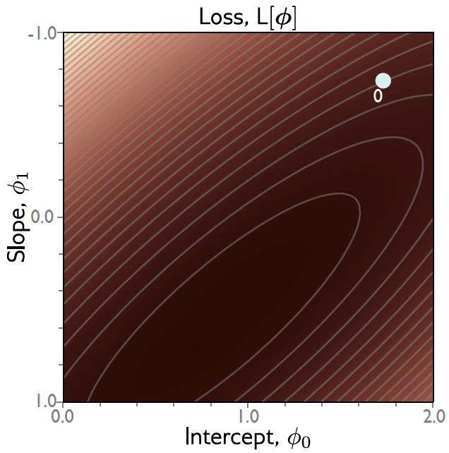
Gradient descent
Step 1: Compute derivatives (slopes of function) with
Respect to the parameters

Slide 26
Gradient descent
Step 1: Compute derivatives (slopes of function) with
Respect to the parameters

Slide 27
Gradient descent
Step 1: Compute derivatives (slopes of function) with
Respect to the parameters

Slide 28

Gradient descent
Step 1: Compute derivatives (slopes of function) with
Respect to the parameters

Slide 29


Gradient descent
Step 1: Compute derivatives (slopes of function) with
Respect to the parameters
Step 2: Update parameters according to rule
$α$ = step size or learning rate if fixed

Slide 30


Gradient descent
Step 1: Compute derivatives (slopes of function) with
Respect to the parameters
Step 2: Update parameters according to rule
$α$ = step size

Slide 31
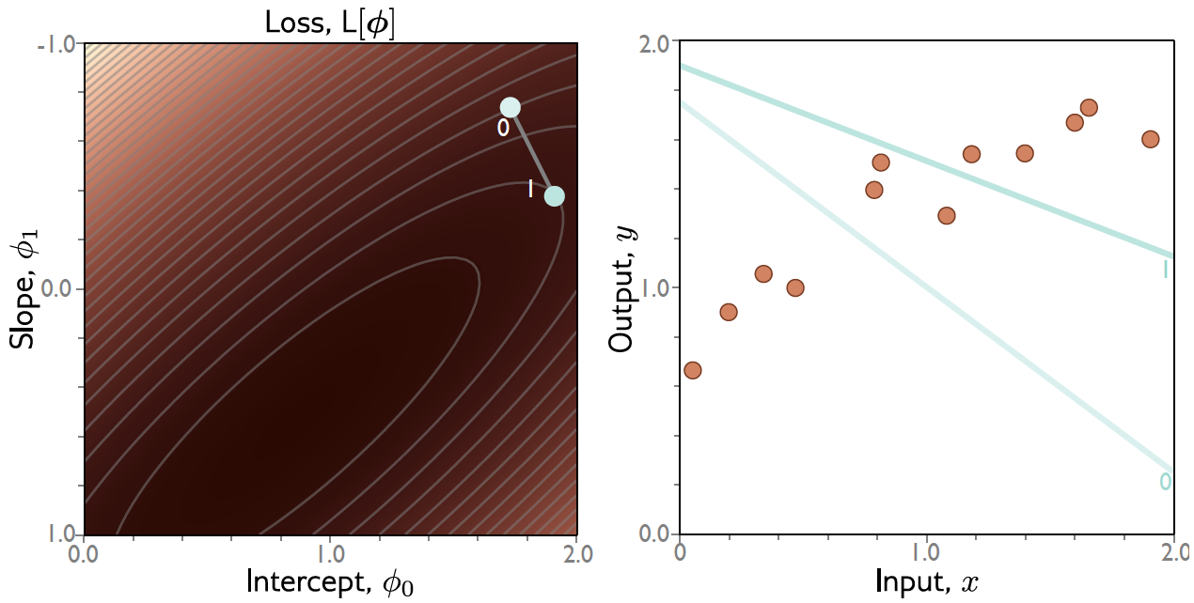
Gradient descent

Slide 32

Gradient descent
Step 1: Compute derivatives (slopes of function) with
Respect to the parameters
Step 2: Update parameters according to rule
$α$ = step size

Slide 33

Gradient descent
Step 1: Compute derivatives (slopes of function) with
Respect to the parameters
Step 2: Update parameters according to rule
$α$ = step size

Slide 34
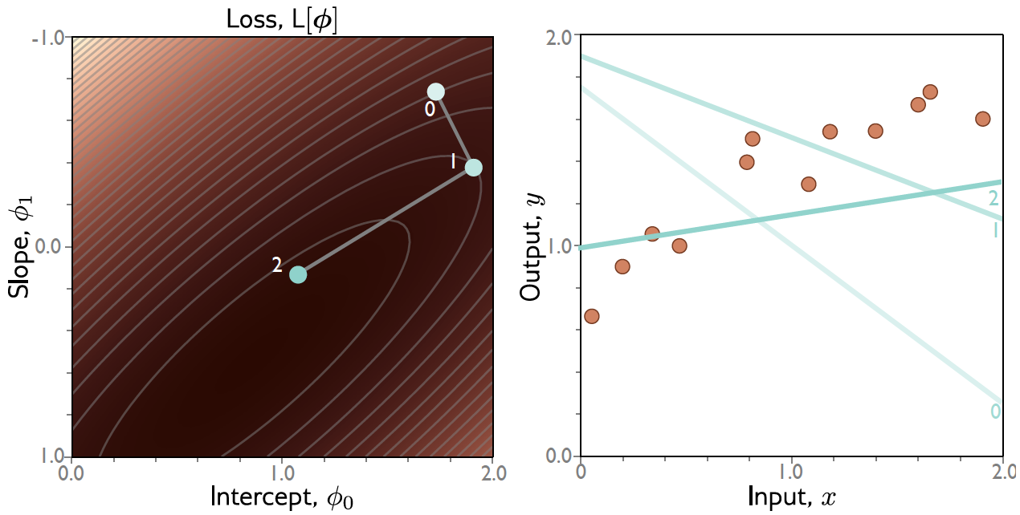
Gradient descent

Slide 35
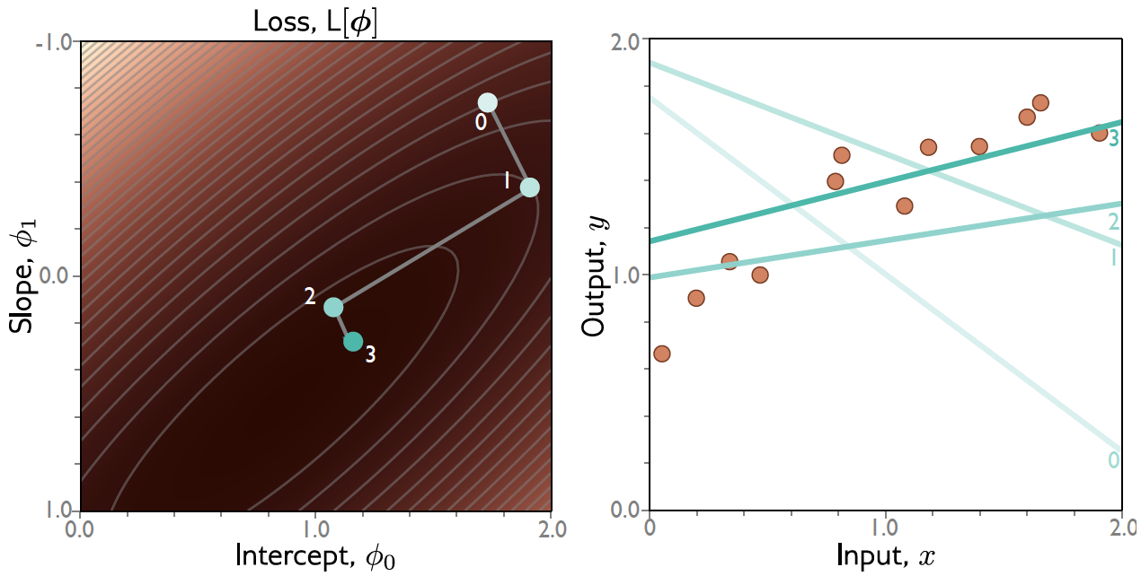
Gradient descent

Slide 36
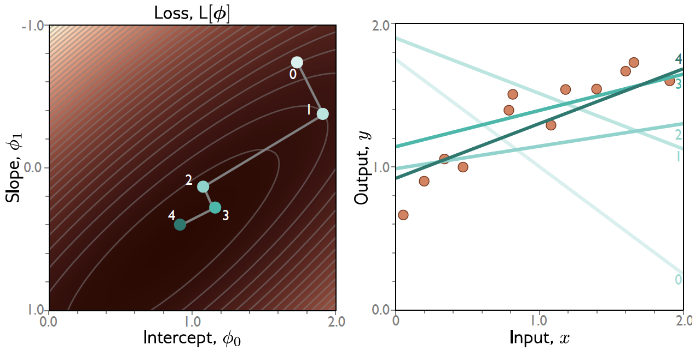
Gradient descent

Slide 37
Line Search
Step 1: Compute derivatives (slopes of function) with
Respect to the parameters
Step 2: Update parameters according to rule
$α$ = step size

Slide 38
Gradient descent

Slide 39
Convex problems
Non convex
Convex
Non-Convex

Slide 40
Convex problems
Non convex
Convex
Non-Convex
Test for convexity is that 2nd derivative is positive everywhere

Slide 41
Convexity in higher dimensions
Test for convexity is that determinant of Hessian (2nd derivative matrix) is positive everywhere.

Slide 42
Fitting models
Maths overview
Gradient descent algorithm
Linear regression example
Gabor model example
Stochastic gradient descent
Momentum
Adam

Slide 43
Gabor model

Slide 44
Gabor model

Slide 45
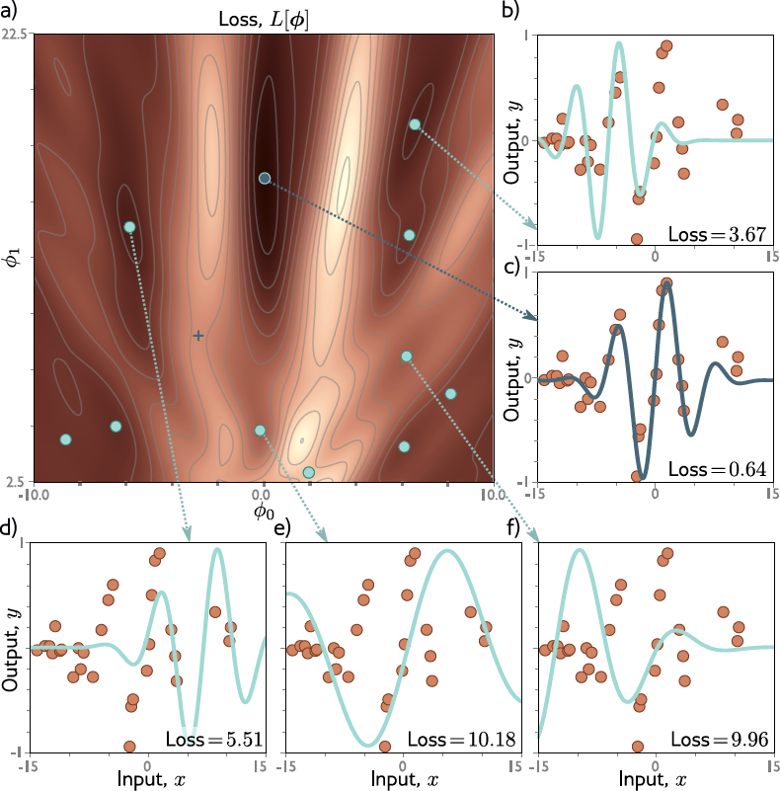

Slide 46
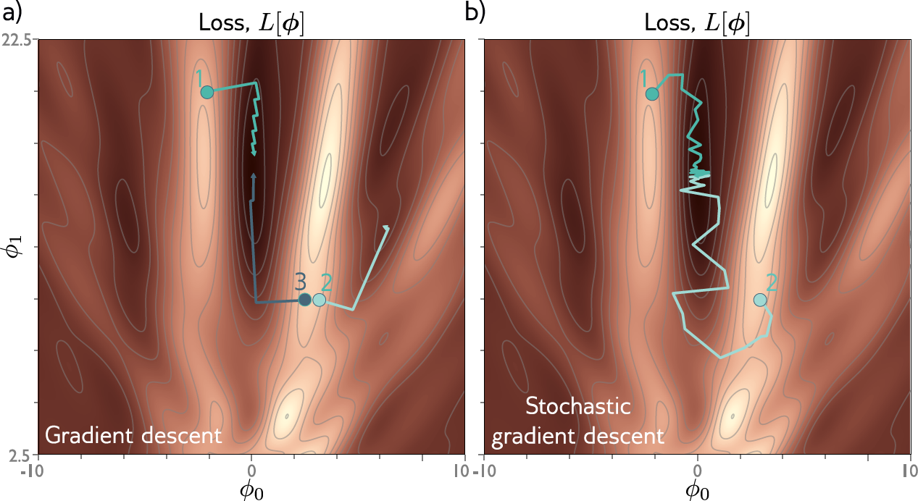
Gradient descent gets to the global minimum if we start in the right “valley”
Otherwise, descent to a local minimum
Or get stuck near a saddle point

Slide 47
Fitting models
Maths overview
Gradient descent algorithm
Linear regression example
Gabor model example
Stochastic gradient descent
Momentum
Adam

Slide 48
IDEA: add noise
Stochastic gradient descent
Compute gradient based on only a subset of points – a mini-batch
Work through dataset sampling without replacement
One pass though the data is called an epoch

Slide 49
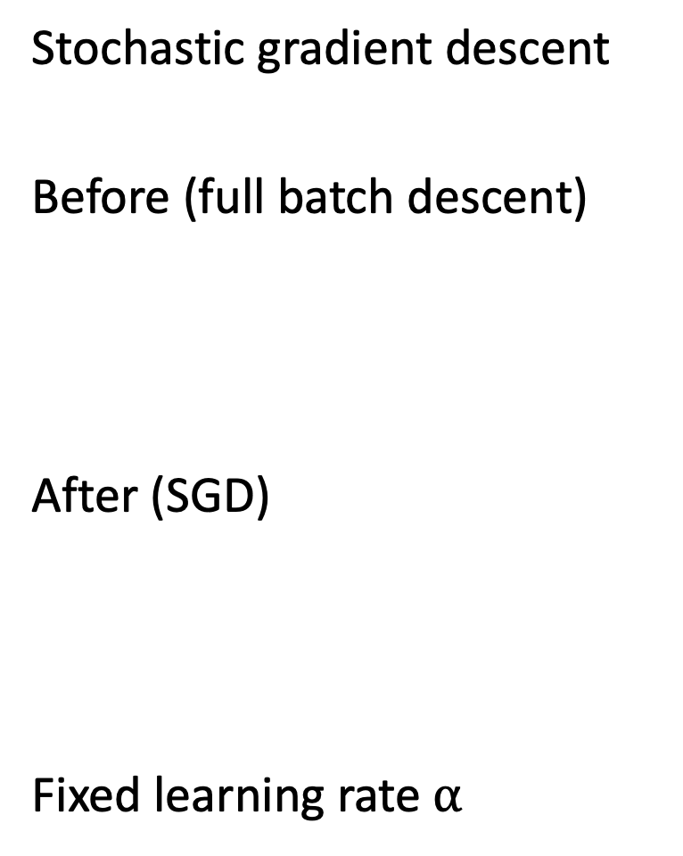
Stochastic gradient descent
Before (full batch descent)
After (SGD)
Fixed learning rate $α$

Slide 51
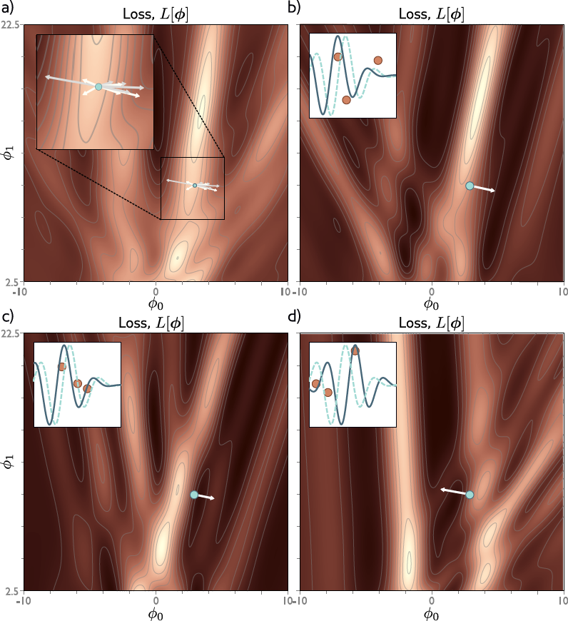

Slide 52
Properties of SGD
Can escape from local minima
Adds noise, but still sensible updates as based on part of data
Uses all data equally
Less computationally expensive
Seems to find better solutions
Doesn’t converge in traditional sense
Learning rate schedule – decrease learning rate over time

Slide 53
Fitting models
Maths overview
Gradient descent algorithm
Linear regression example
Gabor model example
Stochastic gradient descent
Momentum
Adam

Slide 54
Momentum
Weighted sum of this gradient and previous gradient

Slide 55
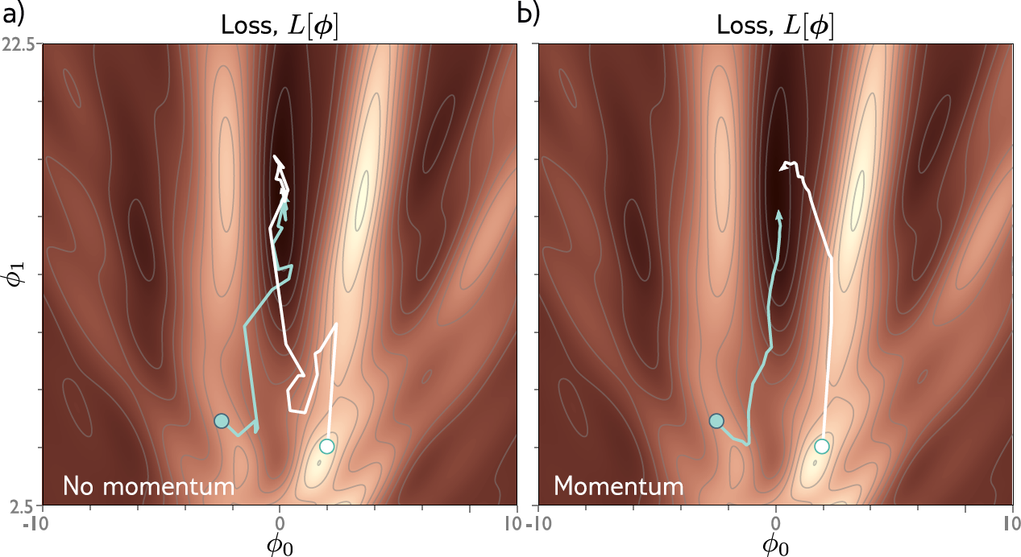

Slide 56
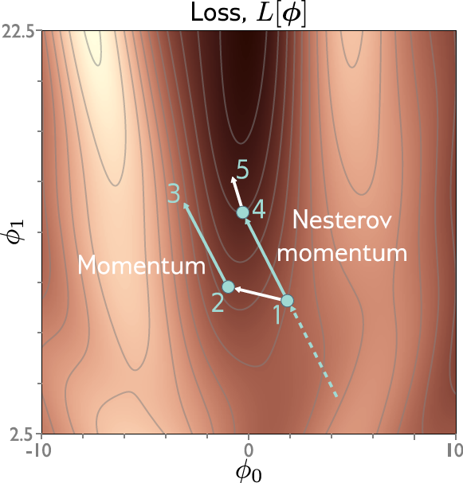
Nesterov accelerated momentum
Momentum is kind of like a prediction of where we are going
Move in the predicted direction, THEN, measure the gradient

Slide 57
Fitting models
Maths overview
Gradient descent algorithm
Linear regression example
Gabor model example
Stochastic gradient descent
Momentum
Adam

Slide 58
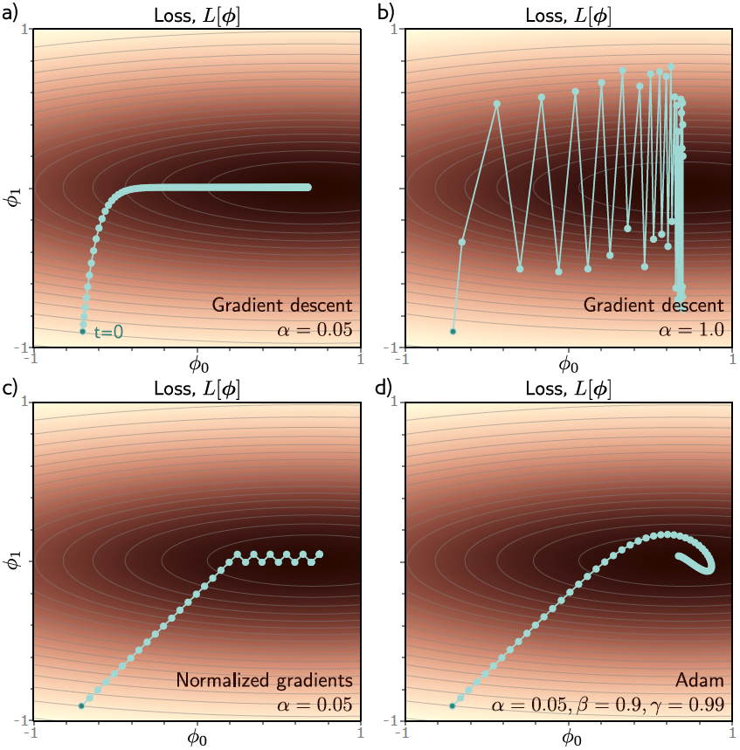
Adaptive moment estimation (Adam)

Slide 59
Normalized gradients
Measure mean and pointwise squared gradient
Normalize:

Slide 60
Normalized gradients
Measure mean and pointwise squared gradient
Normalize:

Slide 61
Normalized gradients
Measure mean and pointwise squared gradient
Normalize:

Slide 62
Adaptive moment estimation (Adam)
Compute mean and pointwise squared gradients with momentum
Moderate near start of the sequence
Update the parameters

Slide 63
Adaptive moment estimation (Adam)

Slide 64
Hyperparameters
Choice of learning algorithm
Learning rate
Momentum

Slide 65
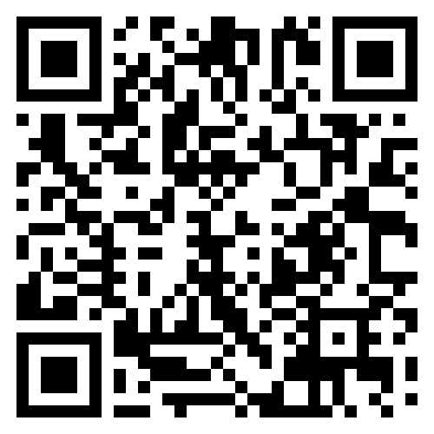
Feedback

