Slide 1

CM20315 - Machine Learning
Prof. Simon Prince
9. Regularization

Slide 2
Regularization
Why is there a generalization gap between training and test data?
  Overfitting (model describes statistical peculiarities)
  Model unconstrained in areas where there are no training examples
Regularization = methods to reduce the generalization gap
Technically means adding terms to loss function
But colloquially means any method (hack) to reduce gap

Slide 3
Regularization
Explicit regularization
Implicit regularization
Early stopping
Ensembling
Dropout
Adding noise
Bayesian approaches
Transfer learning, multi-task learning, self-supervised learning
Data augmentation

Slide 4

Explicit regularization
Standard loss function:
Regularization adds and extra term
Favors some parameters, disfavors others.
$λ$>0 controls the strength

Slide 5

Explicit regularization
Standard loss function:
Regularization adds an extra term
Favors some parameters, disfavors others.
$λ$>0 controls the strength

Slide 6
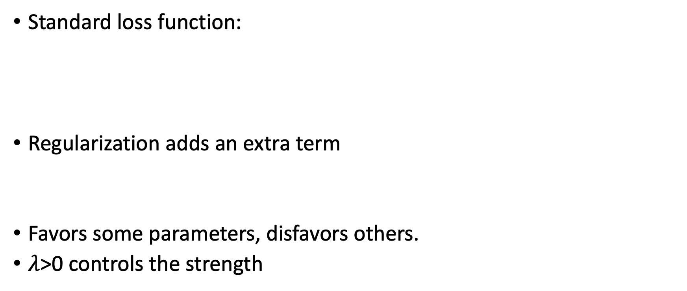
Explicit regularization
Standard loss function:
Regularization adds an extra term
Favors some parameters, disfavors others.
$λ$>0 controls the strength

Slide 7
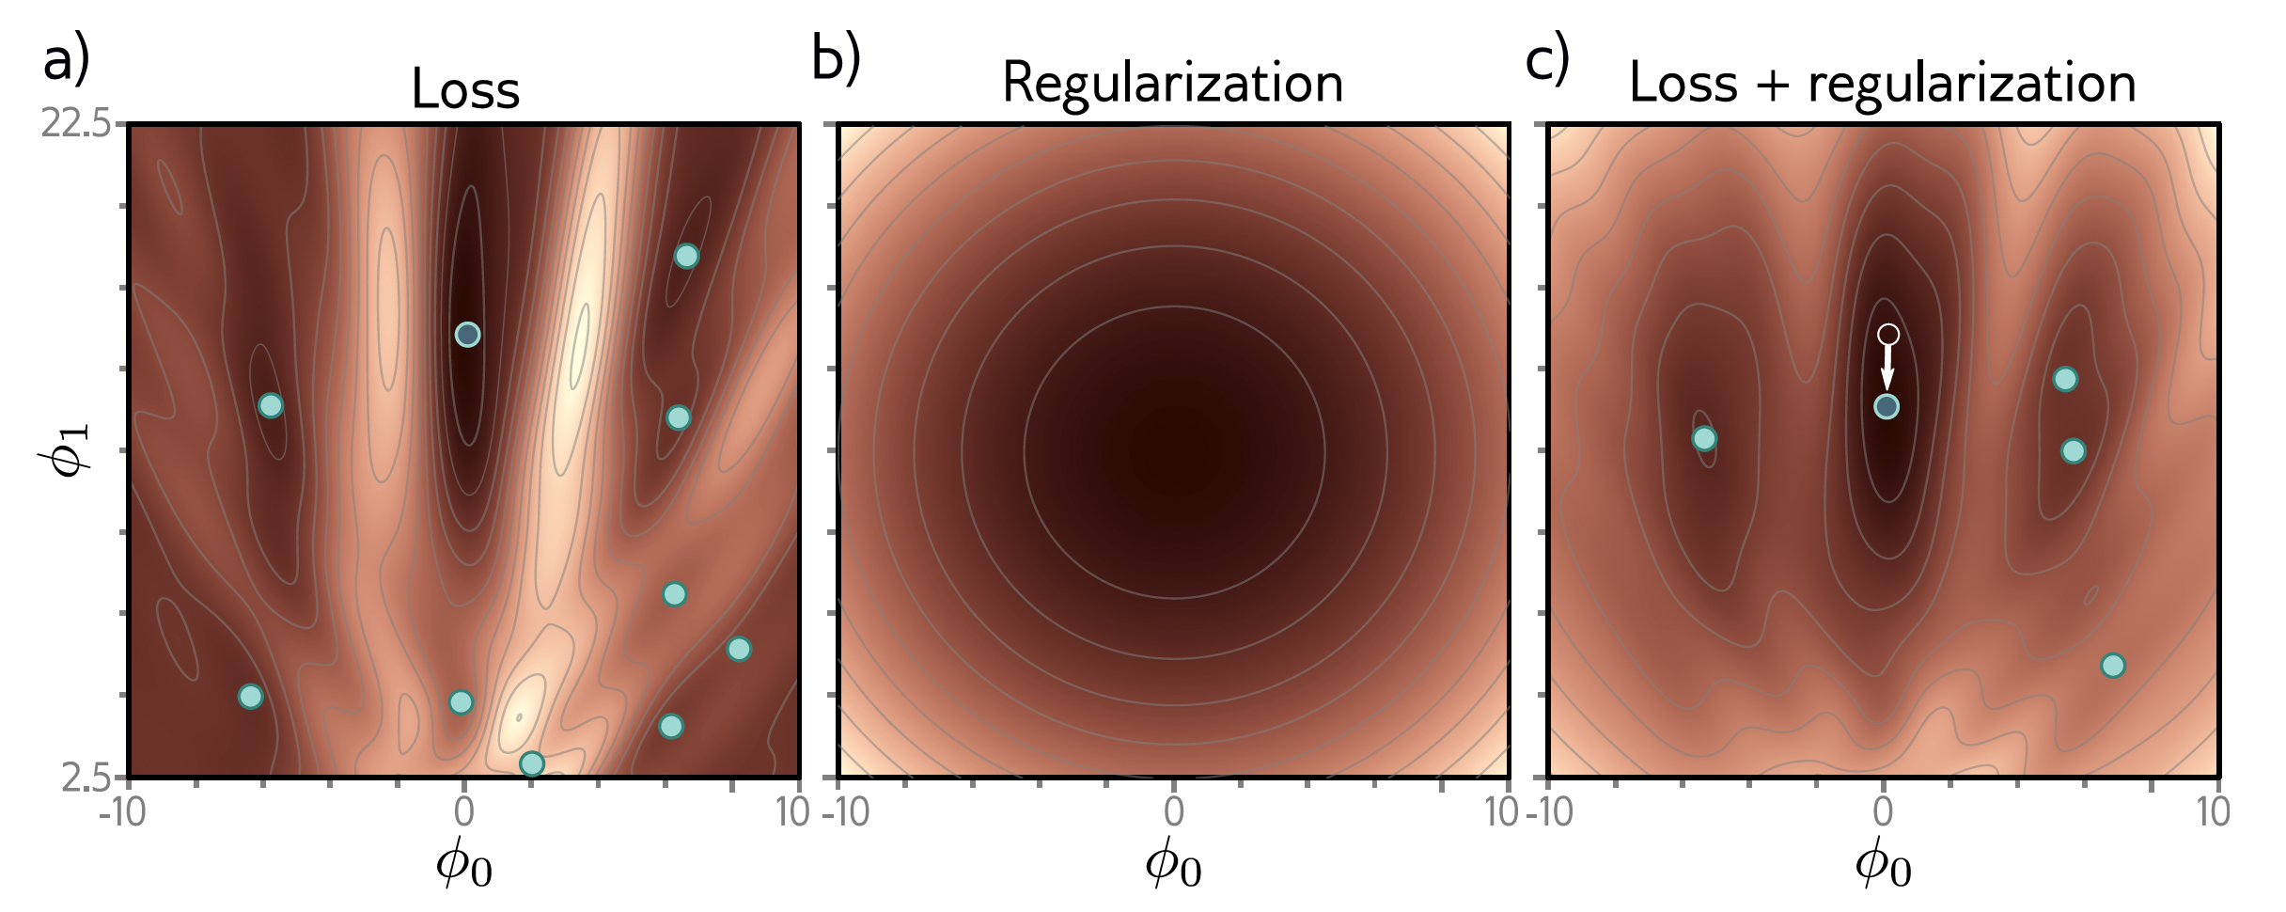
Explicit regularization

Slide 8
Explicit regularization

Slide 9
Explicit regularization

Slide 10
Probabilistic interpretation
Maximum likelihood:
Regularization is equivalent to a adding a prior over parameters
… what you know about parameters before seeing the data

Slide 11
Equivalence
Explicit regularization:
Probabilistic interpretation:
Mapping:

Slide 12
Equivalence
Explicit regularization:
Probabilistic interpretation:
Mapping:

Slide 13
L2 Regularization
Can only use very general terms
Most common is L2 regularization
Favors smaller parameters
Also called Tikhonov regularization, ridge regression
In neural networks, usually just for weights and called weight decay

Slide 14
Why does L2 regularization help?
Discourages slavish adherence to the data (overfitting)
Encourages smoothness between datapoints

Slide 15
L2 regularization

Slide 16
Regularization
Explicit regularization
Implicit regularization
Early stopping
Ensembling
Dropout
Adding noise
Bayesian approaches
Transfer learning, multi-task learning, self-supervised learning
Data augmentation

Slide 17
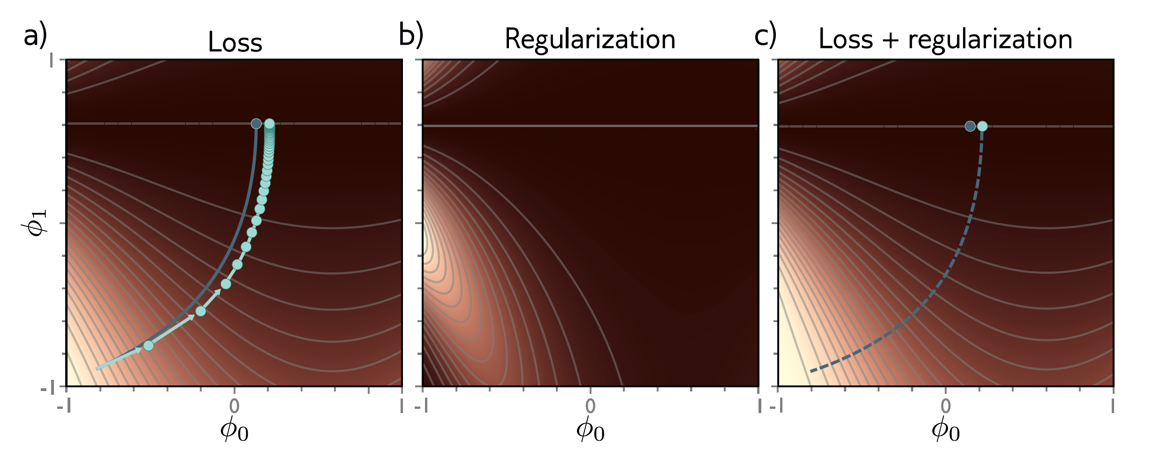
Implicit regularization
Gradient descent approximates a differential equation
(infinitesimal step size)
Finite step size equivalent to regularization
Add in that regularization and differential equation converges to same place

Slide 18
Implicit regularization
Gradient descent disfavors areas where gradients are steep
SGD likes all batches to have similar gradients
Depends on learning rate – perhaps why larger learning rates generalize better.

Slide 19
Implicit regularization
Gradient descent disfavors areas where gradients are steep
SGD likes all batches to have similar gradients
Depends on learning rate – perhaps why larger learning rates generalize better.

Slide 20
Implicit regularization
Gradient descent disfavors areas where gradients are steep
SGD likes all batches to have similar gradients
Depends on learning rate – perhaps why larger learning rates generalize better.

Slide 21
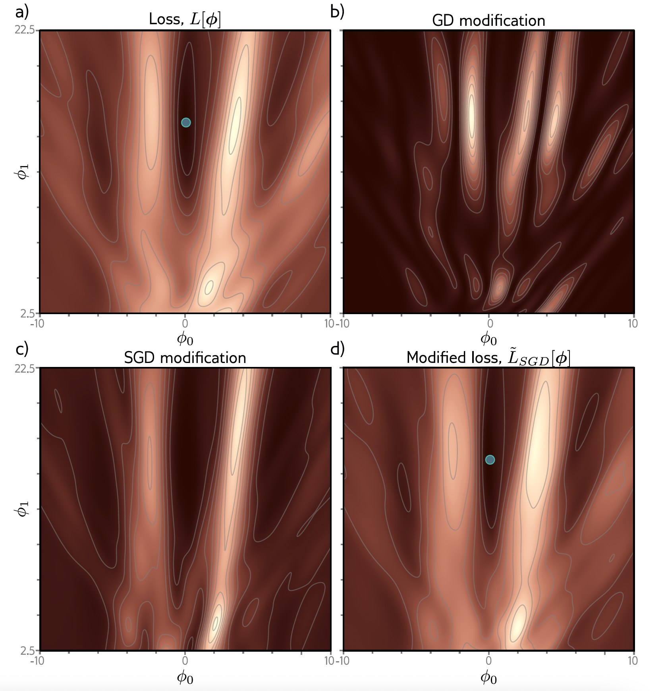

Slide 22
Generally performance
  best for larger learning rates
  best with smaller batches

Slide 23
Regularization
Explicit regularization
Implicit regularization
Early stopping
Ensembling
Dropout
Adding noise
Bayesian approaches
Transfer learning, multi-task learning, self-supervised learning
Data augmentation

Slide 24
Early stopping
If we stop training early, weights don’t have time to overfit to noise
Weights start small, don’t have time to get large
Reduces effective model complexity
Known as early stopping
Don’t have to re-train

Slide 25
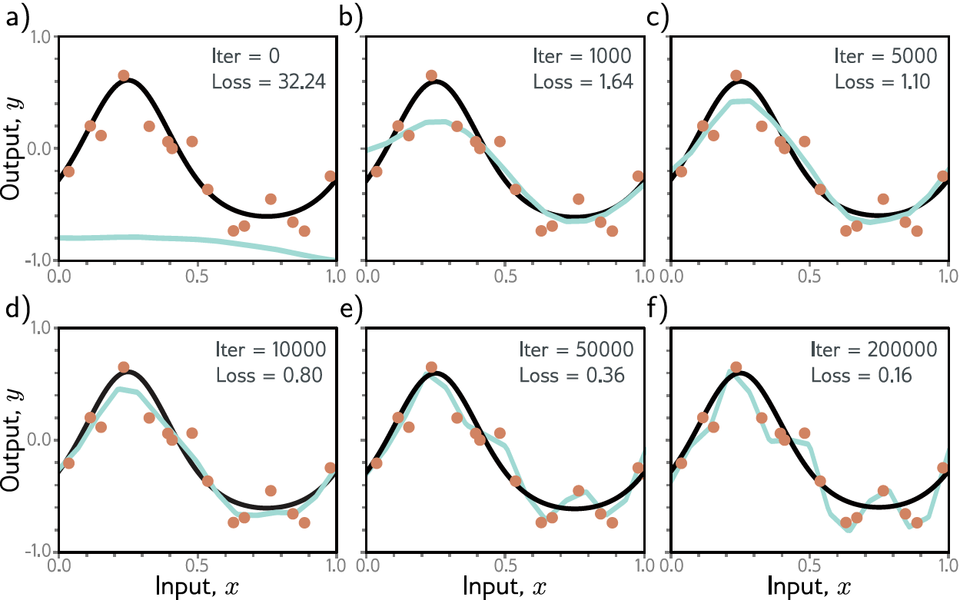

Slide 26
Regularization
Explicit regularization
Implicit regularization
Early stopping
Ensembling
Dropout
Adding noise
Bayesian approaches
Transfer learning, multi-task learning, self-supervised learning
Data augmentation

Slide 27
Ensembling
Average together several models – an ensemble
Can take mean or median
Different initializations / different models
Different subsets of the data resampled with replacements -- bagging

Slide 29
Regularization
Explicit regularization
Implicit regularization
Early stopping
Ensembling
Dropout
Adding noise
Bayesian approaches
Transfer learning, multi-task learning, self-supervised learning
Data augmentation

Slide 30
Dropout

Slide 31
Dropout
Can eliminate kinks in function that are far from data and don’t contribute to training loss

Slide 32
Regularization
Explicit regularization
Implicit regularization
Early stopping
Ensembling
Dropout
Adding noise
Bayesian approaches
Transfer learning, multi-task learning, self-supervised learning
Data augmentation

Slide 33
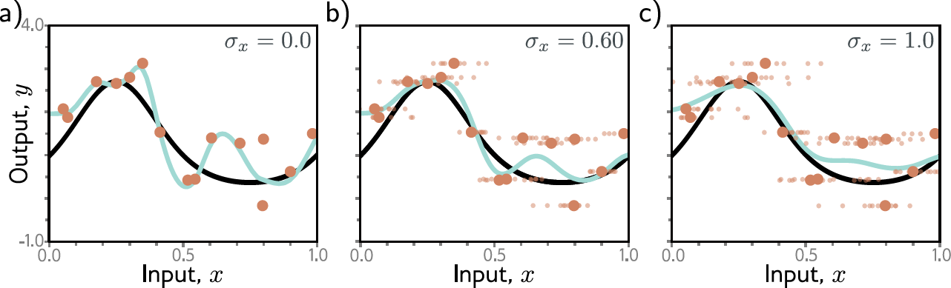
Adding noise
to inputs
to weights
to outputs (labels)

Slide 34
Regularization
Explicit regularization
Implicit regularization
Early stopping
Ensembling
Dropout
Adding noise
Bayesian approaches
Transfer learning, multi-task learning, self-supervised learning
Data augmentation

Slide 35
Bayesian approaches
There are many parameters compatible with the data
Can find a probability distribution over them
Take all possible parameters into account when make prediction
Prior info about
parameters

Slide 36
Bayesian approaches
There are many parameters compatible with the data
Can find a probability distribution over them
Take all possible parameters into account when make prediction
Prior info about
parameters

Slide 37
Bayesian approaches

Slide 38
Regularization
Explicit regularization
Implicit regularization
Early stopping
Ensembling
Dropout
Adding noise
Bayesian approaches
Transfer learning, multi-task learning, self-supervised learning
Data augmentation

Slide 39
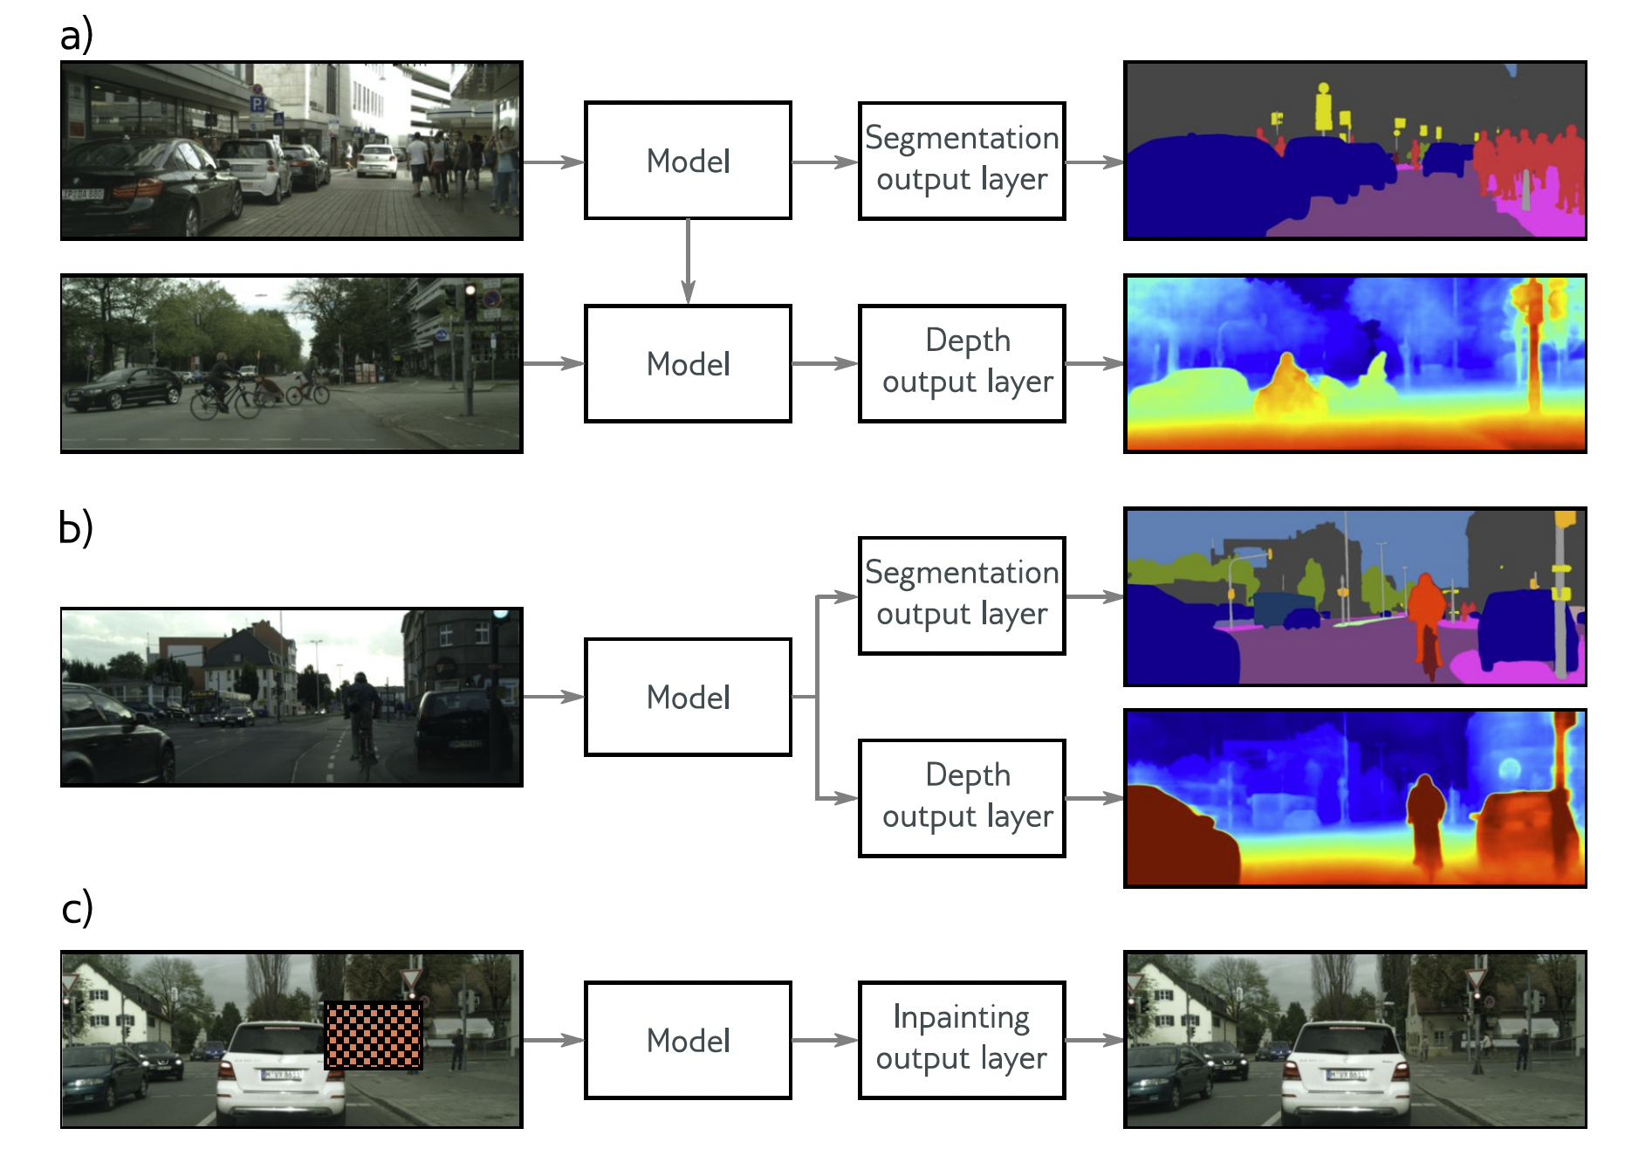
Transfer learning
Multi-task learning
Self-supervised learning

Slide 40
Transfer learning
Multi-task learning
Self-supervised learning

Slide 41
Transfer learning
Multi-task learning
Self-supervised learning

Slide 42
Regularization
Explicit regularization
Implicit regularization
Early stopping
Ensembling
Dropout
Adding noise
Bayesian approaches
Transfer learning, multi-task learning, self-supervised learning
Data augmentation

Slide 43
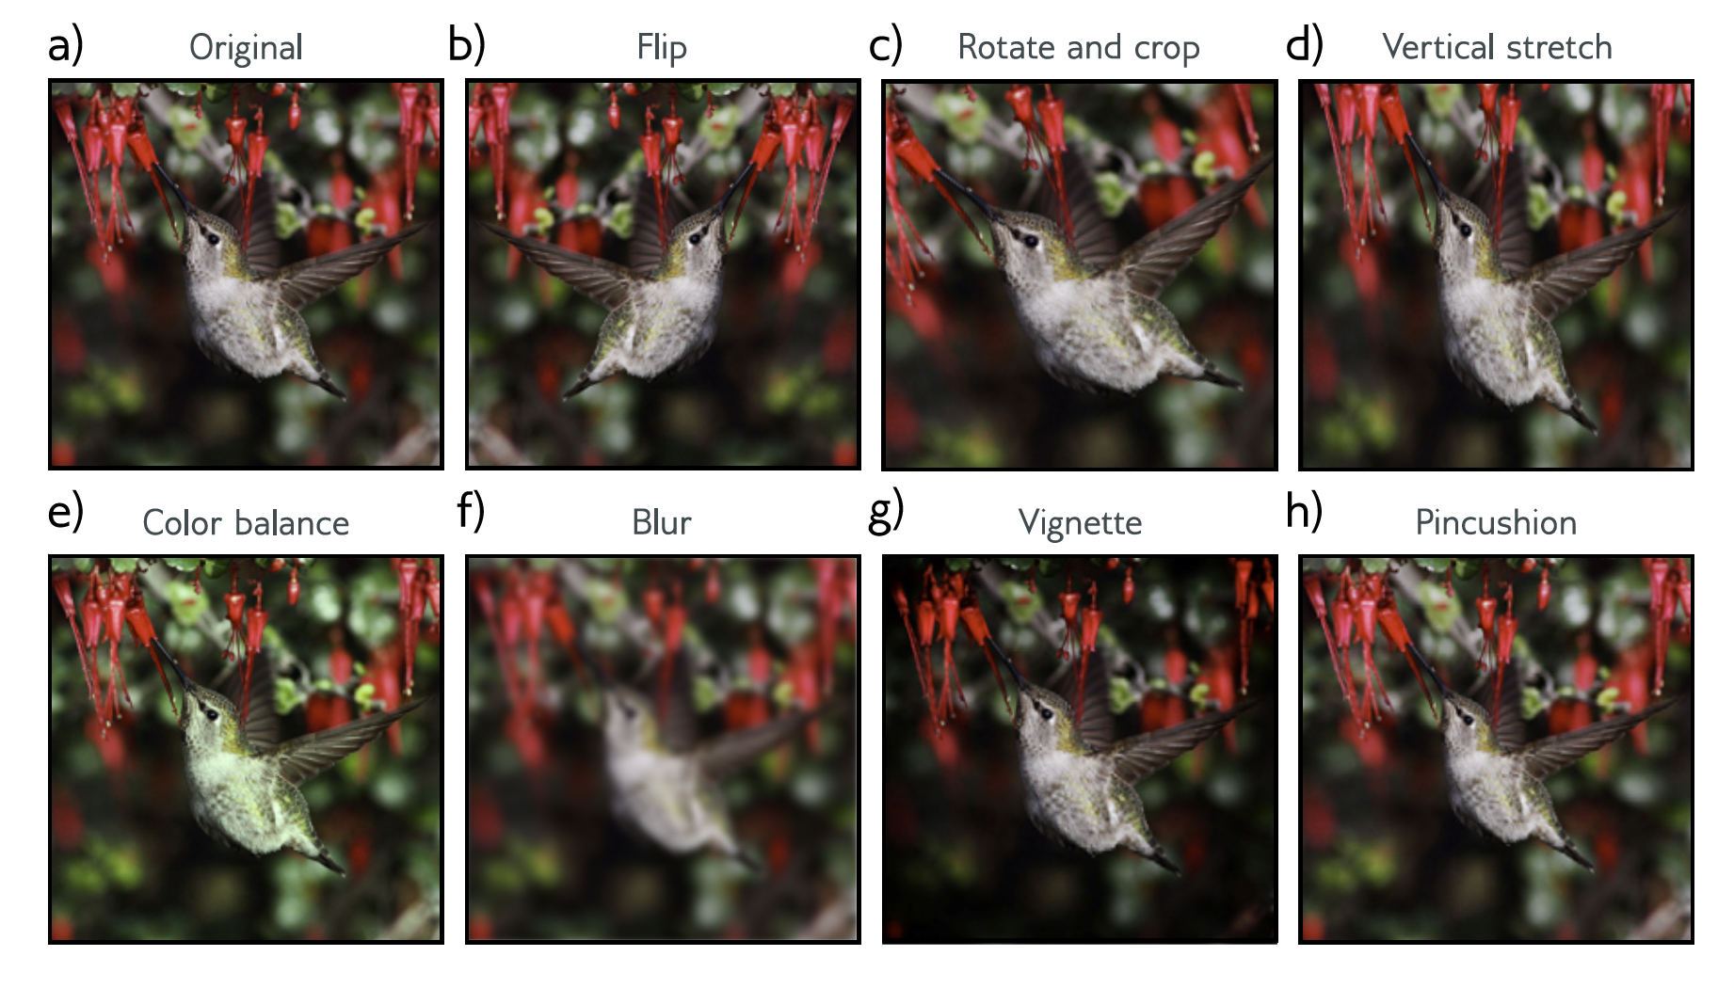
Data augmentation

Slide 44
Regularization overview

Slide 45
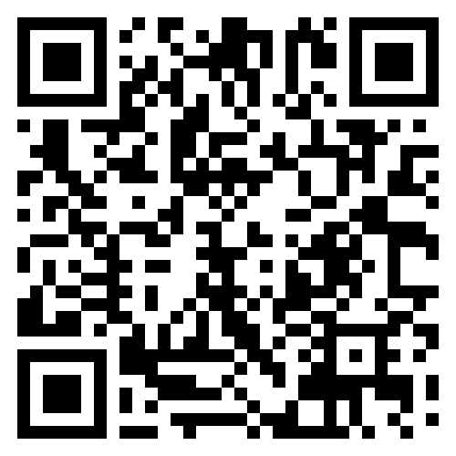
Feedback

