Slide 1
Search 4: Randomized Hill Climbing and Backtracking

Slide 2
Randomized Hill Climbing (RHC)
Neighborhood
Search Strategy: Sample p points randomly in the neighborhood of the currently best solution; determine the best solution of the n sampled points. If it is better than the current solution, make it the new current solution and continue the search; otherwise, terminate returning the current solution.
Advantages: easy to apply, does not need many resources, usually fast.
Challenges: How do I define my neighborhood; what parameter p should I choose?
Notes:
The last technology I like to introduce in today’s presentation are shared ontologies. Shared ontologies are important to standardize communication, and for gathering information from different information sources. Ontologies play an important role for agent-based systems.
Ontologies basically describe...

Slide 3
Example Randomized Hill Climbing
Maximize f(x,y,z)=|x-y-0.2|*|x*z-0.8|*|0.3-z*z*y|
with x,y,z in [0,1]
Neighborhood Design: Create solutions 50 solutions s, such that:
s= (min(1, max(0,x+r1)), min(1, max(0,y+r2)), min(1, max(0, z+r3))
with r1, r2, r3 being random numbers in [-0.05,+0.05].

Slide 4
RHC Pseudo Code
RHC(sp,z,p,seed);
current:=sp;
WHILE true DO{
Sample p solutions in the neighborhood of size z of current;
Compute sol the best solution with respect to f of the p solutions sampled;
IF f(sol)<f(current) THEN current:=sol
ELSE return(current); }
Notes:
The last technology I like to introduce in today’s presentation are shared ontologies. Shared ontologies are important to standardize communication, and for gathering information from different information sources. Ontologies play an important role for agent-based systems.
Ontologies basically describe...

Slide 5
Randomized Hill Climbing With Resampling (RHCR2)
RHCR2(sp,z,p,seed);
sol1=RHC(sp,z,p,seed);
sol2=RHC(sp,z/20,p,sol1,seed);
sol3=RHC(sp,z/400,p,sol2,seed);
Return {(sol1,f(sol1)),(sol2,f(sol2)),(sol3,f(sol3))}
Notes:
The last technology I like to introduce in today’s presentation are shared ontologies. Shared ontologies are important to standardize communication, and for gathering information from different information sources. Ontologies play an important role for agent-based systems.
Ontologies basically describe...

Slide 6
Problems Randomized Hill Climbing
Terminates at a local optimum (moreover, the deviation between local and global optimum is usually unknown)
Has problems with plateau (terminates), especially if the size of the plateau is larger than the neighborhood size.
Has problems with ridges (usually falls of the “golden” path)
The obtained solution strongly depends on the initial configuration.
Too large neighborhood sizes →random search, might shoot over hills.
Too small neighborhood sizes →slow convergence, might get stuck on small hills.
Too large parameter p →slow search;
too small parameter p →terminates without getting really close to the mountain top
Remark: Many of the points raised here are also valid classical hill climbing and other forms of local search.

Slide 7
Pikes Peak (14,110) Ascent Footrace
Pikes Peak Marathon - Home
Pikes Peak Ascent Results August 21, 2021 (pikespeakmarathon.org)
1998 Pikes Peak Ascent Race Report (uh.edu)

Slide 8
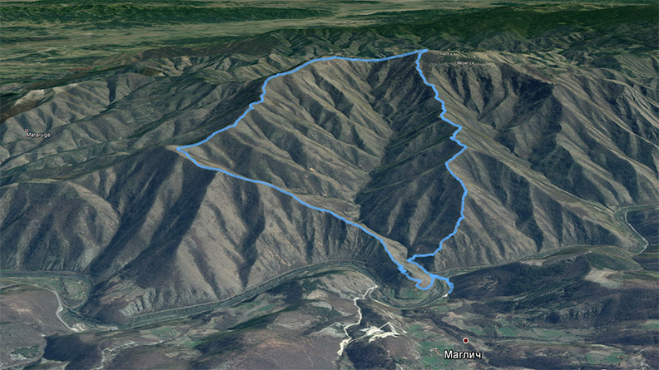
Example: Falling off Ridges

Slide 9
(More) Hill Climbing Variations
Execute algorithm for a number of initial configurations (randomized hill climbing with restart)
Use information of the previous runs to improve the choice of initial configurations.
Dynamically adjust the size of the neighborhood and the number of points sampled. For example, start with large size neighborhoods and decrease the size of the neighborhood as the search evolves or adjust neighborhood sizes based on the gradient (small gradient→small neighborhood; large gradient→large neighborhood). Problem: have to be able to compute the gradient. Gradient - Wikipedia
Adjust p based on the gradient; e.g. if the gradient is large use smaller p’s!
Resample before terminating (e.g. sample p points; if there is no improvement sample another 2p points; if there is still no improvement sample another 4p points; if there is no improvement after that finally terminate).
Use domain specific knowledge to determine neighborhood sizes and number of points sampled.

Slide 10
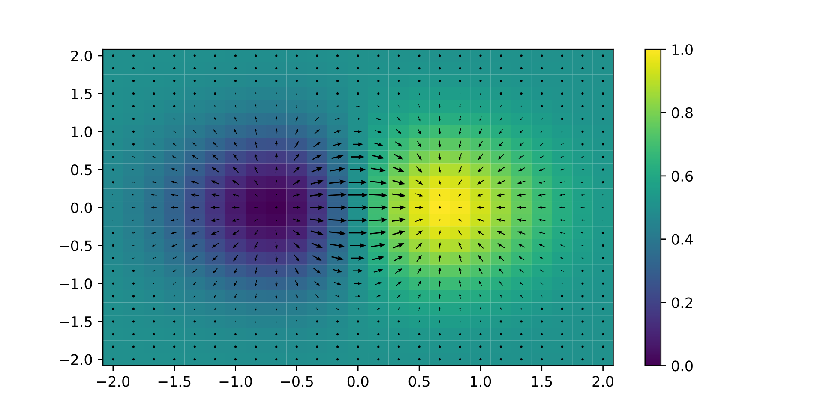
Visualization of the Gradient of a 2D Function

Slide 11
Hill Climbing for State Space Search
Define a neighborhood as the set of states that can be reached by n operator applications from the current state (where n is a constant to be chosen based on the characteristics of a particular search problem)
The state space version creates all states in the neighborhood of the current state (alternatively, it could just create some states which would be a randomized version), and picks the one with the best evaluation as the new current state, or it terminates unsuccessfully if there is no state that is better than the current state.
A variable path has to be added to the hill climbing code that memorizes the path from the initial state to the current state. The path variable is initialized with an empty list. Every time a new current state is obtained the operator or operator sequence that was used to reach this state is appended to the path variable.
A goal test has to be added to the hill climbing code (if it returns true the algorithm terminates returning the contents of its path variable as its solution).
I

Slide 12
News Feb. 7
The discussion of best-first search, greedy best-first search that we started in the last lecture on Feb. 5 will be continued and concluded in the Feb. 12 lecture.
Task1 is due Monday, Feb. 12 end of the day in MS Teams.
Did anyone lose a White(?) Apple Pencil?
Today’s Program
Backtracking (brief; to be continued next week)
GHC Presentation Group A
Constraint Satisfaction Problems (to be continued Feb. 14)
Brief Discussion of Task2

Slide 13
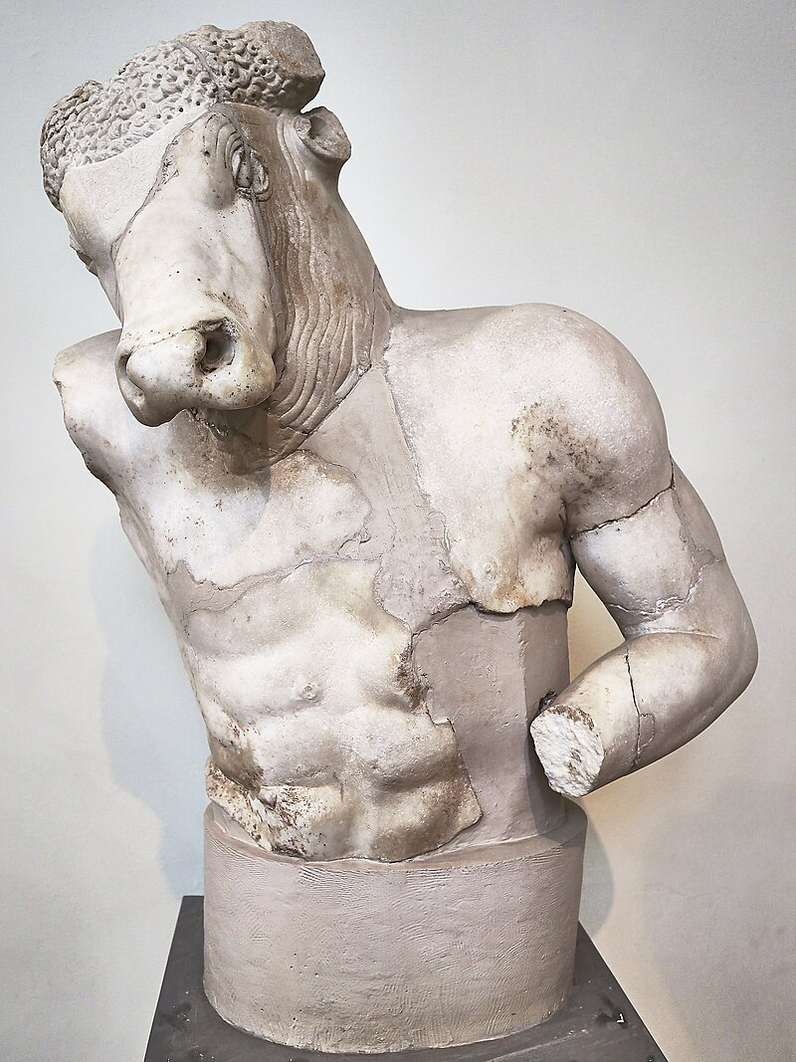
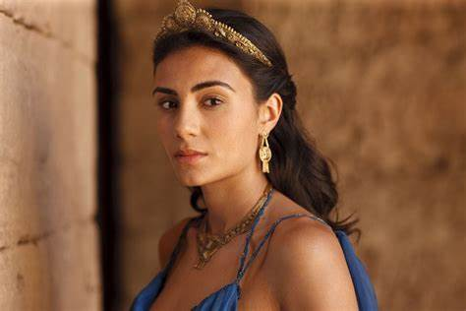
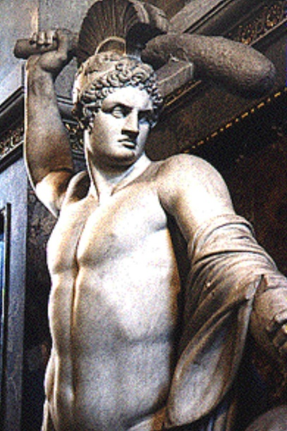
Ancient Backtracking
Ancient Greek legends tell of King Minos of Crete, who had the inventor Daedalus created a labyrinth beneath his palace in which was housed the Minotaur, a fearsome monster with the head of a bull and body of a man.
The Minotaur was said to have been slain by the Greek hero Theseus, who then managed to find his way out of the labyrinth with the aid of a ball of thread that had been given to him by Ariadne, the daughter of Minos.
Minotaur
Ariadne
Theseus

Slide 14
Backtracking Links
Backtracking Introduction – javatpoint
Wikipedia: https://en.wikipedia.org/wiki/Backtracking (look at this document as the pseudocode will be briefly discussed on Feb. 12!)
Moreover, Group D’s GHC presentation on Feb. 14 will involve backtracking and the CSP lectures have more discussions on backtracking.

Slide 15
Expansion Strategies vs. Backtracking
The main difference is that backtracking only applies a single operator to a state and often employs a potentially sophisticated operator evaluation to select such operators intelligently; expansion strategies apply all operators. Consequently, if you want to use backtracking intelligently you need to develop an operator selections functions that selects operators which lead to more promising states first.
Backtracking always works on a specific path whereas expansion strategies can work on multiple paths in parallel. Backtracking only needs to memorize the current path and which operators on the current path have not been applied yet. Expansions search needs to store all states which have not been expanded yet→usually high storage cost
Depth first search strategies give preference to expanding states/applying operators to states with higher depth---depth is the number of operator applications you need to reach this state from the initial state. Backtracking is a depth first search strategy.
.

