Slide 1
Sirius: A Density-based Co-location Mining Framework for Sets of Continuous Spatial Variables
Md Mahin, Aparna Budhavarapu, Karima Elgarroussi, Ernst Leiss and Christoph F. Eick
Department of Computer Science
University of Houston
Organization of the Talk
Importance of Association Analysis
Association Analysis for Continuous Variables
Co-location Mining
Sirius
Case Study: Co-location among COVID-19 and Socio-economic Factors in Virginia
Conclusion
SSTDM 2024 Workshop, December 9, 2024, Abu-Dhabi, UAE

Slide 2
1. Importance of Association Analysis
Jason W. Osborne: “… measures of association are important, almost ubiquitous, and can easily produce errors of inference if not utilized thoughtfully and with attention in details”. [1]
Mark Tessler: “Every day, we encounter various phenomena that make us question how, why, and with what implications they vary. In responding to these questions, we often begin by considering bivariate relationships”.[2]
Werners: “Thresholds…are important focal points for sustainability science which bridge the science-policy interface and produce knowledge salient for sustainability…”[3]

Slide 3
2. Association Analysis for Continuous Variables
Definition Association Analysis: Given a dataset 𝐷, a set of possible patterns 𝑃 with respect to 𝐷, a type of association 𝐴, and an interestingness measure 𝐼_{𝐴} with respect to 𝐴, find all patterns 𝑝, such that: 𝑝 ∈ 𝑃 and 𝐼_{𝐴} (𝑝) ≥ 𝜃 (where 𝜃 is an interestingness threshold) (1)
We are currently working on 3 problems:
Mining threshold associations between continuous spatial variables; e.g. are COVID-19 infection rates above 3% associated with PM_{2.5} concentrations above 30𝜇𝑔/𝑚³? [7]
Threshold Correlation: In Houston, there is almost no correlation between humidity and temperature (the correlation is −0.11); however, there is a strong negative correlation of −0.80 between humidity above 53% and temperatures above 80.98. [8]
Mining co-location patterns between high/low values of a set of continuous variables (this talk).

Slide 4
3. Co-location Mining
Tobler's (1979) First Law of Geography, where "everything is related to everything else, but near things are more related than distant things.“[4]
Luc Anselin: “In general terms, spatial analysis can be considered to be the formal quantitative study of phenomena that manifest themselves in space. This implies a focus on location, area, distance and interaction.” [5]
Yan Huang et. al.: “The goal of spatial co-location pattern mining is to find subsets of spatial features frequently located together in spatial proximity.” Example: Nile crocodile and Egyptian plover.”[6]

Slide 5
4. Sirius
Sirius the “Dog Star”
Research Question: Are values from the wings of the distribution of multiple continuous variables co-located or not?
Example: p= {“COVID-19↑”, “PM2.5↑”}
Are high COVID-19 infection rates co-located with high PM2.5 concentrations?
We developed a density-based framework called Sirius which generalizes influence functions and relies on z-scores to answer the research question.

Slide 6
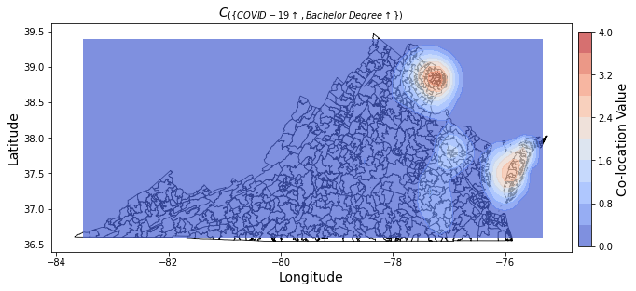
Example of a Collocation Measure
$C_{\{COVID−19↑, Bachelor Degree↑\})}$(u) visualized over the observation area Virginia:
Remark: P is collocated if the volume of C_{P}(u) over the observation area
is high; significantly larger than what we obtain if we place the objects randomly!
$$\int_{Virginia}{C_{P}\left(u\right)du}$$

Slide 7
Normalization to obtain ↑ and $$ Variables
O={(<location>, (V₁=w₁, . . . , V_{n} =w_{n}),…} Assumed Dataset Format
V₁ … V_{n} are continuous variables
Convert each V into variables (V↑ ,V↓), where for any value v:
$φ_{V\text{↑}}\left(v\right)=\left\{\begin{aligned}z_score(v); ifz_score(v)>0 \\ 0, otherwise\end{aligned}\right.$
$φ_{V\text{↓ }}\left(v\right)=\left\{\begin{aligned}−z_score(v); ifz_score(v)< 0 \\ 0; otherwise\end{aligned}\right.$

Slide 8
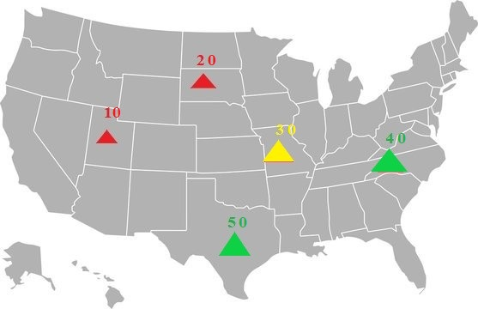
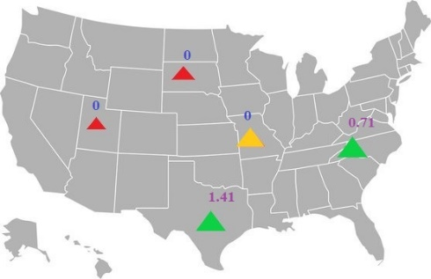
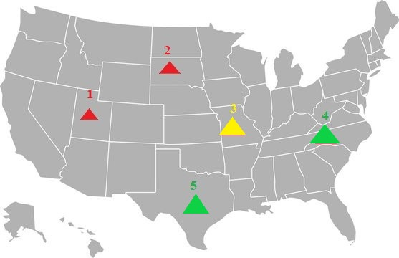
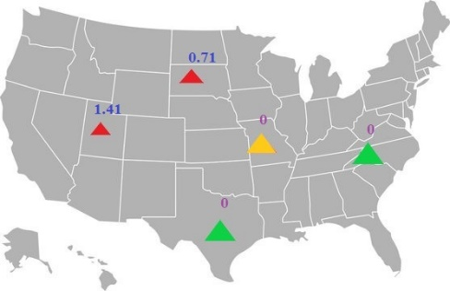
High/Low Patterns
$$φ_{V_{↑}}(v)=\left\{\begin{aligned}z_{score\left(v\right)};if z_{score\left(v\right)}>0 \\ 0;otherwise\end{aligned}\right.$$
A
10
20
30
40
50
A↑,B↑
0
0
0
0.71
1.41
B
1
2
3
4
5
A↓,B↓
1.41
0.71
0
0
0
$$φ_{V_{↓}}\left(v\right)=\left\{\begin{aligned}{−z}_{score\left(v\right)};if z_{score\left(v\right)}<0 \\ 0;otherwise\end{aligned}\right.$$

Slide 9
Computing A↑ Density
D={x₁,x₂,x₃,x₄}
ψ^{D}_{A↑}(x)= Σ_{i} influence(x,x_{i})∗ Highness_{A}(x_{i})
ψ^{D}_{A↑}(x)= influence(x₁,x)∗2.3+ influence(x₂,x)∗1.4+ influence(x₃,x)∗0+ influence(x₄,x)∗0.1
x1 (z_{A}=2.3)
0.04
x3(z_{A}=−2.2)
0.08
x2 (z_{A}=1.4)
x4 (z_{A}=0.1)
0.06
0.6
x

Slide 10
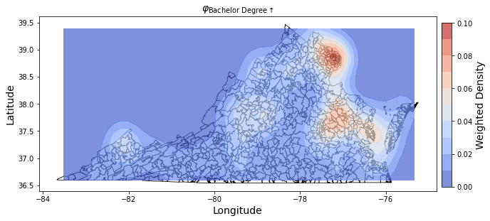
Two Density Functions
$$φ_{\text{Bachelor} \text{Degree}\text{↑}}$$
$$φ_{\text{Population} \text{Density}\text{↓}}$$

Slide 11
Co-location Measure
Binary co-location measure for pattern P where P ={p1, p2} and u is a location in the observation area.
$$C_{P}\left(u\right)=\left\{\begin{aligned}gmean\left({zs\left(φ_{p1}\left(u\right)\right)}_{ }∗{zs{(φ}_{p2}\left(u\right))}_{}\right); zs\left(φ_{p1}\left(u\right)\right)>0 ∧ zs\left(φ_{p2}\left(u\right)\right)>0 \\ \\ \\ 0; Otherwise\end{aligned}\right.$$
C_{P} takes non-zero values in u if both density z-scores are positive in u.
Gmean(.) calculates the geometric mean of the two z-scores.
Gmean, and not ordinary mean, is used to associate higher values to equally high z-scores; e.g:
gmean(2,2)=2>gmean(1,3)=sqrt(3)≈1.73
Notes:
There has been a lot of work on tradi itinal and semi-supervised clustering. Traditional clustering is applied to unclassified examples and relies on a notion of closeness. The focus of traditional clustering is to identify groups in datasets trying to minimizing given fitness function, such as trying to minimize the tightness of a clustering.

Slide 12
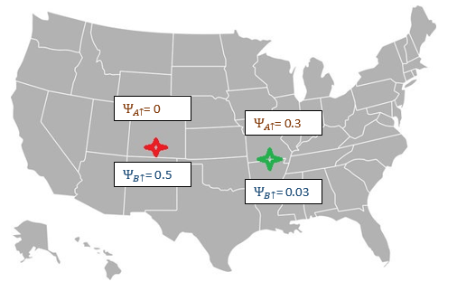
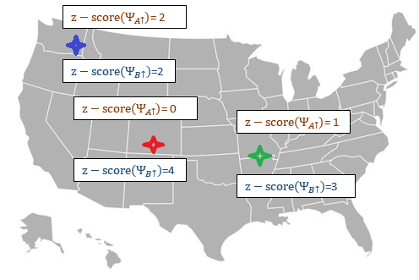
Multi-Variate Co-location Measure
$$C_{p}(l)=\left\{\begin{aligned}gmean\left(z\left(ψ_{v_{1}}\left(l\right)\right),…,z\left(ψ_{v_{n}}\left(l\right)\right)\right);if ∀v_{i}εP: z\left(ψ_{v_{i}}\left(l\right)\right)>0 \\ 0;otherwise\end{aligned}\right.$$
Red | ${gmean(z (Ψ}_{A↑})$*$z(Ψ_{B↑}))$ = 0
Green | ${gmean(z(Ψ}_{A↑})$*$z(Ψ_{B↑}))$ = 1.7
Blue | ${gmean(z(Ψ}_{A↑})$*$z(Ψ_{B↑})$) = 2
Red | $Ψ_{A↑}$*$Ψ_{B↑}$ = 0
Green | $Ψ_{A↑}$*$Ψ_{B↑}$ = 0.009
Red | ${z (Ψ}_{A↑})$*$z(Ψ_{B↑})$ = 0
Green | ${z(Ψ}_{A↑})$*$z(Ψ_{B↑})$ = 3
Blue | ${z(Ψ}_{A↑})$*$z(Ψ_{B↑})$ = 4
12

Slide 13
Co-location Strength of P in Observation Area F
$\text{Global} \text{Co}\text{−}\text{location} \text{Strength} \text{of} \text{P}:\int_{F}{C_{P}\left(u\right)dxdy}$
Co-location pattern P is interesting when: $\int_{F}{C_{P}\left(u\right)dxdy}\text{> }\text{w}$
For regions Z in the observation area F, P is regional pattern in Z (with θ is being z-score-based threshold)
$$∀u ∈Z, CP(u) > θ$$
That is, AUC of C_{P}(u) over F serves as the interestingness measure for association P!
Notes:
There has been a lot of work on tradi itinal and semi-supervised clustering. Traditional clustering is applied to unclassified examples and relies on a notion of closeness. The focus of traditional clustering is to identify groups in datasets trying to minimizing given fitness function, such as trying to minimize the tightness of a clustering.

Slide 14
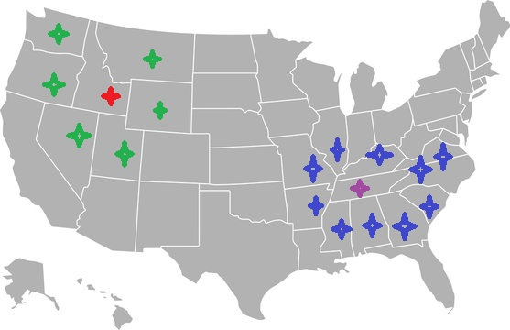
Research Gap
Bi-Variate Moran I
Is it a multivariate association? No, primarily developed as univariate measure
Divide Continuous Variable A,B into High/Low Pattern
A-> | A↑ | A↓
B-> | B↑ | B↓
Is it expandable as multivariate association?
At most two variable association possible
If High values of surrounded by High values and Low Values surrounded by High values
Does a location such as Red Star influenced by blue or pink stars? No, but Tobler’s First Law of Geometry says should!
Association Between High/Low values of one variable and spatial lag of another Variable
Can we measure Regional Association with it? No, we need extension measure LISA

Slide 15
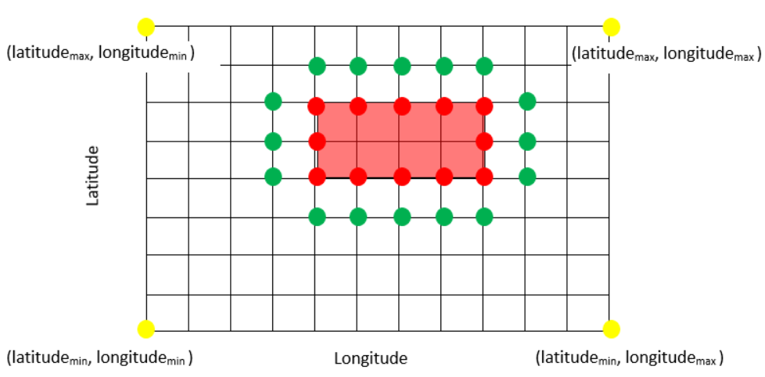
Finding Regional Co-locations
A grid based rectangular hotspot growing algorithm proposed
Notes:
There has been a lot of work on tradi itinal and semi-supervised clustering. Traditional clustering is applied to unclassified examples and relies on a notion of closeness. The focus of traditional clustering is to identify groups in datasets trying to minimizing given fitness function, such as trying to minimize the tightness of a clustering.

Slide 16
5. Case Study: Co-location among COVID-19 and Socio-economic Factors in Virginia
Analyzed eight zip-code-level variables from the state of Virginia (896 zip codes)
The variables include the COVID-19 infection rate, Population density; Bachelor Degree attainment, Unemployment rate, Poverty rate, Median Income, Family with four or more members; and household car ownership or No Car.
Link to the dataset

Slide 17
What Results Say for Binary Patterns
Co-located: Mean is one standard deviation above the random mean
Anti Co-located: Mean is one standard deviation below the random mean
Binary Pattern | Actual Mean vs Random Mean | Co-location std vs Random std
{COVID-19↑ , Population↑} | 0.16 vs 0.12 | 0.49 vs 0.47
{COVID-19↑ , Population↓} | 0.12 vs 0.14 | 0.36 vs 0.50
{COVID-19↓ , Population↑} | 0.19 vs 0.28 | 0.81 vs 0.72
{COVID-19↓ , Population↓} | 0.27 vs 0.28 | 0.60 vs 0.77

Slide 18
What Other Measures Say
No proof of relation using bi-variate Moran I

Slide 19
Extendability to Multi-variate Pattern
Ternary Pattern | Mean
{COVID-19↑ , Population↑, Unemployment↑} | 0.03
{Population↓ , Degree↓, Income↑} | 0.23

Slide 20
6. Conclusion
In contrast to other approaches, Sirius is a density-based co-location mining framework for measuring co-location among continuous variables from their wings of distribution. The proposed measure C_{P}(u) is a function that assesses the strength of a collocation pattern P over an observation area and its volume over the observation area serves as the interestingness function.
As a collocation measure estimates the geometric mean of z-scores of the highness/lowness of respective continuous variables, they allow a statistical interpretation of the observed values.
Compared to traditional measure like LISA/Moran I, Sirius is more flexible as it is extendable for analysis of more than two variables; moreover, our approach relies on influence functions which are in sink with Tobler’s First Law of Geography.
We still need to find “better” datasets to demonstrate the merit of our approach.
We plan to develop methods to automatically choose the bandwidth in collocation measures.
f

Slide 21
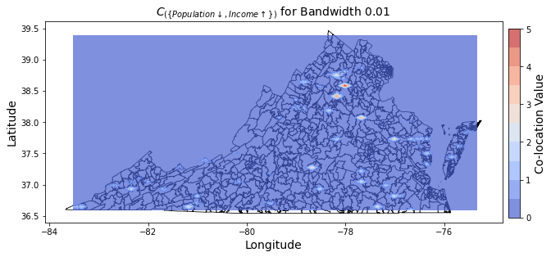
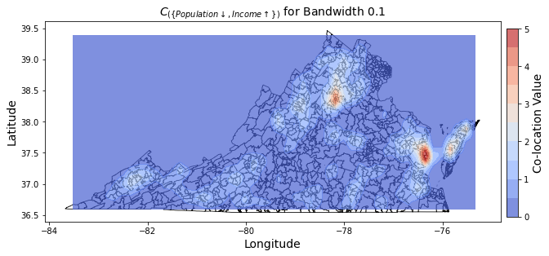
Bandwidth and Collocation Measures
Bandwidth 0.01
Bandwidth 0.1
Varying influence due to Bandwidth
Notes:
There are many possible supervised clustering algorithm. In our work, we investigate representative-based supervised clustering algorithms that aim

Slide 22
References
Adelson, J.L., Osborne, J.W. and Crawford, B.F., 2018. Correlation and other measures of association. In The reviewer’s guide to quantitative methods in the social sciences (pp. 55-71). Routledge.
Tessler, M., 2022. Bivariate Analysis: Associations, Hypotheses, and Causal Stories. In Social Science Research in the Arab World and Beyond: A Guide for Students, Instructors and Researchers (pp. 51-86). Cham: Springer International Publishing.
Saskia E Werners et. al.: Thresholds, tipping and turning points for sustainability under climate change; Current Opinion in Environmental SustainabilityVolume 5, Issues 3–4, September 2013, Pages 334-340
Tobler, W., 2004. On the first law of geography: A reply. Annals of the association of American geographers, 94(2), pp.304-310.
Anselin, L., 2019. The Moran scatterplot as an ESDA tool to assess local instability in spatial association. In Spatial analytical perspectives on GIS (pp. 111-126). Routledge.
Huang, Y. and Zhang, P., 2006, November. On the relationships between clustering and spatial co-location pattern mining. In 2006 18th IEEE International Conference on Tools with Artificial Intelligence (ICTAI'06) (pp. 513-522). IEEE.
Mahin, M., and Eick, C. F. Norma: A framework for finding threshold associations between continuous variables using point-wise functions. In 2024 IEEE International Conference on Big Data (BigData) (Washington, DC, USA, December 15–18 2024), IEEE. Accepted, to appear.
Eick, C. F., Mahin, M., Chen, G., and Zhang, H. On threshold correlation with application to studying the relationship of temperature and relative humidity. In Proceedings of the 6th ACM SIGSPATIAL International Workshop on AI for Geographic Knowledge Discovery (Hamburg, Germany, November, 2023), pp. 53–62.

Slide 23
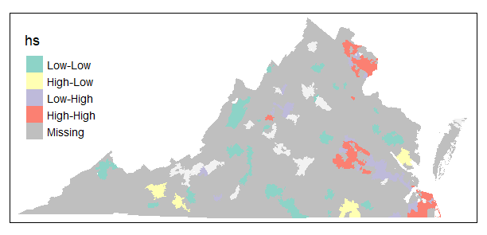
Advantage Over LISA
Inflexibility
vs
Bandwidth 0.01
Bandwidth 0.1
Varying influence due to Bandwidth
Notes:
There are many possible supervised clustering algorithm. In our work, we investigate representative-based supervised clustering algorithms that aim

