Slide 1
Analyzing the Composition of Cities
Using Spatial Clustering
Zechun Cao University of Houston | Sujing Wang University of Houston | Germain Forestier University of Haute Alsace | Anne Puissant University of Strasbourg | Christoph F. Eick University of Houston
Organization
Motivation
Problem Definition and Preview of the Methodology
Clustering Framework and Interestingness Functions
The CLEVER Clustering Algorithm
Related Work
Summary and Future Work

Slide 2
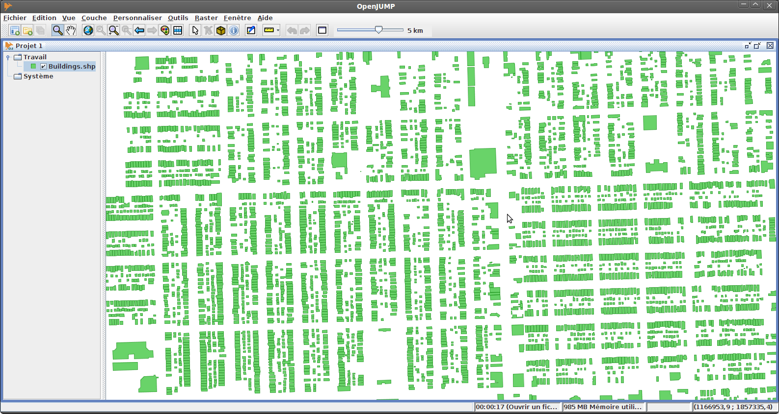
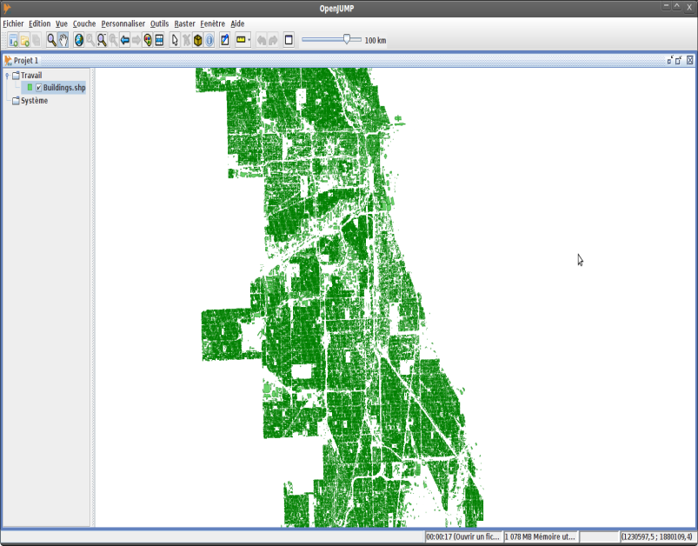
1. Motivation
2
A lot of POI datasets (e.g. in Google Earth) are becoming available now.
http://bloomington.in.gov/documents/viewDocument.php?document_id=2455;dir=building/buildingfootprints/shape
https://data.cityofchicago.org/Buildings/Building-Footprints/w2v3-isjw
Buildings of the City of Chicago (830,000 Polygons) :
Challenges:
Extract Valuable Knowledge/Summaries from such datasets→ Data Mining
Facilitate Querying and Visualizing of such dataset→ HPC / BigData Initiative

Slide 3
Motivation Continued
3
The step of urbanization leads to different functional regions in a city, called urban patches/regions throughout the remainder of this talk, such as residential areas, business districts, industrial and recreational areas. Different types of urban patches support different needs of people’s lifes and “serve as a valuable organization technique for framing detailed knowledge of a metropolitan area” [Yuan 2012].
In this talk, we center on describing a methodology for summarizing the composition of a city in particular, and of a spatial dataset in general.
We claim that automated tools producing high-level summaries for POI datasets for planners, scientists, and policy makers are important, as those people are drowning in data.

Slide 4
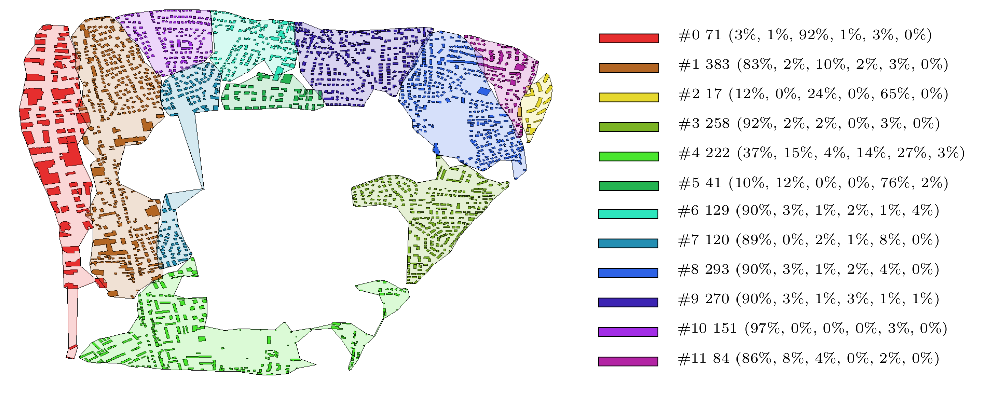
2. Problem Definition and Preview of the Proposed Methodology
4
Subtopics:
Disparity Analysis/Emergent Pattern Discovery (“how do two groups differ with respect to their patterns?”) [SDE10]
Change Analysis ( “what is new/different?”) [CVET09]
Problem Definition:
The goal is a partition a spatial dataset, such as the above town, consisting of buildings of different types, into contiguous spatial regions that are uniform with respect to their signatures.
“Signatures are compact presentations…that capture important characteristics of massive datasets.” [Applegate 2011]

Slide 5
Building Blocks of Proposed Methodology
5
Spatial Clustering Algorithms
Methodology
Interestingness
Functions
Signatures
Polygons

Slide 6
Objectives of Signature-based Composition Characterization
6
The space is partitioned into a set of regions (spatial clusters) such that:
Regions are assumed to be contiguous and annotated by signatures.
The regions should be homogeneous with respect the signature they express—a region should not contain sub-regions that express a very different signatures.
Signatures of neighboring regions should not be similar—otherwise, they should be merged into a single region!
In some applications certain signatures are more interesting/desirable than other signatures.
Comment: There are significant computational challenges to accomplish this task in practice.

Slide 7
Approach of the Proposed Methodology
7
The approach models the scope of spatial clusters as polygons and describes their characteristics using histogram-style distribution signatures
It formally deﬁnes the problem of ﬁnding uniform regions in spatial data as a maximization problem. A novel spatial clustering approach is proposed for identifying regions based on uniformity measures, which have to be expressed as reward-based ﬁtness functions which are then maximized by the spatial clustering algorithm.

Slide 8
3. Spatial Clustering Framework and Interestingness Functions
8
We assume we have POI datasets that have the following structure:
(<spatial attributes>;<non-spatial attributes>)
e.g. (longitude, lattitude, class_variable) or (longitude, lattitude, continous_variable)
Clustering occurs in space of the spatial attributes; regions/urban patches are found in this space.
The non-spatial attributes are used by the fitness function but neither in distance computations nor by the clustering algorithm itself.
In general, the spatial clustering algorithm finds contiguous regions in the spatial space, maximizing a fitness function q.
Notes:
Our proposed framework makes the following assumptions…

Slide 9
Spatial Clustering Framework Continued
9
The spatial clustering algorithms we currently investigate solve the following maximization problem of a fitness function q:
Input:
A dataset O, a distance function d defined on instances of O
A fitness function q(X) that evaluates clusterings X={c₁,…,c_{k}} as follows:
q(X)= Σ_{c∈X} reward(c)=Σ_{c∈X} i(c) ∗size(c)^{β}
with β≥1
Objective:
Find c₁,…,c_{k} ⊆ O such that:
c_{i}∩c_{j}=∅ if i≠j
X={c₁,…,c_{k}} maximizes q(X)
All cluster c_{i}∈X are contiguous (each pair of objects belonging to c_{i} has to be delaunay-connected with respect to c_{i} and to d) in the space of the spatial attributes
c₁∪…∪c_{k} ⊆ O
c₁,…,c_{k} are usually ranked based on the reward each cluster receives, and low reward clusters are frequently not reported
Notes:
Our appoach employs reward-based fitness functions that have the following form; clusters receive rewards based on the interestingness and rewards increase nonlinearly with cluster-size dependent on the value of β, favoring clusters c with more objects. This requirement is important because we want to encourage region discovery algorithms to merge neighboring clusters if they have similar characteristics. The quality of a clustering is the sum of the rewards its individual clusters receive.

Slide 10
Example1: Purity Interestingness Function
10
The purity interestingness function is used for analyzing interestingness with respect to a categorical non-spatial attribute. Purity interestingness i_{PUR}(c) of a cluster c is computed using the following formula:
Let $R={\max_{t}p}_{t} \left(c\right), t∈cl(O)$
$$i_{PUR}\left(c\right)=\left\{\begin{aligned}\text{ 0} , R<th \\ {\left(R−th\right)}^{η} , otherwise\end{aligned}\right. (4)$$
where cl(O) is the set of classes in the dataset O and p_{t} is a function that computes the proportions of the objects of class t belonging cluster c; η> 0 is the scaling factor and th > 0 is the threshold. For example, assuming that th = 0.4, η = 1, and s(c)=(0.6, 0, 0, 0, 0.4, 0) indicating that 60% of the objects belong to the ﬁrst category, and 40% of the objects belong to the fourth category, we obtain: i_{PUR}(c) = 0.6 − 0.4 = 0.2 for cluster c.

Slide 11
Example Clustering Result Obtained Using the Purity Interestingness Function
11
Subtopics:
Disparity Analysis/Emergent Pattern Discovery (“how do two groups differ with respect to their patterns?”) [SDE10]
Change Analysis ( “what is new/different?”) [CVET09]

Slide 12
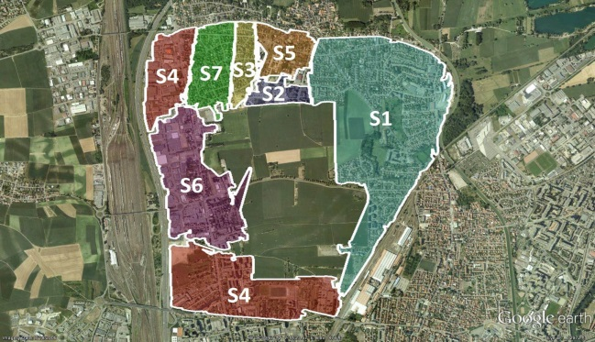
Example 2: Popular Signature Interestingness Function
12
Figure 2: Example of a Spatial Clustering of Buildings Annotated by Popular Signatures.
Popular signature interestingness function i_{POP} (c):
Let cld = d(s(c), closest(s(c),P))
$$i_{POP}\left(c\right)= \left\{\begin{aligned}0, cld>D \\ {\left(D−cld\right)}^{η}, otherwise\end{aligned}\right. (5)$$
where s(c) is the signature of cluster c, closest(s,P) computes the closest signature in P to s, d denotes Euclidian distance, D is a match threshold, and η is a form parameter having value in (0, ∞).
Popular Signatures for the Dataset
Signature ID | Single House | Garage | Commercial Building | Light Building | Collective House | School
S1 | 77% | 3% | 2% | 2% | 17% | 0%
S2 | 87% | 4% | 1% | 3% | 4% | 1%
S3 | 2% | 6% | 0% | 0% | 92% | 0%
S4 | 99% | 0% | 0% | 0% | 0% | 0%
S5 | 48% | 1% | 46% | 3% | 2% | 0%
S6 | 4% | 0% | 96% | 0% | 0% | 0%
S7 | 37% | 22% | 4% | 1% | 32% | 4%
S8 | 62% | 6% | 13% | 12% | 4% | 1%
S9 | 85% | 1% | 14% | 0% | 0% | 0%
Dataset | 78% | 4% | 7% | 3% | 8% | 1%
Notes:
Signature ID
Single House
Garage
Commercial Building
Light Building
Collective House
School
S1
77%
3%
2%
2%
17%
0%
S2
87%
4%
1%
3%
4%
1%
S3
2%
6%
0%
0%
92%
0%
S4
99%
0%
0%
0%
0%
0%
S5
48%
1%
46%
3%
2%
0%
S6
4%
0%
96%
0%
0%
0%
S7
37%
22%
4%
1%
32%
4%
S8
62%
6%
13%
12%
4%
1%
S9
85%
1%
14%
0%
0%
0%
Dataset
78%
4%
7%
3%
8%
1%

Slide 13
Popular Singnature Clustering Results
13
Table 2: Popular Building Type Signature Clustering Results for 2008
Cluster ID | Single House | Garage | Commercial Building | Light Building | Collective House | School | No. of Building | Closest Signature | Distance
0 | 89% | 4% | 2% | 0% | 5% | 0% | 56 | S2 | 0.04
1 | 75% | 7% | 4% | 0% | 13% | 0% | 69 | S1 | 0.07
2 | 73% | 8% | 6% | 2% | 12% | 0% | 52 | S1 | 0.09
3 | 29% | 2% | 9% | 45% | 15% | 0% | 55 | S8 | 0.49
4 | 72% | 6% | 11% | 1% | 10% | 0% | 157 | S1 | 0.13
5 | 88% | 4% | 2% | 3% | 5% | 0% | 199 | S2 | 0.02
6 | 100% | 0% | 0% | 0% | 0% | 0% | 112 | S4 | 0.01
7 | 44% | 1% | 46% | 5% | 4% | 0% | 100 | S5 | 0.05
8 | 87% | 4% | 1% | 3% | 3% | 1% | 335 | S2 | 0.01
9 | 85% | 1% | 13% | 1% | 1% | 0% | 320 | S9 | 0.01
10 | 77% | 5% | 8% | 0% | 10% | 0% | 39 | S1 | 0.09
11 | 77% | 3% | 1% | 1% | 17% | 2% | 198 | S1 | 0.03
12 | 36% | 20% | 3% | 4% | 34% | 4% | 142 | S7 | 0.05
13 | 99% | 1% | 0% | 0% | 0% | 0% | 121 | S4 | 0.01
14 | 98% | 2% | 0% | 0% | 0% | 0% | 57 | S4 | 0.02
15 | 89% | 0% | 0% | 0% | 11% | 0% | 27 | S2 | 0.09

Slide 14
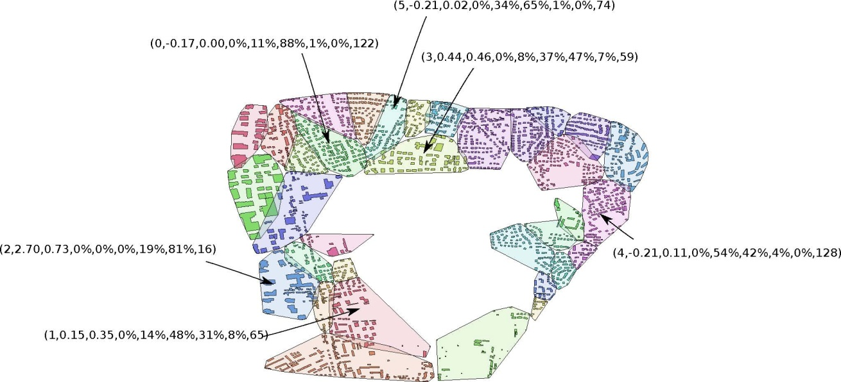
Example3: Variance Interestingness Function
14
Task: Partition a city into uniform urban patches with respect to the size of buildings that occupy each urban patch. In this case, signatures are vectors of buildings sizes and we like to minimize the variance of building sizes in spatial clusters.
The Low variance interestingness function i_{V}(r) assesses the variance of a continuous attribute in a cluster c; the interestingness of the cluster c is inversely proportional to the variance of the continuous attribute of the objects in the cluster:
$$i_{V}\left(c\right)=\left\{\begin{aligned}0, var\left(c\right)>var(O) \\ 1, var\left(c\right)=0 \\ {\min\left(1, (\log_{100}{var(O}\right)/var(c)))}^{},otherwise\end{aligned}\right.$$
where var(c) is the variance for a continuous attribute in cluster c, var(O) is variance of the continuous attribute in the dataset O.

Slide 15
4. The Spatial Clustering Algorithm CLEVER
15
CLEVER is a k-medoids-style representative-based clustering algorithm.
CLEVER allows for a plug-in fitness function q which is maximized during the search for an “optimal” spatial clustering
It employs randomized hill climbing to find better solutions in the neighborhood of the current solution. In general, p solutions are sampled in the neighborhood of the current solution where p is an algorithm parameter—the sampling rate of CLEVER.

Slide 16
Representative-based Clustering
16
Attribute1
2
1
3
4
Attribute2
Objective: Find a set of objects O_{R} such that the clustering X
obtained by using the objects in O_{R} as representatives minimizes q(X).
Characteristic: cluster are formed by assigning objects to the closest
representative
Popular Algorithms: K-means, K-medoids, CLEVER,…
Notes:
The objective of representative-based supervised clustering is…

Slide 17
Pseudo Code CLEVER Algorithm
17
Input: Dataset O, distance-function d or distance matrix M, a fitness function q
Output: Clustering X, quality q(X), rewards for clusters in X
1: Randomly create a set of k’ representatives
2: Sample p solutions in the neighborhood of the current representative set by changing the representative set
3: If the best solution of the p solutions improves the clustering quality of the current solution; its set becomes the current set of representatives and search continues with Step 2; otherwise, terminate returning the current clustering.

Slide 18
Example --- Neighborhood-size=2
A
Dataset: {1, 2, 3, 4, 5, 6, 7, 8, 9, 0}
Current Solution: {1, 3, 5}
Non-representatives: {2, 4, 6, 7, 8, 9, 0}
{1, 3, 5}
Insert 7
{1, 3, 5, 7}
Replace 3 with 4
Next Solution:{1, 4, 5, 7}
Remarks:
Representative sets are modified random obtaining a clustering
in the neighborhood of the current clustering.
2. Modificaton operators and operator parameters are chosen by a
random generator, giving each parameter the same chance to be selected.

Slide 19
Sensitivity Analysis
B
Table 4: Building Type Purity Clustering Sensitivity Results
Run ID | q(X ) | No. of Clusters | No. of Iterations | Generated Clusterings
1 | 776.81 | 7 | 38 | 1635
2 | 764.68 | 8 | 43 | 1920
3 | 756.20 | 10 | 25 | 645
4 | 747.56 | 11 | 39 | 1830
5 | 746.39 | 12 | 29 | 1245
6 | 744.51 | 9 | 30 | 1470
7 | 741.23 | 11 | 24 | 1170
8 | 738.21 | 3 | 31 | 1470
9 | 737.03 | 13 | 29 | 1245
10 | 736.27 | 16 | 45 | 1950
11 | 727.90 | 11 | 39 | 2010
12 | 726.31 | 8 | 48 | 2175
13 | 719.12 | 10 | 23 | 960
14 | 716.62 | 23 | 36 | 1395
15 | 715.18 | 14 | 20 | 525
16 | 710.86 | 16 | 26 | 1380
17 | 707.44 | 9 | 31 | 1140
18 | 693.47 | 18 | 37 | 1605
19 | 688.78 | 16 | 31 | 1665
20 | 685.85 | 16 | 24 | 1005
Mean | 729.02 | 12.05 | 32.40 | 1422
STD | 24.63 | 4.55 | 7.88 | 444.40
Max | 776.81 | 23.00 | 48.00 | 2175.00
Min | 685.85 | 3.00 | 20.00 | 525.00

Slide 20
5. Related Work
18
Unsupervised topic discovery approaches to summarize the composition of cities/… have been proposed [Yuan 2012, Yin 2011]. Urban patches are annotated by topics their composition expresses
Some spatial regression approaches identify uniform regions in spatial data [Celepcikay 2009, Vucetic 2000]. [Sheng 2010] proposes an approach that finds the top-k similar regions for a signature/query.
There are a lot of spatial clustering approaches; however, all form clusters based on distance based criteria.
Signatures have been successfully used in other applications such as telecommunication [Cortez 2001] and visualization [Wong 2000] .

Slide 21
6. Summary and Future Work
19
We presented a methodology for summarizing the composition of cities that relies on 3 main ideas:
The task of finding uniform regions in a spatial dataset is formulated as a maximization problem of a signature-based. plug-in uniformity measure and introduce a prototype-based clustering algorithm called CLEVER to find such regions.
Regions are annotated with signatures and mining particular types of signature plays a key role in the methodology.
Polygons are used to describe the scope of a regions/urban patches.

Slide 22
6. Summary and Future Work
20
Currently we are working on “better” scoping algorithms that determine the boundaries of urban patches.
We are planning to investigate other spatial clustering algorithms that are capable to find spatial clusters of arbitrary shape, namely polygonal and agglomerative spatial clustering algorithms.
Finding the “best” characterization of the composition of a city is like finding a needle in a hay stack: therefore, parallel versions of spatial clustering algorithms are needed.
We are looking for new case studies / datasets to test / enhance our methodology.
In general, developing a theory of signatures and signature mining deserves more exploration.

Slide 23
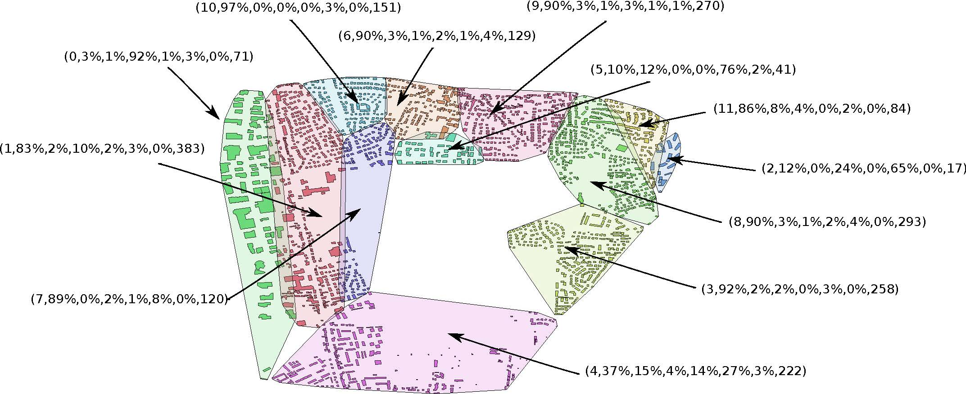
Any Question?
21

Slide 24
Randomized Hill Climbing
A variant of hill climbing where p sample points are randomly selected from the neighborhood of the current solution
Two main parameters: p and neighborhood definition
Usually fast, because no exhaustive sampling

Slide 25
CLEVER—General Loop
Select initial solution by randomly selecting k-hat representatives
Find p neighbors of current solution using a given neighborhood definition
If the best neighbor improves fitness, it becomes new solution.
If no neighbor improves fitness, the neighborhood is resampled using p*2 and then p*(q-2) no. of samples
If even after resampling fitness does not improve, the algorithm terminates

Slide 26
Neighborhood Definition
CLEVER samples solution based on a given neighborhood size that is defined as the number of operators applied to the current solution
Operators Used: Insert, Replace, Delete
Each operator is assigned a certain selection probability.
Insert and Delete operator change no. of representatives and in turn no. of clusters, enabling the algorithm to search for a variable number of clusters k.

Slide 27
Methodologies and Tools to Analyze and Mine Related Datasets
However, developing a spatial clustering algorithm which directly maximizes ϕ(X) is quite challenging, as this would require to identify and to keep track of which spatial clusters are neighboring in order to compute ϕ(X), which leads to quite signiﬁcant clustering overhead, and to theoretical problems. If prototype-based clustering algorithms, such as K-medoids or K-means are used, a Voronoi tessellation can be used to derive cluster models from the set of cluster prototype which are convex polygons; unfortunately, it is not computationally feasible to compute Voronoi cells in higher dimensional spaces, as the complexity of the algorithm is exponential with respect to the dimensionality of the dataset. Consequently, it is only feasible to compute the Voronoi tessellation in 1D, 2D, and for small datasets in 3D. For density-based clustering algorithm the situation is even worse; for example, we are not aware of any methods which are capable of producing cluster models from a DBSCAN clustering.

Slide 28
Advantages CLEVER Over Other Representative-based Algorithms
Searches for the optimal number of clusters k
Quite generic: can be used with any reward-based fitness function → can be applied to a large set of tasks
Less likely to terminate prematurely—reason: uses neighborhood sizes of larger than 1 and changes the number of clusters k during the search, which make it less likely that it terminates prematurely.
Usually, significantly better cluster quality than SPAM
At an average, samples less neighbors than PAM
Uses dynamic sampling; only uses a large number of samples when it gets stuck.

Slide 29
Disadvantages and Problems with CLEVER
Relatively slow; particularly, if dataset sizes are above 5000 or q(X) is expensive to compute.
Bad choices for k-hat might lead to poor results
Sensitive to initialization
Cluster shapes are limited to convex polygons
Cannot detect nested clusters
CLEVER has no concept of outliers: therefore, the algorithm has to waste resources and representatives to separate non-reward regions from reward regions.
Remark: Disadvantages in blue are general disadvantage of representative-based
clustering algorithms.

Slide 30
CLEVER - CLustEring using representatiVEs and Randomized hill climbing
CLEVER( , neigbhborhoodDef, p, q)
1. Randomly select initial set of -representatives. Set it to currReps.
2. regions = findRegions (currReps). {Find regions for current set of representatives}
3. currentFitness = findFitness (regions) {Find total fitness for the current regions}
4. Set nonReps to the data objects that are non-representatives.
5. bestFitness = currentFitness
6. while TRUE do
7. neighbors = findNeighbors (currReps, nonReps, p, neighborhoodDef) {Pick p neighbors from the neighborhood of current representatives as defined by the parameter 'neighborhoodDef'}.
8. for each neighbor ∈ neigbhors do
9. newRegions = findRegions (neighbor). {Find regions using the
neighboring solution}
10. newFitness = findFitness (newRegions) {Find total fitness for
newly found regions}
11. if newFitness > bestFitness
12. bestNeighbor = neighbor {replacement}
13. bestFitness = newFitness
14. bestRegions = newRegions
15. end
16.end for
17. if fitness improved
18. currReps = bestNeighbor
19. currentFitness = bestFitness
20. regions = bestRegions
21. if resampling done
22. revert to original p value.
23. end
24. Go back to step 7.
25. else
26. if resampling done twice and fitness does not improve after resampling
27. Terminate and return obtained regions, region representatives, no. of representatives (k), and fitness.
28. else if first resampling
29. p = p * 2 {resample with higher p value}
30. Go back to step 7.
31. else {Resample again}
32. p = p * (q – 2) (resample with much higher p value)
33. Go back to step 7.
34. end
35. end
36.end

Slide 31
CLEVER Parameters
 | Initial no. of clusters
p | Sample size. No. of samples to be selected randomly from the solution neighborhood
q | Resampling factor. If algorithm fails to improve fitness with p and p*2 samples, sample size is increased by factor of (q-2).

Slide 32
findNeighbors (reps, nonReps, p, neigbhborhoodDef, neighborhoodSize)
1. for 1 to p do
2. currentReps = reps
3. currentNonReps = nonReps
4. for 1 to neighborhoodSize do
5. op = selectOperator (operators, opProbabilities) {Randomly
select an operator as per user specified operator selection
probabilities}
6. if op = 'insert'
7. newRep = selectNewRep (currentNonReps) {Randomly select a
non-representative}
8. delete(currentNonReps, newRep)
9. neighbor = add (currentReps, newRep) {Add newRep to the
currentReps to get a new neighbor}
10. else if op = 'delete' OR op = 'replace'
11. rep = selectRep(currentReps) {Randomly select a
Representative}
12. if op = 'delete'
13. neighbor = delete (currentReps, rep) {Delete select rep
from current set of representative to get a new neighbor}
14. add(currentNonReps, rep)
15. else if op = 'replace'
16. newRep = selectNewRep (nonReps) {Randomly select a
non-representative}
17. neighbor = replace (currentReps, rep, newRep) {Replace
selected representative with new representative to get
a new neighbor}
replace(currentNonReps ,newRep, rep)
18. end
19. end
20. currentReps = neighbor
21. end for
22. Add neighbor to neighbors.
23. end for
23. Return neighbors.

Slide 33
findNeighbors() Parameters
operators | Set of operators that can be applied on a solution. Possible values are ‘Insert’, ‘Replace’ and ‘Delete’.
opProbabilities | User-specified probabilities for each operator selection. Sum of probabilities of all operators is 1.

Slide 34
Approach Chosen
Consequently, we are using diﬀerent heuristics to ﬁnd uniform spatial clusters without having to deal with the question which clusters are neighboring, and rely on approaches which use simpliﬁed versions of ϕ(X) instead; in particular:
We use prototype-based spatial clustering algorithms that are guaranteed to obtain contiguous spatial clusters without the necessity of knowing which clusters are neighboring. These algorithms maximize reward functions which encourage the merging of similar neighboring clusters and the splitting of non-homogeneous clusters if it leads to a signiﬁcant increase in the total reward.
We reformulate the above optimization task in two ways:
We make the problem supervised, by using interest­ingness functions which assess the quality of spatial clusters based on uniformity measures which capture a domain expert’s notion of uniformity. Moreover, as we will see later, those uniformity measures assume that certain signatures are more desirable than other signatures.
ii. Instead of comparing the signatures of all neighboring clusters—as ϕ does—we employ an approach which identiﬁes a set of popular signatures and then uses those signatures to annotate clusters. In particular.

Slide 35
Motivation CLEVER
The PAM/SPAM algorithm uses a simple hill climbing procedure
PAM terminates very quickly in terms of no. of replacements; mostly, because it only considers simple replacements.
PAM/SPAM does not perform well in terms of clustering quality
PAM is inefficient in the sense that it samples all possible replaced of a representative with a non-representative
PAM/SPAM search for a fixed number of clusters k; k has to be known in advance.

