Slide 1
Supervised Clustering—
Algorithms and Applications
Christoph F. Eick
Department of Computer Science
University of Houston
Organization of the Talk
Motivation—why is it worthwhile generalizing machine learning techniques which are typically unsupervised to consider background information in form of class labels?
Introduction to Supervised Clustering
CLEVER and STAXAC—2 Supervised Clustering Algorithms
Applications: Using Supervised Clustering for
  Dataset Editing
  Noise Removal from Images
  Distance Metric Learning
  Subclass Discovery
Conclusion

Slide 2
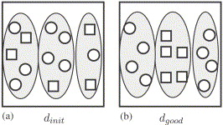
3 Examples of Making Originally Unsupervised Methods Supervised
consider
X
Supervised X
class labels
Supervised Similarity Assessment (Derive distance functions that provide a good performance a classification algorithm, such is k-NN)—see below!
Supervised Clustering—to be discussed in the remainder of this talk!
Supervised Density Estimation
“Bad” distance function
“Good” distance function

Slide 3
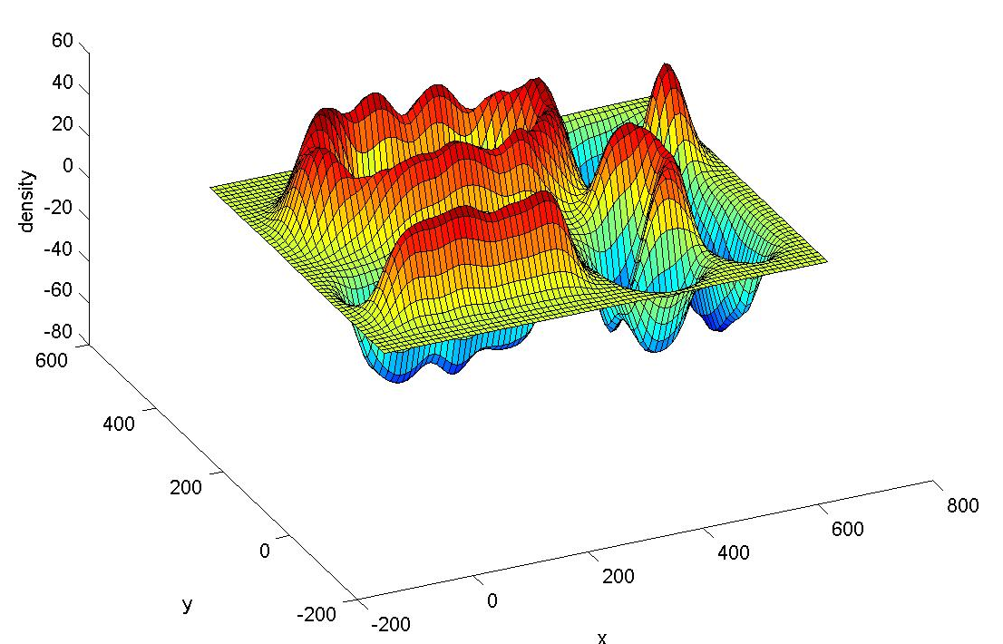
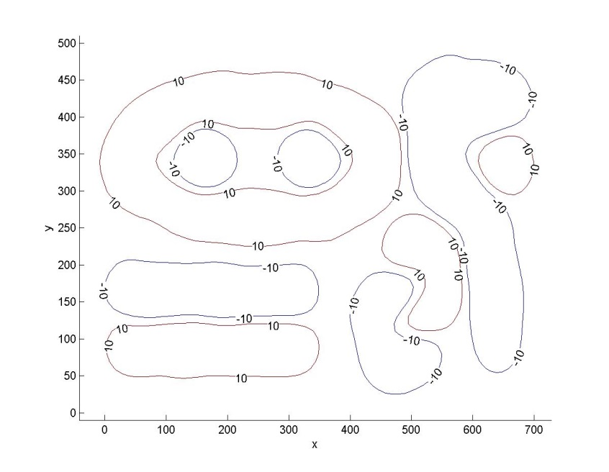
Supervised Density Estimation

Slide 4
Objectives of Today’s Presentation
Getting the message across that making unsupervised learning techniques supervised is an interesting and worthwhile activity. It describes work that has been conducted over the last 19 years and summarized in more than 20 publications.
Presents a lot of ideas, heuristics and methodologies in doing that, some of which can be reused in other contexts.
Covers some ‘lesson learnt’ along the way!
Covers a lot of ground and therefore centers on breadth, rather than on a in depth discussion, comparison and evaluation of a particular approach.
Does not cover much the quantitative evaluation of the presented methodologies and algorithms and the comparison with its competitors.
Does not review much related work.

Slide 5
Organization of the Talk
Motivation—why is it worthwhile generalizing machine learning techniques that typically unsupervised to consider background information in form of class labels?
Introduction to Supervised Clustering
CLEVER and STAXAC—2 Supervised Clustering Algorithms
  Dataset Editing
  Noise Removal from Images
  Distance Metric Learning
  Subclass Discovery
Conclusion

Slide 6
Traditional Clustering
Partition a set of objects into groups of similar objects. Each group is called cluster.
Clustering is used to “discover classes” in a data set. (“unsupervised learning”).
Clustering relies on distance information to determine which clusters to create.
Notes:
There has been a lot of work on tradi itinal and semi-supervised clustering. Traditional clustering is applied to unclassified examples and relies on a notion of closeness. The focus of traditional clustering is to identify groups in datasets trying to minimizing given fitness function, such as trying to minimize the tightness of a clustering.

Slide 7
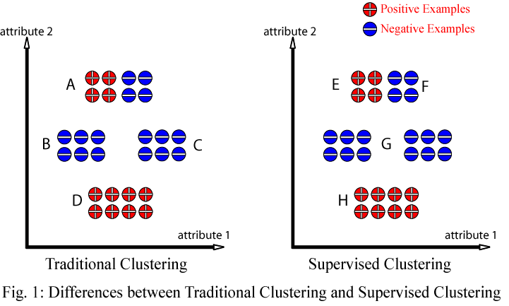
Objective of Supervised Clustering: Maximize cluster purity
while keeping the number of clusters low (expressed by a
fitness function q(X)).

Slide 8
Supervised Clustering Discovers Subclasses
Attribute1
Ford Trucks
:Ford
:GMC
GMC Trucks
GMC Van
Ford Vans
Ford SUV
GMC SUV
Attribute2
Notes:
Finally, supervised clustering can be used to identify subclasses of a given set of classes. Consider, we have cars that are classified as Ford or General Motors cars. A supervised clustering algorithms would identify subclasses, such as…

Slide 9
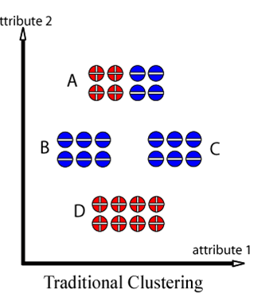
Objective Functions for Supervised Clustering
For a single cluster C:
Purity(C):=(Number of Majority Class Examples in C) /
(Number of Examples that belong to C)
2. For a clustering X={C₁,…,C}_{k}:
ψ(X)=Σ_{i}Purity(C_{i})*(|C_{i}|**β)
where β≥1 is a parameter and |C| is the number of examples in cluster C
Assuming β=1, we obtain:
ψ(X)=0.5∗8+1∗6+1∗6+1∗8=24

Slide 10
Organization of the Talk
Motivation—why is it worthwhile generalizing machine learning techniques that typically unsupervised to consider background information in form of class labels?
Introduction to Supervised Clustering
CLEVER and STAXAC—2 Supervised Clustering Algorithms
Applications: Using Supervised Clustering for:
  Dataset Editing
  Noise Removal from Images
  Distance Metric Learning
  Subclass Discovery
Conclusion

Slide 11
3. CLEVER and STAXAC—2 Supervised Clustering Algorithms
CLEVER a representative-based supervised clustering algorithm
STAXAC an agglomerative, supervised hierarchical clustering algorithm

Slide 12
Representative-Based Clustering
Aims at finding a set of objects among all objects (called representatives) in the data set that best represent the objects in the data set. Each representative corresponds to a cluster.
The remaining objects in the data set are, then, clustered around these representatives by assigning objects to the cluster of the closest representative.
Remark: The popular k-medoid algorithm, also called PAM, is a representative-based clustering algorithm; moreover, K-means although it uses centroids and not representatives forms clusters in the same way!
Notes:
There are many possible supervised clustering algorithm. In our work, we investigate representative-based supervised clustering algorithms that aim

Slide 13
Representative-based Supervised Clustering
Attribute1
2
1
Clustering
maximizes
purity
3
4
Attribute2
Objective: Find a set of objects O_{R} in the dataset O to be clustered, such that the clustering X obtained by using the objects in O_{R} as representatives minimizes q(X); e.g. the following q(X):
q(X):= Σ_{i} purity(C_{i})*(|C_{i}|^{β}) with β≥1
Solution Space: Sets of representatives; e.g. O_{R}={o_{2,}o₄,o₂₂,o₉₁}.
13

Slide 14
Randomized Hill Climbing
Neighborhood of
Randomized Hill Climbing: Sample p points randomly in the neighborhood of the currently best solution; determine the best solution of the p sampled solutions. If it is better than the current solution, make it the new current solution and continue the search; otherwise, terminate returning the current solution.
Niche: Can be used if the derivative of the objective functions cannot be computed
Advantages: easy to apply, does not need many resources, usually fast.
Problems: How do I define my neighborhood; what parameter p should I
choose, is the sampling rate p fixed or not, what about resampling to avoid premature termination?

Slide 15
CLEVER—A Representative-based
Supervised Clustering Algorithm
CLEVER (ClustEring using representatiVEs and Randomized hill climbing) is a representative-based, clustering algorithm
  Obtains a clustering X maximizing a plug-in interestingness/fitness function: Reward(X) = Σ_{C∈X}interestingness(C) x size(C)^{β}
in the case of supervised clustering: Σ_{i}Purity(C_{i})*|C_{i}|**β
It employs randomized hill climbing to find better solutions in the neighborhood of the current solution. In general, p solutions are sampled in the neighborhood of the current solution and the best of those solutions becomes the new current solution—p is the sampling rate of CLEVER.
A solution is characterized by a set of representatives which is modified by the hill climbing procedure by inserting, deleting, and replacing representatives.
CLEVER resamples p’ more solutions before terminating.
CLEVER complexity: O(n*r*t) n:=#of objects; t:#of iterations; r is average sampling rate.

Slide 16
Pseudo Code CLEVER Algorithm
Input: Dataset O, distance-function d or distance matrix M, a fitness function q, sampling rate p, resampling rate p’, k’
Output: Clustering X, fitness function q(X), rewards for clusters in X
Randomly create a set of k’ representatives
Sample p solutions in the neighborhood of the current representative set by changing the representative set
If the best solution of the p solutions improves the clustering quality of the current solution; its set becomes the current set of representatives and search continues with Step 2; otherwise, resample p’ more solutions, and terminate returning the current clustering if there is no improvement.

Slide 17
Example --- Neighborhood-size=2
Dataset: {1, 2, 3, 4, 5, 6, 7, 8, 9, 0}
Current Solution: {1, 3, 5}
Non-representatives: {2, 4, 6, 7, 8, 9, 0}
{1, 3, 5}
Insert 7
{1, 3, 5, 7}
Replace 3 with 4
Next Solution:{1, 4, 5, 7}
Remarks:
Representative sets are modified at random obtaining a clustering in the neighborhood of the current clustering.
Modification operators and operator parameters are chosen at random.

Slide 18
Advantages CLEVER Over Other Representative-based Algorithms
Searches for the optimal number of clusters k
Quite generic: can be used with any reward-based fitness function → can be applied to a large set of tasks
Uses dynamic sampling; only uses a large number of samples when it gets stuck.

Slide 19
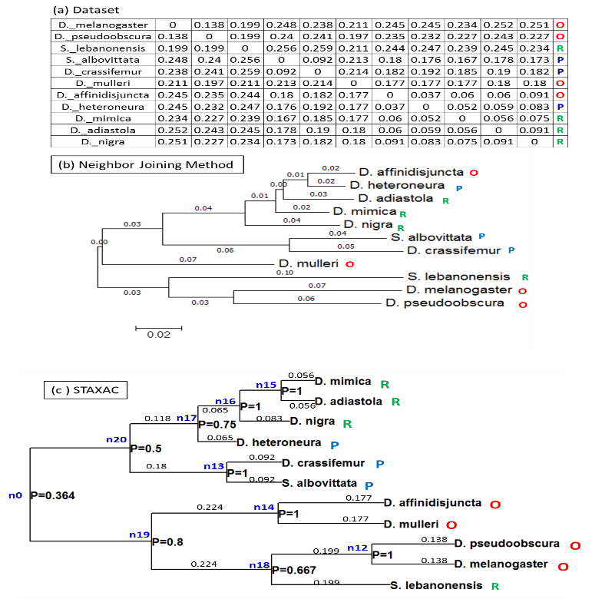
STAXAC—A HIERARCHICAL SUPERVISED CLUSTERING ALGORITHM
Supervised taxonomies are generated considering background information concerning class labels in addition to distance metrics, and are capable of capturing class-uniform regions in a dataset

Slide 20
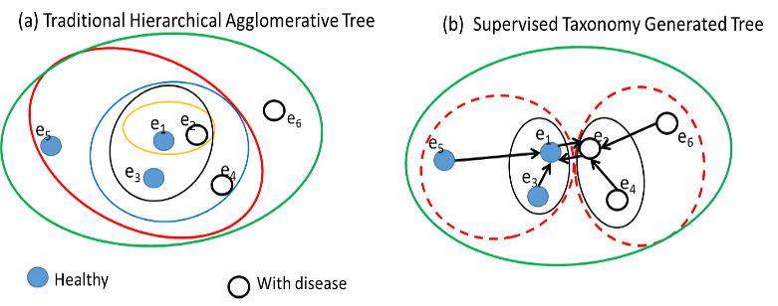
How STAXAC Works
1-Nearest Neighbor Relationship

Slide 21
Pseudo-Code STAXAC Algorithm
Algorithm 1: STAXAC (Supervised TAXonomy Agglomerative Clustering)
Input: examples with class labels and their distance matrix D.
Output: Hierarchical clustering
1. Start with a clustering X of one-object clusters.
2. ∀C* ,C’∈X; merge-candidate(C*,C’) ⇔ (1-NN_{X}(C*) = C’ or 1-NN_{X}(C’ )=C* )
3. WHILE there are merge-candidates (C*, C’) left
BEGIN
a. Merge the pair of merge-candidates (C*,C’) obtaining a
new cluster C=C*∪C’ and a new clustering X’ for which Purity(C) has the largest value
b. Update merge-candidates:
∀C’’ merge-candidate(C’’,C) ⇔ (merge-candidate(C’’,C*) or
merge-candidate(C’’,C’))
c. Extend dendrogram by drawing edges from C’ and C* to C
END
4. Return the constructed dendrogram

Slide 22
Properties of STAXAC
STAXAC works agglomeratively merging neighboring clusters, giving preference to obtaining clusters that have higher purity. It creates a hierarchical clustering that maximizes cluster purity.
In contrast to other hierarchical clustering algorithms, STAXAC conducts a wider search, merging clusters that are neighboring and not necessarily the closest two clusters
STAXAC uses proximity graphs, such as Delaunay, Gabriel, and 1-NN graphs, to determine which clusters are neighboring. Proximity graphs need only be computed at the beginning of the run. Its current implementation uses Gabriel and 1-NN graphs.
STAXAC creates supervised taxonomies; unsupervised taxonomies are widely used in bioinformatics. It is also related to conceptual clustering.

Slide 23
Organization of the Talk
Motivation—why is it worthwhile generalizing machine learning techniques that typically unsupervised to consider background information in form of class labels?
Introduction to Supervised Clustering
CLEVER and STAXAC—2 Supervised Clustering Algorithms
Applications: Using Supervised Clustering for
  Dataset Editing
  Noise Removal from Images
  Distance Metric Learning
  Subclass Discovery
Conclusion

Slide 24
4.a: Application to Data Set Editing
Problem Definition:
Given Dataset O
1. Remove “bad” examples from O
O_{edited} ← O\{“bad” examples}
2. Use O_{edited} to obtain a model
The goal is data set editing is to improve the accuracy of classification models. Dataset editing can be viewed as an approach to alleviate overfitting as it tends to remove “noisy” examples.
24

Slide 25
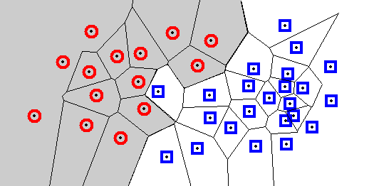
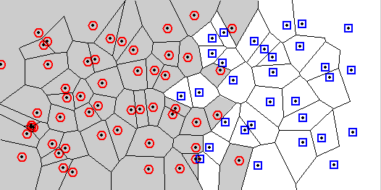
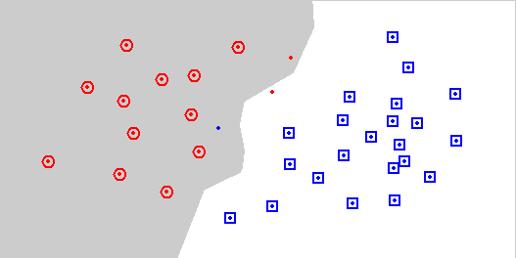
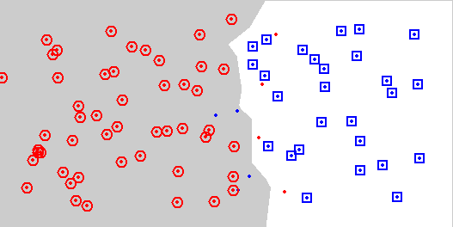
Wilson Editing
Wilson 1972
Remove points that do not agree with the majority of their k nearest neighbours
Earlier example
Overlapping classes
Original data
Original data
Wilson editing with k=7
Wilson editing with k=7

Slide 26
Using Supervised Clustering for Dataset Editing
Two Ideas:
Replace object in the cluster by their representative [EZV04]
Remove minority examples from clusters [AE15]
Attribute1
Attribute1
A
B
D
C
E
F
Attribute2
Attribute2
Dataset clustered using a supervised clustering; e.g. by using CLEVER
b. Dataset edited using cluster representatives.
Notes:
One application of supervised clustering is data set editing. The idea of dataset editing is to remove examples from a training set with the goal to enhance accuracy of a classifier. The idea is to use the cluster representatives instead of the whole dataset when training a classifier. The cluster representatives are determined using supervised clustering.

Slide 27
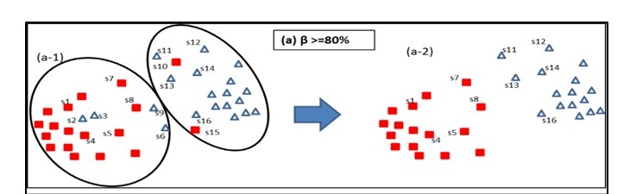
6.3.The HC-edit Approach
HC-EDIT
Create a supervised taxonomy ST for dataset O using STAXAC
Extract a clustering from ST for a given purity threshold β
Delete all minority examples of the obtained clusters to edit the dataset
27

Slide 28
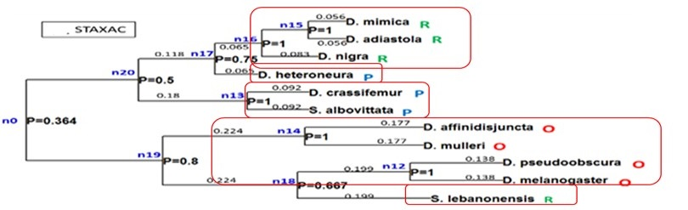
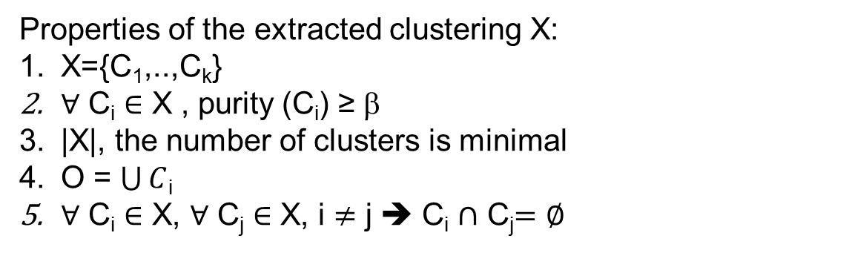
Extracting Clusters from a Supervised Taxonomy
Need algorithm which extracts a clustering whose clusters’ purity is above a purity threshold β>0. Below you see the clusters that have been extracted from the ST introduced earlier using β=1.
Properties of the extracted clustering X:
X={C₁,..,C_{k}}
$∀$ C_{i} $∈$ X , purity (C_{i}) ≥ β
|X|, the number of clusters is minimal
O = $\bigcup{C}$_{i}
$∀$ C_{i} $∈$ X, $∀$ C_{j} $∈$ X, i $≠$ j ➔ C_{i} $∩$ C_{j}$=∅$

Slide 29
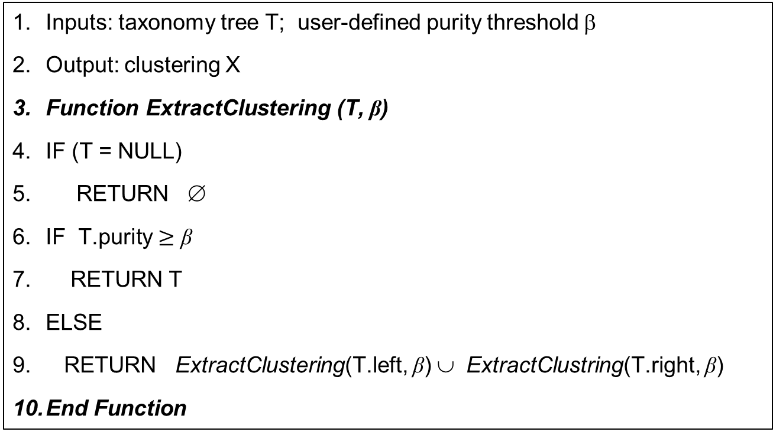
Algorithm: ExtractClustering (T, β)
Inputs: taxonomy tree T; user-defined purity threshold β
Output: clustering X
Function ExtractClustering (T, β)
IF (T = NULL)
RETURN ∅
IF T.purity $≥$ β
RETURN T
ELSE
RETURN ExtractClustering(T.left, β) ∪ ExtractClustring(T.right, β)
End Function

Slide 30
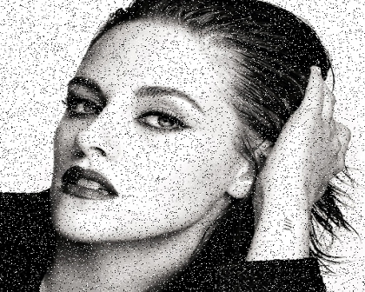

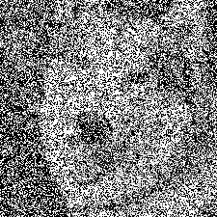
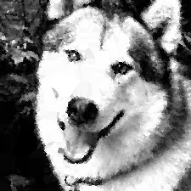
4.b. Application: Remove Salt and Pepper Noise from Images
Challenge: To recognize noisy black and white pixels from healthy ones
Noisy
Repaired by SHCF
20% noise
70% noise

Slide 31
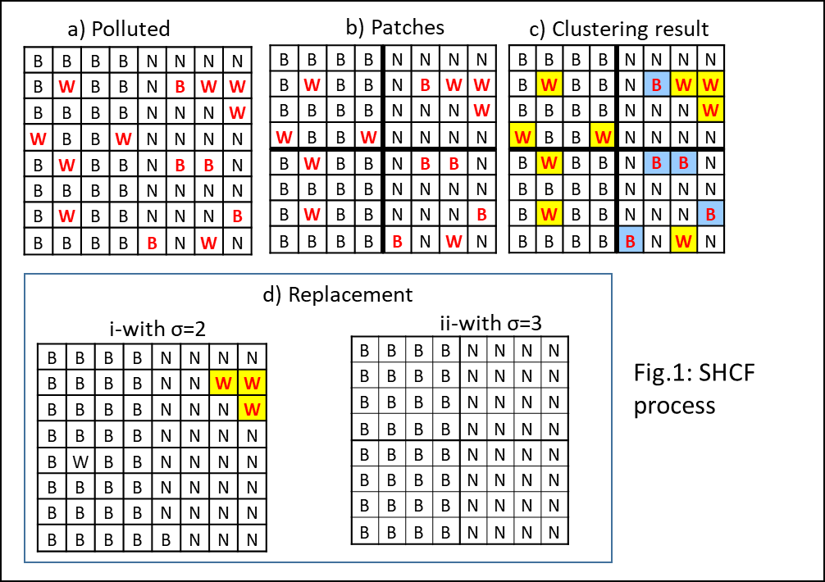
SHCF: Overview
(1) Assign label to pixels Fig. 1.a
(2) Divide image into patches by adding an equal-size grid cells to the image Fig.1.b
(3) Use STAXAC to create a ST for each patch
Noisy
image
(4) Extract 100% purity B/W clusters from each ST Fig.1.c (Clusters are yellow & blue patches)
(5) Identify corrupt pixels from small clusters based on a cluster size threshold σ
Fig.1.c
(6) Replace a corrupt pixel with its nearest healthy pixel Fig.1.d
(ex: σ=2 & σ=3)
Repaired
image

Slide 32
SHCF Compared With Competing Algorithms
Ours

Slide 33
Contributions S&P Noise Removal
SHCF is capable of identifying healthy salt and pepper pixels from a digital image corrupted with high density SPNs. The noise detection strategy relies on supervised hierarchical clustering to identify groups of corrupt pixels; as opposed to individual pixels.
It proposes a replacement method which is order independent as it does not reuse updated pixel values to repair subsequent corrupt pixels.
SHCF does well in removing SPNs from images containing “healthy” black and/or white pixels.
SHCF does mostly well, compared to its competitors, for images with high SPN densities.

Slide 34
Similarity Assessment Framework:
4.c Applications to Distance Metric Learning
Objective: Learn a good (weights of a) distance function θ for classification tasks.
Our approach: Apply a (supervised) clustering algorithm with the distance function θ to be evaluated to the dataset obtaining k clusters. Change the weights of the distance function to make each cluster purer!
Our goal is to learn the weights of an object distance function θ such that all the clusters are pure (or as pure is possible).

Slide 35
Idea: Coevolving Clusters and Distance Functions
Weight Updating Scheme /
Search Strategy
Clustering X
Distance
Function Θ
Cluster
“Bad” distance function Θ₁
“Good” distance function Θ₂
q(X) Clustering
Evaluation
Goodness of
the Distance
Function Θ

Slide 36

Idea Inside/Outside Weight Updating
o:=examples belonging to majority class
x:= non-majority-class examples
Cluster1: distances with respect to Att1
xo oo ox
Action: Increase weight of Att1
Idea: Move examples of the
majority class closer to each other
Cluster1: distances with respect to Att2
o o xx o o
Action: Decrease weight for Att2

Slide 37
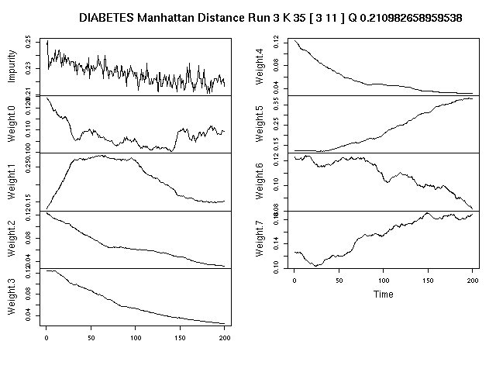
Sample Run IOWU for Diabetes Dataset

Slide 38
5.4 ST/ Creating Background Knowledge
4.d: Application to Subclass Discovery
Attribute1
Ford Trucks
:Ford
:GMC
GMC Trucks
GMC Van
Ford Vans
Ford SUV
GMC SUV
Attribute2
38

Slide 39
Newsworthy Cluster
In the next slide, we present a subclass discovery algorithm that relies on the notion of a news-worthy cluster:
  A news-worthy cluster contains at least σ instances and
  Its purity is above θ; that is, its contamination with instances of other classes is below θ.
The algorithm extracts newsworthy clusters from a supervised taxonomy that has been created for a dataset O.

Slide 40
5.4 ST/ Creating Background Knowledge
An Algorithm to Discovery Subclasses
Algorithm: Subclass Discovery
Inputs:
O; input dataset
σ; a user-defined threshold concerning the minimum number of instances a cluster should have to be considered as newsworthy
θ_{min}; a user-defined purity threshold that specifies how much contamination of instances is tolerable in a cluster
1: Create a ST T from O using STAXAC
2: Extract a clustering X from T by whose purity is above θ_{min}
3: Sort the clusters in X={C₁,…,C_{k}} by their size obtaining a sequence S
4: Delete clusters from S whose number of instances is less than σ
5: Display the remaining clusters in S in a histogram where each bin displays the number of instances in the respective cluster; label each bin with the name of the majority class of the respective cluster
6: Analyze the composition of the obtained histogram with respect to class labels to determine modalities of particular classes
40

Slide 41
5. Conclusion
We argued for the merit of generalizing unsupervised machine learning techniques by considering background knowledge in form of class labels.
We introduced supervised clustering that discovers subclasses of the underlying class structure of a dataset.
We presented 2 hierarchical clustering algorithms CLEVER and STAXAC; one employs randomized hill climbing and the other creates clusters by merging neighboring clusters.
Supervised clustering creates valuable background knowledge for datasets that is useful for subclass learning, distance metrics learning, removing noise from images, dataset editing,…

Slide 42
References
Supervised Clustering
Christoph F. Eick, Banafsheh Vaezian, Dan Jiang, Jing Wang: Discovery of Interesting Regions in Spatial Data Sets Using Supervised Clustering. PKDD 2006: 127-138
Christoph F. Eick, Nidal M. Zeidat, Zhenghong Zhao:Supervised Clustering - Algorithms and Benefits. ICTAI 2004: 774-776 200 citations
Christoph F. Eick, Nidal M. Zeidat: Using Supervised Clustering to Enhance Classifiers. ISMIS 2005: 248-256
Wei Ding, Tomasz F. Stepinski, Rachana Parmar, Dan Jiang, Christoph F. Eick: Discovery of feature-based hot spots using supervised clustering. Computers & Geosciences 35(7): 1508-1516 (2009)
W Ding, R Jiamthapthaksin, R Parmar, D Jiang, TF Stepinski, CF Eick: Towards Region Discovery in Spatial Datasets, Pacific-Asia Conference on Knowledge Discovery and Data Mining, 2007: 88-99.
CLEVER
Chun-Sheng Chen, Nauful Shaikh, Panitee Charoenrattanaruk, Christoph F. Eick, Nouhad J. Rizk, Edgar Gabriel: Design and Evaluation of a Parallel Execution Framework for the CLEVER Clustering Algorithm. PARCO 2011: 73-80
Zechun Cao, Sujing Wang, Germain Forestier, Anne Puissant, Christoph F. Eick: Analyzing the composition of cities using spatial clustering. UrbComp@KDD 2013: 14:1-14:8
Christoph F. Eick, Rachana Parmar, Wei Ding, Tomasz F. Stepinski, Jean-Philippe Nicot: Finding regional co-location patterns for sets of continuous variables in spatial datasets. GIS 2008: 30
STAXAC
Paul K. Amalaman, Christoph F. Eick: HC-edit: A Hierarchical Clustering Approach to Data Editing. ISMIS 2015: 160-170
Paul K. Amalaman, Christoph F. Eick, C Wang: Supervised Taxonomies—Algorithms and Applications
IEEE Transactions on Knowledge and Data Engineering, 2017: 29 (9), 2040-2052

Slide 43
References
Noise Removal from Images
Paul K. Amalaman, Christoph F. Eick: "SHCF: A Supervised Hierarchical Clustering Approach to Remove High Density Salt and Pepper Noise from Black and White Content Digital Images“, Jan. 2022 under review for publication in Multimedia Tools and Applications.
Data Set Editing
Christoph F. Eick, Nidal M. Zeidat, Ricardo Vilalta: Using Representative-Based Clustering for Nearest Neighbor Dataset Editing. ICDM 2004: 375-378
Paul K. Amalaman, Christoph F. Eick: HC-edit: A Hierarchical Clustering Approach to Data Editing. ISMIS 2015: 160-170
Supervised Density Estimation
Dan Jiang, Christoph F. Eick, Chun-Sheng Chen:On supervised density estimation techniques and their application to spatial data mining. GIS 2007: 65-69
Chun-Sheng Chen, Vadeerat Rinsurongkawong, Christoph F. Eick, Michael D. Twa: Change Analysis in Spatial Data by Combining Contouring Algorithms with Supervised Density Functions. PAKDD 2009: 907-914
Romita Banerjee, Karima Elgarroussi, Sujing Wang, Akhil Talari, Yongli Zhang, Christoph F: K2: A Novel Data Analysis Framework to Understand US Emotions in Space and Time. Int. J. Semantic Computing 13(1): 111-133 (2019).
Supervised Distance Function Learning
Christoph F. Eick, Alain Rouhana, Abraham Bagherjeiran, Ricardo Vilalta: Using Clustering to Learn Distance Functions for Supervised Similarity Assessment. MLDM 2005: 120-131
Abraham Bagherjeiran, Christoph F. Eick: Distance Function Learning for Supervised Similarity Assessment. Case-Based Reasoning on Images and Signals 2008: 91-126

Slide 44
Any Questions???

Slide 45
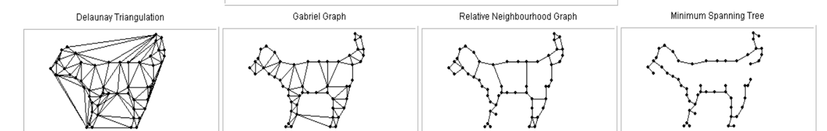
Proximity Graphs
Proximity graphs provide various definitions of “neighbour”:
NNG = Nearest Neighbour Graph
MST = Minimum Spanning Tree
RNG = Relative Neighbourhood Graph
GG = Gabriel Graph
DT = Delaunay Triangulation

Slide 46
Background Editing Techniques
Representative-based Supervised Clustering Editing
Use a representative-based supervised clustering approach to cluster the data. Delete all non representative examples (mentioned on the last slide)
Wilson Editing
Wilson editing relies on the idea that if an example is erroneously classified using the k-NN rule it has to be removed from the training set
Multi-Edit
The algorithm repeatedly applies Wilson editing to m random subsets of the original dataset until no more examples are removed
46

Slide 47
Problems With Wilson Editing
Excessive examples removal—especially in the decision boundary areas
(a) Original dataset
Natural boundary
(b)
Wilson Editing Result
Natural boundary
New boundary
47

Slide 48
Benefits of Dataset Editing
6.4. HC-edit/ Experimental Results
48

Slide 49
Thoughts on Subclass Discovery
Motivation: why is it worthwhile identifying interesting subclasses of disease?
What are the characteristics of an interesting subclass?
  Needs to have a certain amount of instances.
  Not much contamination from instances of other classes; e.g. its purity is high!
  Instances of the subclass needs to be similar / cover a contiguous region in the attribute space.
  The instances of the subclass should be somewhat separated from other examples of the same class / other subclasses.
  ?!?
Ford Trucks

Slide 50
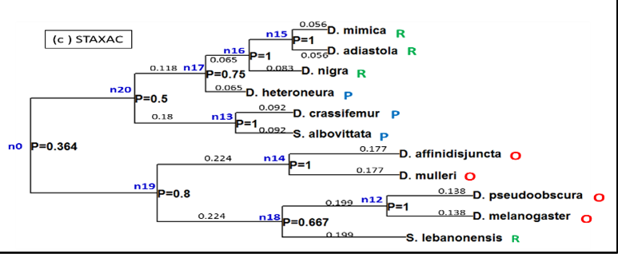
Subclass/Class Modality Discovery Using STs
50

Slide 51
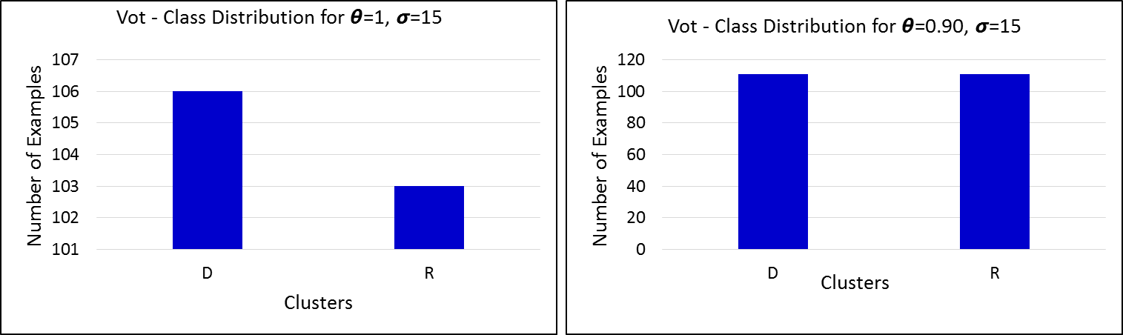
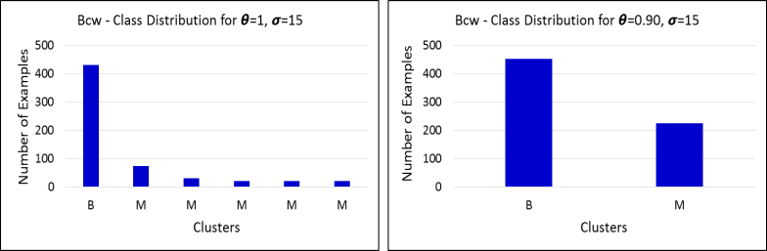
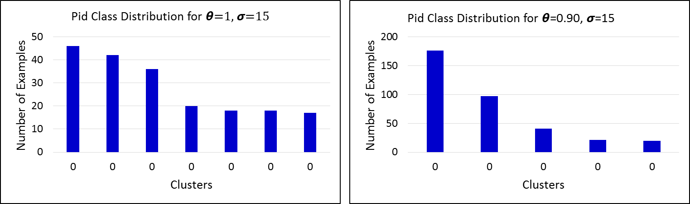
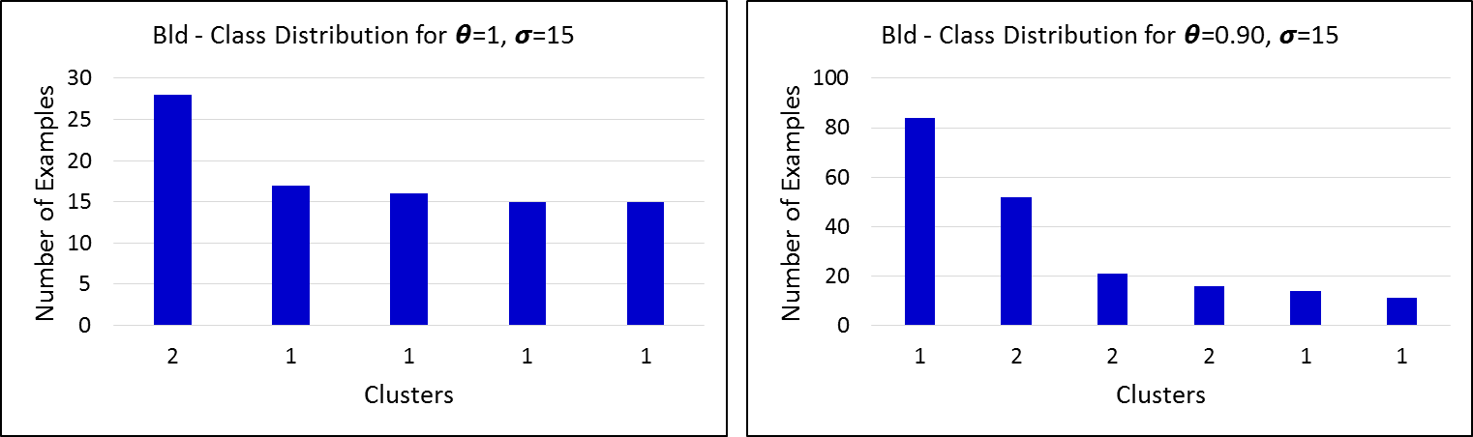
5.4 ST/ Experimental Results
Example Result Subclass Discovery
90.0%
95.7%
87.7%
98.8%
25.6%
46.2%
48.7%
50.4%
In general when purity decreases, the number of examples in the subclasses increases
In the Pid figure, all clusters are dominated by class 0, no regions that are dominated by the instances of the other classes in the dataset.
For the Bcw dataset the cluster M is split up into 5 subclasses when the purity threshold is increased to 100
The Vot dataset contains two unimodal classes

Slide 52
Research Framework Distance Function Learning
Weight-Updating Scheme /
Search Strategy
Distance Function
Evaluation
Random Search
K-Means
Randomized
Hill Climbing
Supervised
Clustering
Other Work
Inside/Outside
Weight Updating
NN-Classifier
…
…

