Slide 1

ISMIS Oct 21-23, 2015, Lyon, France
1
Paul Amalaman, and Christoph F. Eick
Department of Computer Science
University of Houston
HC-edit: A Hierarchical Clustering Approach To Data Editing

Slide 2
Talk Organization
2
Introduction
Data Editing
Supervised Taxonomy & The STAXAC Algorithm
HC-edit
Related Work
Summary and Conclusion

Slide 3
  1. Introduction
5
K-neighborhood, N_{k}(x)
Given an example x, a training dataset O, the k-neighborhood of x, noted N_{k}(x), consisting of its k nearest neighbors of x.
K-NN rule
Given N_{k}(x), the k-NN rule for x states:
Assign to x the class label of the majority class labels in N_{k}(x).
k-NN Classifiers

Slide 4
K-NN Classifiers
3
Advantages
  Easy to implement
  Accuracy typically high
  Complex decision boundaries
Disadvantages
  Need to store the training set—the dataset is the model!
  Slow

Slide 5
2. Data Editing
4
Introduction
Data Editing
  Background: Data Editing Algorithms
    Wilson Editing
    Multi-Edit
    Representative-based Supervised Clustering Editing
Supervised Taxonomy & The STAXAC Algorithm
HC-edit
Related Work
Summary and Conclusion

Slide 6
2. Data Editing
6
Problem Definition:
Given
1. Dataset O
2. Remove “bad” examples from O
Oedited < O\{“bad” examples}
3. Use Oedited as the model for a k-NN classifier
The goal of the presented paper is to improve the accuracy of k-NN classifiers by developing new data editing approaches

Slide 7
Background: Some Data Editing Algorithms
7
Wilson Editing [Wilson 72]
Wilson editing relies on the idea that if an example is erroneously classified using the k-NN rule it has to be removed from the training set
Multi-Edit [Devijver 80]
The algorithm repeatedly applies Wilson editing to m random subsets of the original dataset until no more examples are removed
(Representative-based) Supervised Clustering Editing [Eick 2004]
Use a representative-based supervised clustering approach to cluster the data. Delete all non representative examples

Slide 8
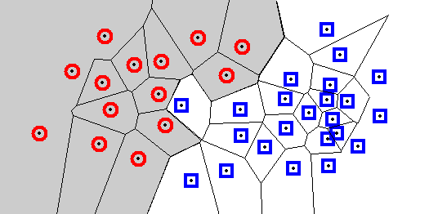
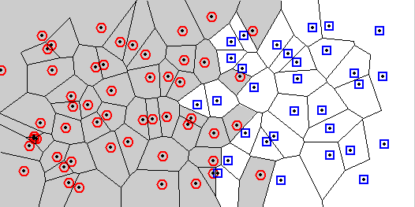
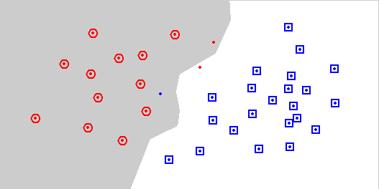
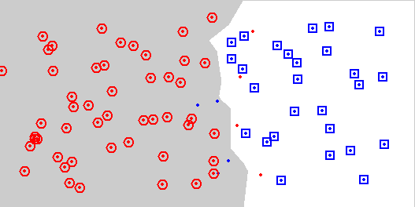
Examples Wilson Editing
8
Developed by Wilson in 1972
Remove points that do not agree with the majority of their k nearest neighbours
Earlier example
Overlapping classes
Original data
Original data
Wilson editing with k=7
Wilson editing with k=7

Slide 9
Background: Data Editing Algorithms
9
Problem With Wilson Editing:
Excessive examples removal—especially in the decision boundary areas
(a) Original dataset
Natural boundary
(b)
Wilson Editing Result
Natural boundary
New boundary

Slide 10
Supervised Clustering
10
Goal: Obtain class uniform clusters that are dominated by instances of a single class
Traditional clustering
Supervised clustering

Slide 11
Representative-based Supervised Clustering Editing
11
Attribute1
2
1
Clustering
maximizes
purity
3
4
Attribute2
Objective: Find a set of objects O_{R} in the dataset O to be clustered, such that the clustering X obtained by using the objects in O_{R} as representatives minimizes q(X); e.g. the following q(X):
q(X):= Σ_{i} purity(C_{i})∗(|C_{i}|**α) with α>1
Notes:
The objective of representative-based supervised clustering is…

Slide 12
Supervised Taxonomy & The STAXAC Algorithm
12
Introduction
Editing Algorithms
Supervised Taxonomy & The STAXAC Algorithm
HC-edit
Related Work
Summary and Conclusion

Slide 13
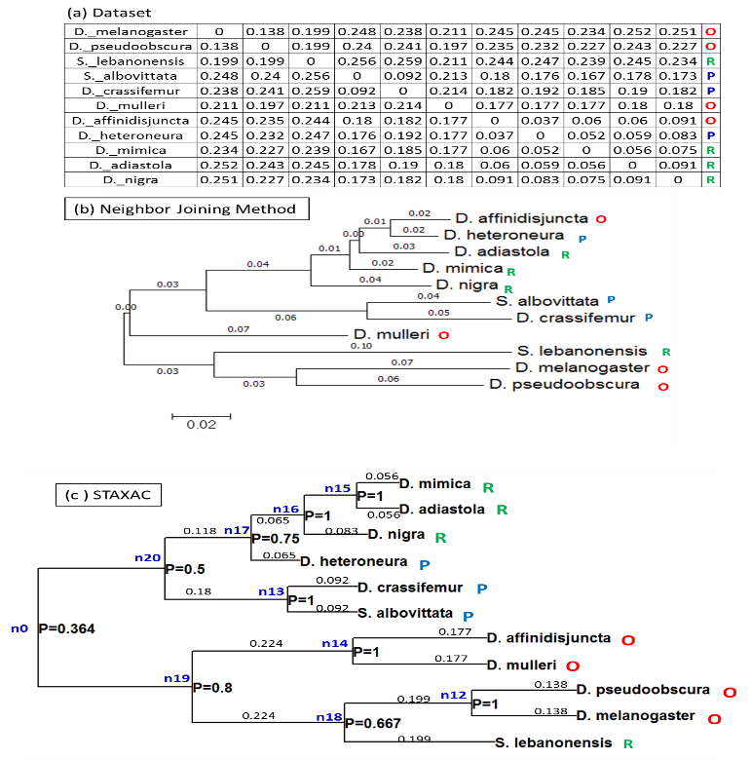
3. Supervised Taxonomy
13
Supervised Taxonomy (ST).
Supervised taxonomies are generated considering background information concerning class labels in addition to distance metrics, and are capable of capturing class-uniform regions in a dataset

Slide 14
Uses of Supervised Taxonomies
Data Set Editing (this talk)
Bioinformatics (e.g. try to identify interesting subclasses of known diseases)
Clustering
Meta Learning—create useful background from datasets by developing algorithms that operate on supervised taxonomies
14

Slide 15
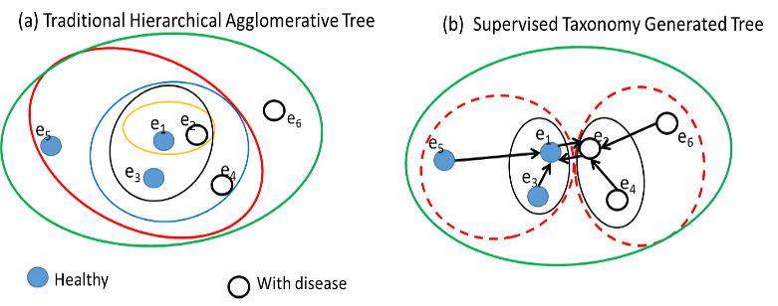
The STAXAC Algorithm
15

Slide 16
The STAXAC Algorithm
16
Algorithm 1: STAXAC (Supervised TAXonomy Agglomerative Clustering)
Input: examples with class labels and their distance matrix D.
Output: Hierarchical clustering
1. Start with a clustering X of one-object clusters.
2. ∀C* ,C’∈X; merge-candidate(C*,C’) ⇔ (1-NN_{X}(C*) = C’ or 1-NN_{X}(C’ )=C* )
3. WHILE there are merge-candidates (C*, C’) left
BEGIN
a. Merge the pair of merge-candidates (C*,C’) obtaining a
new cluster C=C*∪C’ and a new clustering X’ for which Purity(X’) has the largest value
b. Update merge-candidates:
∀C’’ merge-candidate(C’’,C) ⇔ (merge-candidate(C’’,C*) or
merge-candidate(C’’,C’))
c. Extend dendrogram by drawing edges from C’ and C* to C
END
4. Return the constructed dendrogram

Slide 17
Properties of STAXAC
17
In contrast to other supervised clustering algorithms, STAXAC is a hierarchical clustering that maximizes cluster purity.
Individual clusterings can be extracted using different purity thresholds—HC-edit that is introduced later relies on this property.
In contrast to other hierarchical clustering algorithms, STAXAC conducts a wider search, merging clusters that are neighboring and not necessarily the closest two clusters
STAXAC uses a 1-NN graph to determine which clusters are neighboring
Proximity graphs need only be computed at the beginning of the run.
STAXAC could be generalized by using more powerful proximity graphs, such as Gabriel Graphs, to conduct a wider search.

Slide 18
Proximity Graphs
18
Proximity graphs provide various definitions of “neighbour”:
NNG = Nearest Neighbour Graph
MST = Minimum Spanning Tree
RNG = Relative Neighbourhood Graph
GG = Gabriel Graph
DT = Delaunay Triangulation (neighbours of a 1NN-classifier)

Slide 19
HC-edit
19
Introduction
Editing Algorithms
Supervised Taxonomy & The STAXAC Algorithm
HC-edit
Related Work
Summary and Conclusion

Slide 20
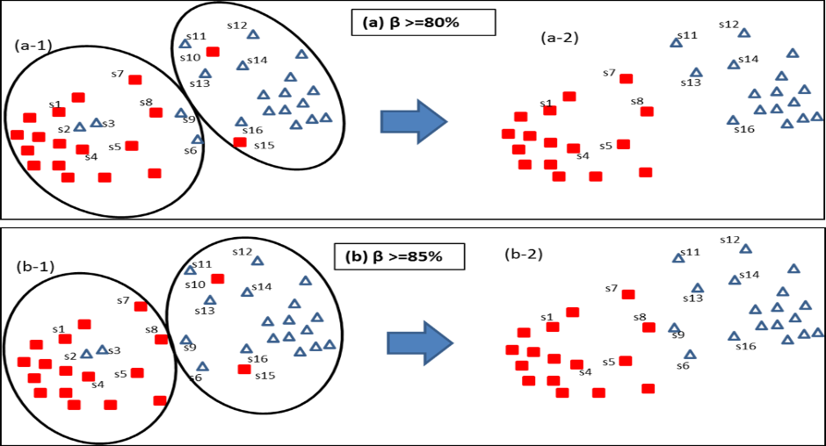
4. The HC-edit Approach
20
HC-Edit Approach:
Create a supervised taxonomy ST for dataset O using STAXAC
Extract a clustering from ST for a given purity threshold β
Remove minority examples from each cluster
Classification: Use k-NN weighted vote rule to classify an example

Slide 21
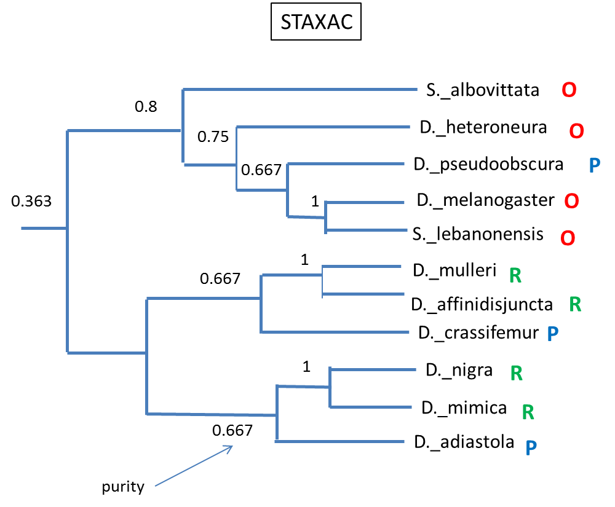
HC-Edit Code
21
Inputs:
T: tree generated by hierarchical clustering algorithm such as STAXAC (with
purity information and examples associated with for each node cluster) for a dataset O
β: cluster purity threshold
Output: Oedited, a dataset that is a subset of the original dataset O
Function EDIT_TREE (T)
O_{edited}:= ∅;
EXTRACT_EXAMPLES(T);
RETURN O_{edited};
END
Function EXTRACT_EXAMPLES (T)
BEGIN
IF T=NULL EXIT
IF purity(T) >= β
Add majority examples of T to Oedited
ELSE
EXTRACT_EXAMPLES (T.right)
EXTRACT_EXAMPLES (T.left)
END

Slide 22
Top Clusters of size ≥20 Extracted from T
22

Slide 23
Clusters of size ≥20 continued
23

Slide 24
How to choose β?
24
If β is set to 1, no editing occurs.
As β decreases more objects will be removed in the editing process, and the obtained clusters contain more instances
We also observed that using very low values for β leads to low accuracy, as clusters get too contaminated by examples belonging to other classes.
Moreover, only a finite subset of β values needs to be considered: a subset of the node purities that occur in the supervised taxonomy. Basically, only a finite number of clusterings can be extracted from the supervised taxonomy and for many purity values the extracted supervised clusterings are the same .
Therefore, one could set a lower bound γ for β and use n-fold cross-validation for purities that occur in the tree in [γ,1), and choose the purity value that leads to the highest accurarcy for the editing of the dataset.
r

Slide 25
Experimental Results
25

Slide 26
5. Related Work
26
Devijver, P. and Kittler, J.: “On the Edited Nearest Neighbor Rule”. IEEE 1980 Pattern Recognition.Vol.1, 72-80→Multi-Edit
Eick, C.F., Zeidat, N., and Vilalta, R.: “Using Representative-Based or Nearest Neighbor Dataset Editing”. ICDM 2004: 375-378 →RBSCE
Wilson, D.L.,: “Asymptotic Properties of Nearest Neighbor Rules Using Edited Data”, IEEE Transactions on Systems, Man, and Cybernetics, 2:408-420, 1972→Wilson Editing
Saitou, N., Nei., M.: The neighbor-joining method: a new method for reconstructing phylogenetic trees. Mol. Biol. Evol. 4(4) (1987)→UPGMA
Vázquez, F., Sánchez, J., Pla, F.: A stochastic approach to Wilson’s editing algorithm; in LNCS, vol. 3523, pp. 35–42. Springer, Heidelberg (2005) → Wilson Probing

Slide 27
Summary and Conclusion
27
Introduction
Editing Algorithms
Supervised Taxonomy & The STAXAC Algorithm
HC-edit
Related Work
Summary and Conclusion

Slide 28
6. Summary and Conclusion
28
We proposed HC-edit that identifies regions in the dataset of high purity using supervised clustering and removes minority examples from the identified regions. HC-edit takes as input a hierarchical clustering augmented with purity information in the nodes.
In general, the supervised taxonomy can be viewed as a “useful” intermediate result which allows to inspect multiple supervised clusterings before selecting the “best” one.
Traditional k-nearest neighbor methods used the parameter k for both editing and classification. By allowing two parameters for modeling—purity for editing, and k for the classification—, HC-edit provides greater landscape for a model selection.
The experiments reveal that the HC-edit has improved accuracy for many datasets—usually removing less of training examples than other methods.

Slide 29

Future Work
Explore more sophisticated techniques to select purity thresholds for extracting “good” supervised clusterings for editing and meta learning.
Generalize STAXAC to use more complicated proximity graphs, such as Gabriel graphs.
Explore the usefulness of supervised taxonomies for other applications
29

Slide 30
Multi-Edit
Multi-edit: Repeatedly applies Wilson
A: DIFFUSION: Divide the dataset O into N>=3 random
subsets S1 ,…SN
B: CLASSIFICATION: Classify Si using the K-NN rule
with S(i+1) Mod N as the training set (i=1,…,N)
C: EDITING: Discard all incorrectly classified examples
D: CONFUSION: Replace O by subset Or consisting of the union of all remaining examples in S1,…SN
E: TERMINATION: if the last iteration produced no editing then terminate; otherwise go to step A.

Slide 31
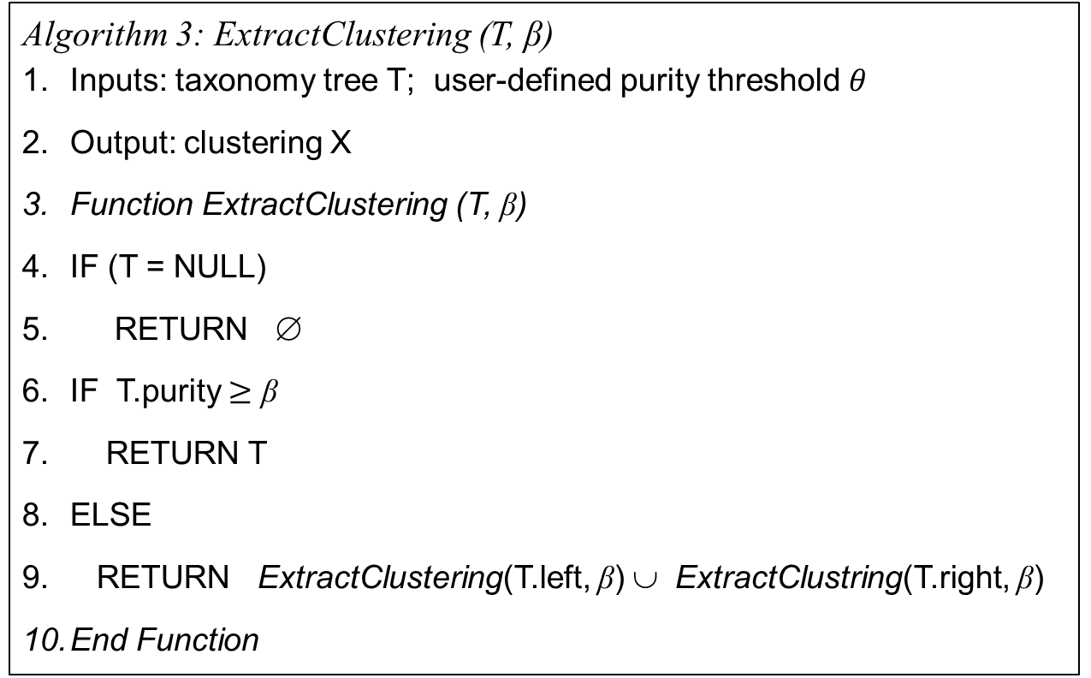
Extracting a clustering from a STAXAC generated Tree
Algorithm 3: ExtractClustering (T, β)
Inputs: taxonomy tree T; user-defined purity threshold 𝜃
Output: clustering X
Function ExtractClustering (T, β)
IF (T = NULL)
RETURN ∅
IF T.purity $≥$ β
RETURN T
ELSE
RETURN ExtractClustering(T.left, β) ∪ ExtractClustring(T.right, β)
End Function

