Slide 1



PAID: Power-efficient
AI-optimized Databases
Ayoub Bouhatous
Cadi Ayyad University, Marrakech, Morocco
Ladjel Bellatreche
LIAS/ISAE-ENSMA, Poitiers, France
El Hassan Abdelwahed
Cadi Ayyad University, Marrakech, Morocco
Carlos Ordonez
University of Houston, Houston, USA
Prepared By: Dipta Chandra Paul, University of Houston
<number>
Notes:
<number>

Slide 2
Motivation
As people run more and more queries daily, DBMS power demands are rising.
Energy consumption in data centers is rising rapidly.
Query execution consumes significant CPU power.
The ICT sector contributes between 1.8%–2.8% of global CO₂ emissions.
There's a growing need for energy-aware and eco-friendly(green) query optimization strategies.
<number>
Notes:
<number>

Slide 3
Our contributions
First to integrate new AI and old AI: NN and GA in query optimization for energy.
New I/O + energy cost model
Opens a new direction in green DBMS development.
<number>
Notes:
<number>

Slide 4
The Problem
Most database optimizers only target response time.
They use static CPU configurations without adapting to query characteristics.
No consideration of the power-performance trade-off.
High energy waste occurs in large-scale workloads.
<number>
Notes:
<number>

Slide 5
Previous Approaches to Energy Efficiency
Dynamic Voltage and Frequency Scaling (DVFS).
Use of hardware accelerators (GPU, FPGA).
ML models: linear regression, random forests.
Limitations: inaccurate modeling, no dynamic hardware adjustment (number of cores and CPU frequency)
<number>
Notes:
<number>

Slide 6
Gaps in Existing Work
Machine learning models only predict energy, without acting on results.
No dynamic tuning of CPU settings per query.
Lack of integration with database query optimizers.
<number>
Notes:
<number>

Slide 7
Solution Overview
Propose PAID: a subsystem that integrates machine learning into query optimization.
Combines old AI (Genetic Algorithms) with new AI (Neural Networks).
Neural Network (NN) to predict power and time.
Genetic Algorithm (GA) to optimize CPU configuration.
Dynamically selects cores (1,2,4,8) and CPU frequency (0.4GHz – 3.4GHz)
A trade-off between energy and speed.
<number>
Notes:
<number>

Slide 8
Architecture of PAID
Input: SQL query + initial CPU configuration.
NN model estimates power and execution time.
GA searches for optimal settings to minimize energy and delay.
Feedback loop for iterative refinement
<number>
Notes:
<number>

Slide 9
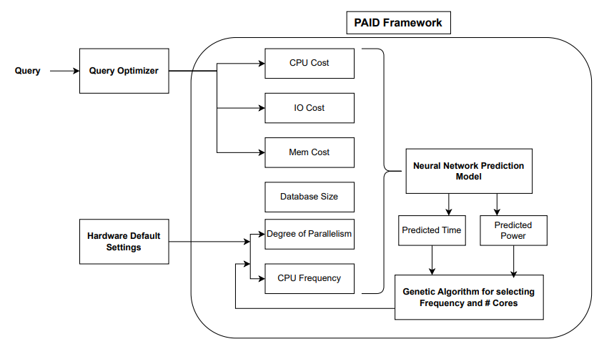
Diagram of PAID
Fig: The PAID Subsystem
<number>
Notes:
<number>

Slide 10

Query and System Features
Query Vector:
CPU Configuration Vector:
Where,
    COST_CPU: estimated CPU instructions.
    COST_IO: disk read/write operations.
    COST_MEM: memory access cost.
    DBSize: size of the database.
    Frequency: CPU clock rate.
    NumCores: number of CPU cores allocated.
<number>
Notes:
<number>

Slide 11



Neural Network Design
Input Layer: 6 neurons (query + system features)
3 Hidden layers, ReLU activation.
Output Layer: 2 neurons (power, time), linear activation.
Optimizer: Adam.
Loss Function: Mean Absolute Error (MAE).
Power prediction: | Time prediction:
<number>
Notes:
<number>

Slide 12
Why Neural Networks?
Capable of capturing nonlinear relationships.
More accurate than regression or decision trees.
Generalizes better on complex workloads.
<number>
Notes:
<number>

Slide 13
Genetic Algorithm: Overview & Process
Bio-inspired search algorithm.
Fitness = Energy X Time (lower is better).
Evolution via crossover and mutation.
Execution Steps:
Initialize population with random CPU settings.
Evaluate fitness of each using NN predictions.
Select top-performing configurations.
Apply crossover and mutation.
Iterate until an optimal configuration is found.
<number>
Notes:
<number>

Slide 14

Optimization Objective
Minimize product of power and execution time.
Optimization Goal:
Constraints:
  Frequency ∈ [0.8 GHz – 3.4 GHz].
  Cores ∈ [1 – 4].
<number>
Notes:
<number>

Slide 15
Experiment Setup
DBMS: PostgreSQL 14.1.
Server: Dell Precision Tower 3620.
Hardware: Intel Core i7 (4 cores, 8 threads), 16 GB DDR4 RAM and a 256 GB SSD.
Benchmarks: TPC-H with 10GB, 30GB, 50GB data.
Energy measurements using Yocto-Watt sensor.
<number>
Notes:
<number>

Slide 16
Performance Comparison (NN vs RFR)
NN significantly improves time prediction accuracy.
Metric | Model | MAE | R²
Power | RFR | 2.3 | 63.8%
 | NN | 2.5 | 64.2%
Time | RFR | 54.7 | 47.5%
 | NN | 13.8 | 83.6%
Table: Evaluation results of RFR and NN in predicting power consumption and time of queries.
<number>
Notes:
<number>

Slide 17
Impact of CPU Configuration (case studies)
Q1: Simple SELECT query.
Q11: Joins and aggregates.
Q22: Highly nested and complex query.
Observations:
  More cores reduce time.
  Frequency effect is non-linear.
<number>
Notes:
<number>

Slide 18
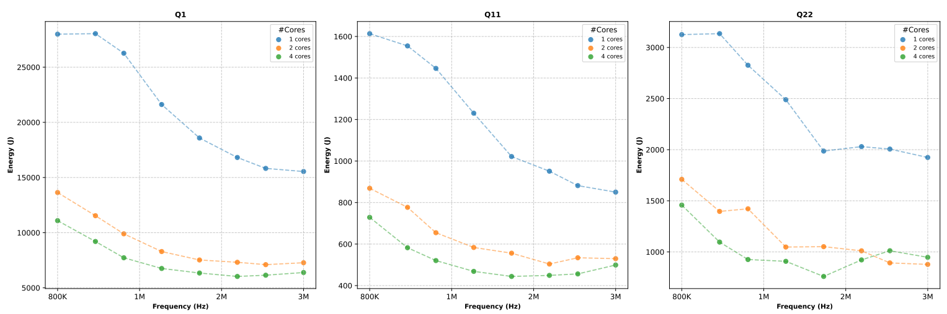
Visualization of Query Results
Fig: Impact of variation of CPU configuration on queries Q1, Q11, and Q22.
<number>
Notes:
<number>

Slide 19
Key Takeaways
Up to 30% reduction in energy consumption.
NN offers strong prediction accuracy.
GA selects efficient hardware settings dynamically.
NN + GA combo outperforms static settings.
<number>
Notes:
<number>

Slide 20
Limitations
Requires accurate training data.
NN training consumes energy, but periodically
GA introduces extra computation.
Optimization may be slower for very complex queries.
<number>
Notes:
<number>

Slide 21
Conclusions
PAID improves query efficiency through smart tuning.
It highlights the critical trade-off between execution time and energy use in query processing.
The framework demonstrates how machine learning can guide hardware-aware query optimization.
<number>
Notes:
<number>

Slide 22
Future work
Extend model to support GPU tuning.
Handle distributed database environments.
Add more layers to the neural network for improved prediction.
Measure the power consumed by the neural network itself.
<number>
Notes:
<number>

