Slide 1





The Consortium for Translational & Precision Health (CTPH)
Data Subcard: Evaluating Privacy, Fairness, Quality, and Protection in Tabular Data, as Part of System Card Framework
Tadesse K Bahiru
Computational Biomedicine Lab
University of Houston
Carlos Ordonez, Ph.D.
Data-Intensive Parallel Algorithms for AI
University of Houston
Ioannis A. Kakadiaris, Ph.D.
Computational Biomedicine Lab
University of Houston
Notes:
Welcome to the presentation

Slide 2
Acknowledgment
This paper was partly supported by NIH award UM1TR004539 and the Hugh Roy and Lillie Cranz Cullen Endowment Fund (University of Houston)
The views expressed are those of the authors and do not represent the official policies of the sponsors

Slide 3

Introduction
AI is revolutionizing healthcare: aiding in diagnosis, predicting patient outcomes, and optimizing hospital operations
However, it relies on high-quality, fair, and privacy-compliant datasets
Current datasets suffer from
Missing values, duplicates, inconsistencies
Biases across demographic groups
Privacy risks due to quasi-identifiers
Weak documentation and compliance practices
Image source: Generated with Google Gemini Pro (2025)

Slide 4
Related Work
Accountability Frameworks and Documentation
System Cards (Gursoy & Kakadiaris, arXiv’22): accountability framework for AI decision systems
Datasheets for Datasets (Gebru et al., CACM’21): structured data documentation
Data Readiness and Quality Auditing
Data Readiness Report (Sambasivan et al., FAccT’21): data quality
AIDRIN (Hiniduma et al., SSDBM’24): integrates quality and privacy evaluation
Data Quality Toolkit (Gupta et al., arXiv’21): label purity, outliers, feature relevance
Fairness Auditing
AI Fairness 360 (Bellamy et al., 2019, IBM Journal of Research & Development)
Fairlearn (Bird et al., AIES’20): fairness metrics & mitigation tools

Slide 5

Research Gaps
Fragmented Evaluation Approaches
Existing tools address single aspects and lack unified multi-dimensional evaluation
Limited Compliance (Security and Privacy) Integration
Few methods incorporate regulatory requirements
Low Interpretability and Usability
Outputs are raw metrics without practitioner-friendly insights
External Data Privacy Risks
Many tools require moving data off the owner’s machine
Image source: Generated with Google Gemini Pro (2025)

Slide 6
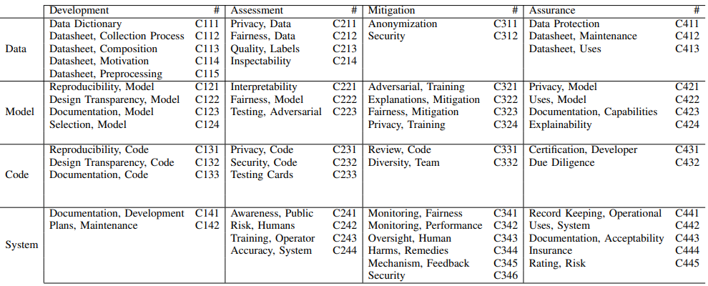
Method
Data subcard is a part of the System Cards framework to evaluate tabular medical datasets
It focuses on four criteria from the framework:
Privacy, Data (C211)
Fairness, Data (C212)
Quality, Data (C213*)
Protection, Data (C411)
System Accountability Benchmark^{[1]}
1. F. Gursoy and I. A Kakadiaris. System cards for AI-based decision-making for public policy. arXiv preprint arXiv:2203.04754, 2022.

Slide 7
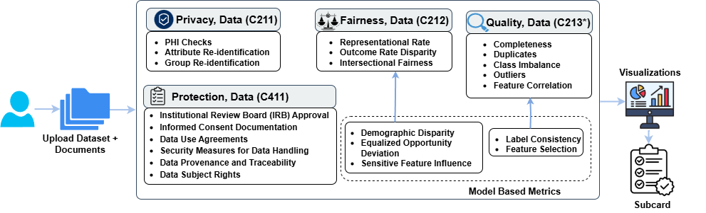
Method (2)
It is a unified method that evaluates four aspects directly on the user machine
Two stages evaluation
Data-level evaluation
Model-based diagnostics
Output: Structured Data Subcard → JSON + visual dashboard

Slide 8





Method (3)
LLM with RAG
Visualization
Subcard Local GUI
Dataset 1
Dataset 2
Dataset Schemas
Documents
Subcard
High level overview of method workflow

Slide 9
Method: Privacy, Data (C211)
Privacy risk is assessed along three complementary dimensions
Protected Health Information (PHI) Detection
Microsoft Presidio used to flag identifiers under HIPAA’s Safe Harbor rule
Attribute-Level Re-Identification
Each quasi-identifier (e.g., age, race, gender) examined for unique or rare values
Rare values increase the chance of isolating an individual
Group-Level Re-Identification
Re-identification probability estimated by combining quasi-identifiers into equivalence classes
A Monte Carlo procedure simulates different attacker knowledge levels, providing mean, max, and variance of re-ID risk

Slide 10
Method: Fairness, Data (C212)
We employed established dataset fairness evaluation methods to assess Fairness, Data (C212)
Data-level Fairness Metrics
Representational rate: measures the share of each demographic group in the dataset
Outcome rate^{[1]}: checks how outcomes are distributed within each group (e.g., disease vs. no disease across genders)
Intersectional outcome rate^{[2]} evaluates fairness at intersections of attributes (e.g., young women, older men)
M. Feldman, S. A. Friedler, J. Moeller, C. Scheidegger, and S. Venkatasubramanian, “Certifying and removing disparate impact,” in Proc. 21st ACM SIGKDD Int. Conf. Knowledge Discovery and Data Mining (KDD), Sydney, Australia, Aug. 2015, pp. 259–268.
M. Kearns, S. Neel, A. Roth, and Z. S. Wu, “Preventing fairness gerrymandering: Auditing and learning for subgroup fairness,” in Proc. 35th Int. Conf. Machine Learning (ICML), Stockholm, Sweden, Jul. 2018, pp. 2564–2572.

Slide 11
Method: Fairness, Data (C212) (2)
Model-based Fairness Metrics
Demographic Disparity (DD)^{[1]}: maximum difference in predicted outcomes between groups
Equalized Opportunity Deviation (EOD)^{[2]}: difference in true positive rates between groups
SHAP-based sensitive influence (SI)^{[3]}: quantifies the degree to which sensitive attributes drive predictions
C. Dwork, M. Hardt, T. Pitassi, O. Reingold, and R. Zemel, “Fairness through awareness,” Proc. 3rd Innovations in Theoretical Computer Science Conf. (ITCS), Cambridge, MA, USA, Jan. 2012, pp. 214–226
M. Hardt, E. Price, and N. Srebro, “Equality of opportunity in supervised learning,” Advances in Neural Information Processing Systems (NeurIPS), Barcelona, Spain, Dec. 2016, pp. 3315–3323
S. M. Lundberg and S.-I. Lee, “A unified approach to interpreting model predictions,” Advances in Neural Information Processing Systems (NeurIPS), Long Beach, CA, USA, Dec. 2017, pp. 4765–4774

Slide 12
Method: Quality, Data (C213*)
We applied existing statistical methods to evaluate dataset quality
The Subcard broadens this by assessing the quality of the entire dataset
Metrics include
Completeness: missing values across features
Data-type validation: consistency with clinical formats
Duplicate detection: identifying repeated records
Correlation checks: multicollinearity among features
Outlier detection: univariate and multivariate
Class imbalance: distribution of outcome variables
* indicates our modification of the system card quality criteria to full dataset evaluation

Slide 13
Method: Protection, Data (C411)
Approach
Use a local LLM for privacy
Add a lightweight RAG pipeline that retrieves relevant clauses from compliance and privacy documents before inference
Inputs to Retrieval
GDPR Articles and Recitals that apply to datasets
HIPAA Privacy Rule and Security Rule guidance PDFs
Dataset package documents: IRB approval letter, informed consent form, data use agreement, security policy, data provenance log, data subject rights policy

Slide 14
Method: Protection, Data (C411) (2)
Evaluation Criteria
Institutional Review Board (IRB) Approval
Informed Consent Documentation
Data Use Agreements
Security Measures for Data Handling
Data Provenance and Traceability
Data Subject Rights
Score: 1 if met, 0 if not met
Also return: brief justification and the citation of retrieved snippet(s)

Slide 15
Method: Protection, Data (C411) (3)
Sample Data Protection Evaluation
Criterion 1. IRB Approval
Input: Check if dataset has IRB approval (protocol ID + date)
Output: Score = 1
Approval letter found (UH-2025-014, Jan 10, 2025)
Improvement: track renewal dates
Criterion 2. Informed Consent
Input: Check if dataset includes informed consent forms
Output: Score = 1
Consent forms specify voluntary use, withdrawal rights, anonymization
Improvement: add machine-readable consent summary

Slide 16
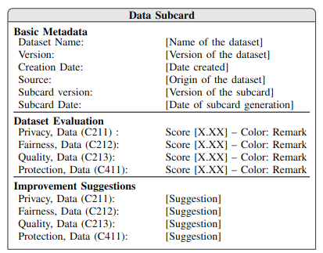
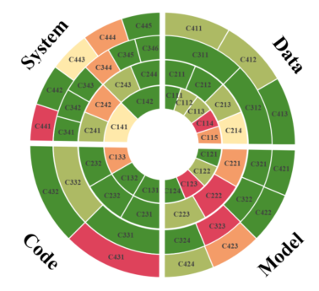
Method: Data Subcard
The primary outcome is of the method is a card
It consolidated report that translates complex diagnostics into an actionable summary
Scoring thresholds (Likert style):
≥ 0.80 → Green (Strong)
0.60–0.79 → Yellow (Adequate)
< 0.60 → Red (Deficient)
Data subcard Template
System card framework sample visualization ^{[1]}
1. F. Gursoy and I. A Kakadiaris. System cards for AI-based decision-making for public policy. arXiv preprint arXiv:2203.04754, 2022.

Slide 17
Experimental Setup Datasets
Developed in Python with popular libraries
Pandas for data handling
NumPy for numerical operations
scikit-learn for model training and evaluation
Matplotlib and Seaborn for visualization
Public Datasets
UCI Diabetes Readmission (~100K records)
UCI Heart Disease (303 records)

Slide 18
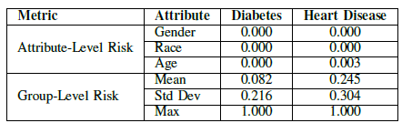
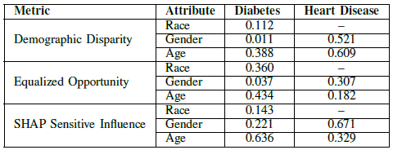
Results
Privacy, Data (C211)
No direct identifiers detected in either dataset
Attribute-level risk negligible (age unique in 0.003% of Heart records)
Fairness, Data (C212)
Diabetes dataset: age drives outcome disparities, minimal gender/race gaps
Heart dataset: strong disparities across gender and age

Slide 19
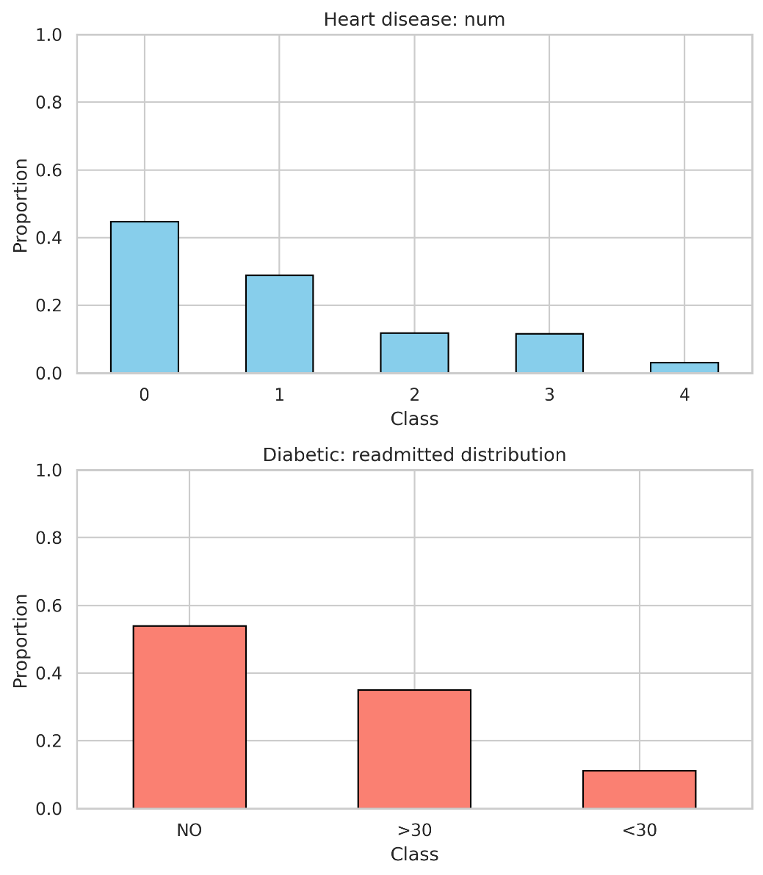
Results (2)
Quality, Data (C213*)
Diabetes dataset
Heavily imbalanced (readmission “No” > 50%)
Outliers concentrated in encounter frequency variables (especially outpatient visits)
Fewer anomalies in labs/medications
Heart Disease dataset
Nearly complete, but missing values in vessel count and thalassemia
Outliers in cholesterol and blood pressure
Moderate class imbalance (disease vs. no disease)

Slide 20
Strengths of our approach
Privacy (C211): No direct identifiers, but group-level risks emerged from attribute combinations
Fairness (C212): Strong age and gender effects in Heart; Diabetes showed skewness despite minimal gender/race bias
Quality (C213): Missing values, outliers, and imbalance highlighted Subcard’s ability to capture multi-dimensional issues
Overall: Subcard framework delivers structured, interpretable insights beyond isolated metrics

Slide 21
Limitations
Heart and Diabetes are useful testbeds, but relatively clean and only moderately challenging
Real clinical datasets are messy, with missing records, inconsistent formats, and hidden biases
The data subcard generalizes beyond benchmarks to handle complex medical data
In real-world settings, fairness and protection remain the most challenging criteria

Slide 22
Conclusions
Data Subcard extends the System Cards framework to audit tabular medical datasets
Runs locally, preserving confidentiality while ensuring robust assessment
Combines data-level and model-based diagnostics for interpretable results
Provides scores, subcards, and recommendations to identify risks before training
Paves the way for dataset certification, supporting responsible and accountable AI

Slide 23
Future Work
Protection, Data (C411)
Add compliance checks and verify documents such as IRB and consent forms
Refining Scoring Methods
Calibrate thresholds for more accurate scoring
Incorporate uncertainty quantification to reflect confidence levels
Expanding Dataset Coverage
Extend evaluation to longitudinal datasets
Include heterogeneous and multi-source clinical data for external validity
Evaluation and Certification
Release the Subcard as downloadable object code
Owners evaluate their datasets locally to preserve privacy
Results are uploaded back to the System Cards framework for certification

