Slide 1
Sparse Matrix Algorithms for Evolving Neural Networks
Carlos Ordonez University of Houston USA
Notes:
<number>

Slide 2
Motivation: Evolution
Data set constantly changing:
  A few new points
  few dimensions change
=> Model: Neural network changes
Challenges
  Data set is large: large n, high d
  Data changes can be sporadic or frequent
  Neural network is a large model (LLM is huge)
  Avoid total recomputation: expensive, slow
Notes:
<number>

Slide 3
Motivation: Hardware today
Blazing processing at GHz speed today
  Multicore CPUs: <10, 3 4 5 GHz
  GPUs: 1000s: 1-2 GHz
RAM: 100s of GBs
Much faster secondary storage
  NVM approaching RAM speed
  SSD, HDD left behind
  Larger I/O blocks
Notes:
<number>

Slide 4
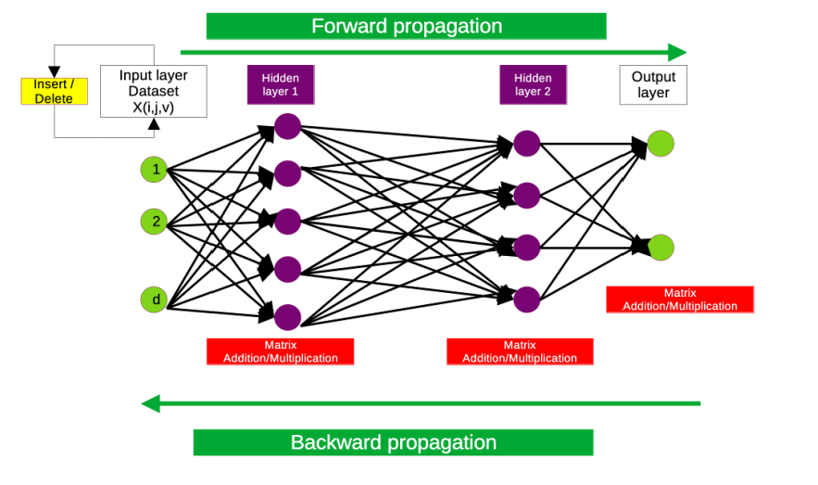
Deep Neural Network Computation
Notes:
<number>

Slide 5
Data set
Dense matrix:
  classical algorithms in main memory
  Old machine learning
  streams
  small graphs
Sparse matrix:
  Text
  Graphs
  naturally captures change
Notes:
<number>

Slide 6
Computing NNs
Dense matrix
  Parallelism: natural and required
  Ideal for multicore CPUs & GPUs: vectorized ISA
  Tuned CPU/GPU code for matrix + and *; C compiler optimizations
Sparse matrix
  Parallelism difficult: storage, skew, I/O pattern
  BLAS, LAPACK, MKL, CUDA still evolving
  No universal solution for sparse matrix *
Notes:
<number>

Slide 7
Needed: New Algorithms
Faster hardware, but NN is bigger problem
SQL query processing efficient and scalable BUT
  Disk I/O cost model obsolete
  Query plan more complicated than necessary
  linear algebra<>relational algebra
HPC: C compiler optimization, RAM-oriented, low level threads
AI practice: done in Python: Primitive data access mechanisms, but flexible and easy to learn
Notes:
<number>

Slide 8
Potential solution based on DB
State of the art:
  Theory: fast search+sort, many data structures
  HPC: compiler optimization to CPU code, RAM-oriented, threads, GPU Cuda
  DB: I/O optimiz., cost models, abstraction, external memory algorithms, BUT SQL rigid, slow for math
Practical constraint: Algorithms should work in Python and plain files
SOLUTION: Combine them! Coordinate tuples processed with I/O parallel efficient algorithms (but without SQL queries)
<number>
Notes:
<number>

Slide 9
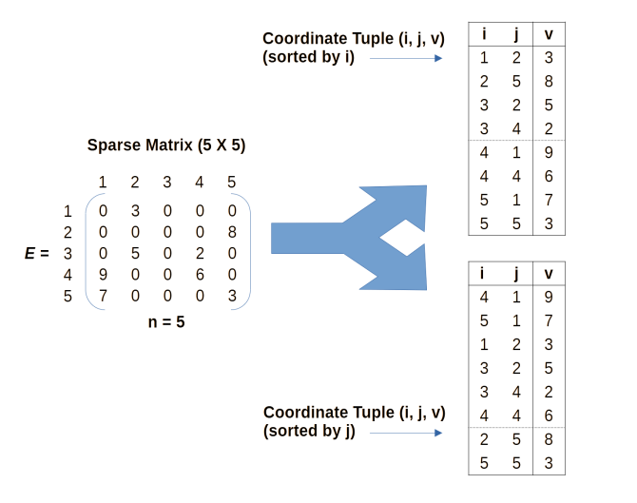
Sparse matrix storage format
Main memory:
  CSR
  CSC
  COO: similar to coordinate tuples
Secondary storage
  dense blocks
  No solution for sparse
Notes:
<number>

Slide 10
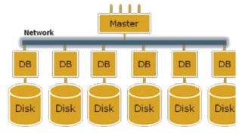
Parallel Theory Models for Large n
Before: distributed memory
Today: cloud!
Theory today
  PRAM
  BSP
  PP
  logP
Shared Memory
(SMP)
Shared Disk
Shared Nothing
(network)
Notes:
<number>

Slide 11
Future Research: Main problems
Insertion/deletion of matrix entry batches
Sparse Matrix linear algebra operators
Integrating algorithms into deep NN architecture
Notes:
<number>

Slide 12
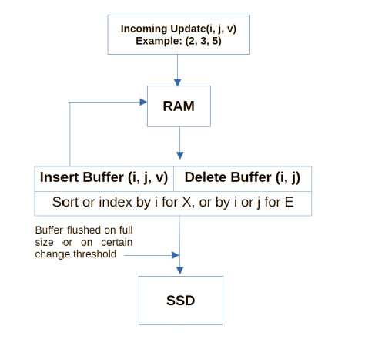
Problem I: Insertion/deletion
Includes point insert, delete; updating a few values
Not on a fixed time window
A table of coordinate tuples; not COO: 3 arrays
Periodic inserts+deletes, more inserts
Batch algorithm for buffer
LSM: propagate changes
Notes:
<number>

Slide 13
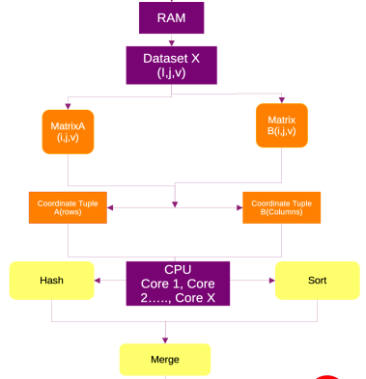
Problem II: matrix operators
Addition: easier; Multiplication: harder, well studied with CPU/RAM
Addition
  both small/large matrix; both on RAM, both on sec. Storage
  Simple sort + merge
Multiplication
  Combinations of small/large matrix; both on RAM, both on sec. Storage
  Sort (sec. storage) + merge (by blocks in main memory), write output to sec. storage
Notes:
<number>

Slide 14
Problem III: integration
Forward propagation
  Only matrix multiplication and matrix addition
  Maintain NN intermediate layers in RAM
  Track delta changes
Backward propagation
  Gradients for output layer and intermediate layers
  Parallelism: large blocks to reduce gradients
  Consider SGD improvements
Notes:
<number>

Slide 15
Recap: plugging in 3 problem solutions
Notes:
<number>

Slide 16
Development: theory in practice
SQL? only for input layer for DB sources, but not good for text (CSV) files
C++? only for specific functions, figuring out how to call existing libs. RAM ops
Python: required!
  Pandas: YES
  Numpy: YES
  Pytorch: dense very good; sparse tensor OK
  TensorFlow, forget?
Notes:
<number>

Slide 17
Conclusions
DB solution: theory and HPC need to be adapted
  solid DB systems working today (SQL, noSQL, new SQL); COO tuples open new algorithmic possibilities; in constrast with CSR and CSC in main memory
  principled DB solutions will be more valuable as n grows, storage gets faster and data set evolves
NNs
  will keep growing and they need to be refreshed
  today: mostly dense matrix calls
  neurons state/layers can be queried: learn, explain, debug
Notes:
<number>

Slide 18
THEORY: extra slides
For a 45-min talk
Read paper
Notes:
<number>

Slide 19
Problem I: Insertion/deletion: Time Complexity and Parallel Speedup
Time complexity: O(delta)
Parallel: p processors (distributed)
Two DB solutions:
  Batch algorithm for buffer
  LSM: propagate changes
Notes:
<number>

Slide 20
Problem II: Matrix operators:
Time Complexity and Parallel Speedup
Time complexity: O(n log n), O(n)
Parallel speedup: p
Notes:
<number>

Slide 21
Problem III: integration with best NNs (lots of ongoing research)
Dynamic Data set
Evolving Target NNs
  Plain Deep Net for classification; closest to old ML
  Transformer, only LLM?
  GCNs, including GNNs
Notes:
<number>

Slide 22
Problem III: Integration: Global time complexity & parallel speedup
Difficult: Number of iterations orthogonal to complexity; convergence and numeric stability aspects
Serial: dense, sparse
Parallel speedup: dense, sparse
CPU and GPU require separate study
Practice: hybrid, dynamic, mixed I/O cost required
Notes:
<number>

