Slide 1
Inspecting Neural Networks
with Queries
Dipta Chandra Paul · Hashirul Quadir · Nicholas Anderson · Carlos Ordonez
Department of Computer Science, University of Houston, USA
1/20
Notes:
(~20s) Good morning/afternoon. I'm Dipta Chandra Paul from the University of Houston. This is joint work with Hashirul Quadir, Nicholas Anderson, and my advisor Carlos Ordonez. Our paper, 'Inspecting Neural Networks with Queries,' is about one idea: monitoring a neural network while it trains using ordinary SQL, instead of custom Python instrumentation.

Slide 2
Motivation & The Problem
Deep neural networks are powerful but opaque "black boxes" — and in practice, diagnosing a training run is usually limited to watching a single loss curve.
The usual way to look deeper — dumping full weights and raw tensors to disk — creates an unsustainable I/O bottleneck; storing the full state can take longer than the PyTorch computation itself.
Weights are the largest and most redundant part of that state — they barely change between iterations and are hard to interpret alone — yet every new question still means new low-level Python instrumentation.
The result is a dilemma: monitoring is either too shallow (loss only) or too costly (full-state dumps).
2/20
Notes:
(~55s) Deep networks are powerful but opaque. In practice, when we train one, the only thing most people watch is a single loss curve. If you want to look deeper, the standard move is to dump the full weights and raw tensors to disk, and that creates an unsustainable I/O bottleneck. Storing the entire network state can take longer than the PyTorch computations themselves, and analyzing it means writing custom, low-level Python scripts that you rewrite for every new question. That's the gap we close.

Slide 3




Our Contributions
Monitor through SQL, not Python
Treat a training neural network as a data source and query its state with standard SQL over a relational database.
Three compact primitives
Store only binary neuron activations, floating-point biases, and predictions — weight matrices are deliberately left out.
Three inspection queries
Efficient SQL surfaces oscillating neurons, bias distribution, and the neurons driving misclassifications.
Lightweight by design
A buffered, periodic transfer pipeline keeps the monitoring overhead to a modest 16–22% of PyTorch time.
3/20
Notes:
(~55s) Our contributions. First, the conceptual shift: treat a training network as a data source and query its state with standard SQL. Second, store only three compact primitives, binary activations, floating-point biases, and predictions, leaving the weights out. Third, three efficient SQL queries that find oscillating neurons, the bias distribution, and the neurons behind misclassifications. Fourth, a buffered pipeline that keeps overhead to a modest 16 to 22 percent.

Slide 4
Why SQL, Not Plain Python?
SQL is declarative: a new diagnostic question becomes a new query, not new Python instrumentation code.
Monitoring stays separate from PyTorch — it runs in its own space, with plenty of CPU and memory, so there is no reason to couple it to the training process.
Standard SQL queries are portable across any engine that speaks SQL.
The cost: network state must be reshaped into relational tables — our schema is designed to make that reshaping cheap.
4/20
Notes:
(~55s) This slide is our approach, and why we chose it. I want to defend it directly, because someone will ask why not just do this with plain Python calls. The answer: SQL is declarative, so a new diagnostic question becomes a new query, not new instrumentation code. And we deliberately keep monitoring separate from PyTorch; it runs in its own space, with plenty of CPU and memory, so there's no reason to couple it to training. The queries are also portable across any SQL engine. The one cost is reshaping the state into tables, and our schema is built to make that cheap.

Slide 5
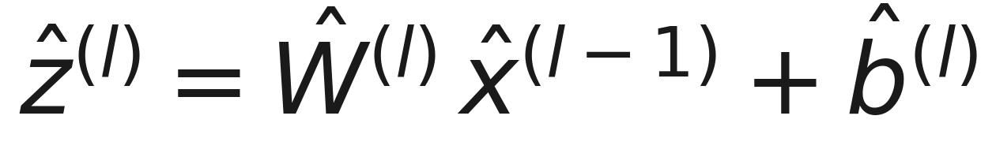
Background: The Multilayer Perceptron
The MLP is the foundational building block of modern deep learning — from CNN classification heads to transformer feed-forward layers.
We focus squarely on understanding the MLP; you cannot understand larger networks without first understanding it.
We are deliberately cautious: we do not claim to “understand” transformers — that would be too ambitious.
Forward pass: each hidden layer computes a pre-activation, then a non-linear activation
Hidden layers use ReLU; the output uses sigmoid, and a cutoff τ produces the binary label.
5/20
Notes:
(~45s) Quick background, and a stronger claim than it first appears. The MLP is the foundational building block of deep learning, yet it is still not well understood, even by many who've taken AI courses. So we focus squarely on understanding the MLP; you can't understand larger networks without it. I want to be explicit and cautious: we do NOT claim to understand transformers, that would be too ambitious. On the math: each hidden layer computes a pre-activation, then a non-linearity, ReLU in the hidden layers, sigmoid at the output, with a cutoff producing the binary label.

Slide 6


What We Store — the Forward Pass
We observe only the FORWARD pass — not the backward pass (gradients, backpropagation).
stored: b (bias), x (activation → 1 bit) excluded: W (weights), ẑ (pre-activation)
Excluded
Stored
Weights W — largest component, redundant across iterations, hard to interpret alone.
Gradients — the backward pass; out of scope here.
Continuous pre/post-activations — magnitude isn’t needed for our queries.
Activation x — 1 bit per (neuron, data point): did it fire?
Bias b — a small, directly interpretable float.
Predictions — to trace misclassifications back to neurons.
Loss & accuracy scalars — negligible cost.
6/20
Notes:
(~60s) This is the heart of the storage decision, and I want to make one thing explicit up front: we observe only the FORWARD pass, not the backward pass, not gradients, not backpropagation. Tied to the equation: we exclude the weights W, which are the largest and hardest to interpret, and we exclude the continuous pre-activations. We store the bias b, which is small and interpretable, and the activation x, as a single bit, just whether the neuron fired, plus the predictions. If someone asks 'what about the gradient, what about backprop?', the honest answer is that's the backward pass, it's differential-equation territory, and we don't claim it. What we can understand from the forward pass is bias, activation, and misclassification.

Slide 7
Why Binary Activations?
32×
Bit-packed in the buffer
  Activations are packed 8 per byte, a 32× smaller in-memory footprint than floats, so each flush carries many samples and bulk-inserts in one COPY.
Normalized for SQL
  On flush the bits expand into rows; in Postgres is_triggered is an ordinary integer column, queried with standard SQL (no bit operations needed).
Query sufficiency
  Every query needs only whether a neuron fired — never the magnitude.
Pipeline fit
  Binary states bulk-insert cleanly in a single transaction.
less information per activation — 1 bit (fired / not) vs a 32-bit float
Biases stay as compact floats; only the activation is reduced to a single bit.
7/20
Notes:
(~60s) Why binary activations? The information content of an activation is one bit, fired or not, versus a 32-bit float, so up to 32 times less to move per activation. Now an honest clarification, because it matters: SQL has no native bit operations. So we store the activations as compact byte-level values, a boolean or a packed bitfield, and the queries read bytes. The saving comes from the information being binary, not from doing bit-level tricks inside SQL. Biases, by the way, stay as compact floats; only the activation collapses to a bit. The other two reasons: our queries only need whether a neuron fired, and binary states bulk-insert cleanly in one transaction.

Slide 8
Database Schema
Five normalized tables (3NF / BCNF), organized by experiment → iteration → neuron → data point.
Experiment
Iteration
Prediction
experiment_id, name,
dataset, hyperparameters
experiment_id,iteration_id,loss, val_loss, accuracy
experiment_id, point_id,
actual_class, predicted_class
Bias
Activation
experiment_id, iteration_id,
layer_id, neuron_id, bias
experiment_id, iteration_id,
point_id, layer_id, neuron_id,
is_triggered
Activation is the largest table by orders of magnitude — one row per (iteration, neuron, data point).
8/20
Notes:
(~50s) The schema is five normalized tables, organized hierarchically: experiment, iteration, then down to neuron and data point. Experiment holds metadata, Iteration holds per-step loss and accuracy, Prediction holds actual versus predicted class, Bias holds one float per neuron. And Activation, highlighted, is the large one: one row per iteration, per neuron, per data point, so it dominates storage by orders of magnitude.

Slide 9
Lightweight Transfer Pipeline
inserts
SQL
Training Loop
(PyTorch / ReLU)
Extraction
& Logging
PostgreSQL
Database
Inspection
Queries
binary activations · biases · predictions · metadata
The dominant cost of fine-grained monitoring is parameter transfer, not query evaluation.
Binary activations are buffered and bulk-inserted only when the buffer is full — sharply cutting transfer overhead.
Biases are transferred every f iterations: they change little step-to-step, so logging every iteration would be redundant.
A user-defined buffer size and frequency f tune the balance between freshness and overhead.
9/20
Notes:
(~55s) The transfer pipeline keeps us efficient. The key point: the dominant cost is parameter transfer, not query evaluation. So activations are buffered and bulk-inserted only when the buffer fills. Biases are handled separately, they barely change between iterations, so we only move them every f iterations instead of every step. The user controls the buffer size and that frequency f, trading freshness against overhead.

Slide 10
Our Proposed Queries - 1: Neuron Activation
Identify neurons whose activation flips repeatedly across consecutive iterations — they have not converged.
Uses the OLAP window function LAG to compare each neuron’s activation to its previous iteration, then counts the flips.
WITH Flips AS (
SELECT layer_id, neuron_id, point_id, is_triggered,
LAG(is_triggered) OVER (
PARTITION BY layer_id, neuron_id, point_id
ORDER BY iteration_id) AS prev
FROM activation WHERE experiment_id = %d )
SELECT layer_id, neuron_id, COUNT(*) AS total_flips
FROM Flips
WHERE prev IS NOT NULL AND is_triggered <> prev
GROUP BY layer_id, neuron_id
ORDER BY total_flips DESC;
10/20
Notes:
(~60s) Query one finds oscillating neurons: units whose activation keeps flipping across iterations, meaning they haven't settled on a stable decision boundary. We use the window function LAG, partition by neuron and data point, order by iteration, so each row sees the same neuron's activation in the previous iteration, and we count the flips. For the analyst, a high flip count is an immediate signal to intervene, usually by lowering the learning rate, with no custom Python.

Slide 11
Our Proposed Queries - 2: Misclassification
Find which last-hidden-layer neurons fire systematically during false positives and false negatives.
Joins activation with prediction at the final iteration, restricted to misclassified points.
SELECT a.layer_id, a.neuron_id,
CASE WHEN p.actual_class=0 AND p.predicted_class=1
THEN 'False Positive'
WHEN p.actual_class=1 AND p.predicted_class=0
THEN 'False Negative' END AS mistake_type,
ROUND(AVG(a.is_triggered)*100, 2) AS fire_rate_pct
FROM activation a JOIN prediction p
ON a.point_id=p.point_id AND a.experiment_id=p.experiment_id
WHERE p.actual_class <> p.predicted_class
AND a.iteration_id = (SELECT MAX(iteration_id) ...)
AND a.layer_id = (SELECT MAX(layer_id)-1 ...)
GROUP BY a.layer_id, a.neuron_id, p.actual_class, p.predicted_class
HAVING AVG(a.is_triggered) > 0.5
ORDER BY mistake_type, fire_rate_pct DESC;
11/20
Notes:
(~60s) Query two asks which neurons drive the errors. We join activation with prediction, restrict to the final iteration and the last hidden layer, and keep only misclassified points. The CASE splits errors into false positives and false negatives, and we compute each neuron's firing rate on those mistakes. The output is a short list of the last-layer neurons that systematically light up during errors, which, in our runs, exposed neurons memorizing a spurious shortcut.

Slide 12
Our Proposed Queries - 3: Bias Histogram
Connect the distribution of biases to neuron behavior — exposing where the network places its decision boundary.
Buckets biases with NTILE(4) (equi-depth, quantile-based); per bucket reports % active / inactive / oscillating.
WITH NeuronStats AS (
SELECT b.layer_id, b.neuron_id, b.bias,
NTILE(4) OVER (ORDER BY b.bias ASC) AS bucket,
CASE WHEN SUM(a.is_triggered) < COUNT(*)*0.10 THEN 'Inactive'
WHEN SUM(a.is_triggered) >= COUNT(*)*0.90 THEN 'Active'
ELSE 'Oscillating' END AS behavior
FROM bias b JOIN activation a USING (...)
WHERE b.experiment_id=%d AND b.iteration_id=%d
GROUP BY b.layer_id, b.neuron_id, b.bias )
SELECT bucket, COUNT(*) AS neurons,
pct_active, pct_inactive, pct_oscillating
FROM NeuronStats GROUP BY bucket ORDER BY bucket;
12/20
Notes:
(~60s) Query three connects the bias distribution to behavior. We use NTILE to bucket neurons into an equi-depth histogram by bias value, then label each neuron Active, Inactive, or Oscillating from its activations, and report the mix per bucket. This shows where in the bias space the network is actually doing work, and where it failed to place a boundary.

Slide 13
Time & Space Complexity
Network depth D, average width W, data points n. We analyze the two cases separately — one variable held fixed in each.
Quantity | Fixed dataset (vary architecture) | Fixed architecture (vary dataset)
Bias snapshot | O(D · W) floats | O(1)
Activation snapshot | O(D · W) bits | O(n) bits
Neuron Activation query | O(D · W) | O(n)
Bias-histogram query | O(D · W) | O(n)
Misclassification query | O(W) — no depth penalty | O(n)
Key insight: with the dataset fixed there is no n at all; excluding weights removes the dominant storage term, and an index lets misclassification auditing scale independently of depth D.
13/20
Notes:
(~60s) Complexity, and I've separated this cleanly into two cases, one variable fixed in each. Note I use D for depth and W for width. With the dataset fixed and the architecture varying, there is no n at all: a bias snapshot is order D-times-W, and excluding the weights removes what would be the dominant term. With the architecture fixed and the dataset varying, storage grows linearly in n, and storing a bit instead of a float keeps that from becoming a bottleneck. The nicest result: the misclassification query touches only the last hidden layer, so with an index it's order W, independent of depth D.

Slide 14
Experiment Setup
Evaluated on a single local server (not the cloud):
  Intel i7-4770 · 32 GB main memory · 6 TB locally attached HDD.
Software:
  Python 3.13 · PyTorch 2.9.1 · PostgreSQL 17.9 · Pandas / NumPy / Scikit-learn.
Evaluation datasets (Table 1)
Dataset | Domain | Rows (n) | Dimensions (d)
KDD | Network traffic | 494,021 | 42
Adult Income | Financial | 32,561 | 14
Pima Indians Diabetes | Medical | 768 | 8
Three diverse, public datasets spanning network, financial, and medical domains.
14/20
Notes:
(~40s) The evaluation ran on a single local server, not the cloud, an Intel i7-4770 with 32 gigabytes of main memory and a local SSD, using PyTorch 2.9 and PostgreSQL 17. We used three diverse public datasets: KDD network traffic, the largest at nearly half a million rows; Adult Income, financial; and Pima Indians Diabetes, a small medical set. So we span large to small across three domains.

Slide 15
Insight 1: Neuron Activation
>91%
Adult Income:
  A major training issue — a clear signal to intervene, e.g. by lowering the learning rate.
Pima Diabetes:
  Oscillation also widespread — the small dataset destabilized learning.
KDD:
  With far more data, oscillation was lower — more data stabilizes activation patterns.
of 224 hidden neurons oscillated on Adult Income — some groups at 100%
Oscillation rate is an immediate, code-free convergence diagnostic.
15/20
Notes:
(~55s) What did the queries reveal? On oscillation: on Adult Income, more than 91 percent of the 224 hidden neurons oscillated, some groups at 100 percent, a clear sign training was unstable, fixable by lowering the learning rate. On Pima, the small set, oscillation was also widespread. On KDD, with far more data, it was much lower; more data stabilizes activation patterns. So the oscillation rate is an immediate, code-free convergence diagnostic.

Slide 16
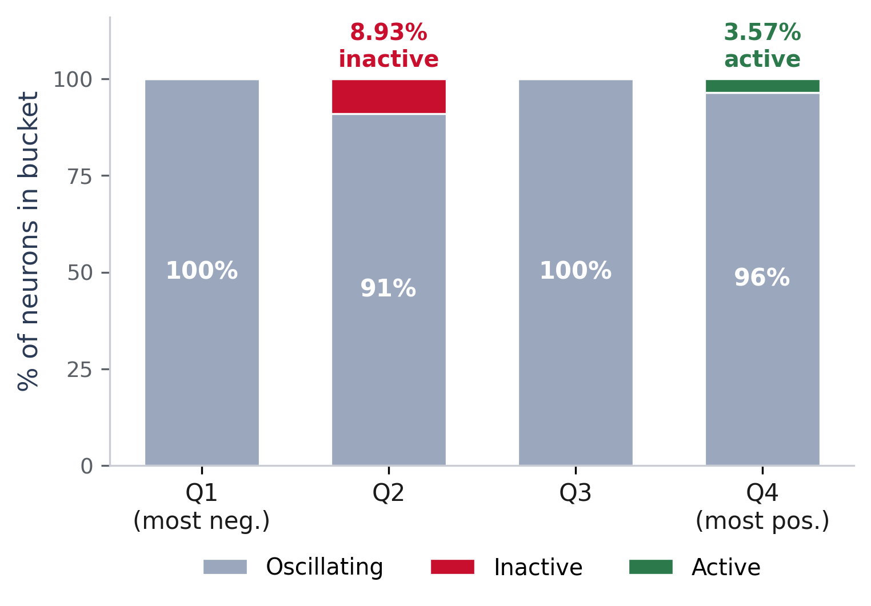
Insights: Bias & Misclassification
Bias Distribution
Misclassification
Adult Income: a few last-layer neurons fired far more on errors — memorizing a spurious shortcut.
KDD: false positives and false negatives were driven by different neuron sets.
Pima: noisier, but the query still isolated the neurons most correlated with errors.
A high concentration of error neurons may signal the network lacks capacity.
Across all four bias buckets, neurons are overwhelmingly oscillating — the network settled almost no firm decision boundaries.
Fully inactive neurons appear only in Q2 (8.93%); fully active only in Q4 (3.57%).
So the network uses only a narrow slice of its bias space, leaving broad input regions unserved.
16/20
Notes:
(~55s) Two more insights, and here's the bias histogram. On Adult Income the inactive neurons appeared only in the negative-middle bucket, at about nine percent, and the fully active ones only in the top bucket, at three and a half percent; the network used only a narrow slice of its bias space, with the rest oscillating. On the misclassification side: on Adult, a few last-layer neurons fired far more on errors, a fingerprint of a spurious shortcut; on KDD, false positives and negatives were driven by different neuron sets. This is neuron-level auditing you can't get from aggregate metrics.

Slide 17
Database I/O Overhead
16–22%
Dataset | PyTorch (s) | Transfer (s) | Overhead
KDD | 1329.0 | 208.0 | 16%
Adult Income | 100.0 | 22.0 | 22%
Pima Diabetes | 2.7 | 0.6 | 22%
time overhead added to the training loop
Why it stays modest: only biases and binary activations are stored — never full weight matrices — keeping extraction well below the cost of the PyTorch computations themselves.
17/20
Notes:
(~50s) And the efficiency result. Across the three datasets, the database transfer added about 16 to 22 percent on top of PyTorch's own compute. I'll be measured here; I wouldn't call 16 to 22 percent 'very low', it's reasonable and modest, and it stays modest precisely because we move only biases and binary activations, never the full weight matrices. The primary criticism of in-database ML is the I/O bottleneck, and this keeps it well in hand.

Slide 18
Limitations
Currently targets MLPs for binary classification — multi-class and CNN / RNN / attention layers need schema extensions.
Binary activations discard magnitude, so saturation and gradient-flow analysis fall outside the current schema.
Storage still scales jointly with depth D, width W, and data size n; tested on three tabular datasets, single-node PostgreSQL.
Choosing the refresh frequency f in a principled way is an open problem — SGD converges non-linearly.
Results are qualitative — a monitoring aid, not a formal explainability method like SHAP (Shapley-value attribution) or LIME (local surrogate models). We do not compute Shapley values.
18/20
Notes:
(~50s) Limitations, honestly stated. It's currently MLPs for binary classification; multi-class and CNN, recurrent, or attention layers need schema extensions. Binary activations drop magnitude, so no saturation or gradient-flow analysis. Storage scales with depth D, width W, and data size n, on a single PostgreSQL node. Choosing the refresh frequency f is open. And to be precise about scope: this is a monitoring aid, not a formal explainability method like SHAP, which is Shapley-value attribution, or LIME. We do not compute Shapley values.

Slide 19
Related Work & Positioning
Prior work — MLflow/W&B (run-level), DeepBase/NeurDB (DB-for-NN), SQL4NN/ICDT (query languages) — stores far more network state than we do.
System / class | Granularity | Stores weights? | Overhead | Off-the-shelf DB
NNQuery (ours) | per-neuron, per-iteration | No — binary activations + biases | modest | Yes (PostgreSQL)
MLflow / W&B | run-level | artifacts only | low | platforms
DeepBase / NeurDB | per-unit / representations | often yes | higher | custom engines
SQL4NN / ICDT | models-as-data | — | — | language design
Honest scope
We are not the only system that monitors neural networks — we occupy a deliberately narrow, low-overhead niche.
We do not yet compare experimentally against other systems; that is a planned next step.
Why no weights: internal-layer weights are too many to interpret; bias, activation, and misclassification answer the key questions far more cheaply.
19/20
Notes:
(~50s) Let me position us directly and be upfront about scope, because these are fair questions. Compared to others, we're per-neuron and per-iteration, we don't store weights, our overhead is modest, and we run on an off-the-shelf database. Two honest disclaimers: we are not the only system that monitors networks, we occupy a deliberately narrow, low-overhead niche, and we don't yet compare experimentally against other systems, which is a planned next step. On weights specifically: internal-layer weights are too numerous and need careful per-neuron interpretation, whereas bias, activation, and misclassification answer the key questions at a fraction of the cost. That's a deliberate design choice we can defend.

Slide 20
Conclusions & Future Work
Conclusions
Future Work
A lightweight relational system monitors NN training by storing binary activations, biases, and predictions — not weights.
Standard SQL traces misclassifications, studies bias distribution, and finds oscillating neurons.
Confirmed across three datasets: transfer cost stays a modest fraction (16–22%) of PyTorch compute.
Scale to CNNs and transformer-based models.
Capture continuous activation behavior while preserving low I/O overhead.
Log weight matrices at a much lower frequency than activations.
Move from passive monitoring to active, query-triggered training interventions.
Benchmark against MLflow / W&B in larger deployments.
20/20
Notes:
(~45s) To conclude: a lightweight relational system monitors a network during training by storing binary activations, biases, and predictions, never the weights, and standard SQL traces misclassifications, studies bias, and finds oscillating neurons at a modest 16 to 22 percent overhead. Going forward: scale to CNNs and transformers, capture continuous activation cheaply, log weights at a low frequency, and move from passive monitoring to active, query-triggered interventions. Thank you, I'm happy to take questions.

