Slide 1
I/O efficient Algorithms for Sparse Matrix Multiplication and Addition
Hashirul Quadir, Daniel Biediger, Carlos Ordonez University of Houston USA
Notes:
‹#›

Slide 2

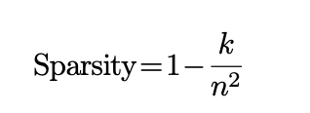
The Scale of Modern Data
Large-scale sparse matrices are ubiquitous in domains like recommendation engines, social network analysis, and scientific computing
These matrices are characterized by 90-99.9 % sparsity, meaning the vast majority of potential entries are zero
Matrix multiplication acts as the fundamental computational operation for both machine learning training and inference
‹#›/16

Slide 3
Limitations of Traditional State-of-the-Art libraries
Traditional in-memory sparse formats like Compressed Sparse Row (CSR) and Coordinate (COO) are strictly bounded by physical memory
In comparison to the COO representation, CSR and CSC constitute the predominant storage formats
Modern GPUs accelerate neural networks using massive parallelism, but they remain heavily constrained by VRAM limitations.
‹#›/16

Slide 4
Mapping Operations to Data Science Target Models
Matrix-Matrix Multiplication (A∗B) corresponds to the Training Phase in machine learning, evaluating batch gradient descent
Matrix-Vector Multiplication (A∗v) corresponds to the Testing/Inference Phase, such as computing predictions in linear regression
These operations are critical for Model Compression and Network Pruning, saving bandwidth during inference once a network is pruned
‹#›/16

Slide 5
Applications in Graph Analytics
A network of n vertices is inherently represented by an n×n adjacency matrix, naturally mapping to square sparse dimensions
(A∗B) natively mirrors graph transformations and message-passing in Graph Neural Networks (GNNs), such as discovering 2-hop paths
(A∗v) represents iterative traversal algorithms like PageRank, Breadth-First Search (BFS), or Single Source Shortest Path (SSSP)
‹#›/16

Slide 6

The Core Processing Methodology
Our methodology works to implement external memory algorithms inspired by database query optimization to balance CPU and I/O operations
Execution relies on a strict three-phase, database-style I/O workflow: Read, Process, Write
We seamlessly program relational execution logic using standard Data Science Python libraries (Pandas, NumPy) to bypass a dedicated DBMS
‹#›/16
Notes:
‹#›

Slide 7
Leveraging the Coordinate (COO) Format
The Coordinate (COO) format is established as the most vital structure for external memory algorithms
Its straightforward mapping naturally mirrors the relational model of row, column, and value tuples
This format permits sequential I/O streaming directly from standard CSV files without incurring complex decoding overhead
‹#›/16
Notes:
‹#›

Slide 8
Chunked Vectorized Ingestion
A dense 1,000,000×1,000,000 matrix requires approximately 8 terabytes of storage, demanding external memory techniques.
Execution avoids memory spikes by transitioning from line-by-line parsing to chunked vectorized ingestion.
Data is partitioned horizontally across available CPU workers, allowing each worker to process a discrete subset of rows independently
Data is partitioned horizontally across available CPU workers, allowing each worker to process a discrete subset of rows independently
‹#›/16
Notes:
‹#›

Slide 9
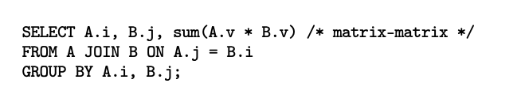
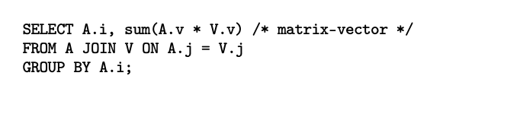
Matrix Operations as SQL Relational Queries
Matrix multiplication (A∗B) executes as a Join-Group-Aggregate sequence (INNER JOIN)
Matrix addition (A+B) is conceptually executed as a FULL OUTER JOIN on the coordinate keys (i, j)
Matrix-vector multiplication (A∗v) treats the vector as a relational table and joins on the column subscript
‹#›/16
Notes:
‹#›

Slide 10
Space and Time Complexity
Relational algorithms reduce matrix multiplication sorting and matching phases to an O(n log n) time complexity
For sparse addition, the merge phase evaluates to an efficient O(n) linear operation
To bypass O(n²) external memory scaling, we assume O(1) non-zero entries per row, bounding overall space complexity to strictly linear constraints
‹#›/16

Slide 11
The Standard Sort-Merge Algorithm
Matrices are structured using the standard i, j, and v schema to facilitate sequential traversal
To evaluate the multiplication B∗A, matrix B is sorted primarily by column and matrix A is sorted primarily by row to align with the dataset dimensions.
The sorted matrices are traversed using a two-subscript merge to find matching columns in the left matrix and rows in the right matrix.
‹#›/16

Slide 12
Hardware Setup and Environments
Local server: Intel Xeon E5-2686 v4 processor @ 2.30GHz and 32 GB of RAM Hard disk
Cloud server: GPU experiments utilized a Google Colab NVIDIA Tesla T4 GPU to evaluate massive parallelism
Evaluations focused on a spectrum dimensions, maintaining the ratio for sparse and ultra-sparse scaling
‹#›/60

Slide 13
Quantitative Execution Scaling (Raw Data)
Vector-Matrix Scalability: For Matrix-Vector multiplication on 100k rows, Python Pandas SpMV drastically outperforms the database engine
Pandas relational joins execute in a fraction of the time compared to native scalar iteration loops (Numba COO)
‹#›/60

Slide 14
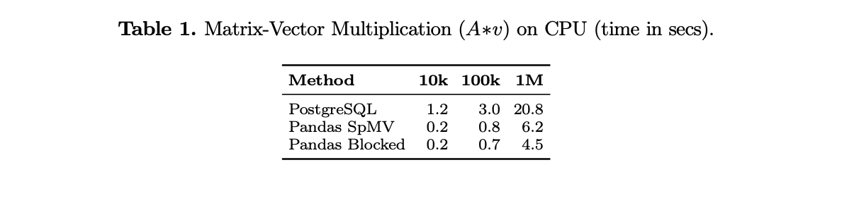
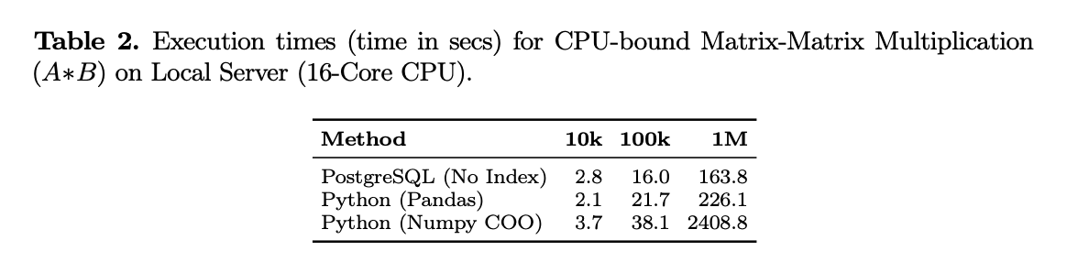
CPU Benchmarks: Python vs. SQL
The Pandas relational model bypassed the scalar iteration bottleneck, dropping compute time by an order of magnitude versus Numba COO programs
For Matrix-Vector multiplications, Python frameworks easily bypassed PostgreSQL's heavy transactional broadcast overhead
As parallel joins rapidly accelerated processing, sequential read/write I/O firmly took over as the dominant execution constraint
‹#›/16
Notes:
‹#›

Slide 15
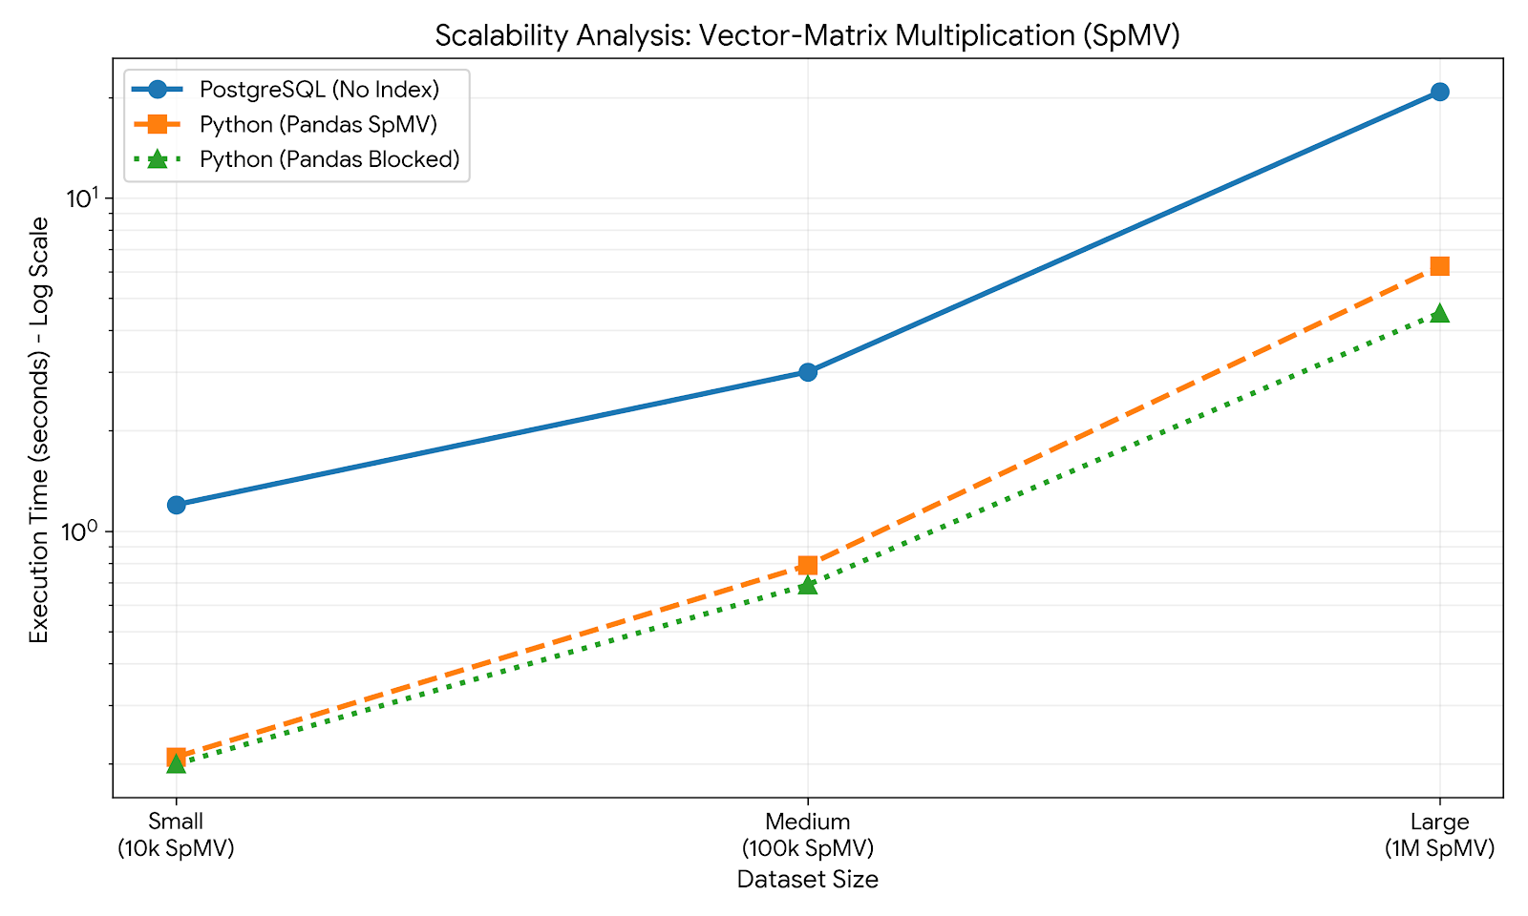
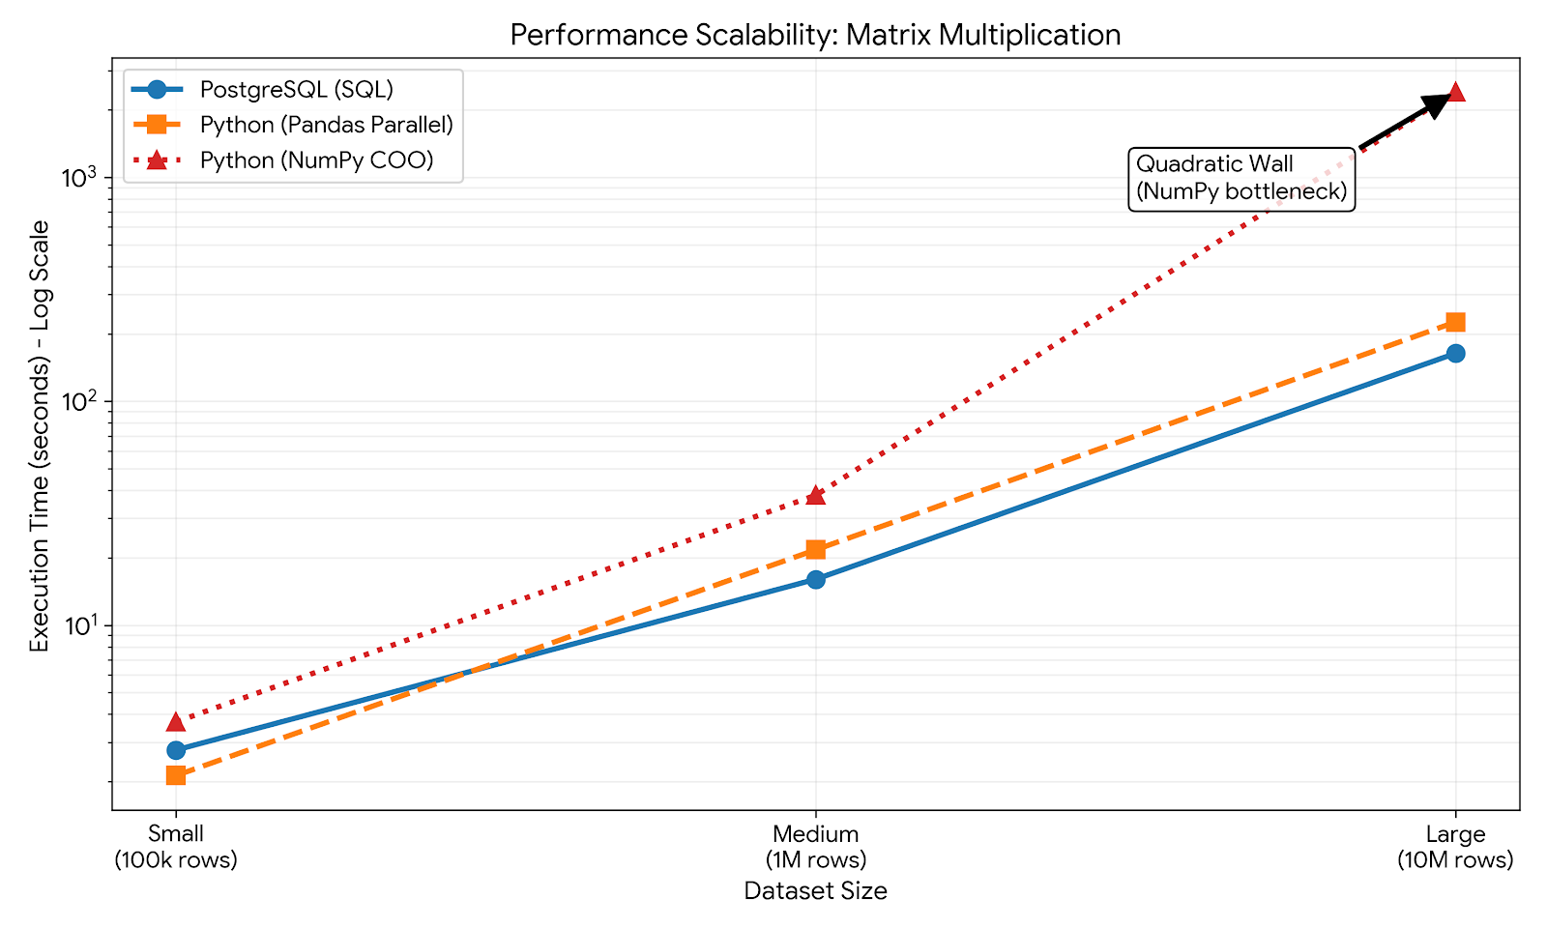
Visualizing Performance
  The Pandas database approaches maintain distinct linear scaling, contrasting with accumulation bottlenecks seen in native Python loops
  Python-based frameworks substantially outperform traditional PostgreSQL computationally as dataset sizes climb
‹#›/16
Notes:
‹#›

Slide 16
Cloud GPU Execution Evaluation
PyTorch unleashes thousands of CUDA cores via cuSPARSE, yielding huge speedups for smaller sparse workloads
However, the GPU approach still heavily struggles with I/O sequential scaling at the highest limits
Standard SQL relational database engines cannot natively interface with or execute on GPU hardware
‹#›/16
Notes:
‹#›

Slide 17
Format Conversion Bottlenecks on GPUs
GPU hardware threads strictly require Compressed Sparse Row (CSR) arrays for contiguous access, conflicting with native COO tabular streams
Our Python-based relational join structurally avoids this penalty by processing the native COO stream directly
‹#›/16
Notes:
‹#›

Slide 18
Conclusions & Future work
Relational database-inspired algorithms are highly scalable alternatives for massive sparse matrices when CPU compute dominates
Pandas workflows seamlessly eliminate PostgreSQL transaction overhead while avoiding fatal GPU format conversion penalties
However, dense datasets fundamentally break this approach, as massive storage I/O overwhelms system operations
Future algorithms will be extended to handle rectangular matrices for broader collaborative filtering and feature extraction datasets
We will explore hybrid models where one matrix remains in memory while secondary tables stream continuously
We aim to eliminate the O(1) density bounds by entirely externalizing intermediate computations to process denser graphs efficiently

