Slide 1
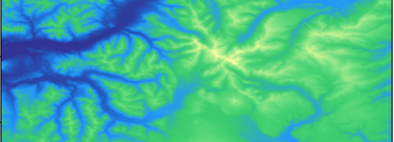
Exploring Topographic Data with Transitive Closure on Graphs
Adam Nelson-Archer, Christoph F. Eick, Carlos Ordonez
University of Houston
Dept. of Computer Science

Slide 2
Motivation: Why recursive graph queries in Python?
Graph reachability is fundamental in databases and GIS
Recursive query evaluation is usually restricted to DBMS systems
Python workflows dominate data science
Need a lightweight, correct, reproducible framework

Slide 3
Problem Statement: Bringing Recursive Queries to Python
• Recursive query processing is traditionally limited to DBMS systems.
• Python dataframes are widely used, but lack native recursive query support.
• We introduce a lightweight recursive framework over plain tabular files.
• Terrain graphs provide a realistic and controllable test domain.
• The goal is accessibility, correctness, and practical graph analytics.

Slide 4
Main Contributions
• A formal DEM-to-graph construction pipeline
• A seminaive recursive query engine in Pandas
• Validation against SQLite recursive views
• A tunable terrain benchmark via slope phase transitions

Slide 5
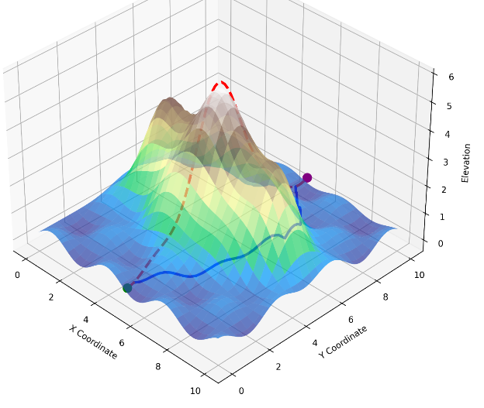
Overview of the Framework
• Input is a DEM from any arbitrary geographic location.
• The DEM is transformed into a directed graph using local slope constraints.
• A slope threshold controls path feasibility across terrain.
• Transitive closure materializes all reachable paths.
• Higher-level recursive queries are evaluated over the closure.

Slide 6
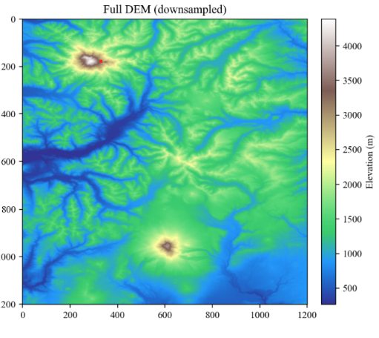
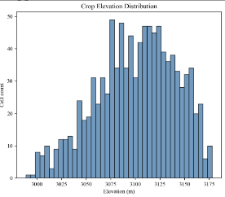
Data Model: DEM Representation
We use a USGS 3DEP DEM crop centered on Mount Rainier, but this system could work with any arbitrary input DEM.
Each cell corresponds to one terrain location.
Spatial resolution is approximately 7.1 meters per cell.
Two scales are used:
  n = 1,024 (32×32)
  n = 10,000 (100×100)

Slide 7
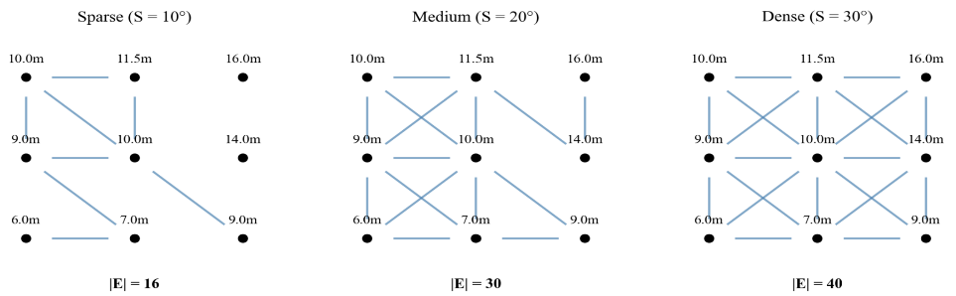
Graph Construction: Slope-Filtered Directed Graphs
• Each DEM cell connects to its 8 neighboring cells.
• Edge direction follows signed elevation difference.
• Each edge stores slope angle θ.
• A slope threshold S determines passable terrain.
• Varying S changes graph density.

Slide 8
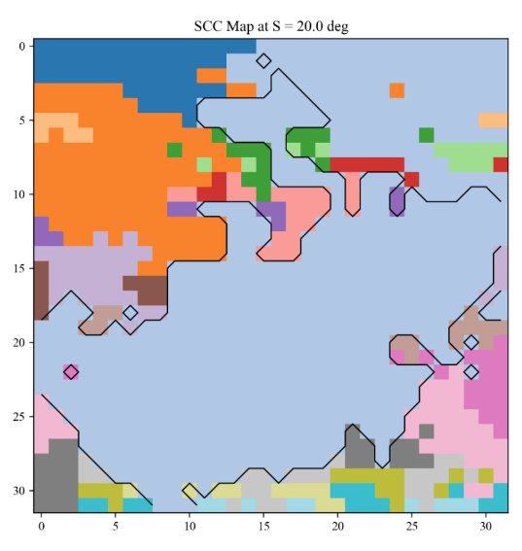
Graph Validation and Structural Properties
The graph construction preserves four invariants:
antisymmetry
no self-loops
expected vertex degree
exact slope correctness
• Edge count scales linearly with n.
• Construction cost is O(n).

Slide 9
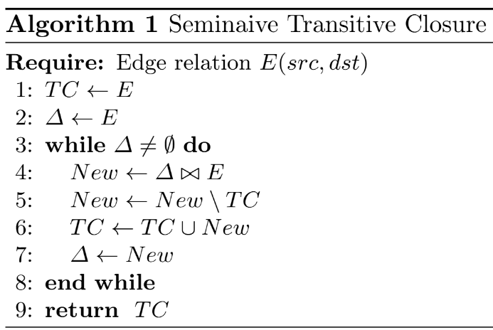
System and Algorithms: Seminaive Transitive Closure
• Recursive reachability is computed using seminaive evaluation.
• Only newly discovered tuples are expanded at each iteration.
• This avoids redundant recomputation.
• The algorithm converges to the least fixpoint.

Slide 10
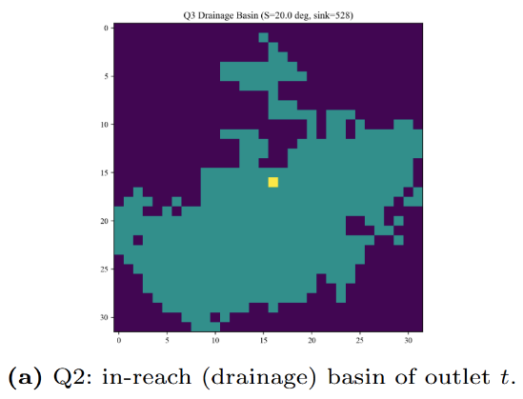
Query Expressiveness over the Transitive Closure
Once closure G⁺ is materialized, multiple graph queries become simple.
"Can I hike from here to the summit?"
Point-to-Point Reachability
"Where does water flow from this valley?"
Drainage Basin Extraction
"Where is the best flat gathering spot?"
Reachable Hub Detection
"How much of the mountain is freely traversable?"
Strongly Connected Components (SCC)
"Which single washed-out trail cuts off the route?"
Bottleneck Detection
"What is the actual walking distance taking zigzags into account?"
Shortest Path Evaluation

Slide 11
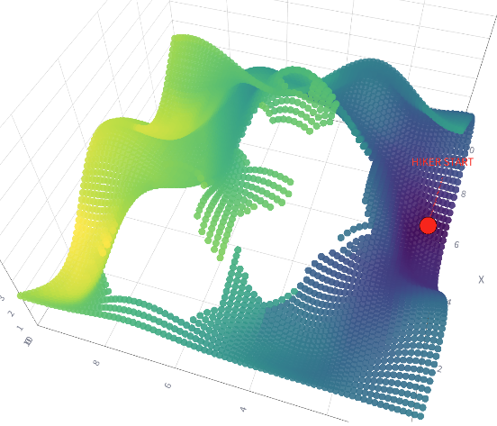
Application: Queries and Visualizations
These queries could be run from a phone while on a hike, enabling complex visuals that would be inaccessible if we were using pure SQL queries
Example: “How far can I safely traverse if my slope threshold is 20°?”
Here, one side of the mountain is too steep for the hiker to access, but the other side is within the threshold.

Slide 12
Recursive Queries as Relational Algebra with Loops
• Recursive queries can be expressed as iterative relational algebra operations.
• The intermediate transitive closure (TC) is stored as a dataframe of discovered paths.
• Each iteration performs joins, projections, and duplicate elimination over the frontier.
• This loop-based relational algebra can be directly implemented in Pandas.
• Higher-level graph queries are then expressed over the materialized closure.

Slide 13
Experimental Setup
• Terrain graphs were generated from Mount Rainier DEM crops.
• Experiments used Python 3.12, Pandas 2.2, and SQLite.
• Hardware:
AMD Ryzen 7 2700X
32GB RAM
Windows 11
• SQLite was used as a correctness oracle.

Slide 14
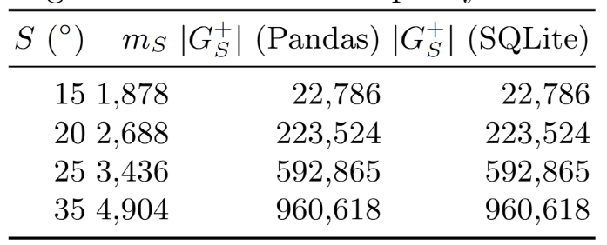
Experimental Results: Correctness Validation
• The Pandas seminaive implementation was validated against SQLite.
• Results matched exactly at every tested slope threshold.
• No row discrepancies were found.

Slide 15
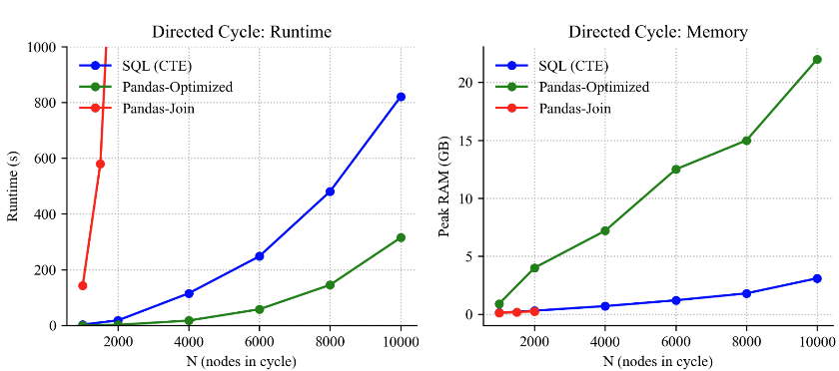
Experimental Results: Python vs. SQL
• We cannot outperform direct query efficiency on a DBMS.
• However, we achieve results that are close, or have minor tradeoffs.
• The advantage is that the data is in a more expressive format.

Slide 16
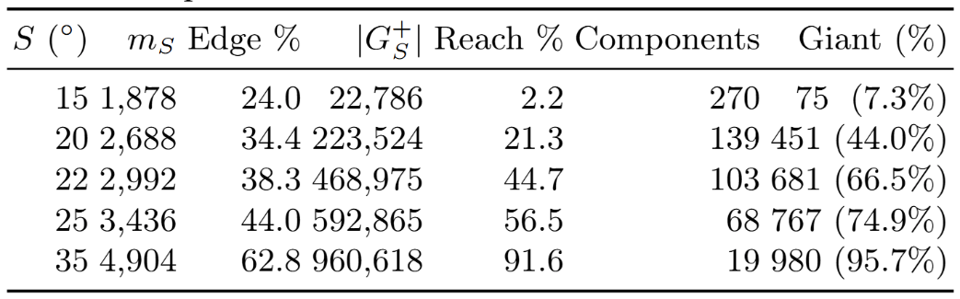
Phase Transition: Tunable Benchmark Generation
• Varying slope threshold S changes graph structure dramatically.
• Around S ≈ 20°, a giant component rapidly emerges.
• Reachability grows from fragmented to near-quadratic.
• This creates a controllable family of recursive workloads.

Slide 17
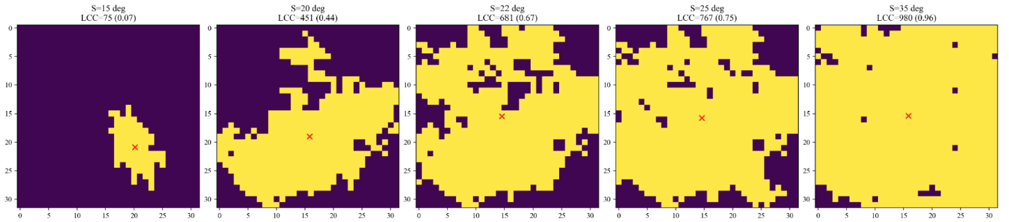
Spatial Expansion of the Giant Component
• The phase transition is visible spatially.
• At low slope thresholds, reachable regions remain fragmented.
• Near the critical threshold, components merge rapidly.
• At higher thresholds, most terrain becomes connected.

Slide 18
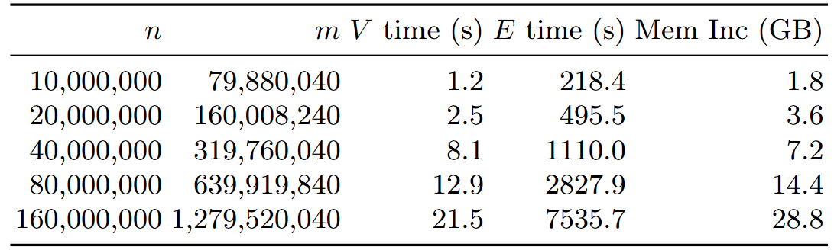
Graph Construction Scalability
• Graph generation scales linearly with terrain size.
• Large terrain graphs remain practical to construct.
• Construction overhead is small relative to recursive evaluation.
• This supports the framework as a benchmark generator.

Slide 19
Conclusions and Future Work
• We presented a lightweight recursive query framework in Python.
• We formalized a DEM-to-graph pipeline for slope-constrained reachability.
• We validated correctness against SQLite with zero discrepancies.
• We showed that slope thresholds generate tunable benchmark workloads.
Future work includes:
• Evaluating the framework on additional DBMS platforms such as PostgreSQL and DuckDB.
• Exploring alternative storage models for transitive closure and intermediate recursive state, including compressed and incremental representations.
• Extending the framework toward intelligent pathfinding, integrating terrain-aware cost models and adaptive route optimization.

