Slide 1
Intrusion Detection System (IDS): Anomaly Detection using Outlier Detection Approach
Published in: International Conference on Intelligent Computing, communication & Convergence (ICCC-2016)
Presented by: Ayman El Aassal

Slide 2
Table Of Content
Contributions
Issues of existing techniques
Intrusion Detection Systems
Outlier Detection Approach
Experimental Setup
Results
Discussion
Conclusion

Slide 3
Contributions
Developing the Outlier Detection Approach to enhance the detection rate for less frequent attacks.
This new approach will reduce training time and space requirement for intrusion detection

Slide 4
Intrusion Detection Systems
Goal of IDS: Find out if a system is operating normally.
Anomalies are consequences of successful exploitation of system vulnerabilities.
Two types of IDS:
Host-based: Detect possible attacks in individual computer which the IDS runs in.
Network-based: Detects attacks on the network by monitoring and examining packets content and format.

Slide 5
Intrusion Detection Systems
Misuse vs Anomaly detection:
Misuse: Signature based detection. Attacks are detected based on information of previously known attacks.
Anomaly: Behavior based detection. “Normal” system behavior is modeled, and any activity outside of it is considered suspicious.
This paper focuses on Anomaly based approach

Slide 6
Goals of proposed Anomaly Based IDS
High detection rate,
Low FPR,
Adaptive to small variations in patterns,
Real Time detection.
Notes:
instance-based learning is a family of learning algorithms that, instead of performing explicit generalization, compares new problem instances with instances seen in training, which have been stored in memory

Slide 7
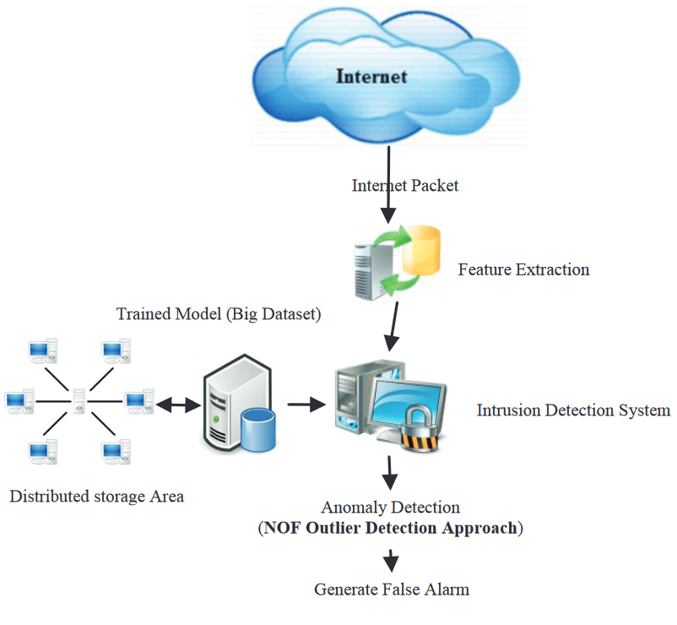
System Architecture
Features are extracted from Internet Packets.
IDS compare the feature with the trained model.
The model is trained on big dataset stored in Distributed storage area.
False alarm -> generate alarm

Slide 8
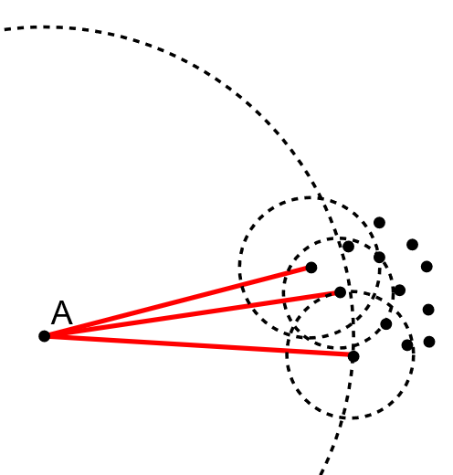
Local Outlier Factor
Main idea: Comparing the local density of a point with the densities of its neighbors. A has lower densities than its neighbors

Slide 9
Local Outlier Factor
$k$-$distance\left(A\right)$: The distance of object A to the $k^{th}$ nearest neighbor.
$N_{k}\left(A\right):$ The set of k nearest neighbors of A, includes all objects at this distance
$reachability$-${distance}_{k}\left(A,B\right)=max⁡\{$ k-distance(B), d(A,B) }

Slide 10
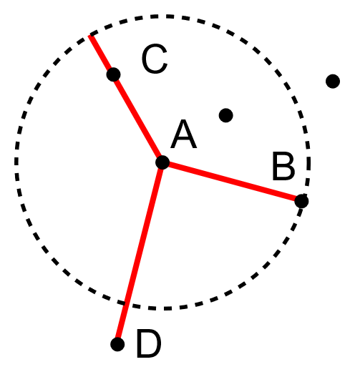
Local Outlier Factor
Consider the following for k=3:
$reachability$-${distance}_{k}\left(C,A\right)=$
$max⁡\{$ k-distance(A), d(C,A) } = k-distance(A)
$reachability$-${distance}_{k}\left(D,A\right)=$
$max⁡\{$ k-distance(A), d(D,A) } = d(D,A)

Slide 11
Local Outlier Factor
The reachability distance of an object C from A is the true distance of the two objects, but at least k-distance(A)

Slide 12
Local Outlier Factor
The Local Reachability Density of object A:
$${lrd}_{k}\left(A\right)=1/ \left(\frac{\sum_{B∈N_{k}(A)}{{rd}_{k}(A,B)}}{|N_{k}(A)|}\right)$$
Which is the inverse of the average reachability of the object A from its neighbors

Slide 13
Local Outlier Factor
The Local Outlier Factor:
$${LOF}_{k}\left(A\right)=\frac{\sum_{B∈N_{k}(A)}{\frac{{lrd}_{k}(B)}{{lrd}_{k}(A)}}}{|N_{k}(A)|}$$
Which is the average local reachability density of the neighbors divided by the object’s own local reachability density.

Slide 14
Local Outlier Factor
LOF(k) $≈$ 1: similar density as neighbors
LOF(k) $<$ 1: Higher density than neighbors (inlier)
LOF(k) $>$ 1: Lower density than neighbors (outlier)

Slide 15
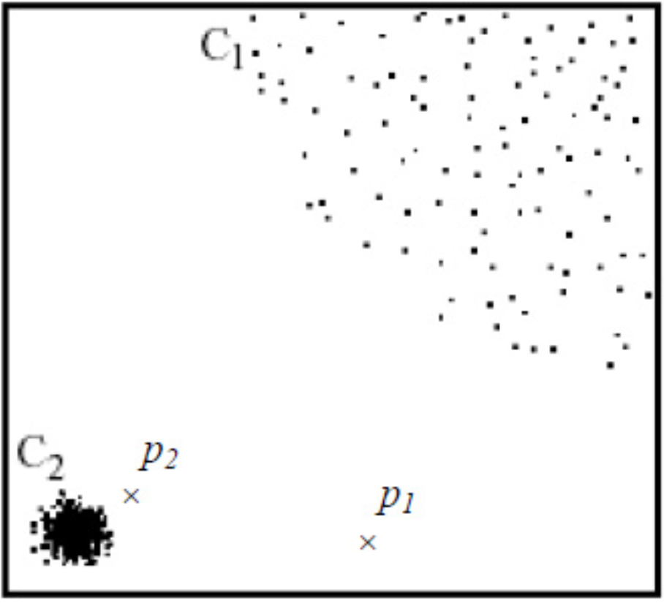
Local Outlier Factor (Example)
C2 is denser than C1.
Points in C1 are more distant to each other than p2 is to C2.
P2 will not be considered an outlier if only the nearest neighbor distance is considered.

Slide 16
Experimental Setup
Machine specs: Windows 7, intel premium (R), CPU G2020, processor speed 2.90GHz.
Training data: 2000 connection records.
Testing data: 5000 connection records.
The data comes with 41 features and is labeled “normal” or “attack”.

Slide 17
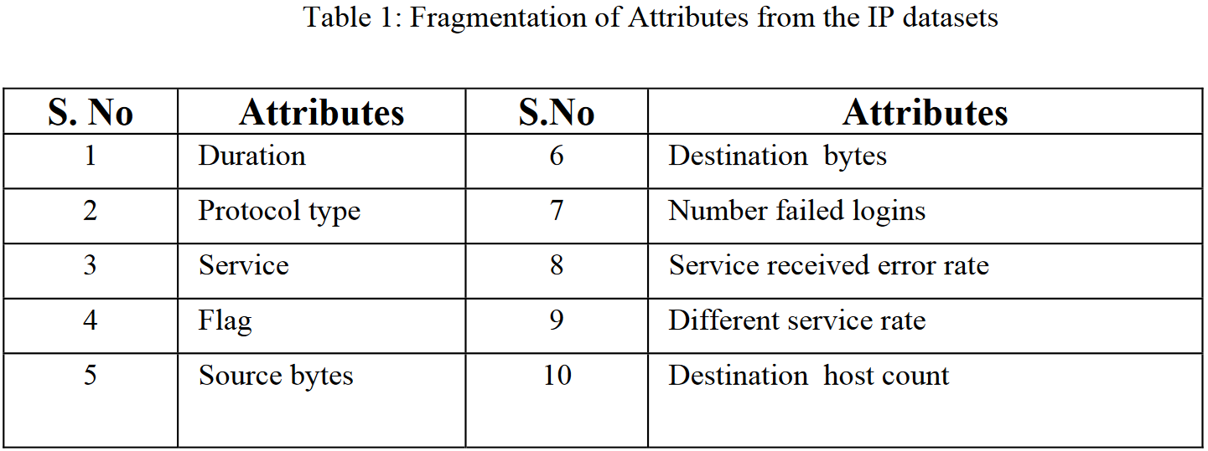
Experimental Setup
Example of features used

Slide 18
Experimental Setup

Slide 19
Experimental Setup

Slide 20
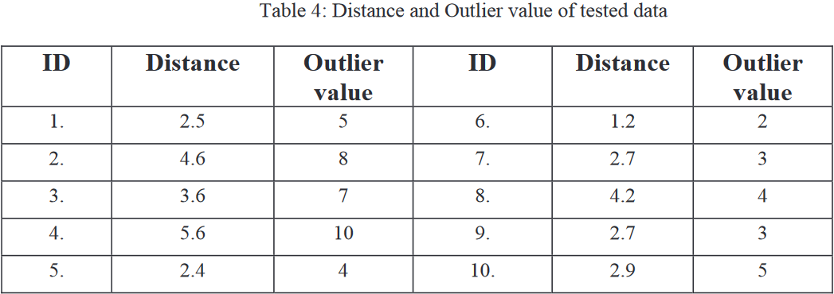
Results

Slide 21
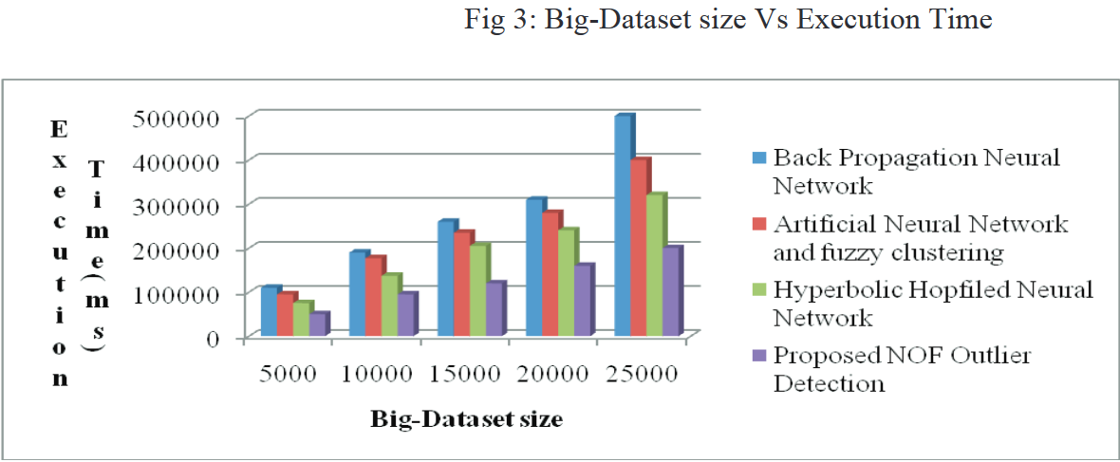
Discussion

Slide 22
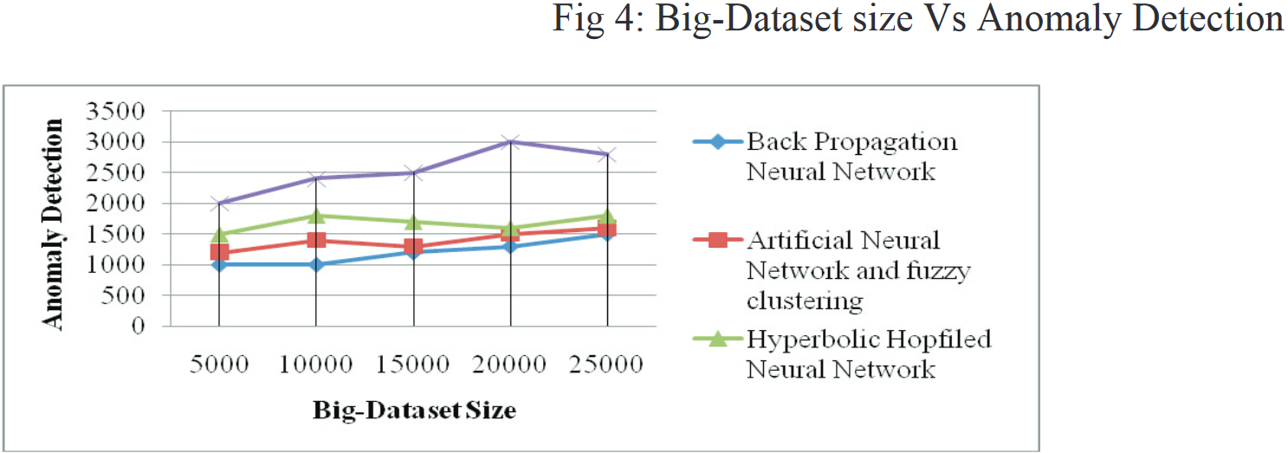
Discussion

Slide 23
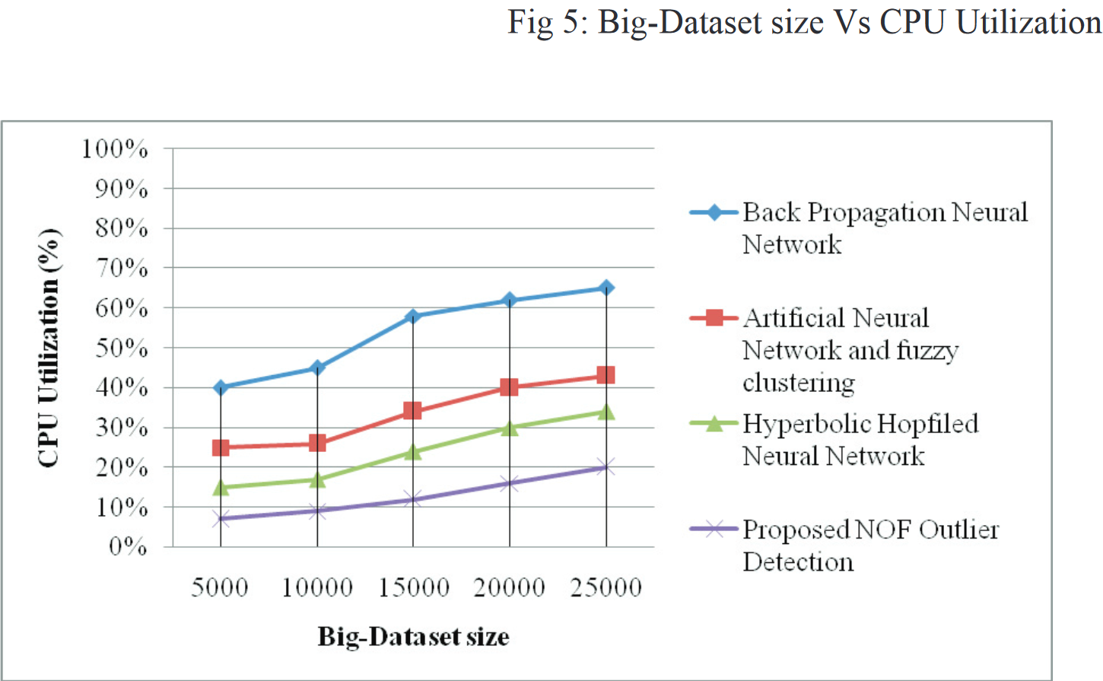
Discussion

Slide 24
Conclusion
Anomaly based detection based on Local Outlier Factor results in better detection rate more efficiently in terms of training time, space, and CPU power

Slide 25
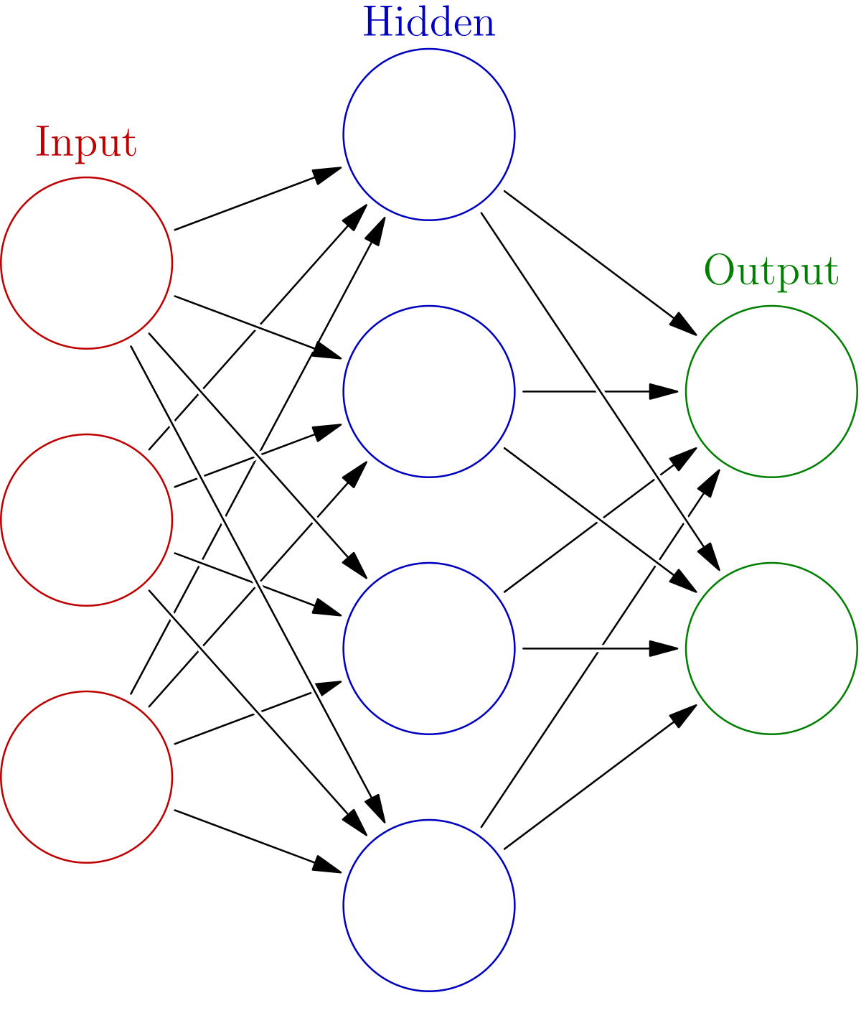
Neural Network
It is a group of connected I/O units.
Each connection has a weight
It is made of three main layers: Input, Hidden, and Output.

Slide 26
Back Propagation Neural Network
Back propagation is a standard way of training the NN.
It is used to adjust the weight of the connections in order to reduce the error rate after each iteration.

Slide 27
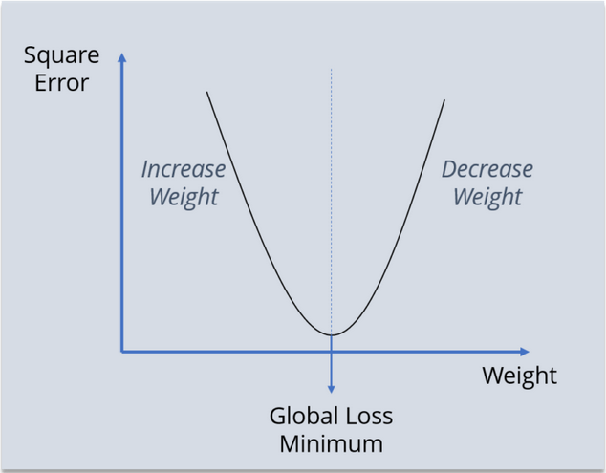
Back Propagation Neural Network
Back propagation is a standard way of training the NN.
It is used to adjust the weight of the connections in order to reduce the error rate after each iteration.

Slide 28
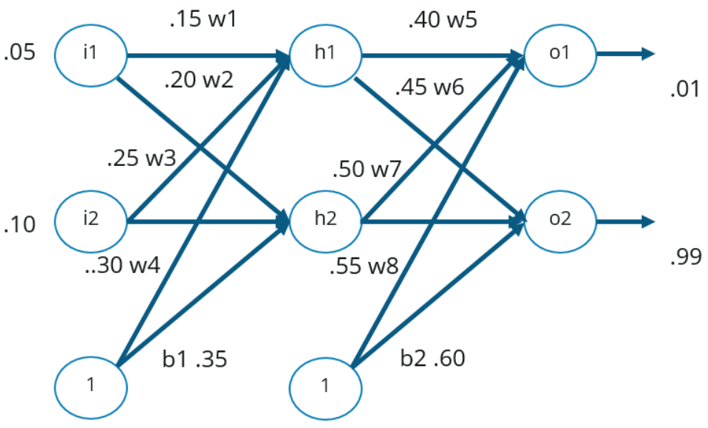
Back Propagation Neural Network

Slide 29
Back Propagation Neural Network
Step1: Forward Propagation
Step2: Compute error
Step3: Backward Propagation

Slide 30
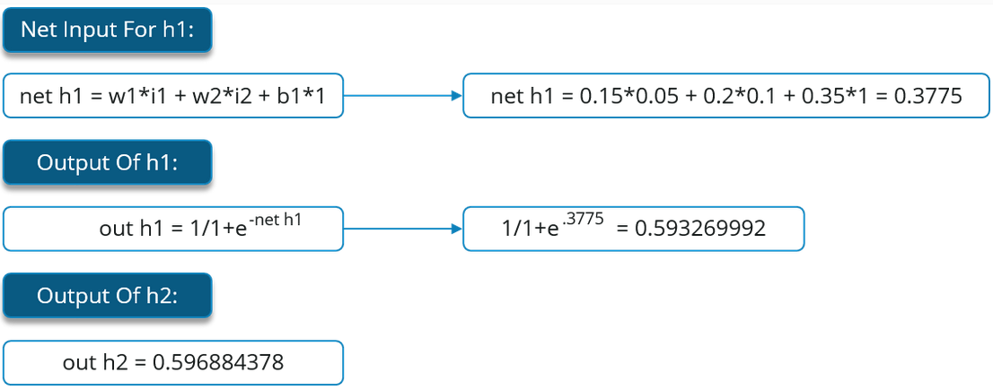
Back Propagation Neural Network
Step1.a: Calculate Output of hidden layers

Slide 31
Back Propagation Neural Network
Step1.b: Calculate output of Output layer

Slide 32
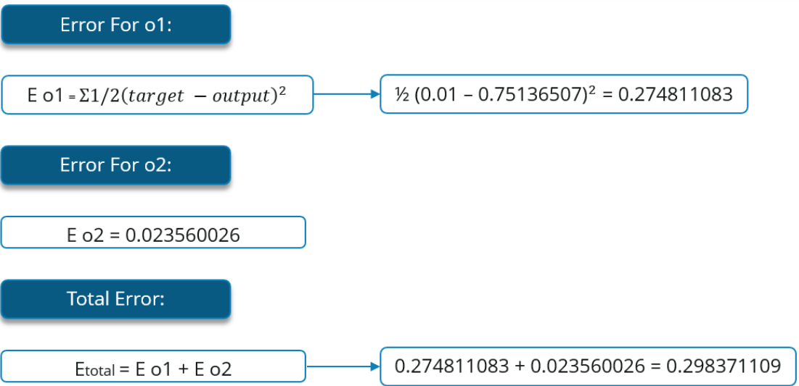
Back Propagation Neural Network
Step2: Calculating the error

Slide 33
Back Propagation Neural Network
Step3: Calculate the Rate of change (gradient) for W5

Slide 34
Back Propagation Neural Network
Step3.a: Calculating each term separatly

Slide 35
Back Propagation Neural Network
Step3.a: Calculating each term separately

Slide 36
Back Propagation Neural Network
Step3.b: Calculate the final updated weight
n: learning factor

Slide 37
Back Propagation Neural Network
The last step is repeated for all the weights in the neural network.
The neural network is trained through repeated back propagation.
The model is trained when the error is minimized.

