Slide 1
Toward Credible Evaluation of Anomaly-Based Intrusion-Detection Methods

Slide 2
There are three broad categories of detection approaches,
Signature-based: relies on pre-specified attack signatures.
Anomaly-based: typically depends on normal patterns, classifying any deviation from normal as malicious.
Specification-based: similar fashion to the anomaly-based approach, employs a model of valid program behavior in a form of specifications the development of which requires user guidance.

Slide 3
The problem?
In academic research, anomaly-based detection approach is perceived as more powerful in comparison to misuse-based methods.
It has higher potential to address novel attacks.
But, the industry favor's misuse-based detection technique.
Although anomaly-based techniques report a high detection rate of 98% at the low false alarm rate of 1%.
So, the validity of experimental research in academic computer science, in general, is questionable.

Slide 4
The Approach
Examined the evaluation practice of the anomaly-based detection techniques.
Adequate comparison of the strengths and limitations of anomaly based detection techniques.
Surveyed 276 papers that published during the period of 2000–2008.
61 journals
215 conference/workshop papers
Analyzed three major components
Employed datasets
The characteristics of the performed experiments
The methods that used for performance evaluation.

Slide 5
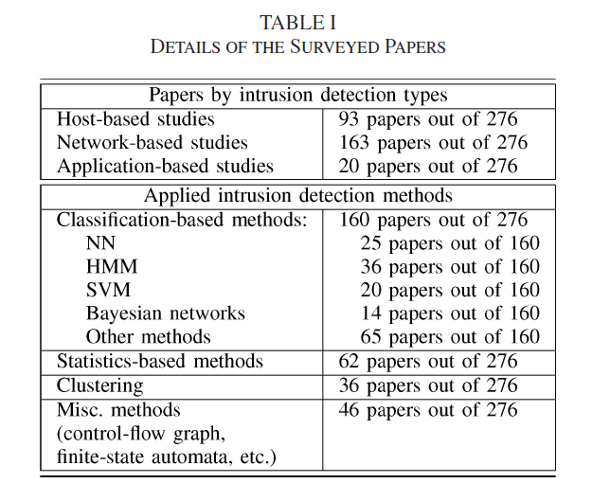
NN – Neural Network
HMM – Hidden Markov Model
SVM – support vector machine
Bayesian network

Slide 7
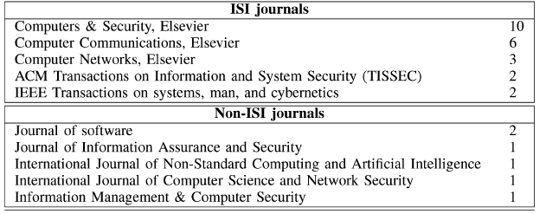
Total – 61
International Scientific Indexing (ISI) Journals – 40
Non-ISI Journal - 11

Slide 8
DATASETS

Slide 13
Experiments

Slide 16
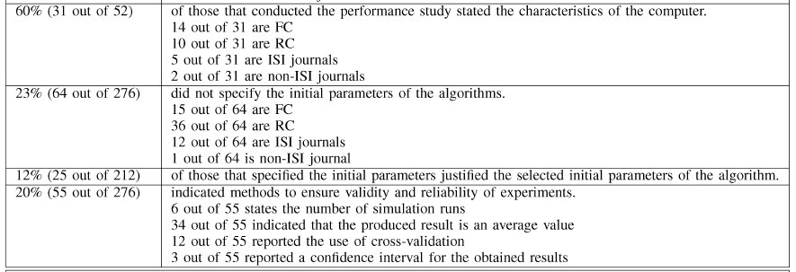

Slide 19
PERFORMANCE EVALUATION

Slide 22
Conclusion
The majority of surveyed works do not satisfy the standard requirements.
Our findings confirm a common trend in the experimental computer science field that shows a lack of a scientific rigor in academic research.
A common perceptions of the highly ranked publication venues is the better quality of their published papers, our survey results do not support that.

