Slide 1
CloudRadar: A Real-Time Side -Channel Attack Detection System in Clouds
UNIVERSITY OF HOUSTON
Start
What is Cloud Radar?
Key Points
How it works?
Design Challenges
Advisor: Dr. S.Huang
Implementation
Evaluation
Conclusion
By : Naina Chaturvedi
References

Slide 2
UNIVERSITY of HOUSTON | TECHNOLOGY
What is Cloud Radar??
What is Cloud Radar?
CloudRadar, a system to detect, and hence
mitigate, cache-based side-channel attacks
in multi-tenant cloud systems.
It exploits signature-based detection to identify when the protected virtual machine
(VM) executes a cryptographic application,
at the same time, it uses anomaly-based
detection techniques to monitor the co-
located VMs to identify abnormal cache
behaviors that are typical during cache-
based side-channel attacks.

Slide 3
UNIVERSITY of HOUSTON
Cache-based side-channel attacks and Multi-Tenant System
A side-channel attack is any attack based on information gained from the physical implementation of a system, rather than exploting brute force or theoretical weaknesses in the algorithms.
For example, timing information, power consumption, electromagnetic leaks or even sound can provide an extra source of information, which can be exploited to break the system.
Cache-based side-channel analysis is a new technique that uses the application-specific behavior of cache memory to leak secret information about a running algorithm to the attacker.
In this paper , the author show that correlation in the occurrence of
the two events offer strong evidence of side-channel attacks.
Multi-tenant cloud systems : a software architecture in which a single instance of software runs on a server and serves multiple tenants. A tenant is a group of users who share a common access with specific privileges to the software instance. It’s the feature to maximize resource utilization by consolidating virtual machines (VMs) leased by different tenants on the same physical machine.
Cache-based side-channel attacks
Multi-Tenant System

Slide 4
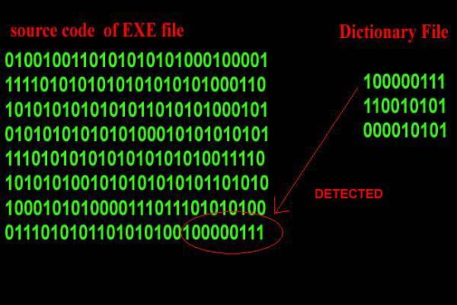
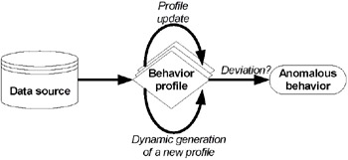
UNIVERSITY of HOUSTON
Signature-based detection and Anomaly-based
detection
Signature based detection : Operate in the same way as a virus scanner, by searching for a known identity or signature for each specific intrusion event.
Like anti-virus software, depend on receiving regular signature updates, to keep in touch with variations in hacker technique. Signature-based IDS is only as good as its database of stored signatures.
Anomaly-based detection : is an intrusion detection system for detecting both network and computer intrusions and misuse by monitoring system activity and classifying it as either normal or anomalous.
The two phases of a majority of anomaly detection systems consist of the training phase (where a profile of normal behaviors is built) and testing phase (where current traffic is compared with the profile created in the training phase)
Signature-based detection
Anomaly-based
detection

Slide 5
UNIVERSITY of HOUSTON
Two Key Points
1.The victim has unique micro-architectural behaviors when executing cryptographic applications that need protection from side-channel attacks. So the cloud provider is able to identify the occurrence of such events using a signature-based detection method.
2. The attacker VM creates an anomalous cache behavior when it is stealing information from the victim.
Key Points

Slide 6
UNIVERSITY of HOUSTON
Two Key Points
Positives and Negatives
In this table, “true positive”, “false negative”, “false positive” and “true negative” are events
The false positive rate is the proportion of all negatives that still yield positive test outcomes, i.e., the conditional probability of a positive test result given an event that was not present.
Specificity (also called the true negative rate) measures the proportion of negatives that are correctly identified as such (e.g., the percentage of healthy people who are correctly identified as not having the condition).

Slide 7
UNIVERSITY of HOUSTON
How it works ??
1.Utilizes the existing host system facilities to collect micro-architectural features from hardware performance counters that are available
in all modern commodity processors.
2.Non-intrusively interacts with the existing virtualization framework to monitor the VM’s cache activities while inducing little performance penalty.
Results :
It effectively detects side-channel attacks with high true positives and low false positives.
CloudRadar achieves :
• The first approach to detect cache side-channel attacks using techniques that
combine both signature-based and anomaly-based detection techniques.
• A non-intrusive system design that requires no changes to the hardware,
hypervisor and guest VM and applications, which shows potential of immediate
adoption in modern clouds.
• Full prototype implementation and extensive evaluation of the proposed approach and detection techniques.
How it works?

Slide 8
UNIVERSITY of HOUSTON
Defenses Against Side-Channel Attacks
Partitioning caches: Prevent the cache sharing by dividing the cache into different zones by users or ways for different VMs.
Randomization: Add randomization to the attacker’s measurements, making it hard for him to get accurate information based on his observations.
Avoiding co-location: VM placement policies were designed to reduce the co-location probability between victim and attacker VMs.
Defenses Against Side-Channel Attacks
Performance counters were originally designed for software debugging and system performance tuning.
But they can be used to detect security breaches and vulnerabilities.
The performance counters can reveal programs’ execution characteristics, which can further reflect the programs’ security states.
Intrusion Detection Using Hardware Performance Counters

Slide 9
UNIVERSITY of HOUSTON
Design Challenges
Main Focus :
Focus on cross-VM side-channel threats in public IaaS clouds that are shared between processor cores.
Signature based detection system :
Signatures of side-channel attacks must be generated from all known side-channel attack techniques and used to compare with events collected from production systems.
Cloud Radar Design Overview :
Features used by CloudRadar are hardware event values read from the performance counters available in commercial processors.
key insight for motivation : Is in cache side-channel attacks, to effectively exfiltrate secret information from the victim’s sensitive execution, the attacker needs to repeatedly conduct side-channel activities and deduce his own cache uses based on the execution time of his own memory activities. Then makes inferences using Pattern !!
“if such distinction can be detected by the attacker using timing channels, it can be detected by the cloud provider using performance counters.”
Design Challenges
Cloud Radar Design Overview

Slide 10
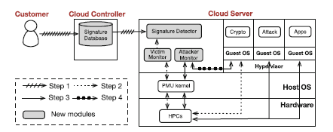
UNIVERSITY of HOUSTON
Implementation
Implementation
Generating Cryptographic Signature : Indicate to the Cloud Controller what sensitive applications to be protected, by providing the signatures generated offline using performance counters.
Cloud Controller will run these crypto programs on a dedicated server with the same configuration as the Cloud Server that hosts the protected VM, and use performance counters to generate the signatures for the customer.
The signatures will be stored in the Signature Database for future reference. They will also be sent to the Cloud Server that hosts this VM.

Slide 11
UNIVERSITY of HOUSTON
Implementation
Implementation
Detecting Cryptographic Applications : Victim Monitor monitors the protected VM using performance counters. It periodically (e.g., every 100μs) records the event counts as a time sequence.
Signature Detector keeps comparing the most recent window of data points in the sequence with the signature.
If a signature match is found, the Signature Detector can identify the protected VM is performing a cryptographic application, and signal this result to the Attacker Monitor.

Slide 12
UNIVERSITY of HOUSTON
Implementation
Implementation
Monitoring Cache Activities : The Attacker Monitor exploits performance counters to monitor all untrusted VMs simultaneously.
Attacker Monitor identifies active vCPUs .
Attacker Monitor uses a kernel module to check the state and CPU affinity of each vCPU of each VM .
The Attacker Monitor marks the vCPUs in the running state that are sharing the same LLC with the protected VM as monitored. Then it sets up performance counters to measure each monitored vCPU’s cache misses and hits in turn.
When the Attacker Monitor is notified that a cryptographic application is happening in the protected VM, it will compare each monitored vCPU’s cache misses and hits.

Slide 13
UNIVERSITY of HOUSTON
Implementation
Implementation
Eliminating Side Channels : Once the Attack Monitor notices that
one co-tenant VM has abnormal cache behavior exactly when the protected VM
executes cryptographic applications, it will raise alarm for side-channel attacks.
The Cloud Controller will report this incident to the cloud provider for further processing such as shut down the malicious VM or eventually block the attacker’s account.
Attacker Monitor uses a kernel module to check the state and CPU affinity of each vCPU of each VM

Slide 14
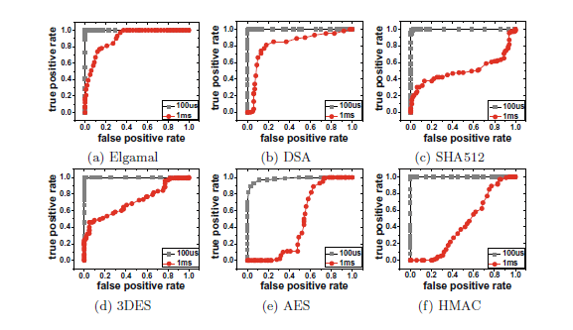
UNIVERSITY of HOUSTON
Accuracy of Cryptographic Operation Detection
To detect a cryptographic operation, we used the branch instruction counts as the signature.
The author considered detection of a cryptographic application as a binary classification and measure its true positive rate and false positive rate.
True positive happens when a cryptographic application is correctly identified.
False positive is defined as non-cryptographic applications identified as cryptographic.
How Cloud Radar measures this :
CloudRadar first generates a signature for each application. In the detection phase, the victim VM generates a random memory block and feeds it to the crypto application.
They ran experiment 100 times, and measure the number of times CloudRadar can correctly identify the cryptographic under different thresholds.
Detection Accuracy

Slide 15
UNIVERSITY of HOUSTON
Accuracy of Cryptographic Operation Detection(Cont..)
Figure shows the ROC curves of the six cryptographic applications. (Receiver Operating Characteristic) curves to show the relations between the true positive rate and false positive rate.Two different sampling granularities: 100μs and 1ms have been choosen.
Observations and results :
From this figure we can see 100μs gives better accuracy than 1ms: CloudRadar can achieve close to 100% true positive rate with zero false positive rate when the DTW threshold is set between 0.3 and 0.4.
For 1 ms Elgamal and DSA application can be detected with less accuracy, while SHA512, AES, HMAC and 3DES cannot be differentiated from non-cryptographic applications with reasonable false positive and false negative at the same time.
Detection Accuracy

Slide 16
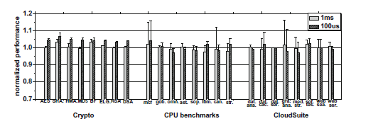
UNIVERSITY of HOUSTON
Performance Overhead.
CloudRadar can identify the attack on the order of milliseconds.
Considering side-channel attackers usually need at least several cryptographic operations to steal the keys, this small latency can achieve our real-time design goal.
A mix of benchmarks and real-world applications to evaluate the performance of
CloudRadar is used in the paper.
Observations and results :
CloudRadar has little impact on the performance of the monitored VM, even in the worstcase, performance overhead is within 5%.
Performance Overhead

Slide 17
UNIVERSITY of HOUSTON
Improvements in CloudRadar
Detecting Other Side Channels
One can extend CloudRadar to detect cache-based side-channel attacks in other cloud models or in non-virtualization environments.
The only change we need to make is to use performance counters to monitor the processes or threads instead of VMs.
We can use performance counters to count the corresponding events that the attacker uses to retrieve information.
we can monitor the DRAM bandwidth event to detect the DRAM side-channel attacks
Improvements in CloudRadar

Slide 18
UNIVERSITY of HOUSTON
Improvements in CloudRadar
Potential Evasive Attacks
To evade the detection of CloudRadar, a side-channel attacker can try to reduce the cache probing speed, so the abnormal increase in cache misses or hits may not be observed by CloudRadar.
The attacker needs a much longer time to recover the
keys, making side-channel attacks more difficult and less
practical.
An attacker can also try to evade the detection by adding noise to CloudRadar’s observations.
Improvements in CloudRadar

Slide 19
UNIVERSITY of HOUSTON
Limitations of Cloud Radar
Each of its three modules (Victim Monitor, Attacker Monitor and Signature Detector) requires an exclusive use of one physical CPU core as they keep conducting data collection and analysis at full CPU speed. This can potentially reduce the server’s capacity for hosting VMs.
Due to the limited number of performance counters available in modern processors, CloudRadar has to multiplex the monitoring for each VM using the same counter.
When the number of monitored vCPUs scales up, CloudRadar may miss attacks.
Limitations of CloudRadar

Slide 20
UNIVERSITY of HOUSTON
Conclusion
CloudRadar, a real-time detection system to detect cache based side-channel attacks in clouds.
CloudRadar leverages the existing hardware performance counter feature to both monitor a victim VM’s cryptographic operations and capture a potential attacker VM’s abnormal behavior during this time.
CloudRadar is designed as a lightweight extension to the cloud system and does not require new hardware, hypervisor/OS or application modifications.
Results :
The evaluation shows Cloud Radar can detect cache based
side-channel attacks with high fidelity, while introducing little overhead to the cloud applications.
Conclusion

Slide 21
UNIVERSITY of HOUSTON
References
CloudRadar: A Real-Time Side-Channel Attack Detection System in Clouds
http://link.springer.com/chapter/10.1007%2F978-3-319-45719-2_6
Side-Channel Attacks: Ten Years After Its Publication and the Impacts on Cryptographic Module Security Testing
http://csrc.nist.gov/groups/STM/cmvp/documents/fips140-3/physec/papers/physecpaper19.pdf
Defending against cache-based side-channel attacks
http://ac.els-cdn.com/S1363412703001043/1-s2.0-S1363412703001043-main.pdf?_tid=faf09d24-9084-11e6-be2500000aacb35d&acdnat=1476281330_c4a212c4cadc07504d1d939c6d55ee01
References

Slide 22
UNIVERSITY of HOUSTON
Acknowlegdements
I would like to thank Dr.Huang for giving me this opportunity to explore study CloudRadar and present it to the whole class!
I hope we would work on the improvements required in the CloudRadar by our understanding .
Acknowledgements

Slide 23
UNIVERSITY of HOUSTON
Thanks !!
Thanks!

