Slide 1
Improving Security and Performance in the Tor Network through Tunable Path Selection
Robin Snader and Nikita Borisov
Presented by Zechun Cao

Slide 2
Overview
Tor Design
Proposed Method
Bandwidth Measurement
Router Selection Algorithm
Evaluation and Discussions

Slide 3
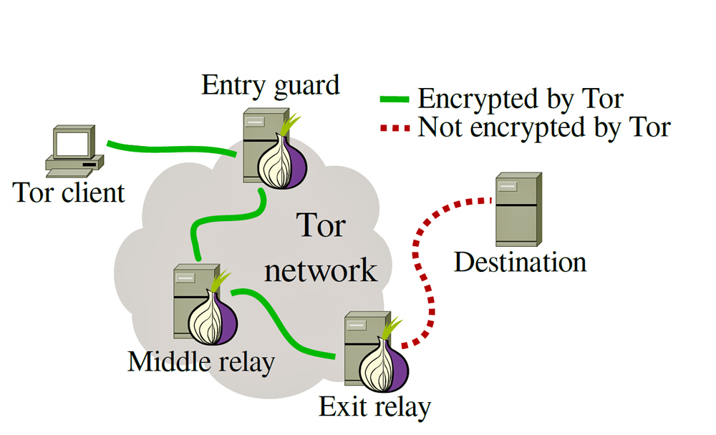
Tor Design
Tor connects client and destination server by a 3-node circuit
As of Oct 2016, Tor has more than 7,000 routers available around the world

Slide 4
Tor Design
How does Tor select the path?
Tor adopts self-report bandwidth mechanism
Every router registered with a directory service
Periodically report the peak bandwidth achieved over a period of time, upper bound is 10MB/s
Tor constructs circuit weighted by the reported bandwidth to balance the traffic

Slide 5
Tor Design
Potential problems
Self report bandwidth value is not verified in any way, vulnerable to hackers
Fast changing network condition makes bandwidth prediction inaccurate, highly variable performance
Tor native load-balancing algorithm is a single, static compromise between performance and anonymity

Slide 6
Tor Design
CDF of the time required to transfer a 1MB file over the Tor network in July of 2007
CDF of the time required to transfer a 1MB file over the Tor network in July of 2009

Slide 7
Proposed Method
How is the performance of a router measured?
Opportunistic monitoring
Evaluation aggregation
Tunable Router Selection Algorithm

Slide 8
Bandwidth Measurement
Three Methods to Consider
Tor native method – self report
Active probing
Uses up valuable bandwidth resources
Increases the risk of failure or compromise
Opportunistic monitoring

Slide 9
Opportunistic Monitoring
Passive Observation
Each router in the Tor network keeps track the bandwidth it has recently seen for each of its peers
Around 800 routers contacted within a single day
Results aggregated and uploaded to directory server
Directory server aggregates $N^{2}$ observations to $N$ evaluations

Slide 10
Opportunistic Monitoring
(a) Accuracy of probing for bandwidth prediction in real Tor network
(b) Accuracy of passive observation for bandwidth prediction in real Tor network
(c) Accuracy of advertised bandwidth for bandwidth prediction in real Tor network

Slide 11
Evaluation Aggregation
Multiple observations of a router by a single node
Take the Max of observed values over a long interval
Partition attacks, where attacker focuses all of its bandwidth on nodes of interest, thus those nodes are more likely to be selected
Spotlight attacks, where attacker focuses all of its bandwidth of one node at a time for a single interval

Slide 12
Evaluation Aggregation
Multiple observations of a router by a single node
Moving average of recent observations
$$B_{new}=\left(1−α\right)B_{old}+αB_{obs}$$
If attacker ignores a node for a sufficient period of time, that node’s estimation of the attacker will drop
Suffer from bandwidth fluctuations

Slide 13
Evaluation Aggregation
Multiple observations of a router by a single node
Min-Max weighted moving average
Carries advantage from moving average aggregation
But allows bandwidth increase rapidly, and decay slowly if poor service is provided
$$B_{new}=\left(1−α\right) max(B_{old}, B_{obs})+α min(B_{old}, B_{obs})$$

Slide 14
Evaluation Aggregation
Multiple observations of a router by multiple nodes
Median-of-five Measurement
Queries five nodes, and take the median value
EigenSpeed Measurement
A node uploads its own observation vector by incorporating the observations of other nodes, weighted by their observed bandwidth.
Higher bandwidth capacity can estimate other nodes’ capacities more accurately, forcing attackers to spend resources to attack the system

Slide 15
Evaluation Aggregation
(a) Actual node bandwidth vs. achieved bandwidth (r=0.223)
(b) Current Tor bandwidth measurement vs. achieved bandwidth (r=0.176)
(c) Median-of-five bandwidth measurement vs. achieved bandwidth (r=0.680)
(d) EigenSpeed bandwidth measurement vs. achieved bandwidth r=(0.881)

Slide 16
Evaluation Aggregation
Fig. Fractional network utilization for the bandwidth evaluation algorithms presented

Slide 17
Tunable Router Selection Algorithm
Flexibility between performance and anonymity
Given a list of routers and their rankings
If the list is indexed from $0−(n−1)$
The selected router is that with the index $[n×f_{s}(x)]$
$f_{s}\left(x\right)=\frac{1−2^{sx}}{1−2^{s}}$, $f_{s}:\left[0,1\right]→[0,1]$
For example, s=15 implies among 1,700 routers, the most highly ranked router will be chosen 23% of the time

Slide 18
Tunable Router Selection Algorithm
Fig. Cumulative distributions of routers selected by ranking for some selection levels

Slide 19
Tunable Router Selection Algorithm
Features to Note
Router selected based on ranking, not metric itself, hackers have to put more resources
$f_{s}$ is well defined for all real $s$, negative value could result in picking low bandwidth router
Coin toss strategy used to pick between know routers group and new routers group

Slide 20
Tunable Router Selection Algorithm
Discovering Selection Level with Single Path
With single malicious router, hacker trains naïve Bayesian classifier with 100,000 paths. Then applies the classifier to another 100,000 paths for evaluation.
Uniform dataset achieves 4.568 in absolute average value, 4.567 in skewed dataset, in which level 0 is chosen 20% of the time, level 15 at 52%, all other levels 2% for each

Slide 21
Tunable Router Selection Algorithm
Fig. Actual selection level and most likely selection level according to a naiıve Bayesian classifier
Fig. Mean and standard deviation of guessed level by actual selection level according to a naive Bayesian classifier, for both a uniform and skewed distribution of selection levels.

Slide 22
Tunable Router Selection Algorithm
Discovering Selection Level with Multiple Paths
Hackers are able to correlate tunnels at a single level
K-S (Kolmogorov-Smirnov) tests whether an empirical distribution fits a hypothesized distribution
For each selection level, 500 exit router one at a time, after each choice the range of selection levels passing the K-S test is recorded. The experiment repeats 100 times at each selection level.

Slide 23
Tunable Router Selection Algorithm
It decreases most quickly for the lower selection levels
The possible selection level range is reduced to only three possibilities after only 50 observations at level 1
But takes nearly five times as many observations to reduce the possibilities that far for selection level 13
How many observations we need?
Fig. Average range of possible selection levels according to a known-distribution Kolmogorov-Smirnov test

Slide 24
Tunable Router Selection Algorithm
Stopping when only one level passes K-S test, it works well for intermediate selection levels
Selection level 1 is misidentified as selection level 0 nearly 80% of the time
Selection level 13 being misidentified as selection level 15 a substantial fraction of the time
Fig. First unique matching selection level according to a known-distribution Kolmogorov-Smirnov test

Slide 25
Evaluation and Discussion
Whole System Evaluation
Performance
Real Tor Network: Only one router is deployed
Simulated Tor Network: All routers are deployed
Anonymity

Slide 26
Evaluation and Discussion
Performance in Real Tor Network
Deploy Tunable Tor to a single client
Keep exit router, host server fixed, while intermediate routers are chosen based on the proposed method
Approximately 40,000 trials for native Tor client, 20,000 trials for Tunable Tor client
Download 1MB file over HTTP protocol

Slide 27
Evaluation and Discussion
Fig. Cumulative distribution of transfer times for a 1MB file for vanilla Tor and several selection levels in real Tor network
Fig. Cumulative distribution of transfer times for a 1MB file for vanilla Tor and several selection levels in simulated Tor network

Slide 28
Evaluation and Discussion
Anonymity
Fig. Gini coefficient of router selection equality by selection level
Fig. The fraction of tunnels compromised if an attacker compromises the top given fraction of Tor routers, for vanilla Tor and for various selection levels

Slide 29
Thank you!
Questions?

