Slide 1
Stepping Stone Detection at The Server Side
A Real-Time Algorithm to Detect whether a proxy being is used as a Stepping Stone
Devin Crane

Slide 2
Reference
R. Lin et all, “Stepping stone detection at the server side,” in the proceeding 4th IEEE Conference on Computer Communications Workshops (INFOCOM WKSHPS), pp.964-969, 2011.

Slide 3
Contents
Introduction
Previous Work
New Approach
Hacking Vulnerabilities
Conclusion

Slide 4
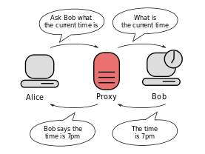
Proxy Server
Originally created to enhance web browsing performance for a group of users
Saves the results of all requests for a certain amount of time
Facilitates anonymous browsing by concealing a user’s IP address

Slide 5
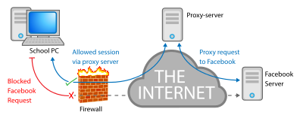
Proxy Server
Can be used to circumvent firewalls, such as accessing Facebook from school
But a proxy is also used maliciously

Slide 6
Goal
Detect the use of a stepping stone from the server’s perspective
No general method currently available
Dependent on use of Nagle’s algorithm, explained later

Slide 7
Contents
Introduction
Previous Work
New Approach
Hacking Vulnerabilities
Conclusion

Slide 8
Previous Work
A common solution is to check the header variables in a HTTP request for things like X-Forwarded-For or Via. Means the request should have relayed by a web proxy.
Doesn’t work for anonymous proxies, since it can simply choose to not add the header to a forwarded HTTP request

Slide 9
Previous Work
Other stepping stone detection research seeks to detect whether a host is being used as a stepping stone
This newly proposed approach seeks to detect whether a TCP connection is initiated by a stepping stone, from a server’s perspective

Slide 10
Previous Work - Hopper et al
Focused on anonymous routing networks, such as Tor or the use of a proxy
Used a latency-based attack to detect the location of a client behind the Tor network, based on the network latency between the client and the entry node of the Tor network
Measured the application-layer latency based on the time difference between when the proxy receives an HTML page and when the client processes the HTML page
Can be thwarted by making the proxy parse the HTML page and issue corresponding HTTP requests on behalf of the client, thereby making the measured network latency and application-layer latency too similar to detect

Slide 11
Contents
Introduction
Previous Work
New Approach
Hacking Vulnerabilities
Conclusion

Slide 12
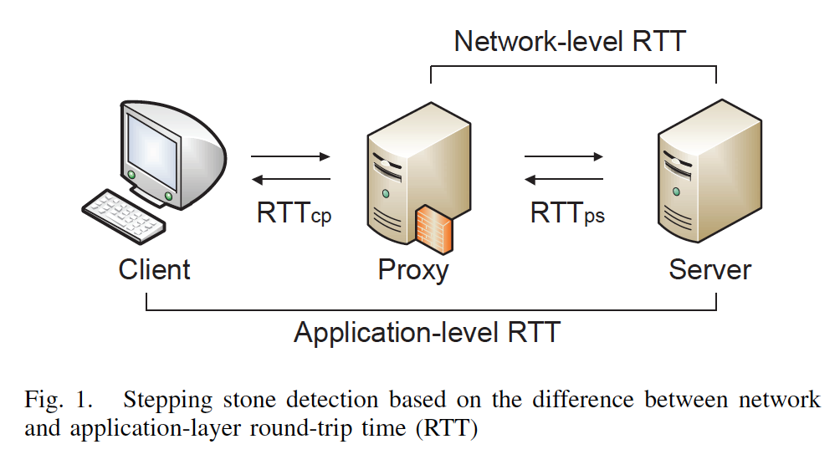
New Approach
Detect stepping stones from the server side by contrasting the network and application-layer latencies

Slide 13
Nagle’s Algorithm
Built into most, possibly all, of TCP implementations today
Basic idea is to reduce the number of packets generated by a TCP sender
Combines smaller packets into bigger packets
Because the algorithm changes the traffic pattern of TCP packet streams, the traffic generated by a client would have different patterns compared with the traffic relayed by a proxy
To be referred to as ‘Nagle’s’ going forward

Slide 14
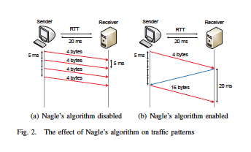
Nagle’s Algorithm
Without applying Nagle’s, the inter-arrival times (IAT) of consecutive packets are retained as the data generation intervals at the sender application.
If it is enabled, it will buffer data and form a larger packet until old data are acknowledged. So, in most cases, the IAT of generated packets will be close to the round-trip time (RTT) between the sender and the receiver.
IAT is the time between the
“start” of two events.

Slide 15
Proxy-present scenarios
The following 4 scenarios will explain how Nagle’s and the distance from the proxy to the client and server will change the traffic patterns from client to server.
Nagle-disabled proxy with RTT_{cp} < RTT_{ps}
Nagle-disabled proxy with RTT_{cp} > RTT_{ps}
Nagle-enabled proxy with RTT_{cp} < RTT_{ps}
Nagle-enabled proxy with RTT_{cp} > RTT_{ps}
Assume client sends out 4-byte messages every 5ms to the server via the proxy.
RTT_{cp} = RTT between the client and proxy
RTT_{ps}= RTT between the proxy and server
IAT_{s} = inter-arrival times of packets arriving at the server.
PS_{s} = Payload sizes of packets arriving at the server

Slide 16
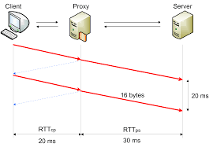
Case 1: Nagle-disabled proxy with RTT_{cp} < RTT_{ps}
Proxy is basically a repeater. Since the client still has Nagle’s enabled, the packet inter-arrival times (IAT) sent by the client will be about equal to RTT_{cp}. IAT_{s} is about equal to RTT_{cp .}

Slide 17
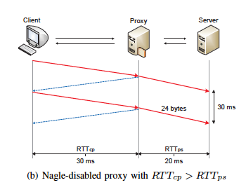
Case 2: Nagle-disabled proxy with RTT_{cp} > RTT_{ps}
Same as Case 1, except RTT_{cp} > RTT_{ps}. IAT_{s} is about equal to RTT_{ps}, not RTT_{cp} like in Case 1.

Slide 18
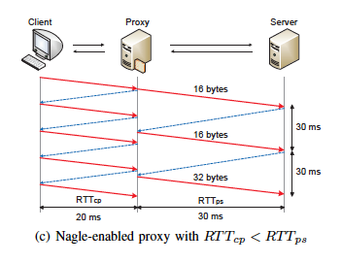
Case 3: Nagle-enabled proxy with RTT_{cp} < RTT_{ps}
Two-phase buffering effect happens here. Buffering happens at the client, and then Nagle’s means the proxy buffers until the ACK returns from the server before sending more. IAT_{s} is about equal to RTT_{ps}.
Packet payload sizes
follow
N-modal distr.

Slide 19
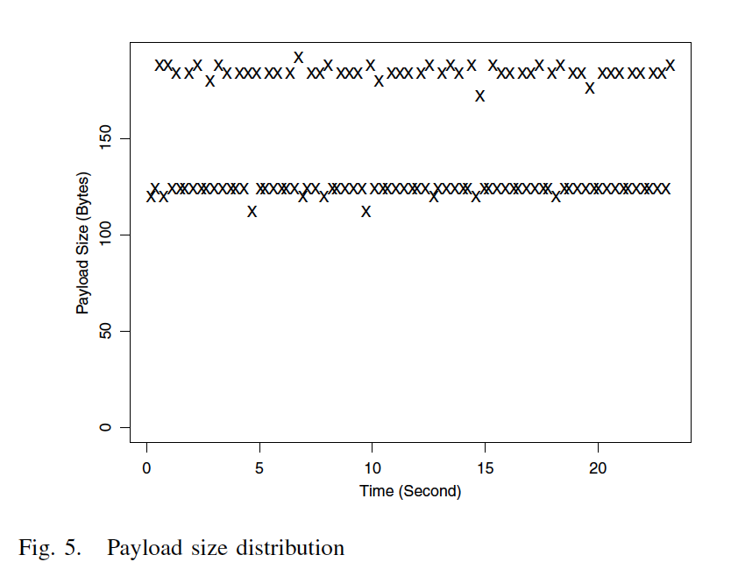
n-modal property

Slide 20
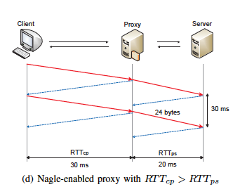
Case 4: Nagle-enabled proxy with RTT_{cp} > RTT_{ps}
Similar to Case 3, except RTT_{cp} > RTT_{ps}. Since the proxy can send out packets at a faster pace than the client, the two-phase buffer effect that case 3 doesn’t happen here. IAT_{s} is about equal to RTT_{cp}.

Slide 21
Case Summary
If a proxy relays TCP traffic for a client towards a server, the patterns of the packets arriving at the server will reveal the presence of the proxy node. Also, the traffic patterns may be different depending on whether Nagle’s is enabled at the proxy and the relative magnitude or distance of RTT_{cp} and RTT_{ps}.
The 4 cases show that IAT_{s} and PS_{s} (packet payload sizes arriving at the server) are indicators for detecting the presence of the proxy node between a client and a server.

Slide 22
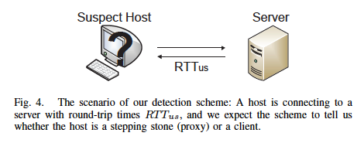
New Detection Scheme
Enough IAT_{s} and PS_{s} samples must have been collected
Compare IAT_{s} and IAT_{gen} (interval in which the client generates small data chunks)
If #2 appr. equal, Nagle’s is not enabled at the client and time to abort, to be discussed further in the Security Analysis, or Potential Hacks, section
Next, if IAT_{s} is not close to RTT_{us} (below), the remote peer is a proxy based on cases 1, 2, and 4.

Slide 23
New Detection Scheme
5. However, if IAT_{s} is close to RTT_{us} , and PS_{s} holds the n-modal property, PS_{s} does consistently spread over a certain value over time.
Normalize PS_{s} into PN_{s} by dividing PS_{s} by the size of the data chunk generated by the client (4 bytes in this case)
This makes PN_{s} the number of chunks delivered by a packet arriving at the server.
Divide PN_{s} into a number of segments, with window size n, 10 in this case
If the number of chunks in a segment is clustered around a value, the segment is single-modal
If ratio of single-modally distributed segments is lower than a threshold, the remote peer is deemed a proxy, otherwise it is a client

Slide 24
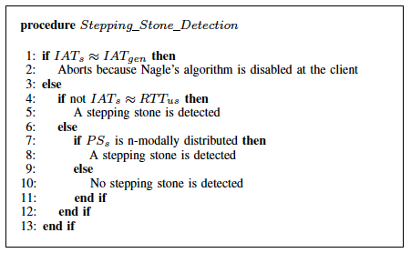
New Detection Scheme Algorithm

Slide 25
Controlled Experiments
3 computers: client, proxy, and server, all with Ubuntu Linux 2.6.32 and gigabit Ethernet switch
Switch between two configurations to emulate conditions with and without the proxy as a stepping stone
C-S configuration, client connects via TCP to server directly
C-P-S configuration, used program Socksify to redirect the client’s TCP connections to the server via proxy, where Dante is installed as a SOCKS server
Each experimental run, client sends 1,000 4-byte data chunks very 5 ms
dummynet used to inject latency from client to proxy to simulate different RTT_{cp} and RTT_{ps}

Slide 26
Controlled Experiments
The server used the new scheme to determine if a proxy was in use by inferring RTT_{us,} IAT_{s,} and PS_{s} based on the received packets
100 runs for C-S config, >= 50 runs for each of 4 cases of the C-P-S config
Most wrong decisions made in the Case 3 scenarios, RTT_{cp} < RTT_{ps}

Slide 27
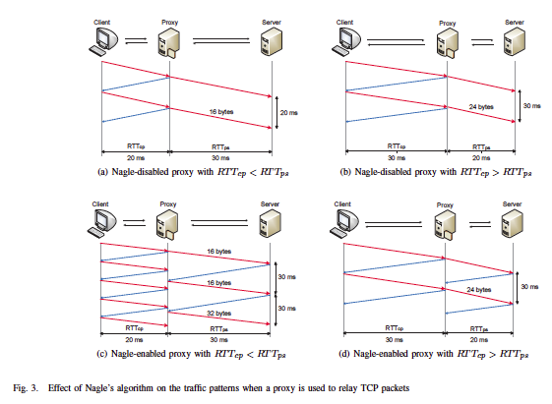
Controlled Results

Slide 28
Internet Experiments
Conducted on PlanetLab to get uncontrollable cross-traffic
304 nodes, randomly chose 2 nodes as client and server for C-S config and 3 nodes for C-P-S config
Enabling Nagle’s is randomly decided
> 10,000 C-S runs; > 2,000 of C-P-S runs of 4 cases
Scheme can’t detect proxy if RTT_{cp} < 5 ms; removed. < 1%
Mostly breaks when RTT_{cp} is similar to RTT_{ps}, but the scheme relies on this not being true, only 7% of runs. Also, Case 3. Internet queuing delays may lead to unstable RTT_{cs}

Slide 29
Internet Results

Slide 30
Performance
New scheme achieves 92% accuracy in 99% of runs. Can serve as a strong complement to other stepping stone detection algorithms, like Hopper et all, for the scenarios it isn’t as successful.
Table 1
Table 2

Slide 31
Contents
Introduction
Previous Work
New Approach
Hacking Vulnerabilities
Conclusion

Slide 32
Potential hacks of new scheme
Disable Nagle’s on both client and proxy
New scheme requires Nagle’s to be enabled at the client so it doesn’t work.
Must find another detection method
However, if the proxy also turns it off, it’s easily detectable since IAT_{s} is similar to IAT_{gen}

Slide 33
Potential hacks of new scheme
Nagle’s disabled on both client and proxy, but the client simulates Nagle’s at the application layer
Client can simulate Nagle’s make it look as if it directly connects to the server
Packets can be purposely sent with interval time RTT_{ps} so that IAT_{s} is similar to RTT_{ps}.
However, this can be detected by occasionally blocking the TCP ACK during detection process.
Nagle’s will cause buffering and wait for an ACK.
The client will then have to release a packet every RTT_{ps}.
If an ACK is blocked longer than RTT_{ps,} and still see new packets at the server, this evasion is likely happening.

Slide 34
Potential hacks of new scheme
Nagle’s is disabled on the client but enabled on the proxy node
Client and proxy would be seen as a virtual node with a long internal processing delay. Hard to detect, but Hopper et al’s distance based scheme could help detect in this case

Slide 35
Contents
Introduction
Previous Work
New Approach
Hacking Vulnerabilities
Conclusion

Slide 36
Conclusion
Proposed a new scheme that allows a server to detect whether a remote peer of a TCP connection is a stepping stone
Because Nagle’s Algorithm changes the traffic patterns of TCP packet streams, the client traffic would have different patterns when compared with proxy-relayed traffic
Therefore this new scheme detects the presence of a stepping stone by observing the interarrival times and payload size of the packets arriving at a server
Considered a starting point to give critical Internet users the power to refuse anonymous access whenever necessary

Slide 37
Thank you
Any questions?

