Slide 1
9-1-1 DDoS:
Threat, Analysis and Mitigation

Slide 2
DDoS on 9-1-1
9-1-1 emergency service: allows anonymized call
Requires all carriers to transmit 911 calls to special end point without subscribers validation
Don’t require SIM to make a 911 call
Therefore, it’s possible to launch a DDoS

Slide 3
Mobile phone botnets
Malware installed in smartphone, normally very stealthy
Make calls without notice of device owner
Steal personal information

Slide 4
Cellular Network
IMSI (Internal Mobile Subscriber Identity)
Unique identification number across all cellular networks
Usage: identify subscriber
15 digit stored in SIM
IMEI (International Mobile Station Equipment Identity)
Identifying mobile equipment
Stored in firmware/burned into ROM
Required in authentication phase

Slide 5
Cellular Network
NSI (Non-Service Initialized)
Register and unregister process
Basically, your device isn’t connected into network
Emergency Calls
The “emergency” button in your lock screen
CM_SERVICE_REQUEST: indicate this is an emergency call
At least require an IMEI
Can be made even under NSI

Slide 6
E911
PSAP (Public-Safety Answering Point)
Centers that handle 911 calls
Selective Router (SR)
Special telephony switches used to connect 911 calls to PSAP
Telephone Switch (TS)
Process of a call being connected to PSAP

Slide 7
E911
Caller Identification and Location Information
Used to retrieve caller information
Call Routing
A 911 call is received
Transfer the call to local SR
If no available SR, the call is dropped or transferred to alternative SR
SR connect the call to PSAP
If no available PSAP or no available call taker, the call is transferred or dropped

Slide 8
Several kinds of attack bots
NA (non-anonymized)
Ordinary smartphone infected with an OS level malware
Anonymized (A)
Hide IMSI when making the call
Virtually entering no-SIM state
Persistent Anonymized (A*)
Bot that ramdomized IMEI or IMSI
The most stealthy one

Slide 9
Implementation of NA bot
Launched from OS level
A proxy between RILD and RIL
RIL: Radio Interface Layer, the interface between low level hardware and high level telephony service
RILD: Radio Interface Layer Daemon, interface between telephony service and RIL
The proxy send some fake command in owner’s part
Injecting audio into the outgoing call (only certain model)

Slide 10
Implementation of A bot
Cellular protocol stack:
managed by a separate real-time OS (RTOS)
Interacting with Android
Our goal: switch protocol stack into no-SIM mode
Implement a rootkit inside firmware
Can manage RTOS’s state machine
Fool the phone!
How to do this? OsmocomBB

Slide 11
Implementation of A bot
Layered protocol stack
L1: radio interface
L2: data link layer
L3: RR (lowest)-MM(IMEI and IMSI are handled)-CM
Since we can manipulate RTOS’s state machine now
Initiate 911 call
Mask IMSI and IMEI before they reach upper layer
The device is in psudo no-SIM state now

Slide 12
Implementation of A bot
OsmocomBB
The only way to freely research the implementation of a mobile’s baseband software
Architecture of the bot
Caller
Anonymizer
Caller: handle state machine
Build emergency call request via MM and CR layer
Anonymizer
Masking IMEI/IMSI

Slide 13
Implementation of A bot
Normal register process
Switch on
IMSI attach
Validation
request contains IMSI and location register
Authentication
Carrier sends authentication request to mobile
Answer with encrypted message
Finished register

Slide 14
Implementation of A bot
Anonymize process
Initialize a SIM card missing report
Invoke flag MMR_NREG_REQ
Detached from network
No SIM card, can still make memrgency calls

Slide 15
Implementation of A* bot
Detect smartphone’s status (If owner is press the key?)
Detach SIM (Same as A bot)
Set a random IMEI number
IMEI and/or IMSI are spoofed
Initialize 911 call repeatly

Slide 16
Implementation of A* bot
A* bot anonymizer
Same as A bot with no-sim state but added IMEI spoofing
Randomized during location update procedure
Each call with a new IMSI
Can’t be blocked!

Slide 17
Experiment
Test Environment
A base transceiver station
Wireshark capturing traffic
Build a simulated model of E911 system based on NC, Charlotte

Slide 18
E911 Network Simulation
Robustness
Heavy-tail degree distribution
Robust to random failures
SR redundancy
83% PSAPs are connected to single SR
Highly risky!
Traffic overflows
No enough call takers

Slide 19
E911 Network Simulation
PSAP workload
Yes, you can get busy signal even in an real emergency situation
PSAP call balancing
No such resources
PSAP call waiting
Calls can be held

Slide 20
Attack simulation
Time
The peak hours
Call Event Generation
Call processing time
Time for saying “9-1-1, what’s your emergency?”
Redial
How many people will call again?
SR capacity

Slide 21
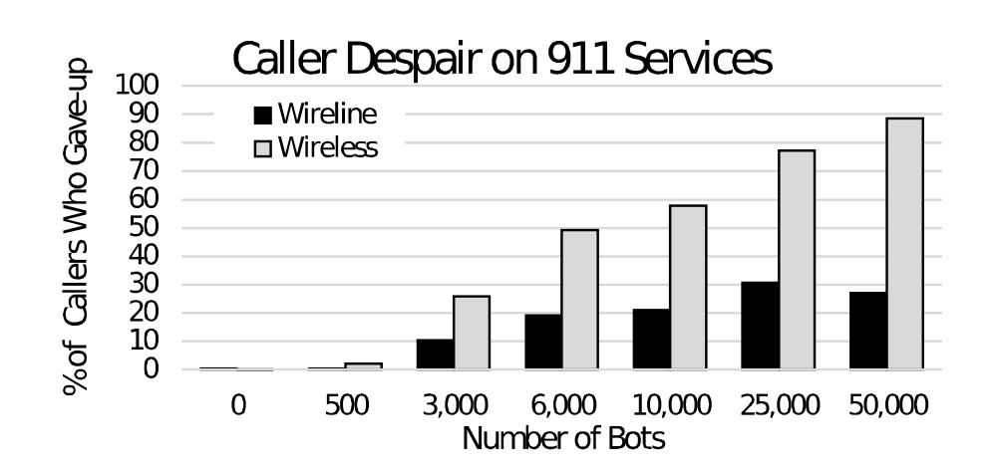
Attack simulation results
Callers who give up

Slide 22
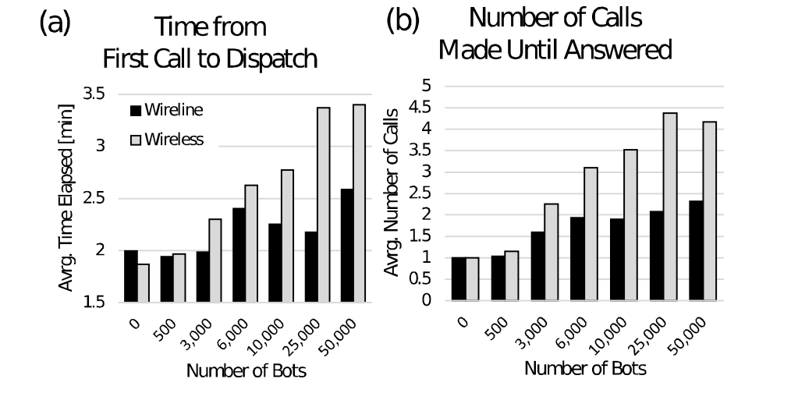
Attack simulation results
More bots, more legimate calls
Callers are desperately redialing

Slide 23
Attack simulation results
Network performance
87% SR overloaded
Affection 98% callers
PSAP performance
Wireline: 75% calls affected
Wireless: 91% calls affected
Why?

Slide 24
Countermeasures
Disallow NSI calls?
Trusted Device identification?
Human presence detection?
Call firewall?

Slide 25
Afterthoughts
Critical challenge
Ethical problem
Wide range regulation change (government, manufacturer, carrier)

