Slide 1
Evolution strategies
Chapter 4

Slide 2
ES quick overview
Developed: Germany in the 1970’s
Early names: I. Rechenberg, H.-P. Schwefel
Typically applied to:
numerical optimisation
Attributed features:
fast
good optimizer for real-valued optimisation
relatively much theory
Special:
self-adaptation of (mutation) parameters standard

Slide 3
ES technical summary tableau
Representation | Real-valued vectors
Recombination | Discrete or intermediary
Mutation | Gaussian perturbation
Parent selection | Uniform random
Survivor selection | (μ,λ) or (μ+λ)
Specialty | Self-adaptation of mutation step sizes

Slide 4
Introductory example
Task: minimimise f : R^{n} → R
Algorithm: “two-membered ES” using
Vectors from R^{n} directly as chromosomes
Population size 1
Only mutation creating one child
Greedy selection

Slide 5
Introductory example: pseudocde
Set t = 0
Create initial point x^{t} = ⟨ x₁^{t},…,x_{n}^{t} ⟩
REPEAT UNTIL (TERMIN.COND satisfied) DO
Draw z_{i} from a normal distr. for all i = 1,…,n
y_{i}^{t} = x_{i}^{t} + z_{i}
IF f(x^{t}) < f(y^{t}) THEN x^{t+1} = x^{t}
ELSE x^{t+1} = y^{t}
FI
Set t = t+1
OD

Slide 6
Introductory example: mutation mechanism
z values drawn from normal distribution N(ξ,σ)
mean ξ is set to 0
variation σ is called mutation step size
σ is varied on the fly by the “1/5 success rule”:
This rule resets σ after every k iterations by
σ = σ / c if p_{s} > 1/5
σ = σ • c if p_{s} < 1/5
σ = σ if p_{s} = 1/5
where p_{s} is the % of successful mutations, 0.8 ≤ c ≤ 1

Slide 7
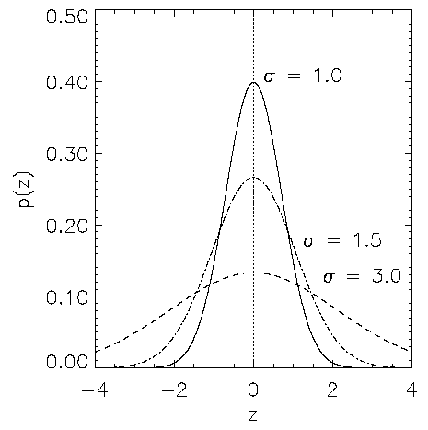
Illustration of normal distribution
http://en.wikipedia.org/wiki/Normal_distribution

Slide 8
Another historical example: the jet nozzle experiment
Task: to optimize the shape of a jet nozzle
Approach: random mutations to shape + selection
Initial shape
Final shape
http://en.wikipedia.org/wiki/Propelling_nozzle

Slide 9
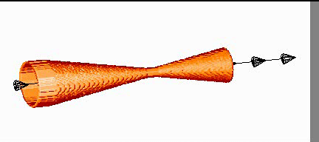
Another historical example: the jet nozzle experiment cont’d
Next Time
http://ls11-www.cs.uni-dortmund.de/people/schwefel/EADemos/#bot

Slide 10
The famous jet nozzle experiment (movie)

Slide 11
Representation
Chromosomes consist of three parts:
Object variables: x₁,…,x_{n}
Strategy parameters:
Mutation step sizes: σ₁,…,σ_{nσ}
Rotation angles: α₁,…, α_{nα}
Not every component is always present
Full size: ⟨ x₁,…,x_{n}, σ₁,…,σ_{n} ,α₁,…, α_{k} ⟩
where k = n(n-1)/2 (no. of i,j pairs)

Slide 12
Mutation
Main mechanism: changing value by adding random noise drawn from normal distribution
x’_{i} = x_{i} + N(0,σ)
Key idea:
σ is part of the chromosome ⟨ x₁,…,x_{n}, σ ⟩
σ is also mutated into σ’ (see later how)
Thus: mutation step size σ is coevolving with the solution x

Slide 13
Mutate σ first
Net mutation effect: ⟨ x, σ ⟩ → ⟨ x’, σ’ ⟩
Order is important:
first σ → σ’ (see later how)
then x → x’ = x + N(0,σ’)
Rationale: new ⟨ x’ ,σ’ ⟩ is evaluated twice
Primary: x’ is good if f(x’) is good
Secondary: σ’ is good if the x’ it created is good
Reversing mutation order this would not work

Slide 14
Mutation case 1: Uncorrelated mutation with one σ
Chromosomes: ⟨ x₁,…,x_{n}, σ ⟩
σ’ = σ • exp(τ • N(0,1))
x’_{i} = x_{i} + σ’ • N(0,1)
Typically the “learning rate” τ ∝ 1/ n^{½}
And we have a boundary rule σ’ < ε₀ ⇒ σ’ = ε₀

Slide 15
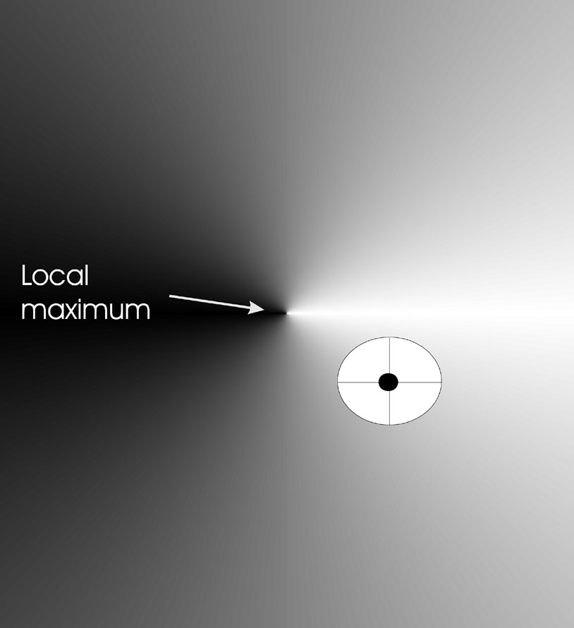
Mutants with equal likelihood
Circle: mutants having the same chance to be created

Slide 16
Mutation case 2: Uncorrelated mutation with n σ’s
Chromosomes: ⟨ x₁,…,x_{n}, σ₁,…, σ_{n} ⟩
σ’_{i} = σ_{i} • exp(τ’ • N(0,1) + τ • N_{i} (0,1))
x’_{i} = x_{i} + σ’_{i} • N_{i} (0,1)
Two learning rate parmeters:
τ’ overall learning rate
τ coordinate wise learning rate
τ ∝ 1/(2 n)^{½} and τ ∝ 1/(2 n^{½}) ^{½}
And σ_{i}’ < ε₀ ⇒ σ_{i}’ = ε₀

Slide 17
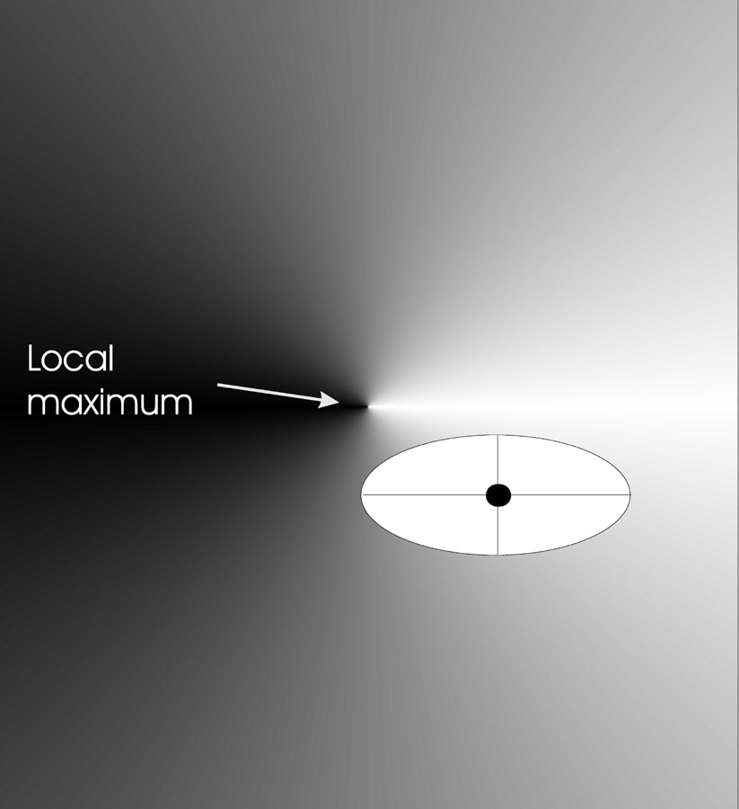
Mutants with equal likelihood
Ellipse: mutants having the same chance to be created

Slide 18
Mutation case 3: Correlated mutations
Chromosomes: ⟨ x₁,…,x_{n}, σ₁,…, σ_{n} ,α₁,…, α_{k} ⟩
where k = n • (n-1)/2
and the covariance matrix C is defined as:
c_{ii} = σ_{i}²
c_{ij} = 0 if i and j are not correlated
c_{ij} = ½ • ( σ_{i}² - σ_{j}² ) • tan(2 α_{ij}) if i and j are correlated
Note the numbering / indices of the α‘s

Slide 19
Correlated mutations cont’d
The mutation mechanism is then:
σ’_{i} = σ_{i} • exp(τ’ • N(0,1) + τ • N_{i} (0,1))
α’_{j} = α_{j} + β • N (0,1)
x ’ = x + N(0,C’)
x stands for the vector ⟨ x₁,…,x_{n} ⟩
C’ is the covariance matrix C after mutation of the α values
τ ∝ 1/(2 n)^{½} and τ ∝ 1/(2 n^{½}) ^{½} and β ≈ 5°
σ_{i}’ < ε₀ ⇒ σ_{i}’ = ε₀ and
| α’_{j} | > π ⇒ α’_{j} = α’_{j} - 2 π sign(α’_{j})

Slide 20
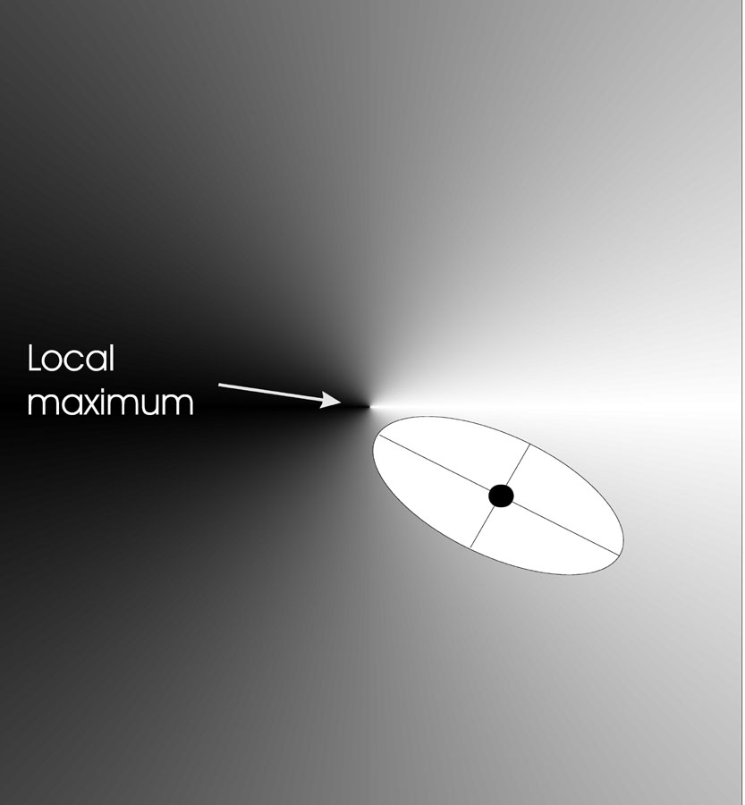
Mutants with equal likelihood
Ellipse: mutants having the same chance to be created

Slide 21
Recombination
Creates one child
Acts per variable / position by either
Averaging parental values, or
Selecting one of the parental values
From two or more parents by either:
Using two selected parents to make a child
Selecting two parents for each position anew

Slide 22
Names of recombinations
 | Two fixed parents | Two parents selected for each i
z_{i} = (x_{i} + y_{i})/2 | Local intermediary | Global intermediary
z_{i} is x_{i} or y_{i} chosen randomly | Local discrete | Global discrete

Slide 23
Parent selection
Parents are selected by uniform random distribution whenever an operator needs one/some
Thus: ES parent selection is unbiased - every individual has the same probability to be selected
Note that in ES “parent” means a population member (in GA’s: a population member selected to undergo variation)

Slide 24
Survivor selection
Applied after creating λ children from the μ parents by mutation and recombination
Deterministically chops off the “bad stuff”
Basis of selection is either:
The set of children only: (μ,λ)-selection
The set of parents and children: (μ+λ)-selection

Slide 25
Survivor selection cont’d
(μ+λ)-selection is an elitist strategy
(μ,λ)-selection can “forget”
Often (μ,λ)-selection is preferred for:
Better in leaving local optima
Better in following moving optima
Using the + strategy bad σ values can survive in ⟨x,σ⟩ too long if their host x is very fit
Selective pressure in ES is very high (λ ≈ 7 • μ is the common setting)

Slide 26
Self-adaptation illustrated
Given a dynamically changing fitness landscape (optimum location shifted every 200 generations)
Self-adaptive ES is able to
follow the optimum and
adjust the mutation step size after every shift !

Slide 27
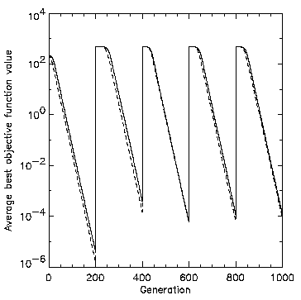
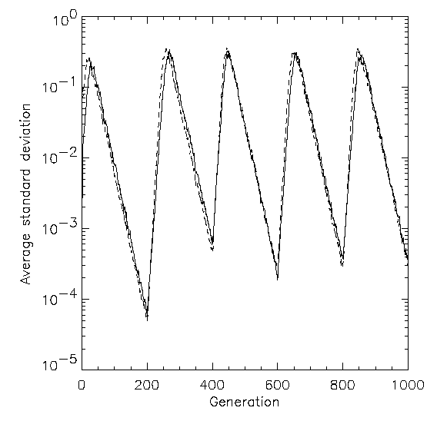
Self-adaptation illustrated cont’d
Changes in the fitness values (left) and the mutation step sizes (right)

Slide 28
Prerequisites for self-adaptation
μ > 1 to carry different strategies
λ > μ to generate offspring surplus
Not “too” strong selection, e.g., λ ≈ 7 • μ
(μ,λ)-selection to get rid of misadapted σ‘s
Mixing strategy parameters by (intermediary) recombination on them

Slide 29
Example application: the cherry brandy experiment
Task to create a colour mix yielding a target colour (that of a well known cherry brandy)
Ingredients: water + red, yellow, blue dye
Representation: ⟨ w, r, y ,b ⟩ no self-adaptation!
Values scaled to give a predefined total volume (30 ml)
Mutation: lo / med / hi σ values used with equal chance
Selection: (1,8) strategy

Slide 30
Example application: cherry brandy experiment cont’d
Fitness: students effectively making the mix and comparing it with target colour
Termination criterion: student satisfied with mixed colour
Solution is found mostly within 20 generations
Accuracy is very good

Slide 31
Example application: the Ackley function (Bäck et al ’93)
The Ackley function (here used with n =30):
Evolution strategy:
Representation:
-30 < x_{i} < 30 (coincidence of 30’s!)
30 step sizes
(30,200) selection
Termination : after 200000 fitness evaluations
Results: average best solution is 7.48 • 10 ^{–8} (very good)

