Slide 1
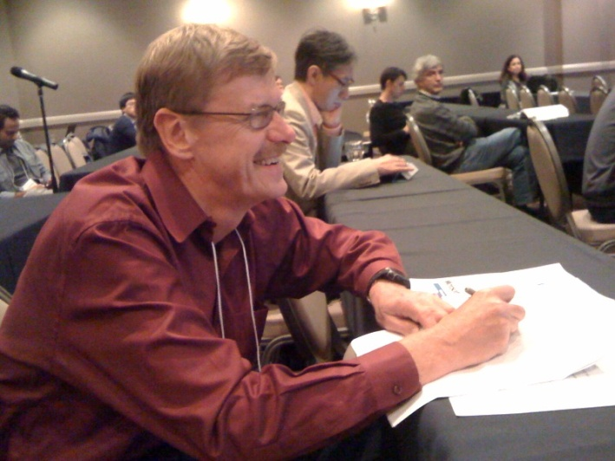
Report ACM-GIS 2011, Chicago
http://acmgis2011.cs.umn.edu/
273 attendees; only 160 paper submissions; acceptance rate was very high in 2011: 19%(long papers)+22%(poster)=41%
A lot of travel grants and therefore a lot of student participants; quite few faculty participants
Chicago Lakefront View of Downtown
Attending ACM-GIS 2011 (photo
taken by Wei Ding)

Slide 2
Report ACM-GIS 2011, Chicago
A lot of workshops(http://acmgis2011.cs.umn.edu/workshops/index.html )—this tells you were the current research activities lie.
A lot of papers on trajectories (more than 20%) many of which lack depth (either theoretical or experimental)
One paper from the University of Oklahoma which analyzes change in rain fall patterns has some similarity with our spatial progression work
Interesting parking slot assignment paper
Somewhat interesting work on spatial ontologies
Colocation paper from the University of Minnesota that centers on regional knowledge extraction

Slide 3
Report ACM-GIS 2011, Chicago
Several papers on location prediction (a German paper tried to predict your location based on the path you drove on the road was kind of unique) and on analyzing streaming spatial data which pose data analysis/data structure/HPC problems
Somewhat interesting demos: Microsoft displayed a system where you can walk through a city in 3D. http://readwriteworld.cloudapp.net/
Some visualization papers; in particular, Schneiderman’s “visualization gives you answers to questions you did not consider before” (University of Maryland) HCI/Visualization talk was interesting. http://www.cs.umd.edu/~ben/ http://www.treemappa.com/
Funding agencies were mostly absent---nothing about NSF CYBERGIS: http://www.cigi.illinois.edu/cybergis/index.php
http://cybergis.cigi.uiuc.edu/node/31
ACM SIGSPATIAL?!?: http://www.sigspatial.org/

