Slide 1
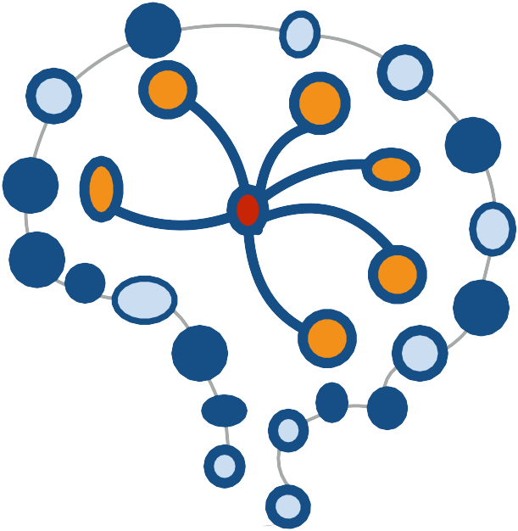
STAT 453: Introduction to Deep Learning and Generative Models
Sebastian Raschka http://stat.wisc.edu/~sraschka/teaching
Lecture 16
Introduction to Autoencoders

Slide 2
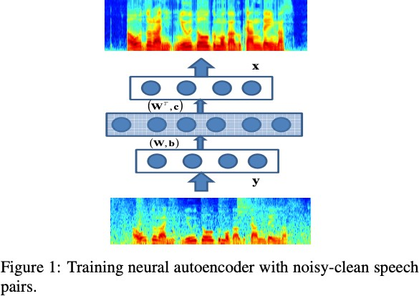
Lu, X., Tsao, Y., Matsuda, S., & Hori, C. (2013, August). Speech enhancement based on deep denoising autoencoder. In
Interspeech (pp. 436-440).

Slide 3
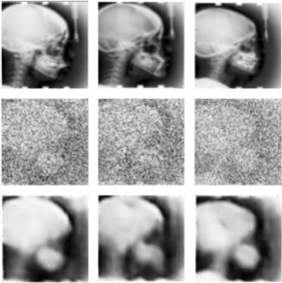
Gondara, L. (2016, December). Medical image denoising using convolutional denoising autoencoders. In 2016 IEEE 16th International Conference on Data Mining Workshops (ICDMW) (pp. 241-246). IEEE.

Slide 4
Lab Overview
Fully-connected Autoencoders
Convolutional Autoencoders
Other Types of Autoencoders

Slide 5
An Hourglass-Shaped Multilayer Perceptron
Fully-connected Autoencoders
Convolutional Autoencoders
Other Types of Autoencoders

Slide 6
A Basic Fully-Connected (Multilayer-Perceptron) Autoencoder
Encoder Decoder
hidden units / embedded space / latent space / bottleneck
Outputs
= reconstructed inputs
Inputs

Slide 7
A Basic Fully-Connected (Multilayer-Perceptron) Autoencoder
X
i
0 0 2
0 2
L(x, x ) = ||x — x ||
=
(x — x )
2
i
i
Encoder Decoder
If we don't use
non-linear activation functions and minimize the MSE, this is very similar
to PCA
However, the latent dimensions will not necessarily be orthogonal
and will have
~ same variance
hidden units / embedded space / latent space / bottleneck
Inputs
Outputs

Slide 8
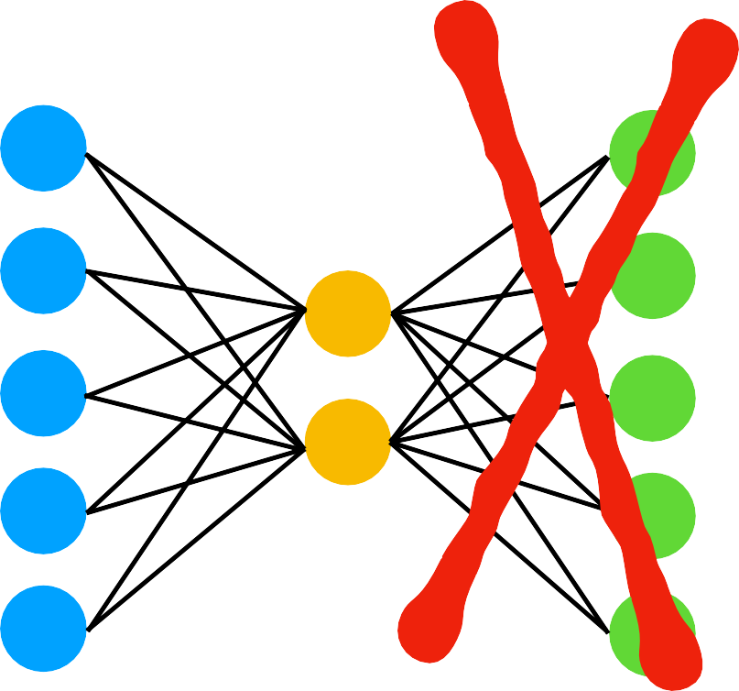
Potential Autoencoder Applications
After training, disregard this part
Use embedding as input to classic machine learning methods (SVM, KNN, Random Forest, ...)
Or, similar to transfer learning, train autoencoder on large image dataset, then fine tune encoder part on your own, smaller dataset and/or provide your own output (classification) layer
Latent space can also be used for visualization (EDA, clustering), but there are better methods for that

Slide 9


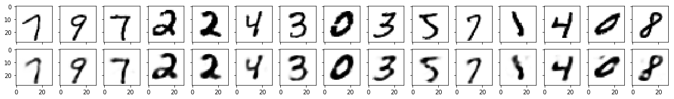
A Simple Autoencoder
fully connected layer fully connected layer
+ leaky relu 784 => 32
+ sigmoid 32 => 784
Reshape 28*28 => 784
Reshape
784 => 28*28
32 dim
Encoder
Decoder
https://github.com/rasbt/deeplearning-models/blob/master/pytorch_ipynb/autoencoder/ae-basic.ipynb
original
reconstructed

Slide 10
Convolutional Autoencoders
& Transposed Convolutions / Deconvolutions
Fully-connected Autoencoders
Convolutional Autoencoders
Other Types of Autoencoders

Slide 11


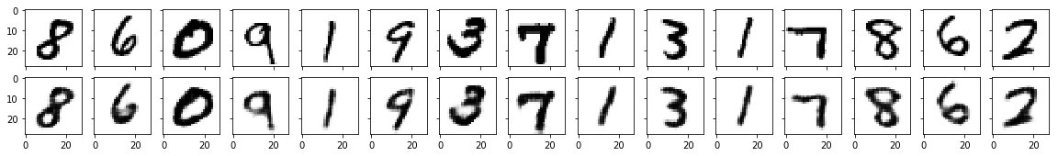
A Convolutional Autoencoder
1 or more convolutional layers
1 or more "de"convolutional layers
Encoder
Decoder
original
reconstructed

Slide 12
Transposed Convolution
Allows us to increase the size of the output feature map compared to the input feature map
Synonyms:
  often also (incorrectly) called "deconvolution" (mathematically, deconvolution is defined as the inverse of convolution, which is different from transposed convolutions)
  the term "unconv" is sometimes also used
  fractionally strided convolution is another (better?) term for that

Slide 13
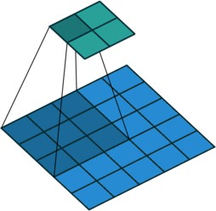
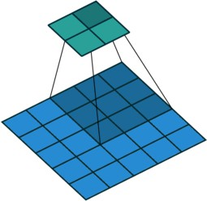
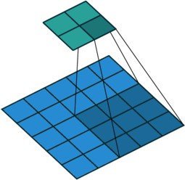
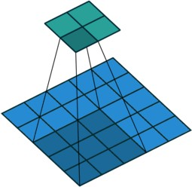
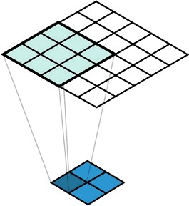
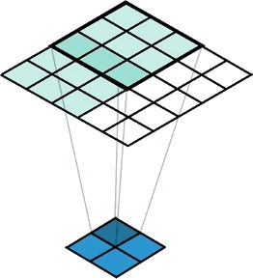
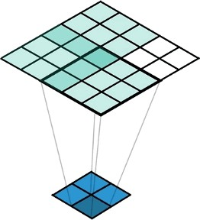
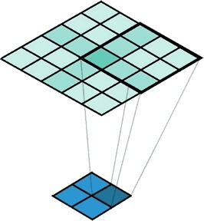
Regular Convolution:
output
input
Dumoulin, Vincent, and Francesco Visin. "A guide to convolution arithmetic for deep learning." arXiv preprint arXiv:1603.07285 (2016).
Transposed Convolution (stride = 2)
output
input
A Conv2DTranspose with 3x3 kernel and stride of 2x2 applied to a 2x2 input to give a 5x5 output. (https://medium.com/apache-mxnet/transposed-convolutions-explained-with-ms-excel-52d13030c7e8)

Slide 14
Beyond "Regular" Fully-Connected or Convolutional Autoencoders
Fully-connected Autoencoders
Convolutional Autoencoders
Other Types of Autoencoders

Slide 15
Autoencoders and Dropout
Add dropout layers to force networks to learn redundant features
Encoder
Decoder

Slide 16
Denoising Autoencoder
Add dropout after the input, or add noise to the input to learn to denoise images
Encoder
Decoder
Vincent, P., Larochelle, H., Bengio, Y., & Manzagol, P. A. (2008, July). Extracting and composing robust features with denoising autoencoders. In Proceedings of the 25th International Conference on Machine Learning (pp. 1096-1103). ACM.

Slide 17
Sparse Autoencoder
Add L1 penalty to the loss to learn sparse feature representations
^{X} |Enc_{i}(x)|
i
Encoder
Decoder
X
i
2
L = ||x — Dec(Enc(x))|| +
|Enc
(x)|
2
i

Slide 18
Variational Autoencoder
−𝔼
[
log p x
[i]
| z
+KL q z | x
[i]
∥p(z)
[i]
( )]
( (
) )
L =
z∼q z | x
[i]
w
w
w( )
Expected neg. log likelihood term; wrt to encoder distribution
Kullback-Leibler divergence term where p(z) = 𝒩 ₍μ = 0,σ² = 1₎
q_{w}(z | x)
p_{w}(x | z)
z
Encoder
Decoder
Gaussian probability density
Probability distribution
of the data
Kingma, D. P., & Welling, M. (2013). Auto-encoding Variational Bayes. arXiv preprint arXiv:1312.6114.

