Slide 1

Something Interesting About Finding Something Interesting
COSC 6335 Student Presentations on Nov. 17, 2011
[Group1] Amalaman,Paul Koutoua; Joshi,Sushil; Kampalli Santhamurthy,Divya Durga: A Study on Data Pre-processing for Mining the Global Terrorism Database.
[Group2] Anurag,Ananya; Dotson Jr,Ulysses Sidney; Edamalapati,Raghavendra Rao;
Francis Xavier,John Brentan: Hide and Seek: Privacy Preserving Data Mining.
[Group3] Arun,Balakrishna Sarathy; Asodekar,Pallavi; Chilukuri,Brundavan; Nalan Chakravarthy,Vidya Thirumalai: Spam Filtering using Classification.
[Group4] Chohan,Gaurav; Veerappan,Vaduganathan; Wang,Ning; Wen,Xi: Temporal Data Mining with Up-to-date Pattern Trees.
[Group5] Conjeepuramkrishnamoorthy,Manasee; Gondu,Ananth Kumar; Hernandez Herrera,Paul; Kao,Hsu-Wan: Data Mining in Social Networks—Emotion Analysis and Applications.
[Group6] Kethamakka,Uma Shankar Koushik; Komma,Gayathri; Xi,Chen; Zhu,Rui: Clustering by Passing Messages Between Data Points.
[Group7] Marathe,Deepti A; Mauricio,Aura Elvira; Souran,Malvika; Vanegas,Carlos R: The Wisdom of Crowds.
[Group8] Mohanam,Naveen; Nyshadham,Harshanand; Poolla,Veda Shruthi; Siga,Dedeepya: Finding Social Topologies Based on the Emails sent and Photo Tags in Social Networking Sites.

Slide 2
Improving the Classification of Terrorist Attacks
A Study on Data Pre-processing for Mining the Global Terrorism Database
From:
José V. Pagán
Electrical & Computer Engineering and Computer Science Department
Polytechnic University of Puerto Rico
San Juan, Puerto Rico
By
Amalaman,Paul Koutoua
Joshi,Sushil
Kampalli Santhamurthy,Divya Durga

Slide 3
INTRODUCTION
Terrorism- Evolution, causes and growth
A case study to illustrate how data mining technique can be used
Main source of data: GTD
Global Terrorism Database -open-source database including information on terrorist events around the world since 1970

Slide 4
CHARACTERISTICS OF GTD
Contains information on over 98,000 terrorist attacks
Includes information on more than 43,000 bombings, 14,000 assassinations, and 4,700 kidnappings since 1970
Over 3,500,000 news articles and 25,000 news sources were reviewed to collect incident data from 1998 to 2010 alone
GTD Website (at University of Maryland):
http://www.start.umd.edu/gtd/

Slide 5
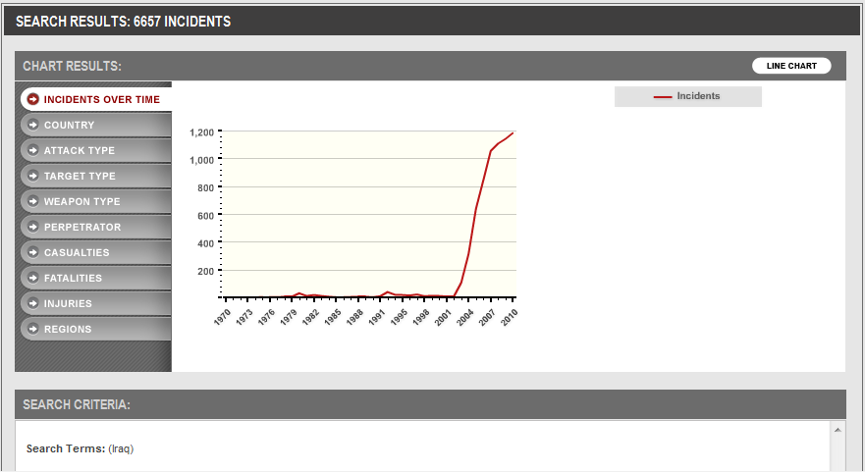
Iraq Search Result

Slide 6
“Terrorism data is often incomplete or inaccurate and only represents the outcome, not the process ”
To counter these limitations, new approaches for visual & computational analysis have been developed
Reveal unknown trends and help the analyst gain insights to formulate better hypotheses and models

Slide 7
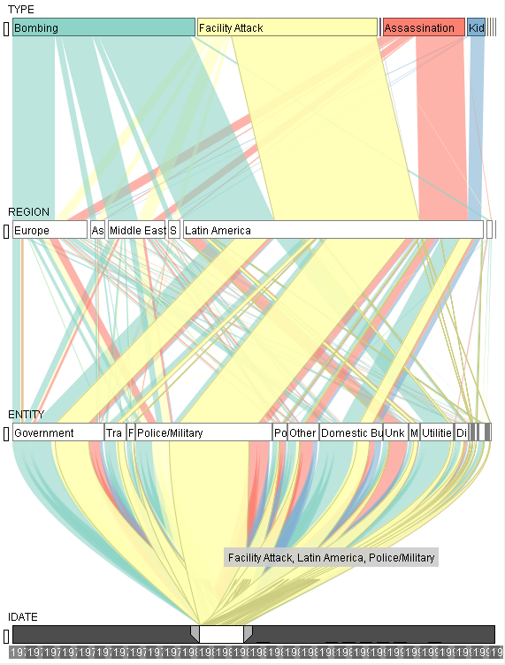
Example of a Visual approach
(Ziemkiewicz)
Visual analysis of correlations across data dimensions

Slide 8
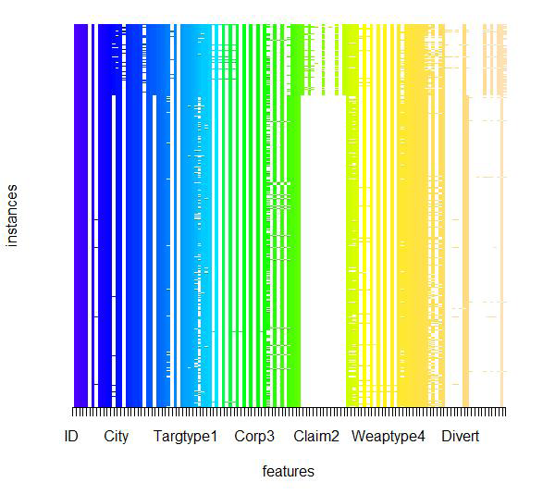
MISSING DATA IN GTD

Slide 9
DATA PREPROCESSING
Why Pre-processing?
Tasks – Data cleaning, Data integration, Data transformation, Data reduction, Data discretization
Main concentrations in this study-Eliminating Outliers, Treating Missing Data & Discretization Techniques
classifiers considered are Linear Discriminant Analysis (LDA), K-Nearest Neighbor (KNN), and Recursive Partitioning (RPART)

Slide 10
Eliminating Outliers
Clustering-groups attribute values, detects and removes outliers
Binning- sorts attribute values and partitions into bins;
Regression-smoothes data by using regression functions.

Slide 11
Treating Missing Data
Case deletion
discards instances with missing values for at least one feature
Applied(exclusive)->data missing completely at random (class label)
Mean Imputation
replacing the missing data by mean of all known values
Drawback-> deflate variance & inflate the significance statistical tests
Median Imputation (MDI)
replacing the missing data by median of all known values
Recommend-> when the distribution of the values of a given feature is skewed
KNN Imputation (KNNI)
imputing the missing values of an instance using similarity in instance of interest
? -> distance function

Slide 12
Discretization Techniques
Splitting methods ->Starts with empty list of cut points and adds new ones
Merging methods ->Starts with complete list (cont. values) and removes them
Supervised methods use the class information when selecting discretization cut points, while unsupervised methods do not
3 methods used in the study-> IR discretization, Entropy discretization & Equal width discretization

Slide 13


1R discretization
binning
after data is sorted, continuous values number of disjoint intervals
boundaries adjusted based on the class labels
Entropy discretization
finds the best split (bins pure) as possible
majority values -> same class label (information gain)
Equal Width discretization
divides the range of each feature into k intervals of equal size
straight forward
outliers dominated
handle skewed data

Slide 14
Attributes selected
-The date and city location of the incident,
-The type of weapons used to commit the terrorist act
-The number of casualties
-The amount of wounded victims
-The type of attack and
- the identified terrorist group responsible

Slide 15
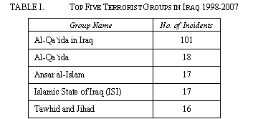
Iraq Data – Result Summary

Slide 16
These five groups account for 169 instances or 60% of all incidents with a known perpetrator in Iraq
The resulting dataset has 1.5% of missing values, with 28.6% of the features and 9.9% of the instances missing at least one value.
After data cleansed, 4 methods for treating missing values and 3 discretization methods applied
misclassification error for the LDA, KNN and RPART classifiers is computed

Slide 17
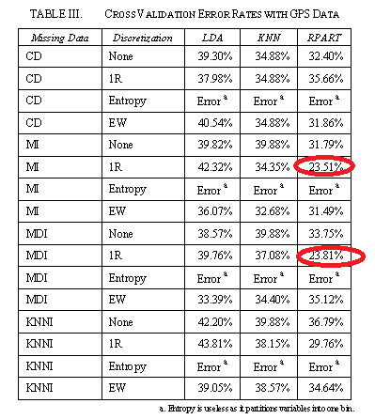
Error Report

Slide 18
CONCLUSION
RPART is a better classifier than LDA and KNN
IR is better discretization than entrophy and Equal Width
None of the methods used to treat missing values consistently reduced classification error rates by themselves
Strongly recommended that the GTD includes GPS coordinates in the future to facilitate the classification of terrorist groups
Note: Comparisons apply for this problem

Slide 19
Please Evaluate Our Presentation…☺

Slide 20
Privacy Preserving Data Mining
Hide and Seek

Slide 21
Privacy
What is privacy as related to data mining?
Why are concerns of privacy so important?
  Laws
  Business Interests
What benefits can be gained?

Slide 22
The Problem
Data mining tries to find unknown relationships.
What can be done if two parties want to run data mining techniques on the union of two confidential databases?
D₁
D₂
f(D1 ∪ D2)

Slide 23
Distributed Privacy-Preserving Data Mining:
Horizontal partitioning
Vertical partitioning
Distributed privacy-preserving data mining overlaps closely with cryptography field
The broad approach to these methods tends to compute functions over inputs provided by multiple recipients without actually sharing the inputs with one another

Slide 24
cont ...
Two kinds of adversarial behavior:
Semi-honest Adversaries:
Malicious Adversaries
1 out of 2 oblivious-transfer protocol
two parties: a sender, and a receiver. The sender’s input is a pair
(x0, x1), and the receiver’s input is a bit value σ {0, 1}.
Solution for semi honest adversaries

Slide 25

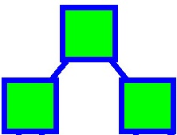
Basics
Parent node contains condition to classify the dataset

Slide 26
Entropy and gain
Information Gain = H_{C}(T) - H_{C}(T|A)
Maximize gain
Or, minimize H’C(T|A)

Slide 27
H’C(T|A), when expanded translates to this ☺simple formulae☺
Terms have form (X)·ln(X)
where X=x1+x2
  P₁ knows X1, P₂ knows X2

Slide 28
Xlnx protocol
Input: P₁’s value X1, P₂’s value X2
No party knows the input of other. It is a private protocol.
Output: P₁ obtains w₁ , P₂ obtains w₂
w₁ + w₂ ≈ (v₁ + v₂)·ln(v₁+v₂)

Slide 29
Future Challenges
Understand what privacy means and what we really want
  A very non-trivial task and one that requires interdisciplinary cooperation between the participating parties.
  Computer scientists should help to formalize the notion, but lawyers, policy-makers, social scientists should be involved in understanding the concerns.
  Some challenges here:
    Reconciling cultural and legal differences relating to privacy in different countries.
    Understanding when privacy is “allowed” to be breached (should searching data require a warrant, cause and so on).

Slide 30
Challenges
Secure computation can be used in many cases to improve privacy,
  If the function itself preserves sufficient privacy, then this provides a “full solution”
  If the function does not preserve privacy, but there is no choice but to compute it, using secure computation minimizes damage.

Slide 31
Final Word
Privacy-preserving data mining is truly needed
  Data mining is being used: by security agencies, governmental bodies and corporations
  Privacy advocates and citizen outcry often prevents positive use of data mining.

Slide 32
References
http://www.todaysengineer.org/2003/Oct/data-mining.asp
Benny Pinkas. “Cryptographic techniques for privacy preserving data mining” HP Labs
www.cs.utexas.edu/~shmat/courses/cs395t_fall04/brickell.ppt

Slide 33
Please Evaluate Group 2

Slide 34
Spam filtering using classification
GROUP 3
Balakrishna Sarathy Arun
Brundavani Chilukuri
Pallavi Asodekar
Vidya Nalan Chakravarthy

Slide 35
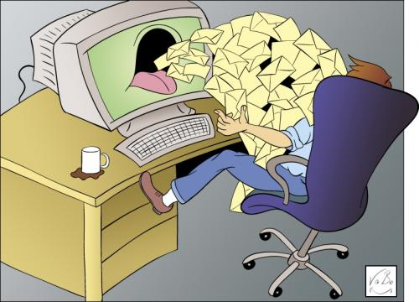
WHAT IS SPAM ?

Slide 36
SPAM FILTERING
Why is it important?
  Waste of space, bandwidth, money
  Privacy and security
    90% of viruses though emails
Challenges
  Defining/classifying spam
Types of spam filtering
  Collaborative Filtering
  Content-based Filtering

Slide 37
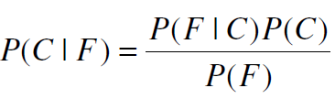

BAYESIAN SPAM FILTERING
Classifier - Naïve Bayes
Bayes Theorem
Joint Probability
  Where F = {f1,…fn} and C = {legitimate,spam}
Notes:
P(C|F) = P(F|C)P(C) / P(F)
(where F is set of features and C (legitimate, spam) are two classes)

Slide 38
TRAINING PHASE
Generation of tokens from emails
Feature vector construction
  Dimensionality reduction
Probability Distribution

Slide 39
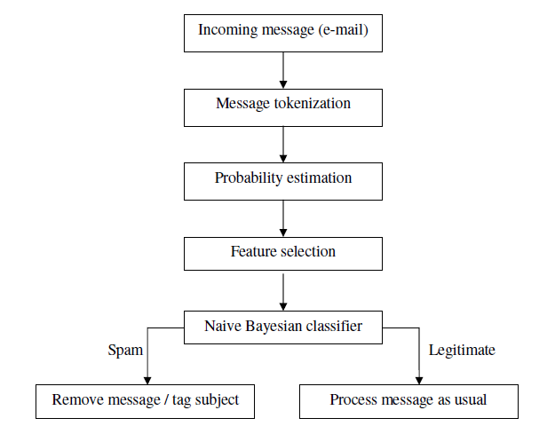
TESTING

Slide 40
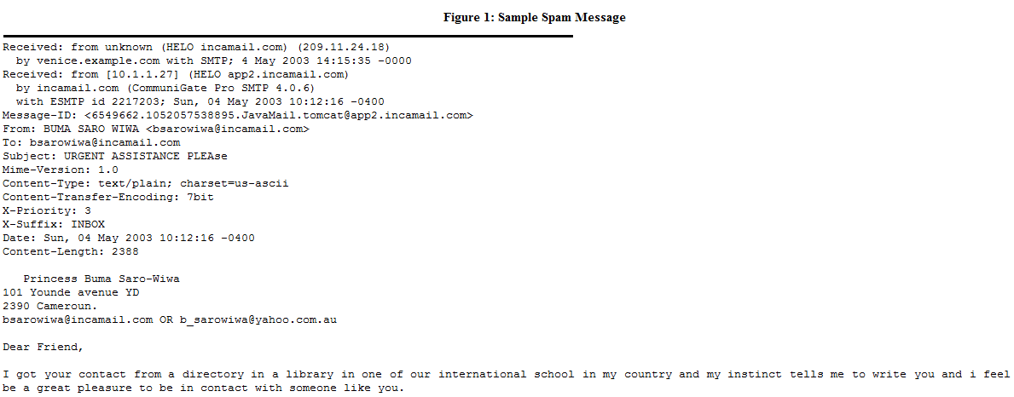
EXAMPLE:

Slide 41
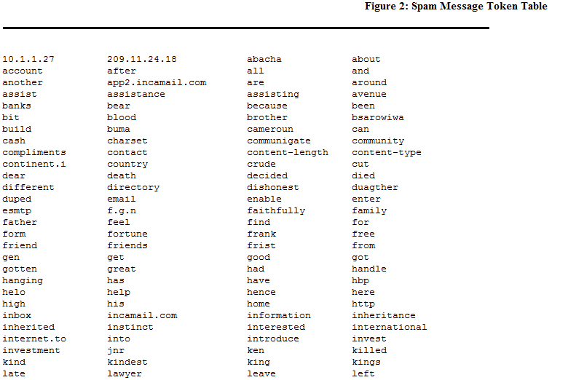

Slide 42
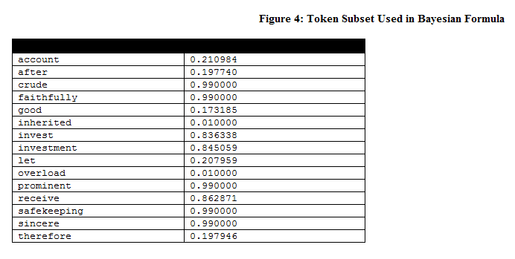
Legitimate probability = Token frequency in legitimate messages / Number of legitimate messages trained on
Spam probability = Token frequency in spam messages / Number of spam messages trained on
Spamicity = Spam probability / (Legitimate probability + Spam probability)
Once the Bayesian filter has selected 15 tokens, it plugs their spamicity values into Bayes’ formula and calculates the probability of the message being spam.

Slide 43
ADVANTAGES
Can be customized on a per-user basis
Very effective
Performance Improvement with usage
Superior to other algorithms

Slide 44
DISADVANTAGES
Bayesian Poisoning
Takes time to learn
Filter initialization
Tricking Bayesian Filters with the usage of pictures

Slide 45
CONCLUSIONS
Usage of classifiers for spam filtering
Performance of Naïve Bayes compared to other techniques

Slide 46
REFERENCES
[1]http://en.wikipedia.org/wiki/Bayesian_spam_filtering
[2] Konstantin Tretyakov “Machine Learning Techniques in Spam Filtering”,May 2004
[3] Jon Kågström, “Improving Naïve Bayesian Spam Filtering”, 2005
[4] http://www.process.com/precisemail/bayesian_example.htm

Slide 47
Evaluate Group 3
Thank you!

Slide 48
Temporal data mining with up-to-date pattern trees
Presentation By Group 4:
Vaduganathan V Veerappan
Gaurav Chohan
Shelly Xi Wen
Ning Wang

Slide 49
1. Introduction
2. Experimentation
3. Experimental results
4. Conclusions and future works

Slide 50
Introduction
What is Temporal Data Mining ?
Up-to-date Pattern
({Itemset},{Lifetime})
Frequent itemset

Slide 51
Frequent Itemset
An itemset that occurs frequently !!
REALLY ?????????????
How frequent is enough frequent ?
10 ? 20? 200? 500?
All Based on Threshold value.

Slide 52
Motivation
Ever growing database
Mining Decision made on recent data should be more significant.
Sliding window Approach –
NOT very Efficient
Solution : UDP tree☺ : Efficient

Slide 53
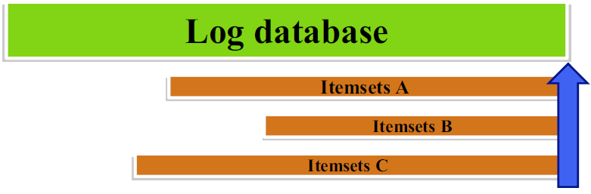
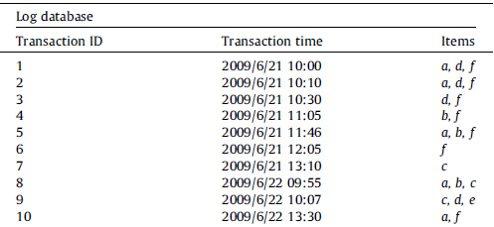
Up-to-date tree construction
Database compressed to tree structure with frequent items
Hong et al. proposed the concept of up-to-date patterns which concerned the most recent items with an unfixed length of window size.
Assume the user-defined minimum support threshold is set at 50%.
Consider ‘c’ . Its count is 3 and the minimum count is 0.5 * 10 =5 .
Thus ‘c’ is not frequent. But its frequent in the life time <5,10>.

Slide 54
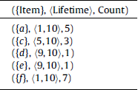
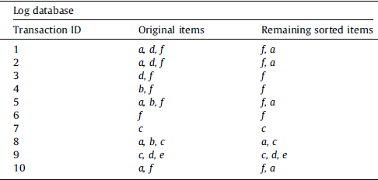
Up-to-date tree construction contd….
Up-to date- pattern 1
Sorted transactions

Slide 55
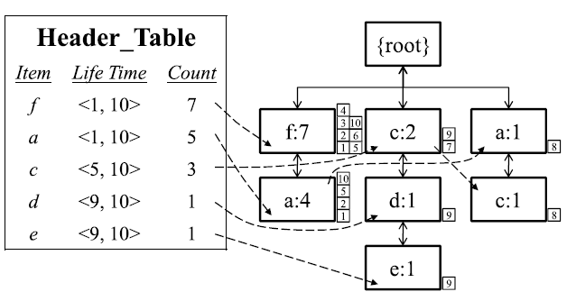
Final UDP tree

Slide 56
Experimental results
Purpose
compare the performance of the UDP-tree and the up-to-date approach.
Two real datasets were used
BMS-POS: from a large electronics retailer
Retail

Slide 57
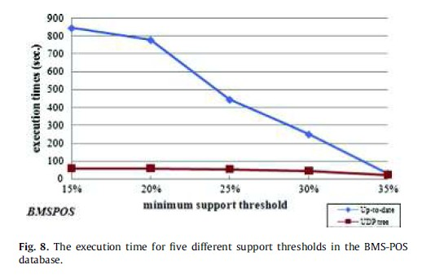
First BMSPOS run by two algorithms.

Slide 58
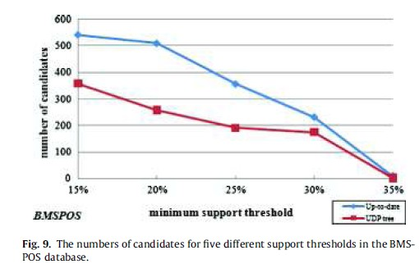
Second compare the number of candidates

Slide 59
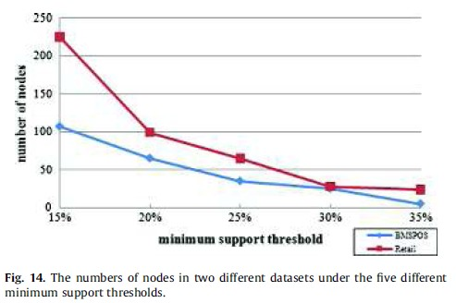
the number of nodes generated by UDP in two datasets

Slide 60
Conclusions
Proposed the up-to-date patterns to avoid the problem of a fixed length
Further design the UDP tree to help mine up-to-date patterns efficiently
Proposed the UDP-growth mining algorithm to derive the up-to-date patterns easily
Better performance in the execution time and the number of generated candidates

Slide 61
Future works
Try to maintain the up-to-date patterns efficiently and effectively when the database changes rapidly
Use other appropriate models to speed up the execution time of an updated database

Slide 62
Thank you ~~ ☺
Please give the evaluation~

Slide 63
Data Mining in Social Networks – Emotion Analysis and Applications
Presentation by
Manasee Conjeepuram Krishnamoorthy
Ananth Kumar Gondu
Paul Hernandez Herrera
Hsu-Wan Kao
Time: 15s
Notes:
15s

Slide 64

Emotion analysis – Why?
Growth in popularity of online social networks has affected the way people interact with friends and acquaintances
Predict the relationship strength between two individuals
Purpose – NOT to identify emotion but to indicate if the text contains emotions or not
Obtain great insight on social relationships and social behavior
Time: 30s
Notes:
30s

Slide 65
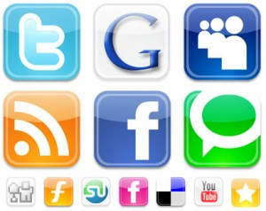
Introduction
Online Social Networks are a major component of an individual’s social interaction
Extract emotion content of text in online social networks
Goal– Ascertain if the text is an expression of the writer’s emotions or not
Text Mining techniques are performed on comments retrieved from a social network
Time: 25s
Notes:
25s

Slide 66
Introduction contd…
Framework – includes a model for data collection, data base schemas, data processing and data mining steps
Technique adopted – unsupervised learning
Algorithm used – k-means
Case study – Lebanese facebook users
Time: 15s
Notes:
15s

Slide 67

Emotions
  For mining purposes –identify 6 basic emotions
      Happiness, Sadness, Anger, Fear, Disgust, Surprise
  Other approach is to identify emotions at 2 levels
      Positive feeling, Negative feeling
      Energy level associated with the emotion
  Social factors also have a profound effect on one's emotions
Time: 20s
Notes:
20s

Slide 68
Emotion Mining
Emotion Mining
Valance of the text
Is the text subjective
or factual?
Recognition of emotions
And its strength or arousal
Classifies text according to strength of emotion and also partitions into subjective or factual
Time: 25s
Notes:
20s

Slide 69
Techniques to automate Emotion Mining
Techniques to automate Emotion Mining
Keyword Spotting:
Lexicon grouping words – emotional connotation
Words are unambiguous
Simple and economical
Lexical affinity measures:
A probabilistic affinity is attached to each word for a certain emotion
Performs poorly when facing intricate sentences
Statistical Natural Language Processing Technique:
Employ machine learning algorithms to learn words' lexical affinity
Hand Crafted Models
Complex sytems and findings are difficult to genaralize
Time: 30s
Notes:
30s
Introduction
What is emotion mining? - three
categories of emotion mining
3. Factors affecting emotion mining
Challenges faced – explain
40s

Slide 70
Languages in online social networks
Texts in online social networks have specificity
Users use an informal and less structured language
Some features of online language
  Intentional misspelling (helloooooo)
  Interjections (hmmm' indicates thinking)
  Gramatical markers (use of upper-case letters)
  Social acronyms (brb)
  Emoticons ( :) indicates joy)
Time: 20s
Notes:
20s

Slide 71
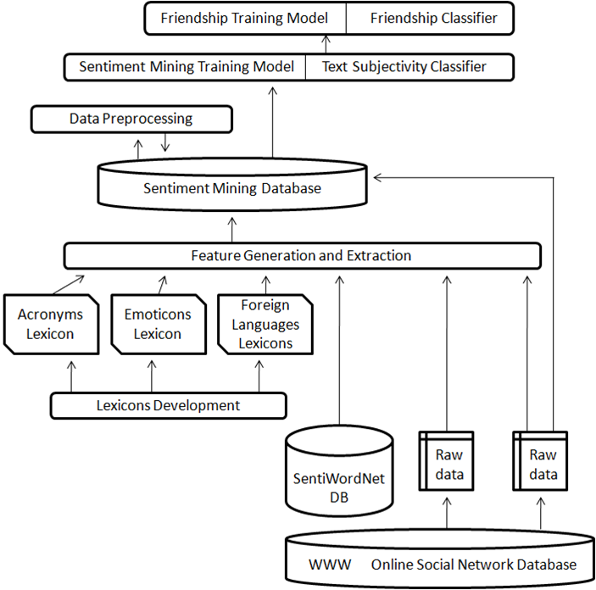
Proposed Framework
Step 1: Data Collection
  Gather information from social networking sites
  Store it in an organized manner
Time: 25s
Notes:
25s

Slide 72
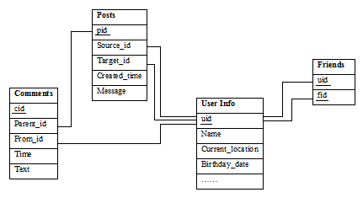
Proposed Framework contd..
Organizing Obtained Data
Time: 20s
Notes:
20s

Slide 73
Proposed Framework contd…
Step 2: Lexicon Development
  Deals with informal languages
  Social Acronyms
    Brb
    Ttyl
  Emoticons: ☺, ☹, :P …
  Foreign Languages
Time: 40s
Notes:
40s

Slide 74
Proposed Framework contd…
Step 3: Feature Generation
  All informal languages are converted to English
  Stored in sentiment mining database
Time: 15s
Notes:
15s

Slide 75
Proposed Framework contd…
Step 4: Data pre-processing
  Removing redundancy
  Normalizing
Time: 15s
Notes:
15s

Slide 76
Proposed Framework contd…
Step 5 and 6: Creating Training Model for text subjectivity and Text Subjectivity Classification
  Use k-means to run form 3 levels of clusters, neutral, moderately subjective and subjective
  We get centroids for 3 clusters
  Use centroids to classify into 3 clusters
Time: 40s
Notes:
40s

Slide 77
Proposed Framework contd…
Step 7: Friendship classification
  Based on the subjectivity, we divide into 2 categories
    Close Friends
    Acquaintances
Time: 25s
Notes:
25s

Slide 78
Model Evaluation
Training data set consisted of 2087 comments
850 comments manually categorized
Classes: subjective, moderately subjective, objective
Comment Id | Comment | Class
1 | Carooooooooooooooooooooo im going to kiiilll uuuuuuuuuuuuuuuu…n u know why! But I still looove u(a little bit :P ) don’t worry :P mwahhh | subjective
2 | I love your profile pic, its much better like this ☺ | Moderately subjective
3 | 86 and how much did u get? | Objective
Time: 30s
Notes:
30seconds

Slide 79
Model Evaluation contd..
After feature generation
Step 1:
Step 2:
Step 3:
Step 4:
Comment Id | Repeated Letters | Number Emoticon | Rating Emoticon | Number Acronyms | Number affective words | Rating affective words
1 | 7 | 2 | 3 | 1 | 5 | 0.767681
2 | 0 | 1 | 1.5 | 0 | 5 | 0.770241
3 | 0 | 0 | 0 | 0 | 0 | 0
After data preprocessing
Comment Id | Repeated Letters | Number Emoticon | Rating Emoticon | Number Acronyms | Number affective words | Rating affective words
1 | 1 | 0.01094 | 1 | 0.02305 | 0.45267 | 0.267515
2 | 0 | 0.01094 | 0.5 | 0 | 0.45267 | 0.267515
3 | 0 | 0 | 0 | 0 | 0.04382 | 0.013532
Centroids of 3 clusters
Number Punctuation Marks | Repeated Letters | Number Emoticon | Number Acronyms | Number affective words | Rating affective words | Subjectivity Weight
0.742402 | 0.855892 | 0.3073 | 0.2093 | 0.4032 | 0.3772 | 0.1440489
0.1469 | 0.120589 | 0.16317 | 0.1749 | 0.2113 | 0.261 | 0.889034
0.104403 | 0.03921 | 0 | 0.1159 | 0.1026 | 0.1734 | 0.244849
Classifier output
Comment Id | Comment Subjectivity Weight | Class
1 | 1.440489 | Subjective
2 | 0.889034 | Moderately Subjective
3 | 0.244849 | Objective
Time: 45s
Notes:
45s

Slide 80
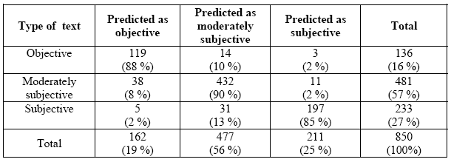
Model Evaluation contd..
Diagonal elements represent correct predictions
Clustering results
Time: 45s
Notes:
45s

Slide 81



Conclusion and future work
  This framework provides high accuracy on emotion analysis on text.
  It has good prediction on the friendship between people.
  Unstructured language on the internet (new lexicons)
  Variety of languages
  The consideration of sentence structures and syntax
  New ways for learning and coping with the changes of language used online
Time: 50s
Notes:
1 min

Slide 82
References
Slides based on: “A framework for Emotion Mining from Text in Online Social Networks – Mohammad Yassine, Hazem Hajj – 2010 IEEE International Conference on Data Mining Workshops
M. Thelwall, D.Wilkinson and S.Uppal. “Data Mining emotion in social network communication: Gender differences in MySpace”. In journal of the American Society for Information Science and Technology
Time: 10s

Slide 83


Slide 84
Clustering by Passing Messages Between Data Points
Brendan J. Frey, et al. Science 315, 972 (2007)
Presented by Group 6

Slide 85
True Representative clustering by Koushik
  seeks “exemplars”: the representatives selected from actual data points.
  Initial step: randomly picking exemplars
    → randomly pick mayor candidates from a city
assigns the remaining objects to the closest exemplars.
Examples:
  k-medioid
  DBSCAN

Slide 86
Problem with Conventional Approaches by Koushik
sensitive to initial selection of exemplars
→ what if picked candidates are not qualified for mayor ?
Local optimal: multiple runs to avoid bad selection of exemplars
  → pick candidates again and again ……
works well only when the number of clusters is small

Slide 87
Affinity Propagation Overview by Koushik
considering all the data points as potential exemplars
→ All people in the city can be mayor candidate
Initial network established based on similarity between all data points
Message passing between data points along network
→ people communicate to each other to find out who is qualify for mayor
Most reachable data points will finally be the exemplars
→ people vote for their closest candidates

Slide 88
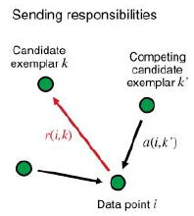
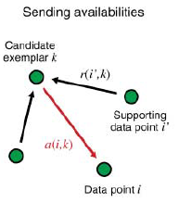
Affinity Propagation Mechanism by Gayathri
Input: Collection of real valued similarities between data points
Goal: to minimize the squared error
Terms: Responsibility, Availability

Slide 89
Affinity Propagation Mechanism by Gayathri
Steps:
Create a network based on the similarities between the data points.
Find the availabilities and responsibilities of the data points.
The data point which has the maximum value (sum of availability and responsibility) is considered as an exemplar for that point.
Repeat the above steps until the decision of exemplar remains constant.

Slide 90
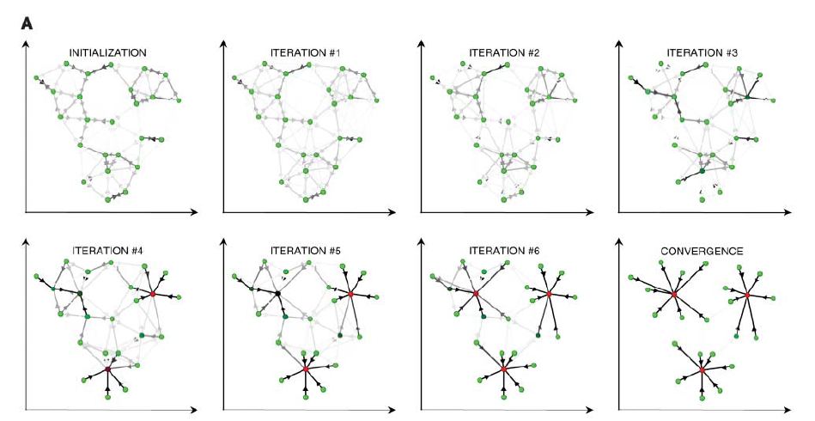

Affinity Propagation Mechanism by Gayathri

Slide 91
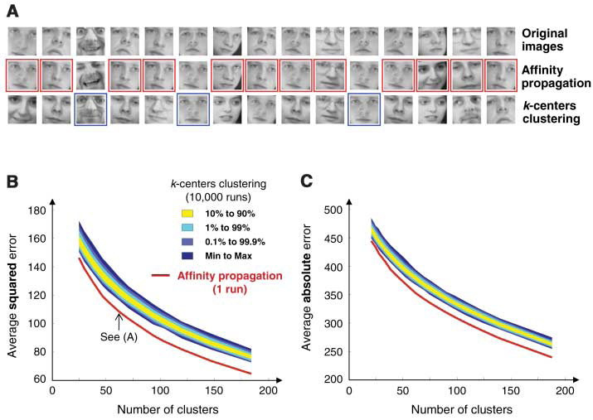
Application I: Clustering images of faces by Chen
-Shorter computational time
-lower squared error
-lower sum of absolute pixel differences

Slide 92
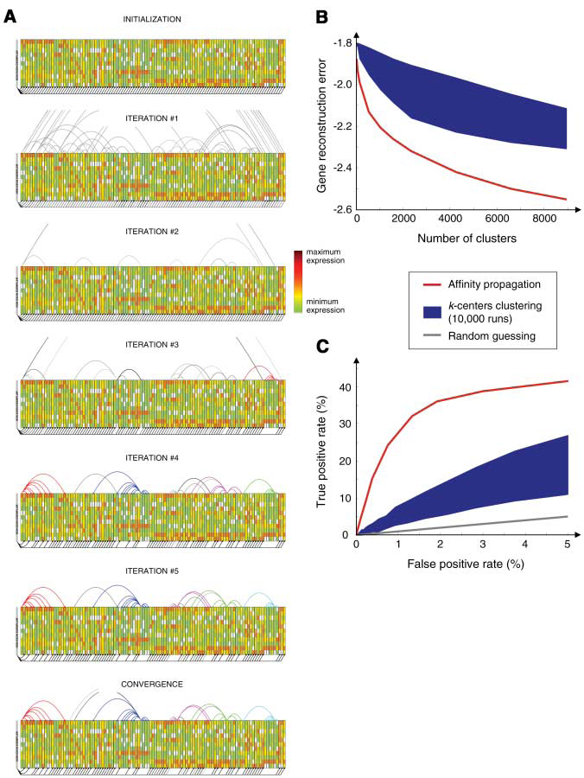
Application II: Clustering for gene searching by Chen
- Shorter computational time
- lower reconstruction errors
- Significantly higher TP rates, especially at low FP rates

Slide 93
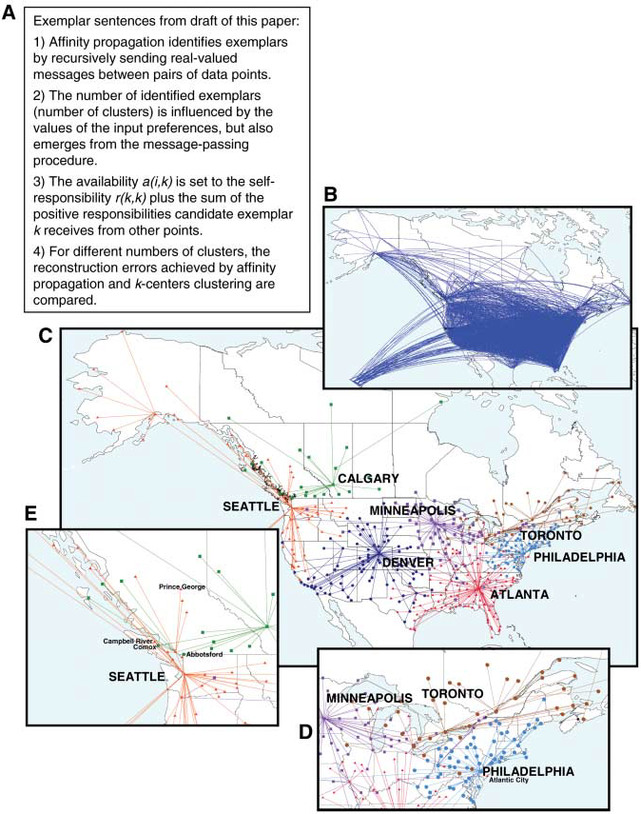
Application III: Unusual Measure of Similarity by Rui
similarities are not symmetric: s(i,k) ≠ s(k,i)
similarities do not satisfy the triangle inequality: s(i,k) < s(i, j) + s( j,k)
Notes:
Affinity propagation is also robust when unusual similarity measures are used.
there are situations when similarity from point a to b is different from that of b to a.
As well as similarity do not satisfy the triangle inequality.
While many clustering methods can not handle this, affinity propagation can apply and the forms pretty good clusters as we can see.

Slide 94
Summary by Rui
Affinity propagation has several advantages over related techniques:
  Considering all data points to avoid unlucky initialization
  Applicable to unusual measures of similarity
Disadvantage:
  require precomputation of pair-wise similarities among data points

Slide 95
Please Grade Group 6!
Thank you!

Slide 96
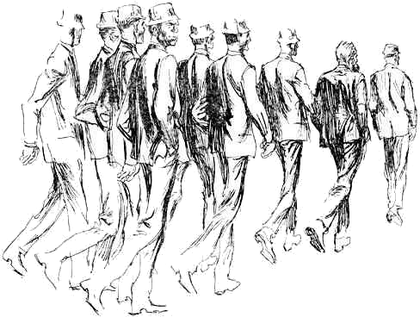
the wisdom of crowds
data mining
team 7
ensemble methods
wisdom of crowds / uses
wisdom of crowds failures
conclusion
introduction

Slide 97
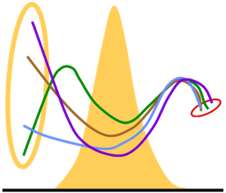
ensemble methods
classification: until now, predict class labels using a single classifier
ensemble methods: improve accuracy
multiple
model
predictions
final
decision

Slide 98
ensemble methods
necessary conditions
  independent classifiers
  base classifiers perform better than random guessing
key
  base classifiers make different errors
improvement of accuracy can be proven mathematically

Slide 99
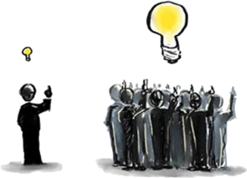
the wisdom of crowds

Slide 100
elements for a wise crowd
diversity
independence
decentralization
aggregation

Slide 101
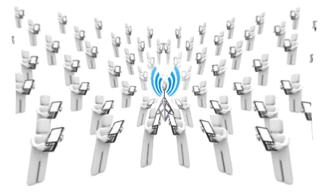
wisdom of crowds uses
prediction markets
delphi methods
internet fraud prevention
expert stock picker
wisdom of wireless crowds

Slide 102

crowd wisdom fails due to
imitation
    crowd emulates others
    information cascade leads to copying results
    crowd considers other people’s opinions
homogeneity
    no independent thinking
centralization
    power resides in central location
    important decisions based on local ,specific knowledge

Slide 103
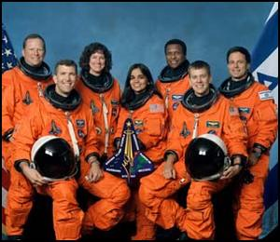
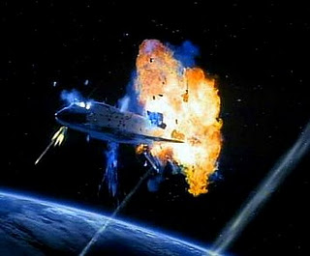
crowd wisdom failure
space shuttle columbia disaster

Slide 104
conclusion
elements of a wise crowds
  diversity
  independence
  decentralization
  aggregation
uses
  prediction markets
  delphi methods
  internet fraud prevention
  expert stock picker
  wisdom of wireless crowds

Slide 105
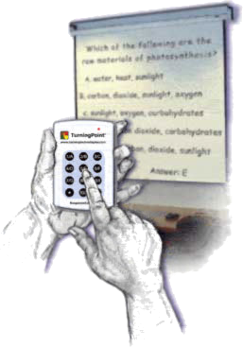
evaluate team 7, please !

Slide 106
Finding Social topologies based on the emails sent & photo tags in Social Networking site
A Knowledge Discovery & Data Mining problem
Group8
Mohanam,Naveen
Nyshadham,Harshanand
Poolla,Veda Shruthi
Siga,Dedeepya
Source :
An accepted paper from Social Network Mining and Analysis – KDD 2011 Conference
Paper Title:
An Algorithm and Analysis of Social Topologies from Email and Photo Tag
T. J. Purtell ,Diana MacLean ,Seng Keat The ,Sudheendra Hangal ,Monica S. Lam & Jeffrey Heer
Computer Science Department , Stanford University

Slide 107
Introduction
As People’s Participation in social media increases, Online social identities accumulate contacts and data.
Need a mechanism for creating a succinct but contextually rich representation of a person’s “social landscape”
Social landscape should facilitate activities such as browsing personal social media feeds or sharing data with nuanced social groups.

Slide 108
Author’s Contribution
Formulated the social topology extraction problem as the compression of a group-tagged data set in which each group has a significance value, into a set containing a smaller number of overlapping and nested groups that best represent the value of the initial data set.
Four variants of a greedy algorithm that constructs a user’s social topology based on egocentric, group communication data.
Experiments conducted on 2,000 personal email accounts and 1,100 tagged Face book photograph collections to find the algorithm variants producing different topologies.

Slide 109
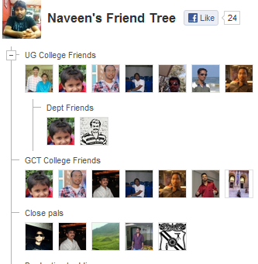
What is Social Topology?
Refers to a structure and content of a person’s social affiliations, comprising a set of overlapping and nested groups – as a first-class structure for facilitating social-based tasks such as data sharing or digital archive browsing
Exploited the observation that a user’s social topology is captured implicitly in routine communications, photographs and others forms of personal data

Slide 110
Related work to this problem
Clustering algorithms
  Assumes global structure of network is available
  Networks are evaluated based on public information
  Input model of the graph is reduced to edges between individuals
    Visualization and interface
      Derives overlapping and hierarchical groups
      Requires many parameter settings
    Association Rule mining
      Finds related item datasets using a specific seed
      develop an interactions rank metric that gives an ordering over unique recipient groups
    Graph summarization
      Focuses on reducing the size and complexity of network data

Slide 111
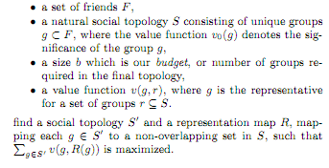
Algorithm – Problem Statement
Nested groups lends increased granularity to the topology, while permitting overlapping groups allows us to represent people who play multiple roles in the subject’s life.
The value of a group rejects the proportion of information that the user chooses to share with it, and we consider groups with a higher information share to be more important than others.
The social topology construction is a task of compression, in which we want to reduce the natural social topology into a manageable size, while maximizing its value.
A value function that evaluates the value of each group in the generated social topology based on its mapping from the original one.

Slide 112
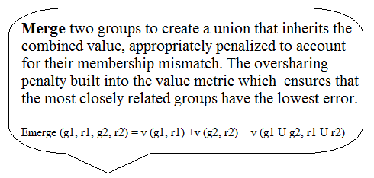
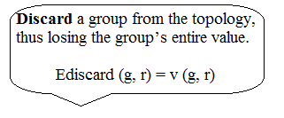
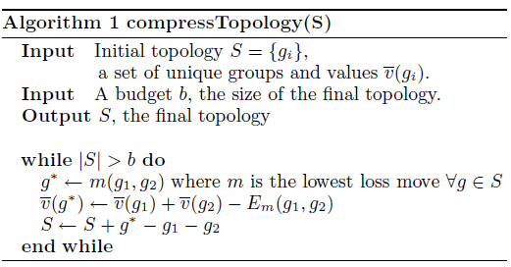
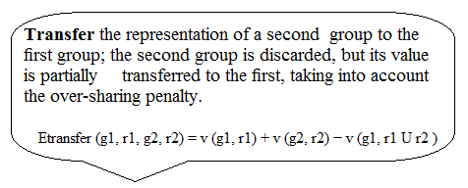
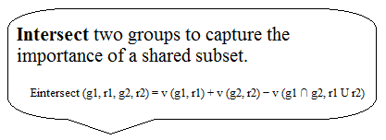
Greedy Algorithm

Slide 113
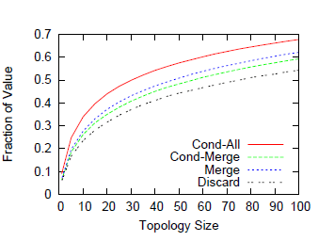
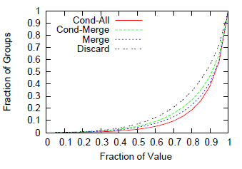
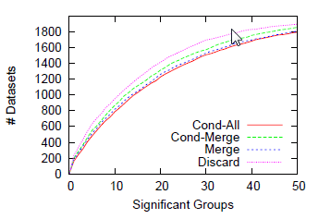
Experiments conducted
Four variants for algorithm evaluation
Discard : Considers only discard moves.
merge. Considers discards and merges
cond-merge. Considers discards and merges, with a conditional probability metric for sharing penalty
cond-all. Considers all moves, with a conditional probability metric for sharing penalty.
Analysis of email dataset:
Small scale topologies
Value concentration
Significant groups

Slide 114
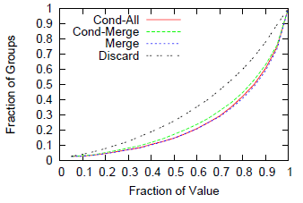
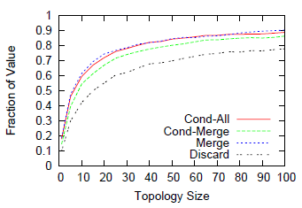
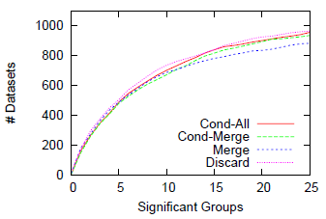


Analysis of photos
Value concentration
Small social topologies
Significant groups
Evaluation by edit distance
Topology size for email corpus
Topology size for photo corpus

Slide 115




Facebook – GroupGenie App

Slide 116
Conclusion
Unlike most other social network analysis algorithms that detect groups from global network data, this algorithm helps individuals automatically identify and use their social groups by analyzing their online social actions.
This greedy algorithm can be used to produce the best representation of social topology in a given space budget. Offers insight into people’s social relationships
as captured by their online activities
The results demonstrate the ability of the algorithm to distill out a small number of groups from thousands of emails and hundreds of photos.
Algorithm is incorporated in a Facebook application called GroupGenie.
Algorithm and source code are publicly available, and can be downloaded at
the URL http://mobisocial.stanford.edu/groupgenie

Slide 117
Evaluate Group8
Thank You !

