Slide 1

COSC 6335: Data Mining
2024 Group D Task
Team Members
Rakesh Chowdary Bhimineni - 2299435
Nithin Kumar Balisetty – 2299352
Sujan Chithaluri - 2304283

Slide 2
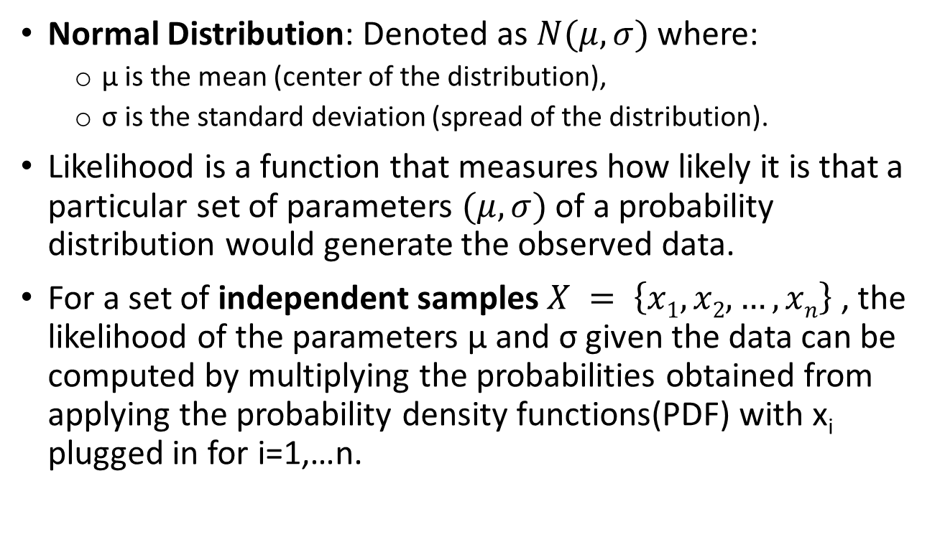
Likelihood
Normal Distribution: Denoted as $N(μ,σ)$ where:
  μ is the mean (center of the distribution),
  σ is the standard deviation (spread of the distribution).
Likelihood is a function that measures how likely it is that a particular set of parameters $(μ,σ)$of a probability distribution would generate the observed data.
For a set of independent samples $X = \left\{x1,x2,…,xn\right\}$ , the likelihood of the parameters μ and σ given the data can be computed by multiplying the probabilities obtained from applying the probability density functions(PDF) with x_{i} plugged in for i=1,…n.

Slide 3
Task
Dataset X={0, 4, 5, 7} is given and X~N(μ,σ)?
Compute the likelihood of the 4 samples and L ((μ,σ)|X) using:
a. N(2,1)
b. N(4,1)
Remark: L ((μ,σ)|X)= p_{μ,σ}(0)*p_{μ,σ}(4)*p_{μ,σ}(5)*p_{μ,σ}(7)
c. What values does the maximum likelihood estimator (MLE) choose for (μ,σ)? What is the probability of the 4 samples and what is L((μ,σ)|X) for the MLE choice for (μ,σ)?

Slide 4
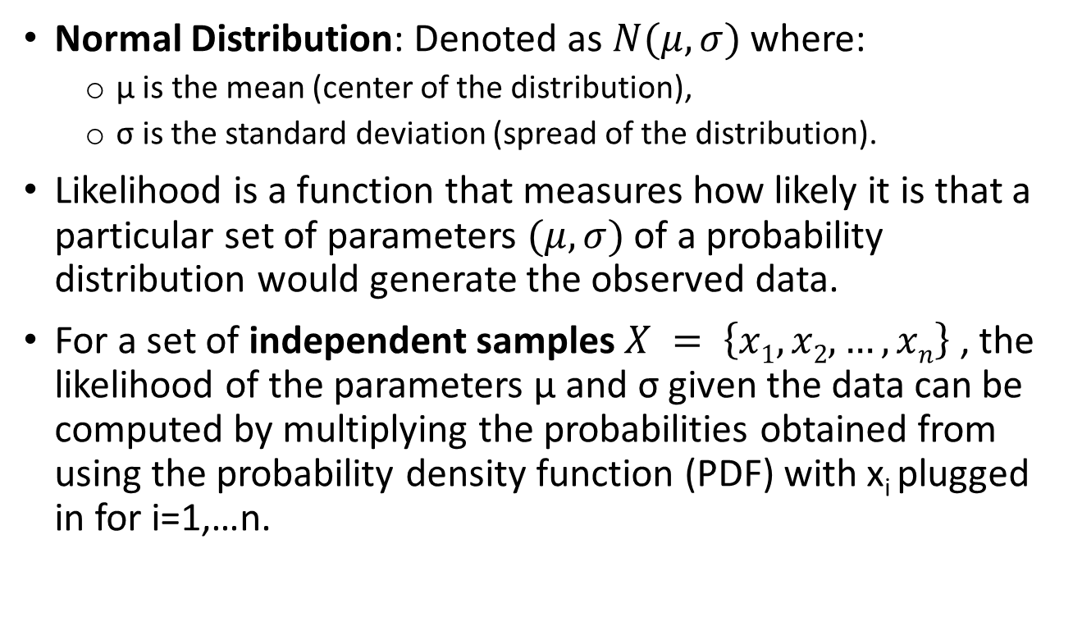
Likelihood
Normal Distribution: Denoted as $N(μ,σ)$ where:
  μ is the mean (center of the distribution),
  σ is the standard deviation (spread of the distribution).
Likelihood is a function that measures how likely it is that a particular set of parameters $(μ,σ)$of a probability distribution would generate the observed data.
For a set of independent samples $X = \left\{x1,x2,…,xn\right\}$ , the likelihood of the parameters μ and σ given the data can be computed by multiplying the probabilities obtained from using the probability density function (PDF) with x_{i} plugged in for i=1,…n.

Slide 5
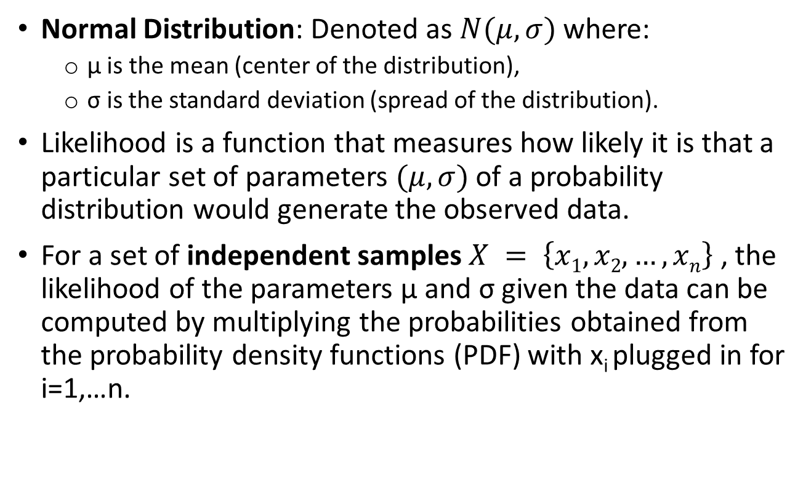
Likelihood
Normal Distribution: Denoted as $N(μ,σ)$ where:
  μ is the mean (center of the distribution),
  σ is the standard deviation (spread of the distribution).
Likelihood is a function that measures how likely it is that a particular set of parameters $(μ,σ)$of a probability distribution would generate the observed data.
For a set of independent samples $X = \left\{x1,x2,…,xn\right\}$ , the likelihood of the parameters μ and σ given the data can be computed by multiplying the probabilities obtained from the probability density functions (PDF) with x_{i} plugged in for i=1,…n.

Slide 6
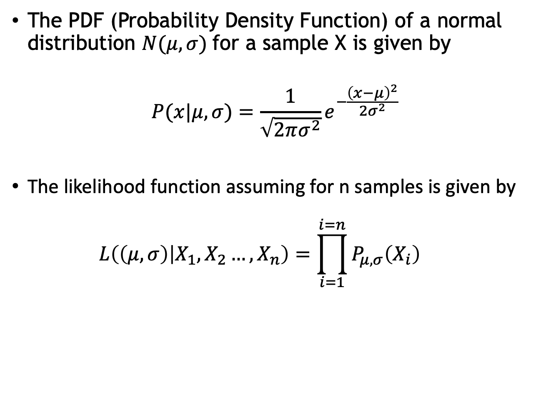
Used Formulae
The PDF (Probability Density Function) of a normal distribution $N(μ,σ)$ for a sample X is given by
$$P(x|μ,σ)=\frac{1}{\sqrt{2πσ^{2}}}e^{−\frac{{\left(x−μ\right)}^{2}}{2σ^{2}}}$$
The likelihood function assuming for n samples is given by
  $$L\left(\left(μ,σ\right) | X_{1},X_{2}…,X_{n}\right)=\prod_{i=1}^{i=n}{P_{μ,σ}\left(X_{i}\right)}$$

Slide 7
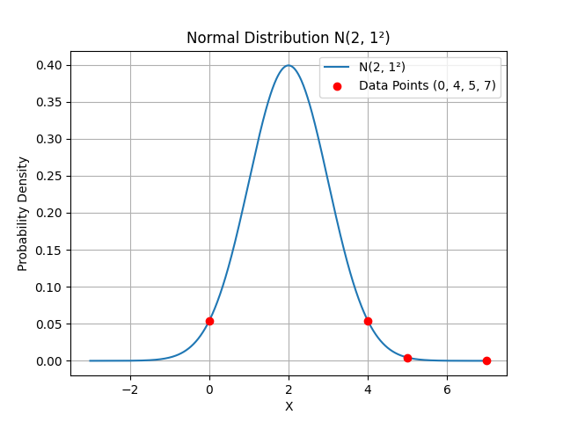
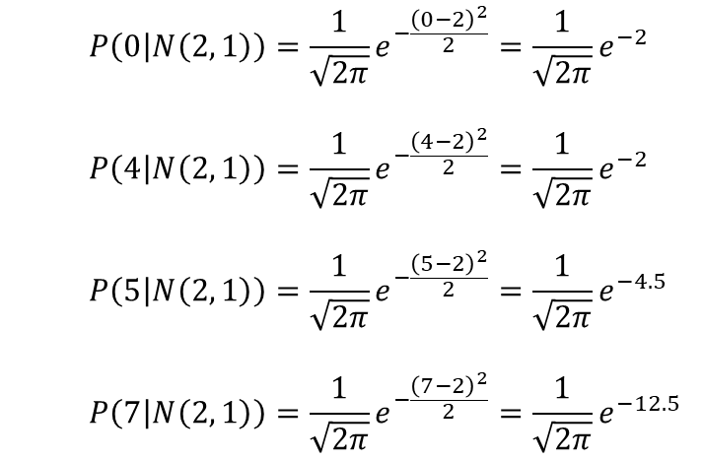
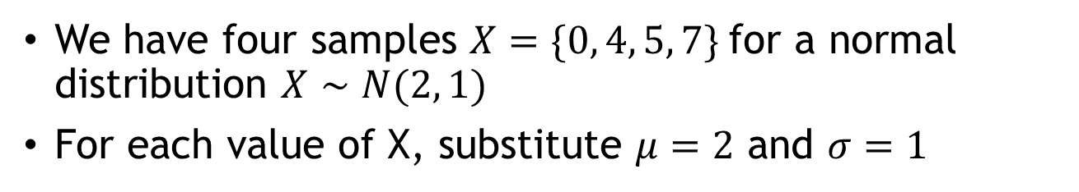
Computing Likelihood – Case A
We have four samples $X=\{0, 4, 5, 7\}$for a normal distribution $X∼N(2, 1)$
For each value of X, substitute $μ=2$ and $σ=1$
  $$P\left(0 | N\left(2, 1\right)\right)=\frac{1}{\sqrt{2π}}e^{−\frac{{\left(0−2\right)}^{2}}{2}}=\frac{1}{\sqrt{2π}}e^{−2}$$
  $$P\left(4 | N\left(2, 1\right)\right)=\frac{1}{\sqrt{2π}}e^{−\frac{{\left(4−2\right)}^{2}}{2}}=\frac{1}{\sqrt{2π}}e^{−2}$$
  $$P\left(5 | N\left(2, 1\right)\right)=\frac{1}{\sqrt{2π}}e^{−\frac{{\left(5−2\right)}^{2}}{2}}=\frac{1}{\sqrt{2π}}e^{−4.5}$$
  $$P\left(7 | N\left(2, 1\right)\right)=\frac{1}{\sqrt{2π}}e^{−\frac{{\left(7−2\right)}^{2}}{2}}=\frac{1}{\sqrt{2π}}e^{−12.5}$$

Slide 8
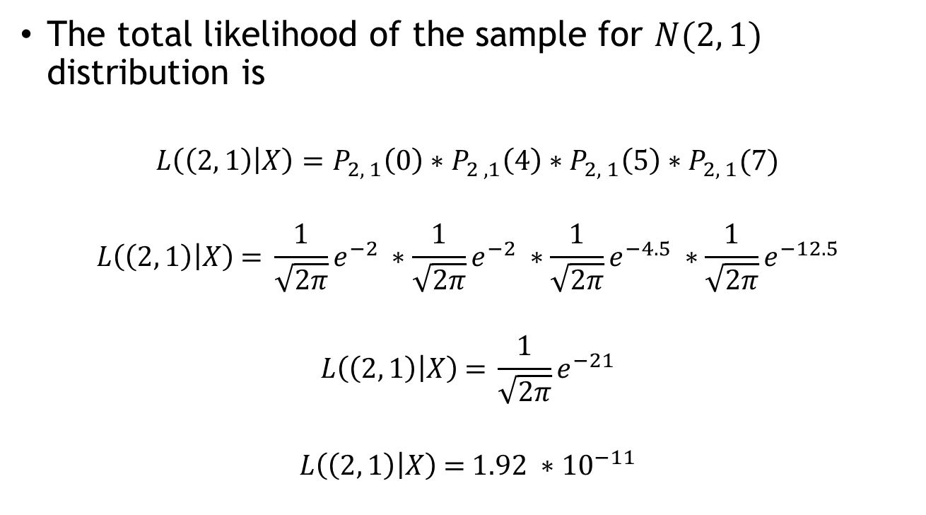
Computing Likelihood – Case A
The total likelihood of the sample for $N(2, 1)$ distribution is
$$L\left(\left(2, 1\right) | X\right)=P_{2, 1}\left(0\right)∗P_{2 , 1}\left(4\right)∗P_{2, 1}\left(5\right)∗P_{2, 1}(7)$$
$$L\left(\left(2, 1\right) | X\right) \text{= }\frac{1}{\sqrt{2π}}e^{−2} ∗\frac{1}{\sqrt{2π}}e^{−2} ∗\frac{1}{\sqrt{2π}}e^{−4.5} ∗\frac{1}{\sqrt{2π}}e^{−12.5}$$
$$L\left(\left(2, 1\right) | X\right) \text{= }\frac{1}{\sqrt{2π}}e^{−21}$$
$$L\left(\left(2, 1\right) | X\right) \text{= }1.92 ∗{10}^{−11}$$

Slide 9
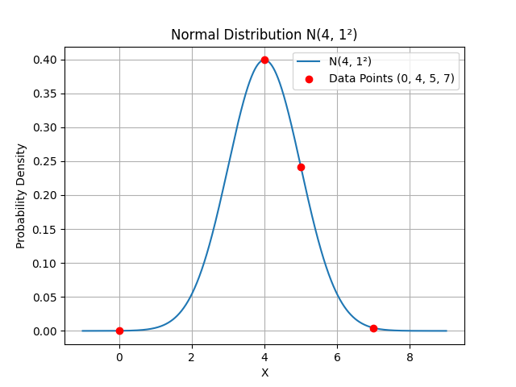
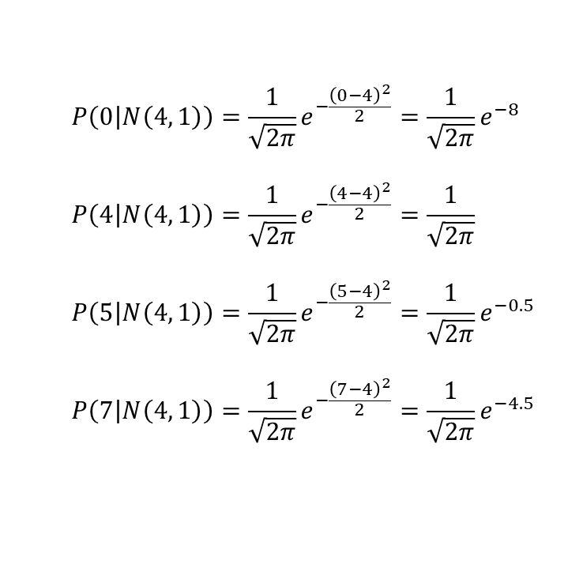
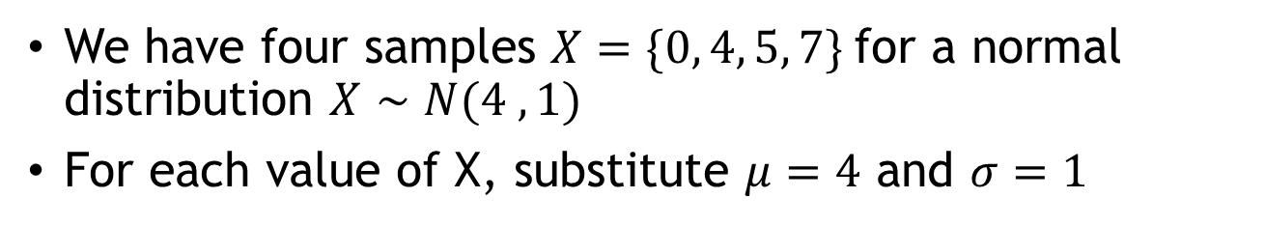
Computing Likelihood – Case B
We have four samples $X=\{0, 4, 5, 7\}$for a normal distribution $X∼N(4 ,1)$
For each value of X, substitute $μ=4$ and $σ=1$
  $$P\left(0 | N\left(4, 1\right)\right)=\frac{1}{\sqrt{2π}}e^{−\frac{{\left(0−4\right)}^{2}}{2}}=\frac{1}{\sqrt{2π}}e^{−8}$$
  $$P\left(4 | N\left(4, 1\right)\right)=\frac{1}{\sqrt{2π}}e^{−\frac{{\left(4−4\right)}^{2}}{2}}=\frac{1}{\sqrt{2π}}$$
  $$P\left(5 | N\left(4, 1\right)\right)=\frac{1}{\sqrt{2π}}e^{−\frac{{\left(5−4\right)}^{2}}{2}}=\frac{1}{\sqrt{2π}}e^{−0.5}$$
  $$P\left(7 | N\left(4, 1\right)\right)=\frac{1}{\sqrt{2π}}e^{−\frac{{\left(7−4\right)}^{2}}{2}}=\frac{1}{\sqrt{2π}}e^{−4.5}$$

Slide 10
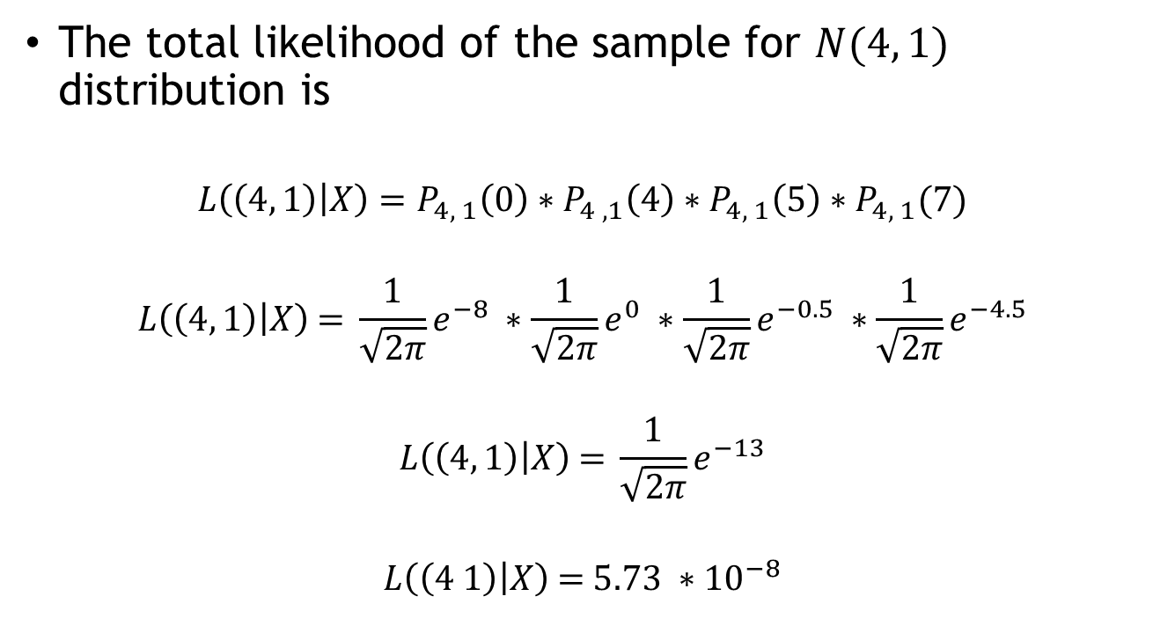
Computing Likelihood – Case B
The total likelihood of the sample for $N(4, 1)$ distribution is
$$L\left(\left(4, 1\right) | X\right)=P_{4, 1}\left(0\right)∗P_{4 , 1}\left(4\right)∗P_{4, 1}\left(5\right)∗P_{4, 1}(7)$$
$$L\left(\left(4, 1\right) | X\right) \text{= }\frac{1}{\sqrt{2π}}e^{−8} ∗\frac{1}{\sqrt{2π}}e^{0} ∗\frac{1}{\sqrt{2π}}e^{−0.5} ∗\frac{1}{\sqrt{2π}}e^{−4.5}$$
$$L\left(\left(4, 1\right) | X\right) \text{= }\frac{1}{\sqrt{2π}}e^{−13}$$
$$L\left(\left(4 1\right) | X\right) \text{= }5.73 ∗{10}^{−8}$$

Slide 11
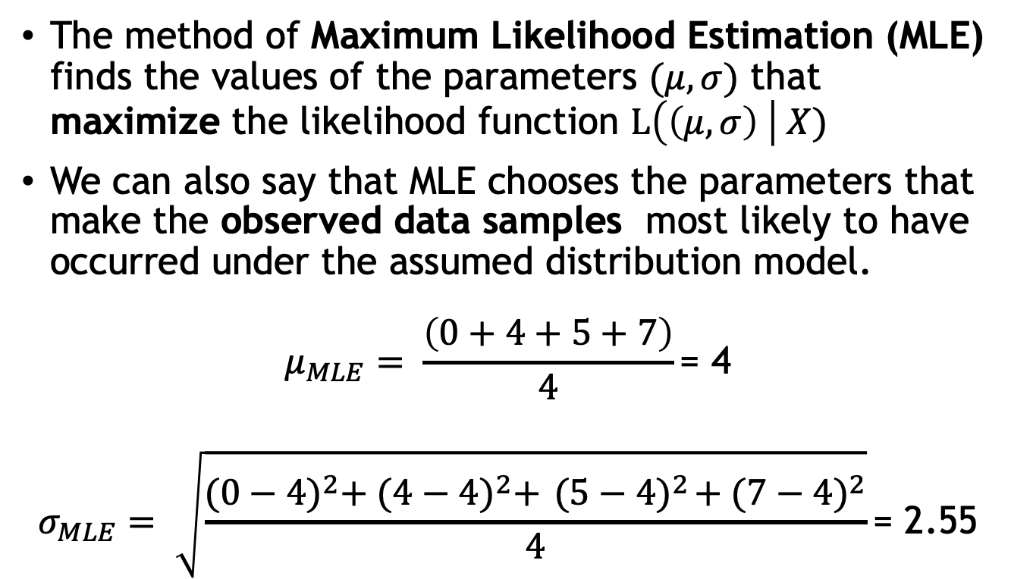
Maximum Likelihood Estimation
The method of Maximum Likelihood Estimation (MLE) finds the values of the parameters $(μ,σ)$ that maximize the likelihood function $L\left(\left(μ,σ\right) \right| X)$
We can also say that MLE chooses the parameters that make the observed data samples most likely to have occurred under the assumed distribution model.
$$μ_{MLE}= \frac{\left(0+4+5+7\right)}{4}\text{= 4}$$
$$σ_{MLE}= \sqrt{\frac{{(0−4)}^{2}+ {(4−4)}^{2}+{ (5−4)}^{2}+{(7−4)}^{2}}{4}}\text{= }\text{2.55}$$

Slide 12
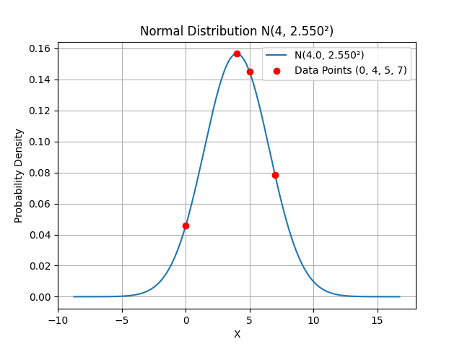

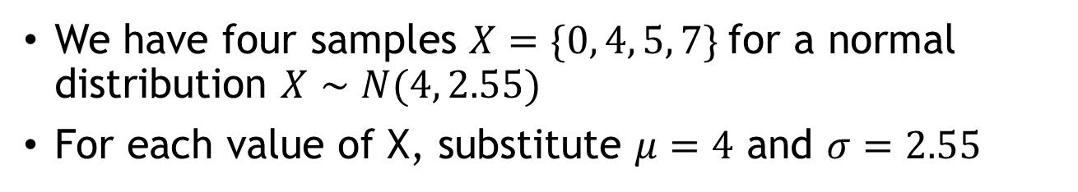
Computing MLE
We have four samples $X=\{0, 4, 5, 7\}$for a normal distribution $X∼N(4, 2.55)$
For each value of X, substitute $μ=4$ and $σ=2.55$
  $$P\left(0 | N\left(4, 2.55\right)\right)=\frac{1}{\sqrt{2π{(2.55)}^{2}}}e^{−\frac{{\left(0−4\right)}^{2}}{2{(2.55)}^{2}}}=\text{0.0457}$$
  $$P\left(4 | N\left(4, 2.55\right)\right)=\frac{1}{\sqrt{2π{(2.55)}^{2}}}e^{−\frac{{\left(4−4\right)}^{2}}{2{(2.55)}^{2}}}=\text{0.1565}$$
  $$P\left(5 | N\left(4, 2.55\right)\right)=\frac{1}{\sqrt{2π{(2.55)}^{2}}}e^{−\frac{{\left(5−4\right)}^{2}}{2{(2.55)}^{2}}}=\text{0.1449}$$
  $$P\left(7 | N\left(4, 2.55\right)\right)=\frac{1}{\sqrt{2π{(2.55)}^{2}}}e^{−\frac{{\left(7−4\right)}^{2}}{2{(2.55)}^{2}}}=\text{0.0783}$$

Slide 13
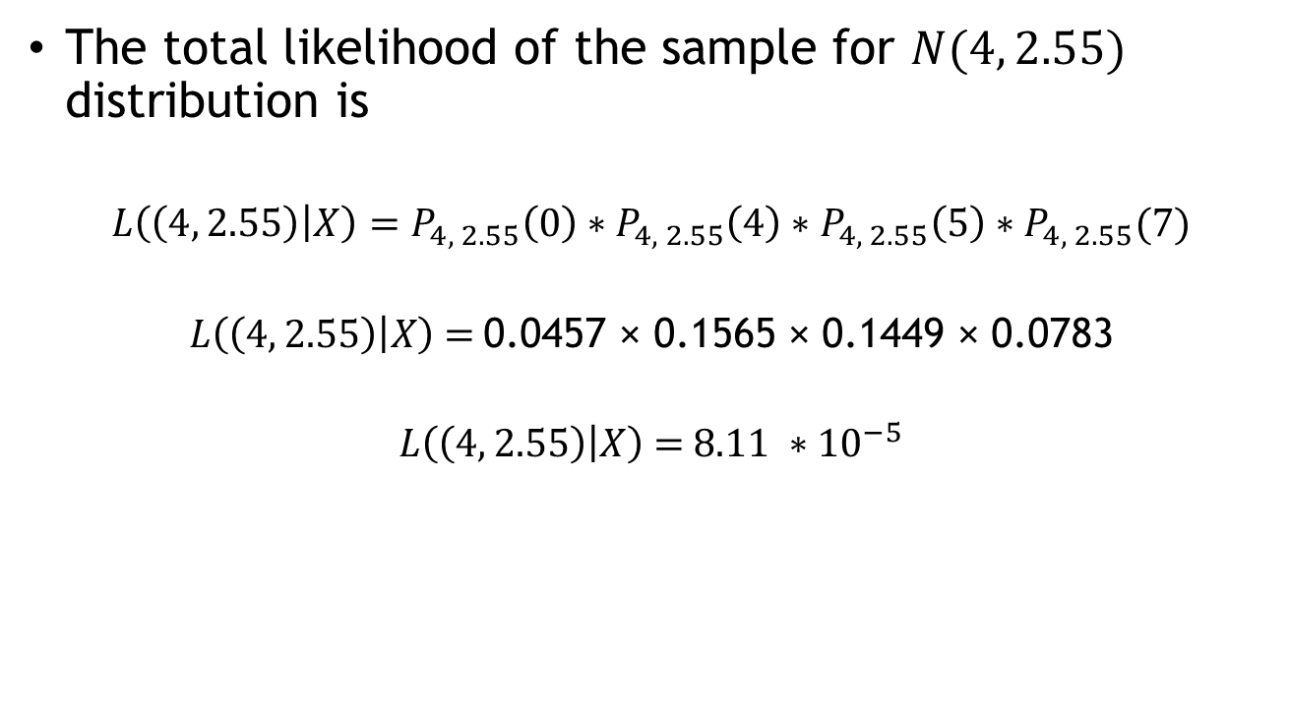
Computing MLE
The total likelihood of the sample for $N(4, 2.55)$ distribution is
$$L\left(\left(4, 2.55\right) | X\right)=P_{4, 2.55}\left(0\right)∗P_{4, 2.55}\left(4\right)∗P_{4, 2.55}\left(5\right)∗P_{4, 2.55}(7)$$
$$L\left(\left(4, 2.55\right) | X\right) \text{=} \text{0.0457} \text{×} \text{0.1565} \text{×} \text{0.1449} \text{×} \text{0.0783}$$
$$L\left(\left(4, 2.55\right) | X\right) \text{=} 8.11 ∗{10}^{−5}$$

Slide 14
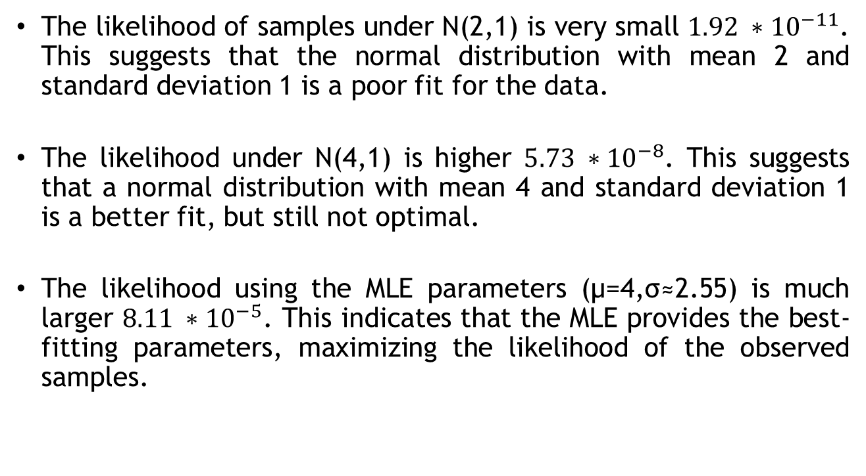
Comparison
The likelihood of samples under N(2,1) is very small $1.92 ∗{10}^{−11}$. This suggests that the normal distribution with mean 2 and standard deviation 1 is a poor fit for the data.
The likelihood under N(4,1) is higher $5.73 ∗{10}^{−8}$. This suggests that a normal distribution with mean 4 and standard deviation 1 is a better fit, but still not optimal.
The likelihood using the MLE parameters (μ=4,σ≈2.55) is much larger $8.11 ∗{10}^{−5}$. This indicates that the MLE provides the best-fitting parameters, maximizing the likelihood of the observed samples.

Slide 15
Conclusion
The likelihood for the MLE parameters is significantly higher than for the fixed parameter distributions, confirming that the MLE provides a much better fit to the data.
This suggests that the true distribution of the data is closer to N(4,2.55) rather than N(2,1) or N(4,1).
Distributions with fixed standard deviations of 1 in both N(2,1) and N(4,1) are not as suitable for the data, especially since the data points are more spread out.

Slide 16
Thank You

