Slide 1
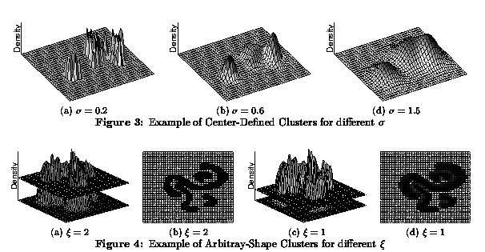
Density-based Clustering
Density-based Clustering algorithms use density-estimation techniques:
to use a non-parametric density function over the space of the attributes; then clusters are identified as areas whose density is above a certain threshold θ (DENCLUE’s Approach)
to create a proximity graph which connects objects whose density is above a certain threshold θ in the neighborhood of an object; then clustering algorithms identify contiguous, connected subsets in the graph which are dense (DBSCAN’s Approach). DBSCAN employs a naïve density estimation approach to estimate the density of dataset points.

Slide 2
COSC 6335 Sept. 26, 2023
Dr. Eick will have no office hour on Sept. 26 and Oct. 3; however, a makeup office hour has been scheduled for We., Sept. 27, 2-3p!
Task2 is due on October 7 (you have 7 more days).
Task 3 is a 1 month group task (groups of 3 students) and you will receive an e-mail by Mahin on October 3 about setting up groups, and the final group compositions will be announced in the lecture on October 5! We also expect that the specification of Task3 will be posted on the course website on October 5. Task5 will center on clustering and maybe outlier detection. Task3 will be due on November 6!
Today’s topics:
  DBSCAN
  DENCLUE (brief; will be continued on October 12); 2 slides NPDE
  Group E GHC Presentation
  Brief Discussion of Task2
  Cluster Evaluation and Validation

Slide 3
More on Clustering
Density-based Clustering will be discussed later
  DBSCAN
  DENCLUE (overview in this lecture and paper walk through on Oct. 12, 2023 lead by group H)
Hierarchical Clustering to be discussed on Sept. 19, 2023

Slide 4
DBSCAN (http://www2.cs.uh.edu/~ceick/7363/Papers/dbscan.pdf )
DBSCAN is a density-based algorithm.
  Density = number of points within a specified radius (Eps)
  Input parameter: MinPts and Eps
  A point is a core point if it has more than a specified number of points (MinPts) within Eps
    These are points that are at the interior of a cluster
  A border point has fewer than MinPts within Eps, but is in the neighborhood of a core point
  A noise point is any point that is not a core point or a border point.

Slide 5
DBSCAN: Core, Border, and Noise Points
MinPts = 7

Slide 6
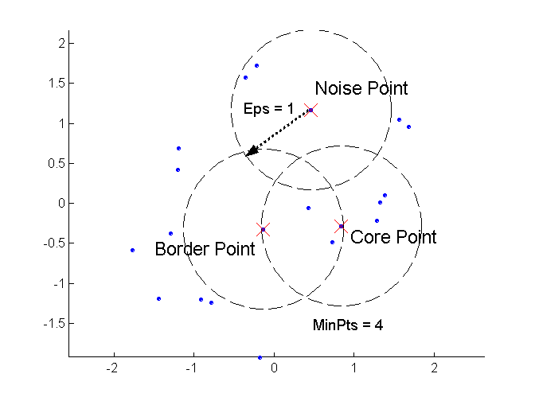
DBSCAN: Core, Border, and Noise Points
Remark: Noise and border points have no outgoing edges in the assumed graph.
Moreover, if there is an edge from a to b then b is directly density reachable from a!

Slide 7
DBSCAN Algorithm (simplified view for teaching)
Create a directed graph whose nodes are the points to be clustered
For each core-point c create an edge from c to every point p in the ε-neighborhood of c
Set N to the nodes of the graph;
If N does not contain any core points terminate
Pick a core point c in N
Let X be the set of nodes that can be reached from c by going forward;
  create a cluster containing X∪{c}
  N=N/(X∪{c})
Continue with step 4
Remarks: points that are not assigned to any cluster are outliers;
http://www2.cs.uh.edu/~ceick/7363/Papers/dbscan.pdf gives a more efficient implementation by
performing steps 2 and 6 in parallel

Slide 8
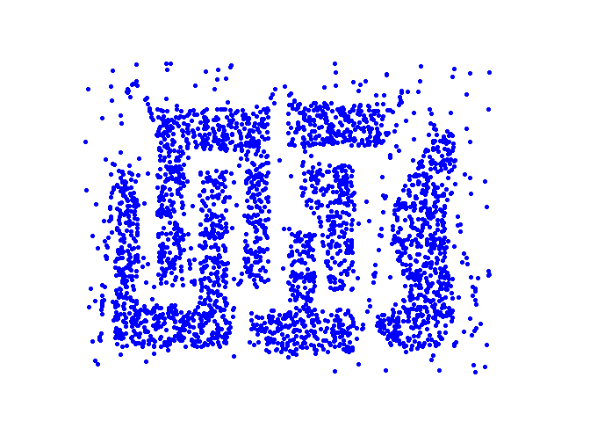
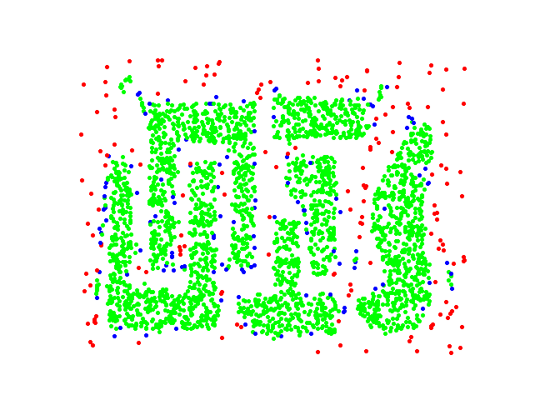
DBSCAN: Core, Border and Noise Points
Original Points
Point types: core, border and noise
Eps = 10, MinPts = 4

Slide 9
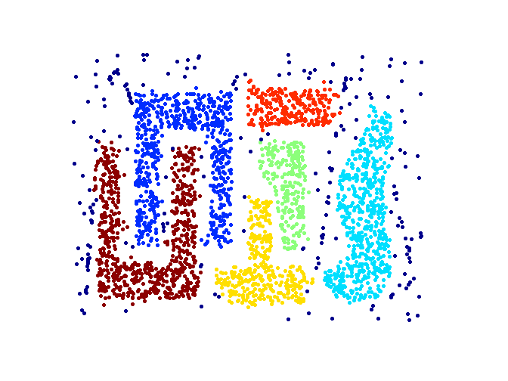
When DBSCAN Works Well
Original Points
Clusters
Resistant to Noise
Supports Outliers
Can handle clusters of different shapes and sizes

Slide 10
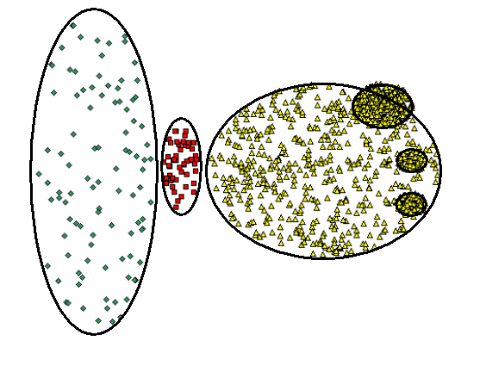
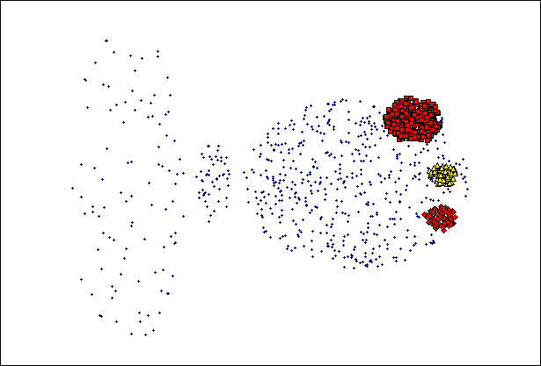
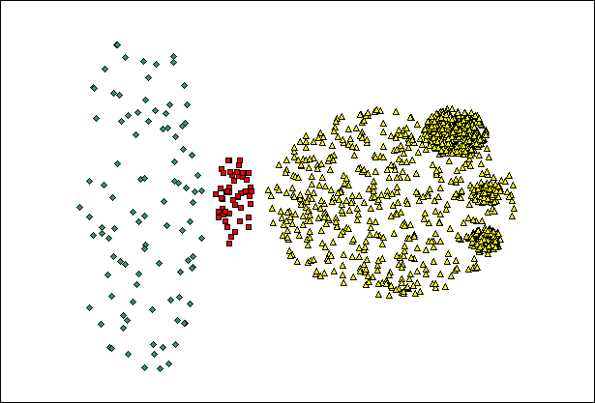
When DBSCAN Does NOT Work Well
(MinPts=4, Eps=9.75).
Original Points
Problems with
Varying densities
High-dimensional data
(MinPts=4, Eps=9.12)

Slide 11
DBSCAN in R
dbscan(iris[3:4], 0.15, 3, showplot=1)
dbscan Pts=150 MinPts=3 eps=0.15
0 1 2 3 4 5 6
border 20 2 5 0 3 2 1
seed 0 46 54 3 9 1 4
total 20 48 59 3 12 3 5
dbscan.r (demo)
http://www.inside-r.org/node/59838

Slide 12
DBSCAN—A Second Introduction
Two parameters:
  Eps: Maximum radius of the neighbourhood
  MinPts: Minimum number of points in an Eps-neighbourhood of that point
N_{Eps}(p): {q belongs to D | dist(p,q) <= Eps}
Directly density-reachable: A point p is directly density-reachable from a point q wrt. Eps, MinPts if
  1) p belongs to N_{Eps}(q)
  2) core point condition:
  |N_{Eps} (q)| >= MinPts
p
MinPts = 5
Eps = 1 cm
q

Slide 13
Density-Based Clustering: Background (II)
Density-reachable:
  A point p is density-reachable from a point q wrt. Eps, MinPts if there is a chain of points p₁, …, p_{n}, p₁ = q, p_{n} = p such that p_{i+1} is directly density-reachable from p_{i}
Density-connected
  A point p is density-connected to a point q wrt. Eps, MinPts if there is a point o such that both, p and q are density-reachable from o wrt. Eps and MinPts.
p
p₁
q
p
q
o
Remark: All pairs of points belonging to the same cluster a density connected

Slide 14
DBSCAN: Density Based Spatial Clustering of Applications with Noise
Relies on a density-based notion of cluster: A cluster is defined as a maximal set of density-connected points
Capable to discovers clusters of arbitrary shape in spatial datasets with noise
Not density reachable
from core point
Density reachable
from core point
Outlier
Border
Eps = 1cm
MinPts = 5
Core

Slide 15
DBSCAN: The Algorithm
  Arbitrary select a point p
  Retrieve all points density-reachable from p wrt Eps and MinPts.
  If p is a core point, a cluster is formed.
  If p ia not a core point, no points are density-reachable from p and DBSCAN visits the next point of the database.
  Continue the process until all of the points have been processed.
  Remark: Some bookkeeping is needed to make sure that only points that have not been assigned to a cluster yet, will be used in step 2.

Slide 16
DBSCAN Questions from Previous Exams
Assume you have two core points a and b, and a is density reachable from b, and b is density reachable from a; what will happen to a and b when DBSCAN clusters the data? [2]
Assume we have a border point a that is within the radius of two core points b and c that are not density connected. What happens with this border point? Create an example dataset which matches this situation!
Assume you run dbscan(iris[3:4], 0.15, 3) in R and obtain.
0 1 2 3 4 5 6
border 20 2 5 0 3 2 1
seed 0 46 54 3 9 1 4
total 20 48 59 3 12 3 5
What does the displayed result mean with respect to number of clusters, outliers, border points and core points?
Now you run DBSCAM, increasing MinPoints to 5:
dbscan(iris[3:4], 0.15, 5).
How do you expect the clustering results to change?
Next, we run DBSCAN changing epsilon to 0.25; how do the results change? [6]

Slide 17
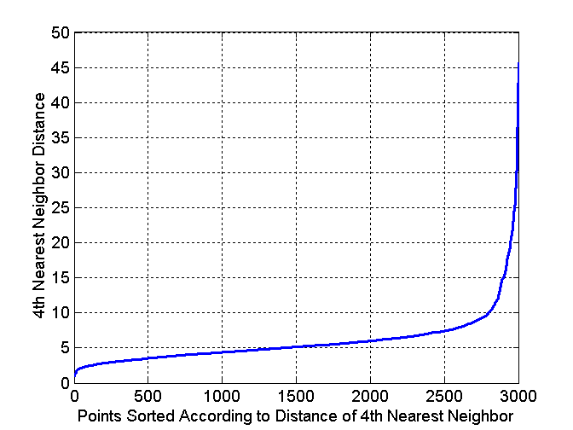
DBSCAN: Determining EPS and MinPts
Idea is that for points in a cluster, their k^{th} nearest neighbors are at roughly the same distance
Noise points have the k^{th} nearest neighbor at farther distance
So, plot sorted distance of every point to its k^{th} nearest neighbor
Run DBSCAN for Minp=4 and ε=5
More on that in Task8 of
ProblemSet3!
Core-points
Non-Core-points
Not now! More discussion on
this topic in the lecture
on Oct. 14 which discusses
Task3!

Slide 18
2. DENCLUE: Clustering using density functions
DENsity-based CLUstEring by Hinneburg & Keim (KDD’98)
Paper: http://www2.cs.uh.edu/~ceick/DM/Denclue2.pdf
Slides Morteza Morteza H. Chehreghani Chehreghani from Sharif University: http://www2.cs.uh.edu/~ceick/DM/DENCLUE.pdf
Randomized Hill Climbing slides (not relevant): http://www2.cs.uh.edu/~ceick/DM/RHC.pptx

Slide 19
2023 DENCLUE Teaching Plan
Source code of DENCLUE??
Everybody reads the DENCLUE 2.0 paper before Oct. 10, 2:30p.
Tuesday, October 10: GHC Group H will lead a discussion (at most 25 minutes) of DENCLUE centering on producing initial answers to the following questions:
What is a density attractor and how are density attractors computed by DENCLUE?
What is a cluster in DENCLUE? How are clusters formed by DENCLUE?
What is a path in DENCLUE? How are paths computed in DENCLUE? What algorithm is used to determine which clusters are merged?
DENCLUE places a (hyper)grid on the top of the dataset… Why??
How does DENCLUE’s hill climbing procedure work? How was it enhanced in DENCLUE 2.0 in comparison of its older version?
What objects in the dataset does DENCLUE classify as outliers?
Report anything else you found interesting
Remark: Dr. Eick will only listen, and maybe make some comments after the discussion.

Slide 20
Density-based Clustering: Pros and Cons
  +: can (potentially) discover clusters of arbitrary shape
  +: not sensitive to outliers and supports outlier detection
  +: can handle noise
  +−: medium algorithm complexities O(n**2), O(n*log(n)
  −: finding good density estimation parameters is frequently difficult; more difficult to use than K-means.
  −: usually, does not do well in clustering high-dimensional datasets.
  −: cluster models are not well understood (yet)

