Slide 1
Exploratory Data Analysis / Data Science Basics
Remark: covers in part Chapter 3 of the first edition Tan book in Part
Organization
Why Exploratory Data Analysis?
Summary Statistics
Visualization
Remark: As many of you already got exposure to this topic in other courses you took, the lecture focuses on the “most important things” and will cover other subtopics quite quickly or skip a few.

Slide 2
1. Why Data Exploration?
A preliminary exploration of the data to better understand its characteristics.
Key motivations of data exploration include
Getting a better understanding of the data
Create background knowledge about the data to be analyzed
Helping to select the right tool for preprocessing, data analysis and data mining
Making use of humans’ abilities to recognize patterns
People can recognize patterns not captured by data analysis tools
Related to the area of Exploratory Data Analysis (EDA)
Created by statistician John Tukey
Seminal book is Exploratory Data Analysis by Tukey
A nice online introduction can be found in Chapter 1 of the NIST Engineering Statistics Handbook
http://www.itl.nist.gov/div898/handbook/index.htm

Slide 3
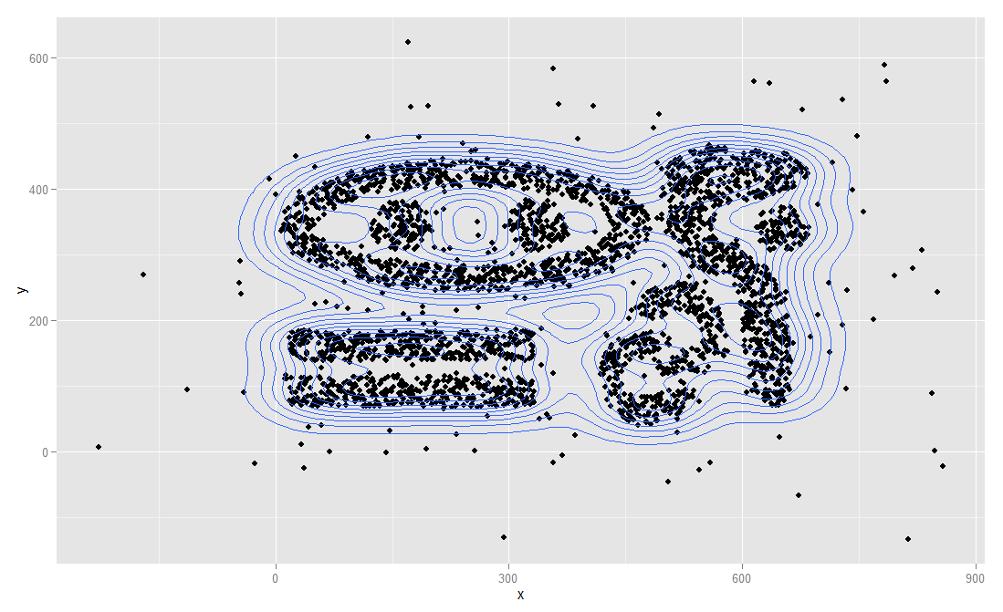
What Clusters do you see in the Display Below?

Slide 4
Exploratory Data Analysis
Get Data
Exploratory Data Analysis
https://www.itl.nist.gov/div898/handbook/eda/section1/eda14.htm
Preprocessing
Data Mining
Apply DS Tool

Slide 5
Techniques Used In Data Exploration
History: In EDA, as originally defined by Tukey
The focus was on visualization
Clustering and anomaly detection were viewed as exploratory techniques
In data mining, clustering and anomaly detection are major areas of interest, and not thought of as just exploratory
In our discussion of data exploration, we focus on
Summary statistics
Visualization

Slide 6
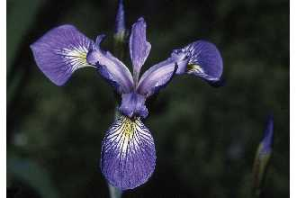
Iris Sample Data Set
Many of the exploratory data techniques are illustrated with the Iris Plant data set.
Can be obtained from the UCI Machine Learning Repository http://www.ics.uci.edu/~mlearn/MLRepository.html
From the statistician Douglas Fisher
Three flower types (classes):
Setosa
Virginica
Versicolour
Four (non-class) attributes
Sepal width and length
Petal width and length
Virginica. Robert H. Mohlenbrock. USDA NRCS. 1995. Northeast wetland flora: Field office guide to plant species. Northeast National Technical Center, Chester, PA. Courtesy of USDA NRCS Wetland Science Institute.

Slide 7
2. Summary Statistics
Summary statistics are numbers that summarize properties of the data
Summarized properties include frequency, location and spread
Examples: location - mean spread - standard deviation
Most summary statistics can be calculated in a single pass through the data

Slide 8
Frequency and Mode
The frequency of an attribute value is the percentage of time the value occurs in the data set
For example, given the attribute ‘gender’ and a representative population of people, the gender ‘female’ occurs about 50% of the time.
The mode of a an attribute is the most frequent attribute value
The notions of frequency and mode are typically used with categorical data

Slide 9
Percentiles
For continuous data, the notion of a percentile is more useful.
Given an ordinal or continuous attribute x and a number p between 0 and 100, the pth percentile is a value of x such that p% of the observed values of x are less than .
For instance, the 50th percentile is the value such that 50% of all values of x are less than .
Key Idea: associate attribute value with a rank!!

Slide 10
R Box Plots (different from textbook)
R Box Plots
Invented by J. Tukey
displaying the distribution of data based on percentiles
Following figure shows the basic parts of a box plots
outlier
Maximum (is at most 1.5 IQR off the 75th percentile)
75th percentile
IQR
50th percentile
25th percentile
Minimum (is at most 1.5 IQR off the 25th percentile)

Slide 11
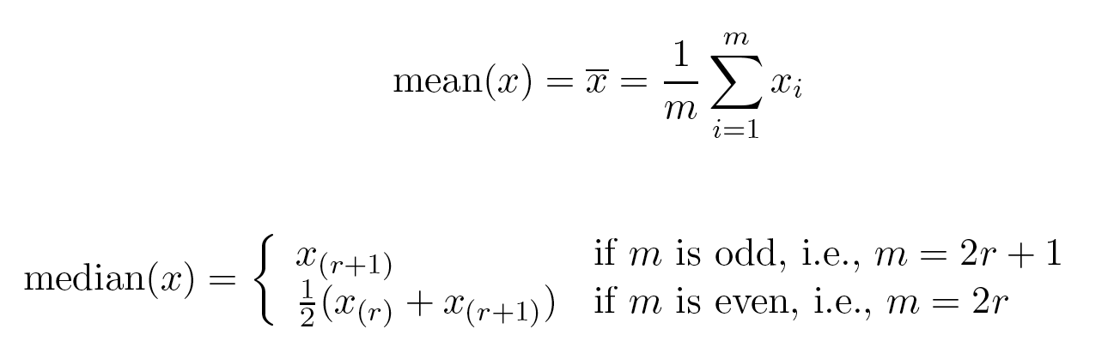
Measures of Location: Mean and Median
The mean is the most common measure of the location of a set of points.
However, the mean is very sensitive to outliers.
Thus, the median or a trimmed mean is also commonly used.

Slide 12
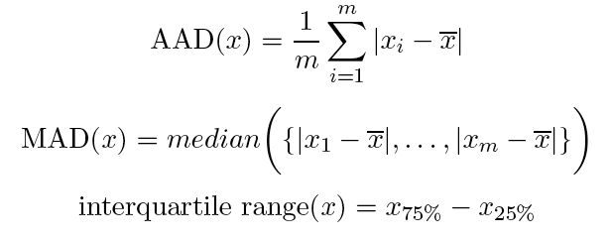
Measures of Spread: Range and Variance
Range is the difference between the max and min
The variance or standard deviation
However, this is also sensitive to outliers, so that other measures are often used.
0, 2, 3, 7, 8
11.5
standard_deviation(x)= s_{x}
3.3
(Mean Absolute Deviation) [Han]
(Absolute Average Deviation) [Tan]
2.8
3
(Median Absolute Deviation)
5

Slide 13
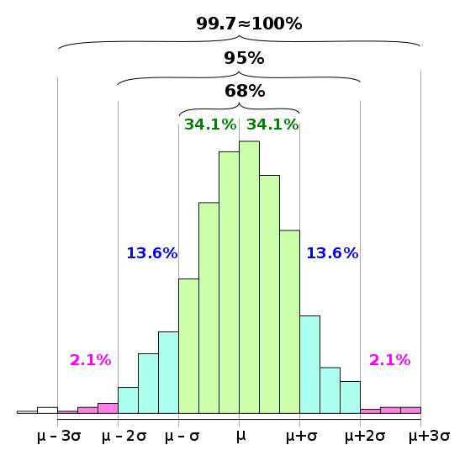
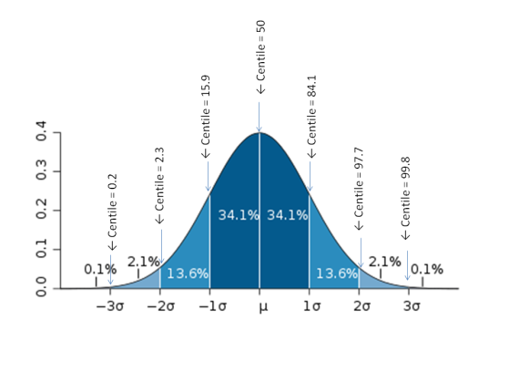

68-95-99.7 Rule
For more details see:
https://en.wikipedia.org/wiki/68%E2%80%9395%E2%80%9399.7_rule
This rule assumes a Gaussian
distribution!
Remark:
is mean value and
is standard deviation

Slide 14
68-95-99.7 Rule continued
Range | Expected fraction of population inside range | Approximate expected frequency outside range | Approximate frequency for daily event
μ ± 0.5σ | 0.382924922548026 | 2 in 3 | Four times a week
μ ± σ | 0.682689492137086 | 1 in 3 | Twice a week
μ ± 1.5σ | 0.866385597462284 | 1 in 7 | Weekly
μ ± 2σ | 0.954499736103642 | 1 in 22 | Every three weeks
μ ± 2.5σ | 0.987580669348448 | 1 in 81 | Quarterly
μ ± 3σ | 0.997300203936740 | 1 in 370 | Yearly
μ ± 3.5σ | 0.999534741841929 | 1 in 2149 | Every six years
μ ± 4σ | 0.999936657516334 | 1 in 7004157870000000000♠15787 | Every 43 years (twice in a lifetime)

Slide 15
Correlation
Key question: Is there are linear relationship between 2 continuous attributes
Secondary question: how strong is this relationship, what is its nature: positive or negative?
Continue with: https://en.wikipedia.org/wiki/Correlation_and_dependence

Slide 16
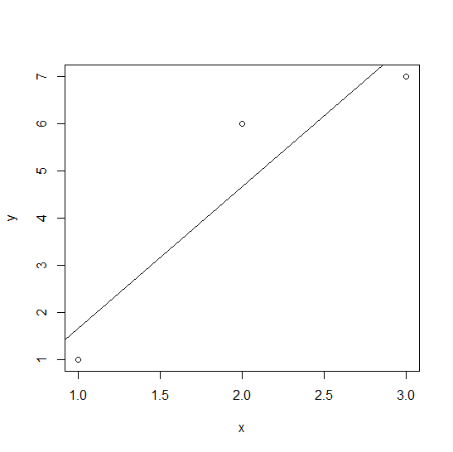
Fitting Linear Models
> x<-c(1,2,3)
> y<-c(1,6,7)
> dataset<-data.frame(x,y)
> mod<-lm(y ~ x, data=dataset)
> mod$coeff
(Intercept) x
-1.333333 3.000000
> plot(x,y)
> abline(c(-1.3333,3))
> summary(mod)$r.squared
[1] 0.8709677
More details: https://en.wikibooks.org/wiki/R_Programming/Linear_Models
In statistics, the coefficient of determination, denoted R² or r² and pronounced "R squared", is the
proportion of the variance in the dependent variable that is predictable from the independent variable; see:
https://en.wikipedia.org/wiki/Coefficient_of_determination

Slide 17
3. Visualization
Visualization is the conversion of data into a visual or tabular format so that the characteristics of the data and the relationships among data items or attributes can be analyzed or reported.
Visualization of data is one of the most powerful and appealing techniques for data exploration.
Humans have a well developed ability to analyze large amounts of information that is presented visually
Can detect general patterns and trends
Can detect outliers and unusual patterns

Slide 18
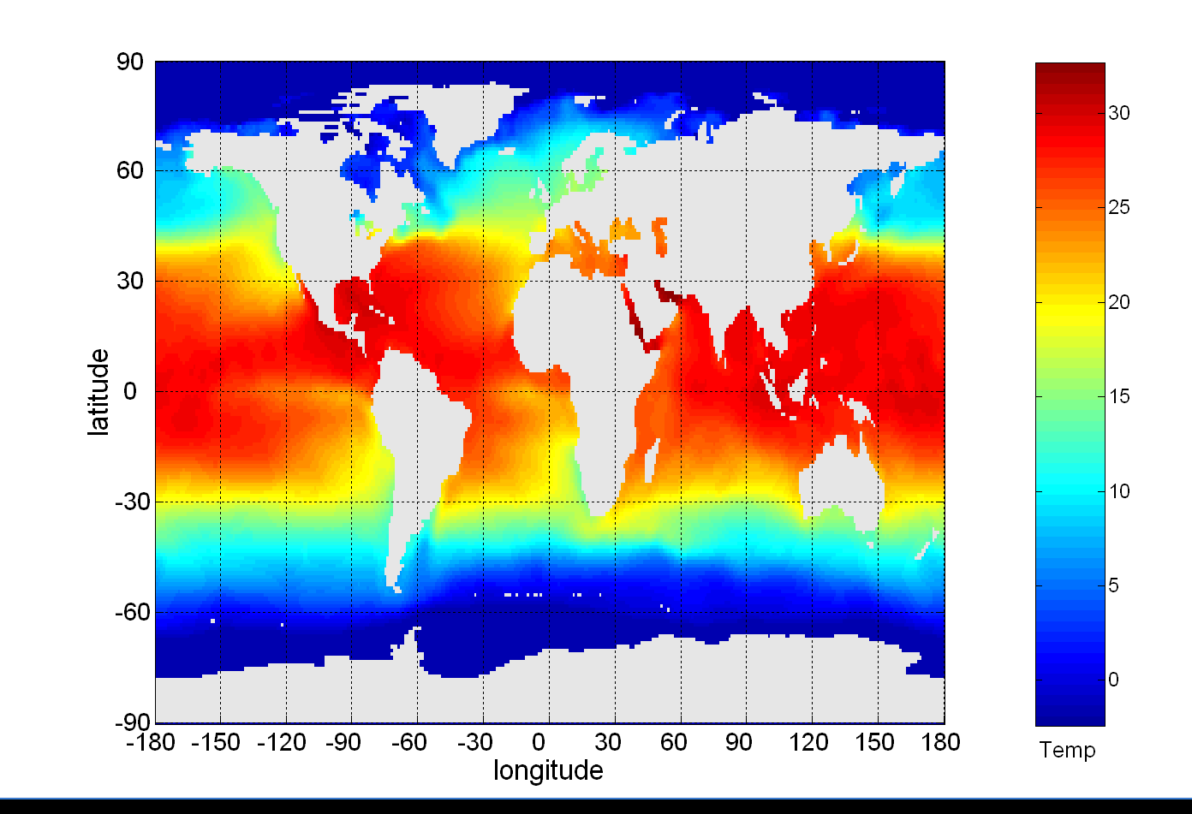
Example: Sea Surface Temperature
The following shows the Sea Surface Temperature (SST) for July 1982
Tens of thousands of data points are summarized in a single figure

Slide 19
Representation
Is the mapping of information to a visual format
Data objects, their attributes, and the relationships among data objects are translated into graphical elements such as points, lines, shapes, and colors.
Example:
Objects are often represented as points
Their attribute values can be represented as the position of the points or the characteristics of the points, e.g., color, size, and shape
If position is used, then the relationships of points, i.e., whether they form groups or a point is an outlier, is easily perceived.

Slide 20
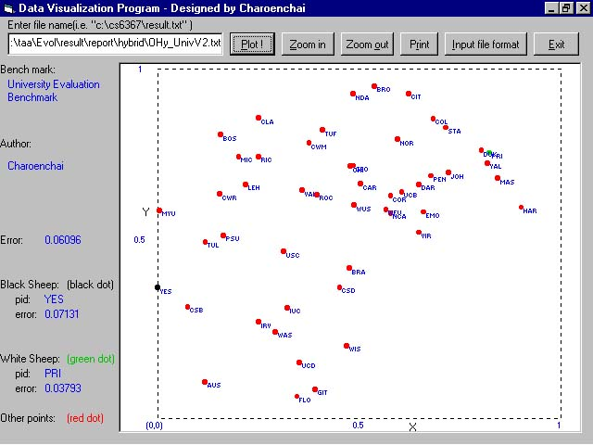
Example: Visualizing Universities

Slide 21
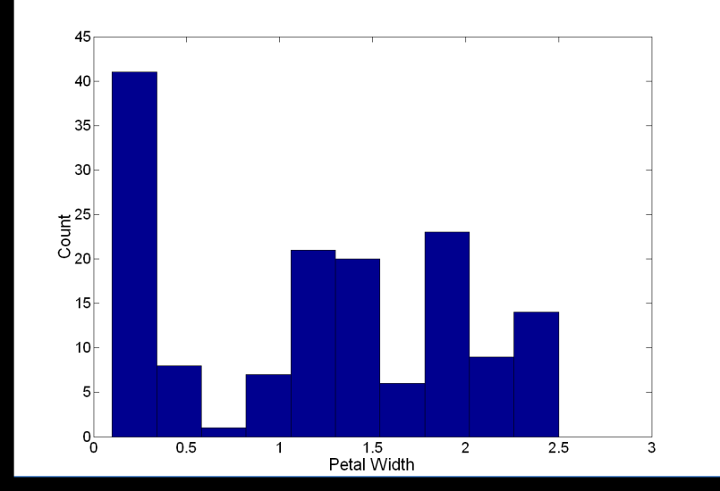
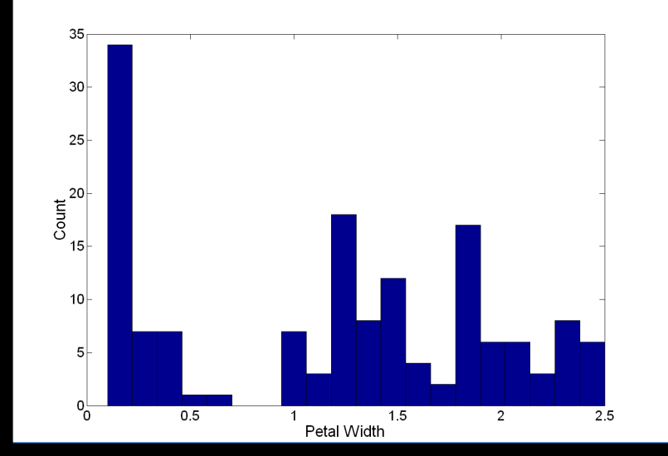
Visualization Techniques: Histograms
Histogram
Usually shows the distribution of values of a single variable
Divide the values into bins and show a bar plot of the number of objects in each bin.
The height of each bar indicates the number of objects
Shape of histogram depends on the number of bins and origin
Example: Petal Width (10 and 20 bins, respectively)

Slide 22
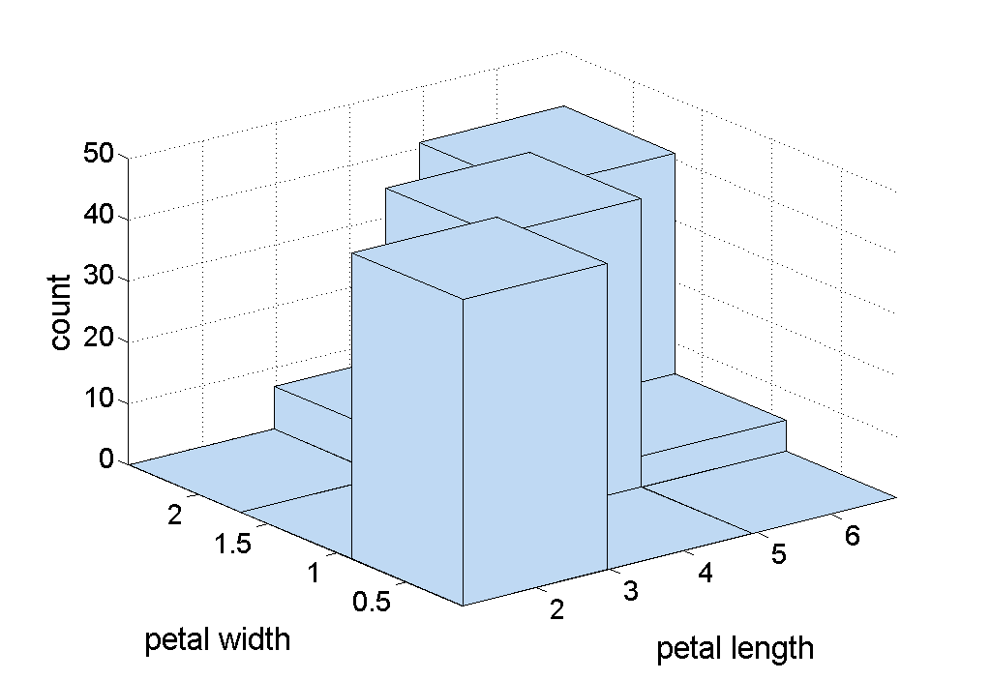
Two-Dimensional Histograms
Show the joint distribution of the values of two attributes
Example: petal width and petal length
What does this tell us?

Slide 23
Visualization Techniques: Histograms
Several variations of histograms exist: equi-bin(most popular), other approaches use variable bin sizes…
Choosing proper bin-sizes and bin-starting points is a non trivial problem!! For example, our bins could be: [0,1], [0,2] or [0.2, 1.2], [1.2,2.2] assuming a equi-bin size of 1 is use.
https://en.wikipedia.org/wiki/Histogram
Example Problem from the midterm exam 2016: Assume you have an attribute A that has the attribute values that range between 0 and 6; its particular values are: 0.62 0.97 0.98 1.01. 1.02 1.07 2.96 2.97 2.99 3.02 3.03 3.06 4.96 4.97 4.98 5.02 5.03 5.04. Assume this attribute A is visualized as a equi-bin histogram with 6 bins: [0,1), [1,2), [2,3],[3,4), [4,5), [5,6]. Does the histogram provide a good approximation of the distribution/density function of attribute A? If not, provide a better histogram for attribute A. Give reasons for your answers!

Slide 24
Visualization Techniques: Box Plots
Box Plots (we do not use the version depicted below!)
Invented by J. Tukey
Another way of displaying the distribution of data
Following figure shows the basic part of a box plot
outlier
90th percentile
Also see: https://en.wikipedia.org/wiki/Box_plot
75th percentile
50th percentile
25th percentile
10th percentile

Slide 25
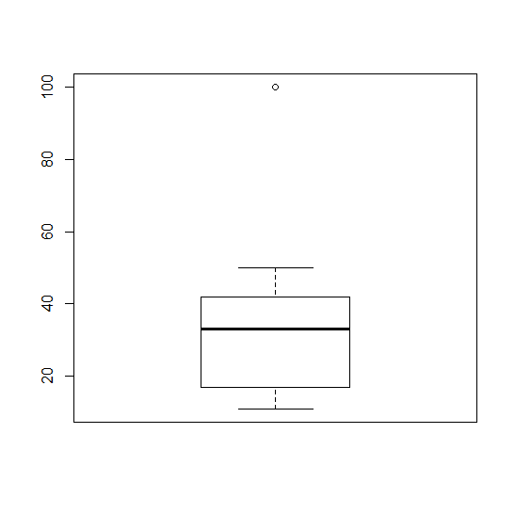
Boxplots in R (we use those!!)
By default, boxplot() in R plots the maximum and the minimum non-outlying values instead of the 10th and 90th percentiles as the book describes. Outliers in BPs are values that are 1.5*IQR or more away from the box, where IQR is the height of the box!
See:
> a<-c(11,12, 22, 33, 34, 100)
> boxplot(a)
> b<-c(11,12, 22, 33, 34, 65)
> boxplot(b)
a<-c(11,12,22, 33, 34, 50, 100)
boxplot(a)
outlier
90th percentile
Maximum non-outlier
75th percentile
50th percentile
IQR (a proxy for standard
deviation)
25th percentile
10th percentile
Minimum non-outlier
Notes:
*

Slide 26
Attribute Standardization / Normalization
The domains of numerical attributes vary a lot in their scale: e.g. height varies between 0 and 8 feet and age varies between 0 and 110 years.
For many data analysis and date mining tasks we want to make attributes “equally important” by using the same range of their attribute values. Attribute Normalization/Standardization approaches address this need:
The two most popular attribute normalization / standardization include:
Z-scores
[0,1] Normalization

Slide 27
Standardization --- Z-scores
Standardize data using z-scores
Calculate the mean, the standard deviation s_{f} :
Calculate the standardized measurement (z-score)
Using mean absolute deviation is more robust than using standard deviation, but using the standard deviation is the choice of many tools.
Result of Z-score standardization is a dataset in which each attribute has a mean of 0 and a standard deviation of 1.
Please Read:
Related: 68-95-99.7 Rule! https://en.wikipedia.org/wiki/68%E2%80%9395%E2%80%9399.7_rule
http://en.wikipedia.org/wiki/Standard_score

Slide 28
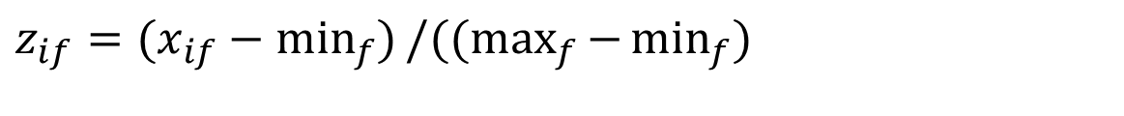
Normalization in [0,1]
PSolution: Normalize interval-scaled variables using
where min_{f} denotes the minimum value and max_{f} denotes the maximum value of the f-th attribute in the data set.
How it works: The minimum value is mapped to 0 the maximum value is mapped to 1, and for the in-between values linear interpolation is used.
Remark: frequently used after applying some form of outlier removal.
$$z_{if}=(x_{if}−\min_{f}{)}/((\max_{f}{−}\min_{f}{)}$$

Slide 29
Comparison Z-scores / [0,1] Normalization
Having the value of 1 in [0,1] normalization indicates the maximum value, and a value of 0 indicates the minimum value and a value of 0.5 indicates … What??
A z-score of -2 indicates a value 2 standard deviations below the mean value, a value of 0 indicates the mean value of the attribute and a z-score of +1 indicates a value one standard deviation above the mean value.
As z-scores allow for statistical interpretation they are usually the preferred choice, but some scientists prefer [0,1] normalization, as they do not like to work with negative values in the dataset.
Datasets are frequently standardized before applying a data mining technique to the dataset! Why??

Slide 30
Visualization Techniques: Scatter Plots
Scatter plots
Attributes values determine the position
Two-dimensional scatter plots most common, but can have three-dimensional scatter plots
Often additional attributes can be displayed by using the size, shape, and color of the markers that represent the objects
It is useful to have arrays of scatter plots can compactly summarize the relationships of several pairs of attributes
For prediction scatter plots see: http://en.wikipedia.org/wiki/Scatter_plot
http://en.wikipedia.org/wiki/Correlation (Correlation)
See example for classification, also called supervised scatter plots, on the next slide

Slide 31
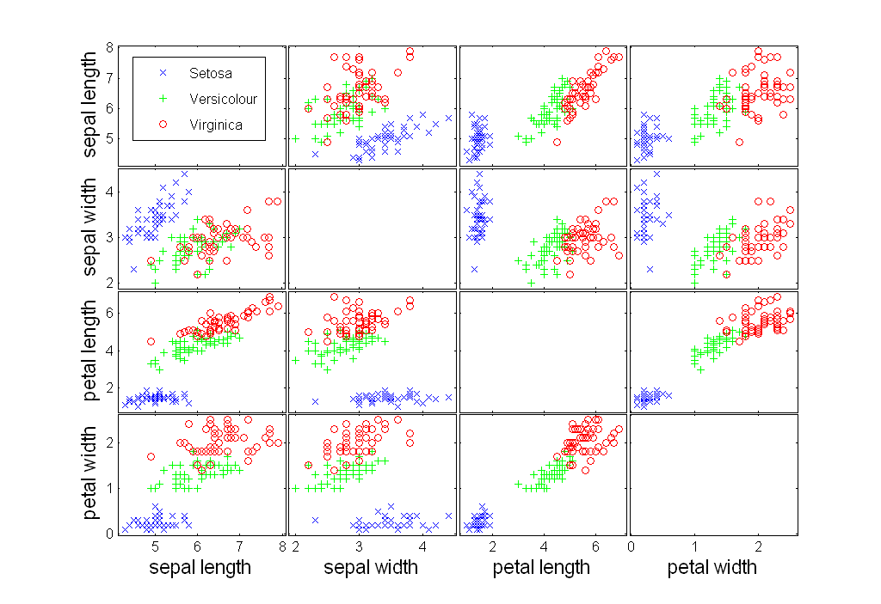
Scatter Plot Array of Iris Attributes

Slide 32
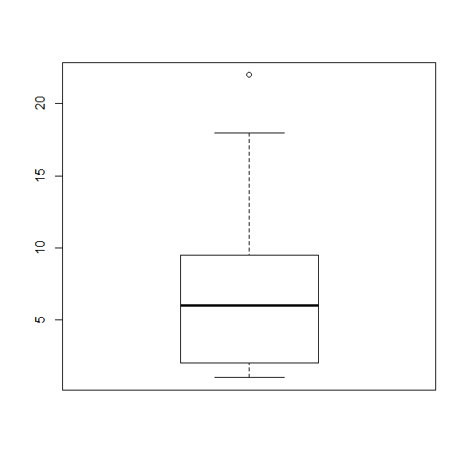
Box Plot Basics
σ:=standard deviation
---line: length less/eq. than 1.5σ
σ:=height of box
---line: Less/eq. than 1.5σ

Slide 33
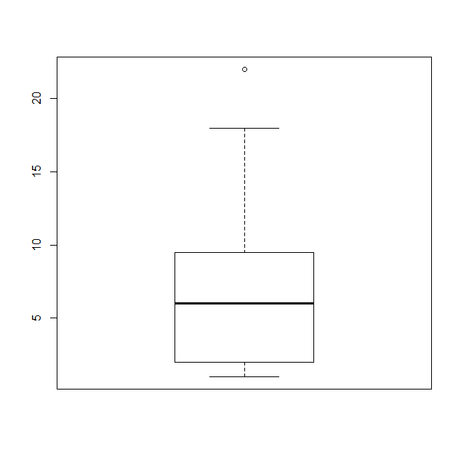
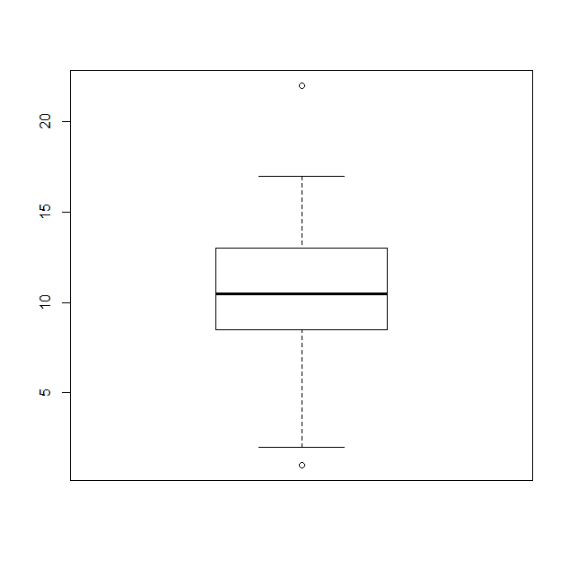
Compare the following to Boxplots x and y
x<-c(1,2,2,2,4,4,8,9,9,10,18,22)
boxplot(x)
y<-c(1,2,8, 9,10,10,11,11,12,14,17,22)
> boxplot(y)
x
y

Slide 34
Example of R Box Plots (2021 Mid1 Question)
b) The following boxplot has been created using the following R-code for an attribute x:
> x<-c(1,2,2,2,4,4,8,9,9,10,18,22)
> boxplot(x)
What is the median for the attribute x? What is the IQR for the attribute x? The lower whisker of the boxplot as at
1; what does this tell you? According the boxplot 18 is not an outlier and 22 as an outlier; why do you believe this
is the case? [5]
Median is 6=(4+8)/2 [1] 25%perc=2 75%=9.5
IQR=9.5-2=7.5 [1]
1 is the lowest value in the dataset that is not an outlier [1] Every value that is 1.5∗IQR above the 75th percentile is
an outlier; that is, for the particular boxplots values above 9.5+1.5*7.5=20.75 and below the 25th percentile -9.25
are outliers; consequently, 22 is an outlier and 1 and 18 is not, and the whiskers are therefore at 1 and 18!

Slide 35
Comparing 2 Box Plots
Questions to ask:
Compare the two medians: are the two medians: more or less the same: at most 1/10 box_size apart, somewhat similar: 0.1 to 0.25 box_size apart, different: 0.25 to 1 box_size apart, very different: more than 1 box_size apart
Compare the IQRs of the two box plots by interpreting them as intervals, computing their overlap (overlap:=length of the intersection of the intervals they cover/length of the union of the intervals they cover): 90-100%: IQRs almost the same; 75-90%: quite similar, 25-75: somewhat overlapping, 25-10%: dissimilar, 10% or less: very dissimilar.
Compare the intervals defined by the two whiskers (WI) of the two boxplots by computing their WI overlap, and draw conclusions as follows: Range of attribute is: 90-100%: almost the same; 75-90%: quite similar, 25-75%: has medium overlap, 25-10%: dissimilar, 10% or less: very dissimilar.
Assess and compare skewness by summarizing the position of the median in the box
Mention and assess agreement/disagreement with respect to outliers that occur in both boxplots
Combine the agreement/disagreement in the 2 boxplots you observed by transforming the answers to questions 1-5 into a final summary.
Heuristic: We use the IQR as a proxy for standard deviation when comparing the respective distributions, and set box_size to (IQR1+IQR2)/2!

Slide 36
How to Compute the Overlap of 2 Intervals
Let I1 and I2 be 2 intervals
Overlap(I1,I2)= length(I1∩I2)/length(I1∪I2)
Example: I1=[2,5], I2=[3,10]
Overlap(I1,I2)= 2/8=0.25

Slide 37
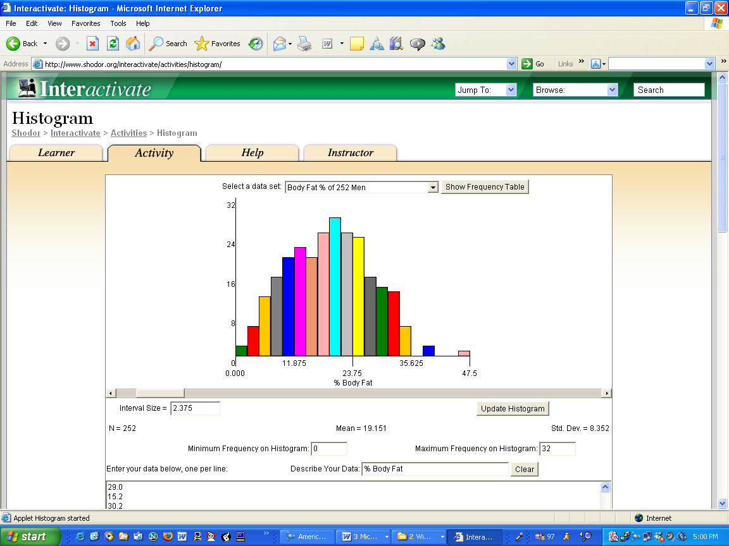
Body fat Histogram B

Slide 38
Interpretation Histograms of Previous Slide
What is the type of the attribute? Positive real numbers
What is the mean value; what is the mode?
Is the a lot of spread or not (compute the standard deviation)? Not much
Is the distribution unimodal (one hill or no hill)) or multi-modal (multiple hills)? One hill or two hills, depending on how you interpret the data. The second hill is not very well separated; therefore I would say unimodal.
Is the distribution skewed (e.g. compare mean with median)? Only very mildly skewed
Are there any outliers? Yes values above 45…?
Are there any duplicate values?
Are there any gaps in the attribute value distribution? Yes two gaps: 1)… 2)…
Characterize the shape of the density function! Bell Curve

Slide 39
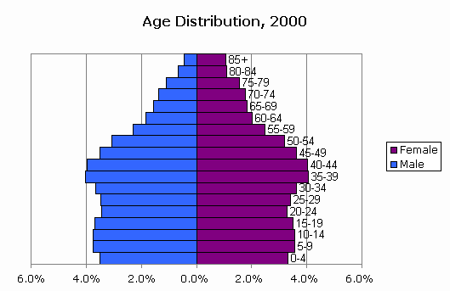
Comparing 2 Histograms
Interpret the following 2 histograms and their relationships which describe the male and female age distribution in the US, based on Census Data.

Slide 40
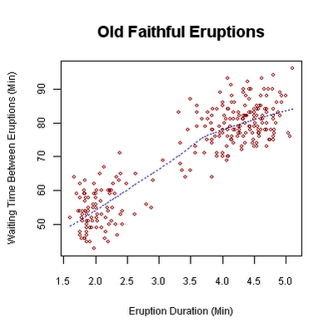
Scatter Plot Old Faithful Eruptions
http://en.wikipedia.org/wiki/Correlation
http://en.wikipedia.org/wiki/Old_Faithful

Slide 41
Supervised Scatter Plot Array of Iris Attributes

Slide 42
Interpreting pedal length/width)
Interpreting Scatter Plots and Similar Display
Characterize the distribution of each class in the attribute space; is it unimodal or multi-modal? Where are the instances of each class mostly located? Unimodal each;…
Characterize the overall distribution (including all examples); do you observe any correlation or other characteristics? quite strong positive correlation between the two attributes.
Analyze the separation of a single class from all the other classes. Analyze the separation between pairs of classes. If classes overlap characterize the extend to which they overlap. Describe decision boundaries for separated classes. Blue is clearly separated from the two other; red and green only slightly overlap; …
Assess the difficulty of the classification based on your findings of looking at a set of scatter plots. Easy

Slide 43
Visualization Techniques: Contour Plots
Contour plots
Useful when a continuous attribute is measured on a spatial grid
They partition the plane into regions of similar values
The contour lines that form the boundaries of these regions connect points with equal values
The most common example is contour maps of elevation
Can also display temperature, rainfall, air pressure, etc.
An example for Sea Surface Temperature (SST) is provided on the next slide
https://plot.ly/r/contour-plots/

Slide 44
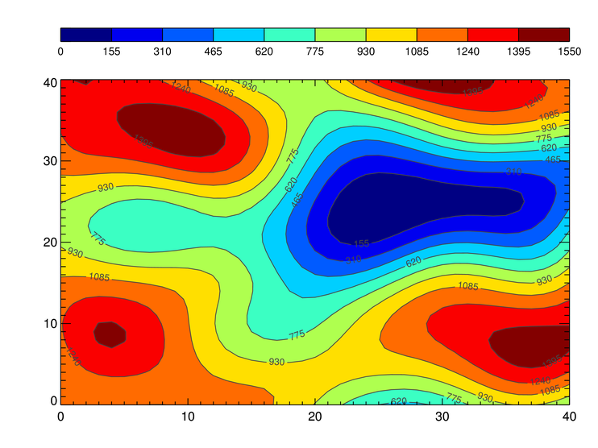
Contour Plot Example

Slide 45
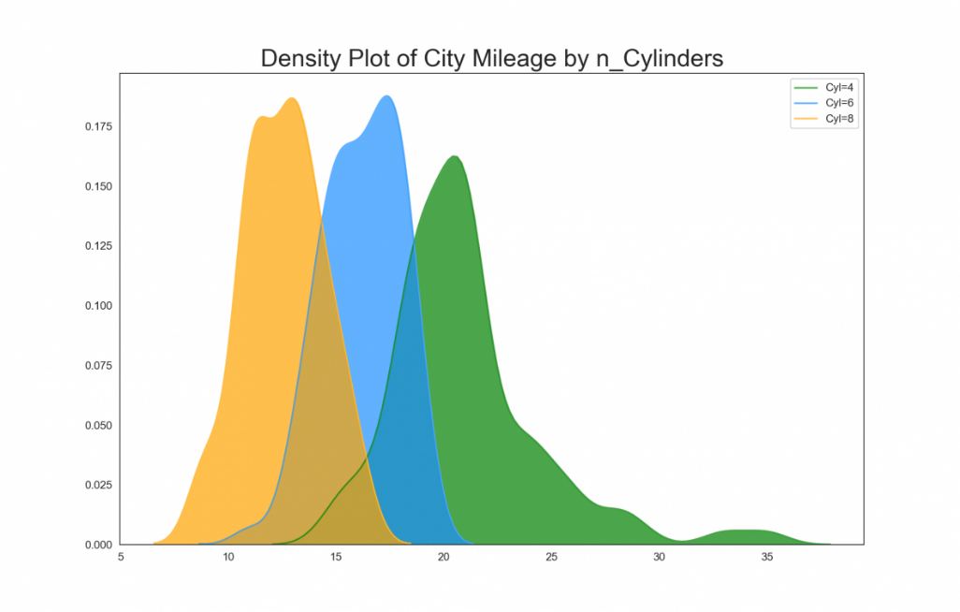
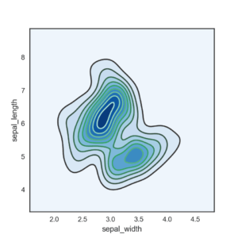
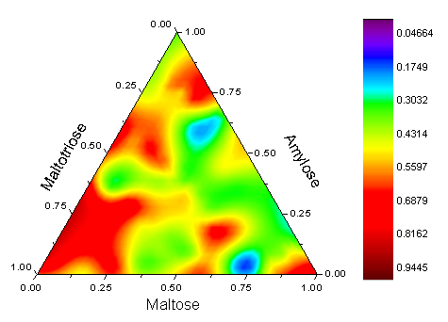
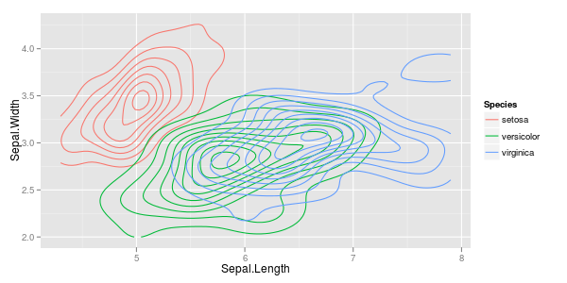
Density Plots

Slide 46
Density Estimation
Already Covered
Examples and R-Code: https://stats.stackexchange.com/questions/30788/whats-a-good-way-to-use-r-to-make-a-scatterplot-that-separates-the-data-by-trea
Density estimation techniques where used to create the plots; the goal of density estimation is to generate a density functions for a given set of samples; usually, non-parametric density estimation approaches are used to create such density plots.
http://en.wikipedia.org/wiki/Density_estimation
http://en.wikipedia.org/wiki/Kernel_density_estimation
Parametric density estimation: http://en.wikipedia.org/wiki/Maximum_likelihood

Slide 47
Density Plots (not covered Sept. 2+4)
https://en.wikipedia.org/wiki/Probability_density_function
http://ggplot2.tidyverse.org/reference/geom_density_2d.html
https://python-graph-gallery.com/2d-density-plot/

Slide 48
Covariance Matrix and Correlation
Covariance matrix – Wikipedia
Correlations in [0.7,1] and [-1,-0.7] are interesting! Correlations in [-0.3,+0.3] are not worth mentioning; all other correlations are “mildly” interesting.

Slide 49
Visualization Techniques: Parallel Coordinates
Parallel Coordinates
Used to plot the attribute values of high-dimensional data
Instead of using perpendicular axes, use a set of parallel axes
The attribute values of each object are plotted as a point on each corresponding coordinate axis and the points are connected by a line
Thus, each object is represented as a line
Often, the lines representing a distinct class of objects group together, at least for some attributes
Ordering of attributes is important in seeing such groupings

Slide 50
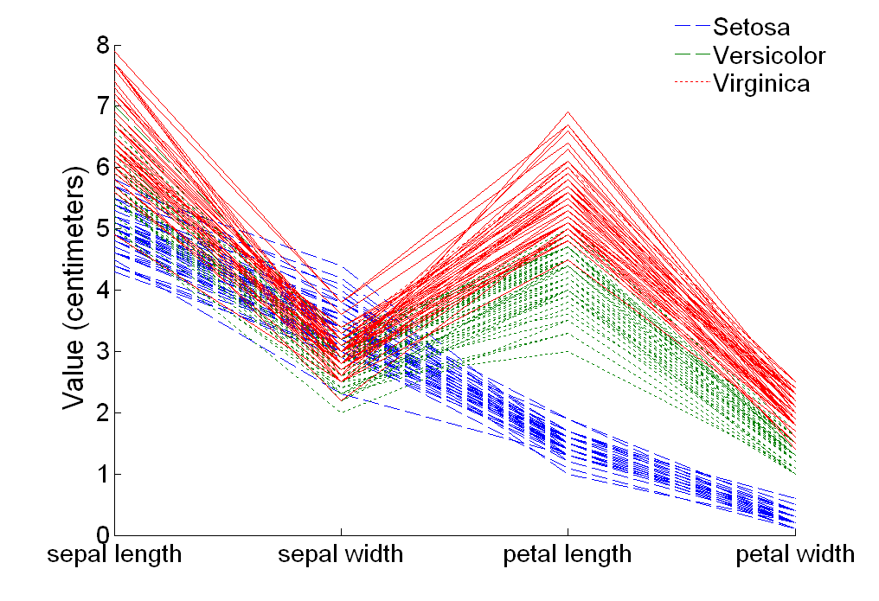
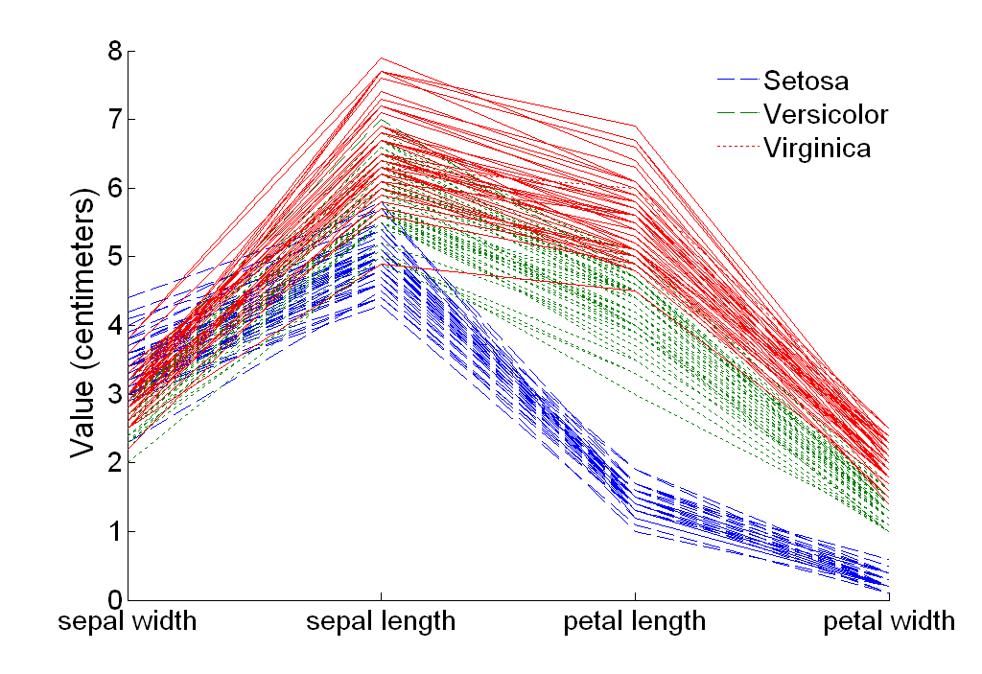
Parallel Coordinates Plots for Iris Data

Slide 51
Other Visualization Techniques
Star Coordinate Plots
Similar approach to parallel coordinates, but axes radiate from a central point
The line connecting the values of an object is a polygon
Chernoff Faces
Approach created by Herman Chernoff
This approach associates each attribute with a characteristic of a face
The values of each attribute determine the appearance of the corresponding facial characteristic
Each object becomes a separate face
Relies on human’s ability to distinguish faces
http://people.cs.uchicago.edu/~wiseman/chernoff/
http://kspark.kaist.ac.kr/Human%20Engineering.files/Chernoff/Chernoff%20Faces.htm#

Slide 52
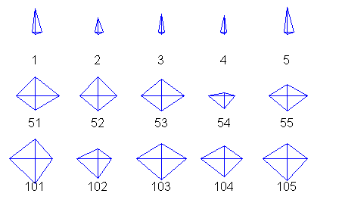
Star Plots for Iris Data
Setosa
Versicolour
Virginica
Pedal length
Sepal Width
Sepal length
Pedal width

Slide 53
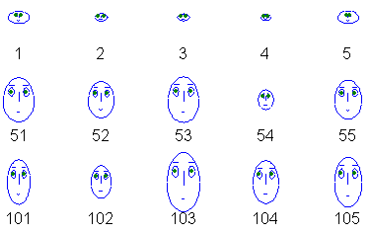
Chernoff Faces for Iris Data
Translation: sepal length→size of face; sepal width →forhead/jaw relative to arc-length;
Pedal length→shape of forhead; pedal width→ shape of jaw; width of mouth→…; width between eyes→…
Setosa
Versicolour
Virginica

Slide 54
Demoing some R-Code using the BNA Dataset
Remark: On Sept. 9!
Good Datasets:
What's a good way to use R to make a scatterplot that separates the data by treatment? - Cross Validated (stackexchange.com)
BNA Dataset Information:
https://archive.ics.uci.edu/ml/datasets/banknote+authentication#
BNA DataSet: www2.cs.uh.edu/~ceick/white/bna.data
Demo Code: www2.cs.uh.edu/~ceick/white/bna.r

Slide 55
Useful Background “Engineering St. Handbook”
http://www.itl.nist.gov/div898/handbook/eda/section1/eda15.htm (graphical techniques)
http://www.itl.nist.gov/div898/handbook/eda/section3/eda35.htm (quantitative analysis)
http://www.itl.nist.gov/div898/handbook/eda/section2/eda23.htm (testing assumptions)
http://www.itl.nist.gov/div898/handbook/eda/section3/eda34.htm (survey graphical techniques)
Remark: The material is very good if your focus is on prediction, hypothesis testing, clustering; however, providing good visualizations/statistics for classification problems is not discussed much…

Slide 56
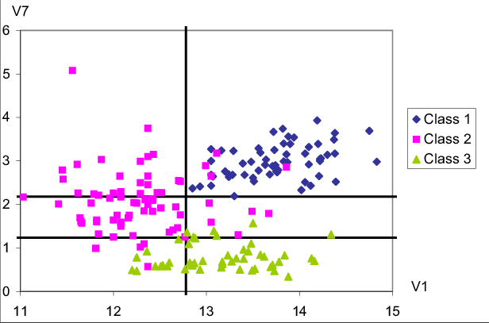
Interpreting on More Supervised Scatter Plots
Later
Interpret the supervised scatter plot depicted below that consists of instances of 3 classes;
moreover, assess the difficulty of separating instances of the 3 classes using attributes V1
and V7 based on the scatter plot!

Slide 57
Interpretation Prev. Supervised Scatter Plot
Characterization of the location of the instances of each class in the attribute space:
The pink class is mostly located in [11,13.3]x[1,3.8], the green class is mostly located in
[12.3,14.2]x[0.3,1.1], the blue class is mostly located in [12.8, 14.8]x[2.1,3.8] in the V1XV7 Attribute space.
The distribution of all three classes is unimodal [2] with no major gaps in the data density [0.5]. Attribute V7 is useful to separate the green class from the other 2 classes[1]; if V7 is less than 1.2 objects mostly belong to the green class[0.5]; Attribute V1 is useful to separate the purple class from the blue class[1]; all the example whose V1 value is above 12.8 are blue[0.5]; additionally using attribute V7 requiring that instances whose attribute values for V1 that lie in [1.2,2.2] leads to a even clearer distinction between the two classes [0.5]. Moreover, using the fact that the V1 value is a higher than 12.2 for instances of the green class, leads to a clearer separation of the green and purple class [0.5] By combining those rules [0.5], the classification task should not be too difficult as the examples are well separated although there are a few exceptions.[1]
It is hard to see any patterns with respect to the relationship of V1 and V7; there definitely seems to be no linear relationship.

Slide 58
Comparing 2 Histogram Comparison
Both histograms: curves are continuous with no gabs or outliers, and somewhat smooth[1], bimodal with 2 (1??; 0??) not well separated maxima at 5-19 and 35-44 [1.5], values significantly drop beyond age 55[1]→skewed distribution
Comparison: Curves are somewhat similar until age 55 [1] (although there are more males initially [0.5]);e.g. shape of the density function and the 2 local maxima match; however, the decline in the male curve is significantly steeper: women live longer[1].

