Slide 1
Organization “Association Analysis”
What is Association Analysis?
Association Rules
The APRIORI Algorithm
Interestingness Measures
Sequence Mining Part2
Coping with Continuous Attributes in Association Analysis Part2
Mining for Other Associations (short) Part2

Slide 2
Association Analysis
Goal: Find Interesting Relationships between Sets of Variables (Descriptive Data Mining)
Relationships can be:
Rules (IF buy-beer THEN buy-diaper)
Sequences (Book1-Book2-Book3)
Graphs
Sets (e.g. describing items that co-locate or share statistical properties, such as correlation)
…
What associations are interesting is determined by measures of interestingness.

Slide 3
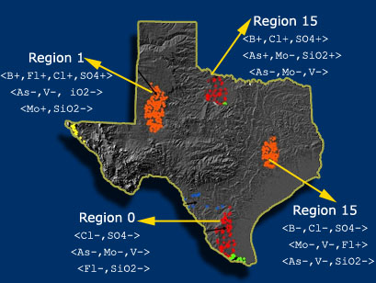
Finding Regional Correlation Sets

Slide 4
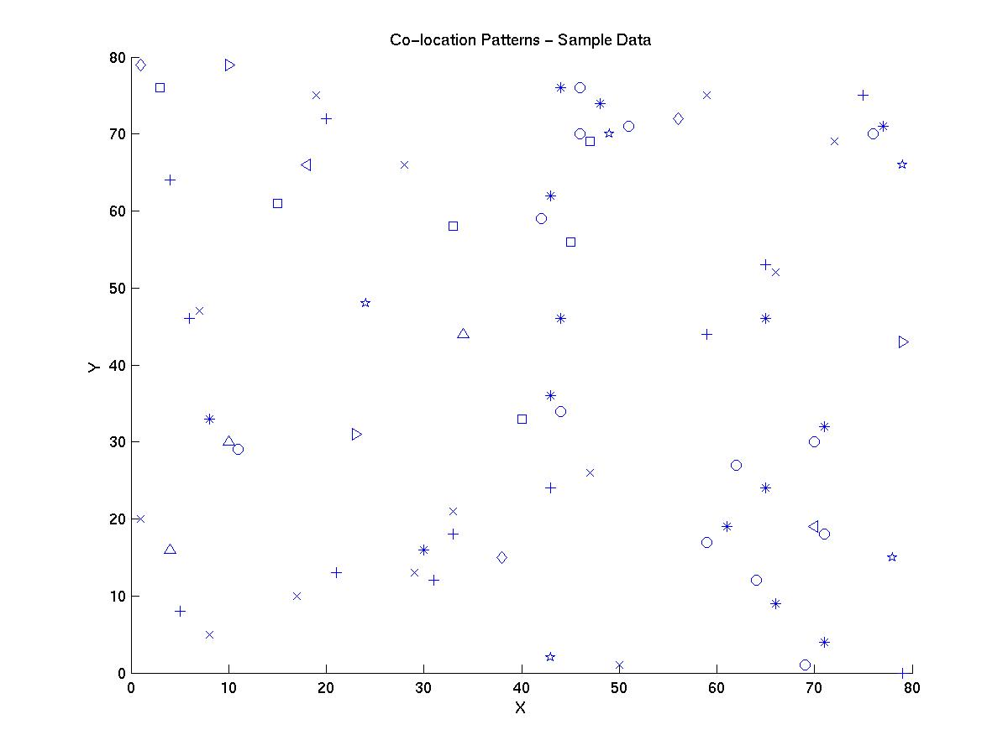

Example Association Analysis: Co-Location
R1
R2
Regional
Co-location
R3
R4
Task: Find Co-location patterns for the following data-set.
Global Co-location: and are co-located in the whole dataset

Slide 5
Project3 (Group Project Association Analysis)
8 Groups of 4:
Choose your own theme:
Implement an association analysis algorithm
Compare two association analysis algorithms
Apply an association algorithm to a dataset
Give a survey about a particular association analysis task (e.g. collocation or graph mining)
…
Deliveries:
10 minute presentation on Th., Nov. 21
Report on Su., Nov. 24, 11

Slide 6
Project4 (Group Project Review a Paper)
16 Groups of 2:
Write a review of a data mining paper
Deliveries:
Report on Su., Dec. 8

Slide 7
Association Rule Mining
Given a set of transactions, find rules that will predict the occurrence of an item based on the occurrences of other items in the transaction
Market-Basket transactions
Example of Association Rules
{Diaper} → {Beer},
{Milk, Bread} → {Eggs,Coke},
{Beer, Bread} → {Milk},
Implication means co-occurrence, not causality!

Slide 8
Definition: Frequent Itemset
Itemset
  A collection of one or more items
    Example: {Milk, Bread, Diaper}
  k-itemset
    An itemset that contains k items
Support count (σ)
  Frequency of occurrence of an itemset
  E.g. σ({Milk, Bread,Diaper}) = 2
Support
  Fraction of transactions that contain an itemset
  E.g. s({Milk, Bread, Diaper}) = 2/5
Frequent Itemset
  An itemset whose support is greater than or equal to a minsup threshold

Slide 9
Definition: Association Rule
Association Rule
  An implication expression of the form X → Y, where X and Y are itemsets
  Example:
  {Milk, Diaper} → {Beer}
Rule Evaluation Metrics
  Support (s)
    Fraction of transactions that contain both X and Y
  Confidence (c)
    Measures how often items in Y
    appear in transactions that
    contain X
Example:

Slide 10
Mining Association Rules
Example of Rules:
{Milk,Diaper} → {Beer} (s=0.4, c=0.67)
{Milk,Beer} → {Diaper} (s=0.4, c=1.0)
{Diaper,Beer} → {Milk} (s=0.4, c=0.67)
{Beer} → {Milk,Diaper} (s=0.4, c=0.67)
{Diaper} → {Milk,Beer} (s=0.4, c=0.5)
{Milk} → {Diaper,Beer} (s=0.4, c=0.5)
Observations:
All the above rules are binary partitions of the same itemset:
{Milk, Diaper, Beer}
Rules originating from the same itemset have identical support but
can have different confidence
Thus, we may decouple the support and confidence requirements

Slide 11
Association Rule Mining Task
Given a set of transactions T, the goal of association rule mining is to find all rules having
  support ≥ minsup threshold
  confidence ≥ minconf threshold
Brute-force approach:
  List all possible association rules
  Compute the support and confidence for each rule
  Prune rules that fail the minsup and minconf thresholds
  ⇒ Computationally prohibitive!

Slide 12
Apriori’s Approach
Two-step approach:
  Frequent Itemset Generation
    Generate all itemsets whose support ≥ minsup
  Rule Generation
    Generate high confidence rules from each frequent itemset, where each rule is a binary partitioning of a frequent itemset
  Rule Pruning and Ordering (remove redundant rules; remove/sort rules based on other measures of interesting; e.g. lift)
Frequent itemset generation is still computationally expensive

Slide 13
Frequent Itemset Generation
Given d items, there are 2^{d} possible candidate itemsets

Slide 14
Frequent Itemset Generation
Brute-force approach:
  Each itemset in the lattice is a candidate frequent itemset
  Count the support of each candidate by scanning the database
  Match each transaction against every candidate
  Complexity ~ O(NMw) => Expensive since M = 2^{d} !!!

Slide 15
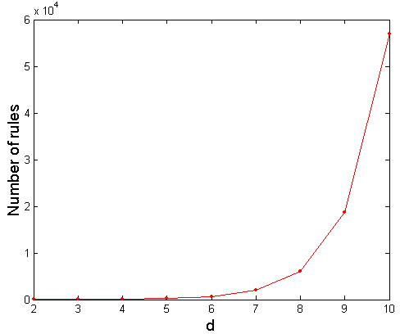
Computational Complexity
Given d unique items:
  Total number of itemsets = 2^{d}
  Total number of possible association rules:
If d=6, R = 602 rules

Slide 16
Frequent Itemset Generation Strategies
Reduce the number of candidates (M)
  Complete search: M=2^{d}
  Use pruning techniques to reduce M
Reduce the number of transactions (N)
  Reduce size of N as the size of itemset increases
  Used by DHP and vertical-based mining algorithms
Reduce the number of comparisons (NM)
  Use efficient data structures to store the candidates or transactions
  No need to match every candidate against every transaction

Slide 17
Reducing Number of Candidates
Apriori principle:
  If an itemset is frequent, then all of its subsets must also be frequent
Apriori principle holds due to the following property of the support measure:
  Support of an itemset never exceeds the support of its subsets
  This is known as the anti-monotone property of support

Slide 18
Illustrating Apriori Principle
Found to be Infrequent
What do we learn from
That?
If we create k+1-itemsets
from k-itemsets we avoid
generating candidates that
are not frequent due to the
Apriori principle.
Pruned supersets

Slide 19
Illustrating Apriori Principle
Items (1-itemsets)
Pairs (2-itemsets)
(No need to generate
candidates involving Coke
or Eggs)
Minimum Support = 3
Triplets (3-itemsets)
If every subset is considered,
⁶C₁ + ⁶C₂ + ⁶C₃ = 41
With support-based pruning,
6 + 6 + 1 = 13

Slide 20
Side Discussion: How to store Sets?
Problem: {A, B, C} is the same as {C, B, A}

Slide 21
Apriori Algorithm
Method:
  Let k=1
  Generate frequent itemsets of length 1
  Repeat until no new frequent itemsets are identified
    Generate length (k+1) candidate itemsets from length k frequent itemsets
    Prune candidate itemsets containing subsets of length k that are infrequent
    Count the support of each candidate by scanning the DB
    Eliminate candidates that are infrequent, leaving only those that are frequent
  Item sets are represented as sequences based on alphabetic order; e.g. {a,d,e} is ade. A k+1 item set is constructed from two k-itemsets that agree in their first k-1 items; e.g. abcd and abcg are combined to abcdg.

Slide 22
Mining Association Rules—An Example
Min. support 50%
Min. confidence 50%
For rule A ⇒ C:
  support = support({A ∩ C}) = 50%
  confidence = support({A ∩ C})/support({A}) = 66.6%
The Apriori principle:
  Any subset of a frequent itemset must be frequent

Slide 23
The Apriori Algorithm
Join Step: C_{k} is generated by joining L_{k-1}with itself
Prune Step: Any (k-1)-itemset that is not frequent cannot be a subset of a frequent k-itemset
Pseudo-code:
    C_{k}: Candidate itemset of size k
    L_{k} : frequent itemset of size k
    L₁ = {frequent items};
    for (k = 1; L_{k} !=∅; k++) do begin
    C_{k+1} = candidates generated from L_{k};
    for each transaction t in database do
      increment the count of all candidates in C_{k+1} that are contained in t
    L_{k+1} = candidates in C_{k+1} with min_support
    end
    return ∪_{k} L_{k};

Slide 24
The Apriori Algorithm — Example
Database D
L₁
C₁
Scan D
C₂
C₂
L₂
Scan D
C₃
Scan D
L₃

Slide 25
How to Generate Candidates?
Suppose the items in L_{k-1} are listed in an order
Step 1: self-joining L_{k-1}
  insert into C_{k}
  select p.item₁, p.item₂, …, p.item_{k-1}, q.item_{k-1}
  from L_{k-1} p, L_{k-1} q
  where p.item₁=q.item₁, …, p.item_{k-2}=q.item_{k-2}, p.item_{k-1} < q.item_{k-1}
Step 2: pruning
  forall itemsets c in C_{k} do
    forall (k-1)-subsets s of c do
      if (s is not in L_{k-1}) then delete c from C_{k}

Slide 26
Example of Generating Candidates
L₃={abc, abd, acd, ace, bcd}
Self-joining: L₃*L₃
  abcd from abc and abd
  acde from acd and ace
Pruning:
  acde is removed because ade is not in L₃
C₄={abcd}

Slide 27
Factors Affecting Complexity
Choice of minimum support threshold
  lowering support threshold results in more frequent itemsets
  this may increase number of candidates and max length of frequent itemsets
Dimensionality (number of items) of the data set
  more space is needed to store support count of each item
  if number of frequent items also increases, both computation and I/O costs may also increase
Size of database
  since Apriori makes multiple passes, run time of algorithm may increase with number of transactions
Average transaction width
  transaction width increases with denser data sets
  This may increase max length of frequent itemsets and traversals of hash tree (number of subsets in a transaction increases with its width)

Slide 28
Compact Representation of Frequent Itemsets
Initially skip!
Some itemsets are redundant because they have identical support as their supersets
Number of frequent itemsets
Need a compact representation

Slide 29
Maximal Frequent Itemset
Initially skip!
An itemset is maximal frequent if none of its immediate supersets is frequent
Maximal Itemsets
Can be use
as a compact
summary
of all frequent
items---but
Lack support
Information.
Infrequent Itemsets
Border

Slide 30
Closed Itemset
Initially skip!
An itemset is closed if none of its immediate supersets has the same support as the itemset

Slide 31
Maximal vs Closed Itemsets
Initially skip!
Transaction Ids
Not supported by any transactions

Slide 32
Maximal vs Closed Frequent Itemsets
Initially skip!
Minimum support = 2
Closed but not maximal
Closed and maximal
# Closed = 9
# Maximal = 4

Slide 33
Maximal vs Closed Itemsets
Initially skip!
Saving of
compact representation.

Slide 34
Rule Generation
Given a frequent itemset L, find all non-empty subsets f ⊂ L such that f → L – f satisfies the minimum confidence requirement
  If {A,B,C,D} is a frequent itemset, candidate rules:
    ABC →D, ABD →C, ACD →B, BCD →A,
    A →BCD, B →ACD, C →ABD, D →ABC
    AB →CD, AC → BD, AD → BC, BC →AD,
    BD →AC, CD →AB,
If |L| = k, then there are 2^{k} – 2 candidate association rules (ignoring L → ∅ and ∅ → L)

Slide 35
Rule Generation for Apriori Algorithm
Lattice of rules (for confidence pruning)
Low Confidence Rule
Pruned Rules

Slide 36
Pattern Evaluation
Association rule algorithms tend to produce too many rules
  many of them are uninteresting or redundant
  Redundant if {A,B,C} → {D} and {A,B} → {D}
  have same support & confidence
Interestingness measures can be used to prune/rank the derived patterns
In the original formulation of association rules, support & confidence are the only measures used

Slide 37
Computing Interestingness Measure
Given a rule X → Y, information needed to compute rule interestingness can be obtained from a contingency table
Contingency table for X → Y
 | Y | Y
X | f₁₁ | f₁₀ | f₁₊
X | f₀₁ | f₀₀ | f_{o+}
 | f₊₁ | f₊₀ | |T|
f₁₁: support of X and Y
f₁₀: support of X and Y
f₀₁: support of X and Y
f₀₀: support of X and Y
Used to define various measures
support, confidence, lift, Gini,
J-measure, etc.
http://www.eumetcal.org/resources/ukmeteocal/verification/www/english/msg/ver_categ_forec/uos1/uos1_ko1.htm

Slide 38
Statistical Independence
Population of 1000 students
  600 students know how to swim (S)
  700 students know how to bike (B)
  420 students know how to swim and bike (S,B)
  In general, between … and … can swim and bike
  P(S∧B) = 420/1000 = 0.42
  P(S) × P(B) = 0.6 × 0.7 = 0.42
  In general: P(S∧B)=P(S)*P(B|S)=P(B)*P(S|B)
  P(S∧B) = P(S) × P(B) => Statistical independence
  P(S∧B) > P(S) × P(B) => Positively correlated
  P(S∧B) < P(S) × P(B) => Negatively correlated
  max(0, P(S)+P(B)-1)≤ P(S∧B) ≤min(P(S),P(B))

Slide 39
Drawback of Confidence
 | Coffee | Coffee
Tea | 15 | 5 | 20
Tea | 75 | 5 | 80
 | 90 | 10 | 100
Association Rule: Tea → Coffee
Confidence= P(Coffee|Tea) = 0.75
but P(Coffee) = 0.9
Although confidence is high, rule is misleading
P(Coffee|Tea) = 0.9375
Problem: Confidence can be large for
independent and negatively correlated
patterns, if the right hand side pattern
has high support.

Slide 40
Statistical-based Measures
Measures that take into account statistical dependence
Probability
multiplier
Kind of measure of independence
Similar to covariance
Correlation for binary Variable

Slide 41
Drawback of Lift & Interest
 | Y | Y
X | 10 | 0 | 10
X | 0 | 90 | 90
 | 10 | 90 | 100
 | Y | Y
X | 90 | 0 | 90
X | 0 | 10 | 10
 | 90 | 10 | 100
Variables with high prior
probabilities cannot have
a high lift--- lift is biased towards
variables with low prior probability.
Statistical independence:
If P(X,Y)=P(X)P(Y) => Lift = 1

Slide 42
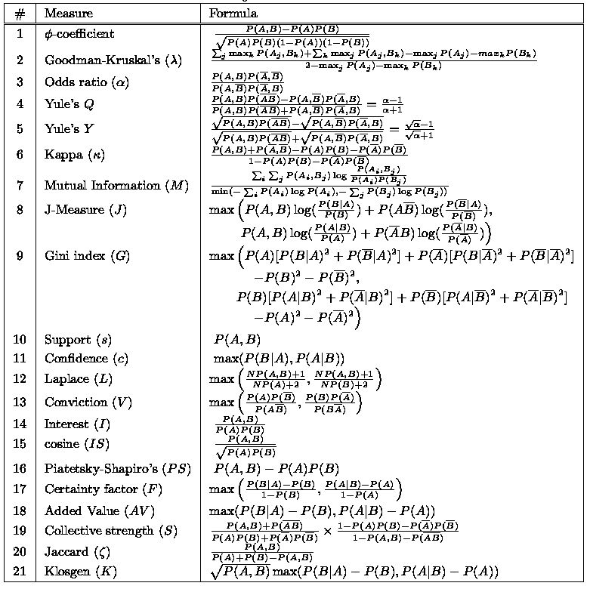
There are lots of measures proposed in the literature
Some measures are good for certain applications, but not for others
What criteria should we use to determine whether a measure is good or bad?
What about Apriori-style support based pruning? How does it affect these measures?

Slide 43
Example: φ-Coefficient
skip
φ-coefficient is analogous to correlation coefficient for continuous variables
 | Y | Y
X | 60 | 10 | 70
X | 10 | 20 | 30
 | 70 | 30 | 100
 | Y | Y
X | 20 | 10 | 30
X | 10 | 60 | 70
 | 30 | 70 | 100
φ Coefficient is the same for both tables

Slide 44
Properties of A Good Measure
Piatetsky-Shapiro:
3 properties a good measure M must satisfy:
  M(A,B) = 0 if A and B are statistically independent
  M(A,B) increase monotonically with P(A,B) when P(A) and P(B) remain unchanged
  M(A,B) decreases monotonically with P(A) [or P(B)] when P(A,B) and P(B) [or P(A)] remain unchanged

Slide 45
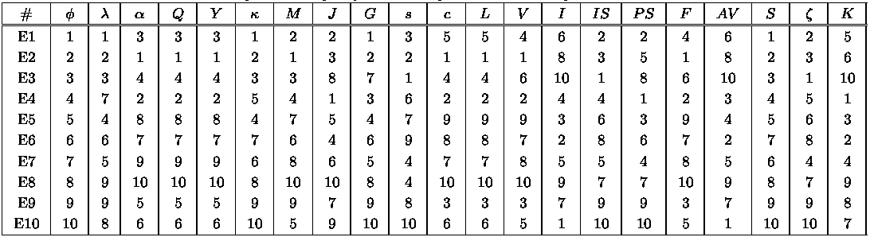
Comparing Different Measures
10 examples of contingency tables:
Rankings of contingency tables using various measures:

Slide 46
Property under Variable Permutation
Does M(A,B) = M(B,A)?
Symmetric measures:
  support, lift, collective strength, cosine, Jaccard, etc
Asymmetric measures:
  confidence, conviction, Laplace, J-measure, etc

Slide 47
Different Measures have Different Properties

Slide 48
Subjective Interestingness Measure
Objective measure:
  Rank patterns based on statistics computed from data
  e.g., 21 measures of association (support, confidence, Laplace, Gini, mutual information, Jaccard, etc).
Subjective measure:
  Rank patterns according to user’s interpretation
    A pattern is subjectively interesting if it contradicts the
    expectation of a user (Silberschatz & Tuzhilin)
    A pattern is subjectively interesting if it is actionable
    (Silberschatz & Tuzhilin)

Slide 49
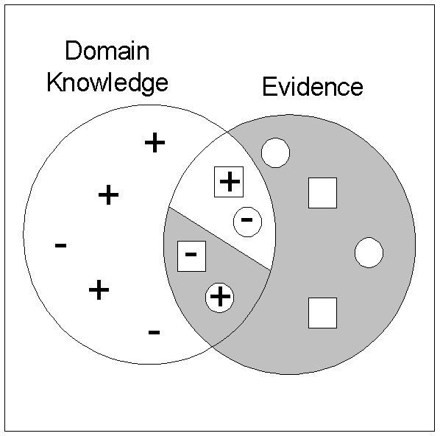
Interestingness via Unexpectedness
Need to model expectation of users (domain knowledge)
Need to combine expectation of users with evidence from data (i.e., extracted patterns)
+
Pattern expected to be frequent
-
Pattern expected to be infrequent
Pattern found to be frequent
Pattern found to be infrequent
+
-
Expected Patterns
-
+
Unexpected Patterns

Slide 50
Association Rule Mining in R
http://www.r-bloggers.com/examples-and-resources-on-association-rule-mining-with-r/
http://www.linkedin.com/groups/Examples-resources-on-association-rule-4066593.S.134055161

