Slide 1
News October 1
It is not acceptable that more than 50% of the students in the course show up 10-30 minutes late for the lecture!
The first COSC 6335 exam has been scheduled for Th., Oct. 10! More details will be discussed on the Oct. 3 class!
Begin working on Task2; it is due on October 14 in Kritik. The will be Task2 Q&A in the October 3 lecture.
Task3 has been posted; it is an individual non-peer reviewed task which is due end of October and which centers on clustering. You can already start working on it!
There will be more discussions on DBSCAN and a demo of clustering algorithms in the Oct. 4 lecture.
The GHC Task of Group F has been posted; they will present on October 3
Today: 1. EM 2. Hierarchical Clustering 3. Cluster Evaluation
Notes:
Have class break into groups and invent clustering algorithms.

Slide 2
It is not acceptable that more than 50% of the students in this course show up 10-30 minutes late for the lecture!

Slide 3
Hierarchical Clustering
Lecture Notes for Chapter 7
Introduction to Data Mining, 2nd Edition
by
Tan, Steinbach, Karpatne, Kumar

Slide 4











Two Types of Clustering
Slide based on one by Eamonn Keogh
Partitional algorithms: Construct various partitions and then evaluate them by some criterion
Hierarchical algorithms: Create a hierarchical decomposition of the set of objects using some criterion
Hierarchical
Partitional
Notes:
Have class break into groups and invent clustering algorithms.

Slide 5
Slide based on one by Eamonn Keogh
One potential use of a dendrogram: detecting outliers
The single isolated branch is suggestive of a data point that is very different to all others
Outlier

Slide 6
A demonstration of hierarchical clustering using string edit distance
Slide based on one by Eamonn Keogh
Piotr
Pedro
Piero
Peter
Peka
Mick
Pyotr
Pietro
Pierre
Peder
Petros
Peadar
Miguel
Krystof
Michael
Michalis
Crisdean
Cristovao
Christoph
Cristobal
Kristoffer
Christophe
Cristoforo
Christopher

Slide 7
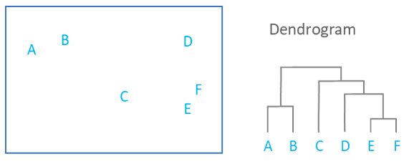
HC Produces Dendrograms
What is a Dendrogram? How to use Dendrograms | Displayr

Slide 8
Hierarchical Clustering
Two main types of hierarchical clustering algorithms:
  Agglomerative:
    Start with the points as individual clusters
    At each step, merge the closest pair of clusters until only one cluster (or k clusters) left
  Divisive:
    Start with one, all-inclusive cluster
    At each step, split a cluster until each cluster contains an individual point (or there are k clusters)
Traditional hierarchical algorithms use a similarity or distance matrix
  Merge or split one cluster at a time

Slide 9
Strengths of Hierarchical Clustering
Constructs sets of clusterings---and not a single clustering--does not have to assume any particular number of clusters: Any desired number of clusters can be obtained by ‘cutting’ the dendrogram at the proper level
They may correspond to meaningful taxonomies
  Example in biological sciences (e.g., animal kingdom, phylogeny reconstruction, …)

Slide 10
Agglomerative Clustering Algorithm
Most popular hierarchical clustering technique
Basic algorithm is straightforward
  Compute the proximity matrix
  Let each data point be a cluster
  Repeat
  Merge the two closest clusters
  Update the proximity matrix
  Until only a single cluster remains
Key operation is the computation of the proximity of two clusters
Different approaches to defining the distance between clusters distinguish the different algorithms

Slide 11
Starting Situation
Start with clusters of individual points and a proximity matrix
p1
p2
p3
p4
p5
. . .
p1
p2
p3
p4
p5
.
.
.
Proximity Matrix

Slide 12
Intermediate Situation
After some merging steps, we have some clusters
C1
C2
C3
C4
C5
C1
C2
C3
C3
C4
C4
C5
Proximity Matrix
C1
C2
C5

Slide 13
Intermediate Situation
We want to merge the two closest clusters (C2 and C5) and update the proximity matrix.
C1
C2
C3
C4
C5
C1
C2
C3
C3
C4
C4
C5
Proximity Matrix
C1
C2
C5

Slide 14
After Merging
The question is “How do we update the proximity matrix?”
C2 U C5
C1
C3
C4
C1
?
C2 U C5
? ? ? ?
C3
C3
?
C4
C4
?
Proximity Matrix
C1
C2 U C5

Slide 15
How to Define Inter-Cluster Distance
p1
p2
p3
p4
p5
. . .
p1
Similarity?
p2
p3
p4
p5
MIN
MAX
Group Average
Distance Between Centroids
Ward’s Method uses squared error
…
.
.
.
Proximity Matrix

Slide 16
How to Define Inter-Cluster Similarity
p1
p2
p3
p4
p5
. . .
p1
p2
p3
p4
p5
MIN
MAX
Group Average
Distance Between Centroids
Other methods driven by an objective function
  Ward’s Method uses squared error
.
.
.
Proximity Matrix

Slide 17
How to Define Inter-Cluster Similarity
p1
p2
p3
p4
p5
. . .
p1
p2
p3
p4
p5
MIN
MAX
Group Average
Distance Between Centroids
Other methods driven by an objective function
  Ward’s Method uses squared error
.
.
.
Proximity Matrix

Slide 18
How to Define Inter-Cluster Similarity
p1
p2
p3
p4
p5
. . .
p1
p2
p3
p4
p5
MIN
MAX
Group Average
Distance Between Centroids
Other methods driven by an objective function
  Ward’s Method uses squared inside cluster distances after merging.
.
.
.
Proximity Matrix

Slide 19
How to Define Inter-Cluster Similarity
p1
p2
p3
p4
p5
. . .
p1
×
×
p2
p3
p4
p5
MIN
MAX
Group Average
Distance Between Centroids
Other methods driven by an objective function
  Ward’s Method uses squared error
.
.
.
Proximity Matrix

Slide 20
Agglomerative Clustering Algorithm
Most popular hierarchical clustering technique
Basic algorithm is straightforward
  Compute the proximity matrix
  Let each data point be a cluster
  Repeat
  Merge the two closest clusters
  Update the proximity matrix
  Until only a single cluster remains
Key operation is the computation of the proximity of two clusters
Different approaches to defining the distance between clusters distinguish the different algorithms

Slide 21
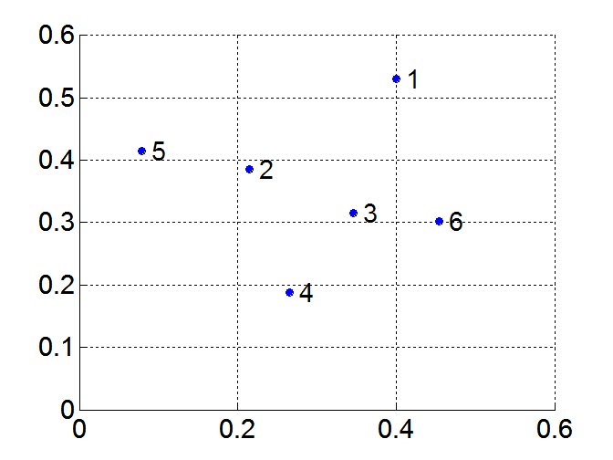
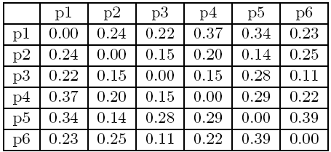
MIN or Single Link
Proximity of two clusters is based on the two closest points in the different clusters
  Determined by one pair of points, i.e., by one link in the proximity graph
Example:
Distance Matrix:

Slide 22
Hierarchical Clustering: MIN
5
1
3
5
2
1
2
3
6
4
4
Nested Clusters
Dendrogram

Slide 23
Strength of MIN
Original Points
Six Clusters
Can handle non-elliptical shapes

Slide 24
Limitations of MIN
Two Clusters
Original Points
Sensitive to noise and outliers
Three Clusters

Slide 25
MAX or Complete Linkage
Proximity of two clusters is based on the two most distant points in the different clusters
  Determined by all pairs of points in the two clusters
Distance Matrix:

Slide 26
Hierarchical Clustering: MAX
4
1
2
5
5
2
3
6
3
1
4
Nested Clusters
Dendrogram

Slide 27
Strength of MAX
Original Points
Two Clusters
Less susceptible to noise and outliers

Slide 28
Limitations of MAX
Original Points
Two Clusters
Tends to break large clusters
Biased towards globular clusters

Slide 29
Group Average
Proximity of two clusters is the average of pairwise proximity between points in the two clusters.
Need to use average connectivity for scalability since total proximity favors large clusters
Distance Matrix:

Slide 30
Hierarchical Clustering: Group Average
5
4
1
2
5
2
3
6
1
4
3
Nested Clusters
Dendrogram

Slide 31
Hierarchical Clustering: Group Average
Compromise between Single and Complete Link
Strengths
  Less susceptible to noise and outliers
Limitations
  Biased towards globular clusters

Slide 32
Cluster Similarity: Ward’s Method
Similarity of two clusters is based on the increase in squared error (see below)---average squared inside cluster distance---after two clusters are merged; somewhat similar to group average.
  Ward's method – Wikipedia
  (Average Squared inside cluster distances C1∪C2)/(Average squared cluster distances inside both C1 and C2)
Less susceptible to noise and outliers
Biased towards globular clusters
Hierarchical analogue of K-means
  Can be used to initialize K-means

Slide 33
Inside Cluster Distance
(Sum of the distances of all pairs of objects in the cluster)/(number of pairs of objects)
C1∪C2 additionally contains the edges depicted in brown!
cohesion

Slide 34
Hierarchical Clustering: Comparison
5
1
4
1
3
2
5
5
5
2
1
MIN
2
MAX
2
3
6
3
3
6
1
4
4
4
5
5
1
4
1
2
2
5
2
Ward’s Method
5
2
3
6
Group Average
3
3
6
4
1
1
4
4
3

Slide 35
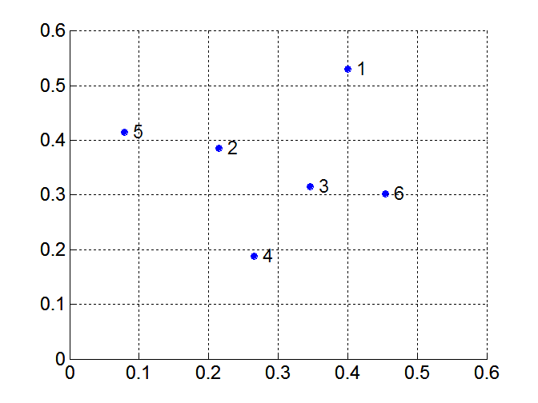
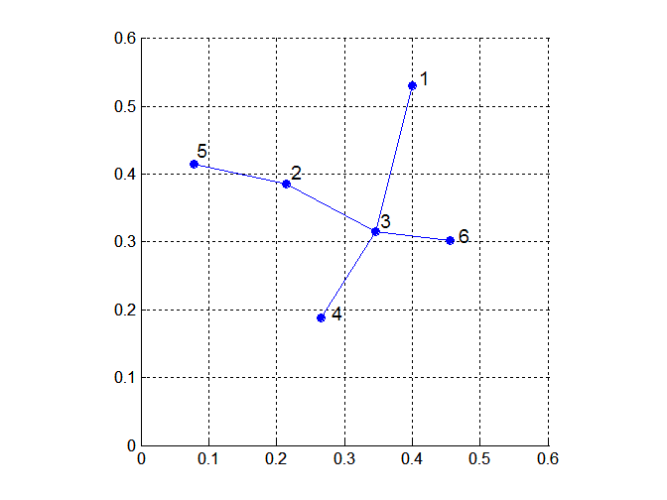
MST: Divisive Hierarchical Clustering
Build MST (Minimum Spanning Tree)
  Start with a tree that consists of any point
  Create subclusters by breaking links in the minimum spanning tree
https://en.wikipedia.org/wiki/Minimum_spanning_tree

Slide 36
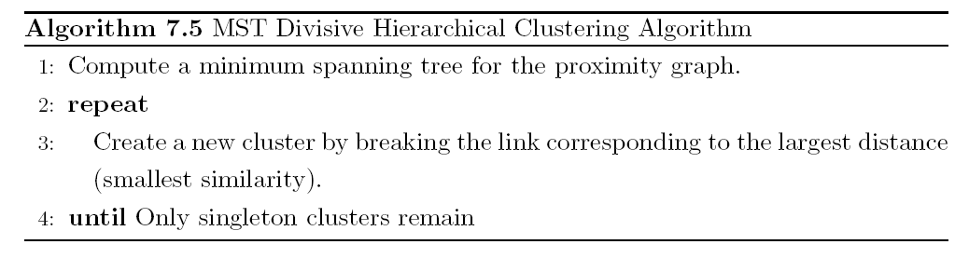
MST: Divisive Hierarchical Clustering
Use MST for constructing hierarchy of clusters
Remark: Selects Splits which maximize inter-cluster distance with respect to C1 and C2 (used to split C).

Slide 37
Hierarchical Clustering: Time and Space Complexity
O(N²) space since it uses the proximity matrix.
  N is the number of points.
O(N³) time in many cases
  There are N steps and at each step the size, N², proximity matrix must be updated and searched
  Complexity can be reduced to O(N² log(N) ) time with some cleverness

Slide 38
Hierarchical Clustering: Problems and Limitations
Once a decision is made to combine two clusters, it cannot be undone→greedy algorithm
No global objective function is directly minimized
Different schemes have problems with one or more of the following:
  Sensitivity to noise and outliers
  Difficulty handling clusters of different sizes and non-globular shapes
  Breaking large clusters
In comparison to other methods: does not search a lot of clusterings and therefore sometimes misses promising clusterings.

