Slide 1
2024 COSC 6335 NN Discussion Organization
Discussion of the slides in this Slideshow
Likely will watch a video for 16 minutes in a later lecture: (5) Gradient descent, how neural networks learn | Chapter 2, Deep learning – YouTube
Simon J.D. Prince, Understanding Deep Learning, MIT Press, 2023. Text Book Resourses (we will cover chapters 6 and 9 of the book in this course).

Slide 2
Neural Networks
Lecture Notes for Chapter 4
Artificial Neural Networks
Introduction to Data Mining , 2nd Edition
by
Tan, Steinbach, Karpatne, Kumar
Slides 9,13-23 added by Dr. Eick

Slide 3
Artificial Neural Networks (ANN)
-0.4
1

Slide 4
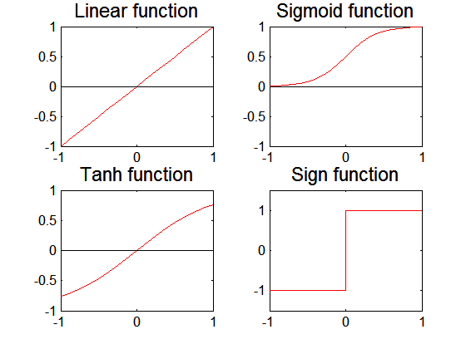
Artificial Neural Networks (ANN)
Various types of neural network topology
single-layered network (perceptron) versus multi-layered network
Feed-forward versus recurrent network
Various types of activation functions (f)

Slide 5
General Structure of ANN
Training ANN means learning the weights of the neurons

Slide 6
Neural Network Terminology
A neural network is composed of a number of units (nodes) that are connected by links. Each link has a weight associated with it. Nodes have biases associated with them. Each unit has an activation level and a means to compute the activation level at the next step in time.
Most neural networks are decomposed of a linear component called input function, and a non-linear component call activation function. Popular activation functions include: relu, sign-function, and sigmoid function.
The architecture of a neural network determines how units are connected and what activation function are used for the network computations. Architectures are subdivided into feed-forward and recurrent networks. Moreover, single layer and multi-layer neural networks (that contain hidden units) are distinguished.
Learning in the context of neural networks centers on finding “good” weights (and biases) for a given architecture so that the error in performing a particular task is minimized. Most approaches center on learning a function from a set of training examples, and use hill-climbing and steepest decent hill-climbing approaches to find the best values for the weights.

Slide 7
Gradient Descent for Multilayer NN
Weight update:
Error/Cost function:
Activation function f must be differentiable
For sigmoid function:
Typically Stochastic gradient descent is used which updates the weights immediately
2
N

Slide 8
NN Comp.
w13
x1
a3
w35
w23
a5
w14
w45
x2
a4
w24
Example: all weights are 0.1 except w45=1; γ=0.2
Training Example: (x1=1,x2=1;a5=1)
g is the sigmoid activation function
g(x)= 1/(1+e^{−x} )
g’(x)= g(x)*(1-g(x))
γ is the learning rate
a4=g(z4)=g(x1*w14+x2*w24)=g(0.2)=0.550
a3=g(z3)=g(x1*w13+x2*w23)=g(0.2)=0.550
a5=g(z5)=g(a3*w35+a4*w45)=g(0.605)=0.647
error(a5)=1-0.647=0.353

Slide 9
Neural Network Learning ---usually Steepest Descent Hill Climbing on a Differentiable Error Function
Important: How far you jump depends on:
the learning rate α.
The input activation of the node b
error in node a
The gradient/slope of the activation function
of node a in point z_{a}---linear input of node a
Current Weight Vector
Direction of Steepest Gradient of the Error Function
Remarks on α:
too low → slow convergence
too high → might overshoot goal
New Weight Vector
b
w
a

Slide 10
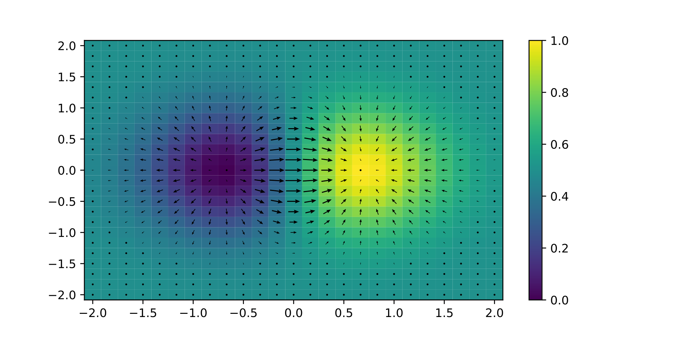
Gradients for an Example Function
Gradient of the 2D function f(x, y) = xe^{−(x2 + y2)} is plotted as arrows over the pseudocolor plot of the function.

Slide 11
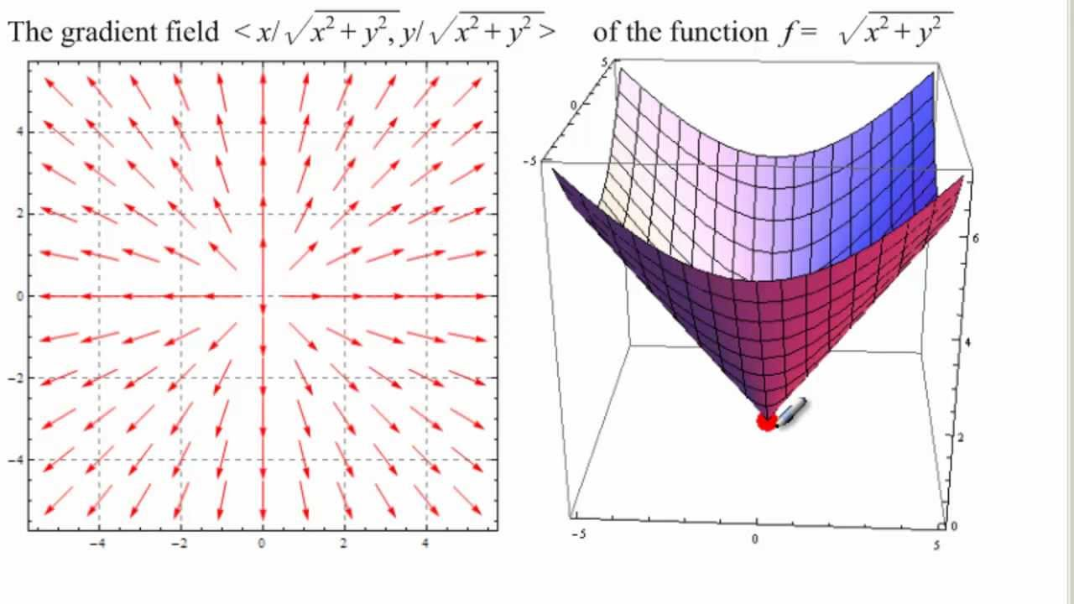
Error Function Gradient based on 2 Weights
Video on this topic: https://www.youtube.com/watch?v=IHZwWFHWa-w&index=3&list=PLZHQObOWTQDNU6R1_67000Dx_ZCJB-3pi&t=0s
Will shows: 5:00-12:00 of this video!
Remark: To minimize the error function we will walk in the inverse direction of the arrows!
If the steepest gradient is in the direction (1,2) then the second weight contributes more to the error.

Slide 12
Learning Multi-layer Neural Network
Neural network learning computes error term e = y-f(w,x) and updates weights accordingly moving in the direction that reduces the error the most following the direction of the steepest gradient.
Problem: how to determine the true value of y for hidden nodes?
Approximate error in hidden nodes by error in the output nodes

Slide 13
Back Propagation Algorithm
Initialize the weights in the network (often randomly)
repeat for each example e in the training set do
O = neural-net-output(network, e) ; forward pass
T = teacher output for e
Calculate error (T - O) at the output units
Compute error term Δ_{i} for the output node
Compute error term Δ_{i} for nodes of the intermediate layer
Update the weights in the network Δw_{ij}=α*a_{i}*Δ_{j}
until all examples classified correctly or stopping criterion satisfied
return(network)
Remark: We call Δ_{I} associated error of node I in the following.

Slide 14
Updating Weights in Neural Networks
w_{ij}:= Old_w_{ij} + α∗input_activation_{i}∗associated_error_{j}
with α being the learning rate.
Multi-layer Network: Associated_Error-node_i= Δ_{i}=
Output Node i: g’(z_{i})*(T-O)
Intermediate Node i connected to j: g’(z_{i})*w_{ij}*associated_error_node_j
w13
a1
a3
Δ3
Node i
x1
w35
w23
a5
Δ5
w14
w45
a2
a4
Node j
Δ4
w24
x2
Gradient - Wikipedia
Multi-layer Network

Slide 15
Weight Update Example
g(x)= 1/(1+e^{−x} )
g’(x)= g(x)*(1-g(x))
γ is the learning rate
w13
x1
a3
w35
w23
a5
a_{i}:= activation of node i
z_{i} := linear input of node i:
a_{i} =g(z_{i})
w14
w45
x2
a4
w24
w35= w35 + γ*a3*Δ5
w45= w45 + γ*a4*Δ5
w13= w13 + γ*x1*Δ3
w23= w23 + γ*x2*Δ3
w14= w14 + γ*x1*Δ4
w24= w24 + γ*x2*Δ4
a4=g(z4)=g(x1*w14+x2*w24)
a3=g(z3)=g(x1*w13+x2*w23)
a5=g(z5)=g(a3*w35+a4*w45)
Δ5=error*g’(z5)=error*a5*(1-a5)
Δ4= Δ5*w45*g’(z4)=Δ5*w45*a4*(1-a4)
Δ3=Δ5*w35*a3*(1-a3)

Slide 16
Example BP
Example: all weights are 0.1 except w45=1; γ=0.2
Training Example: (x1=1,x2=1;a5=1)
g is the sigmoid function
x1
w13
a3
w35
w23
a5
a5 is 0.6483 with the adjusted
weights!
w14
w45
w35= w35 + γ*a3*Δ5=
0.1+0.2*0.55*0.08=0.109
w45= w45 + γ*a4*Δ5=1.009
w13= w13 + γ*x1*Δ3=0.1004
w23= w23 + γ*x2*Δ3=0.1004
w14= w14 + γ*x1*Δ4=0.104
w24= w24 + γ*x2*Δ4=0.104
a4’=g(0.208)=0.551
a3’=g(0.2008)=0.551
a5’=g(0.611554)=0.6483
x2
a4
w24
a4=g(z4)=g(x1*w14+x2*w24)=g(0.2)=0.550
a3=g(z3)=g(x1*w13+x2*w23)=g(0.2)=0.550
a5=g(z5)=g(a3*w35+a4*w45)=g(0.605)=0.647
Δ5=error*g’(a5)=error*a5*(1-a5)=
0.353*0.353*0.647=0.08
Δ4=Δ5*w45*a4*(1-a4)=0.02
Δ3=Δ5*w35*a3*(1-a3)=0.002

Slide 17
Example BP
Example: all weights are 0.1 except w45=1; γ=1 Training Example: (x1=1,x2=1;a5=1)
g is the sigmoid function
w13
a5 is 0.6594 with the adjusted
weights!
x1
a3
w35
w23
a5
w14
w45
w35= w35 + γ*a3*Δ5=
0.1+1*0.55*0.08=0.145
w45= w45 + γ*a4*Δ5=1.045
w13= w13 + γ*x1*Δ3=0.102
w23= w23 + γ*x2*Δ3=0.102
w14= w14 + γ*x1*Δ4=0.12
w24= w24 + γ*x2*Δ4=0.12
a4’=g(0.24)=0.557
a3’=g(0.204)=0.554
a5’=g(0.66045)=0.66
x2
a4
w24
a4=g(z4)=g(x1*w14+x2*w24)=g(0.2)=0.550
a3=g(z3)=g(x1*w13+x2*w23)=g(0.2)=0.550
a5=g(z5)=g(a3*w35+a4*w45)=g(0.605)=0.647
Δ5=error*g’(z5)=error*a5*(1-a5)=
*0.353*0.647*0.353=0.08
Δ4=Δ5*w45*a4*(1-a4)=0.02
Δ3=Δ5*w35*a3*(1-a3)=0.002

Slide 18
Second Video on Weight Learning
https://www.youtube.com/watch?v=IHZwWFHWa-w&list=PLZHQObOWTQDNU6R1_67000Dx_ZCJB-3pi&index=3&t=0s
Is the second part of the Video we saw in the last lecture
Will watch the first 16:30 minutes of this video

Slide 19
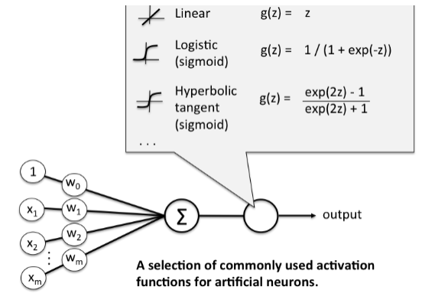
Activation Functions
Transforms neuron’s input into output.
Features of activation functions:
A squashing effect is required
Prevents accelerating growth of activation levels through the network.

Slide 20
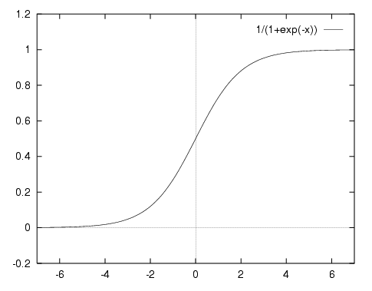
1. Sigmoid or Logistic
Its Range is between 0 and 1.
It is a S - shaped curve.
It is easy to understand and apply but there are reasons which have made it fall out of popularity:
Vanishing gradient problem
Slow convergence.

Slide 21
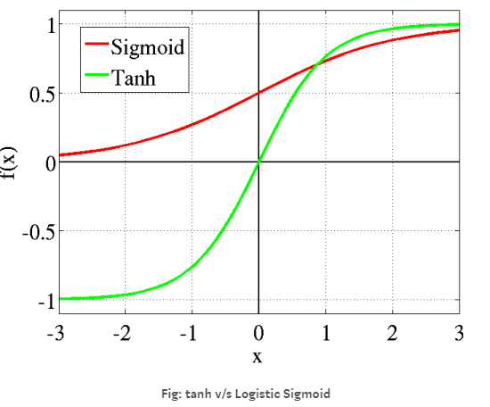
2. Tanh : hyperbolic tangent function
It’s a rescaling of the logistic sigmoid
It is a S -shaped curve.
Outputs range from -1 to 1.
The advantage is that the negative inputs will be mapped strongly negative and the zero inputs will be mapped near zero in the tanh graph.
The tanh function is a popular choice for classification problems involving exactly 2 classes

Slide 22
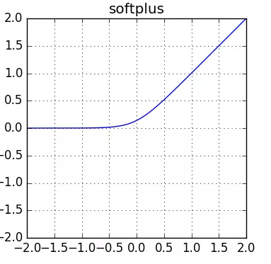
3. Softplus function: hyperbolic tangent function
Difference: Outputs produced by sigmoid and tanh functions have upper and lower limits whereas softplus function produces outputs in scale of (0, +∞).

Slide 23
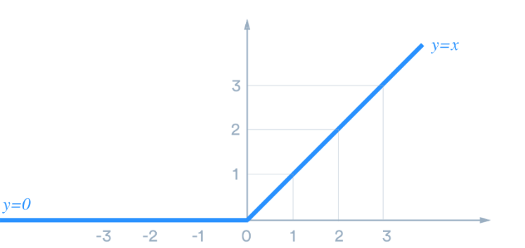
4. ReLu: Rectified Linear units
Most popular.
Avoids and rectifies vanishing gradient problem .
Cheap to compute as there is no complicated math.
Converge faster.

Slide 24
Design Issues in ANN
The remaining slides will not be cover in 2026.
Number of nodes in input layer
One input node per binary/continuous attribute
k or log₂ k nodes for each categorical attribute with k values
Number of nodes in output layer
One output for binary class problem
k for k-class problem
Many other possibilities
Number of nodes in hidden layer
Initial weights and biases

Slide 25
Characteristics of ANN
Multilayer ANN are universal approximators but could suffer from overfitting if the network is too complex
Gradient descent may converge to local minimum
Model building can be very time consuming, but testing can be very fast
Can handle redundant attributes because weights are automatically learnt
Sensitive to noise in training data
Difficult to handle missing and symbolic attributes

Slide 26

More NN Terminology (source Wikipedia)
Batch size: Size of the training set that is used in each iteration. For example if batch size is 4, weights are adjusted using 4 training examples in each iteration of the weight learning process. Sometimes called mini-batch size.
Epoch is 1 complete cycle where Neural network has seen all the data. That is if the batch size is 128 and training set size 2048, one epoch is completed after 16 iterations. That if in the above example the NN learning used 256 iterations that would be 16 epochs as 16*16=256.
In mathematics, statistics, finance, computer science, particularly in machine learning and inverse problems, regularization is the process of adding information in order to solve an ill-posed problem or to prevent overfitting, usually to an objective / cost function. Example L1 regularization:
In the case of neural networks β_{i} are the p weights w_{i} of the neural network and
the first term is the squared prediction error and λ is a parameter called
regularization rate.

Slide 27
More NN Terminology Part2
Batch normalization (also known as batch norm) is a method used to make artificial neural networks more stable and less sensitive to overfitting through normalization of the layers' inputs by re-centering and re-scaling.^{[1]} It was proposed by Sergey Ioffe and Christian Szegedy in 2015.^{[2]}
Dropout: this technique consists of removing some nodes so that the NN is not too heavy. This can be implemented during the training phase. The idea is that we do not want our NN to be overwhelmed by information, especially if we consider that some nodes might be redundant and useless. So, while building our algorithm, we can decide to keep, for each training stage, each node with probability p (called ‘keep probability’) or drop it with probability 1-p (called ‘drop probability’).
Remarks: Both techniques are used to alleviate overfitting

