Slide 1
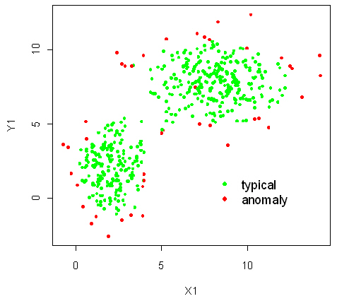
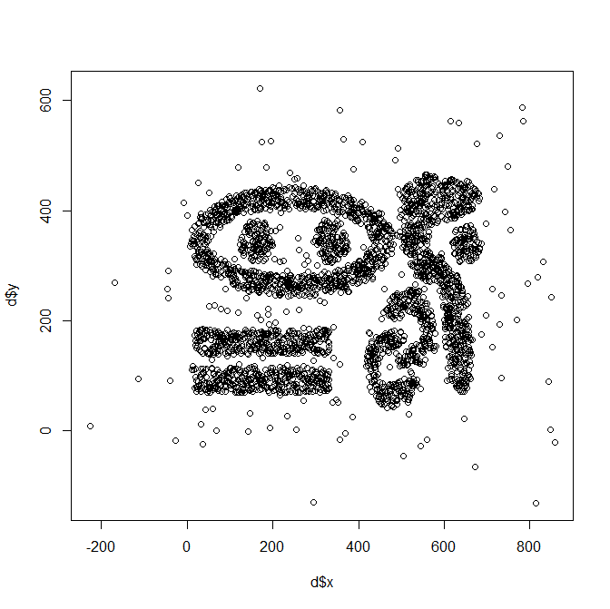
Anomaly/Outlier Detection
Lecture Notes for Chapter 9 (10 first Edition)
Introduction to Data Mining 2nd Edition
by
Tan, Steinbach, Karpatne, Kumar
Many new slides have been added and the original slides have been significantly modified by Christoph F. Eick

Slide 2
0. Anomaly/Outlier Detection
What are anomalies/outliers?
The set of data points that are considerably different than the remainder of the data
Variants of Anomaly/Outlier Detection Problems
Given a database D, find all the data points x ∈ D with anomaly scores greater than some threshold t
Given a database D, find all the data points x ∈ D having the top-n largest anomaly scores f(x)
Given a database D, containing mostly normal (but unlabeled) data points, and a test point x, compute the anomaly score of x with respect to D

Slide 3
How many Outliers?
Challenge
How many outliers are there in the data?
Working assumption:
There are considerably more “normal” observations than “abnormal” observations (outliers/anomalies) in the data

Slide 4
Causes of Anomalies
Data from different classes
Measuring the weights of oranges, but a few grapefruit are mixed in
Natural variation
Unusually tall people
Data errors
200 pound 2 year old

Slide 5
News Feb. 10, 2024
Group Homework Credit activities will start on Feb. 12. 13-18 minutes are allocated to a group to present results for the task assigned to them. Any questions?
Need to have everybody’s questionnaire by Feb. 12!
Setting up groups of exactly 4 students should be completed by Feb. 12; try your best to form a group in the remainder of today.
Today’s Lecture will solely focus on outlier detection.

Slide 6
Outlier
outlier: person, thing, or fact that is very different from other people, things, or facts, so that it cannot be used to draw general conclusions.
In statistics, an outlier is a data point that differs significantly from other observations.^{[1][2]} An outlier may be due to a variability in the measurement, an indication of novel data, or it may be the result of experimental error; the latter are sometimes excluded from the data set.^{[3][4]} An outlier can be an indication of exciting possibility, but can also cause serious problems in statistical analyses.

Slide 7

Lecture Organization
0. Anomaly/Outlier Detection (OLD)
Graphic-based Approaches
Model-based Statistical Approaches
Density-based Approaches without Model
One-Class SVM Approach
Distance-Based Approaches
Clustering-based Approaches
Isolation Forrest
Using Deep Generative Models (DGM) for OLD
Assessment with Respect to Popular Outlier Detection Techniques
Non-traditional Outlier Detection
Contextual Outliers
Collective Outlier

Slide 8
Object vs. Attribute Anomalies
Many anomalies are defined in terms of a single attribute; we call those attribute anomalies.
Height
Shape
Color
Object anomalies are harder to identify as objects are usually described by multiple attributes
Can be hard to find an anomaly using all attributes
Noisy or irrelevant attributes
Object is only anomalous with respect to some attributes
Moreover, an object may not be anomalous in any one attribute

Slide 9
Anomaly Detection Schemes
Many Types of anomaly detection schemes
Graphical
Model-based Statistical Approaches
Density-based without a Model
One-Class SVM Approach
Distance-based
Approaches which use Deep Generative Models (DGM)
Isolation Forests
Not Covered: Profile-based Approaches which rely in Pattern Matching
Build a profile of the “normal” behavior
Profile can be patterns or summary statistics for the overall population
Use the “normal” profile to detect anomalies
Anomalies are observations whose characteristics differ significantly from a set of profile.

Slide 10
General Issues: Anomaly Scoring
Many anomaly detection techniques provide only a binary categorization: An object is an anomaly or it isn’t; we call these approaches classification approaches.
A second approach assign a score called OLS to all points
This score measures the degree to which an object is an anomaly
This allows objects to be ranked
In general, this is the “preferable approach”
However, in the end, you often need a binary decision
Should this credit card transaction be flagged?
Still useful to have a score
Related Challenge: How many anomalies are there?

Slide 11
Anomaly Detection: Supervised or not?
In most applications anomaly detection has to be viewed as unsupervised as no ground truth is available.
However, in a few applications datasets are available which contain objects which have been classified as anomalous or not. In this case, anomaly detection can be viewed as a classification task.
Finally, there is a semi-supervised scenario, where a (usually small subset) of the objects has been classified as anomalous or not, but it is not known if the remaining objects are anomalous are not.

Slide 12
Applications of Outlier Detection
Credit card fraud detection
Telecommunication fraud detection
Network intrusion detection
Homeland Security
Data Cleaning
Sensor Networks
Oil and Gas Line Monitoring
…

Slide 13
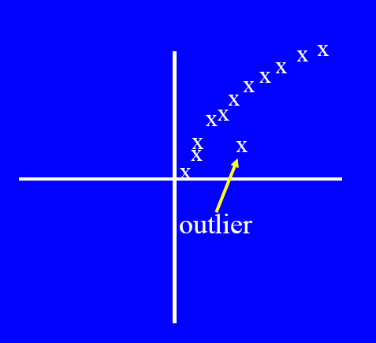
1. Graphical Approaches
Idea: user identifies outliers by visual inspection
Scatter plot (2-D), Spin plot (3-D)
Limitations
Time consuming
Subjective

Slide 14
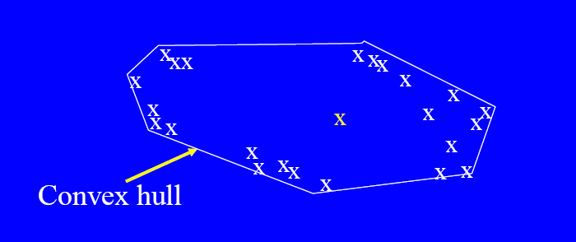
Boundary Methods
Extreme points are assumed to be outliers
Use convex hull method/alpha shapes to detect extreme values
http://cgm.cs.mcgill.ca/~godfried/teaching/projects97/belair/alpha.html

Slide 15
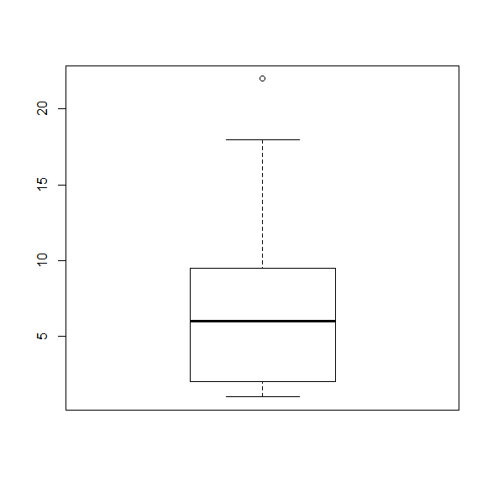
Box-Plot Approach for Outlier Detection
outlier
1.5*IQR
IQR
Mixture of a graphical and a statistical approach
Observations that are more than λ∗IQR (e.g. λ =1.5) above or below the inter-quantile range are outliers.
Decent approach for 1D/single attribute outlier detection but only find high and low outliers and cannot deal with multi-modal distributions.
Sad news: Cannot be used for multi-variate data!

Slide 16
Outlier Detection Example1

Slide 17
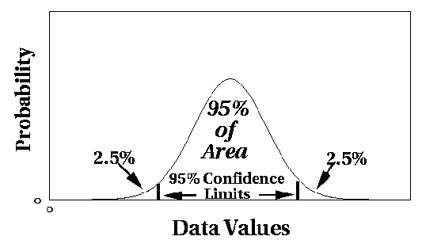
2. Model-based Statistical Approaches
Fit a parametric model M to the data, capturing the distribution of the data (e.g., normal distribution)
Apply a statistical test that depends on
Data distribution
Parameter of distribution (e.g., mean, variance)
Number of expected outliers (confidence limit)
Alternatively, rank points by their likelihood with respect to M
Data
Density Function

Slide 18
Model-Based Anomaly Detection
Build a model for the data and see
Unsupervised
Anomalies are those points that don’t fit well
Anomalies are those points that distort the model
Supervised
Anomalies are regarded as a rare class
Need to have training data

Slide 19
Normal Distribution
One-dimensional Gaussian
Two-dimensional Gaussian

Slide 20
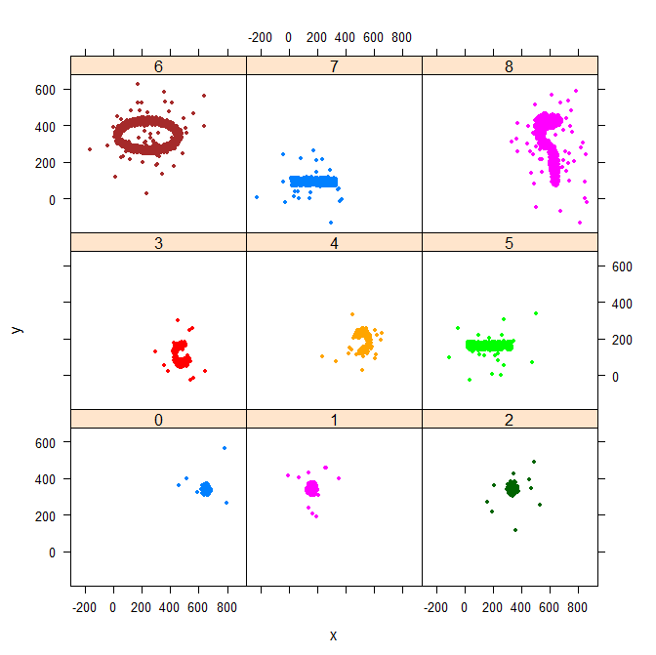
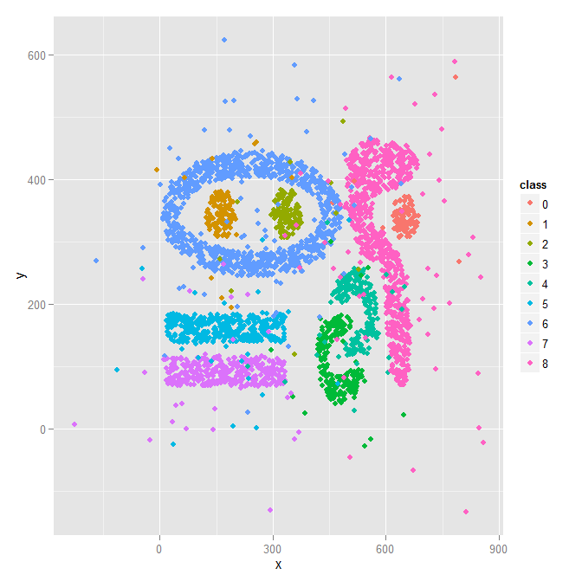
Task5-2020-like Dataset

Slide 21
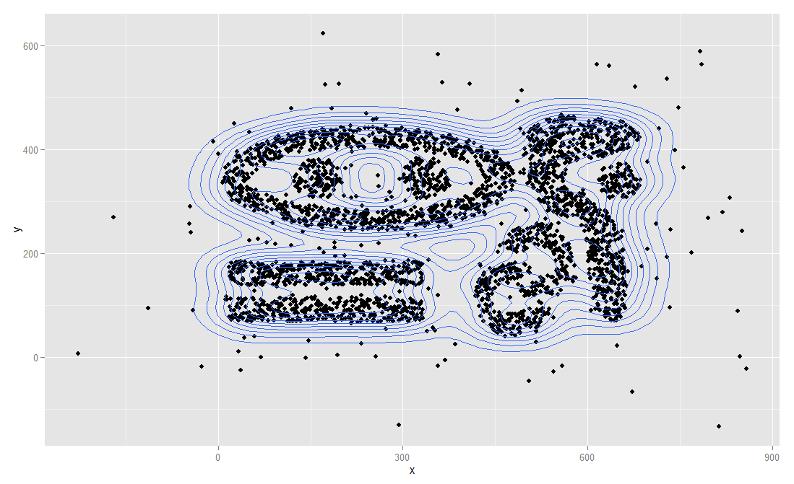
Density Plot for a Dataset
Remark: Using a model-based approach points on the same density contour line should
have the same likelihood to be outliers with respect to the underlying statistical model M.

Slide 22
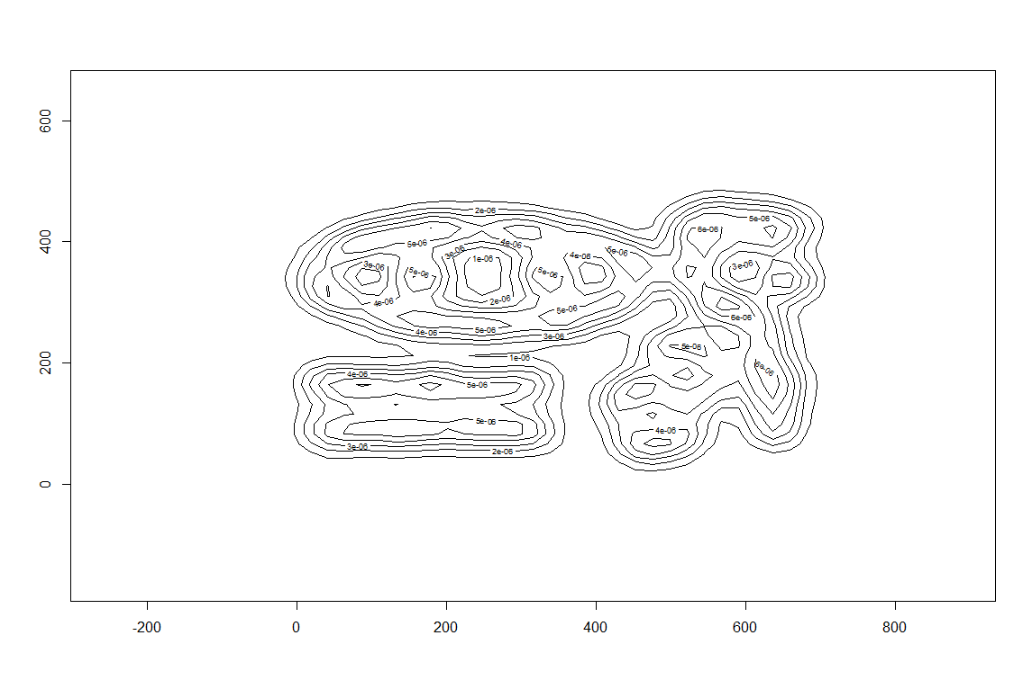
Another “Better” Density Contour Plot

Slide 23
R-Code Used to Create the Complex9_gn16 Displays
#Code for Scatter Plots
setwd("C:/Users/8yetula8\\Desktop")
a<-read.csv("complex9_gn16.txt")
d<-data.frame(x=a[,1],y=a[,2],class=factor(a[,3]))
plot(d$x,d$y)
require("lattice")
require("ggplot2")
xyplot(y ~ x | class, d, groups=d$class, pch=20)
ggplot(d, aes(x=x, y=y, colour=class))+ geom_point()
ggplot(d, aes(x = x, y = y)) + geom_point() + facet_grid(~class)
ggplot (d, aes (x = x, y = y, colour = class)) + stat_density2d ()
p <- ggplot(d, aes(x = x,y = y))
p+geom_point()+geom_density2d()
#another approach; seems to get more meaningful contours
require("MASS")
require("KernSmooth")
y <- cbind(d$x, d$y)
#this apporach uses kernel density estimation;
est <- bkde2D(y, bandwidth=c(20, 18))
contour(est$x1, est$x2, est$fhat)
persp(est$fhat)

Slide 24
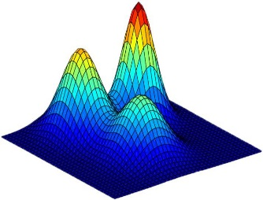
Statistical Approaches for Task 1 in 2026
Fit a model M to the dataset D; e.g.
A 6-variate Gaussian Model
Learn 6-variate Gaussian Mixture Model (http://pypr.sourceforge.net/mog.html https://scikit-learn.org/stable/modules/mixture.html ) by running the EM clustering algorithm; next extract the learnt density function. Plug each point p into the density function d_{M} of model M and compute d_{M}(p) or preferably log(d_{M}(p)), called the log likelihood of p, and add this value as in a new column ols (“outlier score”) to D obtaining D’—the smaller this value is the more likely p is an outlier with respect M.
Sort D’ in ascending order—the first record is the record with the smallest value for log(d_{M}(p))
Perform the remaining tasks using D’
GMM-Model

Slide 25
Likelihood-Ratio Outlier Detection
Assume the data set D contains samples from a mixture of two probability distributions:
M (majority distribution)
A (anomalous distribution)
General Approach:
Initially, assume all the data points belong to M
Let L_{t}(D) be the log likelihood of D at time t
For each point x_{t} that belongs to M explore the affect of moving it to A, obtaining D’.
Let L_{t+1} (D’) be the new log likelihood after removing x_{t}
Compute the difference, Δ = L_{t+1}(D’)/L_{t} (D)
If Δ > c (some threshold), then x_{t} is declared as an anomaly and moved permanently from M to A
E.g.: Likelihood Ratios for Outlier Detection | Alibi Detect
Somewhat similar approaches recently have become popular for Deep Generative Models. [2301.04257] ODIM: Outlier Detection via Likelihood of Under-Fitted Generative Models 66121d1f782d29b62a286909165517bc-Paper.pdf

Slide 26
Limitations of Statistical Approaches
Most of the statistical tests are for a single attributes
In many cases, data distribution/model may not be known and might not fit with the shape of the assumed parametric density function.
For high dimensional data, it may be difficult to estimate the “true” density function.
Sensitive to the selection of hyper parameters.
Rumor: Algorithms that find Mixtures of Gaussians do not always find “good” mixtures.

Slide 27
3. Density-Based Approaches Without Model
Use non-parametric density estimation to compute the density of the objects in the dataset and use the obtained density as OLS.
When using this approach there is no explicit density function.
Pros:
Does not make any assumptions about the shape of the density-function
Often finds “better” density functions than Parametric Approaches
Cons:
Finding good values for the bandwidth hyper-parameter is often challenging.
Computing the density of a query-point is quite time-consuming, but there are methods to speed it up. .

Slide 28
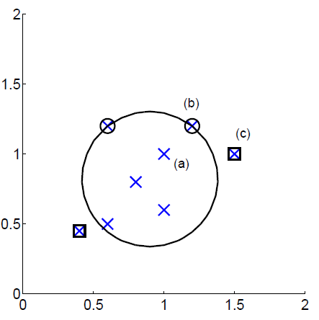
4. One-Class SVM Approach for Outlier Detection
Consider a sphere with center a and radius R
Minimize R and the error resulting from points outside the sphere—their error is their distance to the sphere.
Lowercase greek xi letter, pronounced ‘ksi’
error
More information: http://rvlasveld.github.io/blog/2013/07/12/introduction-to-one-class-support-vector-machines/

Slide 29
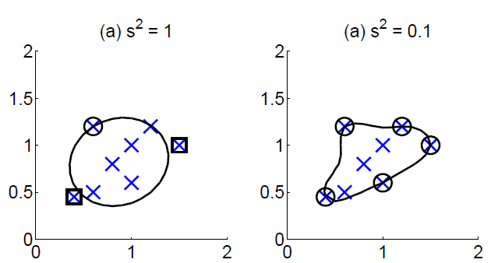
One Class SVM with Kernel Functions
Again kernel functions/mapping to a higher dimensional space can be employed in which case the class boundary shapes change as depicted.

Slide 30
5. News Feb. 12, 2026
The 2026 6335 Groups have been formed.
Still miss 3 questionnaires
Current and Next Topics: Outlier Detection-Exploratory Data Analysis-Clustering
Today’s Topics:
Topics for Task2
Group A GHC Presentation
Continue the discussion of Outlier Detection

Slide 31
5. Distance-based Approaches
Data is represented as a vector of features
Two major approaches
K-Nearest-neighbor based
LOF

Slide 32
Nearest-Neighbor Based Approach
Approach:
Compute the distance between every pair of data points
There are various ways to define outliers:
Data points for which there are fewer than p neighboring points within a distance r
The top n data points whose distance to the kth nearest neighbor is greatest
The top n data points whose average distance to the k nearest neighbors is greatest

Slide 33
One Nearest Neighbor - One Outlier

Slide 34
One Nearest Neighbor - Two Outliers

Slide 35
Five Nearest Neighbors - Small Cluster

Slide 36
Five Nearest Neighbors - Differing Density

Slide 37
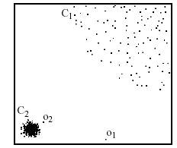
LOF approach
In anomaly detection, the local outlier factor (LOF) is an algorithm proposed by Markus M. Breunig, Hans-Peter Kriegel, Raymond T. Ng and Jörg Sander in 2000 for finding anomalous data points by measuring the local density deviation of a given data point with respect to its neighbors.^{[1]}
The approach measures local reachability density Lrd_{k}(A) which is the inverse reachability distance from the k-nearest neighbors of A to A itself and contrasts it with the average of Lrd_{k}(B) for B∈NN_{k}(A) and takes the quotient of those quantities: if the so obtained OLS is larger than 1, A is considered an outlier candidate. See: Local outlier factor – Wikipedia. LOF is actually a distance-based OD approach, as it uses no density estimation techniques.
In the NN approach, p₂ is not considered as outlier, while LOF approach find both p₁ and p₂ as outliers; moreover, some/all points in cluster C₁ might be considered as outliers!
p₂
×
p₁
×

Slide 38
Relative Density Outlier Scores
Outlier Score

Slide 39
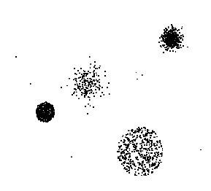
6. Clustering-based Outlier Detection
Clustering-based Outlier: An object is a cluster-based outlier if it does not strongly belong to any cluster
For prototype-based clusters, an object is an outlier if it is not close enough to a cluster center
For density-based clusters, an object is an outlier if its density is too low
For graph-based clusters, an object is an outlier if it is not well connected
Side Problem: Clustering results might be influenced by outlier; e.g. when K-means is used.

Slide 40
Distance of Points from Closest Centroids
Outlier Score

Slide 41
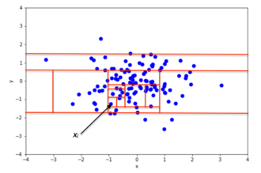
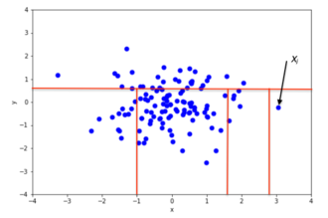
7. Isolation Forest
Isolation forest is an anomaly detection approach that works on the principle that anomalies can be isolated more easily than normal observations. It creates an ensemble of randomly generated decision trees for a dataset and then uses the average path length as an object’s anomaly score. The leaves of the decision tree, called isolation tree, represent the actual objects in the dataset. The approach detects anomalies based on the ordering of attribute values and does not use any distance functions.
Normal Observation x
Outlier x

Slide 42
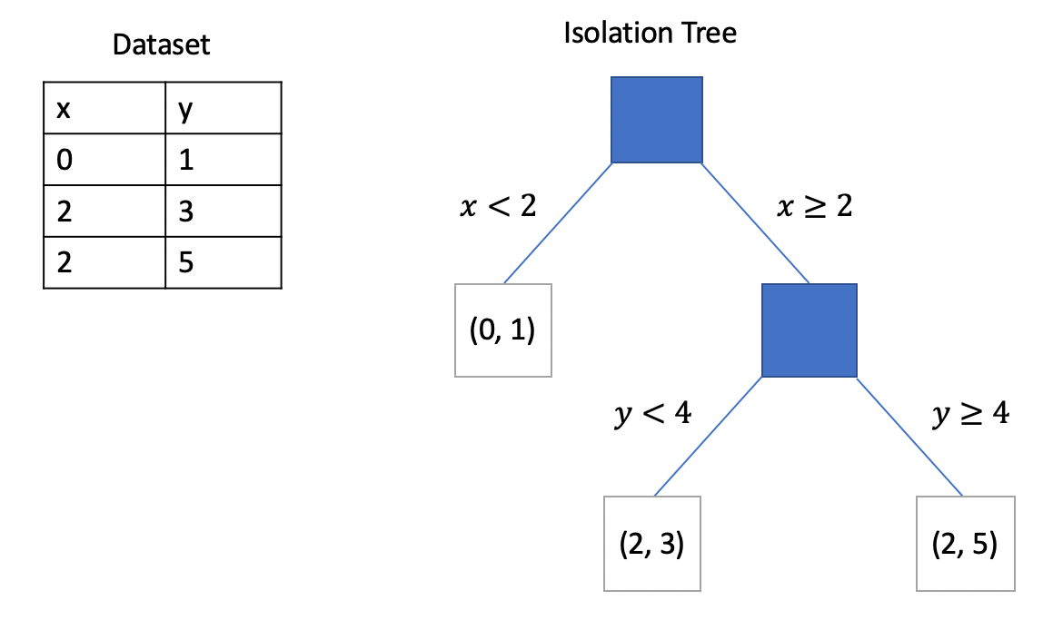
Example of an Isolation Forrest Tree

Slide 43
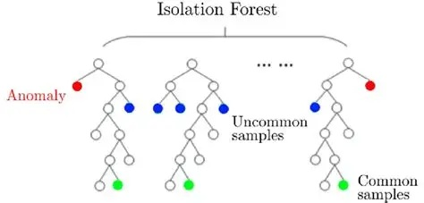
Example of an Isolation Forrest

Slide 44
How the Approach Works
1. Random Partitioning
The algorithm begins by selecting a random feature from the dataset. It then splits the data at a random value within that feature’s range, dividing it into two parts. The number of splits required to isolate a data point is called the isolation path. Anomalies have shorter paths since they differ more from the rest of the data.
2. Ensemble of Isolation Trees
Rather than relying on a single tree, it builds an ensemble of isolation trees. This ensures robustness and reliability in the results.
3. Anomaly Scoring
The anomaly score for each data point is calculated by averaging the path lengths across all trees.
For more details see: Isolation forest - Wikipedia
Software: IsolationForest — scikit-learn 1.8.0 documentation

Slide 45
Isolation Tree for Dataset Nine
X≥7
Y≥10 X≥3
(10,10)|(7,6)
Y≥3 Y≥4
(3,3)|(4,1) (2,4 )| Y≥-18
X≥2 X≥−17
(2,2)|(-20,-18) (-17,-19)|(-18,-19)
Id | X | Y | Tree-Depth
1 | 2 | 2 | 5
2 | 3 | 3 | 3
3 | 4 | 1 | 3
4 | 2 | 4 | 3
5 | 10 | 10 | 2
6 | 7 | 6 | 2
7 | -17 | -19 | 5
8 | -20 | -18 | 5
9 | -18 | -19 | 5
Dataset Nine

Slide 46
8. Outlier Detection with Deep Generative Models
A new hybrid model for improving outlier detection using combined autoencoder and variational autoencoder | Scientific Reports
An efficient method for autoencoder based outlier detection – ScienceDirect
Anomaly detection with autoencoders
Generative adversarial nets for unsupervised outlier detection – ScienceDirect
[2310.09999] Outlier Detection Using Generative Models with Theoretical Performance Guarantees.
ODIM: Outlier Detection via Likelihood of Under-Fitted Generative Models | OpenReview
Density estimation using deep generative neural networks | PNAS
A few recent papers discussing this subject:

Slide 47
9. Assessment

Slide 48
Popular Approaches to Identify Attribute Outliers
Interquartile range approaches, such as box plots are used a lot.
Using the absolute value of the attribute’s z-scores as the outlier score, is another popular choice
Distance-based approaches are applicable for 1D.
Density-based approaches are applicable for 1D and a good choice. Histograms are also useful to get an overview of the density function of a single attribute.
Isolation forests are another choice.
Grubb’s Test (not covered)
Remark: Approaches listed as 1 and 2 can only find outliers on the wings of the attribute range. They cannot identify the outlier, depicted in red, below:
xxxxxxxxxxx x xxxxxxxxxxxxx

Slide 49
Dr. Eick’s Opinion about Approaches to Detect Object Outliers.
Density-based approaches particularly Kernel Density Estimation and Mixture of Gaussians might be the top choice but using them is quite complicated and therefore prone to errors.
Naïve density estimation approaches are less complicated and therefore also a good choice, as you know what you are doing. Many scientists prefer naïve density estimation methods.
Using Deep Generative Models for Outlier Detection shows some promise and might outperform the approaches mentioned above---some day.
Isolation Forests are also quite popular.
I have a negative opinion about Clustering-based, SVM based and distance-based outlier detection approaches.
Approaches which compute outlier scores should be preferred over classification approaches.
In general, there is an abundance of methods and not much agreement which methods are the most suitable for particular outlier detection task.
There is lot of material on popular outlier detection techniques written by people that are not very knowledgeable in outlier detection.

Slide 50
10. Contextual Outliers
Contextual outliers are data points that are considered outliers only within a specific context or condition. The same data point may not be an outlier in a different context.
Example: A temperature reading of 35°C might be typical during the summer but would be a contextual outlier during the winter season in a temperate region. Contexts are typically defined as a neighborhood function with respect to an object v. If the neighbors of an object v significantly deviate from v, v might be a contextual outlier. That is, contextual outlier detection is focused on analyzing such neighborhoods and not the whole dataset.
Links:
Contextual Outliers – GeeksforGeeks
Contextual Outlier Interpretation
Outlier Detection & Analysis: The Different Types of Outliers

Slide 51
11. Collective Outliers
See: Collective Outliers: Unveiling Patterns and Anomalies in Group Behavior - GeeksforGeeks

Slide 52
Grubbs’ Test
Not covered in 2026
https://en.wikipedia.org/wiki/Grubbs%27s_test
Detect outliers in univariate data
Assume data comes from normal distribution
Detects one outlier at a time, remove the outlier, and repeat
H₀: There is no outlier in data
H_{A}: There is at least one outlier
Grubbs’ test statistic:
Reject H₀ if:

Slide 53
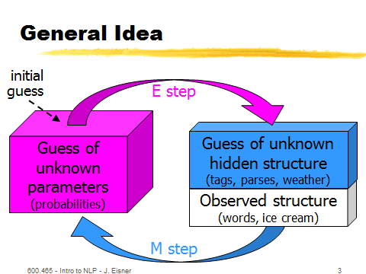
General Idea EM Algorithm
EM Algorithm
Works like K-means

