Slide 1
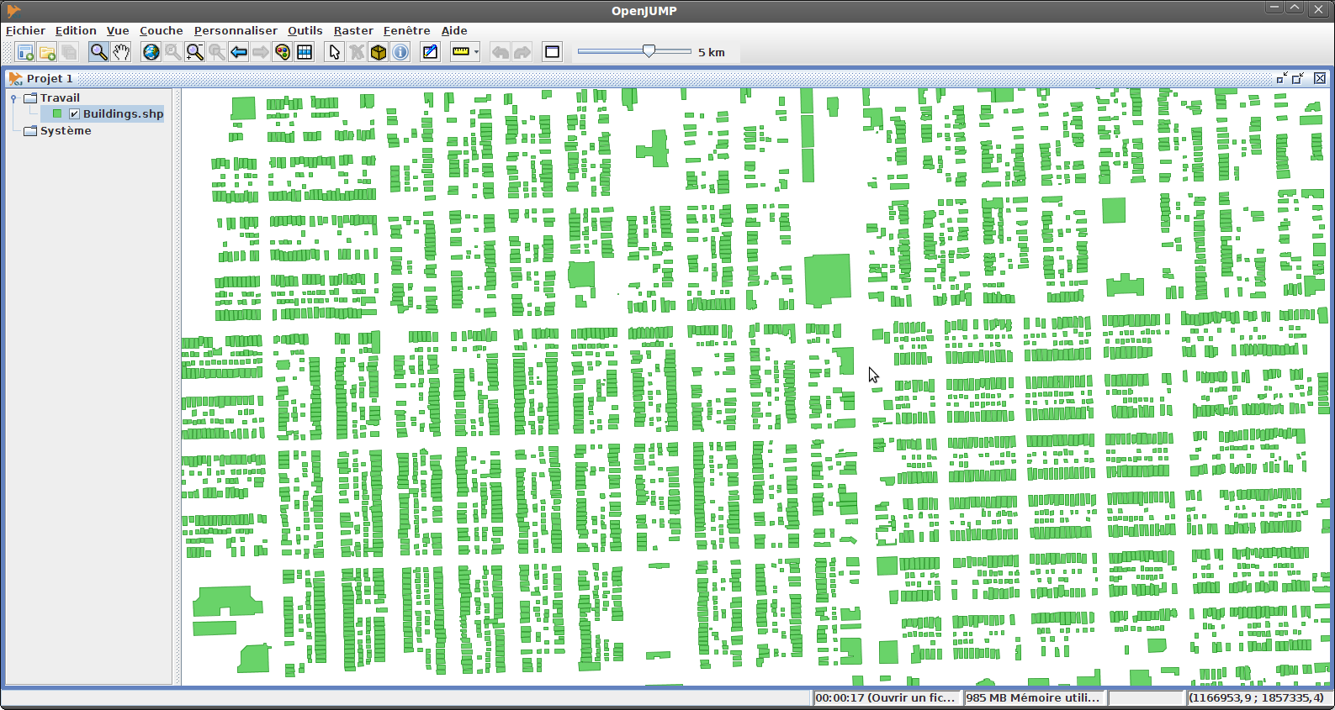
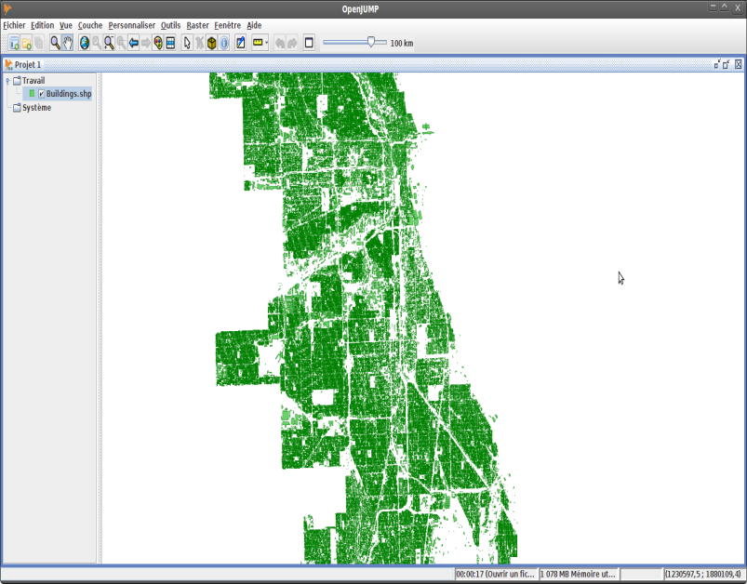
Motivation: Availability of Urban Data
http://bloomington.in.gov/documents/viewDocument.php?document_id=2455;dir=building/buildingfootprints/shape
https://data.cityofchicago.org/Buildings/Building-Footprints/w2v3-isjw
A lot of POI datasets (e.g. in Google Earth) are becoming available now.
Buildings of the City of Chicago (830,000 Polygons) :
Challenges:
Extract Valuable Knowledge from such datasets→ Data Mining
Facilitate Querying and Visualizing of such dataset→ HPC / BigData Initiative

Slide 2
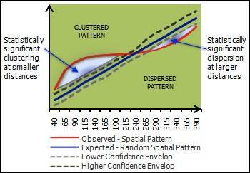
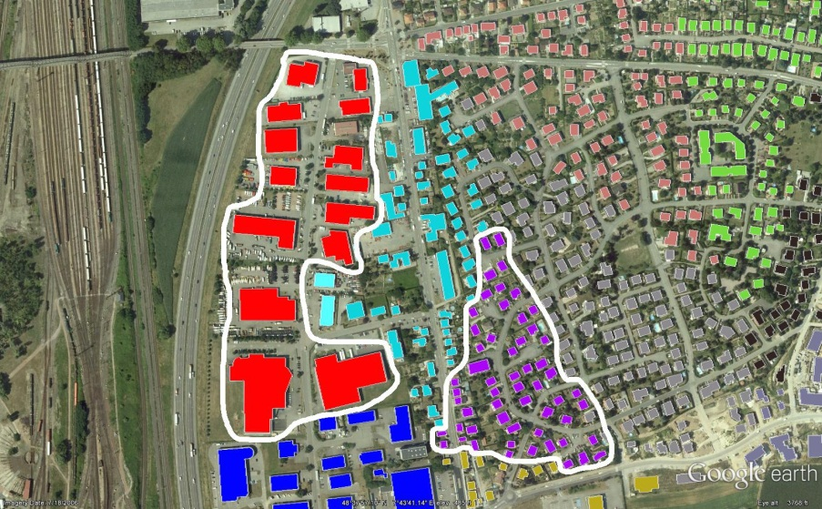
Project5 Questions for Dataset Zinj
Are buildings randomly distributed or is there some clustering?
Are buildings of the same building type collocated, anti-collocated or not?
Are building belonging to different building types collocated, anti-collocated or not—for example, you will try to answer the question if garages are collocated with commercial buildings.
Idea to answer question: create curves based on number of objects within the radius of another object/kNN-distance,… and obtain answers by comparing curves generated for different contexts.
See: http://wiki.landscapetoolbox.org/doku.php/spatial_analysis_methods:ripley_s_k_and_pair_correlation_function

Slide 3
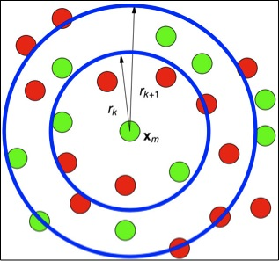
Example: Collocation Red and Green Objects
FOR radii r₁,…,r_{n} DO
FOR all green objects g DO
Compute #-of-red objects within radius r_{j} of g ENDDO
Compute average ro_{j} of values observed in previous loop
Put entry (r_{j}, (ro_{j}/total_number_of_red_objects)) into Curve
ENDDO

Slide 4


An Alternative Approach Using k-Nearest-Neighbor Distance
FOR k=k₁,…,k_{r} DO
FOR all green objects g_{p} DO
Compute distance rd_{p} to k-nearest red object to g ENDDO
Compute average rd_{i} of values observed in previous loop
Put entry (k_{i}, rd_{i}) into the Curve
ENDDO
Remark: For k-values use ⎡0.1% of the red objects⎤; ⎡0.1*1.5 of the red objects⎤, ⎡0.1%*1.5² of the red objects⎤ , ⎡0.1%*1.5³ of the red objects⎤,…, until at most 50% of the red objects—with ⎡x⎤ being the ceiling function computing the smallest integer that is greater equal than x.
d₃
d₆
d₁

