Slide 1
Questions Review October 20, 2011
The decision tree induction algorithm, discussed in class, is a greedy algorithm. Explain!
Compute the Gini-gain for a 3-way split for a 3-class classification problem; the class-distribution before the split is (10, 5, 5) and after the split the class distribution is (0,0,5), (9, 2,0) and (1,3,0).
What is overfitting ? What is underfitting? What can be done to address overfitting/underfitting in decision tree induction?
Most decision tree learning tools use gain-ratio and not information gain; why?
Are decision trees suitable for classification problems involving continuous attributes when classes have multi-modal (http://en.wikipedia.org/wiki/Multimodal) distributions? Give reasons for your answer.
Assume an association rule if smoke then cancer has a confidence of 86% and a high lift of 5.4. What does this tell you about the relationship of smoking and cancer?
See Next Slide
See Slide After Next
K-means has a complexity of O(t*k*n). Explain!
Assume the following dataset is given: (2,2), (4,4), (5,5), (6,6),(9,9) (0,4), (4,0) . K-Means is run with k=3 to cluster the dataset. Moreover, Manhattan distance is used as the distance function to compute distances between centroids and objects in the dataset. Moreover, K-Mean’s initial clusters C1, C2, and C3 are as follows:
C1: {(2,2), (4,4), (6,6)}
C2: {(0,4), (4,0)}
C3: {(5,5), (9,9)}
Now K-means is run for a single iteration; what are the new clusters and what are their centroids?
d((x1,x2),(x1’,x2’))= |x1-x1’| + |x2-x2’|

Slide 2
Problem7
1) Similarity Assessment [9]
Assume the following relation Students(ssn, age, gpa, avg_class_rank, set-languages) that contains students that were admitted in the year 2000 into our undergraduate program is given. You can assume that
Social security numbers (ssn) uniquely identify a student
age is an integer; the maximum age is 50 the minimum age is 20, and the average age is 30 and the standard deviation is 10.
gpa denotes the UH COSC gpa; the average gpa is 2.9 and the standard deviation is 0.6; the maximum gpa is 4.0 the minimum gpa is 0.
Avg_class_rank has 5 values (4=top-5%, 3=top-10%, 2=top-20% 1=top_half, 0=bottom half)
set-languages is the set of languages the student speaks; we assume the number of possible languages is not know in advance.
Define a student distance measure that considers gpa and class_rank of being of major importance, and age and set-languages of being of minor importance.
Using your distance measure compute the distances between the following 3 students
(111111111, 25, 2.8, 1, {English, Hindi})
(222222222, 24, 3.7, 2, {English, Hindi, Bengali, Tamil})
(333333333, 73, 3.8,4, {English, Turkish, Chinese})
You can assume that minimum and maximum and other statistics were computed for past data; new data might not comply with these statistics

Slide 3
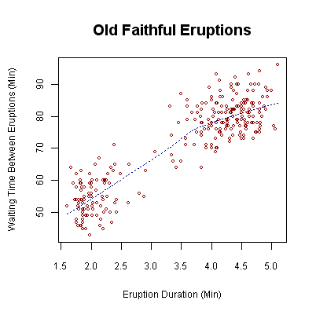
Problem 8
Interpret the following scatter plot that describes dependencies between the eruption duration and eruption time of Old Faithful in Yellowstone National Park! [6]

