Slide 1
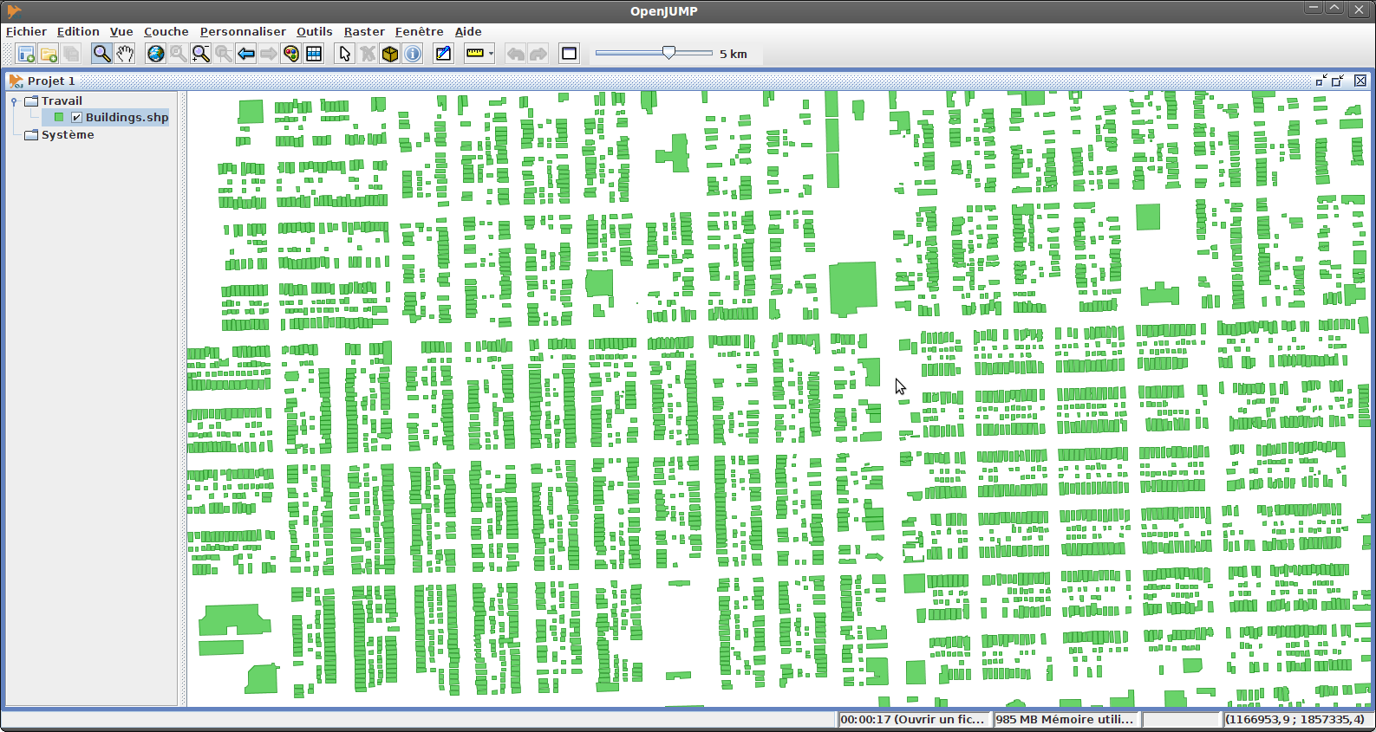
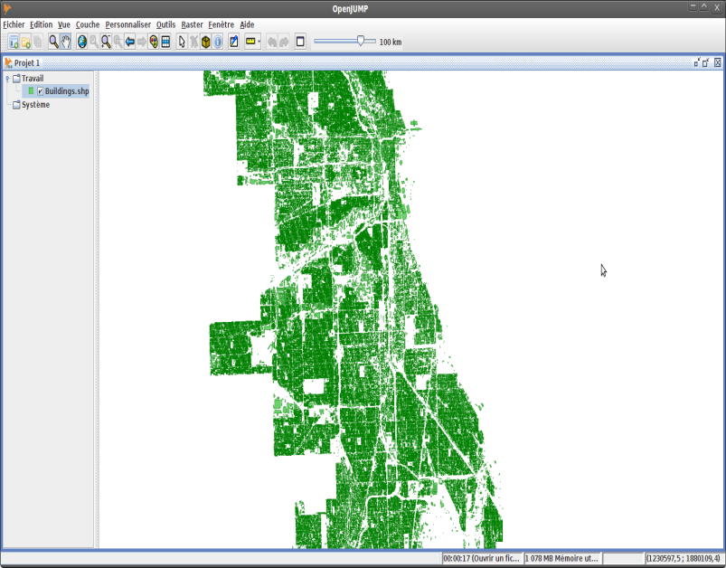
Motivation: Availability of Urban Data
https://data.cityofchicago.org/Buildings/Building-Footprints-current-/hz9b-7nh8
A lot of POI datasets (e.g. in Google Earth) are becoming available now.
Buildings of the City of Chicago (830,000 Polygons)
Typical Format POI datasets: (spatial location, category, other attributes)
Challenges:
Extract Valuable Knowledge from such datasets→ Data Mining
Facilitate Querying and Visualizing of such dataset→ HPC / Big Data

Slide 2

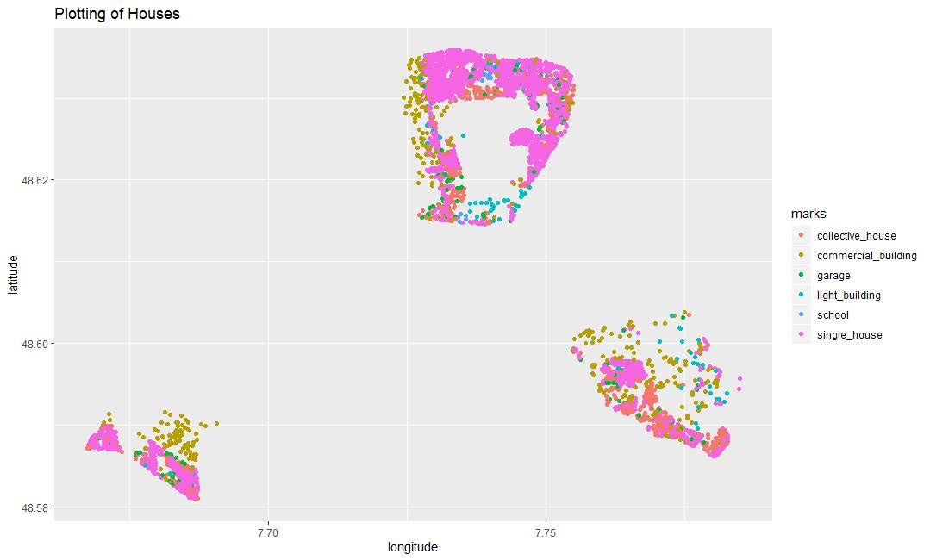
POI Dataset Zinj
Contains buildings represented as (longitude,latitude) polygons, building category, and other information about the specific building from 3 neighborhoods of a city, we call Zinj.
More about Zinj: The Discovery of "Zinj" - The Leakey Foundation (Entertainment)

Slide 3

Example POI Dataset
What spatial patterns do you see in this particular dataset?

Slide 4
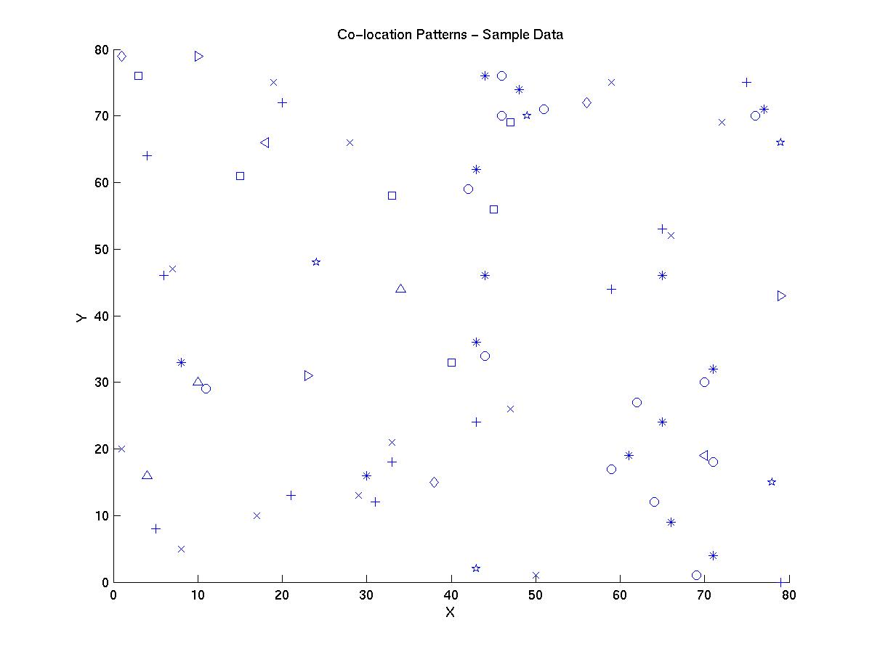
Example Association Analysis: Co-Location
R1
R2
Regional
Co-location
R3
R4
Task: Find Co-location patterns for the following data-set.
Global Co-location: and are co-located in the whole dataset

Slide 5
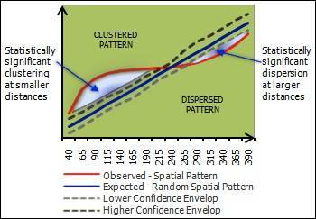
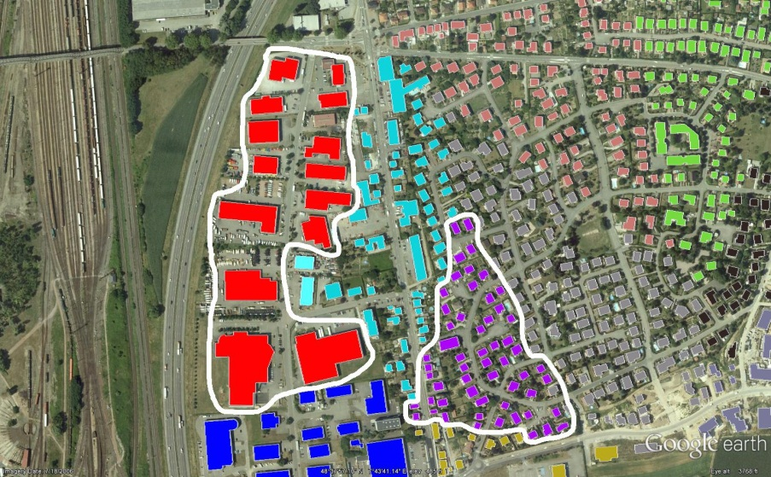
Task3 Questions Respect to Dataset Zinj
Are the buildings collocated, anti-collocated or neither?
Are buildings of the same building type collocated, anti-collocated or neither?
Are building belonging to different building types collocated, anti-collocated or neither—for example, you will try to answer the question if garages are collocated with commercial buildings?
Remark: We will only answer questions 2 and 3 for some building types…
Idea to answer the Questions: create curves based on number of objects within the radius of another object/kNN-distance,… and obtain answers by comparing curves generated for different contexts. Needs to normalized for differences in class instances when comparing different patterns.
See: Ripley's K function Ripley K Functions – Search How Multi-Distance Spatial Cluster Analysis (Ripley's K-function) works—ArcGIS Pro | Documentation

Slide 6
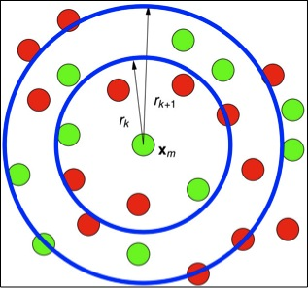
Example: Collocation Red and Green Objects
FOR radii r₁,…,r_{n} DO
FOR all green objects g DO
Compute #-of-red objects within radius r_{j} of g ENDDO
Compute average ro_{j} of values observed in previous loop
Put entry (r_{j}, (ro_{j}/total_number_of_red_objects)) into Curve
ENDDO

Slide 7


An Alternative Approach Using k-Nearest-Neighbor Distance
FOR k=k₁,…,k_{r} DO
FOR all green objects g_{p} DO
Compute distance rd_{p} to k-nearest red object to g_{p} ENDDO
Compute average rd_{i} of values observed in previous loop
Put entry (k_{i}, rd_{i}) into the Curve
ENDDO
Remark: For k-values use ⎡0.1% of the red objects⎤; ⎡0.1*1.5 of the red objects⎤, ⎡0.1%*1.5² of the red objects⎤ , ⎡0.1%*1.5³ of the red objects⎤,…, until at most 50% of the red objects—with ⎡x⎤ being the ceiling function computing the smallest integer that is greater equal than x.
d₃
d₆
d₁

Slide 8
Creating the File Z and Z’
The file Zinj.kml is more than 15 years old, and the version of the KML language it uses might be outdated. Anyway, it still opens using Google Earth but the polygons look a little messed up, but this has no impact on Task3!
From the Zinj.html file create a file Z using the following POI format: (longitude, latitude,building_type)
The buildings are described in the KML file using a longitude-latitude polygon describing the location of the building. Create file Z by extracting the first point of the polygon, and the building type tagged by ‘nature:’.
You might create your own randomized version of file Z, called Z’, by randomly selecting two objects in the file and swapping their class labels; I suggest to use at least 5000 swaps when generating Z’.
This allows you creating your own distance curves for Z and Z’ for the analysis of specific collocation patterns.
I recommend to additionally repeating this process three times, obtaining files Z’, Z’’ and Z’’’ and then to compare a couple of curves, to assess how sensitive the curves are with respect to the randomization process, described above.

Slide 9


