Slide 1
CHAPTER 13:
Alpaydin: Kernel Machines
Significantly edited and extended by Ch. Eick
COSC 6342: Support Vectors
and using SVMs/Kernels for Regression,
PCA, and Outlier Detection
Coverage in Spring 2011: Transparencies for which it does not say “cover” will be skipped!

Slide 2
Kernel Machines
cover
Discriminant-based: No need to estimate densities first; focus is learning the decision boundary and not on learning a large number of parameters of a density function.
Define the discriminant in terms of support vectors a subset of the training examples
The use of kernel functions, application-specific measures of similarity.
Many kernels map the data to a higher dimensional space for which linear discrimination is simpler!
No need to represent instances as vectors; can deal with other types e.g. graphs, sequences in bioinformatics which assume edit distance.
Convex optimization problems with a unique solution

Slide 3
Optimal Separating Hyperplane
(Cortes and Vapnik, 1995; Vapnik, 1995)
Lecture Notes for E Alpaydın 2010 Introduction to Machine Learning 2e © The MIT Press (V1.0)

Slide 4
Margin
Distance from the discriminant to the closest instances on either side
Distance of x to the hyperplane is
We require
For a unique sol’n, fix ρ||w||=1, and to max margin
Lecture Notes for E Alpaydın 2010 Introduction to Machine Learning 2e © The MIT Press (V1.0)

Slide 5
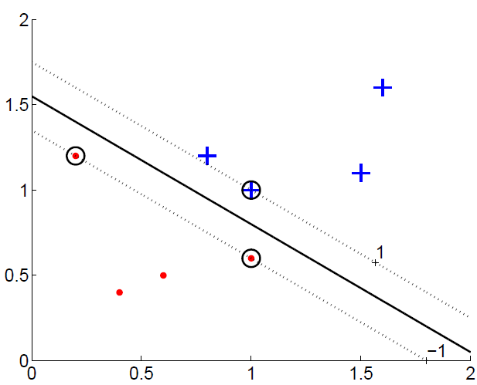
Margin
cover
2/||w||
Remark: Circled points are support vectors

Slide 6
cover
Alternative Formulation of the
optimization problem: α^{t}>0 only
support vectors are relevant
for determining the hyperplane ➔
this can be used to reduce the
complexity of the SVM optimization
procedure by only using support
vectors instead the whole dataset for it.
If you are interested in understanding the mathematical details: Read paper on PCA regression

Slide 7
Most α^{t} are 0 and only a small number have α^{t} >0; they are the support vectors
Idea: If we remove all examples which are not
support vectors from the dataset we still obtain
the same hyperplane, but can do so more quickly!

Slide 8
Soft Margin Hyperplane
Not linearly separable
Soft error
New primal is

Slide 9
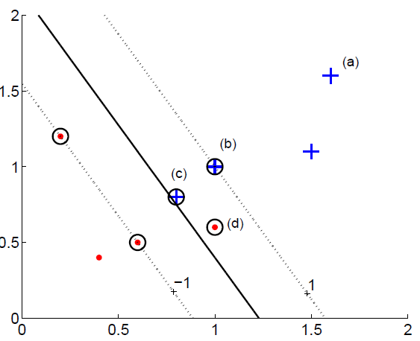
cover
Soft Margin SVM
Blue Class Hyperplane
SVM Decision Boundary
Red Class Hyperplane
Indicate errors; note that points which on the correct
side of each class’ hyperplane have an error of 0.

Slide 10
Multiclass Kernel Machines
cover
1-vs-all (“popular” choice)
Pairwise separation
Error-Correcting Output Codes (section 17.5)
Single multiclass optimization

Slide 11
COSC 6342: Using SVMs for
Regression, PCA, and Outlier
Detection

Slide 12
cover
Example Flatness in Prediction
For example, let us assume we predict the price of a house based on the number of rooms, and we have 2 functions:
f1: #rooms*10000 + 10000
f2: #rooms*20000 -10000
Both agree in their prediction for a two room house costing 30000
f1 is flatter than f2; f1 is less sensitive to noise
Typically, flatness is measured using ||w|| which is 20000 for f2 and 10000 for f1; the lower ||w|| is the flatter f is…
Consequently, ||w|| is minimized in support vector regression; however, in most cases, ||w||² is minimized instead to get rid of the sqrt-function.
Reminder: ||w||=sqrt(w•w)=sqrt(w∗w^{T})

Slide 13
cover
SVM for Regression
“Flatness“ of f;
the smaller ||w||,
the smoother f is /
the less sensitive
f is to noise; also
sometimes called
regularization.
Remember: Dataset={ (x¹,r¹),..,(x^{n},r^{n})}
Use a linear model (possibly kernelized)
  f(x)=w^{T}x+w₀
Use the є-sensitive error function
subject to:
for t=1,..,n

Slide 14
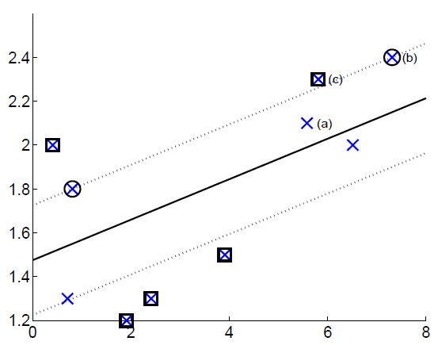
cover
SVMs for Regressions
For a more thorough discussion see: http://www2.cs.uh.edu/~ceick/ML/SVM-Regression.pdf or for a more high-level discussion see: http://kernelsvm.tripod.com/

Slide 15
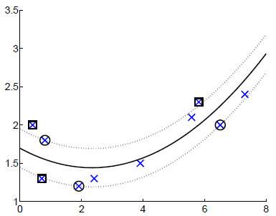
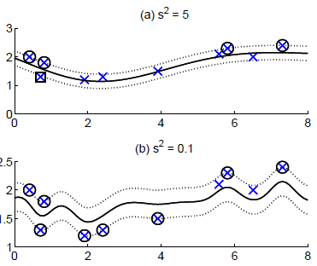
Kernel Regression
cover
Polynomial kernel
Gaussian kernel
Again we can employ mappings φ to a higher dimensional space and kernel functions K, because regression coefficients can be computed by just using the gram matrix for
φ(x^{i})•φ(x^{j}). In this case we obtain regression functions which are linear in the mapped
space, but not linear in the original space, as depicted above!

Slide 16
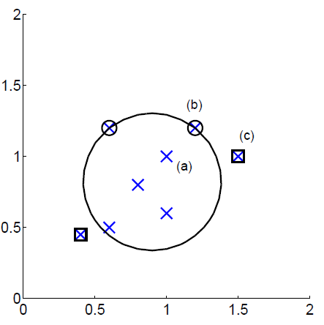
One-Class Kernel Machines for Outlier Detection
cover
Consider a sphere with center a and radius R

Slide 17
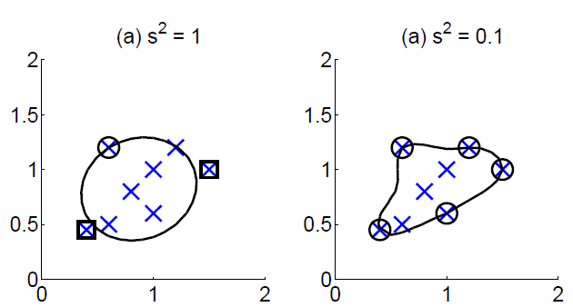
cover
Again kernel functions/mapping to a higher dimensional space can be employed in which case the class boundary shapes change as depicted.

Slide 18
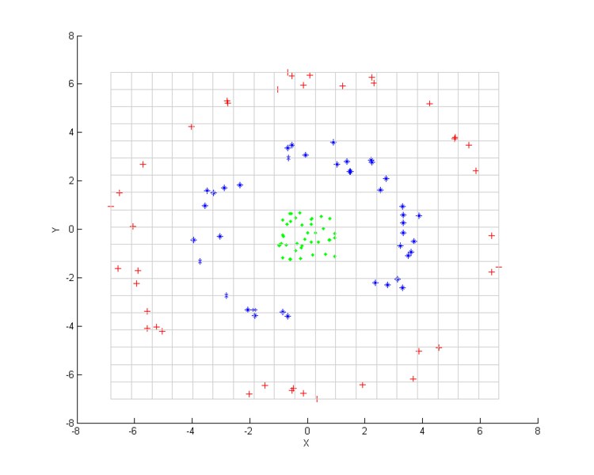
Motivation Kernel PCA
cover
Example: we want to cluster the following dataset using K-means which will be difficult; idea: change coordinate system using a few new, non-linear features.
Remark: This approach uses kernels, but is unrelated to SVMs!

Slide 19
Kernel PCA
cover
Kernel PCA does PCA on the kernel matrix (equal to doing PCA in the mapped space selecting some orthogonal eigenvectors in the mapped space as the new coordinate system)
Kind of PCA using non-linear transformations in the original space, moreover, the vectors of the chosen new coordinate system are usually not orthogonal in the original space.
Then, ML/DM algorithms are used in the Reduced Feature Space.
Reduced Feature
Space (less dimensions)
Original Space
Feature Space
features are a few linear combinations of features in the Feature Space
φ
PCA
Illustration: http://en.wikipedia.org/wiki/Kernel_principal_component_analysis

